Slide 1



Quality Measures of Parameter Tuning for
Aggregated Multi-Objective Temporal Planning
Mostepha Khouadjia, Marc Schoenauer, Vincent Vidal, Johann Dréo, and Pierre Savéant
Team, INRIA Saclay, France
mostepha-redouane.khouadjia@inria.fr
LION7, Catania, 2013
DESCARWIN
Notes:
Tao team

Slide 2

Parameter Tuning
Multi-objective optimization & Aggregation
Proposed tuning approach
DAEx : Divide & Evolve
Experiments & Results
Conclusion & Perspectives
Parameter Tuning : the Big Picture
Parameters ranges
ParamILS,
Irace,
...
Parameter tunning
Tuner
Target
Algorithm
Solves
Problem
instances
Calls with different
parameter settings
Returns solution quality
{fitness, metric, ... }

Slide 3
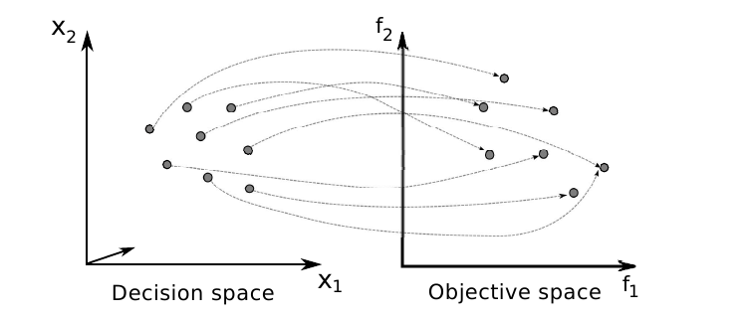
Parameter Tuning
Multi-objective optimization & Aggregation
Proposed tuning approach
DAEx : Divide & Evolve
Experiments & Results
Conclusion & Perspectives
Multi-objective optimization
X : set of feasible solutions (in decision space ⊆ IR^{n})
M >= 2 objective functions f = (f1, f2, . . . , fM) (to optimize)
Z = f (X ) ⊆ IR^{M}
set of feasible outcome vectors (in objective space)

Slide 4
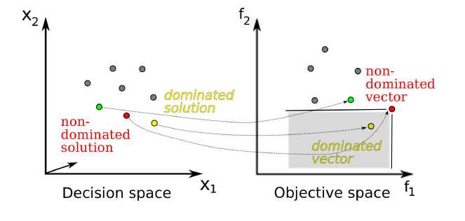
Parameter Tuning
Multi-objective optimization & Aggregation
Proposed tuning approach
DAEx : Divide & Evolve
Experiments & Results
Conclusion & Perspectives
Pareto dominance relation
A solution x ∈ X dominates a solution x ′ ∈ X (x ′ ≺ x) iff
∀i ∈ {1, 2, . . . , M}, fi (x) >= fi (x ′ )
∃j ∈ {1, 2, . . . , M} such that fj (x) > fj (x ′ )

Slide 5
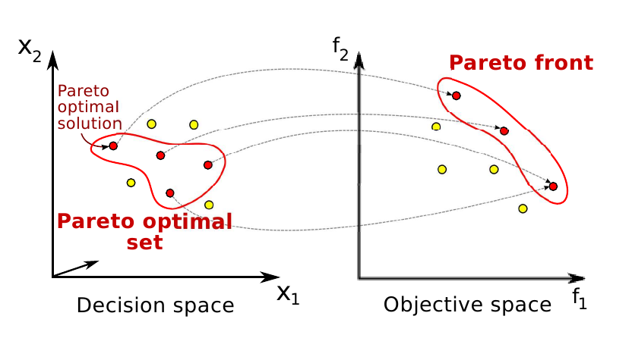
Parameter Tuning
Multi-objective optimization & Aggregation
Proposed tuning approach
DAEx : Divide & Evolve
Experiments & Results
Conclusion & Perspectives
Pareto Set and Pareto Front

Slide 6
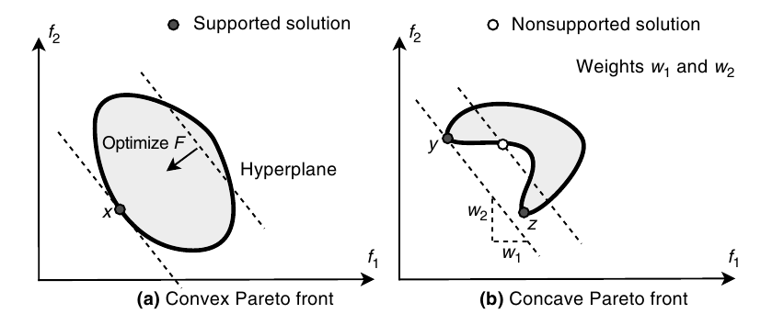
Parameter Tuning
Multi-objective optimization & Aggregation
Proposed tuning approach
DAEx : Divide & Evolve
Experiments & Results
Conclusion & Perspectives
Aggregation

Slide 7
Parameter Tuning
Multi-objective optimization & Aggregation
Proposed tuning approach
DAEx : Divide & Evolve
Experiments & Results
Conclusion & Perspectives
f₁
Pareto front
f₂

Slide 8

Parameter Tuning
Multi-objective optimization & Aggregation
Proposed tuning approach
DAEx : Divide & Evolve
Experiments & Results
Conclusion & Perspectives
f₁
Pareto front
f₂
f₁
Fitness Tuning
f₂

Slide 9
Parameter Tuning
Multi-objective optimization & Aggregation
Proposed tuning approach
DAEx : Divide & Evolve
Experiments & Results
Conclusion & Perspectives
f₁
Pareto front
f₂
f₁
Multi-objective metric ?
Fitness Tuning
f₂

Slide 10
Parameter Tuning
Multi-objective optimization & Aggregation
Proposed tuning approach
DAEx : Divide & Evolve
Experiments & Results
Conclusion & Perspectives
f₁
Pareto front
f₂
f₁
Multi-objective metric ?
Fitness Tuning
Hypervolume Tuning
f₂

Slide 11
Parameter Tuning
Multi-objective optimization & Aggregation
Proposed tuning approach
DAEx : Divide & Evolve
Experiments & Results
Conclusion & Perspectives
f₁
Pareto front
f₂
Multi-objective metric
f₁
f₁
Fitness Tuning
Hypervolume Tuning
f₂
Good convergence and diversity
f₂

Slide 12
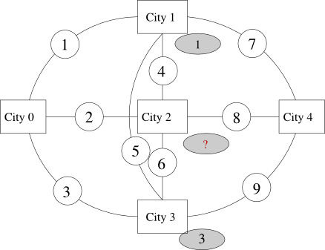

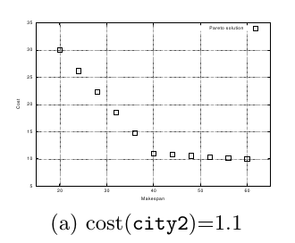
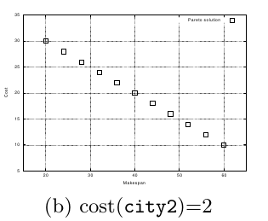
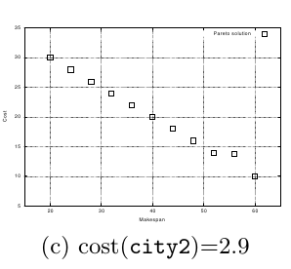
Parameter Tuning
Multi-objective optimization & Aggregation
Proposed tuning approach
DAEx : Divide & Evolve
Experiments & Results
Conclusion & Perspectives
Multi-objective AI Planning
Minimize Makespan
and Cost/Risk
MultiZeno benchmark
#planes: 2
#passengers ∈ {3,6,9}

Slide 13
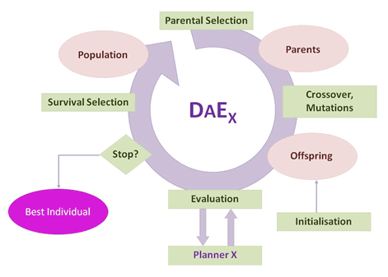
Parameter Tuning
Multi-objective optimization & Aggregation
Proposed tuning approach
DAEx : Divide & Evolve
Experiments & Results
Conclusion & Perspectives
YAHSP, CPT, LPG, ...

Slide 14

Parameter Tuning
Multi-objective optimization & Aggregation
Proposed tuning approach
DAEx : Divide & Evolve
Experiments & Results
Conclusion & Perspectives
DAEYAHSP
Problem
<A, O, I, G> = PD(I,G)
Representation
Ordered list of partial states
S₀= I, S₁, ..., S_{n}, S_{n+1}= G
Evaluation
Solve consecutive sub-problems PD(S_{k},S_{k+1})/ kϵ[0,n]
with embedded single-objective planner YAHSP
Fitness
All problems solved: sum of plan qualities
Fails solving PD(S_{l}, S_{l+1}): penalty + “dist”(S_{l},G)
Crossover: One-point crossover
Mutations : AddGoal, delGoal, addAtom, delAtom
S11
S10
G
S8
S9
S6
S7
S5
S1
S4
I
S3
S2

Slide 15
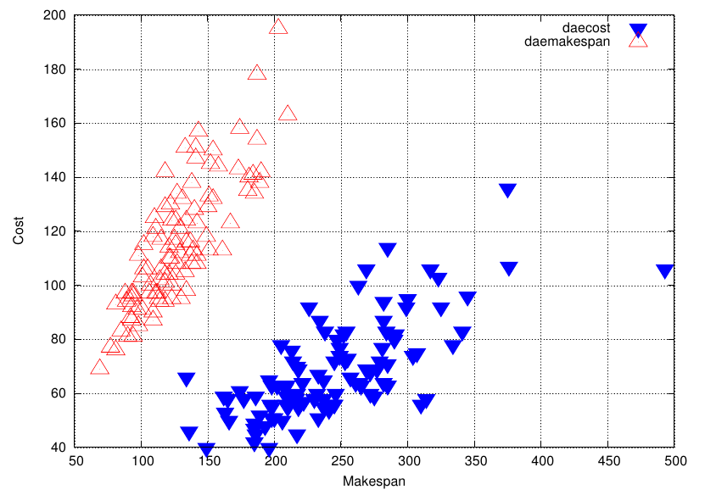
Parameter Tuning
Multi-objective optimization & Aggregation
Proposed tuning approach
DAEx : Divide & Evolve
Experiments & Results
Conclusion & Perspectives
Hybridization and YAHSP strategies
Weight-makespan=1
Weight-cost=0
Weight-makespan=0
Weight-cost=1
YAHSP optimizes cost VS YAHSP optimizes makespan

Slide 16
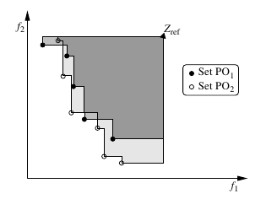
Parameter Tuning
Multi-objective optimization & Aggregation
Proposed tuning approach
DAEx : Divide & Evolve
Experiments & Results
Conclusion & Perspectives
Hypervolume
ParamILS as parameter tuning framework
Quality Measures:
- Hypervolume → AggregHyper
- Fitness → AggergFitness
Parameter setting
ParamILS
Aggregated DAE_YAHSP
Problem
instances
Parameter
domains
Fitness
Population
PISA
Hypervolume
True Pareto front

Slide 17
Parameter Tuning
Multi-objective optimization & Aggregation
Proposed tuning approach
DAEx : Divide & Evolve
Experiments & Results
Conclusion & Perspectives
Experimental Conditions
Implementation: ParadisEO-MOEO
Instances: Zeno3, Zeno6 and Zeno9
Stopping Criterion:
Parameter tuning: 48h (zeno3, zeno6) and 72h ( zeno9)
For each instance: 300s (zeno3), 600s (zeno6), 1800s (zeno9)
→ corresponding respectively to 576, 288, 144 evaluations per
Comparison: AggregHyper, AggregFitness
11 independent runs per
Performance Assessment (PISA)
  Statistical Wilcoxon signed rank test with 95% of confidence level

Slide 18
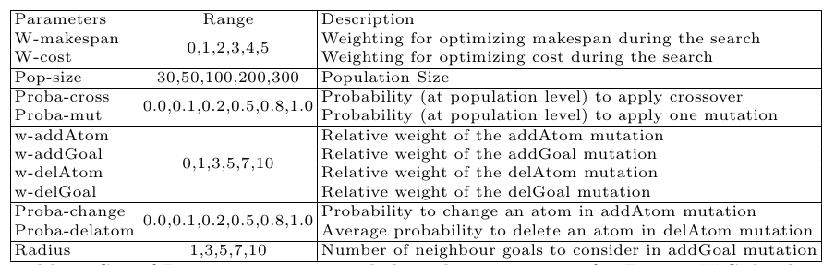
Parameter Tuning
Multi-objective optimization & Aggregation
Proposed tuning approach
DAEx : Divide & Evolve
Experiments & Results
Conclusion & Perspectives
Set of Aggregation Parameters
→ 1.5 * 10⁹ Possible configurations

Slide 19
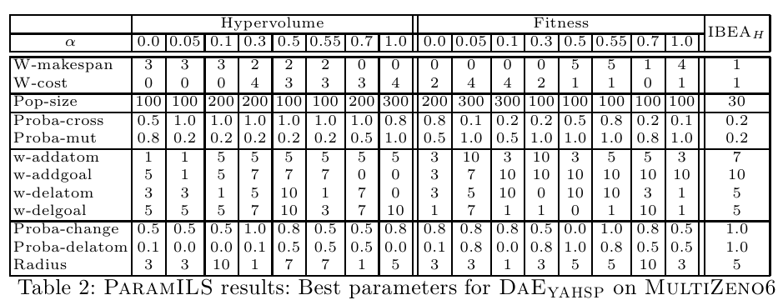
Parameter Tuning
Multi-objective optimization & Aggregation
Proposed tuning approach
DAEx : Divide & Evolve
Experiments & Results
Conclusion & Perspectives
*
* M. Khouadjia, M. Schoenauer, V. Vidal, J. Dréo, and P. Savéant. Multi-Objective AI Planning: Evaluating DAEYAHSP on a Tunable Benchmark. In the 7th International Conference on Evolutionary Multi-Criterion Optimization (EMO'2013). Sheffield UK, 19-22 March 2013.

Slide 20
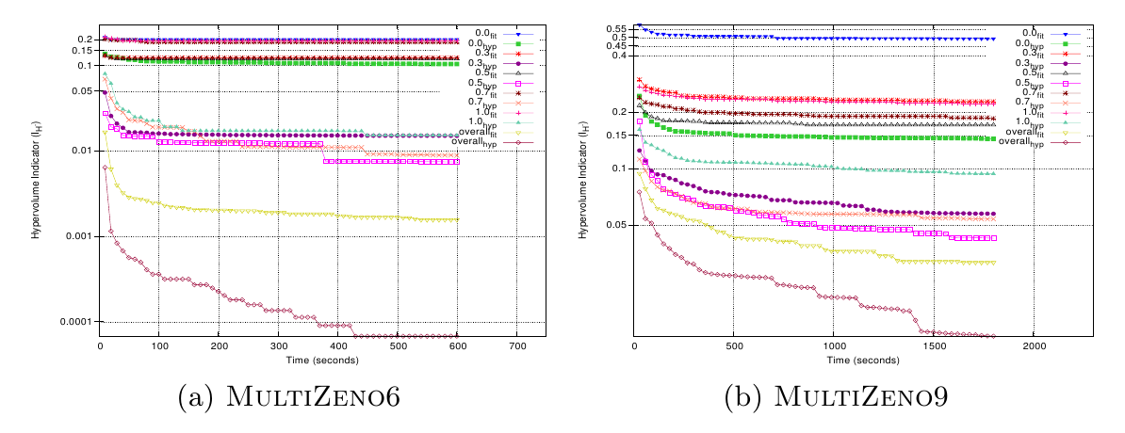
Parameter Tuning
Multi-objective optimization & Aggregation
Proposed tuning approach
DAEx : Divide & Evolve
Experiments & Results
Conclusion & Perspectives
Evolution of Hypervolume

Slide 21
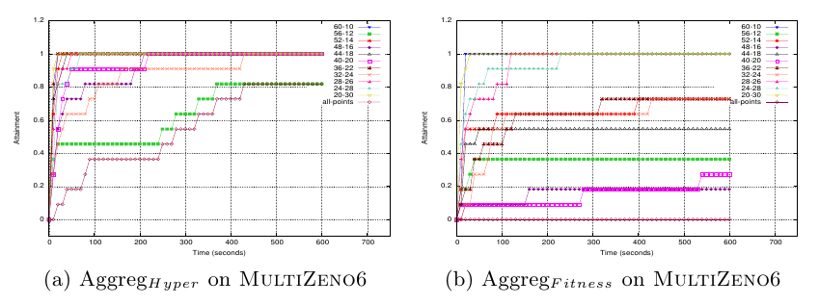
Parameter Tuning
Multi-objective optimization & Aggregation
Proposed tuning approach
DAEx : Divide & Evolve
Experiments & Results
Conclusion & Perspectives
Hitting plots of Pareto Front on MultiZeno6

Slide 22
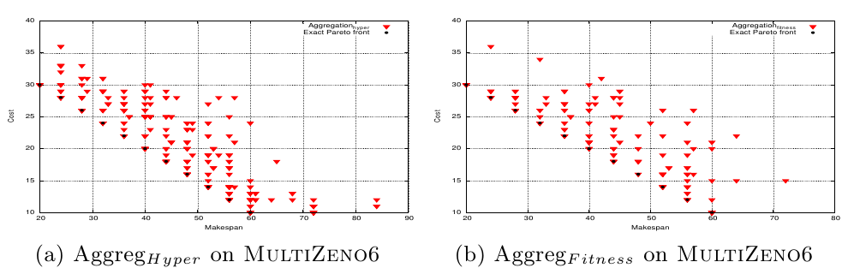
Parameter Tuning
Multi-objective optimization & Aggregation
DAE : Divide & Evolve
Experiments
Results
Conclusion & Perspectives
Pareto Front approximations on MultiZeno6
Merge of 11 final populations

Slide 23
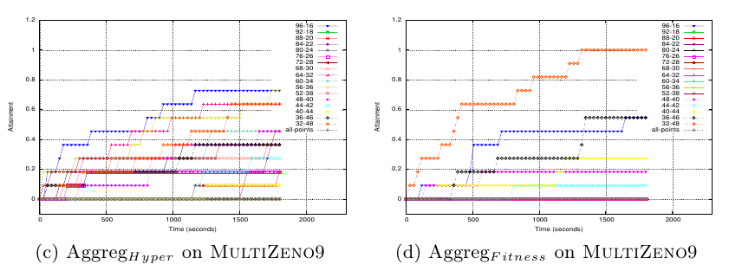
Parameter Tuning
Multi-objective optimization & Aggregation
Proposed tuning approach
DAEx : Divide & Evolve
Experiments & Results
Conclusion & Perspectives
Hitting plots of Pareto Front on MultiZeno9

Slide 24
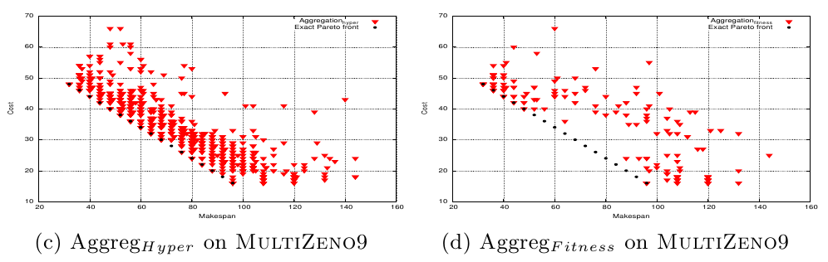
Parameter Tuning
Multi-objective optimization & Aggregation
DAE : Divide & Evolve
Experiments
Results
Conclusion & Perspectives
Pareto Front approximations on MultiZeno9
Merge of 11 final populations

Slide 25
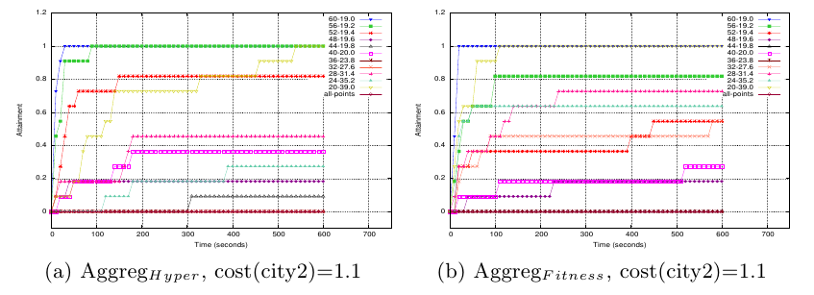
Parameter Tuning
Multi-objective optimization & Aggregation
Proposed tuning approach
DAEx : Divide & Evolve
Experiments & Results
Conclusion & Perspectives
Pareto Front approximations on MultiZeno6 (2)

Slide 26
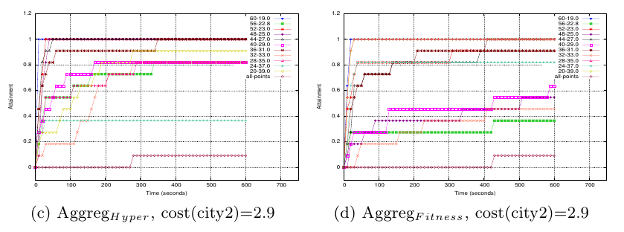
Parameter Tuning
Multi-objective optimization & Aggregation
Proposed tuning approach
DAEx : Divide & Evolve
Experiments & Results
Conclusion & Perspectives
Pareto Front approximations on MultiZeno6 (3)

Slide 27
Parameter Tuning
Multi-objective optimization & Aggregation
Proposed tuning approach
DAEx : Divide & Evolve
Experiments & Results
Conclusion & Perspectives
Conclusions
AggregHyper approach obtains better results than AggregFitness
→ Efficiency of the hypervolume as a quality measure for parameter tuning
Fair comparison with IBEA
Other domains of AI planning
Robustness of parameter settings
Perspectives

Slide 28
Thank you for your attention !

Slide 29


