Slide 1
P3 MCGYVER
Pygame
POO

Slide 2
PYGAME

Slide 3
LES CLASSES
Game
Constants
Items
Characters
Labyrinth
Model

Slide 4
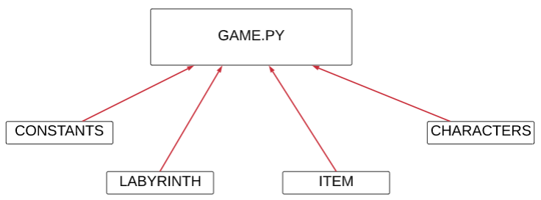
RELATIONS

Slide 5
MERCI

