Slide 1


LESSON 1
TELL ME ABOUT YOURSELF
BEHAVIORAL INTERVIEW QUESTIONS
Get Started

Slide 2




CONTENTS
Course Introduction
Behavioral question introduction
Self-introduction question practice

Slide 3


what are behavioral interview questions?
A behavioral question often starts with “Tell me about a time…” or “Give me an example of…” or “When did you....”
They are also called “STAR Questions”.
why do interviewers use behavioral questions?
behavioral answers show how the interviewee’s mind works and solves problems
Show the interviewees’ passion and what they want to do

Slide 4








CATEGORIES OF BEHAVIORAL QUESTIONS
Customer Services
People management
Project management
Innovation
Mistake/ Failure
Conflicts

Slide 5
Preparing for Your Interview
Predicting the Interview Questions
Analyze the job description
Use more than one job description
Use the industry
Prepare for questions about your resume

Slide 6
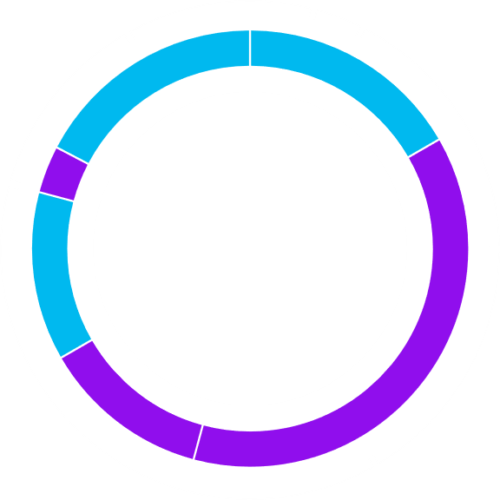
Topic: TELL ME ABOUT YOURSELF
COVERED QUESTIONS
1. Tell me about yourself
2. Tell me about your daily work
3. Tell me about your proudest achievement
4. Tell me about your strengths and weaknesses

Slide 7

ANALYZING QUESTIONS
1
Tell me about yourself
Understanding Your Background
Having insight into your experience
Evaluating Fit for the Role
Identifying Key Strengths

Slide 8

STRUCTURING ANSWER
End with Your Future Goals
Connect to XYZ company's Culture
Showcase Your Skills
5
4
Highlight Relevant Experience
3
Start with Your Background
2
1
The past
The present
The future

Slide 9
SAMPLE ANSWER
Background & Relevant Experiences
Sure! I have a degree in Computer Science from XYZ University, where I developed a strong foundation in software development and problem-solving. After graduation, I joined ABC Company as a backend developer, where I worked on optimizing our e-commerce platform.
Showcase Your Skills & connect XYZ Company’s culture
One of my key achievements was improving the API response time by 40%, which significantly enhanced user experience. I’m particularly skilled in data analysis and coding, which I used to identify bottlenecks in our system. I’m passionate about using technology to solve complex problems, and I believe in a customer-first approach, which aligns with Amazon’s commitment to customer obsession.

Slide 10
SAMPLE ANSWER
Connect to Amazon's Culture
I’m excited about the opportunity at Amazon because I admire the company’s focus on innovation and its leadership principles, especially in areas like frugality and delivering results. I’m eager to contribute to a team that continuously strives to improve and innovate.
End with Your Future Goals
Looking ahead, I hope to grow my career in a fast-paced environment like Amazon, where I can further develop my technical skills and lead projects that make a meaningful impact on customers.

Slide 11
SENTENCE STRUCTURE TEMPLATES
Background & Relevant Experiences
I graduated with a degree in [Degree] from [Your University], where I developed skills in [Relevant Skills/Subjects].
After completing my studies, I began my career at [Company Name] as a [Your Job Title], where I had the opportunity to [Briefly Describe Your Role].
In my role at [Company Name], I worked on [Specific Project or Responsibility], which allowed me to [Describe Achievements or Skills Developed].
Showcase Your Skills & connect XYZ Company’s culture
I have strong skills in [List Key Skills], which I have applied in [Describe How You've Used These Skills].
I am particularly passionate about [Relevant Area of Interest], and I believe that my experience in [Related Experience] aligns well with this position.

Slide 12
SENTENCE STRUCTURE TEMPLATES
Connect to XYZ's Culture
I’m drawn to XYZ because.................................................., especially in terms of [Specific XYZ principle or value].
I admire how XYZ prioritizes [Aspect of XYZ’s Mission or Culture], and I see a strong alignment with my own values, particularly [Your Relevant Value].
End with Your Future Goals
"Looking ahead, I hope to [Describe Your Career Aspirations] and believe that this position at XYZ will allow me to .....................................................
I am eager to contribute to [Specific Area or Project] at XYZ, as I believe it will help me grow in [Relevant Skill or Area].

Slide 13
Variations of "Tell me about yourself”
I have your resume in front of me, but tell me more about yourself.
Take me through your resume.
I'd love to learn more about your journey.
Tell me a little bit more about your background
Tell me something about yourself that's not on your resume.

Slide 14

BRAINSTORMING
Writing Time

Slide 15
ANALYZING QUESTIONS
2
Tell me about your daily work
Understanding Job Role
Evaluating Skills and Competencies
Assessing Work Style and Approach
Identifying Cultural Fit

Slide 16
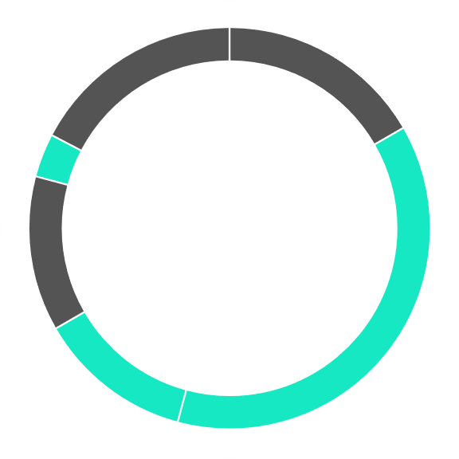
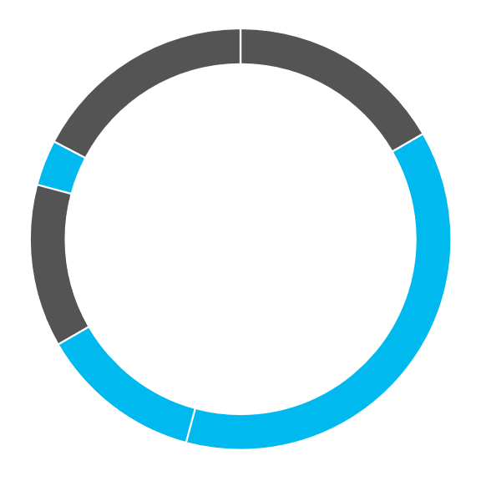
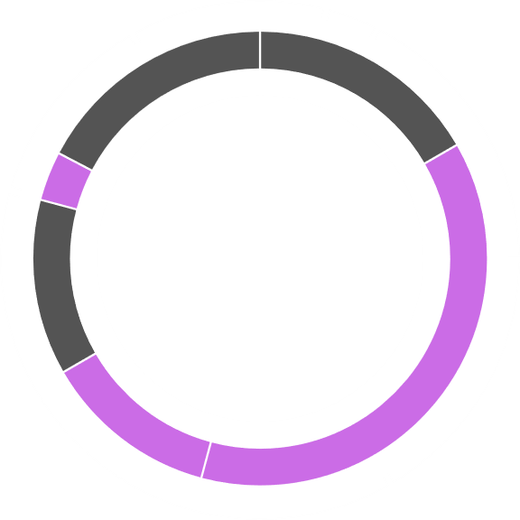
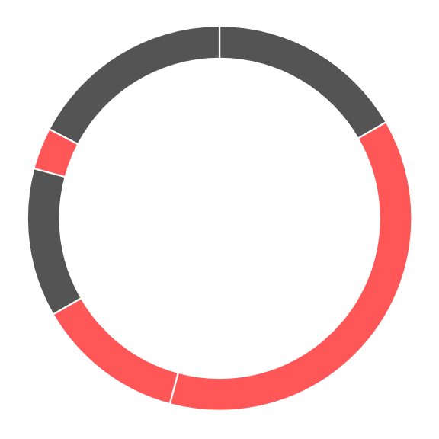





STRUCTURING ANSWER
Describe your main tasks and responsibilities in detail
Emphasize any problem-solving or decision-making aspects
Briefly state your current job title and the company you work for
Share how you reflect on your work and plan for the future
Outline the key activities you engage in throughout your day.
Mention any specific routines or practices that are crucial to your work.
Discuss how you interact with team members and other departments.
Mention any meetings or collaborative efforts you participate in.

Slide 17
SAMPLE ANSWER
Introduction & Daily Routine Overview
I’m currently a backend developer at XYZ Company, where I focus on optimizing our web services and ensuring system reliability. My day typically starts by reviewing system metrics and any alerts that came in overnight. This initial check is crucial for identifying any potential issues before they affect our users.
Highlight Key Responsibilities
After my morning review, I prioritize my tasks based on urgency. A significant part of my day involves coding, where I work on new features or enhancements. For instance, I recently developed a new API endpoint that improved data retrieval speed by 25%, which directly benefits our client applications.

Slide 18
SAMPLE ANSWER
Collaboration, Communication, Reflection and Improvement
I also participate in daily stand-up meetings with my team. During these meetings, we discuss our progress, any roadblocks we’re facing, and our plans for the day. This collaboration helps ensure that we are all aligned and supports our goal of delivering high-quality software on time. At the end of the day, I take some time to reflect on what I accomplished. I review any feedback from code reviews and plan my tasks for the next day. Overall, my daily work focuses on delivering reliable backend services and collaborating effectively with my team.

Slide 19
SENTENCE STRUCTURE TEMPLATES
1. Introduction
I currently work as a [Your Job Title] at [Company Name], where I focus on [Brief Overview of Your Role].
In my role as a [Your Job Title], I am responsible for [Description of Your Responsibilities].
2. Daily Routine Overview
My day typically starts at [Start Time], when I [Describe Initial Task or Routine].
I usually begin my work by [Explain What You Do First Each Day], which helps me [Explain the Purpose].
3. Highlight Key Responsibilities
After my initial tasks, I focus on [Describe Main Responsibilities or Tasks]. For example, I [Specific Task or Project].
A significant part of my day is spent [Explain Main Activities], such as [Give Examples of Specific Tasks].

Slide 20
SENTENCE STRUCTURE TEMPLATES
4. Collaboration and Communication
I participate in [Type of Meetings or Collaboration], where we [Explain Purpose of Meetings].
Collaboration is key, so I [Describe How You Work with Others or Share Progress].
5. Reflection and Improvement
At the end of the day, I take time to [Describe Reflective Practice], which allows me to [Explain the Benefit of This Practice].
I review my accomplishments and plan for the next day by [Explain How You Prepare for Future Tasks].
6. Conclusion
Overall, my daily work involves ................................. and contributes to [Explain How Your Role Aligns with Company Goals].
In summary, I focus on ............................................, which supports [Company's Mission or Values].

Slide 21
Variations of "Tell me about your daily work
What does a typical day look like for you in your current role?
Can you describe your daily responsibilities at work?
What are your main tasks on a day-to-day basis?
How do you usually structure your workday?
What activities do you engage in during a typical workday?
Can you walk me through your daily routine at work?

Slide 22
BRAINSTORMING
Writing Time

Slide 23
THANK YOU

