Slide 1


LESSON 2
TELL ME ABOUT YOURSELF
BEHAVIORAL INTERVIEW QUESTIONS
Get Started

Slide 2


CONTENTS
TOPIC: TELL ME ABOUT YOURSELF
01
REVISE
Revise question 1 & 2
02
Tell me about your proudest achievement
QUESTION 3
03
Tell me about your strengths and weaknesses
QUESTION 4

Slide 3

REVISE QUESTIONS 1 & 2
1
Tell me about yourself
Tell me about your daily work
2

Slide 4


ANALYZING QUESTIONS
proudest achievement
3
Tell me about your proudest achievement
Focusing specifically on the top result of the candidate’s career.
Recruiters can learn about your work ethic, values, personality, and skills
Recruiters want to learn about your successful projects, the details around them, and how you got to the finish line.

Slide 5

STRUCTURING ANSWER
BE SPECIFIC
STAR method
BE HONEST
BE RELEVANT

Slide 6
STRUCTURING ANSWER
STAR method
R = Result: What was the outcome? What have you learned from it?
S = Situation. In what context did your achievement occur?
T = Task: What are the challenges you have faced?
A = Action: What are the skills you have used? How did you overcome it?

Slide 7
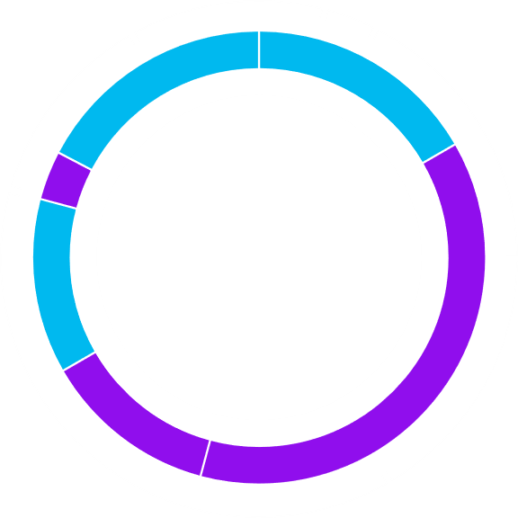
SAMPLE ANSWER
Situation & Task
During my last role as an information technology manager, the business secured several new clients. We needed to expand our team to complete these projects on time and impress the new clients.
Action
The department had a history of hiring new developers who rarely stayed long, so I decided to overhaul the hiring process. After reviewing the procedure, I replaced the current independent programming test with a partnered problem I could work on with the candidate. I also added interview questions that helped us assess each candidate's character and whether they might fit with the business's culture. While solving the coding challenges with candidates, I learnt more about their decision-making processes and teamwork capabilities than we did seeing their solutions to an independent test.

Slide 8
SAMPLE ANSWER
Result:
While it took longer to find suitable candidates, all five people I hired remain with the business today and are real assets to the company. I feel that's because we started looking beyond their coding ability and focused on how well they'd operate within our team. I felt proud to substantially improve retention and identify more valuable members for the team.

Slide 9
SENTENCE STRUCTURE TEMPLATES
Situation
One of the most remarkable accomplishments was perhaps [your achievement] when I was working on [project]/ at [Company XYZ] with my team.
My proudest achievement as a backend engineer was [your achievement]
Task & Action
My responsibility was to [Explain your specific task or goal in that situation]
I was tasked with [Describe what you needed to achieve]
To address this, I [Describe the actions you took to achieve the goal].
I implemented [Explain the strategies, skills, or techniques you used], which involved [Detail any specific steps or processes].
Result
As a result of my efforts, [Describe the outcome and the impact it had].
This led to [results, including any quantifiable metrics or feedback]. I felt proud because............................................

Slide 10
Variations of "Tell me about your proudest achievement”
Can you describe a significant achievement you've had?
What is your greatest professional success?
Share an achievement that you believe defines your work ethic.
What is a milestone in your career that you are particularly proud of?
Can you tell me about a time when you achieved something that had a major impact?
What is the most rewarding project you have worked on?

Slide 11

BRAINSTORMING
Writing Time

Slide 12
ANALYZING QUESTIONS
strengths and weaknesses
4
Tell me about your strengths and weaknesses
To assess self-awareness, humility, and your ability to improve, how you handle challenges and fit within the team.

Slide 13





STRUCTURING ANSWERS
Choose relevant examples
Be honest but positive
STAR TECHNIQUE
Balance your strengths and weaknesses
End on a positive note

Slide 14
SAMPLE ANSWER
About Strengths
Situation
In my previous role as a project manager, I was responsible for coordinating a team to launch a new product under a tight deadline.
Task
The project required close coordination between multiple departments—marketing, design, and engineering—and we had limited time to ensure everything was aligned for a successful product launch.
Action
One of my key strengths is my ability to prioritize tasks and manage time effectively. I broke down the entire project into smaller, manageable tasks and set clear deadlines for each department. I also scheduled daily stand-up meetings to track progress, identify any roadblocks early on, and ensure the team stayed focused and motivated.
Result
Finally, we successfully launched the product on time, and it received positive feedback from customers. This strength has helped me complete tasks effectively so far.

Slide 15
SAMPLE ANSWER
About Weaknesses
Situation
In the past, I found it challenging to delegate tasks effectively, particularly when I felt that the quality of the work might not meet my standards.
Task
For instance, while leading a project to revamp our website, I took on too many responsibilities myself, fearing that delegation would slow down the process or impact quality.
Action
To improve, I recognized the need to trust my team more and started delegating tasks based on each person’s strengths and expertise. I began by setting clearer expectations and providing more guidance upfront, but also giving team members the autonomy to take ownership of their work. I also made an effort to check in regularly without micromanaging.
Result
As a result, the project moved forward much more efficiently. My team felt more empowered and motivated, and the website redesign was completed ahead of schedule. I learned that delegation not only improves efficiency but also helps develop the skills of the team, which ultimately benefited both the project and the team’s overall performance.

Slide 16
SENTENCE STRUCTURE TEMPLATES
For Strengths:
Situation
In my previous role as [position] at XYZ, I was responsible for [task or project].
At XYZ, we faced [challenge], and I was in charge of [responsibility].
Task
My task was to [specific responsibility].
I needed to [objective], ensuring [desired outcome].
Action
To address this, I [action taken] by ..............................
I leveraged my strength in [strength] by ...................................
I focused on [key action] to ensure [specific result].
Result
As a result, we [outcome], which lead to [result].
This approach resulted in [positive result], and we achieved [specific achievement].

Slide 17
SENTENCE STRUCTURE TEMPLATES
For Weaknesses:
Situation
In the past, I found myself struggling with [weakness] while working on [project/task].
At one point in my career, I noticed I had difficulty with [weakness] when [situation].
Task
This was a challenge because I was expected to [task or responsibility], but I had a tendency to [problem].
My task was to [specific goal], but my [weakness] made it difficult to [achieve task].
Action
To address this, I began [action taken], such as [specific steps you took to improve].
I realized I needed to improve in [area], so I [action taken] to handle it more effectively.
Result
By doing this, I was able to [positive outcome], and the result was [achievement].
As a result of my improvements, I was able to [outcome], and the project was completed successfully.

Slide 18
Variations of "Tell me about your stregnths and weaknesses”
Tell me about a time when you turned a weakness into a strength
How do you handle situations where you have to overcome a weakness?
What are your greatest strengths and how have you demonstrated them in the workplace?
Can you give me an example of a time when your strengths helped you succeed in a project?
What skills or qualities do you need to improve to be more effective in your role?

Slide 19
BRAINSTORMING
Writing Time

Slide 20
THANK YOU

