Slide 1


LESSON 3
COMMON BEHAVIORAL QUESTIONS
BEHAVIORAL INTERVIEW COURSE
Get Started

Slide 2


CONTENTS
TOPIC: COMMON BAHVIORAL INTERVIEW QUESTIONS
01
REVISE
Revise question 3 & 4 lesson 2
02
Why are you looking for new jobs?
QUESTION 1
03
Why do you want to join us? What made you choose us but not othercompanies?
QUESTION 2

Slide 3

REVISE QUESTIONS 3 & 4
3
Tell me about your proudest achievement
Tell me about your strengths and weaknesses
4

Slide 4


ANALYZING QUESTIONS
1
Why are you looking for new jobs?
Understanding your motivation and career goals
Fit with the role and the company
Clarifying any gaps in employment or job hopping
Commitment and Stability

Slide 5
STRUCTURING ANSWER
STAR method
Express professional growth
Conclusion
Emphasize positive change
Align with company values
Seeking for a better fit

Slide 6
STRUCTURING ANSWER
STAR method
R = Result: What you can contribute to the company/ role and on reverse
S = Situation. Introduce your role at the previous compamny
T = Task: Describe how and what make you want to find a new job
A = Action: Describe how/ what you have been done to prepare for the new role

Slide 7
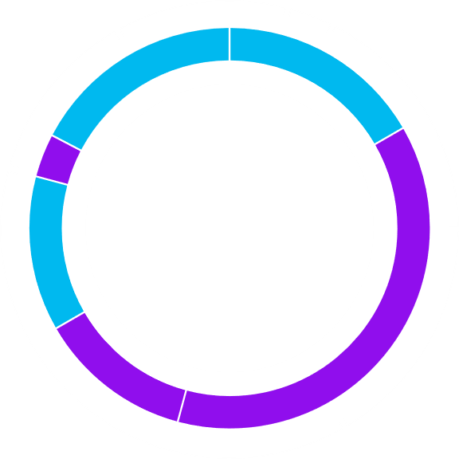
SAMPLE ANSWER
Situation
Worked as a Backend Developer at XYZ, I've had the opportunity to work on various backend services, particularly focusing on optimizing our database queries and improving overall system performance for our e-commerce platform.
Task
While I’ve been able to contribute significantly in this capacity, I feel I’m no longer as challenged as I’d like to be. I’m eager to take on more complex systems, such as working with microservices architectures, cloud infrastructure, and scalable backend solutions. I’m looking for a new role that provides opportunities to dive deeper into these areas and work on projects that push the boundaries of what I’ve done so far.

Slide 8
SAMPLE ANSWER
Action
To make sure I’m prepared for this kind of role, I’ve proactively worked on improving my skills. For example, I’ve completed a certification in AWS to better understand cloud-based architectures, and I’ve been experimenting with microservices in my personal projects. Additionally, I’ve been involved in several cross-team collaborations at work, where I helped integrate new API services.
Result
I believe this role at XYZ will offer exactly the challenges I’m looking for, especially with your focus on building out a microservices infrastructure or expanding into cloud-based solutions. I’m confident that my background in system optimization, along with my growing skills in cloud and microservices, will allow me to make valuable contributions to your team.

Slide 9
SENTENCE STRUCTURE TEMPLATES
Situation
In my current role at XYZ, I’ve been responsible for maintaining and optimizing the backend of our [project/system]. Over the past [X years/months], I’ve had the opportunity to improve system performance and implement [Task].
At [Current Company], I’ve been working as a Backend Developer, mainly focusing on........................................ One of the major projects I’ve contributed to is [significant project], in which I gained a great learning experience.
Task
While I’ve learned a lot in my current role, I’m beginning to feel that I’m not being challenged enough/ reasons in areas I want to grow. Specifically, I’m looking for more opportunities to work with [new technology/skill you want to develop]
I’m at a point in my career where I’m eager to take on more complex problems, particularly [specific task/technology]. I am looking for a role where I can contribute my skills effectively and thrive in [skills/ fields]

Slide 10
SENTENCE STRUCTURE TEMPLATES
Action
To prepare for the role, I’ve been learning [mention new skills, tools, or certifications]. I’ve also taken on additional responsibilities, such as [leadership task, mentoring junior developers] to gain experience in areas I’m passionate about.
I’ve also worked on several side projects, including [mention any personal project], where I’ve been able to experiment with [specific tech or architecture]. I’ve really enjoyed this and feel ready to apply these skills in a more professional/ challenge setting.
Result
I’m really excited about this opportunity at XYZ because it match perfectly with my desire to work on [field]. I believe that my background in [relevant skills/technologies] will allow me to contribute to your team’s success, while also continuing to develop in the areas I’m passionate about.
This role excites me because it offers the chance to work with................. I believe my experience with [relevant technologies or systems] will allow me to make a strong impact and continue to grow as a Backend Developer in the way I’m aiming for.

Slide 11
Variations of “Why are you looking for new jobs?”
What’s motivating your job search right now?
Why do you want to leave your current company?
Why do you feel it’s time for a change?
What are you hoping to achieve with your next job?
What are the key factors that will influence your decision to leave your current job?

Slide 12

BRAINSTORMING
Writing Time

Slide 13
ANALYZING QUESTIONS
4
Why do you want to join us? What made you choose us but not other companies?
To assess motivation, evaluate cultural fit, understand research efforts, get the differentiation from other candidates and explore career aspirations.

Slide 14


Slide 15




STRUCTURING ANSWERS
Express your personal passion for the employer’s product/service/mission.
STAR FORMAT
Explain why you would enjoy the responsibilities of the role.
Key tip: Be specific
Describe how you can see yourself succeeding in the role, given your skills and experience.

Slide 16
SAMPLE ANSWER
Situation
I want to join Amazon as a backend developer because I see it as a unique opportunity to work on innovative technologies that impact millions of users globally. With my background in software development and experience in building scalable systems, I believe I can contribute significantly to your team.
Task
My goal is to leverage my skills in backend development to enhance system performance and reliability, especially in a fast-paced environment like Amazon, where speed and efficiency are crucial

Slide 17
SAMPLE ANSWER
Action:
I thrive in data-driven environments, and I’m excited about Amazon’s commitment to using data to inform decisions. In my previous role, I implemented a microservices architecture that improved system scalability and reduced downtime by 30%. I also enjoy collaborating with cross-functional teams to design APIs that deliver seamless user experiences.
Result:
By joining Amazon, I would have the chance to work on cutting-edge projects that align with my passion for technology and innovation. I am eager to contribute to a company that values both customer obsession and technical excellence, ultimately helping to create robust solutions for users worldwide."

Slide 18
SENTENCE STRUCTURE TEMPLATES
Situation
I want to join XYZ as a backend developer because ………………….. With my background in [skills/ positions].
I've been following your company’s growth and initiatives, particularly in [specific area or project].
Task
My goal is to leverage my skills in [specific responsibility].
I realized that I want to expand my skills in [specific area] and take on more [skills].
Action
I thrive in [skills]................... and I’m excited about XYZ’s commitment to [XYZ’s outstanding aspects]
I leveraged my strength in [strength] by ...................................
Result
By joining XYZ, I would have the chance to work on [fields/ skills] that align with my passion for …………………
Joining your team would allow me to align my work with my values while contributing to [specific skills/ fields]

Slide 19
Variations of “Why do you want to join us? What made you choose us but not other companies?
What interests you about working for our company specifically?
Why did you decide to apply to our organization rather than others?
What attracted you to this position at our company?
Can you explain why you believe our company is the right fit for you?
What sets our company apart from others you considered?
Why do you think you would thrive at our organization?

Slide 20
BRAINSTORMING
Writing Time

Slide 21
THANK YOU

