Slide 1


LESSON 4
COMMON BEHAVIORAL QUESTIONS
BEHAVIORAL INTERVIEW COURSE
Get Started

Slide 2


CONTENTS
TOPIC: COMMON BAHVIORAL INTERVIEW QUESTIONS
01
REVISE
Revise questions 3 & 4 lesson 3
02
Where do you see yourself in the next 3 years?
QUESTION 3
03
Are you in the process with any other companies?
QUESTION 4

Slide 3

REVISE QUESTIONS 1 & 2
1
Why are you looking for new jobs?
Why do you want to join us? What made you choose us but not othercompanies?
2

Slide 4


ANALYZING QUESTIONS
3
Where do you see yourself in the next 3 years?
They are trying to learn about your long-term plans and how well they match the job and the company.
They want to know if you're committed to staying in the role for a while and if your career goals align with what they can offer.

Slide 5
STRUCTURING ANSWER
01
Being Honest and Realistic
02
Showcasing Commitment
03
Highlighting Personal and Professional Growth
04
STAR TECHNIQUE

Slide 6
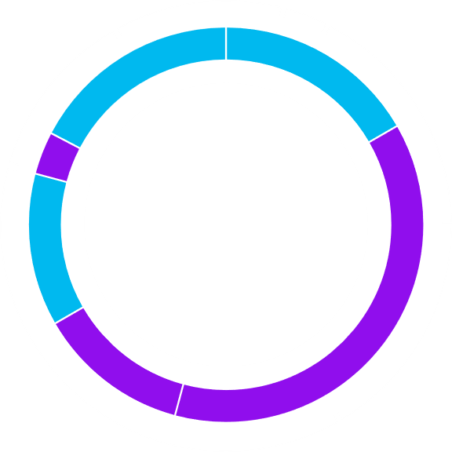
SAMPLE ANSWER
Situation:
Over the next three years, I see myself still working at your company and advancing in my technical skills and taking on more leadership responsibilities.
Task
I aim to become a lead backend developer of a small team, where I can not only contribute to code development but also mentor junior developers and lead related projects. I want to be a person who plays a key role in shaping the architecture of our systems and driving innovation within the team.

Slide 7
SAMPLE ANSWER
Action
To achieve this, I plan to continue upgrading my strength in microservices and serverless architecture. I will pursue relevant certifications and actively participate in team discussions to share insights and best practices. Also, I aim to take the initiative on projects that allow me to showcase my leadership abilities and collaborate with cross-functional teams.
Result:
Three years later, I see myself as a trusted technical leader within the organization, having successfully led several impactful projects that improve system performance and enhance user experience. I believe that this growth will not only benefit my career but also contribute significantly to the company's goals and technological advancements.

Slide 8
SENTENCE STRUCTURE TEMPLATES
Situation & Task
In the next three years, I aim to become/ want to be [specific position].
I hope to take on more responsibility by [describe a particular goal]
In three years from now, I still want to work for your company. During the next 3 years, I plan to become …………………
Action
To get there, I plan to [what you will do]
I will seek opportunities to [mention actions]
Result
By then, I hope to.........................................
By the end of three years, I expect to [describe the outcome]
Ultimately, I aim to enhance my skills in [specific technologies or practices], making a significant impact on my team and the company.

Slide 9
Variations of “Why are you looking for new jobs?”
What are your career goals for the next three years?
How do you envision your professional growth over the next three years?
What position do you hope to hold in three years?
Where do you see your career heading in the next few years?
What skills or experiences do you hope to gain in the next three years?

Slide 10

BRAINSTORMING
Writing Time

Slide 11
ANALYZING QUESTIONS
4
Are you in the process with any other companies?
Your interest in this role, at this company
your job search is well-thought-out and focused, rather than scatter-gun
To assess whether you are discussing with other competitors
Understand how quickly they will have to move if they were to offer you the job

Slide 12









STRUCTURING ANSWERS
Be honest with your interviewer
01
02
Explain your interest in the company
STAR FORMAT
Answer with general information
03
04
Discuss what you are looking for in your next role

Slide 13
SAMPLE ANSWER
Situation & Task
As a backend developer with several years of experience, I have been exploring new opportunities to advance my career and work on exciting projects. My goal is to find a position that not only aligns with my skills but also offers room for professional growth and the chance to contribute to innovative solutions.
Action
Currently, I am in discussions with a couple of other companies. However, I want to emphasize that I am particularly drawn to your organization because of its commitment to innovation and the exciting projects you have in development. I have researched your team and the technologies you use, and I believe my skills in using advanced technology would be a great fit here.
Result
I am keen on finding the right opportunity where I can make a meaningful impact like driving innovation, and I would prioritize joining your team if offered a position. I appreciate the chance to explore this opportunity further with you.

Slide 14
SENTENCE STRUCTURE TEMPLATES
Situation and Task
Yes, I am currently exploring opportunities with other companies."
I have applied to a few other places, including [mention companies if appropriate].
I am in discussions with a couple of other companies right now.
Action
However, I want to emphasize that I am very interested in this position.
I am particularly excited about this opportunity because [reason related to the company].
I really admire [specific aspect of the company]
I feel that this position would allow me to [mention how you can contribute or grow].
Result/ conclusion
I appreciate the chance to discuss this opportunity with you.
I am looking forward to the possibility of joining your team.

Slide 15
Variations of “Are you in the process with any other companies?”
Are you considering any other job opportunities right now?
Do you have any other interviews lined up?
Are you speaking with other companies about potential positions?
Are you applying to other jobs at the moment?
Have you been in talks with any other employers?
Are there other companies you are pursuing?

Slide 16
BRAINSTORMING
Writing Time

Slide 17
THANK YOU

