Slide 1


LESSON 7
LEADERSHIP PRINCIPLE
BIAS FOR ACTION
BEHAVIORAL INTERVIEW COURSE
Get Started

Slide 2


CONTENTS
BIAS FOR ACTION
Revise question 1 & 2 - Learn and Be Curioius LP
QUESTION 1
How have you managed risk in a project?
QUESTION 2
Tell me about a tough decision you made quickly during a project
QUESTION 3
How do you prioritize if you have to work on 4 different projects?

Slide 3

REVISE QUESTIONS 1 & 2
1
Tell me about a time when you had to quickly learn something new to complete a task. How did you approach it?
How do you stay updated on industry trends and new technologies? Give an example of how this has benefited your work.
2

Slide 4

BIAS FOR ACTION?
Speed matters in business. Many decisions and actions are reversible and do not need extensive study. We value calculated risk taking.

Slide 5
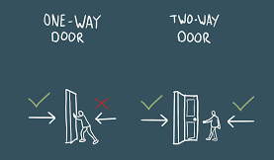
Decision Making using One and Two-Way Doors

Slide 6


ANALYZING QUESTIONS
1
How have you managed risk in a project?
1
To ascertain your ability to plan, forecast, and preemptively deal with any potential issue that could have negatively impacted the project.
To gauge how you deal with unexpected situations and pressure.

Slide 7

STRUCTURING ANSWER
STAR
TECHNIQUE
Discuss the result
Identify the project
Elaborate on the risk identification process
Describe the risk management plan

Slide 8

SAMPLE ANSWER
While working on a major software at XYZ Company, I realized that there were potential risks associated with data migration, which could affect system performance and user experience.
My task was to ensure a smooth migration process while minimizing risks to data integrity and system uptime. I managed risk by implementing a phased migration strategy. This involved migrating a small subset of data first to identify any issues before a full-scale migration. I also conducted thorough testing and created backup plans in case anything went wrong. Throughout the process, I communicated regularly with stakeholders to keep them informed of our progress and any potential issues.
By taking these steps, we successfully completed the migration without any data loss or significant downtime. The phased approach allowed us to address issues early, and stakeholders appreciated the transparency throughout the process. This experience taught me valuable lessons in risk management and the importance of thorough planning.

Slide 9
SENTENCE STRUCTURE TEMPLATES
Situation
While working on [your role] at XYZ, we/I faced risks related to [problems]
During my time at XYZ, there was a time we/ I had struggled with [problems]
In a recent [name project] project, we faced [problems] risks related to
Task & Actions
I initiated a thorough requirements - gathering [information/ things need to complete the task]
Additionally, I conducted [actions/steps]
To mitigate this risk, I [actions]
To manage these risks, I collaborated with [people you worked with]
We identified potential issues and developed a mitigation plan that included [elements]
Results
This proactive approach not only ....................................but also ...............................
By taking these steps, we successfully completed ........

Slide 10
Variations of “How have you managed risk in a project?”
How do you identify and assess risks in a new project?
Can you describe a time when you had to manage a significant risk that threatened project success?
Describe your process for creating a risk management plan for a new project
How do you assess and address risks when working on a project?
Can you share an experience where you successfully managed risks in a project?

Slide 11

BRAINSTORMING
Writing Time

Slide 12
ANALYZING QUESTIONS
2
Tell me about a tough decision you made quickly during a project
They want to get a handle on how you might handle a difficult decision at the company you're interviewing for.
They also want to get a feel for how strong your critical thinking skills are.

Slide 13




STRUCTURING ANSWERS
Tell them what you did, how you did it, and how your decision benefited the employer.
01
PAR/ STAR FORMAT
02
Points to Emphasize (Keep it relevant be, genuine, be concise and highlight your skills.
03
don’t go negative, don’t have a pity party, don’t get too personal

Slide 14
SAMPLE ANSWER
We had to expand the storage capacity of a Commvault server to accommodate new machines that were coming online. We planned to double the capacity of the server from 32 to 64 terabytes. For this upgrade, the server had to be converted to MediaAgent, a procedure that was documented and tested.
We followed the documentation closely, but in production, the Windows batch file that was supposed to convert the server to MediaAgent accidentally deleted some important files on the server, effectively rendering the existing Commvault server useless. All backups from applications/DB started failing.
While experts from Commvault HQ were engaged to find the root cause, the customer was informed about this problem. In an hour, I determined that the problem was not easily fixable. I wanted to use a new server, but the Commvault license was linked to a particular IP address. Instead of waiting to hear back from Commvault HQ and our purchasing department on getting another license, I simply copied the XML license to a new machine, changed the IP, and updated the existing license. At that point, the team could move forward.

Slide 15
SENTENCE STRUCTURE TEMPLATES
Problem
One of the hardest decisions I’ve had to make was [problems]
The most difficult decision I've had to make was one involving [problems]
Action
After careful consideration and weighing the pros and cons, we decided to [what you took]
In order to resolve the problems quickly, I had no choice but to [what you did]
It was a very difficult decision on a personal level.
Result
As a result, [discuss results]
At the end, our decision was paid off [describe results]

Slide 16
Variations of “Tell me about a tough decision you made during a project”
What are some difficult choices you have to make in your position?
Have you ever needed to make a very difficult decision at work? What was the decision?
In your position, what is the most difficult decision you remember making?
Tell me about a time when you had to make a hard decision that affected a project's outcome.
What was one of the toughest decisions you've made while leading a project?

Slide 17
BRAINSTORMING
Writing Time

Slide 18
ANALYZING QUESTIONS
3
How do you prioritize if you have to work on 4 different projects?
to understand your ability to manage multiple tasks efficiently, handle stress and the unexpected, and ensure critical projects are completed on time.

Slide 19

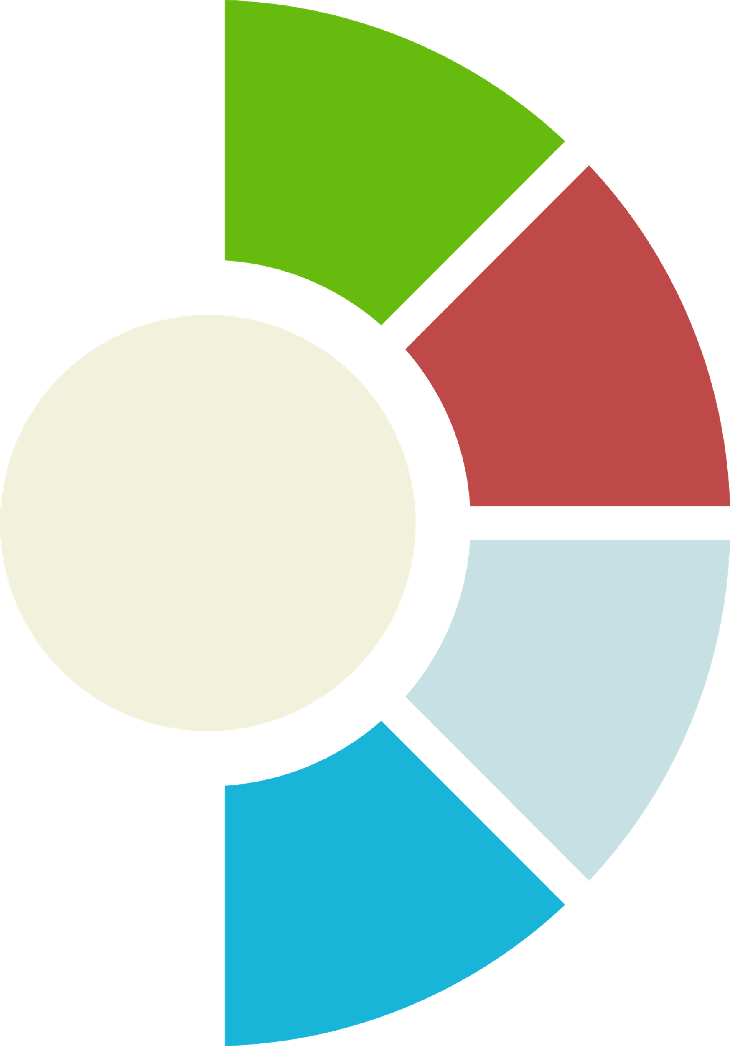





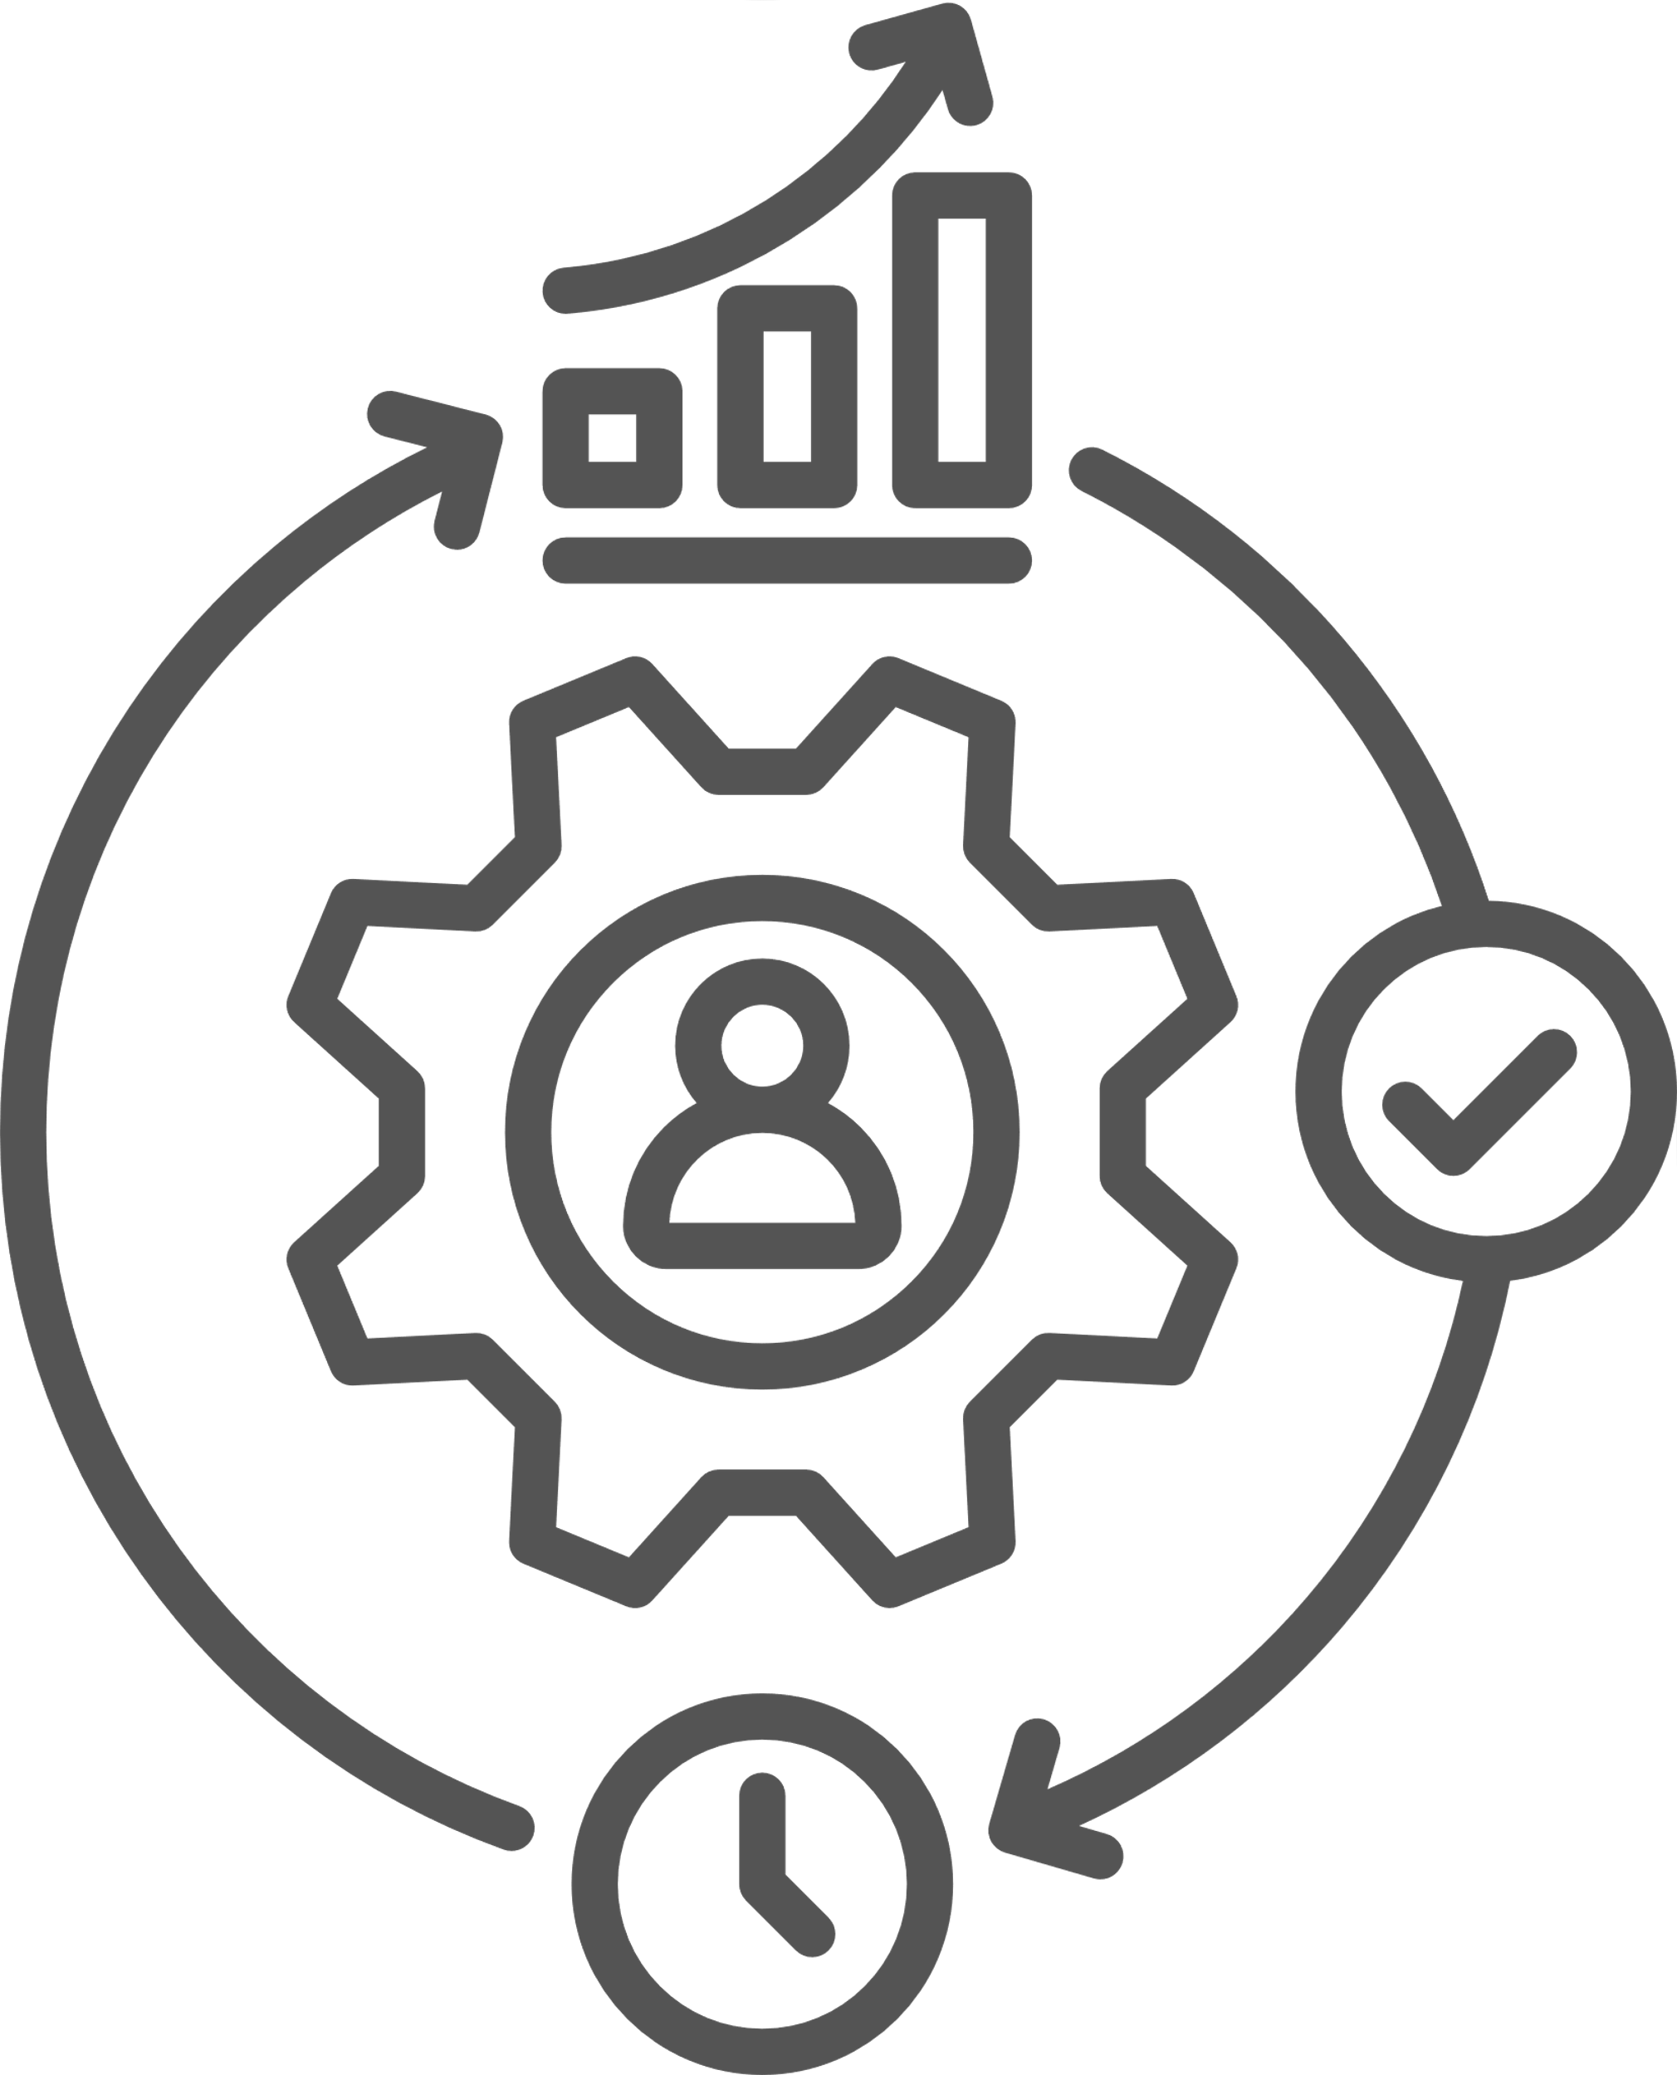

STRUCTURING ANSWERS
Urgency vs Importance:
Examples and Results
PAR/ STAR FORMAT
Daily and Weekly Planning and Time Blocking
Coping Strategies
Project Management Software, Prioritization Frameworks
Stakeholder Engagement, Team Coordination

Slide 20
SAMPLE ANSWER
I was once assigned to work on different projects at the same time. Each project had its own deadlines and requirements. I knew that I had to manage my time and prioritize these projects to ensure that all of them were completed on time and met quality standards.
For me, making a list of all projects and listing out their deadlines are the first things I have to do. I then assessed the importance of each project based on factors like urgency and impact on the team. I used a simple system such as the GGle calender: I marked urgent tasks that needed immediate attention and scheduled time blocks for each project. Communication with my team is a key factor in completing effectively my task because I can understand their priorities and any dependencies. In this way, I could adjust my focus as needed.
I was able to complete all projects on time. By clearly prioritizing and managing my time, I helped ensure that we met our goals without sacrificing quality. This experience taught me the importance of effective prioritization in handling multiple tasks.

Slide 21
SENTENCE STRUCTURE TEMPLATES
[skills/ system] is crucial in my prioritization process.
This ensures my priorities align with [describe your expected goals/ project’s goals]
By prioritizing tasks based on their impact and deadlines, I [what you can achieve]
Use [tools] to keep track of all my tasks and deadlines
I make it a point to keep lines of communication open with my manager and co-workers.
I try to give a heads-up to my team as soon as possible.
If my workload gets to be unmanageable, I check in with [team/ manager/ boss] about which items can drop to the bottom of the priority list, and then I try to reset expectations about different deadlines.”
This allows me to [Do something]

Slide 22
Variations of “Tell me about a tough decision you made during a project”
When you have too much on your plate to complete all the projects in the necessary timeframe, how do you decide what to tackle first?
What specifically goes into your thought process when determining how to prioritize various tasks?
What steps do you take when a top-priority project is looking like it won’t be completed by the deadline? How do you handle that?
How do you communicate the news that a project has slipped and might miss the deadline?

Slide 23
BRAINSTORMING
Writing Time

Slide 24

KEY POINTS TO TAKEAWAY

Slide 25
THANK YOU

