Slide 1

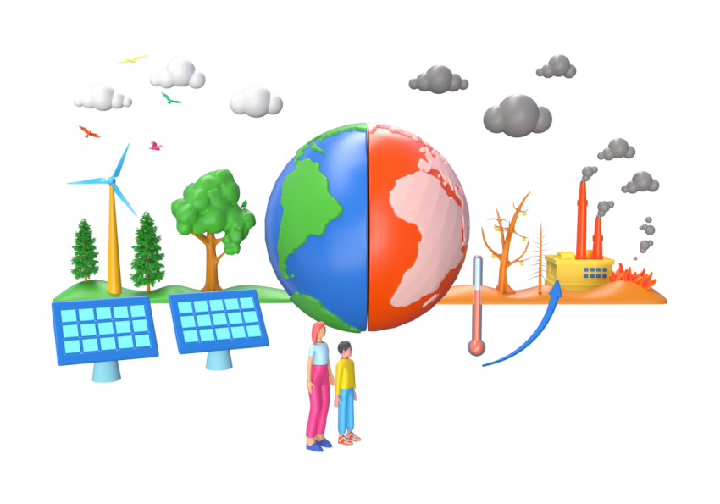
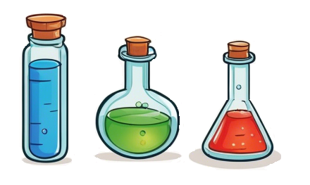







Discover Science Through Technology
Explore the Science of Combustion:
What Makes Fire Burn? Dive into the chemistry behind combustion, the powerful reaction that fuels everything from campfires to engines.
Combustion Detective: Learn to identify combustion reactions and predict what they produce—can you figure out what’s left after the fire?
Balance the Flames: Get hands-on with balancing combustion equations by hand, then level up by coding your way to the perfect balance.
Uncover the Science Behind Our Changing Planet:
Why is Our Planet Warming? Explore the causes and effects of climate change, from rising temperatures to melting ice caps.
Dive into the Data: Analyse real-world data on temperature trends, carbon dioxide levels, and sea level rise. What do the numbers tell us?
Take Action for the Future:
Discuss how we can
Reduce our carbon footprints—what can you do personally, and what can we achieve together?
Get ready to ignite your coding and science skills—
let's burn bright!
Join us in the fight against climate change—because the future is in our hands!
Dive into the Science of Sound:
Decode the Waves: Learn how amplitude and frequency shape the sounds we hear every day
Measure the Speed of Sound: Conduct a hands-on experiment to calculate how fast sound travels using real-world tools. Can you hit the right note?
Explore Sound in Action: Analyse how sound waves behave at different distances—understand why sound waves change
Master Gravity and Fuel for
Epic Space Missions:
Journey to the Stars: Uncover how
gravity shapes every space
mission—from launching rockets to
orbiting planets!
Calculate the Forces of
the Universe: Use Python to crunch the numbers on gravitational forces and see how they impact space travel. Can you plot the perfect course?
Team Up for the Mission: Work together in groups to tackle complex space challenges and present your findings like real NASA scientists.
Ready to tune in to the science of sound? Let's make some waves!
Ready to blast off? Join us and code your way to the stars!
Explore the Future of Medicine with Technology:
Tech That Heals: Discover how AI, smart monitoring devices, and cutting-edge treatments are transforming healthcare and saving lives.
Design Your Own Medical Marvel: Team up to create an innovative healthcare device—bring your creativity and problem-solving skills to the table!
Think Like a Healthcare Futurist: Critically examine the latest medical
Understand the Energy Behind Everyday Life:
What Powers Your Home? Explore how household items consume energy and learn which appliances use the most power.
Master Data with Google Sheets: Use Google Sheets to track and analyse energy usage—gain valuable skills in data entry and analysis.
Calculate Energy Impact: Use formulas
to calculate the energy consumption
of your home and understand the
broader implications of energy use.
Think Critically About Energy: Based on
your analysis, develop insights into
how energy is consumed and consider
how it impacts our environment.
technologies and predict how they could change the future of healthcare.
Image from Videoplasty.com
Are you ready to be part of the next healthcare revolution?
Let’s innovate together!
Ready to uncover the secrets of energy use?
Let’s power up your knowledge!

