Slide 1

Balancing Equations
Chemistry with Programming

Slide 2
Lesson Aims
Predict the products of a given combustion reactant and show the reaction as a word equation.
Write word equations from information about chemical reactions.
Balance a symbol equation.

Slide 3
Combustion
A reaction with oxygen in which energy is transferred to the surroundings as heat and light.

Slide 4
Combustion
Formula:
aX + bO2 -> cCO2 + dH2O

Slide 5
Activity
Guess the product of the reaction
H2 + a02 ->
CH4 + b02 ->
Extension:
What else is needed for these reactions to take place

Slide 6
Activity
Open the worksheet
Follow the link to set up the Python document
Work through the Worksheet

Slide 7
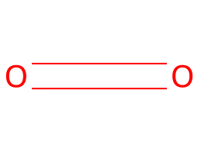
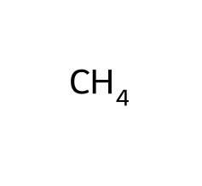
Visualising Chemicals in Python
Smiles =
We are using ‘from rdkit.Chem import Draw’ to draw the reactants.
What does this show us?

Slide 8
Balancing Equations
Balancing equations is linear maths.
Just think you can’t lose matter, so if you have 3 Carbon atoms on the left you have to have 3 Carbon atoms on the right.

Slide 9
Your Turn
aC4H10 + bO2 ->

Slide 10
Extension
Name all the states of the chemicals in the table below
CH4 + aO2 -> bCO2 + dH20
Balance
C8H18 + aO2 -> bCO2 + dH20

Slide 11
Final Activity
Questions
Does combustion require heat?
Is this Equation balanced? 4H2 + 3O2 -> 4H2O + CO2
Water is a product in combustion?

