Slide 1

Balancing Equations
Chemistry with Programming

Slide 2
Lesson Aims
Predict the products of a given combustion reactant and show the reaction as a word equation.
Write word equations from information about chemical reactions.
Balance a symbol equation.

Slide 3

Combustion
A reaction with oxygen in which energy is transferred to the surroundings as heat and light.

Slide 4
Combustion
Formula:
aX + bO2 -> cCO2 + dH2O
a,b,c,d are numbers
X is the chemical combusting

Slide 5
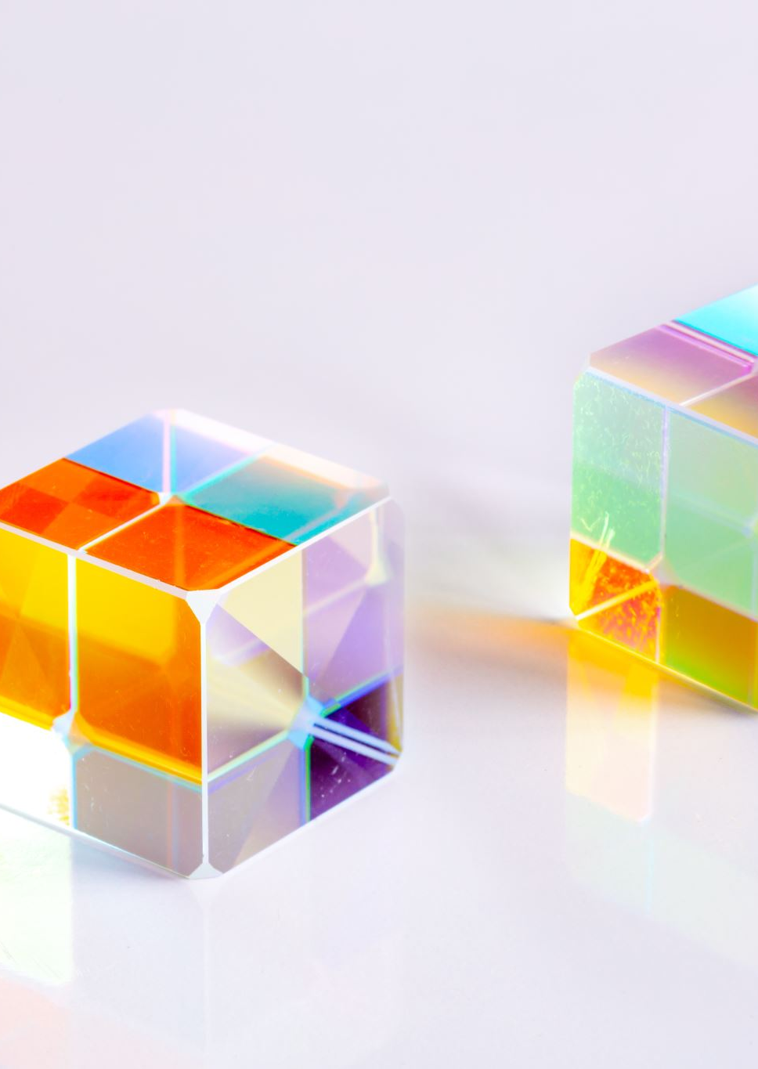
Activity
Guess the product of the reaction
H2 + a02 ->
CH4 + b02 ->
Extension:
What else is needed for these reactions to take place

Slide 6
Activity
Open the worksheet
1
Follow the link to set up the Python document
2
Work through the Worksheet
3

Slide 7
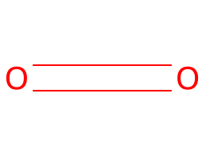
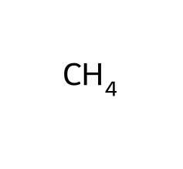
Visualising Chemicals in Python
Smiles =
We are using ‘from rdkit.Chem import Draw’ to draw the reactants.
What does this show us?
Notes:
Molecular structure, bonds in mixtures

Slide 8
Balancing Equations
Balancing equations is linear maths.
Just think you can’t lose matter, so if you have 3 Carbon atoms reacting (left) you have to produce 3 Carbon (right).

Slide 9
Your Turn
aC4H10 + bO2 ->

Slide 10
Extension
Name all the states of the chemicals in the table below
CH4 + aO2 -> bCO2 + dH20
Balance
C8H18 + aO2 -> bCO2 + dH20

Slide 11
Final Activity
Does combustion require heat?
Is this Equation balanced? 4H2 + 3O2 -> 4H2O + CO2
Is water a product in combustion?

Slide 12
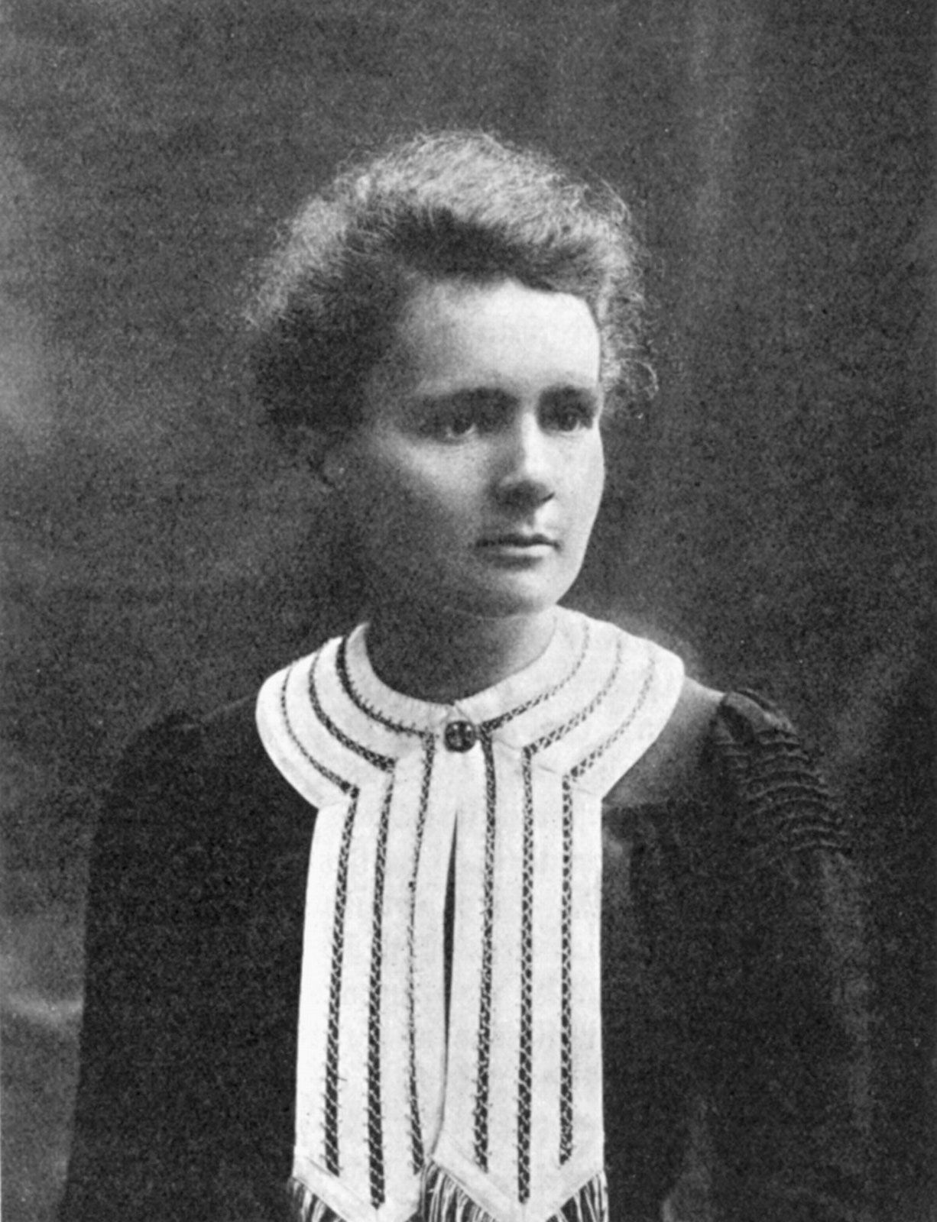
Marie Curie
Marie Curie is remembered for her discovery of radium and polonium, and her huge contribution to finding treatments for cancer. This work continues to inspire our charity's mission to drive fundamental change in end of life care so that everyone can have the best possible quality of life to the end.

