Slide 1

Organisms
Health care research

Slide 2
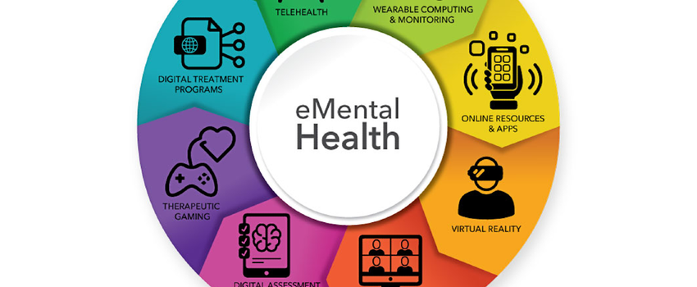
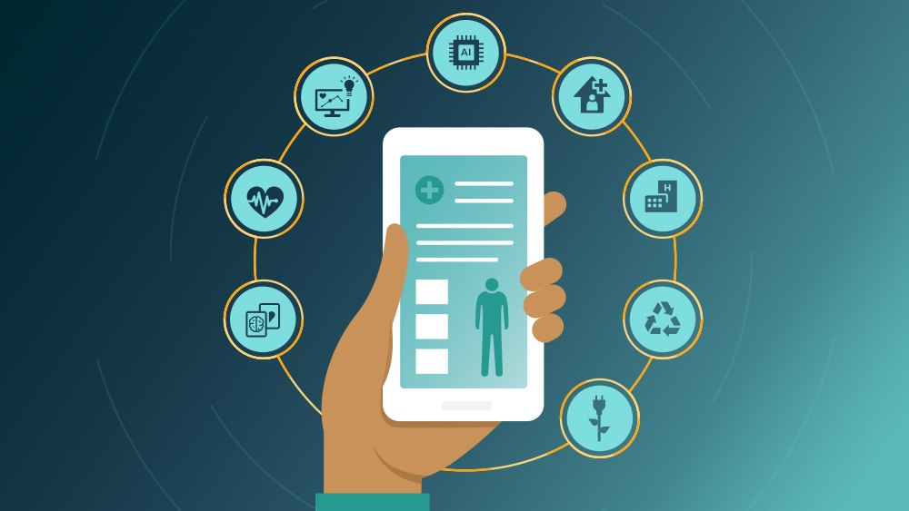
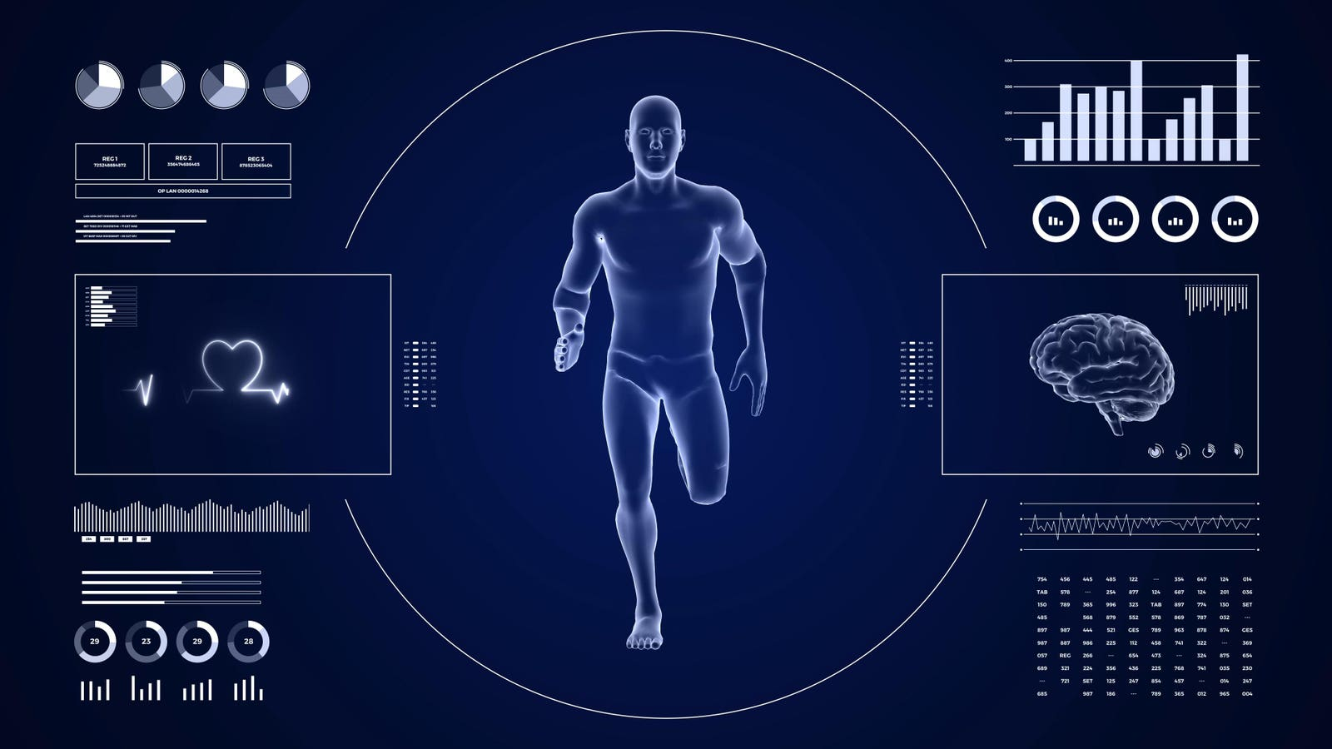
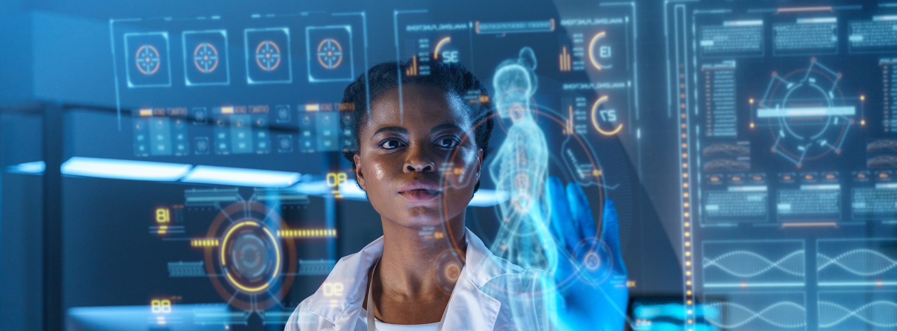

Slide 3
Lesson objectives
Consider the benefits and risks of technology for improving human movement
Make deductions about how medical treatments work based on cells, tissues, organs and systems
Evaluate a possible treatment for a lung disease.

Slide 4
Technology in healthcare
Technology is used everywhere in healthcare, from using AI to X-ray machines.
This set of slides introduces current technology and how it is used to keep us healthy

Slide 5
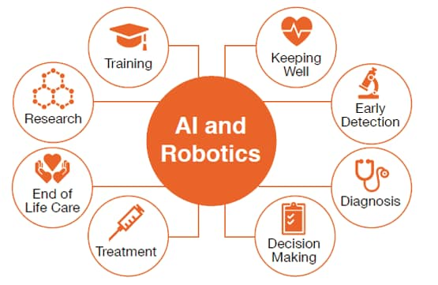
Artificial intelligence (ai)
Robotics
Discovering Drugs
Medical Diagnostics
Precision Medicine
Notes:
How AI is Revolutionizing Healthcare
Surgical Robots: Imagine a robot assisting a surgeon in the operating room. Today, robots are commonly used in surgeries like prostate operations and even complex procedures in the head and neck. These robots help surgeons perform with precision, making surgeries safer and faster.
Discovering New Medicines: When developing new drugs, scientists have to deal with enormous amounts of data. AI steps in to help sort through this information quickly, identifying the best targets for the drugs and making them more effective. It’s like having a super-smart assistant that can speed up the discovery of life-saving medicines.
Medical Diagnostics: Have you ever had an MRI or CT scan? AI can analyze these scans in real-time, helping doctors to quickly and accurately diagnose what’s wrong. This means patients get the care they need faster.
Personalized Medicine: Every patient is unique, and so should be their treatment. AI helps doctors predict which treatments will work best for individual patients based on their medical history. This is called precision medicine, and it’s making healthcare more personalized and effective.

Slide 6
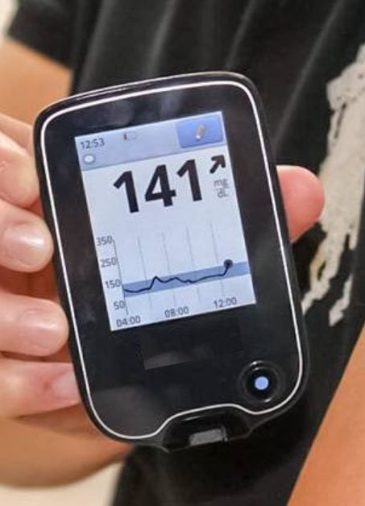
Monitoring devices
Can be used to measure
Glucose
Pulse
Heat
Help you to effectively study, note, and analyse your patients' conditions in real-time regardless of their location
Notes:
Measure Glucose Levels: Keep track of blood sugar levels, essential for managing diabetes.
Monitor Pulse: Check heart rate to ensure it's within a healthy range.
Detect Heat: Monitor body temperature to identify fevers or other issues.
Technology allows doctors to study, note, and analyze patients' conditions in real-time, no matter where they are, ensuring better and faster care.

Slide 7
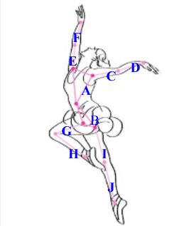
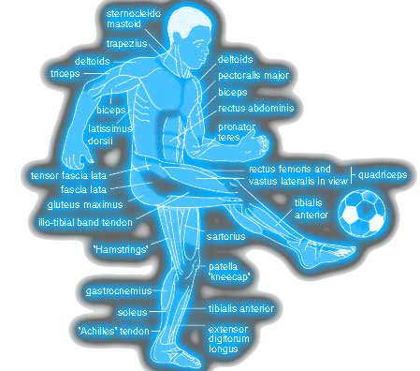
Movement devices
Motion sensors are used to track an athlete's movements, including acceleration, deceleration, and changes in direction.
These devices help in understanding an athlete's agility and responsiveness, which are crucial for sports that require quick movements and changes in pace.
Notes:
What They Do: Motion sensors track how athletes move—whether they're speeding up, slowing down, or changing direction.Why It Matters: These sensors help coaches understand an athlete's quickness and agility, which are super important in sports that need fast moves and rapid changes in pace.

Slide 8
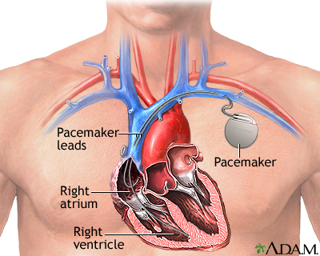
Heart devices
Cardiac implantable electronic devices, including pacemakers, are designed to help control or monitor irregular heartbeats in people with certain heart rhythm disorders and heart failure.
Notes:
What They Do: Cardiac implantable devices, like pacemakers, help control and monitor irregular heartbeats.Why It's Important: These devices are vital for people with certain heart rhythm problems, making sure their hearts beat regularly and safely.

Slide 9
Create your own
Create a piece of technology which solves one of the two issues below
Issue 1: Lung disease: Not enough oxygen being absorbed
Issue 2: Tooth Decay Crisis in younger Children
For example,
Poster / Presentation / Model/ App design / Watch like device …

Slide 10
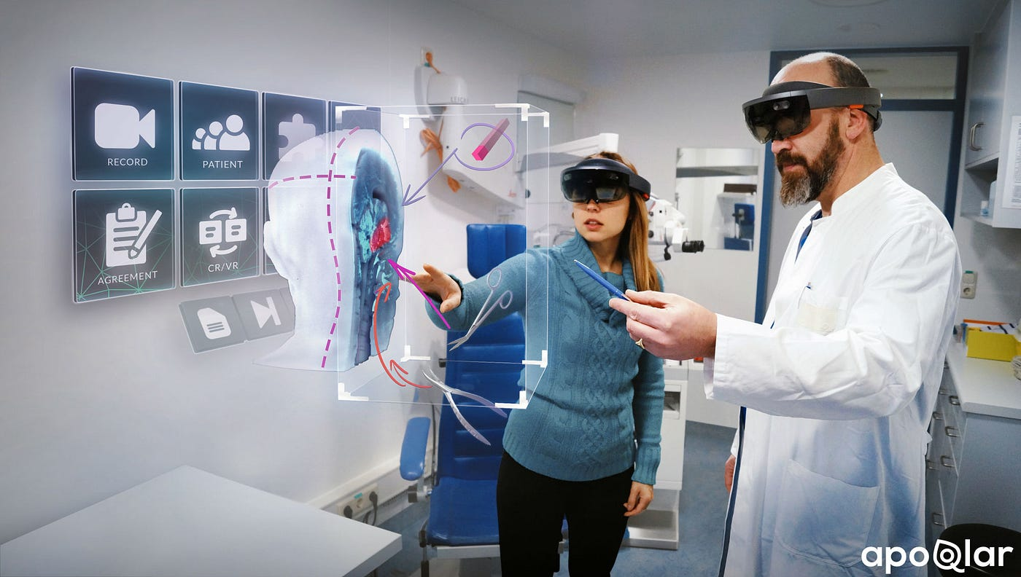
Technology in development
VR/AR
3D Bioprinting
Blockchain technology
Notes:
VR/AR in Healthcare:
Application: VR (Virtual Reality) and AR (Augmented Reality) are being used to diagnose and treat a range of conditions including:
Mental Health: Dementia, depression, PTSD, and phobias.
Physical Disorders: Rehabilitation for stroke patients, pain management, and surgical training.
Benefits: These technologies provide immersive environments for therapy, improve patient outcomes, and offer precise simulations for medical professionals.
3D Bioprinting:
Application: 3D Bioprinting is revolutionizing medical treatments by:
Prosthetics: Enhancing bionic knee and hip prostheses with custom designs that match a patient’s anatomy.
Organ Transplants: Developing bio-printed tissues and organs, potentially eliminating the need for donor organs.
Benefits: Offers personalized healthcare solutions, reduces surgery recovery time, and may solve organ donor shortages in the future.
Blockchain Technology in Healthcare:
Application: Blockchain is transforming how healthcare data is managed by:
Data Security: Providing a secure, decentralized way to store and share patient records.
Transparency: Ensuring that medical data is tamper-proof and traceable.
Benefits: Protects patient privacy, improves data integrity, and fosters trust between patients and healthcare providers.

Slide 11

Fei-Fei Li
Fei-Fei Li is a leading AI researcher and professor at Stanford, known for her groundbreaking work in computer vision and co-founding ImageNet, which revolutionized AI. In healthcare, she advocates for applying AI in diagnostics, improving tools for early disease detection, like cancer. A champion of ethical AI, Li co-founded AI4ALL to promote diversity in the field and emphasizes the need for human-centered AI that respects privacy and equity. Her work bridges cutting-edge AI innovation with a mission to make healthcare more accurate, inclusive, and compassionate.

