Slide 1

Speed of Sound
Waves
Notes:
Students guess outcome of experiment, and what happens when sound changes.
e.g. Louder sound – Larger amplitude
Higher pitch – Higher Frequency

Slide 2
Lesson Objectives
• Understand the relationship between sound characteristics (amplitude, frequency) and wave properties.
• Conduct an experiment to measure the speed of sound using practical tools.
• Analyse data to understand how sound waves behave in different conditions

Slide 3
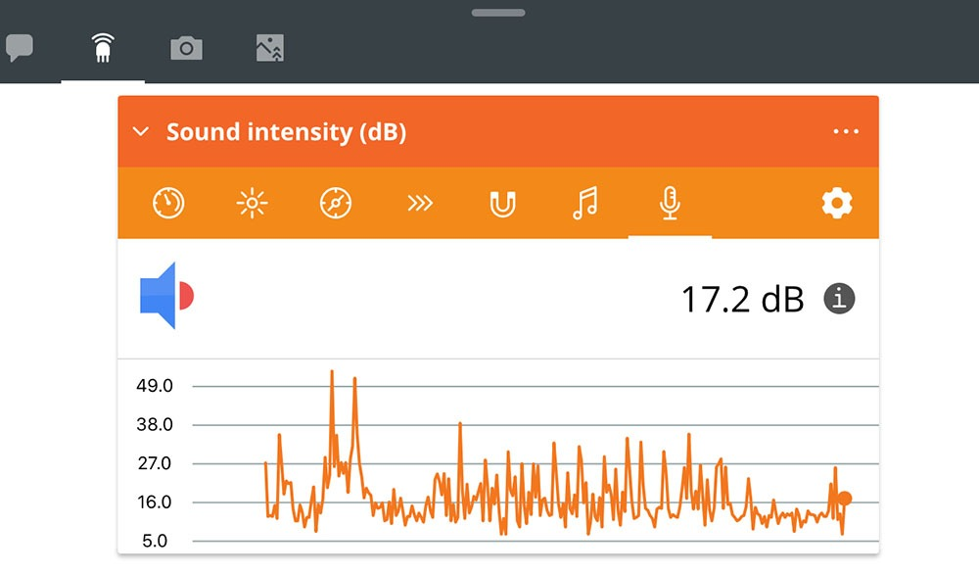
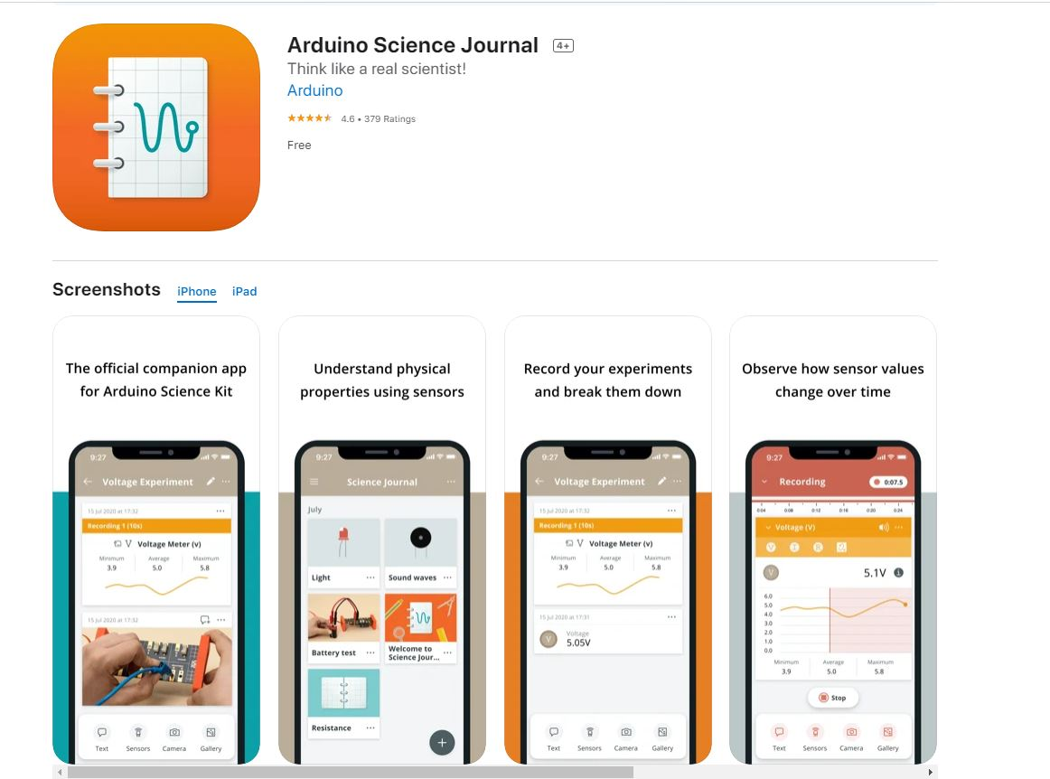
Download
Arduino Science Journal app
You will use this to record the sound waves length

Slide 4
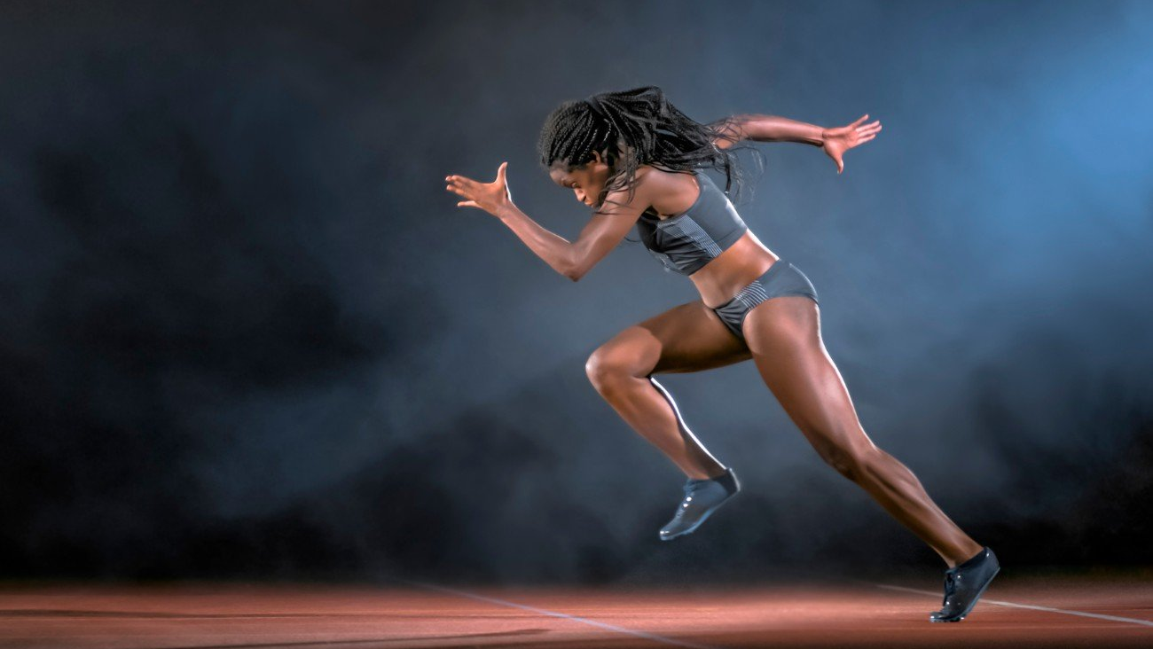
Speed = ?

Slide 5
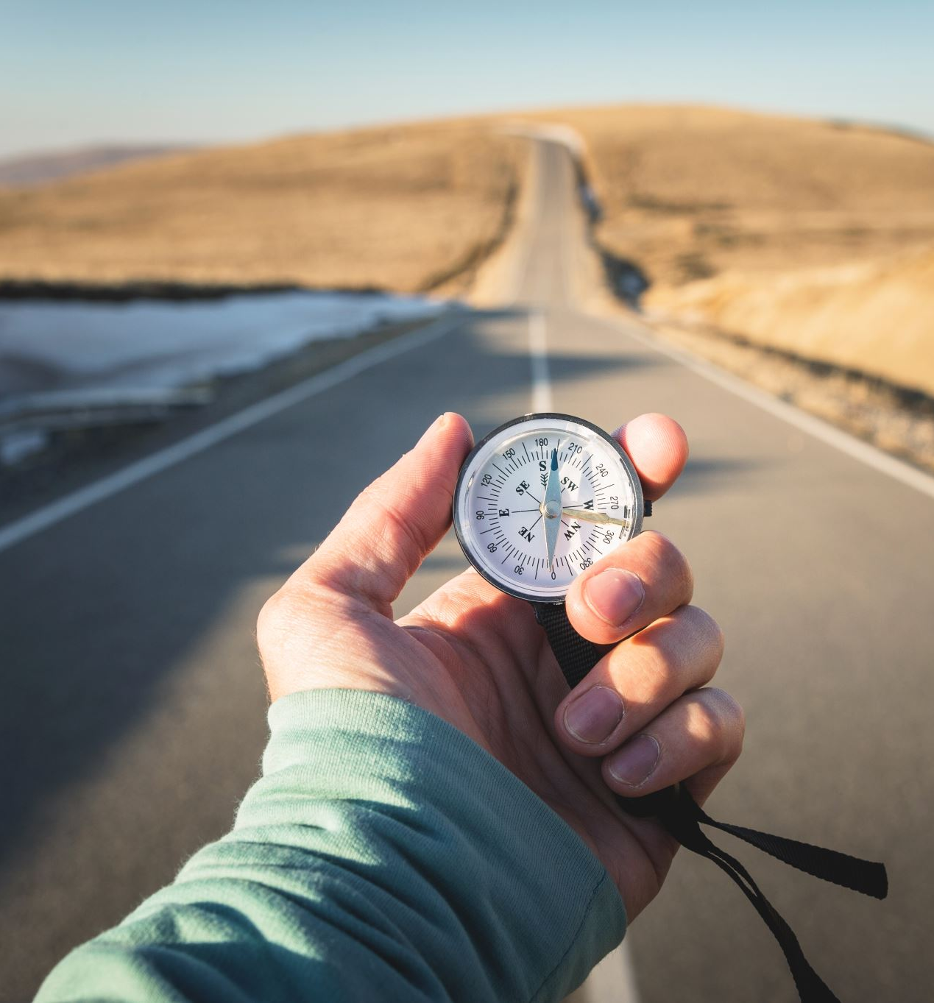
Speed = Distance / Time

Slide 6
Experiments
Equipment
Variables
Method
Notes:
Talk through whats needed – on worksheet
Equipment:
Variables:
Method:

Slide 7
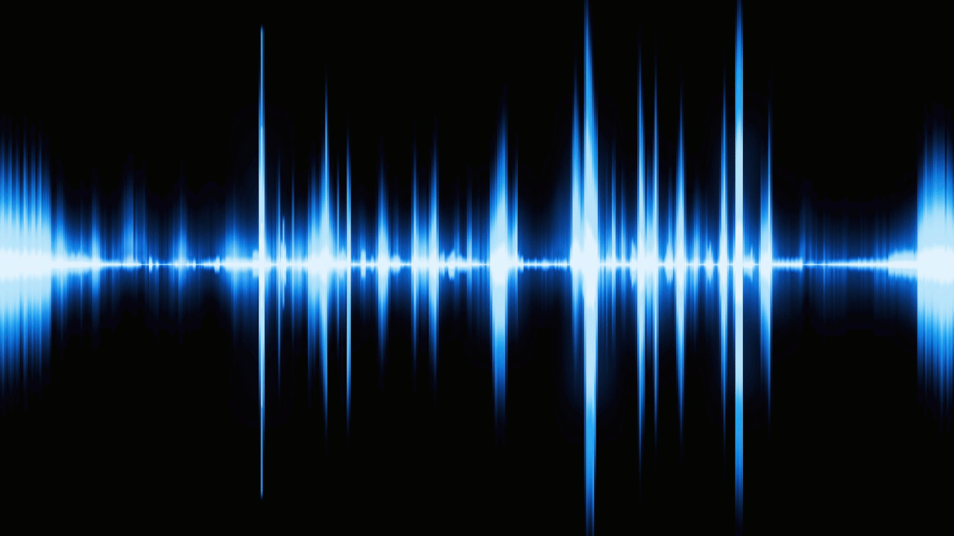
What will happen?
Notes:
Ask students there expectations of changes to sound waves – come back to this slide after the experiment

Slide 8
Plot the Charts
Remember the x-axis should be what you change
Take an average of your results at each distance (sum(all)/ amount(all))
What does this chart show?

Slide 9
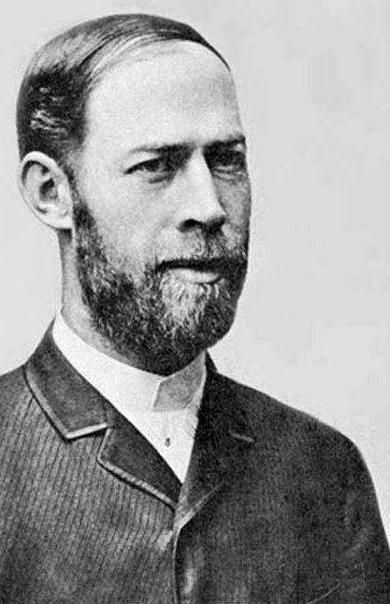
Heinrich Hertz
Heinrich Hertz (1857–1894) was a German physicist known for his groundbreaking work in electromagnetic waves. He confirmed James Clerk Maxwell's theory that electromagnetic waves travel at the speed of light, proving that light itself is a form of electromagnetic radiation. Hertz's experiments, conducted in the 1880s, led to the discovery of radio waves, which paved the way for the development of wireless communication, including radio, television, and radar. The unit of frequency, the hertz (Hz), is named in his honour. Though he died young, his work fundamentally shaped modern physics and communication technology.

