Slide 1

Climate Change
Earth

Slide 2
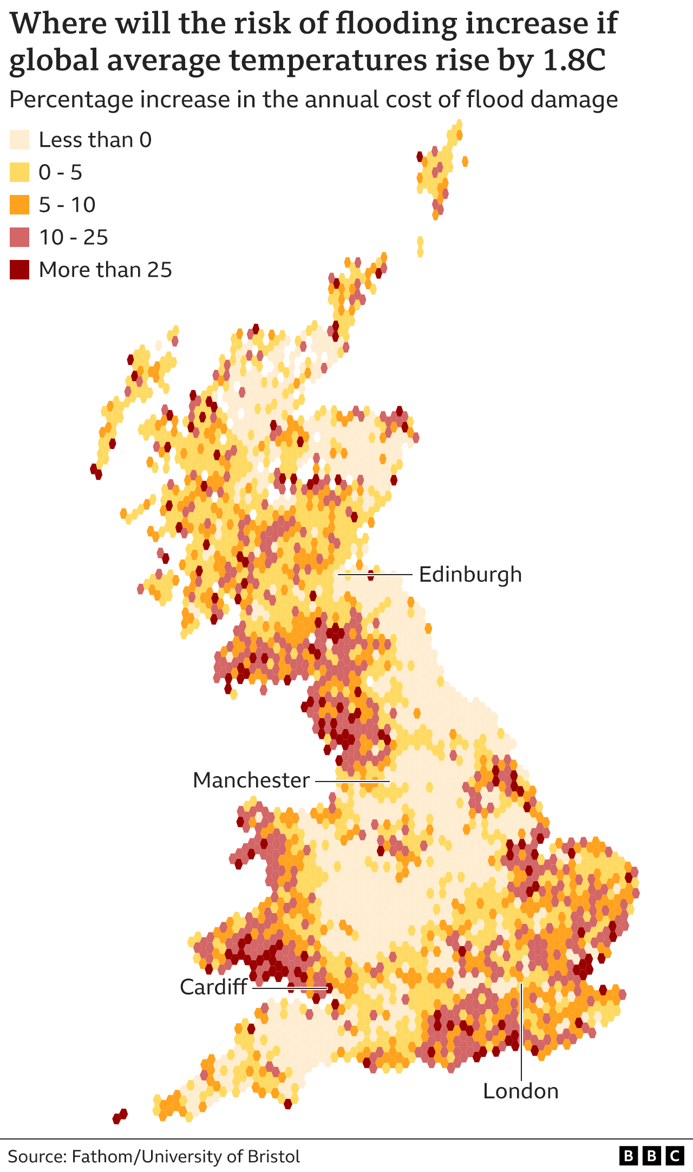
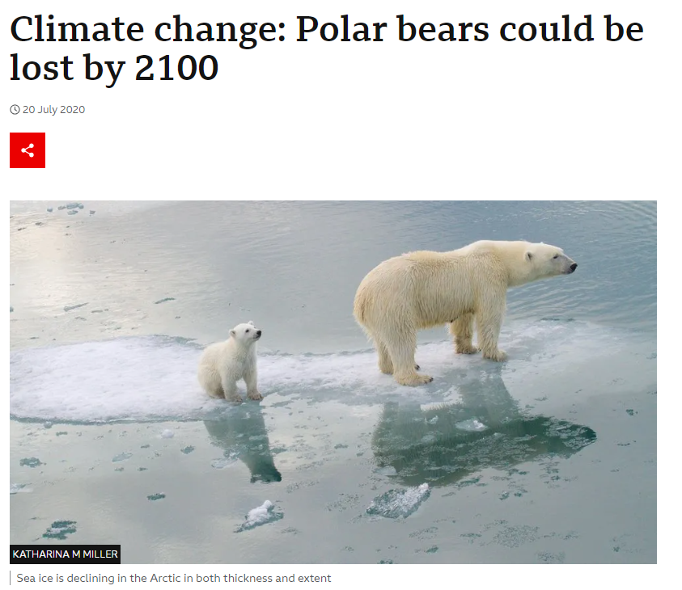

Slide 3
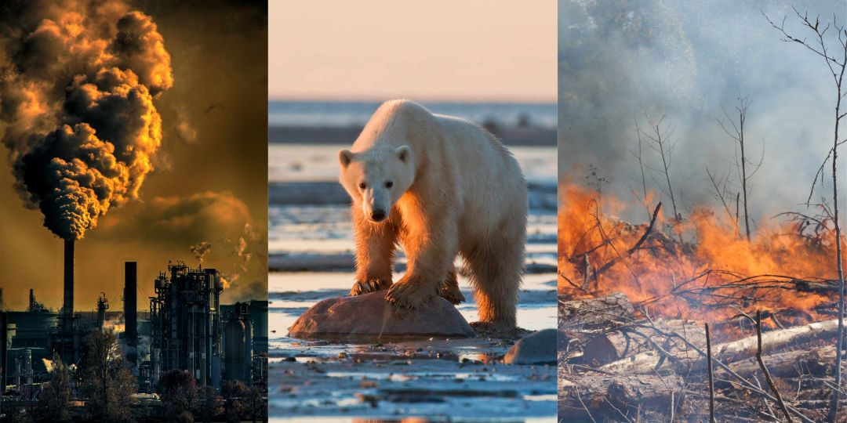
Why is Climate Change happening?
Notes:
Brainstorm with class e.g. hairdryers

Slide 4
Why is Climate Change happening?
Burning of fossil fuels
Deforestation
Agriculture
Notes:
https://www.youtube.com/watch?v=SN5-DnOHQmE
Greenhouse effect video

Slide 5
Lesson Objectives
Understand the causes and effects of climate change.
Analyse data related to climate change, such as temperature, carbon dioxide levels, and sea levels.
Discuss personal and collective actions to reduce carbon footprints.

Slide 6
Python Workbooks
Now open the Worksheet and follow the instructions to start the temperature exercise.
01
You don’t have to code from scratch only read through to understand what’s happening.
02
The first exercise will show you how the global temperature has changed.
03

Slide 7
Temperature
Data: From Nasa
Years: 1880 to current
What is it showing?

Slide 8
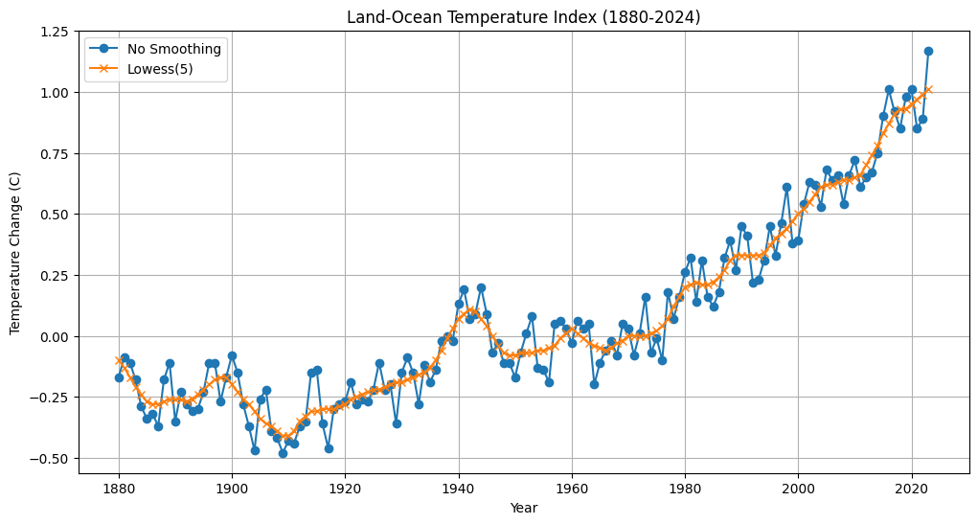
Notes:
Discuss upwards correlation

Slide 9
Greenhouse gas release
Data: From Climate Watch
Years: 1990 - Now
What is it showing?

Slide 10
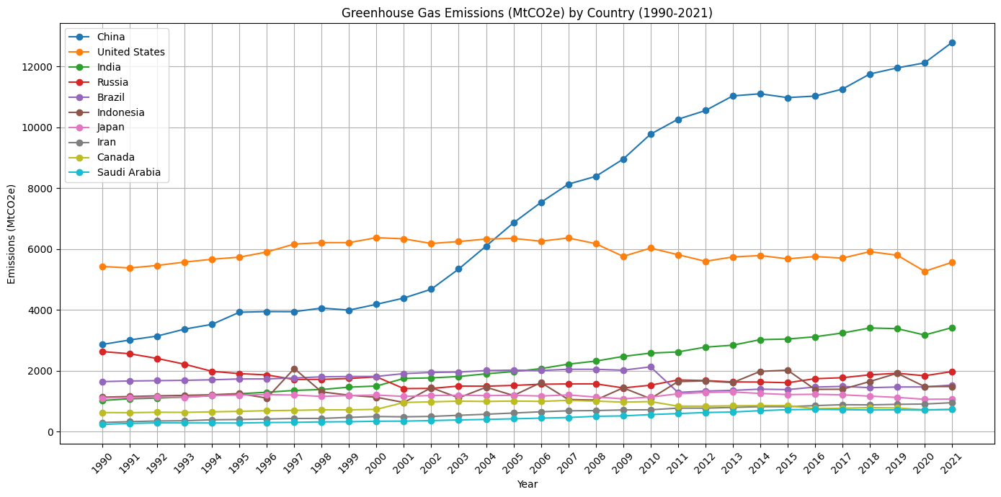
Notes:
Discuss how trend is also going upwards, why may some countries produce more (population etc / years e.g. Industrial revolution)
Suprises?

Slide 11
Extension
Compare The charts
Look at sea level data

Slide 12
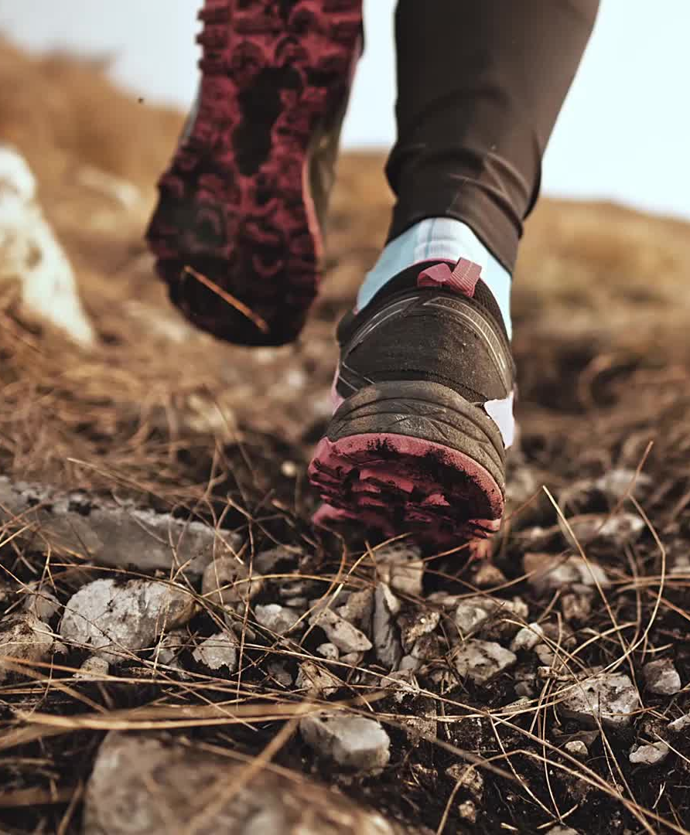
How does climate change impact you? How can you reduce your footprint?

Slide 13
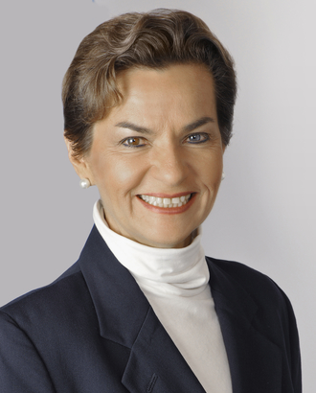
Christiana Figueres
Christiana Figueres is a prominent climate leader and former Executive Secretary of the UNFCCC, where she played a key role in achieving the landmark Paris Agreement in 2015. She co-founded Global Optimism, a platform promoting climate action through innovation and technology. Figueres is a strong advocate for using clean technologies, such as renewable energy, AI for climate modeling, and sustainable practices, to tackle climate change. Her leadership inspires collaboration between governments, businesses, and tech innovators to create solutions for a sustainable future. Figueres exemplifies how diplomacy and technology can drive impactful climate action.

