Slide 1
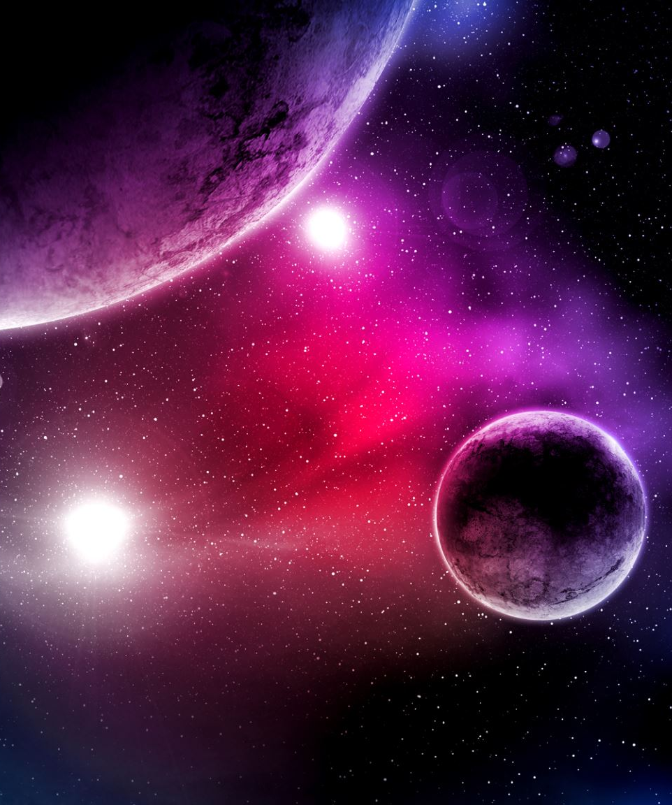
Space
Space Mission

Slide 2
Mission Brief
Space Mission: You have been tasked by the ESA (European Space Agency) to calculate key information for an upcoming space mission.
You will be assigned a target planet and will need to work in a group to successfully generate vital calculations for this mission.

Slide 3
Task One
Discover the Gravity on
Earth
Space
Destination Planet
Why do we need to know each places gravity?

Slide 4

weight (N) = mass (kg) x gravitational field strength (N/kg)
Notes:
Weight is a direct measure of gravity's pull on an object. By learning about weight, students gain a tangible understanding of gravity, a fundamental force of nature. This concept explains why things fall to the ground, why we stay grounded on Earth, and how different planets have different gravitational pulls.
- It helps us calculate how much fuel/ what speed the spacecraft will need to reach to leave a planets pull

Slide 5
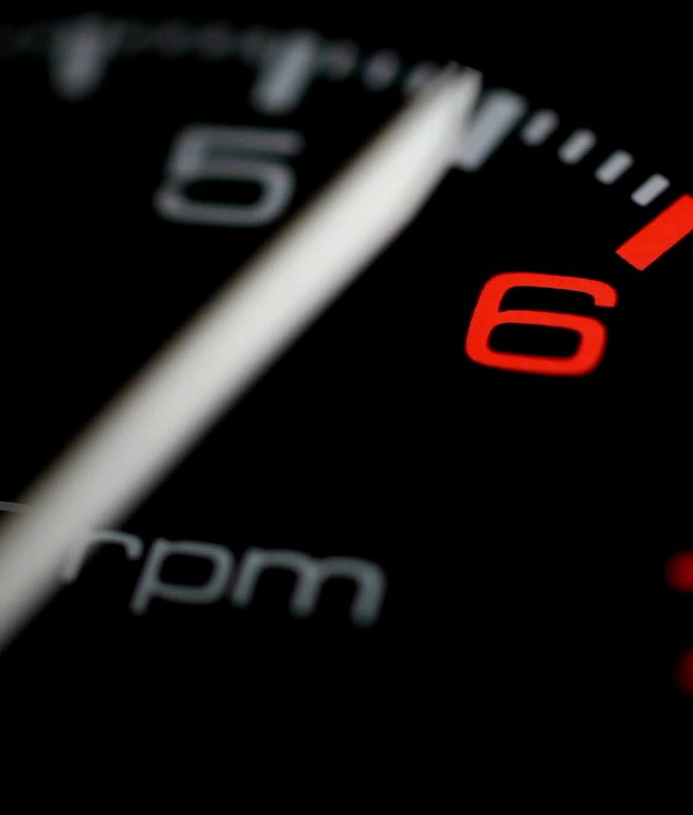
Fuel Consumption
Fuel Remaining=Initial Fuel−(Burn Rate × Time)
Initial Fuel is the amount of fuel at the start of the mission (in kilograms).
Burn Rate is the rate at which fuel is consumed (in kilograms per second).
Time is the duration over which the fuel is consumed (in seconds).

Slide 6
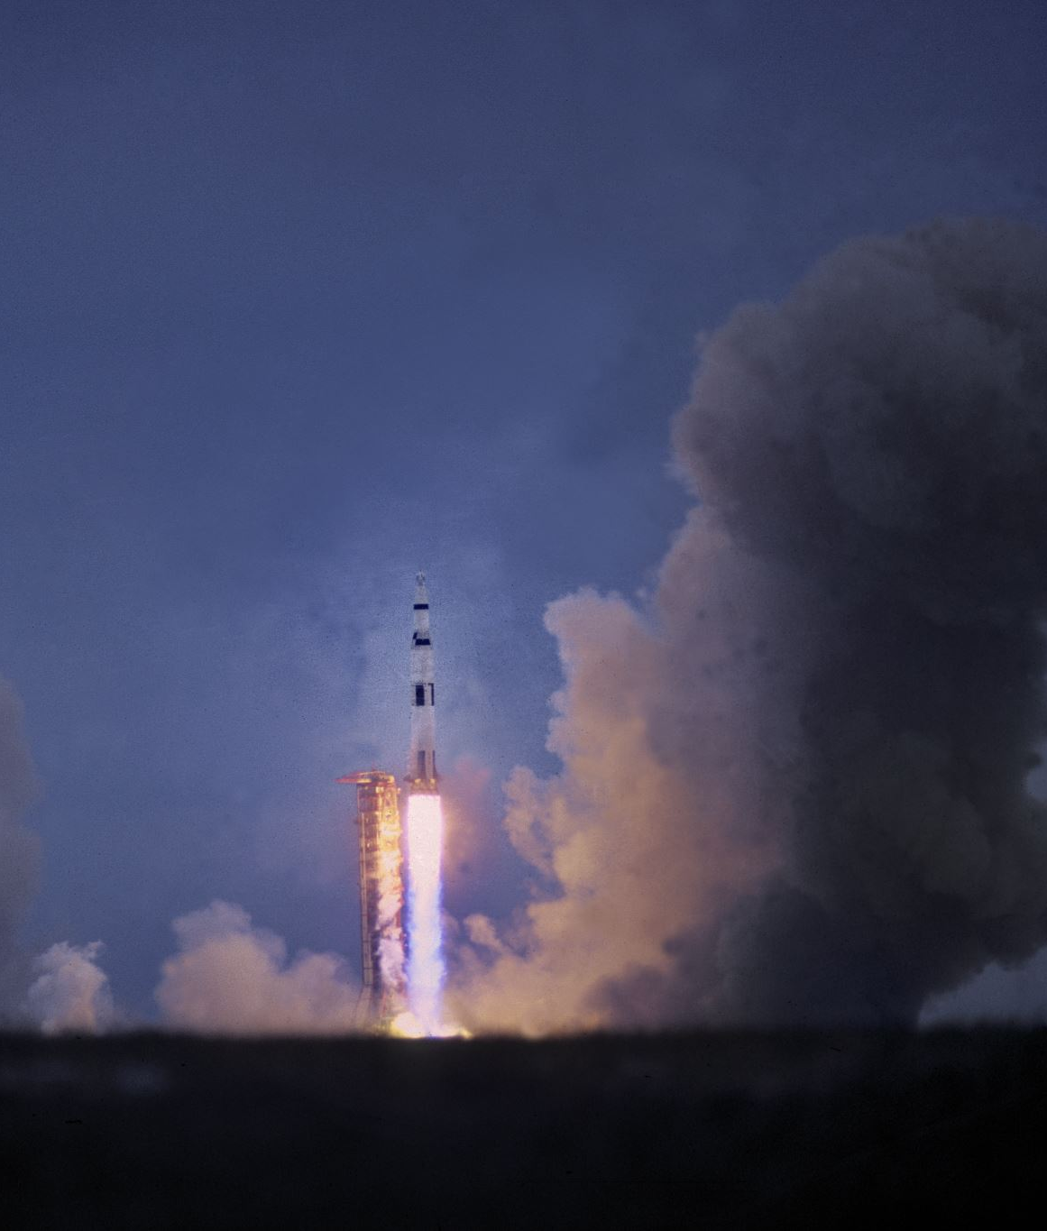
Spacecraft: 1000kg
Burn rate: 0.5 kg/s
Generate a graph of fuel consumption over time

Slide 7
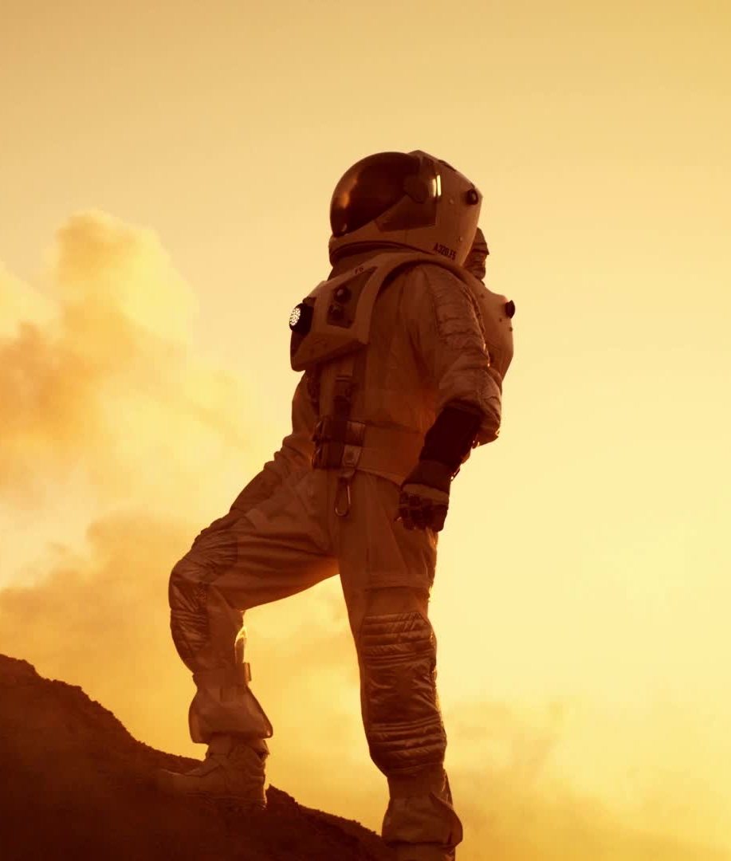
Congratulations
Congratulations space commander you have helped the mission become one step closer to completion.
Extension:
Work out how much fuel is needed to travel from Earth to your destination planet

Slide 8
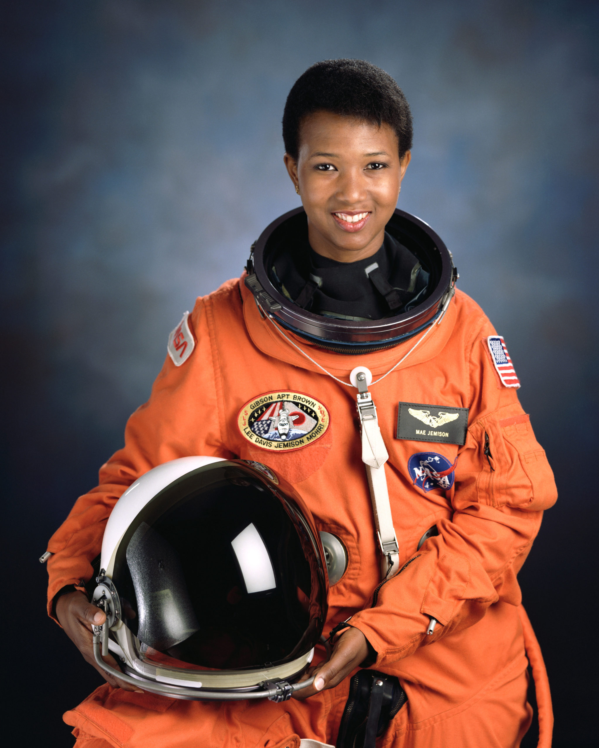
Mae Jemison
Mae Jemison is a pioneering astronaut and physician who became the first African American woman to travel to space in 1992 aboard the Space Shuttle Endeavour. A strong advocate for science education, she founded the Dorothy Jemison Foundation to promote STEM opportunities for young people. Jemison is also known for her work as a medical doctor and educator, encouraging diverse perspectives in science and technology. Her career exemplifies how interdisciplinary skills and a commitment to education can advance space exploration and inspire future generations.

