Slide 1

Energy
Energy use in the Home

Slide 2
Objectives
Understand how household items consume energy.
1
Learn to use Google Sheets for data entry and analysis.
2
Calculate energy consumption and cost using formulas.
3

Slide 3

Name some common items around a house which use energy
Notes:
If there is more time discuss how long you’d use these items on average a day

Slide 4
Key Concepts and Keywords
Watts (W): A unit of power.
Kilowatt (kW): 1000 Watts.
Energy Transferred: Calculated as Power (W) * Time (S).
Cost Formula: Cost = Power (kW) * Time (hours) * Price (per kWh).

Slide 5
Create a Google Sheet
Go to the link: https://docs.google.com/spreadsheets/create and create a new sheet
Name it surname_engage_energy e.g. ‘Smith_engage_energy’

Slide 6
Copy the table into the google sheet
Item | Area Used | kW per Second | W per Second | Time Used (seconds) | Total W
Kettle | Kitchen |  | 2000 W | 180
Fridge | Kitchen |  | 150 W | 86,400
Microwave | Kitchen |  | 1200 W | 120
Toaster | Kitchen |  | 800 W | 120
Oven | Kitchen |  | 2400 W | 3600
Notes:
The table is in the student worksheet

Slide 7
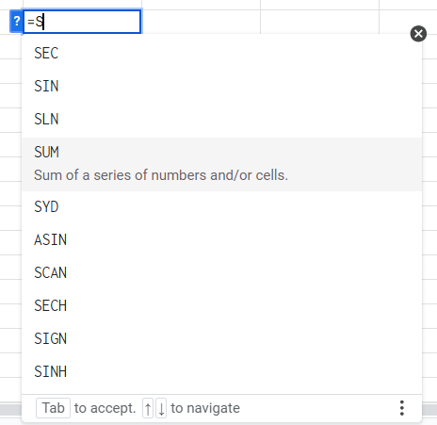
Formulas in Google Sheet
Why Use Formulas?
Save Time, Reduce Errors, Dynamic Data
Commonly Used Google Sheets Formulas:
SUM: Adds a range of numbers.
Example: =SUM(A1:A10) adds all the numbers from A1 to A10.
https://www.w3schools.com/googlesheets/google_sheets_formulas.php

Slide 8
Calculate the total W used Per Item
Example Calculation:
For the Kettle:
In the "Total Energy (W)" column, use the formula: =B2*C2
This calculates 2000 W * 180 seconds = 360,000 W
Type =C2*D2 in cell E2 and press Enter.
Energy Transferred: Calculated as Power (W) * Time (S).

Slide 9
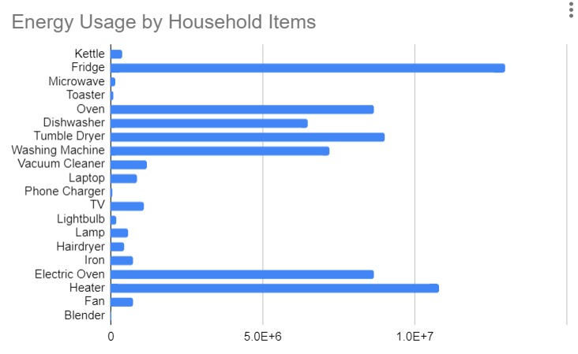
Create a chart
Go to Insert, Chart
Change the values to show a bar chart
Notes:
Give them time to play around with the chart values

Slide 10

Calculate the cost of each item and the total estimated cost. The cost p/kWH can be found Online
Notes:
Use value from : https://www.britishgas.co.uk/energy/guides/what-is-a-kilowatt-hour.html#:~:text=Between%201st%20July%20to%2030th,information%20on%20your%20energy%20bill.

Slide 11
Conversions
Power (W) /1000 = Power (KW)
Time(S)/3600 = Time(Hours)
Cost Formula: Cost = Power (kW) * Time (hours) * Price (per kWh).

Slide 12

Discussion
How can you keep your energy use down?

Slide 13
Extension : Create a Pie chart comparing the energy used in each area of the house

Slide 14

Amory Lovins
Amory Lovins is a physicist and co-founder of the Rocky Mountain Institute, known for his pioneering work in energy efficiency. He advocates for reducing household energy use through smart technologies like LED lighting, solar panels, and advanced insulation. Lovins also promotes the use of smart thermostats and energy management systems to optimize energy consumption in homes. His approach focuses on integrating efficient design and technology to create sustainable, low-energy homes. Lovins' work demonstrates how technology can dramatically reduce energy use, cut costs, and lower carbon emissions, making him a leading figure in sustainable living practices.

