Slide 1

Climate Change
Earth

Slide 2
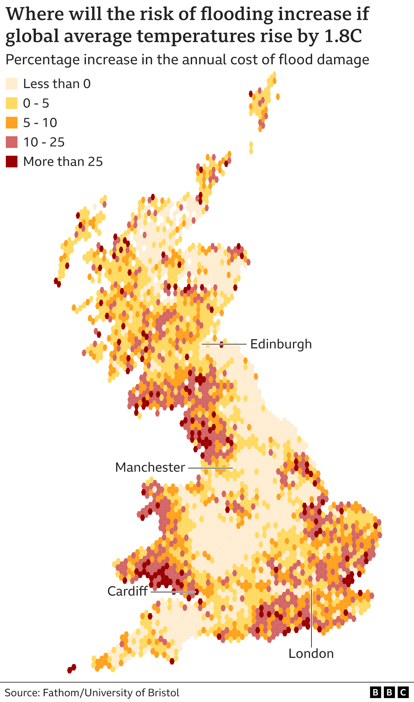
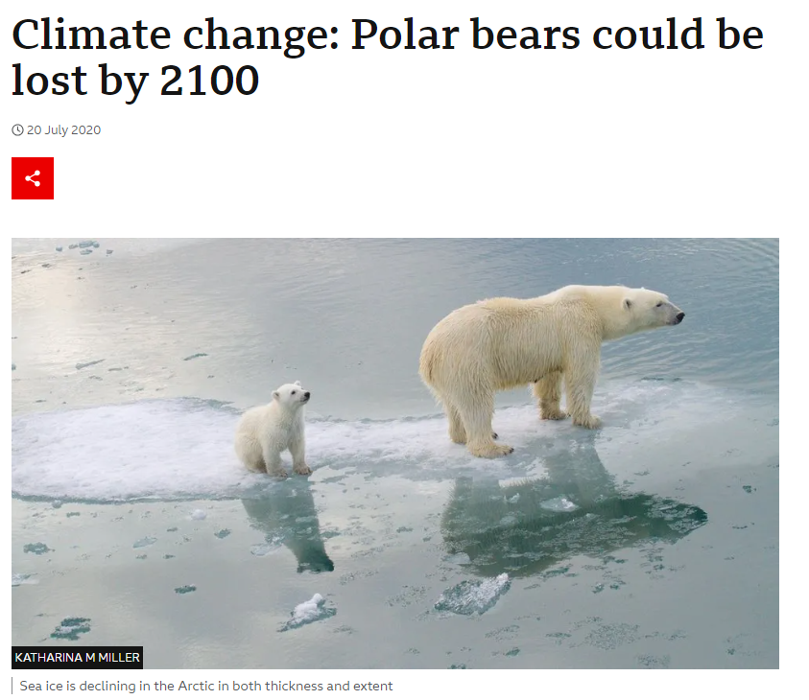

Slide 3
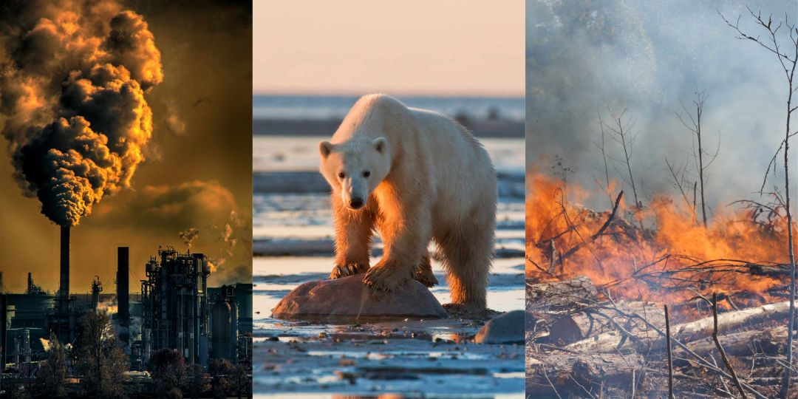
Why is Climate Change happening?
Notes:
Brainstorm with class e.g. hairdryers

Slide 4
Why is Climate Change happening?
Burning of fossil fuels
Deforestation
Agriculture
Notes:
https://www.youtube.com/watch?v=SN5-DnOHQmE
Greenhouse effect video

Slide 5
Lesson Objectives
Understand the causes and effects of climate change.
Analyse data related to climate change, such as temperature, carbon dioxide levels, and sea levels.
Discuss personal and collective actions to reduce carbon footprints.

Slide 6
Python Workbooks
Now open the Worksheet and follow the instructions to start the temperature exercise.
01
You don’t have to code from scratch only read through to understand what’s happening.
02
The first exercise will show you how the global temperature has changed.
03

Slide 7
Temperature
Data: From Nasa
Years: 1880 to current
What is it showing?

Slide 8
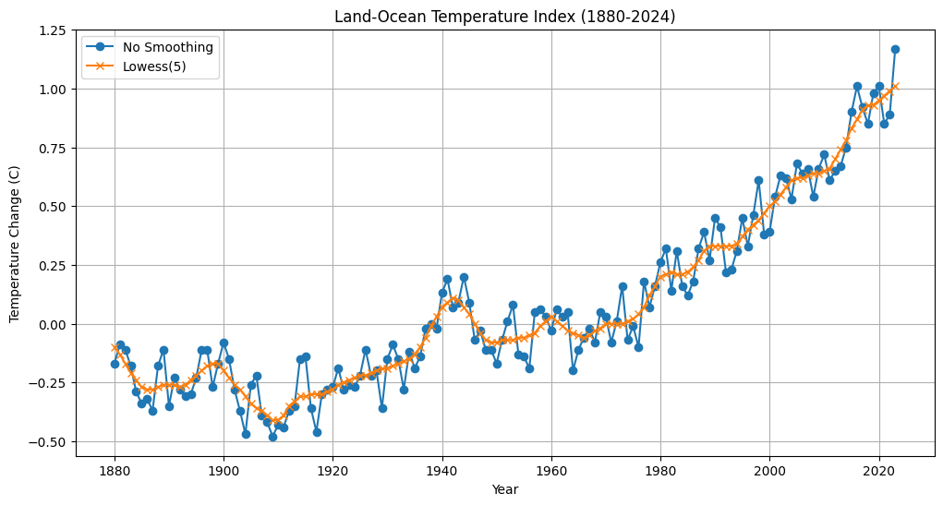
Notes:
Discuss upwards correlation

Slide 9
Greenhouse gas release
Data: From Climate Watch
Years: 1990 - Now
What is it showing?

Slide 10
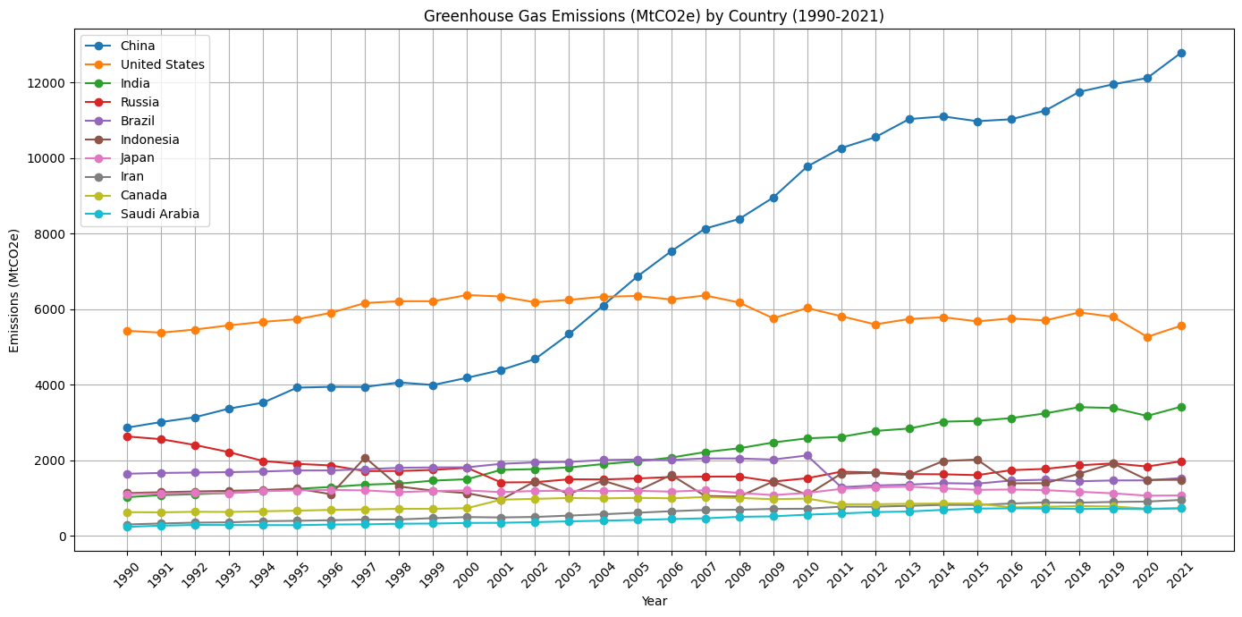
Notes:
Discuss how trend is also going upwards, why may some countries produce more (population etc / years e.g. Industrial revolution)
Suprises?

Slide 11
Extension
Compare The charts
Look at sea level data

Slide 12
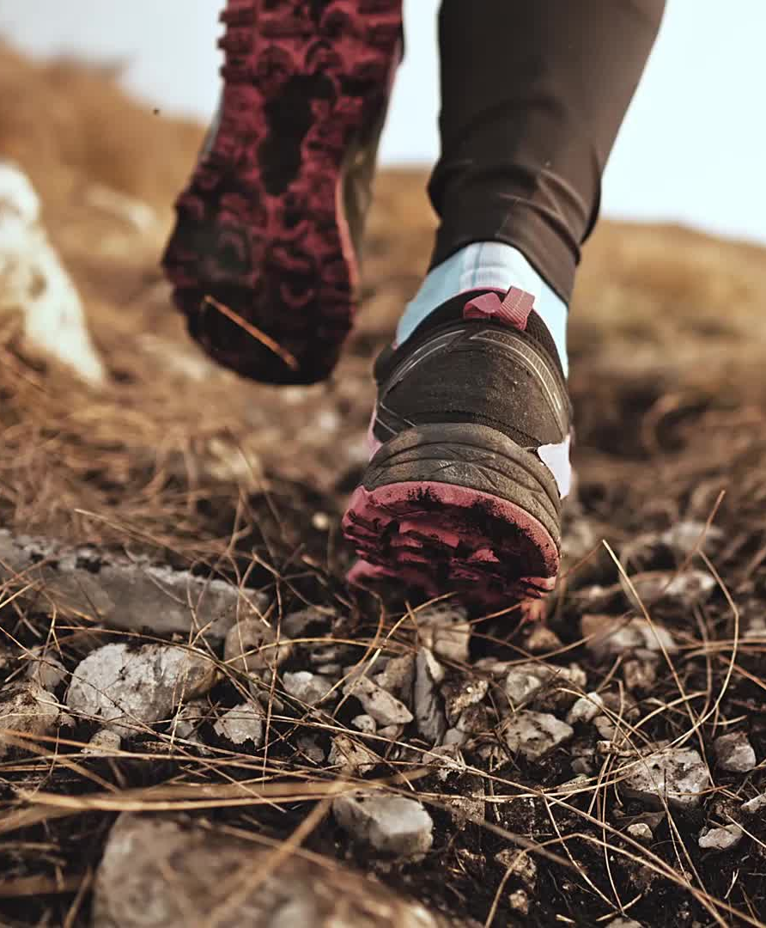
How does climate change impact you? How can you reduce your footprint?

