Slide 1

Energy
Energy use in the Home

Slide 2
Objectives
Understand how household items consume energy.
1
Learn to use Google Sheets for data entry and analysis.
2
Calculate energy consumption and cost using formulas.
3

Slide 3
Name some common items around a house which use energy
Notes:
If there is more time discuss how long you’d use these items on average a day

Slide 4
Key Concepts and Keywords
Watts (W): A unit of power.
Kilowatt (kW): 1000 Watts.
Energy Transferred: Calculated as Power (W) * Time (S).
Cost Formula: Cost = Power (kW) * Time (hours) * Price (per kWh).

Slide 5
Create a Google Sheet
Go to the link: https://docs.google.com/spreadsheets/create and create a new sheet
Name it surname_engage_energy e.g. ‘Smith_engage_energy’

Slide 6
Copy the table into the google sheet
Item | Area Used | kW per Second | W per Second | Time Used (seconds) | Total W
Kettle | Kitchen |  | 2000 W | 180
Fridge | Kitchen |  | 150 W | 86,400
Microwave | Kitchen |  | 1200 W | 120
Toaster | Kitchen |  | 800 W | 120
Oven | Kitchen |  | 2400 W | 3600
Notes:
The table is in the student worksheet

Slide 7
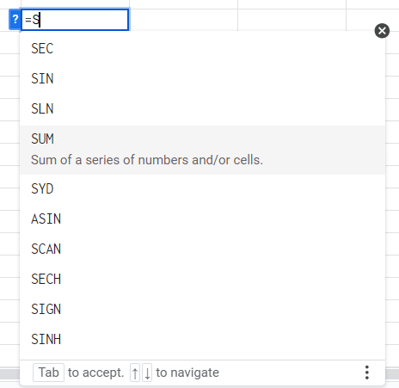
Formulas in Google Sheet
Why Use Formulas?
Save Time, Reduce Errors, Dynamic Data
Commonly Used Google Sheets Formulas:
SUM: Adds a range of numbers.
Example: =SUM(A1:A10) adds all the numbers from A1 to A10.
AVERAGE: Calculates the average of a range of numbers.
Example: =AVERAGE(B1:B10) finds the average of numbers from B1 to B10.
https://www.w3schools.com/googlesheets/google_sheets_formulas.php

Slide 8
Calculate the total W used Per Item
Example Calculation:
For the Kettle:
In the "Total Energy (W)" column, use the formula: =B2*C2
This calculates 2000 W * 180 seconds = 360,000 W
Type =C2*D2 in cell E2 and press Enter.
Energy Transferred: Calculated as Power (W) * Time (S).

Slide 9
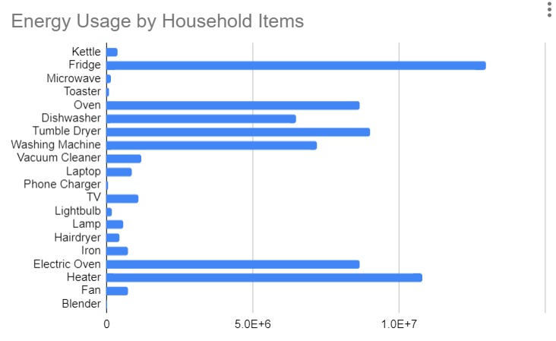
Create a chart
Go to Insert, Chart
Change the values to show a bar chart
Notes:
Give them time to play around with the chart values

Slide 10
Create a chart comparing the energy used by each item

Slide 11

Calculate the cost of each item and the total estimated cost. The cost p/kWH can be found Online
Notes:
Use value from : https://www.britishgas.co.uk/energy/guides/what-is-a-kilowatt-hour.html#:~:text=Between%201st%20July%20to%2030th,information%20on%20your%20energy%20bill.

Slide 12
Conversions
Power (W) /1000 = Power (KW)
Time(S)/3600 = Time(Hours)
Cost Formula: Cost = Power (kW) * Time (hours) * Price (per kWh).

Slide 13
Discussion
How can you keep energy use down?

Slide 14
Extension : Create a Pie chart comparing the energy used in each area

