Slide 1
Network Evolution Analysis

Slide 2
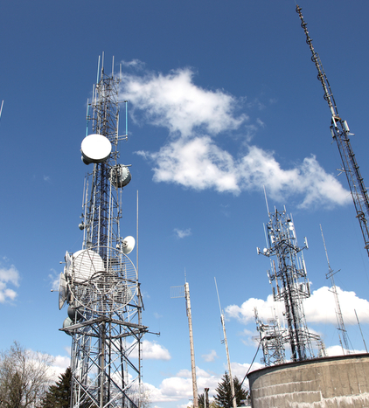
Project’s origins
Nokia passively collects lots of various data from stations from multiple different networks.
The amount of data is far too large to analyze manually, but it can be processed effectively with algorithms.
Our project focuses on creating a program capable of automatically analyzing data regarding software used by operators and alarms in their networks.

Slide 3






Used technologies

Slide 4
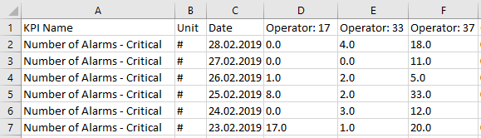
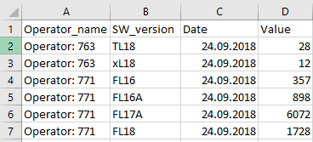
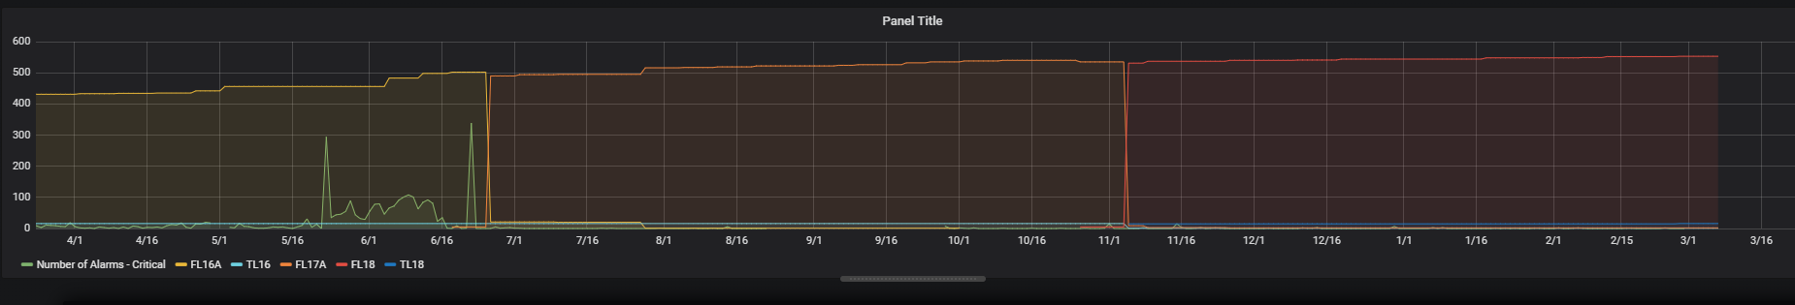
Input Data
PM - performance measurements
CM - configurations management
Visualization

Slide 5
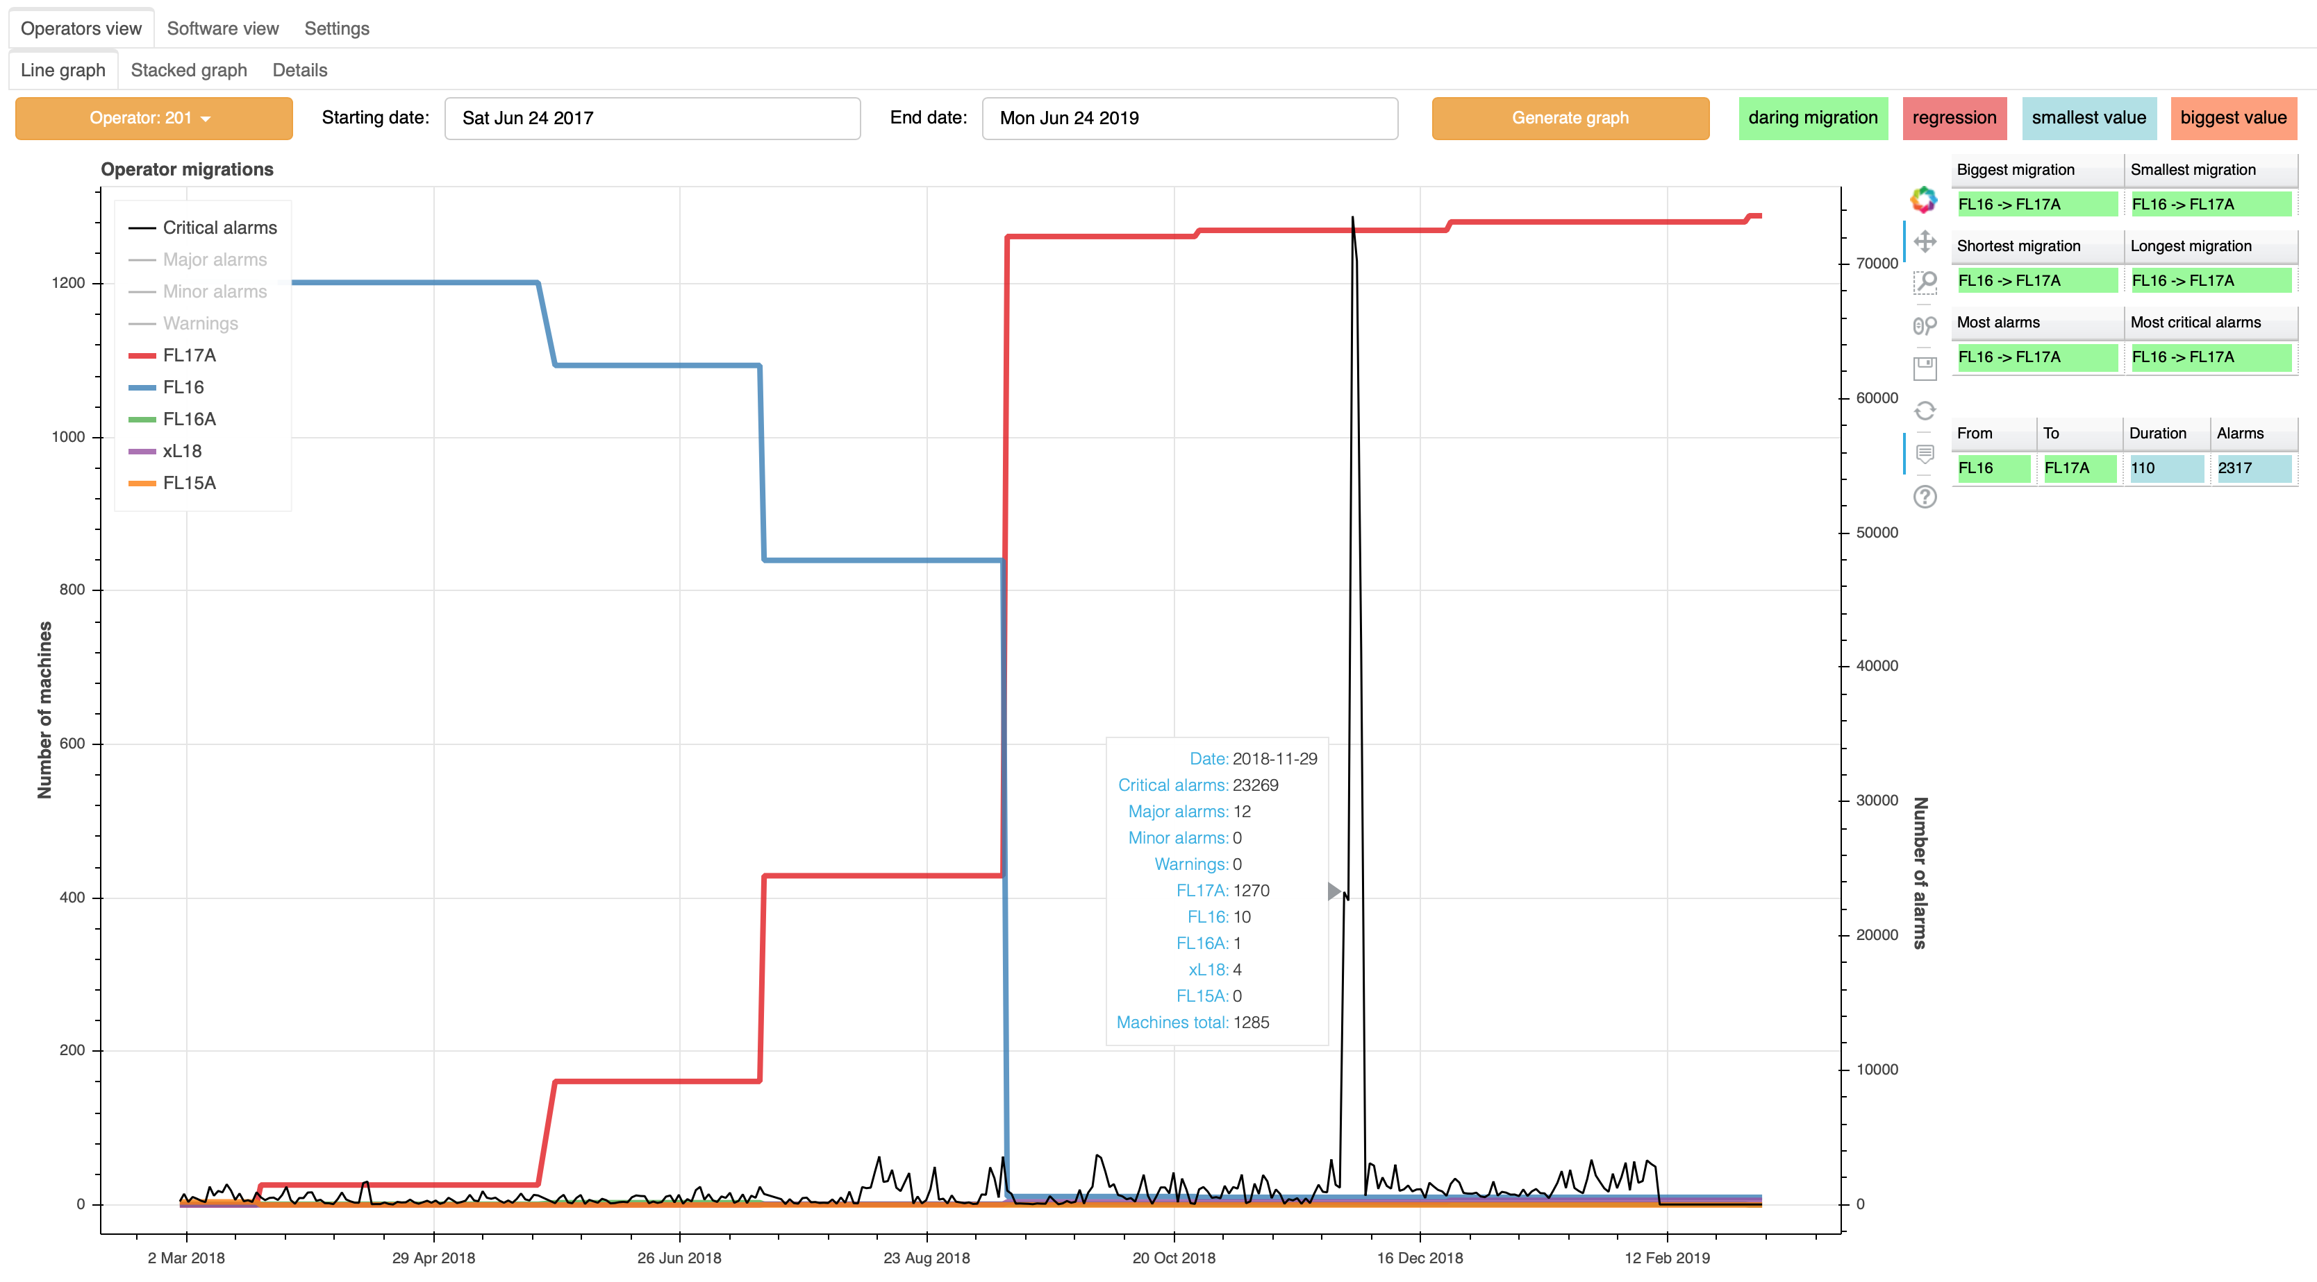
Operators View
We analyze a specific network and calculate all migrations in it.
The data we calculate can be used to get better a understanding of Nokia’s clients’ networks and to create detailed reports for said clients as well.

Slide 6
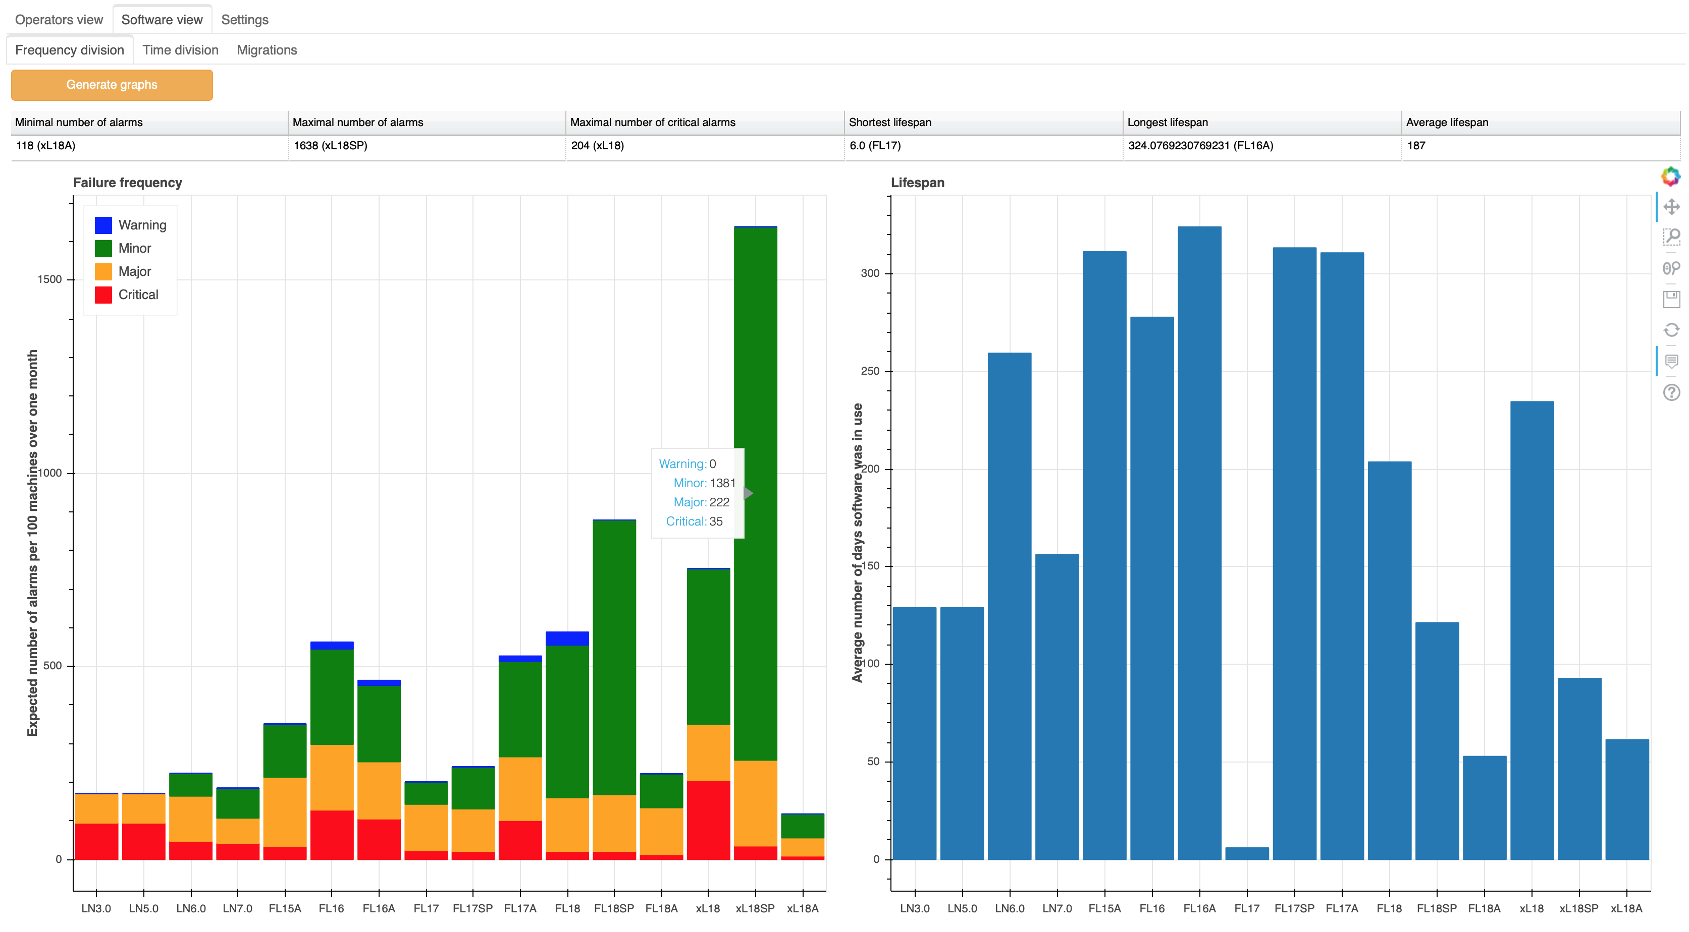
Software View
We combine data from all available networks to create statistics regarding used software.
The data we calculate can be used to help analyze which softwares were the most successful and how difficult were the migrations from any two specific softwares. It can be very helpful for software creators and can be used to advise Nokia’s clients about which software they should use and how they should organize their migrations.

