Slide 1
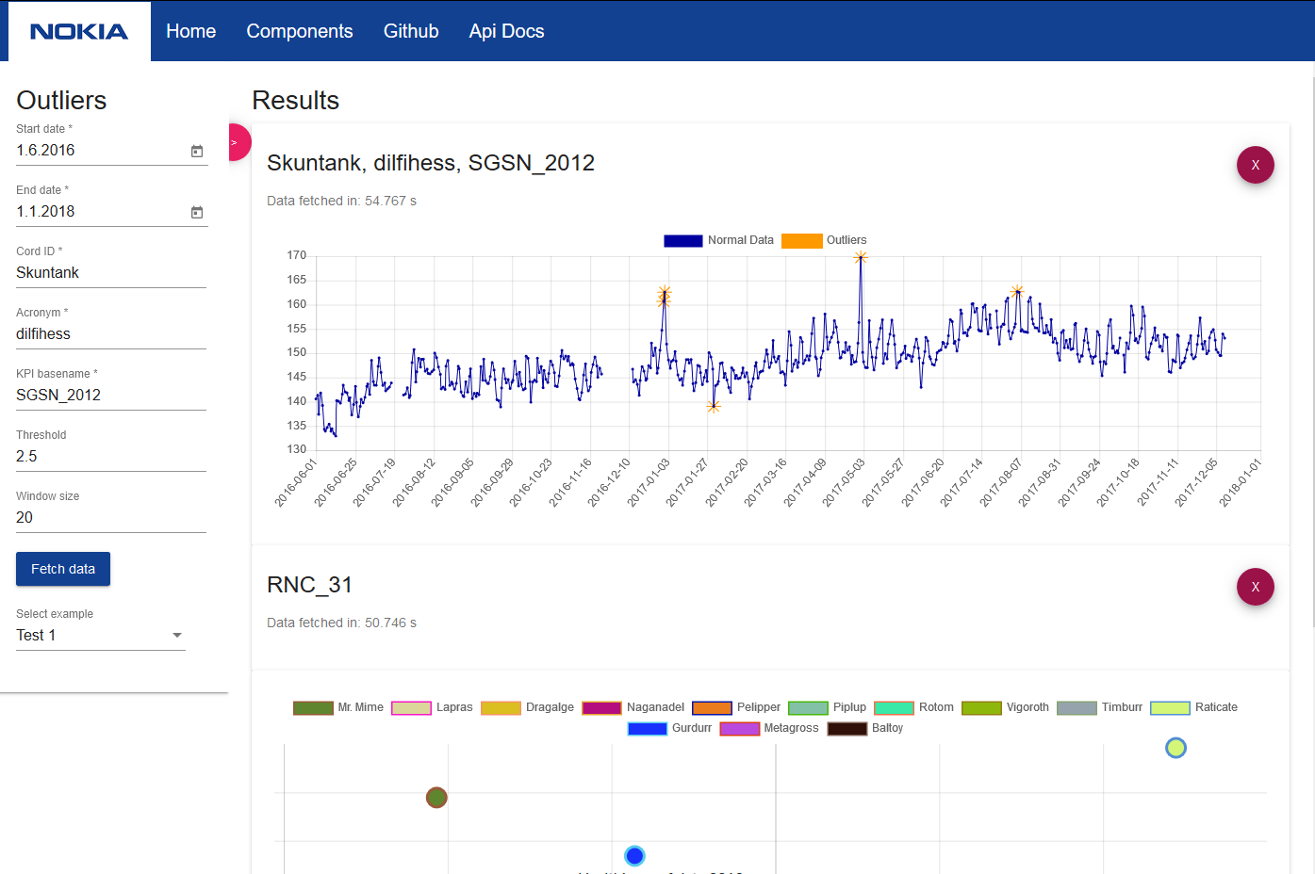





Healthiness of Data
Application for processing Big Data of information describing functioning of cellular base stations.
The data is subject to purification and analysis in order to determine the quality of functioning of telecommunications equipment.
For convenient use, the application provides a web interface with all the interesting results.
http://healthiness-of-data.ovh
https://github.com/nokia-wroclaw/innovativeprojects-healthiness-of-data/
Wojciech Adamek | Dominika Maślanka | Jakub Walecki | Jacek Zalewski

