Slide 1
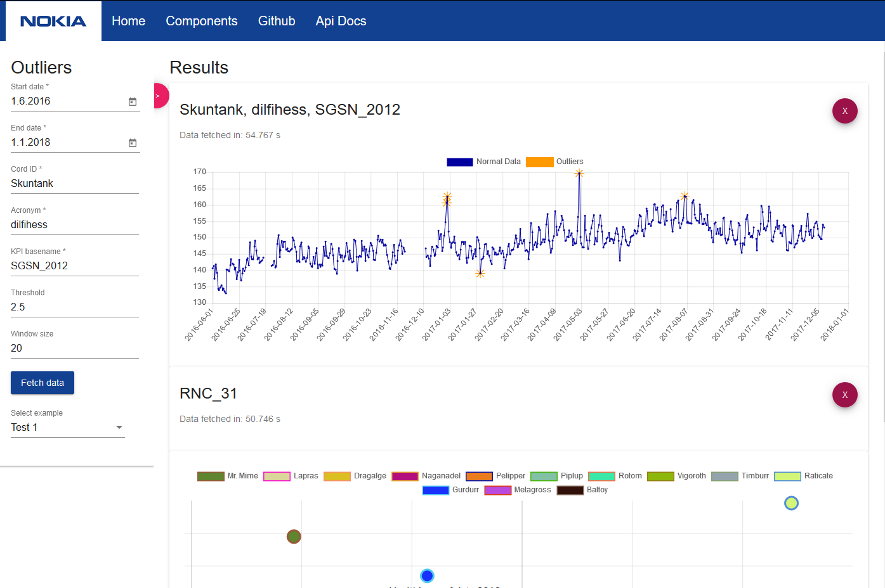





Healthiness of Data
Application for processing and analysing data. The data is first cleaned and then analysed to determine it's quality. It can then ease future decision making and planning concerning the product which delivered the data. For convenience of usage, the application provides a web interface with customizable charts and tables.
http://healthiness-of-data.ovh
https://github.com/nokia-wroclaw/innovativeprojects-healthiness-of-data/
Wojciech Adamek | Dominika Maślanka | Jakub Walecki | Jacek Zalewski

