Slide 1
ISO/IEC 14443 Overview

Slide 2
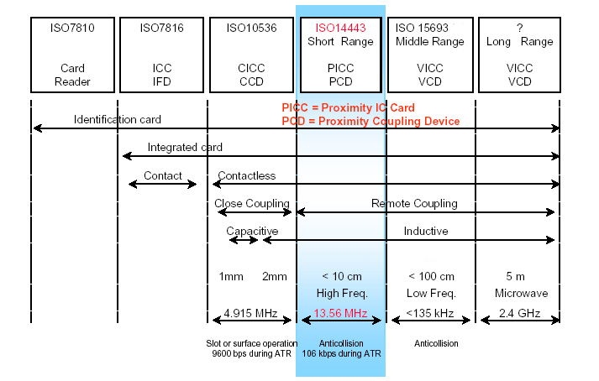
ISO/IEC 14443 Overview
Standards Overview

Slide 3
ISO/IEC 14443 Overview
History
  The development of the standard was assigned to SC17/WG8 in 1994.
  A task force was established comprising several companies.
  The 1st task was to determine what the market wanted in a contactless card.
  The task force studied various applications, that were in use at the time and projected for the foreseeable future.
  Compatibility with application layers of existing contact smart card (ISO/IEC 7816) standards was also taken into consideration for the ease of integration and deployment.
  In the end, the task force defined four parts to the standard:
    1. ISO/IEC14443-1 Physical characteristics
    2. ISO/IEC14443-2 Radio Frequency Power and Signal Interface
    3. ISO/IEC14443-3 Initialization and anticollision
    4. ISO/IEC14443-4 Transmission Protocol

Slide 4
ISO/IEC 14443 Overview
History - Modes of Operation
  The task force felt that a standard must also be capable of defining a card that uses a microprocessor as this offers the flexibility to easily update the application through software.
  After a year of debate a consensus was reached by defining two ‘modes of operation’ in ISO/IEC 14443-2 (the power and signal interface). These are referred to as ‘Type A’ and ‘Type B’.
  In 1998 a third signal interface mode was proposed by Sony (Type C) but rejected as this did not add anything new to the standard.
  All four parts of the ISO/IEC14443 standards were completed by 2001.
  In mid 2001, a number of companies proposed an amendment that would add five additional modes to ISO/IEC14443-2. (Type C > G).
  An SC17 ballot (ISO/IEC JTC1/SC17 N2051) on 11th Jan 2001 eventually concluded to keep only the two modes A and B.

Slide 5
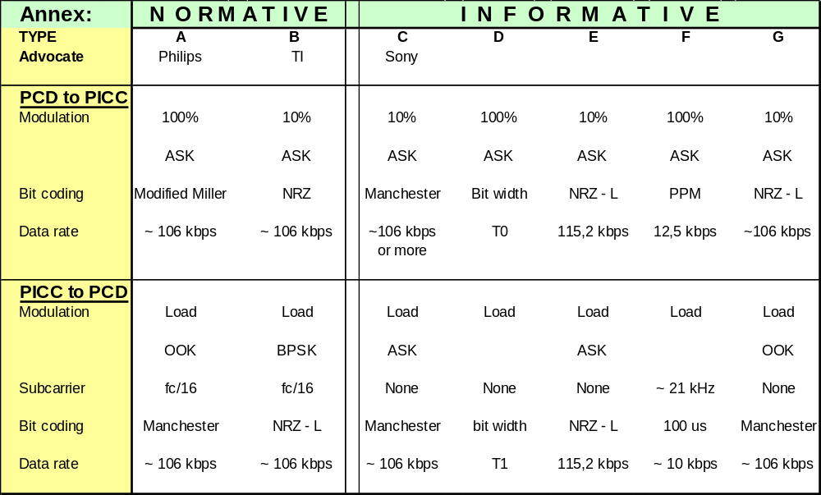
ISO/IEC 14443 Overview
History - Modes of Operation
NOT 'Standard'

Slide 6
ISO/IEC 14443 Overview
Acronyms
  There are a vast amount of acronyms used in the standard. These are summarized in the ‘Symbols and Abbreviated Terms’ section at the front of all parts 1 > 4 of the standard.
  Primary acronyms are:
  PICC – Proximity Integrated Circuit Card (Transponder)
  PCD – Proximity Coupling Device (Reader)
  Also, many of the commands referenced in Parts 3 and 4 are formatted XXXA or XXXB. This identifies them as a Type A or Type B command.
  i.e. REQA - Request Type A PICC Command
  REQB - Request Type B PICC Command

Slide 7
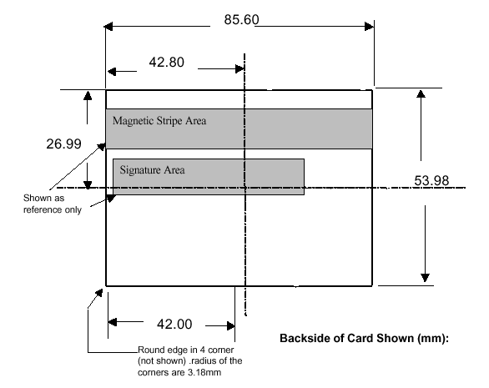
ISO/IEC 14443 Overview
Standard Structure
  ISO/IEC14443-1 Physical Characteristics
  This part of the standard specifies the physical size of the smart card.
  The card is the following size: (85.6mm x 54.0mm x .76mm) referred to as ID-1 size.
  This is the size of a bank credit card.

Slide 8
ISO/IEC 14443 Overview
Standard Structure
    ISO/IEC1443-2 Power and Interface
    The ISO/IEC14443-2 standard has two modes with the following features:
    These features allow the reader to power and communicate with the card over a targeted range of operation of approximately 10 cm.
    Reader to Card (PCD > PICC) Type A Type B
    Frequency 13.56 MHz 13.56 MHz
    Modulation 100% ASK 10% ASK
    Bit coding Modified Miller NRZ
    Data rate 106 kb/s 106 kb/s
    Card to Reader (PICC > PCD)
    Modulation Load Load
    Bit coding OOK BPSK
    Subcarrier 847kHz 847kHZ
    Bit coding Manchester NRZ
    Data rate 106 kb/s 106 kb/s

Slide 9
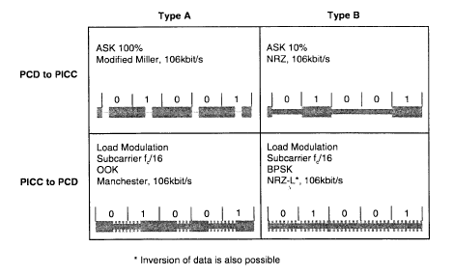
ISO/IEC 14443 Overview
Standard Structure
  ISO/IEC1443-2 Power and Interface
Signal Disappears Completely
Signal ALWAYS present

Slide 10
ISO/IEC 14443 Overview
Standard Structure
  ISO/IEC14443-3 Initialization and Anticollision
  Part three of the standard enables the reader to identify the cards in the magnetic field and establish communications with a specific card. It specifies the byte format, frames and timing used during the 2 initial phases of communication.
  The initialization process includes the commands between the reader and the card that activates the card to the ‘READY’ state.
  This anticollision process follows to identify all PICC’s in the PCD field .
  Part 3 defines 2 anticollision processes for the 2 different modes:
      Type A > Bit-collision detection protocol
      Type B > Slotted ALOHA with dynamic slot adaptation.

Slide 11
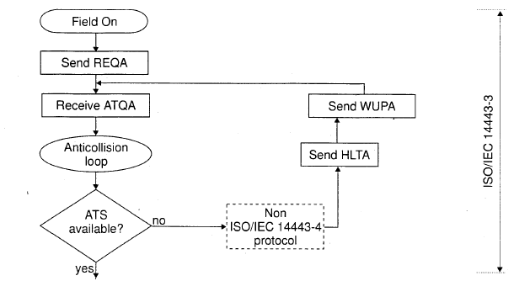
ISO/IEC 14443 Overview
Standard Structure
  ISO/IEC14443-3 Initialization and Anticollision
Idle State
Type A request
Wake-up Type A
Initialization
Ready State
Answer to Request
Type A
Ready State
Anticollision
Answer to Select
Halt Type A
PICC Selection
Active State
Note: Type A process illustrated

Slide 12
ISO/IEC 14443 Overview
Standard Structure
  ISO/IEC14443-4 Transmission protocols
  Part four of the standard defines the half-duplex block transmission protocol. In particular, it defines the activation and deactivation sequences of the protocol.
  The activation sequence is concluded through the Protocol and Parameter Selection (PPS) process, upon which data can be exchanged.
  Upon completion of data exchange, the PICC can be disabled through the de-selection process.
  This standard has been developed with functionality and flexibility in mind.

Slide 13
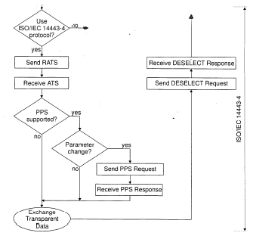
ISO/IEC 14443 Overview
Standard Structure
  ISO/IEC14443-4 Transmission protocols
PICC Selection
De-selection
PICC selection
Active State
Protocol / Parameter
Selection
Protocol/Parameter Selection
Data Exchange
Note: Type A process illustrated

Slide 14
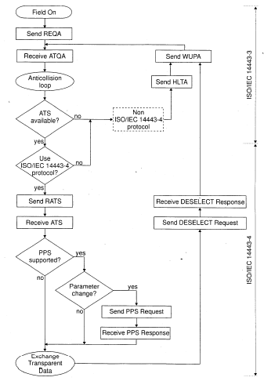
ISO/IEC 14443 Overview
Complete Operation
MIFARE is NOT the same as ‘Type A’.
It is not compliant to ISO/IEC 14443-4, Type A illustrated.
It uses it’s own transmission protocol.
Note: Type A process illustrated

Slide 15
ISO/IEC 14443 Overview
Communication Protocol Stack
ISO/IEC 14443/B –2
Air Interface & Modulation
H/W
TI’s TRF7960 ASIC supports both Type A AND Type B
ISO/IEC 14443/B –3
Initialization & anti-collision
Reader Software can be configured to support remainder of the standard and the application.
ISO/IEC 14443/B –4
Transmission port Layer
S/W
Application Protocol Layer
Security Layer

Slide 16
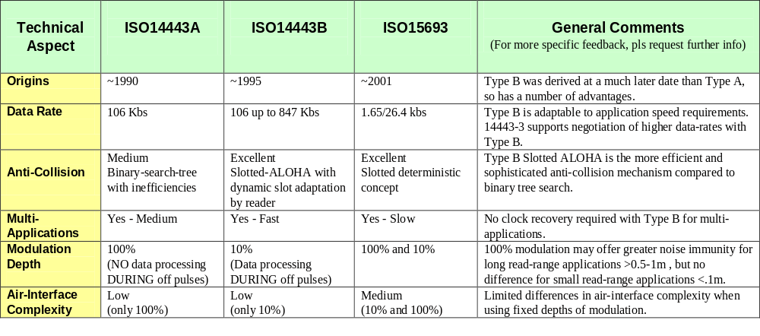
ISO/IEC 14443 Overview
Mode Conclusion
Type B is a more recent, advanced, flexible and efficient Mode of Operation.

