Slide 1

Ignition: Jump-starting an Interpreter for V8
Ross McIlroy
Google London

Slide 2
Agenda
Why we all love JavaScript
The V8 approach
How to retrofit an interpreter into a moving engine

Slide 3
Why we all love JavaScript...

Slide 4
JavaScript
The language of the Web

Slide 5
JavaScript
The language of the Web
Programs are distributed as source - parsing and compiling must be fast

Slide 6
JavaScript
The language of the Web
Programs are distributed as source - parsing and compiling must be fast
Untyped: variables and properties do not have types, values do

Slide 7
JavaScript
The language of the Web
Programs are distributed as source - parsing and compiling must be fast
Untyped: variables and properties do not have types, values do
Prototype-based object model

Slide 8
JavaScript
The language of the Web
Programs are distributed as source - parsing and compiling must be fast
Untyped: variables and properties do not have types, values do
Prototype-based object model
Functional features with closures

Slide 9
JavaScript
The language of the Web
Programs are distributed as source - parsing and compiling must be fast
Untyped: variables and properties do not have types, values do
Prototype-based object model
Functional features with closures
A smattering of interesting features
eval() allows dynamic execution of runtime generated statements within a function
weird scoping rules
default values and implicit type coercion
...

Slide 10
Something Simple
function add(a, b) {
return a + b;
}

Slide 11
Something Simple
function add(a, b) {
return a + b;
}
add(1, 2); // 3
Integer addition

Slide 12
Something Simple
function add(a, b) {
return a + b;
}
add(1, 2); // 3
add(1.2, 3.14); // 4.34
Integer addition
Floating point addition

Slide 13
Something Simple
function add(a, b) {
return a + b;
}
add(1, 2); // 3
add(1.2, 3.14); // 4.34
add(“hello”, “world”); // “helloworld”
Integer addition
Floating point addition
String addition

Slide 14
Something Simple
function add(a, b) {
return a + b;
}
add(1, 2); // 3
add(1.2, 3.14); // 4.34
add(“hello”, “world”); // “helloworld”
add(1, true); // 2
Integer addition
Floating point addition
String addition
Type coercion

Slide 15
Something Simple
function add(a, b) {
return a + b;
}
add(1, 2); // 3
add(1.2, 3.14); // 4.34
add(“hello”, “world”); // “helloworld”
add(1, true); // 2
add(“foo”, true); // “footrue”
Integer addition
Floating point addition
String addition
Type coercion

Slide 16
Something Simple
function add(a, b) {
return a + b;
}
add(1, 2); // 3
add(1.2, 3.14); // 4.34
add(“hello”, “world”); // “helloworld”
add(1, true); // 2
add(“foo”, true); // “footrue”
var bar = {toString:() => “bar”}; add(“foo”, bar); // “foobar”
Integer addition
Floating point addition
String addition
Type coercion
toString() / valueOf()

Slide 17
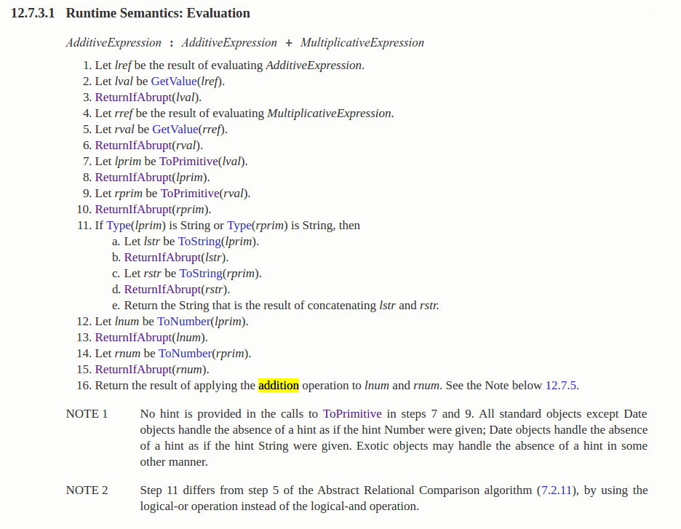
A Glance at Semantics
operator +

Slide 18
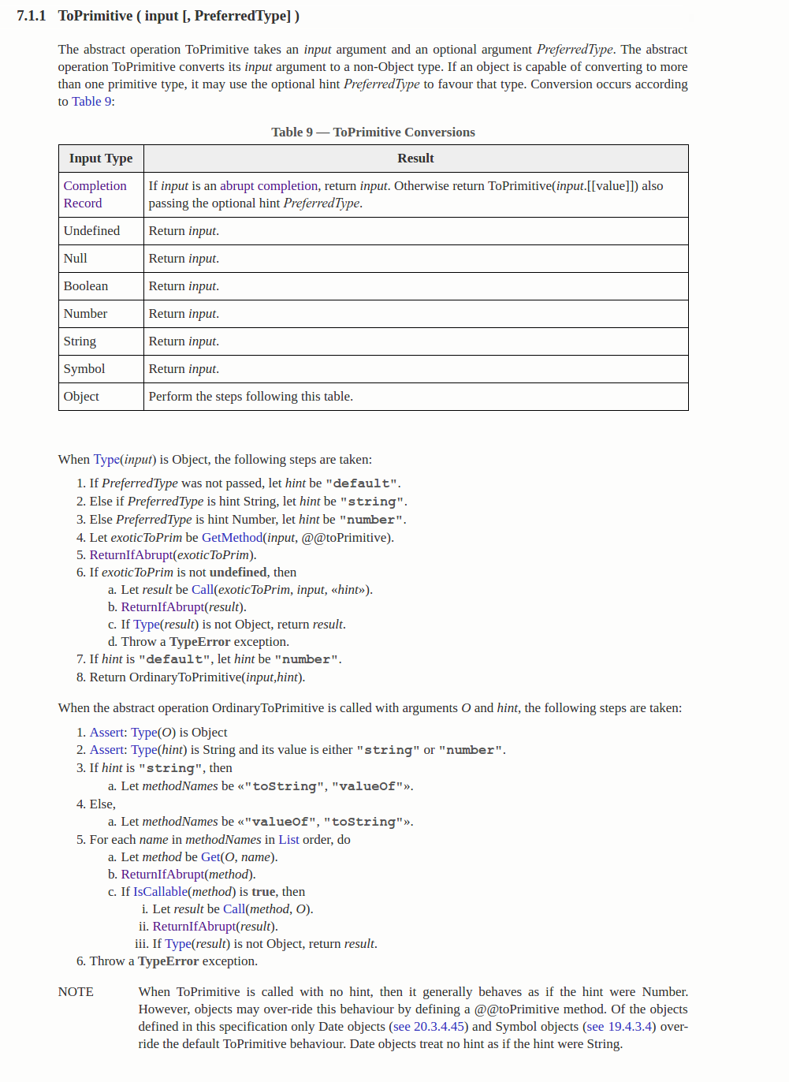
A Glance at Semantics
operator +
ToPrimitive

Slide 19
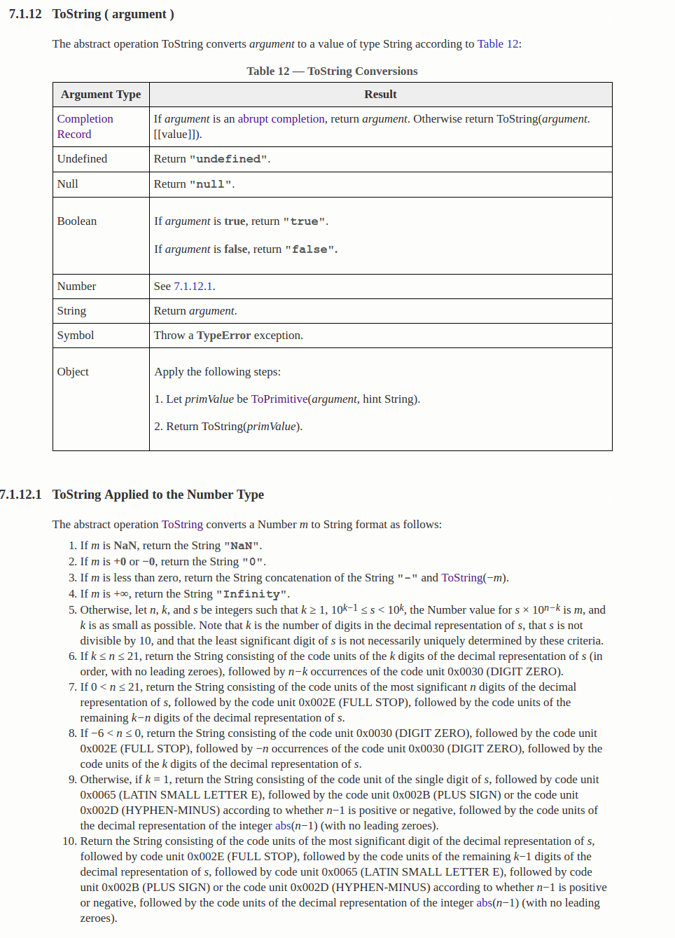
A Glance at Semantics
operator +
ToPrimitive
ToString

Slide 20
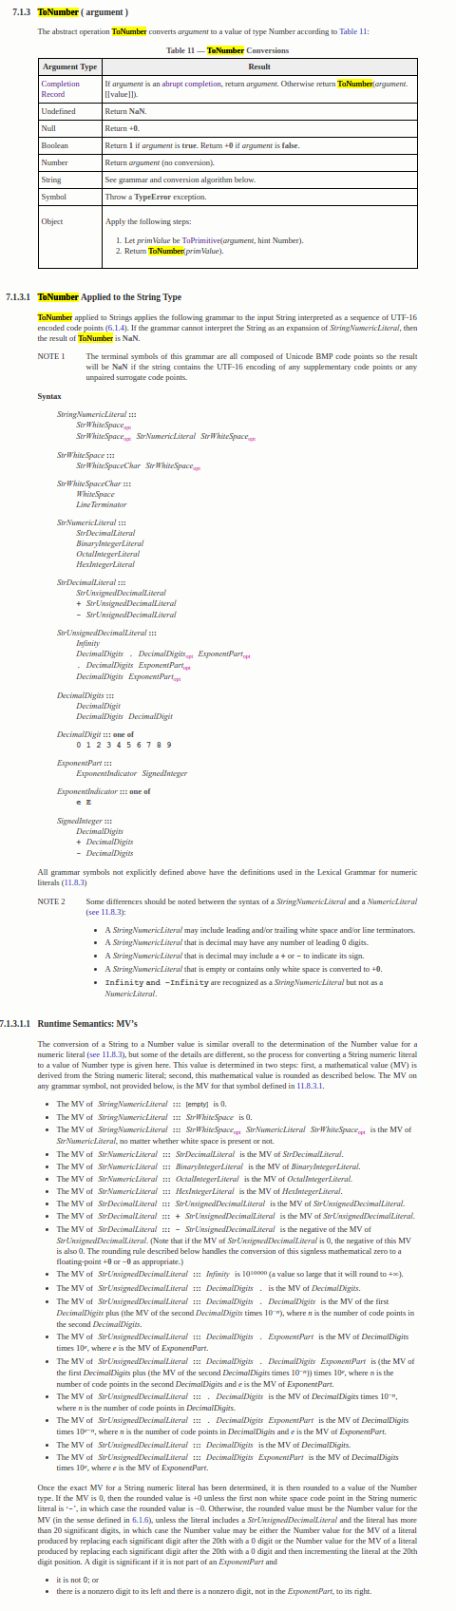
A Glance at Semantics
operator +
ToNumber
ToPrimitive
ToString

Slide 21
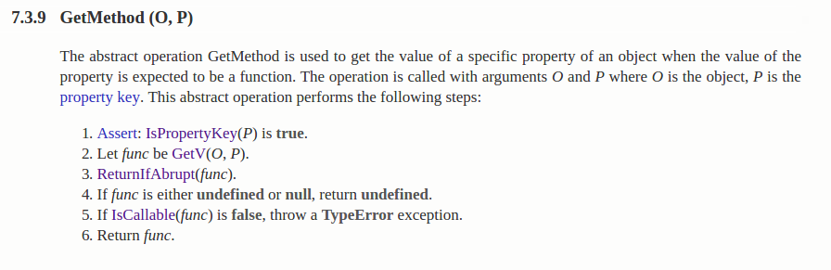
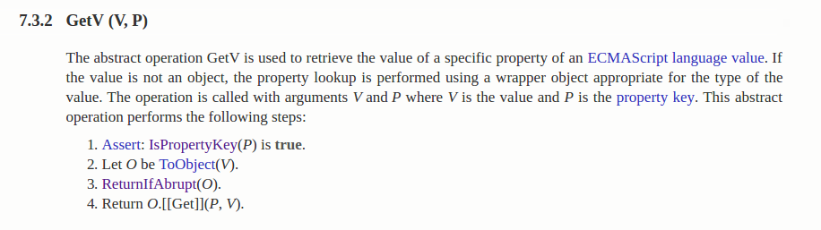
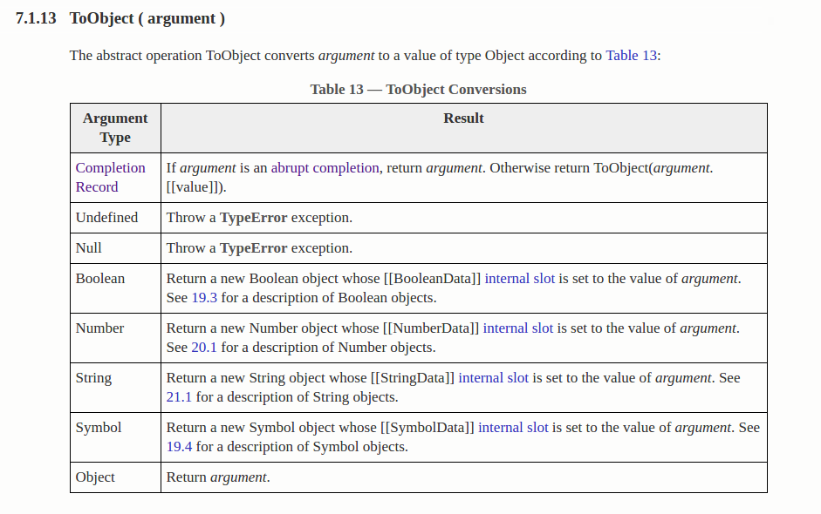
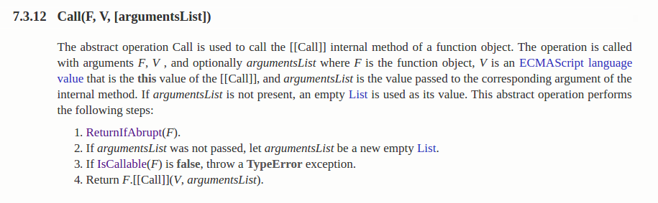
A Glance at Semantics
operator +
ToPrimitive
GetMethod
ToString
ToNumber
GetV
ToObject
Call

Slide 22
A Glance at Semantics
operator +
ToPrimitive
GetMethod
ToString
ToNumber
GetV
ToObject
Call
Arbitrary Javascript

Slide 23
A Glance at Semantics
operator +
ToPrimitive
GetMethod
ToString
ToNumber
GetV
ToObject
Call
Arbitrary Javascript

Slide 24
Everything’s a Function
An object’s constructor is just a function
function Person(name) {
this.name = name;
}

Slide 25
Everything’s a Function
function Person(name) {
this.name = name;
}
Person.prototype.toString = function() { return this.name; }
Method’s are installed on the prototype of an object

Slide 26
Everything’s a Function
function Person(name) {
this.name = name;
}
Person.prototype.toString = function() { return this.name; }
var jill = new Person(“Jill”);
print(jill); // “Jill”
Objects are instantiated
by “new <Function>(...)”

Slide 27
Everything’s a Function
function Person(name) {
this.name = name;
}
Person.prototype.toString = function() { return this.name; }
function Student(name, grade) {
Person.call(this, name);
this.grade = grade;
}
Student.prototype.__proto__ = Person.prototype;
var tom = new Student(“Tom”, 72);
print(tom); // “Tom”
Inheritance emulated by prototype chaining

Slide 28
Everything’s a Function
function Person(name) {
this.name = name;
}
Person.prototype.toString = function() { return this.name; }
function Student(name, grade) {
Person.call(this, name);
this.grade = grade;
}
Student.prototype.__proto__ = Person.prototype;
var tom = new Student(“Tom”, 72);
tom.__proto__ = Object.prototype;
print(tom); // “[object Object]”
Which is completely dynamic....

Slide 29
Except when it’s a Closure
function Counter(start) {
var count = 0;
return {
next: function() { return start + count++; }
}
}

Slide 30
Except when it’s a Closure
function Counter(start) {
var count = 0;
return {
next: function() { return start + count++; }
}
}
var counter = Counter(5);
print(counter.next() + “ -> ” + counter.next()); // 5 -> 6
Closures over parameters, and mutable local variables

Slide 31
Fun with eval()
function func(a, b) {
return eval(a) + (b == 0 ? 0 : func(a, --b));
}
func(“1”, 3); // 4
Executes string within the context of the calling function

Slide 32
Fun with eval()
function func(a, b) {
return eval(a) + (b == 0 ? 0 : func(a, --b));
}
func(“1”, 3); // 4
func(“b = 0”, 200); // 0
Executes string within the context of the calling function
Can modify locals or introduce new ones

Slide 33
Fun with eval()
function func(a, b) {
return eval(a) + (b == 0 ? 0 : func(a, --b));
}
func(“1”, 3); // 4
func(“b = 0”, 200); // 0
func("func = function() {
return 'bar'
}; 'foo'", 50); // “foobar”
Executes string within the context of the calling function
Can modify locals or introduce new ones
Or do crazy things...

Slide 34
The V8 Approach

Slide 35
V8 History
V8 was the first really fast JavaScript Virtual Machine
Launched with Chrome in 2008
10x faster than competition at release
10x faster today than in 2008
2008 - Full-Codegen
Fast AST-walking JIT compiler with inline caching
2010 - Crankshaft
Optimizing JIT compiler with type feedback and deoptimization
2015 - TurboFan
Optimizing JIT compiler with type and range analysis, sea of nodes

Slide 36
Compiler Pipeline (2008)
Source
Parser
Full- codegen
Unoptimized Code
Notes:
Walk the AST and generate code as you go.

Slide 37
Full-Codegen in a nutshell
function Sum(point) = {
return point.x + point.y;
};

Slide 38
Full-Codegen in a nutshell
return
function Sum(point) = {
return point.x + point.y;
};
+
Load Property
Load Property
point
“x”
point
“y”
Parser

Slide 39
Full-Codegen in a nutshell
return
+
Load Property
Load Property
point
“x”
point
“y”

Slide 40
Full-Codegen in a nutshell
... ; prologue
mov eax, [ebp + 0x10] ; point
return
+
Load Property
Load Property
point
“x”
point
“y”
Full-Codegen

Slide 41
Full-Codegen in a nutshell
... ; prologue
mov eax, [ebp + 0x10] ; point
mov ecx, 0x56a79431 ; “x”
return
+
Load Property
Load Property
point
“x”
point
“y”
Full-Codegen

Slide 42
Full-Codegen in a nutshell
... ; prologue
mov eax, [ebp + 0x10] ; point
mov ecx, 0x56a79431 ; “x”
call $LoadNamedProperty
push eax
return
+
Load Property
Load Property
point
“x”
point
“y”
Full-Codegen

Slide 43
Full-Codegen in a nutshell
... ; prologue
mov eax, [ebp + 0x10] ; point
mov ecx, 0x56a79431 ; “x”
call $LoadNamedProperty
push eax
mov eax, [ebp + 0x10] ; point
mov ecx, 0x56a71251 ; “y”
call $LoadNamedProperty
return
+
Load Property
Load Property
point
“x”
point
“y”
Full-Codegen

Slide 44
Full-Codegen in a nutshell
... ; prologue
mov eax, [ebp + 0x10] ; point
mov ecx, 0x56a79431 ; “x”
call $LoadNamedProperty
push eax
mov eax, [ebp + 0x10] ; point
mov ecx, 0x56a71251 ; “y”
call $LoadNamedProperty
pop edx
call $BinaryOpAdd
...
return
+
Load Property
Load Property
point
“x”
point
“y”
Full-Codegen

Slide 45
Full-Codegen in a nutshell
... ; prologue
mov eax, [ebp + 0x10] ; point
mov ecx, 0x56a79431 ; “x”
call $LoadNamedProperty
push eax
mov eax, [ebp + 0x10] ; point
mov ecx, 0x56a71251 ; “y”
call $LoadNamedProperty
pop edx
call $BinaryOpAdd
...
UNINITIALIZED_LOAD_IC
Call into runtime
Determine object layout
Load property with <name>

Slide 46
Hidden Classes
function Point(x, y) = {
this.x = x;
this.y = y;
};
Hidden classes was a technique from Self VM

Slide 47
Hidden Classes
map[Point]
function Point(x, y) {
this.x = x;
this.y = y;
};
var point = new Point(3, 5);

Slide 48
Hidden Classes
map[Point]
function Point(x, y) {
this.x = x;
this.y = y;
};
var point = new Point(3, 5);
3
map[Point1]
0x4: “x”

Slide 49
Hidden Classes
map[Point]
function Point(x, y) {
this.x = x;
this.y = y;
};
var point = new Point(3, 5);
3
map[Point1]
“x”
0x4: “x”

Slide 50
Hidden Classes
map[Point]
3
map[Point1]
“x”
function Point(x, y) {
this.x = x;
this.y = y;
};
var point = new Point(3, 5);
map[Point2]
“y”
5
0x4: “x”
0x4: “x”
0x8: “y”

Slide 51
Inline Caches (ICs)
... ; prologue
mov eax, [ebp + 0x10] ; point
mov ecx, 0x56a79431 ; “x”
call $LoadNamedProperty
push eax
mov eax, [ebp + 0x10] ; point
mov ecx, 0x56a71251 ; “y”
call $LoadNamedProperty
pop edx
call $BinaryOpAdd
...
UNINITIALIZED_LOAD_IC
Call into runtime
Determine object layout
Load property with <name>
Generate specialized IC
Back-patch original call

Slide 52
Inline Caches (ICs)
MONOMORPHIC_LOAD_IC_X
… ; Check object’s map is
… ; Point type, or bailout
mov eax, [eax + 0x4]
ret
... ; prologue
mov eax, [ebp + 0x10] ; point
mov ecx, 0x56a79431 ; “x”
call $LoadNamedProperty
push eax
mov eax, [ebp + 0x10] ; point
mov ecx, 0x56a71251 ; “y”
call $LoadNamedProperty
pop edx
call $BinaryOpAdd
...
UNINITIALIZED_LOAD_IC
Call into runtime
Determine object layout
Load property with <name>
Generate specialized IC
Back-patch original call

Slide 53
Inline Caches (ICs)
MONOMORPHIC_LOAD_IC_X
… ; Check object’s map is
… ; Point type, or bailout
mov eax, [eax + 0x4]
ret
... ; prologue
mov eax, [ebp + 0x10] ; point
mov ecx, 0x56a79431 ; “x”
call $LoadNamedProperty
push eax
mov eax, [ebp + 0x10] ; point
mov ecx, 0x56a71251 ; “y”
call $LoadNamedProperty
pop edx
call $BinaryOpAdd
...
MONOMORPHIC_LOAD_IC_Y
… ; Check object’s map is
… ; Point type, or bailout
mov eax, [eax + 0x8]
ret

Slide 54
Inline Caches (ICs)
MONOMORPHIC_LOAD_IC_X
… ; Check object’s map is
… ; Point type, or bailout
mov eax, [eax + 0x4]
ret
... ; prologue
mov eax, [ebp + 0x10] ; point
mov ecx, 0x56a79431 ; “x”
call $LoadNamedProperty
push eax
mov eax, [ebp + 0x10] ; point
mov ecx, 0x56a71251 ; “y”
call $LoadNamedProperty
pop edx
call $BinaryOpAdd
...
MONOMORPHIC_LOAD_IC_Y
… ; Check object’s map is
… ; Point type, or bailout
mov eax, [eax + 0x8]
ret
BINARY_OP_ADD_IC
…

Slide 55
Compiler Pipeline (2010)
Source
Parser
Full- codegen
Parser
Crankshaft
Unoptimized Code
Optimized Code
Baseline
Optimized

Slide 56
A Little on Crankshaft
function Sum(point) {
return point.x + point.y;
};

Slide 57
A Little on Crankshaft
function Sum(point) {
return point.x + point.y;
};
Sum(new Point(1, 2));
Sum(new Point(100, 6));
Sum(new Point(0.5, 30));
Sum(new Point(0.5, 30));

Slide 58
A Little on Crankshaft
Always Point
function Sum(point) {
return point.x + point.y;
};
Sum(new Point(1, 2));
Sum(new Point(100, 6));
Sum(new Point(0.5, 30));
Sum(new Point(0.5, 30));
Always a number

Slide 59
A Little on Crankshaft
Always Point
function Sum(point) {
return point.x + point.y;
};
Sum(new Point(1, 2));
Sum(new Point(100, 6));
Sum(new Point(0.5, 30));
Sum(new Point(0.5, 30));
Inline property load
Elide map checks
Always a number
Inline FP addition

Slide 60
A Little on Crankshaft
Always Point
Type analysis
function Sum(point) {
return point.x + point.y;
};
Sum(new Point(1, 2));
Sum(new Point(100, 6));
Sum(new Point(0.5, 30));
Sum(new Point(0.5, 30));
Inline property load
Elide map checks
Escape analysis
GVN
Always a number
Inlining
Inline FP addition

Slide 61
A Little on Crankshaft
Always Point
❌
Type analysis
function Sum(point) {
return point.x + point.y;
};
Sum(new Point(1, 2));
Sum(new Point(100, 6));
Sum(new Point(0.5, 30));
Sum(new Point(0.5, 30));
Sum(new StringPair(“foo”, “bar”);
Inline property load
Elide map checks
Escape analysis
GVN
Always a number
❌
Inlining
Inline FP addition

Slide 62
Deoptimization - Always Have a Backup Plan
Deopt points inserted before speculative optimizations
Crankshaft needs to model Full-Codegen’s execution to rebuild a stack frame for the deopt point
Optimized Code
Baseline Code

Slide 63
Compiler Pipeline (2015)
Source
Crankshaft
Parser
Full- codegen
Parser
TurboFan
Unoptimized Code
Optimized Code
Baseline
Optimized

Slide 64
Another Optimizing Compiler?
Crankshaft served us well, but has various shortcomings:
Doesn’t scale to full modern JavaScript
try-catch, for-of, generators, async/await

Slide 65
Another Optimizing Compiler?
Crankshaft served us well, but has various shortcomings:
Doesn’t scale to full modern JavaScript
try-catch, for-of, generators, async/await
Relies heavily on deoptimization
Performance cliffs and deoptimization loops

Slide 66
Another Optimizing Compiler?
Crankshaft served us well, but has various shortcomings:
Doesn’t scale to full modern JavaScript
try-catch, for-of, generators, async/await
Relies heavily on deoptimization
Performance cliffs and deoptimization loops
Limited static type analysis / propagation
Not amenable to asm.js style optimization

Slide 67
Another Optimizing Compiler?
Crankshaft served us well, but has various shortcomings:
Doesn’t scale to full modern JavaScript
try-catch, for-of, generators, async/await
Relies heavily on deoptimization
Performance cliffs and deoptimization loops
Limited static type analysis / propagation
Not amenable to asm.js style optimization
Tight coupling Full-codegen

Slide 68
Another Optimizing Compiler?
Crankshaft served us well, but has various shortcomings:
Doesn’t scale to full modern JavaScript
try-catch, for-of, generators, async/await
Relies heavily on deoptimization
Performance cliffs and deoptimization loops
Limited static type analysis / propagation
Not amenable to asm.js style optimization
Tight coupling Full-codegen
High porting overhead

Slide 69
TurboFan
Sea of Nodes
Relax evaluation order for most operations (value edges)
Skeleton of a CFG remains (control edges) and stateful operations (effect edges)
Provides better redundant code elimination and more code motion

Slide 70
TurboFan
Sea of Nodes
Relax evaluation order for most operations (value edges)
Skeleton of a CFG remains (control edges) and stateful operations (effect edges)
Provides better redundant code elimination and more code motion
Three Level IR
JavaScript: JavaScript’s overloaded operators
Simplified: VM operations, e.g. allocation or number arithmetic
Machine: Machine-level operations, e.g. int32 addition

Slide 71
TurboFan
Sea of Nodes
Relax evaluation order for most operations (value edges)
Skeleton of a CFG remains (control edges) and stateful operations (effect edges)
Provides better redundant code elimination and more code motion
Three Level IR
JavaScript: JavaScript’s overloaded operators
Simplified: VM operations, e.g. allocation or number arithmetic
Machine: Machine-level operations, e.g. int32 addition
Lowering JS graph to simplified graph based on types
Take into account static type information and type feedback

Slide 72
Sea of Nodes
Start
Control edge
x
Value edge
function (x) {
return x ? 1 : 2;
}
Branch
Effect edge
IfFalse
IfTrue
2
1
Merge
phi
End

Slide 73
Retrofitting an Interpreter into
a Moving Engine

Slide 74
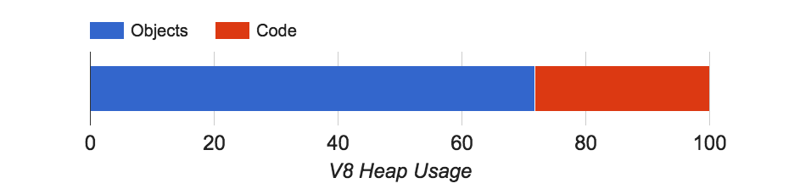
Why Interpret?
Reduce memory usage

Slide 75
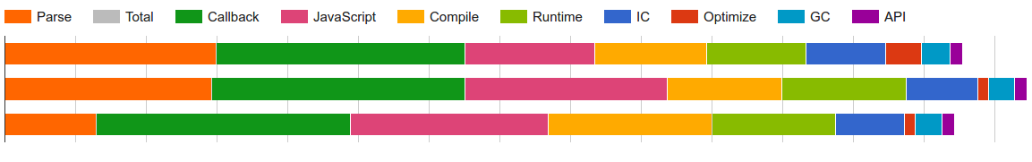
Why Interpret?
Reduce memory usage
Reduce startup time
33% of time spent parsing + compiling

Slide 76
Why Interpret?
Reduce memory usage
Reduce startup time
Reduce complexity
Unoptimized Code
Full- codegen
Crankshaft
Optimized Code
TurboFan
Optimized Code

Slide 77
Ignition - Goals
Reduce memory usage
Compile to bytecode which is 4x smaller than machine code
Reduce overall code memory by 2x
Reduce startup time
Reduce complexity

Slide 78
Ignition - Goals
Reduce memory usage
Compile to bytecode which is 4x smaller than machine code
Reduce overall code memory by 2x
Reduce startup time
Faster compiling to bytecode
Reduce re-parsing for lazy compile and optimize re-compile
Reduce complexity

Slide 79
Ignition - Goals
Reduce memory usage
Compile to bytecode which is 4x smaller than machine code
Reduce overall code memory by 2x
Reduce startup time
Faster compiling to bytecode
Reduce re-parsing for lazy compile and optimize re-compile
Reduce complexity
Bytecode as source of truth
Simplify compilation pipeline

Slide 80
Ignition - Challenges
Don’t regress performance

Slide 81
Ignition - Challenges
Don’t regress performance
Support 100% of the JavaScript language on 9 CPU architectures

Slide 82
Ignition - Challenges
Don’t regress performance
Support 100% of the JavaScript language on 9 CPU architectures
Integrate with V8’s runtime (type feedback, object model, GC, etc)

Slide 83
Ignition - Challenges
Don’t regress performance
Support 100% of the JavaScript language on 9 CPU architectures
Integrate with V8’s runtime (type feedback, object model, GC, etc)
Support the debugger / liveedit

Slide 84
Ignition - Challenges
Don’t regress performance
Support 100% of the JavaScript language on 9 CPU architectures
Integrate with V8’s runtime (type feedback, object model, GC, etc)
Support the debugger / liveedit
Support two pipelines (Crankshaft and TurboFan)

Slide 85
Compiler Pipeline (2015)
Optimize
Crankshaft
Full- codegen
Unoptimized Code
TurboFan
Optimized Code
Baseline
Optimized

Slide 86
Compiler Pipeline (2015)
Optimize
Crankshaft
Full- codegen
Unoptimized Code
TurboFan
Optimized Code
Baseline
Optimized

Slide 87
Compiler Pipeline (2016)
Optimize
Crankshaft
Full- codegen
Unoptimized Code
Ignition
Bytecode
TurboFan
Optimized Code
Baseline
Optimized

Slide 88
Compiler Pipeline (2016)
Optimize
Crankshaft
Full- codegen
Unoptimized Code
Ignition
Bytecode
TurboFan
Optimized Code
Baseline
Optimized

Slide 89
Compiler Pipeline (early 2017 ?)
Optimize
Crankshaft
Baseline
Full- codegen
Ignition
Unoptimized Code
Bytecode
TurboFan
Optimized Code
Optimize
Interpreted
Baseline
Optimized

Slide 90
Compiler Pipeline (early 2017 ?)
Optimize
Crankshaft
Baseline
Full- codegen
Ignition
Unoptimized Code
Bytecode
TurboFan
Optimized Code
Optimize
Interpreted
Baseline
Optimized

Slide 91
Compiler Pipeline (2017 ?)
Ignition
Bytecode
TurboFan
Optimized Code
Optimize
Interpreted
Optimized

Slide 92
Ignition Design Decisions
Focus on reducing code size
Indirect threaded bytecode dispatch
Accumulator as implicit input / output

Slide 93
Ignition Design Decisions
Focus on reducing code size
Indirect threaded bytecode dispatch
Accumulator as implicit input / output
But still as fast as possible
Hand coded using (architecture-independent) macro-assembly
Register machine

Slide 94
Ignition Design Decisions
Focus on reducing code size
Indirect threaded bytecode dispatch
Accumulator as implicit input / output
But still as fast as possible
Hand coded using (architecture-independent) macro-assembly
Register machine
Bytecode can be used to build TurboFan graphs directly
Bytecode is single source of truth
Simpler deoptimization execution modeling

Slide 95
Ignition Bytecode
function f(a, b, c) {
var local = c - 100;
return a + local * b;
}
Notes:
Accumulator avoid the need for pushing and popping the top of the stack.
The accumulator is an implicit argument to many bytecodes and typically holds the result of the operation. Return implicitly returns the accumulator

Slide 96
Ignition Bytecode
LdaSmi #100
Sub a2
Star r0
Ldar a1
Mul r0
Add a0
Return
function f(a, b, c) {
var local = c - 100;
return a + local * b;
}
Notes:
Accumulator avoid the need for pushing and popping the top of the stack.
The accumulator is an implicit argument to many bytecodes and typically holds the result of the operation. Return implicitly returns the accumulator

Slide 97
Ignition Bytecode
LdaSmi #100
Sub a2
Star r0
Ldar a1
Mul r0
Add a0
Return
function f(a, b, c) {
var local = c - 100;
return a + local * b;
}
r0 [local] | undefined
Notes:
Accumulator avoid the need for pushing and popping the top of the stack.
The accumulator is an implicit argument to many bytecodes and typically holds the result of the operation. Return implicitly returns the accumulator

Slide 98
Ignition Bytecode
LdaSmi #100
Sub a2
Star r0
Ldar a1
Mul r0
Add a0
Return
a0 [a] | 5
a1 [b] | 2
a2 [c] | 150
r0 [local] | undefined
function f(a, b, c) {
var local = c - 100;
return a + local * b;
}
Notes:
Accumulator avoid the need for pushing and popping the top of the stack.
The accumulator is an implicit argument to many bytecodes and typically holds the result of the operation. Return implicitly returns the accumulator

Slide 99
Ignition Bytecode
LdaSmi #100
Sub a2
Star r0
Ldar a1
Mul r0
Add a0
Return
a0 [a] | 5
a1 [b] | 2
a2 [c] | 150
r0 [local] | undefined
accumulator | undefined
function f(a, b, c) {
var local = c - 100;
return a + local * b;
}
Notes:
Accumulator avoid the need for pushing and popping the top of the stack.
The accumulator is an implicit argument to many bytecodes and typically holds the result of the operation. Return implicitly returns the accumulator

Slide 100
Ignition Bytecode
LdaSmi #100
Sub a2
Star r0
Ldar a1
Mul r0
Add a0
Return
a0 [a] | 5
a1 [b] | 2
a2 [c] | 150
r0 [local] | undefined
accumulator | 100
function f(a, b, c) {
var local = c - 100;
return a + local * b;
}
Notes:
Accumulator avoid the need for pushing and popping the top of the stack.
The accumulator is an implicit argument to many bytecodes and typically holds the result of the operation. Return implicitly returns the accumulator

Slide 101
Ignition Bytecode
LdaSmi #100
Sub a2
Star r0
Ldar a1
Mul r0
Add a0
Return
a0 [a] | 5
a1 [b] | 2
a2 [c] | 150
r0 [local] | undefined
accumulator | 50
function f(a, b, c) {
var local = c - 100;
return a + local * b;
}
Notes:
Accumulator avoid the need for pushing and popping the top of the stack.
The accumulator is an implicit argument to many bytecodes and typically holds the result of the operation. Return implicitly returns the accumulator

Slide 102
Ignition Bytecode
LdaSmi #100
Sub a2
Star r0
Ldar a1
Mul r0
Add a0
Return
a0 [a] | 5
a1 [b] | 2
a2 [c] | 150
r0 [local] | 50
accumulator | 50
function f(a, b, c) {
var local = c - 100;
return a + local * b;
}
Notes:
Accumulator avoid the need for pushing and popping the top of the stack.
The accumulator is an implicit argument to many bytecodes and typically holds the result of the operation. Return implicitly returns the accumulator

Slide 103
Ignition Bytecode
LdaSmi #100
Sub a2
Star r0
Ldar a1
Mul r0
Add a0
Return
a0 [a] | 5
a1 [b] | 2
a2 [c] | 150
r0 [local] | 50
accumulator | 2
function f(a, b, c) {
var local = c - 100;
return a + local * b;
}
Notes:
Accumulator avoid the need for pushing and popping the top of the stack.
The accumulator is an implicit argument to many bytecodes and typically holds the result of the operation. Return implicitly returns the accumulator

Slide 104
Ignition Bytecode
LdaSmi #100
Sub a2
Star r0
Ldar a1
Mul r0
Add a0
Return
a0 [a] | 5
a1 [b] | 2
a2 [c] | 150
r0 [local] | 50
accumulator | 100
function f(a, b, c) {
var local = c - 100;
return a + local * b;
}
Notes:
Accumulator avoid the need for pushing and popping the top of the stack.
The accumulator is an implicit argument to many bytecodes and typically holds the result of the operation. Return implicitly returns the accumulator

Slide 105
Ignition Bytecode
LdaSmi #100
Sub a2
Star r0
Ldar a1
Mul r0
Add a0
Return
a0 [a] | 5
a1 [b] | 2
a2 [c] | 150
r0 [local] | 50
accumulator | 105
function f(a, b, c) {
var local = c - 100;
return a + local * b;
}
Notes:
Accumulator avoid the need for pushing and popping the top of the stack.
The accumulator is an implicit argument to many bytecodes and typically holds the result of the operation. Return implicitly returns the accumulator

Slide 106
Ignition Bytecode
LdaSmi #100
Sub a2
Star r0
Ldar a1
Mul r0
Add a0
Return
a0 [a] | 5
a1 [b] | 2
a2 [c] | 150
r0 [local] | 50
accumulator | 105
function f(a, b, c) {
var local = c - 100;
return a + local * b;
}
Notes:
Accumulator avoid the need for pushing and popping the top of the stack.
The accumulator is an implicit argument to many bytecodes and typically holds the result of the operation. Return implicitly returns the accumulator

Slide 107
Ignition Bytecode Pipeline
Parser
Abstract Syntax Tree
Bytecode Generator

Slide 108
Ignition Bytecode Pipeline
void BytecodeGenerator::VisitAddExpression(
BinaryOperation* expr) {
Register lhs =
VisitForRegisterValue(expr->left());
VisitForAccumulatorValue(expr->right());
builder()->AddOperation(lhs);
}
Parser
Abstract Syntax Tree
Bytecode Generator

Slide 109
Ignition Bytecode Pipeline
void BytecodeGenerator::VisitObjectLiteral(ObjectLiteral* expr) {
// Copy the literal boilerplate.
int fast_clone_properties_count = 0;
if (FastCloneShallowObjectStub::IsSupported(expr)) {
STATIC_ASSERT(
FastCloneShallowObjectStub::kMaximumClonedProperties <=
1 << CreateObjectLiteralFlags::FastClonePropertiesCountBits::kShift);
fast_clone_properties_count =
FastCloneShallowObjectStub::PropertiesCount(expr->properties_count());
}
uint8_t flags =
CreateObjectLiteralFlags::FlagsBits::encode(expr->ComputeFlags()) |
CreateObjectLiteralFlags::FastClonePropertiesCountBits::encode(
fast_clone_properties_count);
builder()->CreateObjectLiteral(expr->constant_properties(),
expr->literal_index(), flags);
// Allocate in the outer scope since this register is used to return the
// expression's results to the caller.
Register literal = register_allocator()->outer()->NewRegister();
builder()->StoreAccumulatorInRegister(literal);
// Store computed values into the literal.
int property_index = 0;
AccessorTable accessor_table(zone());
for (; property_index < expr->properties()->length(); property_index++) {
ObjectLiteral::Property* property = expr->properties()->at(property_index);
if (property->is_computed_name()) break;
if (property->IsCompileTimeValue()) continue;
RegisterAllocationScope inner_register_scope(this);
Literal* literal_key = property->key()->AsLiteral();
switch (property->kind()) {
case ObjectLiteral::Property::CONSTANT:
UNREACHABLE();
case ObjectLiteral::Property::MATERIALIZED_LITERAL:
DCHECK(!CompileTimeValue::IsCompileTimeValue(property->value()));
// Fall through.
case ObjectLiteral::Property::COMPUTED: {
// It is safe to use [[Put]] here because the boilerplate already
// contains computed properties with an uninitialized value.
if (literal_key->value()->IsInternalizedString()) {
if (property->emit_store()) {
VisitForAccumulatorValue(property->value());
if (FunctionLiteral::NeedsHomeObject(property->value())) {
RegisterAllocationScope register_scope(this);
Register value = register_allocator()->NewRegister();
builder()->StoreAccumulatorInRegister(value);
builder()->StoreNamedProperty(
literal, literal_key->AsPropertyName(),
feedback_index(property->GetSlot(0)), language_mode());
VisitSetHomeObject(value, literal, property, 1);
} else {
builder()->StoreNamedProperty(
literal, literal_key->AsPropertyName(),
feedback_index(property->GetSlot(0)), language_mode());
}
} else {
VisitForEffect(property->value());
}
register_allocator()->PrepareForConsecutiveAllocations(4);
Register literal_argument =
register_allocator()->NextConsecutiveRegister();
Register key = register_allocator()->NextConsecutiveRegister();
Register value = register_allocator()->NextConsecutiveRegister();
Register language = register_allocator()->NextConsecutiveRegister();
builder()->MoveRegister(literal, literal_argument);
VisitForAccumulatorValue(property->key());
builder()->StoreAccumulatorInRegister(key);
VisitForAccumulatorValue(property->value());
builder()->StoreAccumulatorInRegister(value);
if (property->emit_store()) {
builder()
->LoadLiteral(Smi::FromInt(SLOPPY))
.StoreAccumulatorInRegister(language)
.CallRuntime(Runtime::kSetProperty, literal_argument, 4);
VisitSetHomeObject(value, literal, property);
}
}
break;
}
case ObjectLiteral::Property::PROTOTYPE: {
DCHECK(property->emit_store());
register_allocator()->PrepareForConsecutiveAllocations(2);
Register literal_argument =
register_allocator()->NextConsecutiveRegister();
Register value = register_allocator()->NextConsecutiveRegister();
Parser
Abstract Syntax Tree
Bytecode Generator

Slide 110
Ignition Bytecode Pipeline
builder()->MoveRegister(literal, literal_argument);
VisitForAccumulatorValue(property->value());
builder()->StoreAccumulatorInRegister(value).CallRuntime(
Runtime::kInternalSetPrototype, literal_argument, 2);
break;
}
case ObjectLiteral::Property::GETTER:
if (property->emit_store()) {
accessor_table.lookup(literal_key)->second->getter = property;
}
break;
case ObjectLiteral::Property::SETTER:
if (property->emit_store()) {
accessor_table.lookup(literal_key)->second->setter = property;
}
break;
}
}
// Define accessors, using only a single call to the runtime for each pair of
// corresponding getters and setters.
for (AccessorTable::Iterator it = accessor_table.begin();
it != accessor_table.end(); ++it) {
RegisterAllocationScope inner_register_scope(this);
register_allocator()->PrepareForConsecutiveAllocations(5);
Register literal_argument = register_allocator()->NextConsecutiveRegister();
Register name = register_allocator()->NextConsecutiveRegister();
Register getter = register_allocator()->NextConsecutiveRegister();
Register setter = register_allocator()->NextConsecutiveRegister();
Register attr = register_allocator()->NextConsecutiveRegister();
builder()->MoveRegister(literal, literal_argument);
VisitForAccumulatorValue(it->first);
builder()->StoreAccumulatorInRegister(name);
VisitObjectLiteralAccessor(literal, it->second->getter, getter);
VisitObjectLiteralAccessor(literal, it->second->setter, setter);
builder()
->LoadLiteral(Smi::FromInt(NONE))
.StoreAccumulatorInRegister(attr)
.CallRuntime(Runtime::kDefineAccessorPropertyUnchecked,
literal_argument, 5);
}
for (; property_index < expr->properties()->length(); property_index++) {
ObjectLiteral::Property* property = expr->properties()->at(property_index);
RegisterAllocationScope inner_register_scope(this);
if (property->kind() == ObjectLiteral::Property::PROTOTYPE) {
DCHECK(property->emit_store());
register_allocator()->PrepareForConsecutiveAllocations(2);
Register literal_argument =
register_allocator()->NextConsecutiveRegister();
Register value = register_allocator()->NextConsecutiveRegister();
builder()->MoveRegister(literal, literal_argument);
VisitForAccumulatorValue(property->value());
builder()->StoreAccumulatorInRegister(value).CallRuntime(
Runtime::kInternalSetPrototype, literal_argument, 2);
continue;
}
register_allocator()->PrepareForConsecutiveAllocations(5);
Register literal_argument = register_allocator()->NextConsecutiveRegister();
Register key = register_allocator()->NextConsecutiveRegister();
Register value = register_allocator()->NextConsecutiveRegister();
Register attr = register_allocator()->NextConsecutiveRegister();
DCHECK(Register::AreContiguous(literal_argument, key, value, attr));
Register set_function_name =
register_allocator()->NextConsecutiveRegister();
builder()->MoveRegister(literal, literal_argument);
VisitForAccumulatorValue(property->key());
builder()->CastAccumulatorToName().StoreAccumulatorInRegister(key);
VisitForAccumulatorValue(property->value());
builder()->StoreAccumulatorInRegister(value);
VisitSetHomeObject(value, literal, property);
builder()->LoadLiteral(Smi::FromInt(NONE)).StoreAccumulatorInRegister(attr);
switch (property->kind()) {
case ObjectLiteral::Property::CONSTANT:
case ObjectLiteral::Property::COMPUTED:
case ObjectLiteral::Property::MATERIALIZED_LITERAL:
builder()
->LoadLiteral(Smi::FromInt(property->NeedsSetFunctionName()))
.StoreAccumulatorInRegister(set_function_name);
builder()->CallRuntime(Runtime::kDefineDataPropertyInLiteral,
literal_argument, 5);
break;
case ObjectLiteral::Property::PROTOTYPE:
UNREACHABLE(); // Handled specially above.
break;
case ObjectLiteral::Property::GETTER:
builder()->CallRuntime(Runtime::kDefineGetterPropertyUnchecked,
literal_argument, 4);
break;
case ObjectLiteral::Property::SETTER:
builder()->CallRuntime(Runtime::kDefineSetterPropertyUnchecked,
literal_argument, 4);
break;
}
}
execution_result()->SetResultInRegister(literal);
}
Parser
Abstract Syntax Tree
Bytecode Generator

Slide 111
Ignition Bytecode Pipeline
Parser
Abstract Syntax Tree
Bytecode Generator

Slide 112
Ignition Bytecode Pipeline
Register Optimizer
Peephole Optimizer
Dead-code Elimination
Parser
Abstract Syntax Tree
Bytecode Generator

Slide 113
Ignition Bytecode Pipeline
Register Optimizer
Peephole Optimizer
Dead-code Elimination
Parser
Abstract Syntax Tree
Bytecode Generator
Bytecode Array Writer
Bytecode

Slide 114
Ignition Bytecode Pipeline
Register Optimizer
Peephole Optimizer
Dead-code Elimination
Parser
Abstract Syntax Tree
Bytecode Generator
Bytecode Array Writer
Bytecode
Interpreter

Slide 115
Building the Ignition Interpreter
Write in C++

Slide 116
Building the Ignition Interpreter
Write in C++
Need trampolines between Interpreted and JITed functions
Can’t interoperate with fast code-stubs

Slide 117
Building the Ignition Interpreter
Write in C++
Need trampolines between Interpreted and JITed functions
Can’t interoperate with fast code-stubs
Hand-crafted assembly code
Notes:
35000 ASM LOC per architecture

Slide 118
Building the Ignition Interpreter
Write in C++
Need trampolines between Interpreted and JITed functions
Can’t interoperate with fast code-stubs
Hand-crafted assembly code
Would need to be ported to 9 architectures

Slide 119
Building the Ignition Interpreter
Write in C++
Need trampolines between Interpreted and JITed functions
Can’t interoperate with fast code-stubs
Hand-crafted assembly code
Would need to be ported to 9 architectures
Backend of the TurboFan Compiler

Slide 120
Building the Ignition Interpreter
Write in C++
Need trampolines between Interpreted and JITed functions
Can’t interoperate with fast code-stubs
Hand-crafted assembly code
Would need to be ported to 9 architectures
Backend of the TurboFan Compiler
Write-once in macro-assembly
Architecture specific instruction selection optimizations for free
Relatively painless interoperability with existing code-stubs

Slide 121
TurboFan Pipeline
JavaScript Source
JavaScript
Simple
Machine
Scheduler
CodeGen
Machine Code

Slide 122
TurboFan Pipeline
JavaScript Source
JavaScript
Simple
Machine
Scheduler
CodeGen
Interpreter Assembler
Machine Code

Slide 123
TurboFan Pipeline
WebAssembly
JavaScript Source
JavaScript
Simple
Machine
Scheduler
CodeGen
Interpreter Assembler
Machine Code

Slide 124
Building an Interpreter using TurboFan
void Interpreter::DoAdd(InterpreterAssembler* assembler) {
Node* reg_index = assembler->BytecodeOperandReg(0);
Node* lhs = assembler->LoadRegister(reg_index);
Node* rhs = assembler->GetAccumulator();
Node* result = AddStub::Generate(assembler, lhs, rhs);
assembler->SetAccumulator(result);
assembler->Dispatch();
}

Slide 125
Building an Interpreter using TurboFan
void Interpreter::DoAdd(InterpreterAssembler* assembler) {
Node* reg_index = assembler->BytecodeOperandReg(0);
Node* lhs = assembler->LoadRegister(reg_index);
Node* rhs = assembler->GetAccumulator();
Node* result = AddStub::Generate(assembler, lhs, rhs);
assembler->SetAccumulator(result);
assembler->Dispatch();
}
~375 LOC for number addition

Slide 126
Building an Interpreter using TurboFan
void Interpreter::DoAdd(InterpreterAssembler* assembler) {
Node* reg_index = assembler->BytecodeOperandReg(0);
Node* lhs = assembler->LoadRegister(reg_index);
Node* rhs = assembler->GetAccumulator();
Node* result = AddStub::Generate(assembler, lhs, rhs);
assembler->SetAccumulator(result);
assembler->Dispatch();
}
~375 LOC for number addition
~250 LOC for string addition

Slide 127
Building an Interpreter using TurboFan
void Interpreter::DoAdd(InterpreterAssembler* assembler) {
Node* reg_index = assembler->BytecodeOperandReg(0);
Node* lhs = assembler->LoadRegister(reg_index);
Node* rhs = assembler->GetAccumulator();
Node* result = AddStub::Generate(assembler, lhs, rhs);
assembler->SetAccumulator(result);
assembler->Dispatch();
}
~375 LOC for number addition
~250 LOC for string addition
… for type conversions

Slide 128
Indirect Threaded Bytecode Dispatch
Ldar:
0x32e3e920
Star:
0x32e3e9a0
Add:
0x32e400e0
Sub:
0x32e401e0
...

Slide 129
Indirect Threaded Bytecode Dispatch
Ldar
Ldar:
0x32e3e920
movsxbq rax,[r14+r12*1+0x1]
movq rax,[rbp+rax*8]
leaq r12,[r12+0x2]
movzxbl rbx,[r12+r14*1]
movq rbx,[r15+rbx*8]
jmp rbx
Star:
0x32e3e9a0
Add:
0x32e400e0
Sub:
0x32e401e0
...

Slide 130
Indirect Threaded Bytecode Dispatch
Ldar
Ldar:
0x32e3e920
movsxbq rax,[r14+r12*1+0x1]
movq rax,[rbp+rax*8]
leaq r12,[r12+0x2]
movzxbl rbx,[r12+r14*1]
movq rbx,[r15+rbx*8]
jmp rbx
Load operand #0
Star:
0x32e3e9a0
Add:
0x32e400e0
Sub:
0x32e401e0
...

Slide 131
Indirect Threaded Bytecode Dispatch
Ldar
Ldar:
0x32e3e920
movsxbq rax,[r14+r12*1+0x1]
movq rax,[rbp+rax*8]
leaq r12,[r12+0x2]
movzxbl rbx,[r12+r14*1]
movq rbx,[r15+rbx*8]
jmp rbx
Load operand #0
Load register to accumulator
Star:
0x32e3e9a0
Add:
0x32e400e0
Sub:
0x32e401e0
...

Slide 132
Indirect Threaded Bytecode Dispatch
Ldar
Ldar:
0x32e3e920
movsxbq rax,[r14+r12*1+0x1]
movq rax,[rbp+rax*8]
leaq r12,[r12+0x2]
movzxbl rbx,[r12+r14*1]
movq rbx,[r15+rbx*8]
jmp rbx
Load operand #0
Load register to accumulator
Star:
0x32e3e9a0
Advance to next bytecode
Add:
0x32e400e0
Sub:
0x32e401e0
...

Slide 133
Indirect Threaded Bytecode Dispatch
Ldar
Ldar:
0x32e3e920
movsxbq rax,[r14+r12*1+0x1]
movq rax,[rbp+rax*8]
leaq r12,[r12+0x2]
movzxbl rbx,[r12+r14*1]
movq rbx,[r15+rbx*8]
jmp rbx
Load operand #0
Load register to accumulator
Star:
0x32e3e9a0
Advance to next bytecode
Add:
0x32e400e0
Load next bytecode
Sub:
0x32e401e0
...

Slide 134
Indirect Threaded Bytecode Dispatch
Ldar
Ldar:
0x32e3e920
movsxbq rax,[r14+r12*1+0x1]
movq rax,[rbp+rax*8]
leaq r12,[r12+0x2]
movzxbl rbx,[r12+r14*1]
movq rbx,[r15+rbx*8]
jmp rbx
Load operand #0
Load register to accumulator
Star:
0x32e3e9a0
Advance to next bytecode
Add:
0x32e400e0
Load next bytecode
Sub:
0x32e401e0
Dispatch
...

Slide 135
Inline Caches with Code Patching
Machine Code
IC Stubs

Slide 136
Inline Caches with Code Patching
Machine Code
IC Stubs

Slide 137
Inline Caches with Type Feedback Vector
Machine Code
Feedback Vector
IC Stubs

Slide 138
Inline Caches with Type Feedback Vector
Bytecode
Feedback Vector
IC Stubs

Slide 139
Inline Caches with Type Feedback Vector
Bytecode
Feedback Vector
IC Stubs

Slide 140
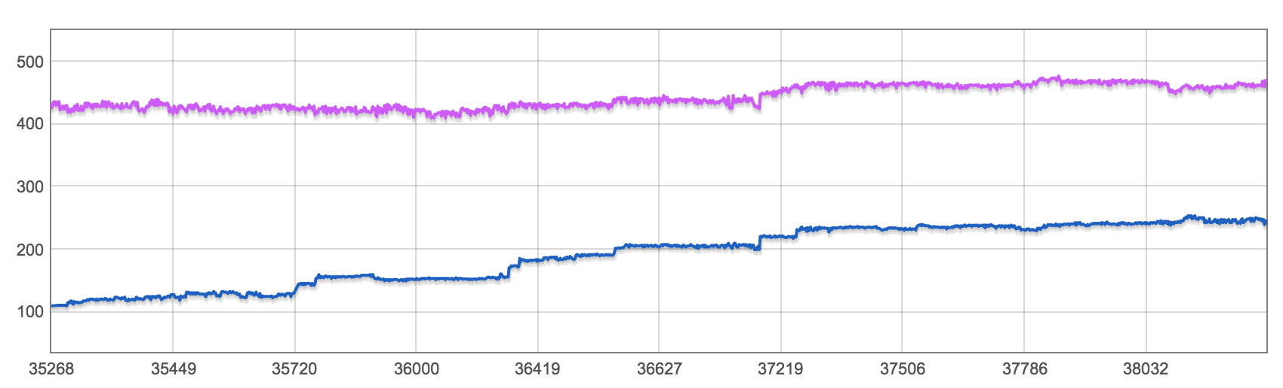
Ignition vs Full-Codegen
Score
Octane (Nexus 5) Crankshaft and TurboFan disabled

Slide 141
Ignition vs Full-Codegen
Score
Octane (Nexus 5) Crankshaft and TurboFan disabled

Slide 142
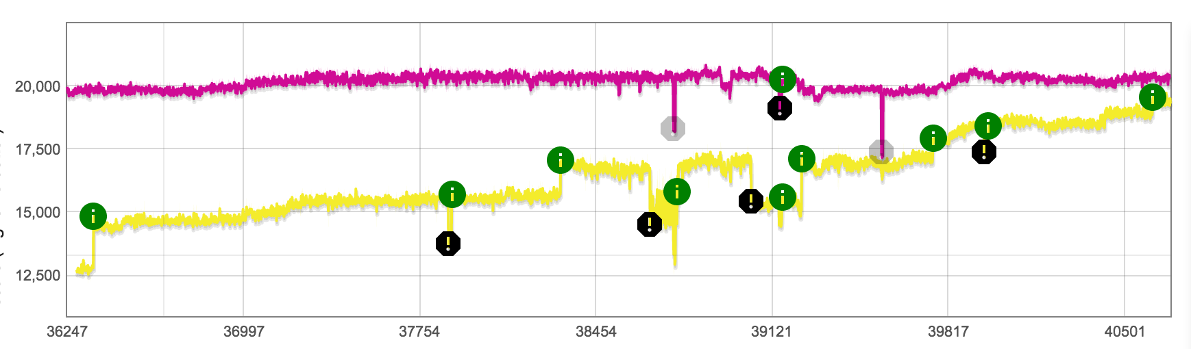
Ignition vs Default
Score
Octane Score (x64)

Slide 143
Ignition vs Default
Score
Octane Score (x64)
5% slower
40% slower

Slide 144
Ignition vs Default
Tune Tiering up
Score
Octane Score (x64)
5% slower
40% slower

Slide 145
Ignition vs Default
Tune Tiering up
OSR
Score
Octane Score (x64)
5% slower
40% slower

Slide 146
Ignition vs Default
Tune Tiering up
OSR
BinaryOp Feedback
Score
Octane Score (x64)
5% slower
40% slower

Slide 147
Ignition vs Default
Tune Tiering up
OSR
BinaryOp Feedback
CS / TF adaption
Score
Octane Score (x64)
5% slower
40% slower

Slide 148
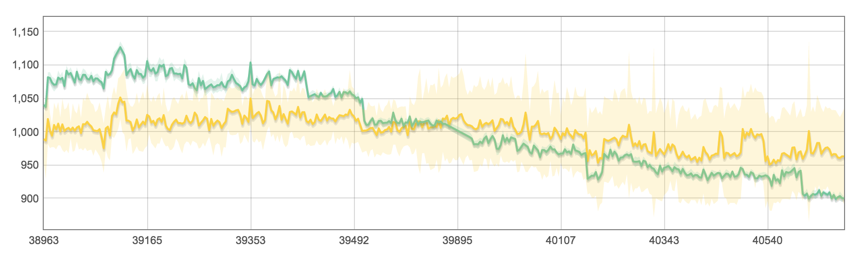
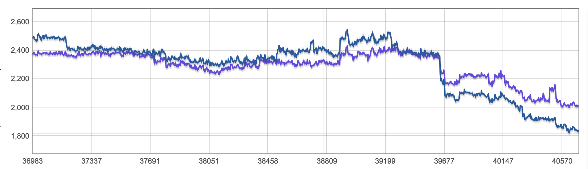
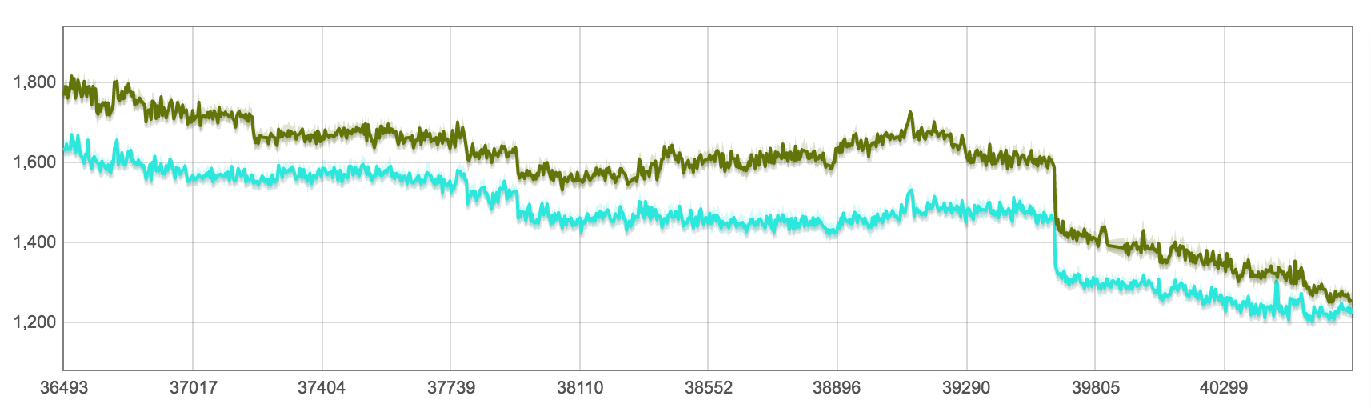
Real Websites
Google Maps
Default
Ignition
Page Load (ms)
LinkedIn
Default
Ignition
Facebook
Ignition
Default

Slide 149
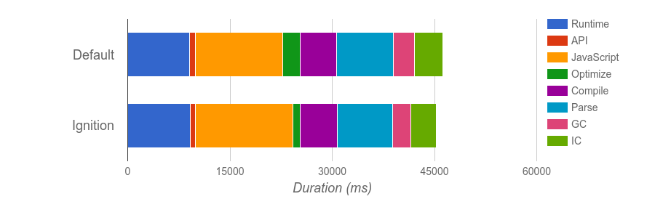
Real Websites

Slide 150
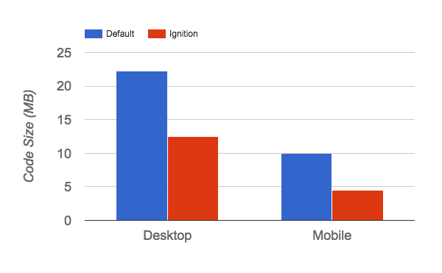
Real Websites

Slide 151
Summary

Slide 152
Summary
JavaScript is hard

Slide 153
Summary
JavaScript is hard
V8 is complex

Slide 154
Summary
JavaScript is hard
V8 is complex
An interpreter can (sometimes) beat a JIT...

Slide 155
Summary
JavaScript is hard
V8 is complex
An interpreter can (sometimes) beat a JIT... but it takes a lot of work!

Slide 156
Ignition Bytecodes
Loading the accumulator LdaZero LdaSmi8 LdaUndefined LdrUndefined LdaNull LdaTheHole LdaTrue LdaFalse LdaConstant Binary Operators Add Sub Mul Div Mod BitwiseOr BitwiseXor BitwiseAnd ShiftLeft ShiftRight ShiftRightLogical Closure Allocation CreateClosure | Globals LdaGlobal LdrGlobal LdaGlobalInsideTypeof StaGlobalSloppy StaGlobalStrict Unary Operators Inc Dec LogicalNot TypeOf DeletePropertyStrict DeletePropertySloppy Call Operations Call TailCall CallRuntime CallRuntimeForPair CallJsRuntime InvokeIntrinsic New Operator New | Test Operators TestEqual TestNotEqual TestEqualStrict TestLessThan TestGreaterThan TestLessThanOrEqual TestGreaterThanOrEqual TestInstanceOf TestIn Context Operations PushContext PopContext LdaContextSlot LdrContextSlot StaContextSlot Cast Operators ToName ToNumber ToObject Arguments Allocation CreateMappedArguments CreateUnmappedArguments CreateRestParameter | Register Transfers Ldar Star Mov Control Flow Jump JumpConstant JumpIfTrue JumpIfTrueConstant JumpIfFalse JumpIfFalseConstant JumpIfToBooleanTrue JumpIfToBooleanTrueConstant JumpIfToBooleanFalse JumpIfToBooleanFalseConstant JumpIfNull JumpIfNullConstant JumpIfUndefined JumpIfUndefinedConstant JumpIfNotHole JumpIfNotHoleConstant Non-Local Flow Control Throw ReThrow Return | Literals CreateRegExpLiteral CreateArrayLiteral CreateObjectLiteral Load Property Operations LdaNamedProperty LdaKeyedProperty KeyedLoadICStrict Store Property Operations StoreICSloppy StoreICStrict KeyedStoreICSloppy KeyedStoreICStrict Complex Flow Control ForInPrepare ForInNext ForInDone ForInStep Generators SuspendGenerator ResumeGenerator

