Slide 1


Initially constructed community KD (weighted directed graph? Embedding space?)
This can be differ from community by community
Temporal network represents its activity
Probability depends on edge weight / distance
At each time step, an event is sampled from KD by sampling multiple nodes at once
The occurrence of event may depend on the community KD (
Sampling method
Random walk? Levi flight? Energy function based on similarities?
Each ‘event’ then strengthen the node / weight of that particular set of nodes in community KD, with a decreasing strength as time past (“event” throws impact to the community KD)
Strengthen method
Increasing edge weight
Decrease internal distance
Decaying method

Slide 2






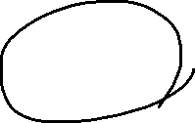






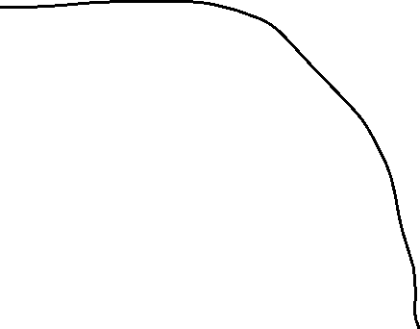


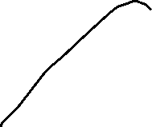



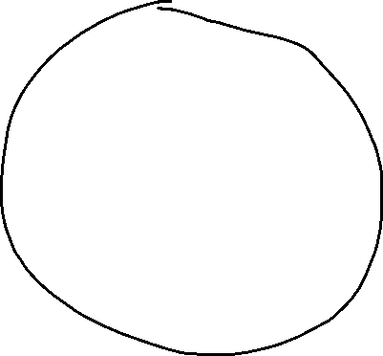












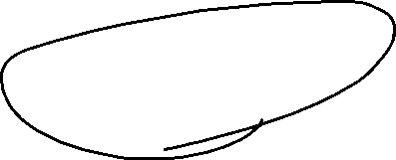
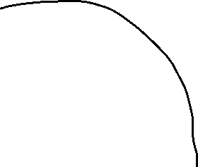
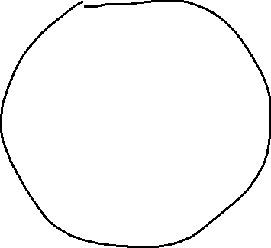


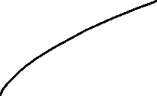



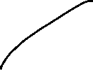
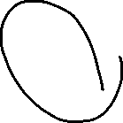




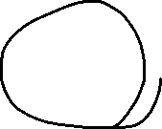






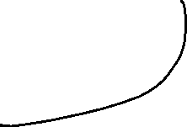

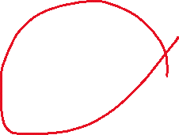


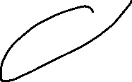






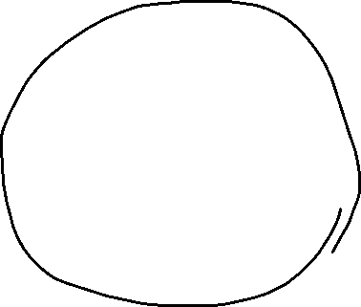
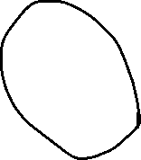

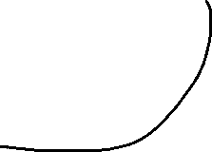




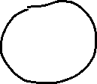

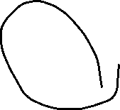


Slide 3













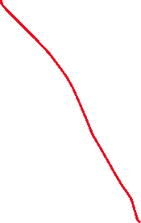


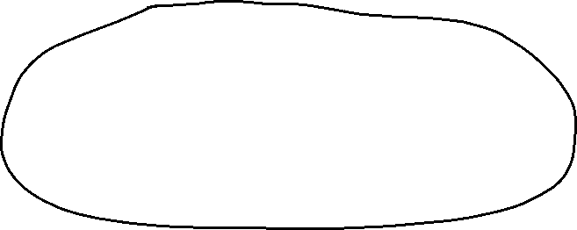
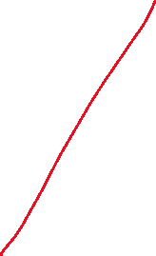



Slide 4


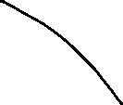

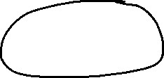


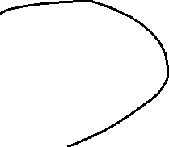





Slide 5
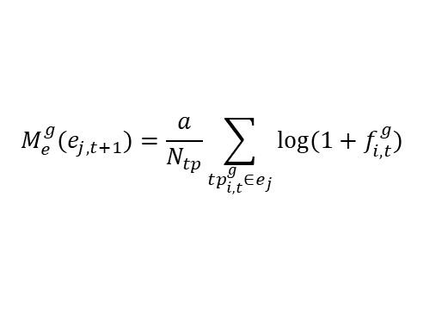

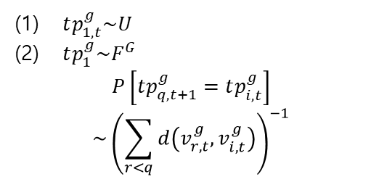



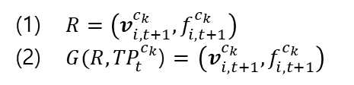
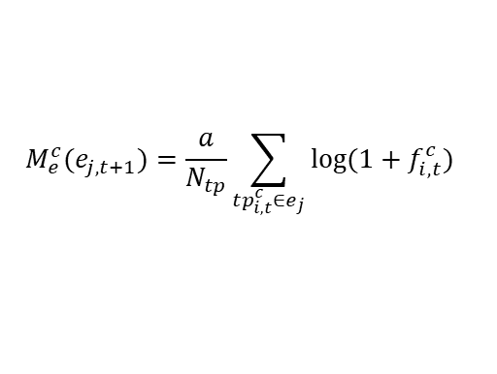
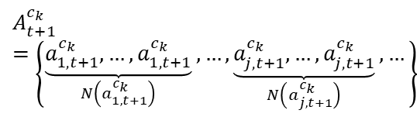

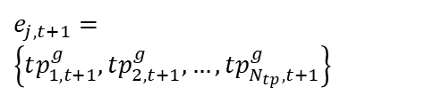

Topics : $i$ , Events : $j$ , Comm. : $k$ , Topics in event : $q$
$R=\left(v_{i,t+1}^{c_{k}}, f_{i,t+1}^{c_{k}}\right)$
$G(R,{TP}_{t}^{c_{k}}$) $=$ $\left(v_{i,t+1}^{c_{k}}, f_{i,t+1}^{c_{k}}\right)$
$$M_{e}^{g}(e_{j,t+1})=\frac{a}{N_{tp}}\sum_{tp_{i,t}^{g}∈e_{j}}{log⁡(1+f_{i,t}^{g})}$$
$$A_{t+1}^{c_{k}}=\left\{\underset{N\left(a_{1,t+1}^{c_{k}}\right)}{\underbrace{a_{1,t+1}^{c_{k}},…,a_{1,t+1}^{c_{k}}}},…, \underset{N\left(a_{j,t+1}^{c_{k}}\right)}{\underbrace{a_{j,t+1}^{c_{k}},…,a_{j,t+1}^{c_{k}}}}, … \right\}$$
$$f_{i,t+1}^{c_{k}}=\left(α×f_{i,t}^{c_{k}}\right)+(1−α)×R$$
Events
Activity
Community comments
(Observables)
“Everyone in the community now sees how other people says, and it changes their collective mind.”
$e_{j,t+1}=\left\{tp_{1,t+1}^{g},tp_{2,t+1}^{g}, …,tp_{N_{tp},t+1}^{g}\right\}$
$$N\left(a_{j,t+1}^{c_{k}}\right)=M_{e}^{g}(e_{j,t+1})×M_{e}^{c}(e_{j,t+1})$$
$tp_{1,t}^{g}\sim U$
$tp_{1}^{g}\sim F^{G}$
$$P\left[tp_{q,t+1}^{g}=tp_{i,t}^{g}\right]$$
$$\sim {\left(\sum_{r<q}{d\left(v_{r,t}^{g}, v_{i,t}^{g}\right)}\right)}^{−1}$$
Accepted
Changing freq. and dist. of topic space
Sampling via random walk
$$R(A_{t+1}^{c_{k}}, V_{t}^{c_{k}},F_{t}^{c_{k}})$$
Rejected
$$p\left(e_{j,t+1}\right)$$
Filter
$$M_{e}^{c}(e_{j,t+1})=\frac{a}{N_{tp}}\sum_{tp_{i,t}^{c}∈e_{j}}{log⁡(1+f_{i,t}^{c})}$$
General Topic space
Community Topic space
Shaped by freq. and dist. of topic space
“According to the posted news and their pre-existing collective notions, users stochastically makes comments .”
$$tp_{i,t}^{g}=\left(v_{i,t}^{g}, f_{i,t}^{g}\right)$$
$$tp_{i,t}^{c_{k}}= \left(v_{i,t}^{c_{k}}, f_{i,t}^{c_{k}}\right)$$
“Posters of the news (users, managers, moderators, journalists, etc.) choose their content based on the collective mind.
$$d_{ab, t}={\left\|v_{a,t}^{g}−v_{b,t}^{g}\right\|}_{2}$$

Slide 6
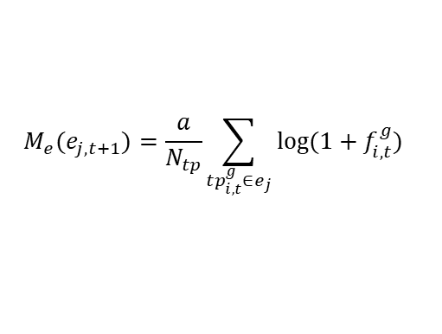



Topics : $i$ , Events : $j$ , Comm. : $k$ , Topics in event : $q$
$R=\left(v_{i,t+1}^{c_{k}}, f_{i,t+1}^{c_{k}}\right)$
$G(R,{TP}_{t}^{c_{k}}$) $=$ $\left(v_{i,t+1}^{c_{k}}, f_{i,t+1}^{c_{k}}\right)$
$$M_{e}(e_{j,t+1})=\frac{a}{N_{tp}}\sum_{tp_{i,t}^{g}∈e_{j}}{log⁡(1+f_{i,t}^{g})}$$
$$A_{t+1}^{c_{k}}=\left\{\underset{N\left(a_{1,t+1}^{c_{k}}\right)}{\underbrace{a_{1,t+1}^{c_{k}},…,a_{1,t+1}^{c_{k}}}},…, \underset{N\left(a_{j,t+1}^{c_{k}}\right)}{\underbrace{a_{j,t+1}^{c_{k}},…,a_{j,t+1}^{c_{k}}}}, … \right\}$$
$$f_{i,t+1}^{c_{k}}=\left(α×f_{i,t}^{c_{k}}\right)+(1−α)×R$$
Events
Activity
Community comments
(Observables)
“Everyone in the community now sees how other people says, and it changes their collective mind.”
$e_{j,t+1}=\left\{tp_{1,t+1}^{g},tp_{2,t+1}^{g}, …,tp_{N_{tp},t+1}^{g}\right\}$
$p\left(e_{j,t+1}\right)$~ mean($\left|s_{i,t}^{c_{k}}\right|$)
$$N\left(a_{j,t+1}^{c_{k}}\right)=p\left(e_{j,t+1}\right)×M_{e}(e_{j,t+1})$$
$tp_{1,t}^{g}\sim U$
$tp_{1}^{g}\sim F^{G}$
$$P\left[tp_{q,t+1}^{g}=tp_{i,t}^{g}\right]$$
$$\sim {\left(\sum_{r<q}{d\left(v_{r,t}^{g}, v_{i,t}^{g}\right)}\right)}^{−1}$$
Accepted
Changing freq. and dist. of topic space
Sampling via random walk
$$R(A_{t+1}^{c_{k}}, V_{t}^{c_{k}},F_{t}^{c_{k}})$$
Rejected
Filter
General Topic space
Community Topic space
Shaped by freq. and dist. of topic space
“According to the posted news and their pre-existing collective notions, users stochastically makes comments .”
$$tp_{i,t}^{g}=\left(v_{i,t}^{g}, f_{i,t}^{g}\right)$$
$$tp_{i,t}^{c_{k}}= \left(v_{i,t}^{c_{k}}, f_{i,t}^{c_{k}},s_{i,t}^{c_{k}}\right)$$
“Posters of the news (users, managers, moderators, journalists, etc.) choose their content based on the collective mind.
$$d_{ab, t}={\left\|v_{a,t}^{g}−v_{b,t}^{g}\right\|}_{2}$$

