Slide 1
Imdb Movie Predictions
Nolan Arendt
Notes:
Introduction slide

Slide 2
—Alejandro gonzalez inarritu
“To make a film is easy; to make a good film is war. To make a very good film is a miracle.”
Notes:
Famous film director.
Directed Birdman and the Revenant

Slide 3
03.
Modeling Process
Data Cleaning
02.
01.
Project Overview
Future analysis
05.
Exploratory data analysis
04.
Workflow
Notes:
Walkthrough of project process

Slide 4
Project OVerview
Predict a movies score and revenue.
Incorporate actress, actor, and director scores into predictions.
Identify highest scoring genres and highest grossing genres.
Identify how correlated movie score and revenue are.

Slide 5
02. Data Cleaning
Acquire data.
Merge datasets.
Handle null values.
Dummify genre and role.
Separate actresses, actors, and directors.

Slide 6


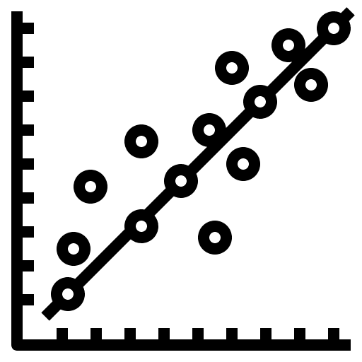

03. Modeling Process
Extra Trees | Random Forests
Linear Regression | XGBoost

Slide 7

Model Selection imdb score
IMDB SCore: Linear Regression
Training Score: 0.760 Baseline: 0.9867
Testing Score: 0.767 RMSE: 0.490
Copy_x : True
Fit_intercept : True
Normalize : True

Slide 8
Model Selection revenue
Revenue : Extra Trees
Training Score: 0.829 Baseline: $187,909,923
Testing Score: 0.766 RMSE: $71,109,157
Max_depth : 8
Min_samples_split : 3
N_estimators : 100

Slide 9
04. Exploratory Data analysis

Slide 10
Top five imdb Scores
Movie Title | Actual Score | Predicted Score | Difference
Shawshank Redemption | 9.30 | 10.00 | 0.70
The Godfather | 9.20 | 9.084 | 0.116
The Godfather Part II | 9.00 | 8.245 | 0.755
Schindler’s List | 8.90 | 8.331 | 0.569
Forrest Gump | 8.80 | 8.825 | 0.025

Slide 11
Top five movie revenues
Movie Title | Actual Revenue | Predicted Revenue | Difference
Avatar | $2,781,505,847 | $2,127,454,351 | $654,051,496
The Avengers | $1,519,557,910 | $1,084,326,906 | $435,231,004
Jurassic World | $1,513,528,810 | $1,230,437,950 | $283,090,860
Avengers: Age of Ultron | $1,405,035,767 | $1,163,597,611 | $241,438,156
Minions | $1,156,730,962 | $909,385,604 | $247,345,358

Slide 12
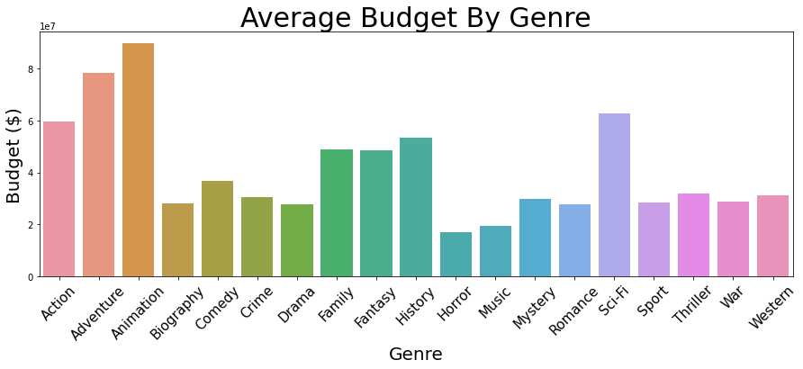
Average budget

Slide 13
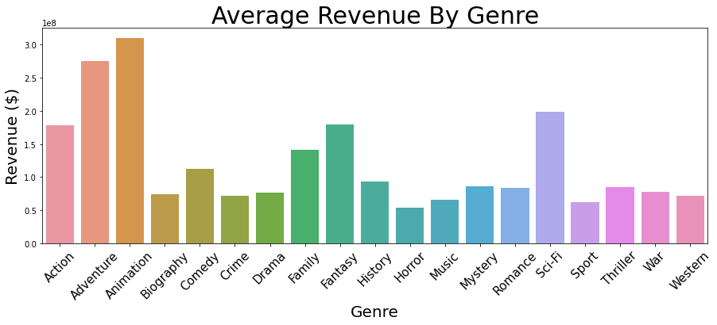
Average revenue

Slide 14
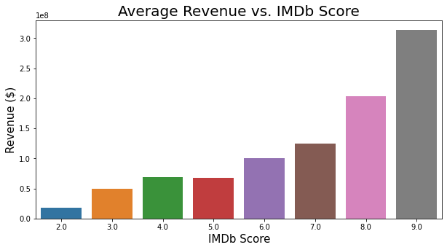
Average revenue

Slide 15
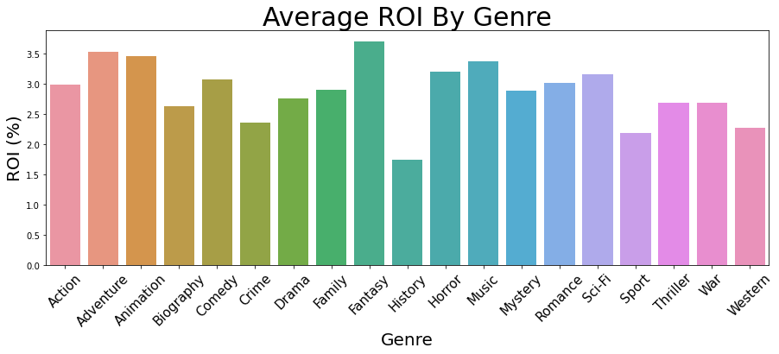
Average roi

Slide 16
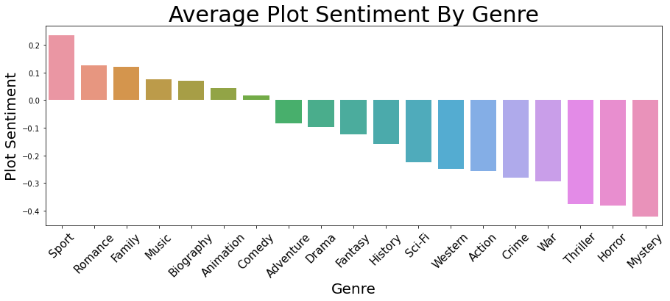
Plot sentiment

Slide 17
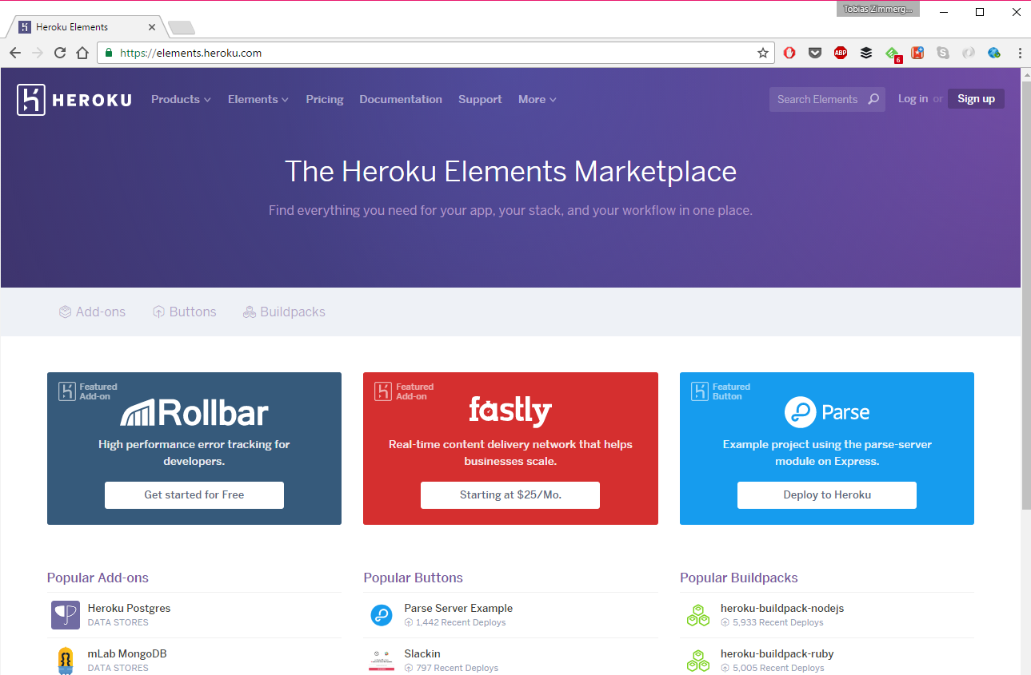
05. Future Analysis
Heroku Application
Predict future movie scores
Feature engineer more roles (writer, producer, etc.)

Slide 18
Thank you!
nolanarendt10@gmail.com
linkedin.com/in/nolanarendt/
github.com/nolanarendt
Please keep this slide for attribution.

