Slide 1
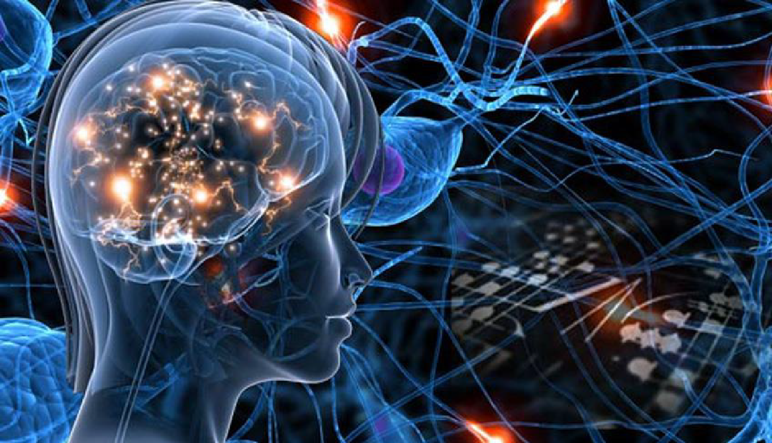
Artificial Intelligence in Healthcare
Session 4:
Reccurent Neural Network (RNN)
& Natural Language Processing (NLP)

Slide 2
Why RNN?
Process sequential data:
Time series
Word sequences
(sequences of pixels, or signals)
Often of variable length
Complex sequential information management:
Ex, I went to Nepal in 2009 = In 2009, I went to Nepal
Long-term information storage

Slide 3
Natural language processing
One of the first applications of RNN is for NLP (Natural Language Processing).
e.g. Unstructured data retrieval:
If you want to know which patients have been diagnosed with a particular disease from a doctor's letters, you need to look not just at the words, but at the sequence of words.
The general idea of recurrent networks is to go through each word and evolve a state vector.
First question: How do you put words as input on a model? -> Embedding

Slide 4
The Embedding principle
When we need to input a class into a model, we can use One Hot Encoding and add a Dense layer.
This is equivalent to unsupervised assignment of a "dense" vector to each of the modalities in the class (as opposed to one-hot encoding, which gives a « sparse » vector, i.e. with 0 on the majority of values).
This transformation from class to vector is called Embedding. (using keras tf.keras.layers.Embedding)
This avoids a priori assumptions about the order of modalities (e.g. you can't say a priori that a redhead is between brown and blond to study the link with skin cancer).

Slide 5
The Embedding principle
For NLP, 1 word = 1 class from the +/- 50,000 words in the dictionary.
If we apply embedding, we'll typically have a Large Language Model (LLM) vector of dimension 50,000 for each word.
In idea, the first value could indicate whether it's a verb or not, the second whether it's an adjective or not, the third whether it evokes a positive feeling or not, etc. This embedding is learned in an unsupervised way, so it's difficult to know exactly what each value actually corresponds to.
A good Embedding must ensure that two synonyms have close vectors, and it must be able to bring out vector operations:
Ex King-Man+Woman must give Queen
To handle invented words, spelling mistakes, and multiple languages, GPT and other LLM models are no longer based on words, but on "tokens" (segmented text units, often around 4 letters long). This breakdown into tokens is determined automatically beforehand, based on the frequency of occurrence in a training database. 1 word = between 1 and 2 tokens on average, and there are some 50,000 tokens in the dictionary.

Slide 6
The general idea of recurrent networks is to go through each word and evolve a state vector.
Example
The diagnosis of MS is excluded
Embedding
Embedding
Embedding
Embedding
Embedding
Embedding
Neural network
Neural network
Neural network
Neural network
Neural network
Neural network
State1
State2
State3
State4
State5
State6
=> Class 0 = No SEP
Successive states are given as model inputs
Each state must contain all the useful information from the previous sequence.
At the end, the report contains all the relevant information in the sentence

Slide 7
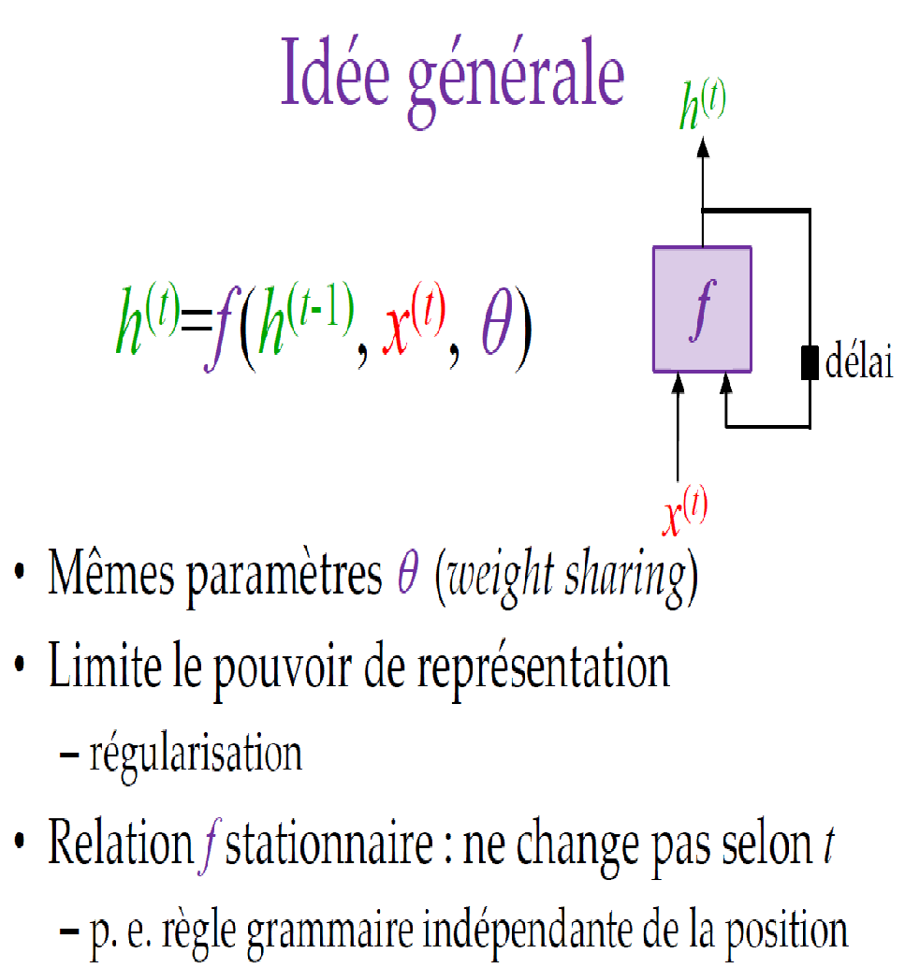
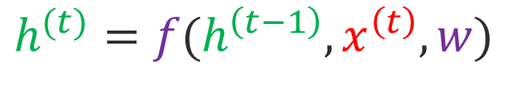


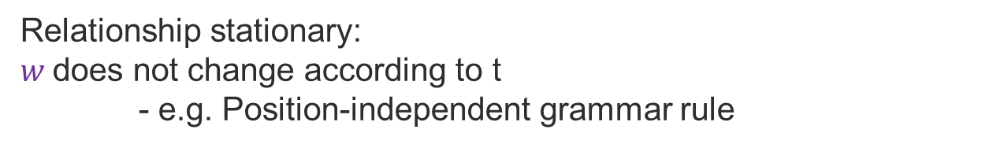
General principle of a RNN
State at time t
Input at time t

Slide 8
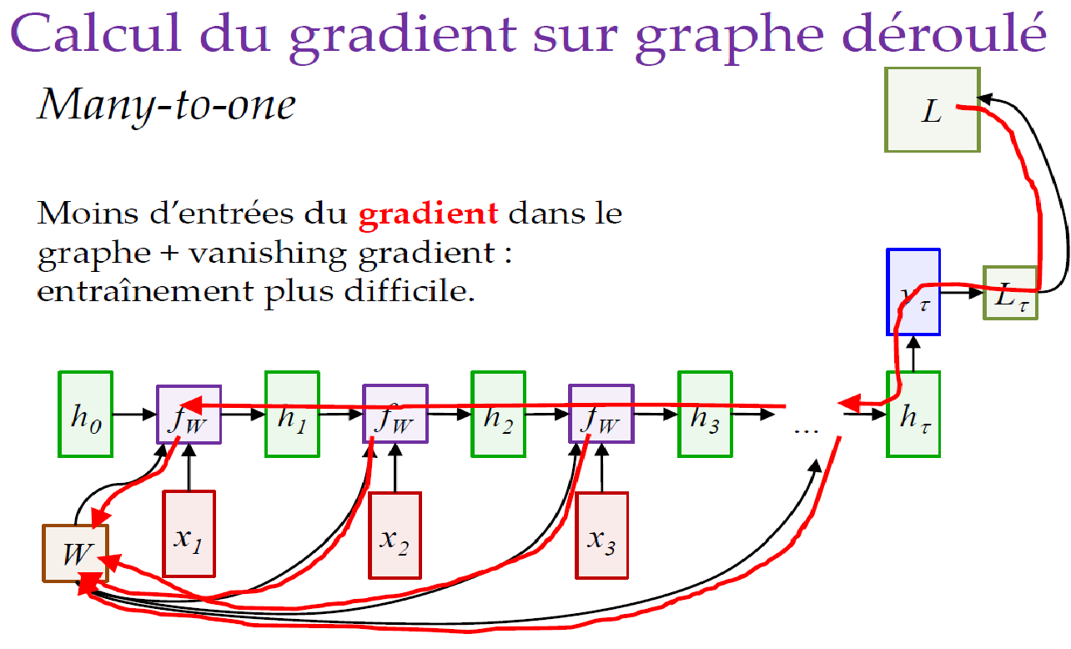
Inference and gradient on the unrolled graph
For inference (i.e. applying the model to data) we calculate sample after sample
To calculate the gradient, we calculate sample after sample in descending order.
No parallelism between time samples
Training and inference time often significant

Slide 9
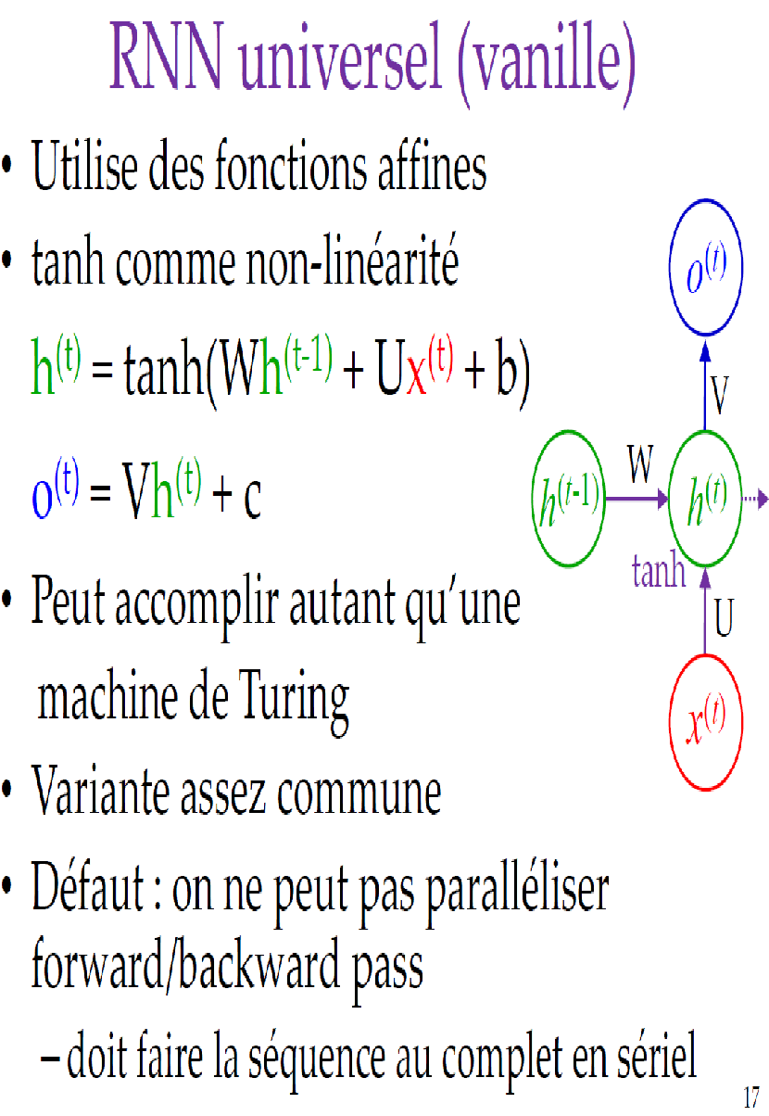
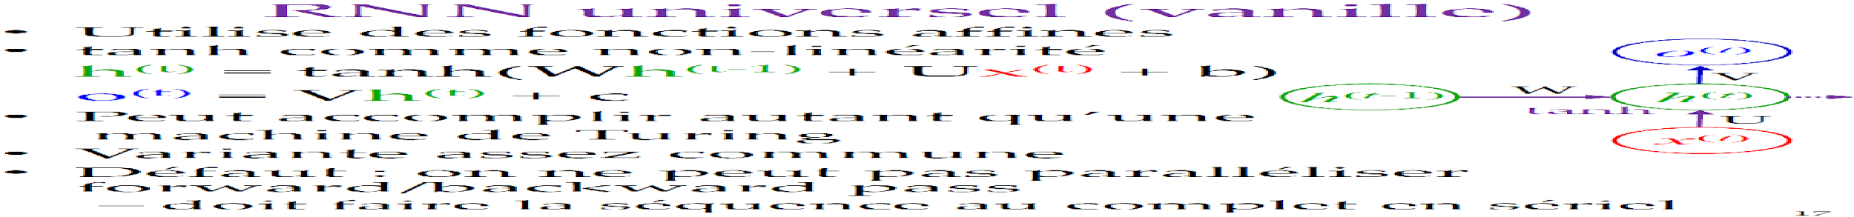
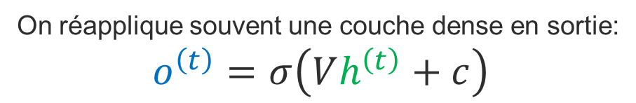
Vanilla RNN
Activation function often used to obtain a state
between -1 and 1 (unbiased variant of the sigmoid)

Slide 10
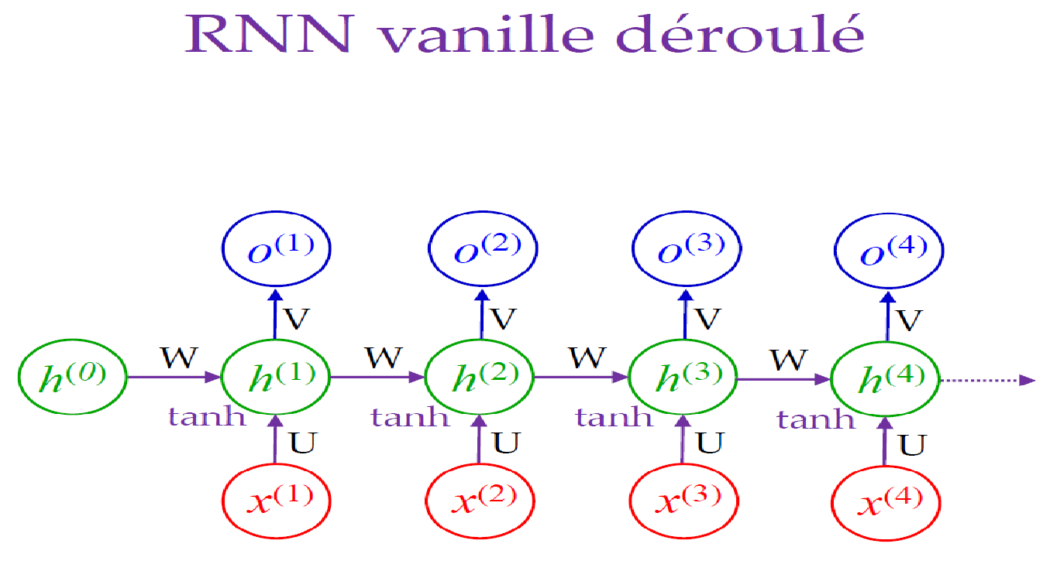
Unrolled Vanilla RNN

Slide 11
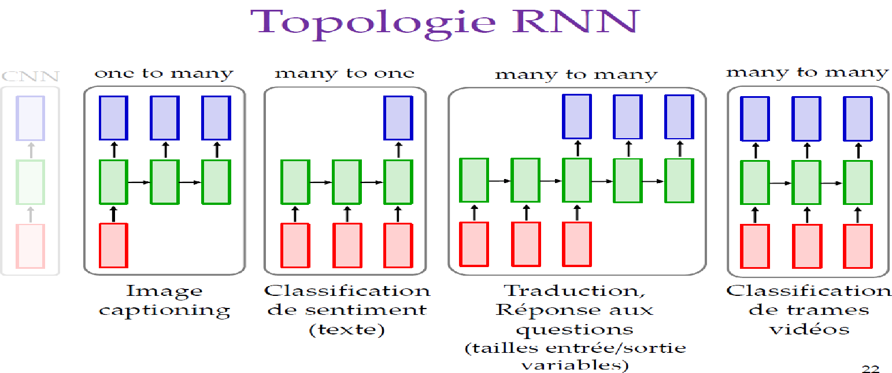
RNN topology
Asynchronous Many-To-Many
Synchronized Many-To-Many
One-To-Many
Many-To-One
e.g. Image captioning
e.g. From a signal, estimate an indicator
e.g. Automatic text translation or summarization. (Variable input and output size)
e.g. Real-time detection of sleep apnea

Slide 12
RNN topology
A few comments:
Many-To-One: would correspond to a classic CNN architecture, but RNN makes it easier to add variable-size inputs.
Synchronized Many-To-Many: corresponds to a U-NET/auto-encoder architecture, but makes it easier to add variable-size inputs.
« One » and « Many » refers to the number of sequential samples, not the actual number of input or output variables. : e.g. "From a fetal heart rate signal, predict the fetal blood pH and pCO2 after delivery" is still Many to One, as there is only one output sample, even if there are 2 values (pH and PCO2).

Slide 13
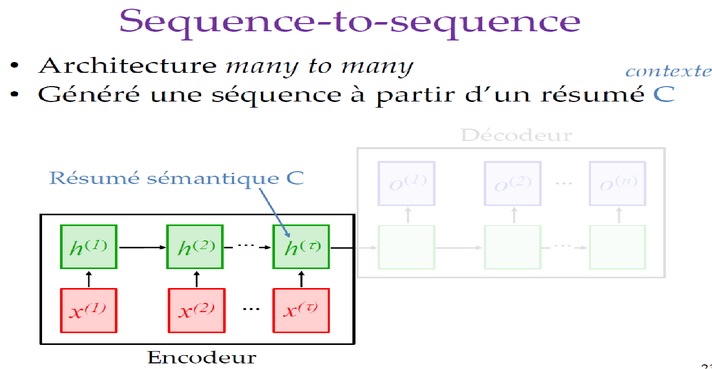
Asynchronous Many-To-Many
Decoder
Semantic summary containing all useful sequence information
The decoder generates a sequence from a semantic summary
Encoder

Slide 14
Auto-regression principle
To generate text with a One-To-Many architecture or the decoder part of an Async Many-To-Many: we obtain a probability distribution for each word (or token).
The next step is to select a word, usually the most probable or one of the most probable. This choice directly influences the following words, making it difficult to encapsulate the information in a semantic summary.
To manage this dependency, we apply an auto-regression :
The selected word is fed back into the input (in the form of one-hot encoding or embedding) to generate the next word.

Slide 15
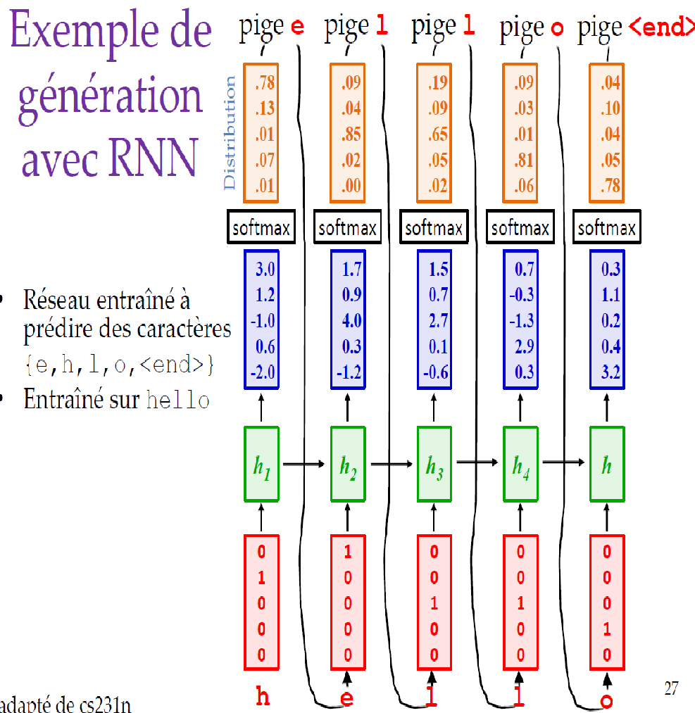
Auto-regression principle
E.g. in the letter-by-letter word generation system. The predicted letter (the one with the highest estimated probability) is used as input to predict the next letter.
Comment:
Auto-regression can be seen as a 4th method of generation (other than auto-encoders, GANs, diffusion models) but it applies mainly to text (or proteins/ADN for alphafold)
e
l
l
<end>
o

Slide 16
Bidirectional RNN
The output o^{(t)} may depend on the entire sequence
Relevant information is sometimes available after input x^{(t)}
- Example 1 To understand the meaning of a word, you sometimes need to know the words after it.
- Example 2 in signal processing: to know the hidden state, it is useful to know what happens next.
It is then possible to apply one RNN in the normal direction and another RNN in the opposite direction.

Slide 17
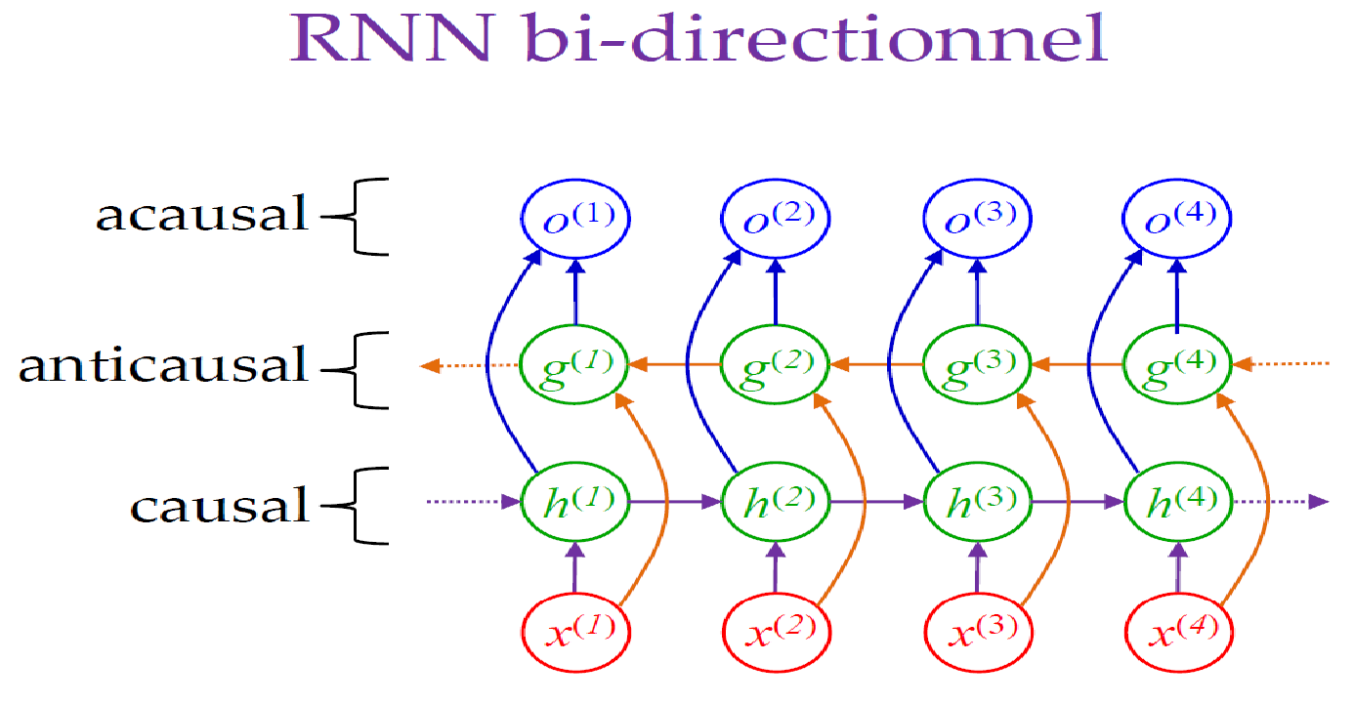
Bidirectional RNN
acausal
anticausal
causal
The output o^{(t)} is the concatenation of g^{(t)} and h^{(t)}

Slide 18
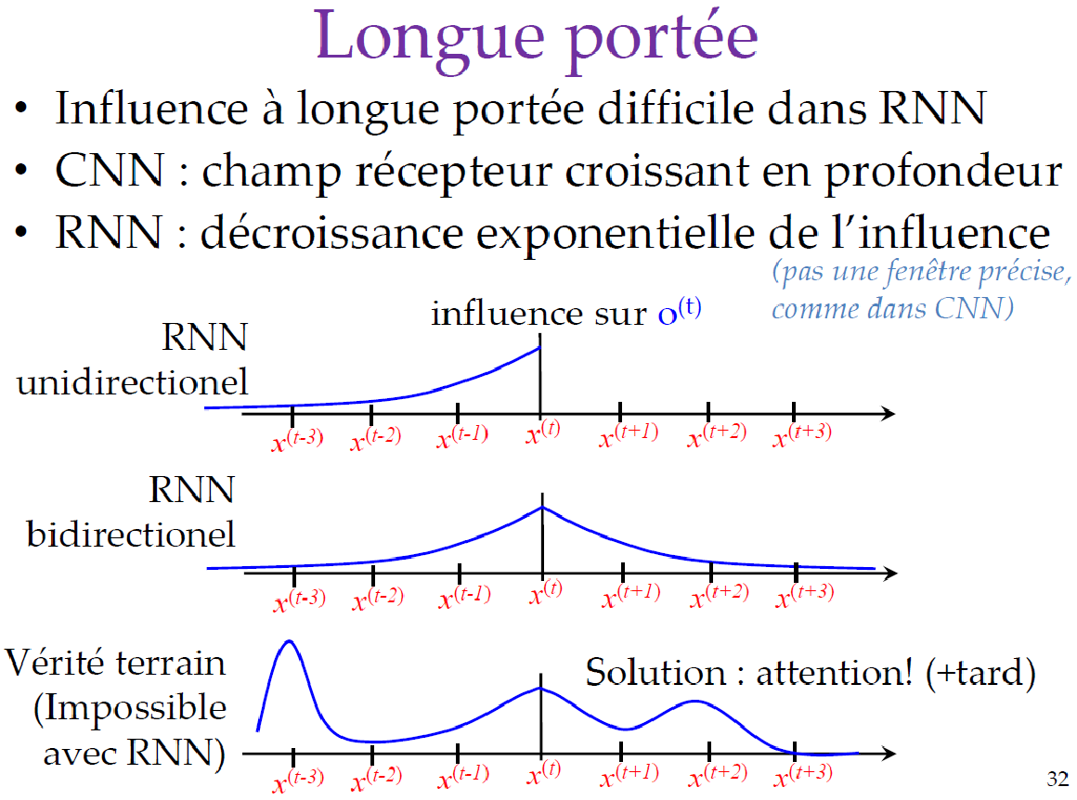
Long range
Long-range influence is difficult in RNN
CNN: Depth-increasing receptive field
RNN: exponential decrease in influence
Influence on
One-directional RNN
Bidirectional RNN
Ground truth (impossible with RNN)

Slide 19
Long Short Term Memory (LSTM) (1997)
Solving RNN problems:
Long-range difficulty
Vanishing gradient (derivatives for older samples tend to decline exponentially)
Key idea: c-state cell(s)_{t}
- Information can be added/removed/exposed via gates

Slide 20
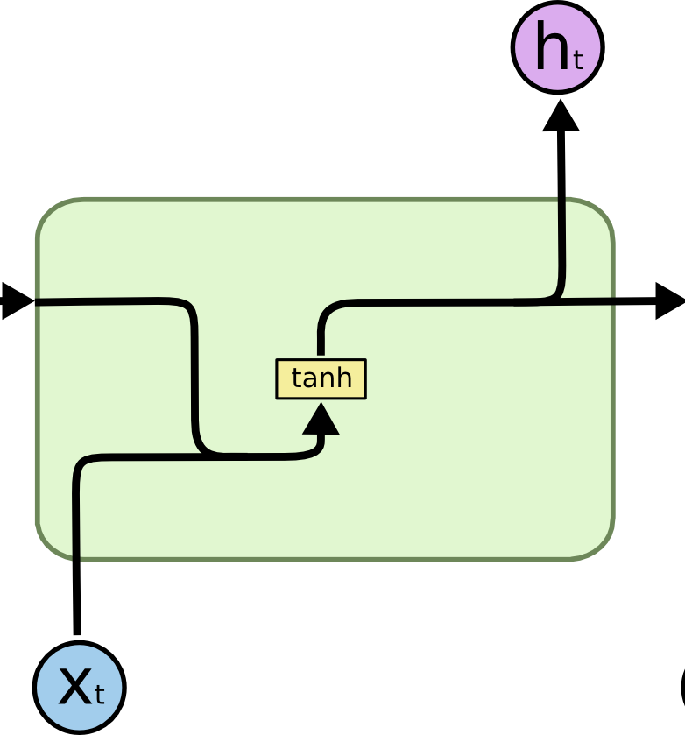
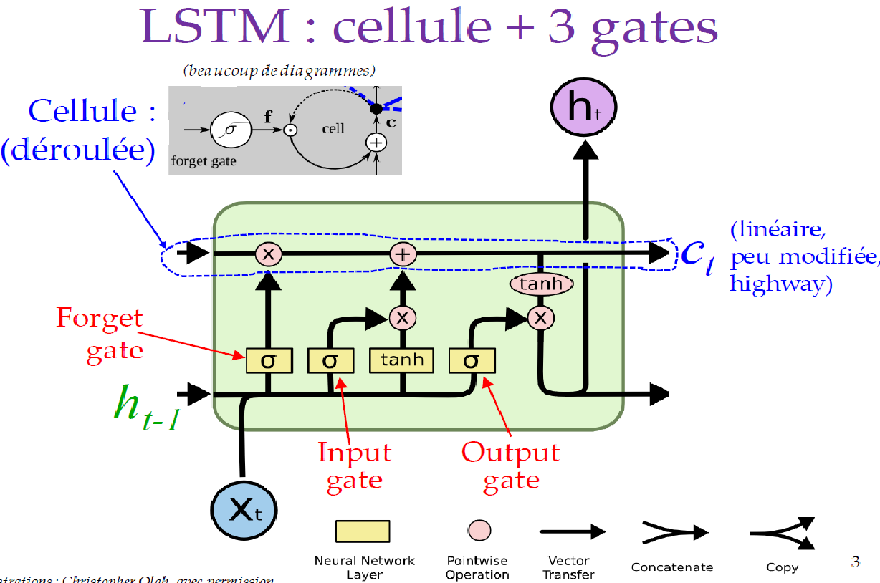
LSTM
Hidden state (quickly affected, short-term memory)
RNN vanilla
Cell state
(Can modify, highway, long-term memory)

Slide 21
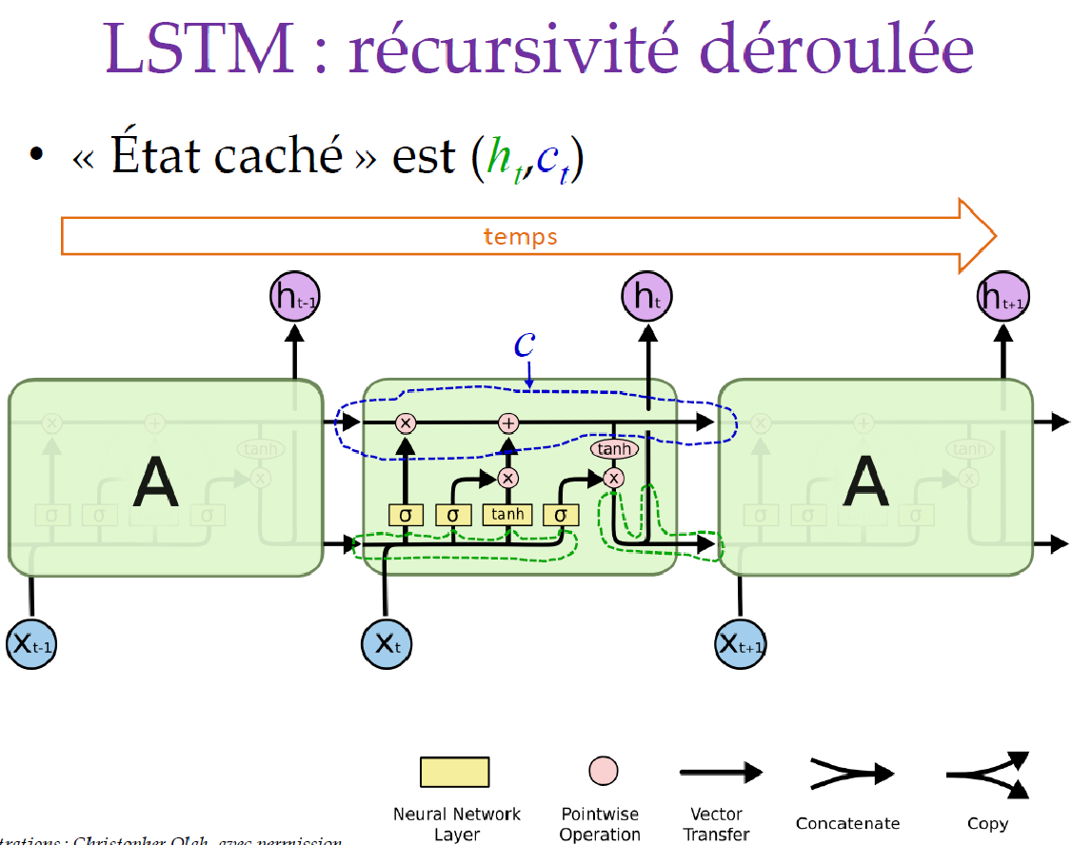
Unrolled LSTM
The complete state is (h_{t} ,c )_{t}

Slide 22
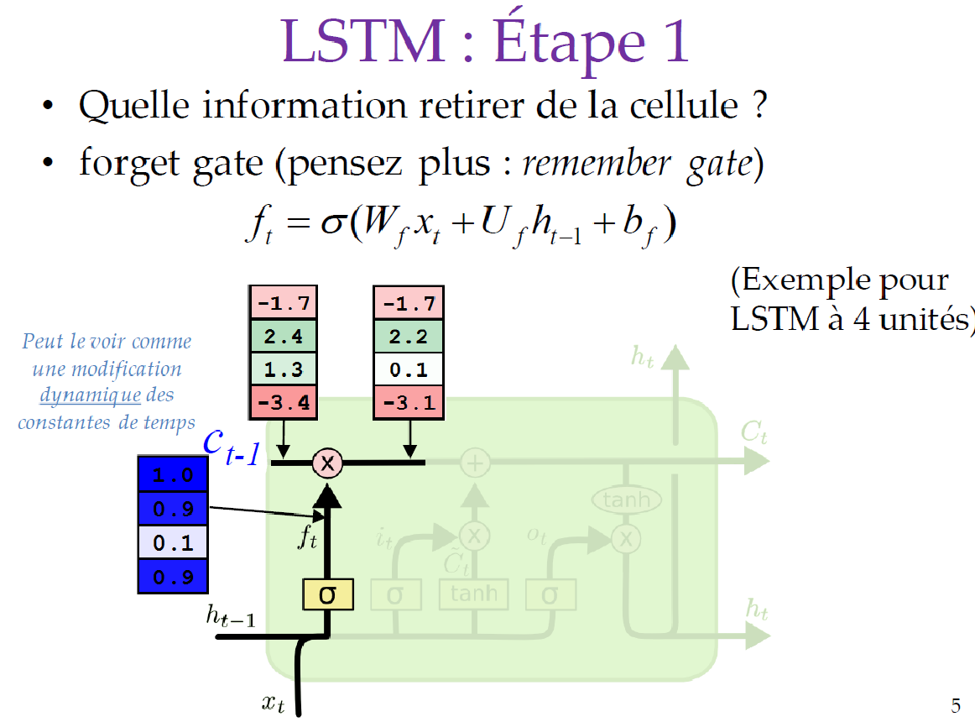
LSTM: stage 1
What information to remove or keep from the cell (forget gate)

Slide 23
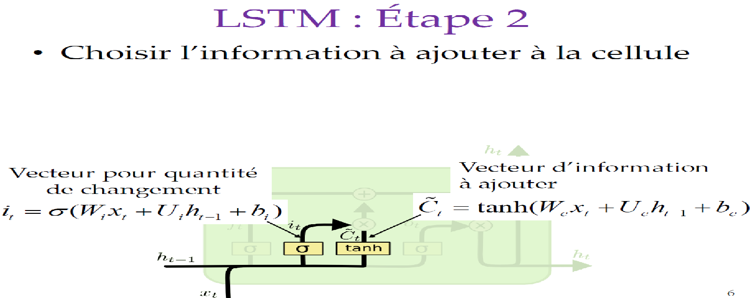
LSTM: stage 2
Select the information to be added in the cell
Information vector to add
Vector for change quantity

Slide 24
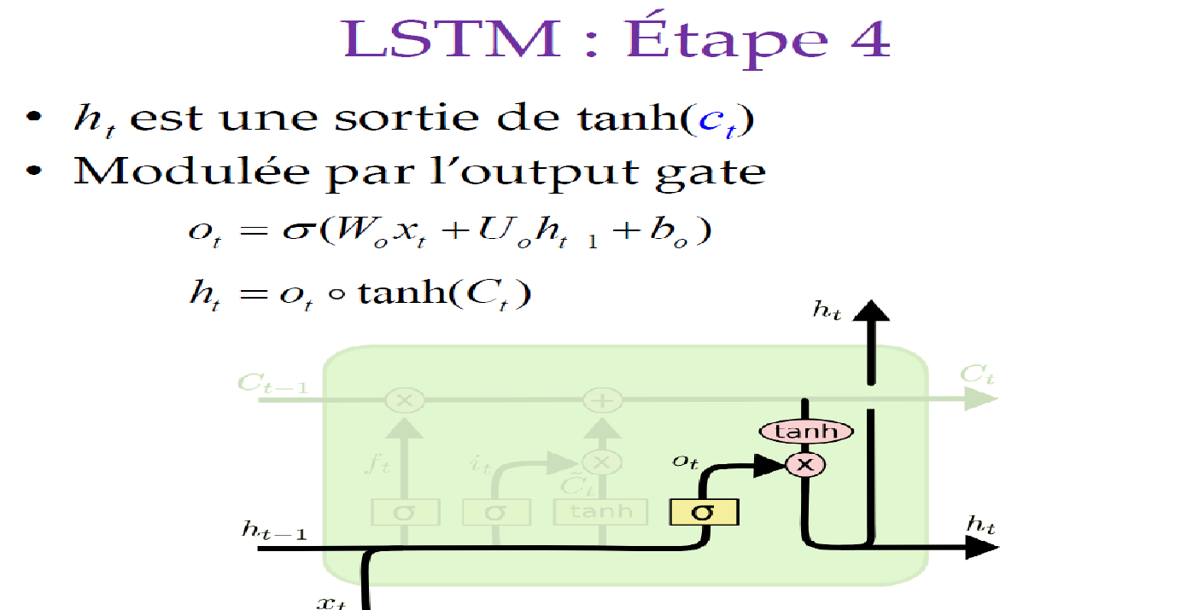
LSTM: stage 3
The hidden state h_{t} is an output of tanh(c_{t} ) modulated by the output gate.

Slide 25
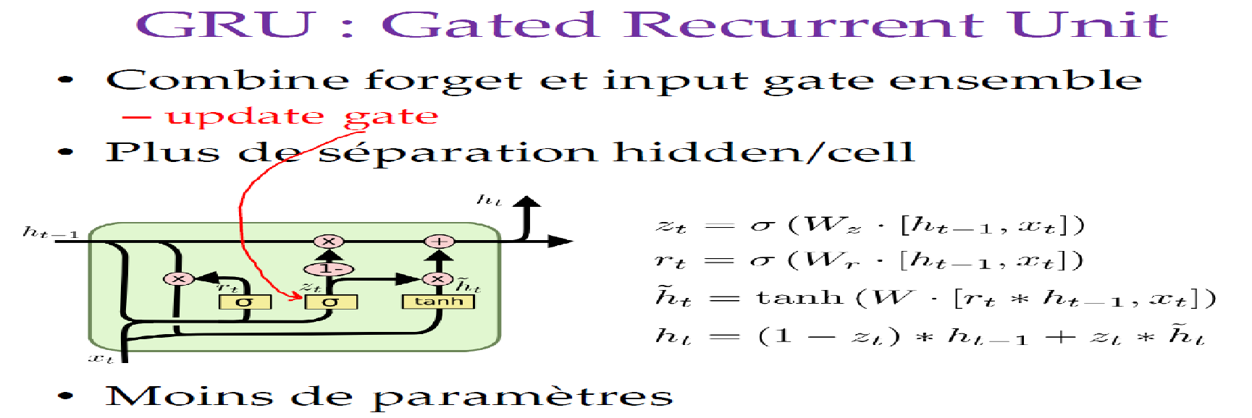
Gated Recurrent Unit (GRU)
A simpler but equally effective variant
Combine forget and input gate => update gate
No hidden/cell separation
Less parameters

Slide 26
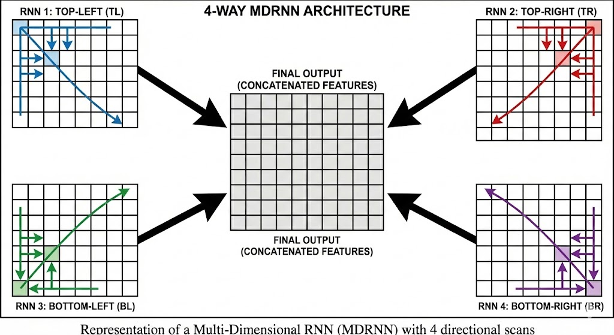
Multi dimensional RNN (MDRNN)
4-way spatial scanning (TL, TR, BL, BR) for a global receptive field.
Captures long-range dependencies better than local CNN kernels.
Native support for variable sizes without resizing or distortion.
Sequential trade-off: Slower than CNNs but richer spatial context.

Slide 27
State Space Models (SSM) — Mamba (Gu & Dao, 2023)
Context (2024-2026)
RNN classical: no parallelization during training
Transformers: attention O(L²) (inference), O(L) memory/token (KV-cache)
SSM : O(L) training, O(1) inference per token
Continuous equation (control theory)
h′(t) = A h(t) + B x(t) ← equation of state
y(t) = C h(t) ← equation of output
Discretization (Zero-Order Hold)
We solve h′ = Ah + Bx over [t, t+Δ] with x constant.
The solution of the diff eq gives :
ht = Ā ht-1 + ĀB xt
yt = C ht
with Ā = exp(ΔA) and ĀB ≈ ΔB (1st order approx.)
→ Same form as a vanilla RNN
but without activation function in the recurrence!
Matrix Exponential
Defined by:
exp(M) = I + M + M²/2! + M³/3! + …
(same formula as ex but for matrices)
If A is diagonalizable :
A = P diag(λ₁,…,λₙ) P⁻¹
exp(A) = P diag(e^{λ₁},…,e^{λₙ}) P⁻¹
Note: the exp arises naturally from the
diff eq , exactly as in
physics/control systems (e.g.: discharge of a capacitor).

Slide 28
Why SSM is parallelizable (and RNN is not)
RNN classical — not composable
ht = tanh(W ht-1 + U xt)
We cannot combine :
tanh(A₄·tanh(A₃·tanh(A₂·tanh(A₁·h₀))))
→ Sequential computation required
tanh is not associative: we cannot
combine operations in a different order.
Associative operator for the SSM
The recurrence ht = Āt ht-1 + ĀBt xt can be written as
an operator ⊕ on pairs (a, b) :
(a₂, b₂) ⊕ (a₁, b₁) = (a₂·a₁, a₂·b₁ + b₂)
with at = Āt and bt = ĀBt xt
SSM linear — associative ⇒ parallelizable
ht = Ā ht-1 + ĀB xt (no tanh!)
⊕ is associative, therefore :
Sequential (RNN) :
((e₁ ⊕ e₂) ⊕ e₃) ⊕ e₄ → O(L) steps
Parallel (parallel scan) :
(e₁ ⊕ e₂) ⊕ (e₃ ⊕ e₄) → O(log L) steps
(Same principle as parallel cumulative sum)
Where is the non-linearity of the model?
Moved outside the recurrence :
The Mamba block applies an activation (SiLU)
and multiplicative gating after the SSM.
→ The recurrence remains linear (parallelizable)
→ Non-linearity comes from stacking blocks

Slide 29
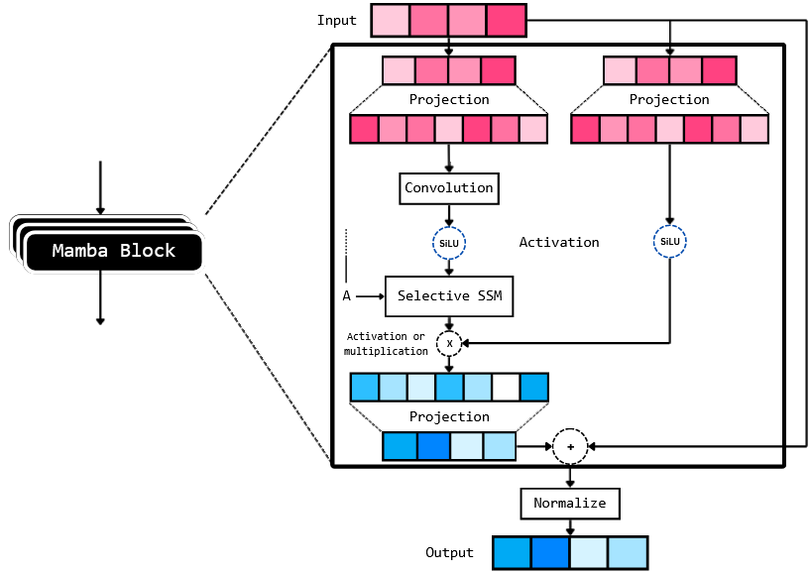
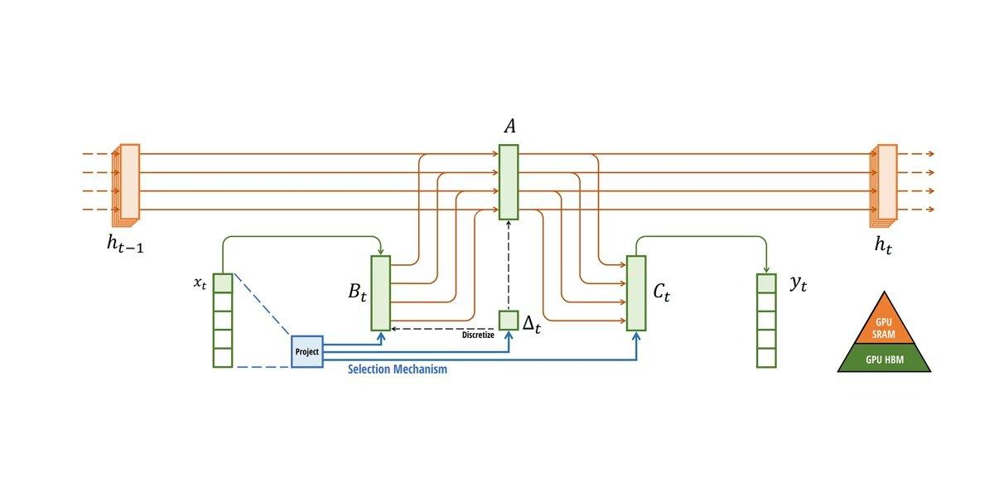
Mamba — Selective State Space Model (S6)
S4 Problem: A, B, C fixed for the entire sequence (LTI)
→ The model treats all tokens the same way
Mamba Innovation: B, C, Δ dependent on input
Bt = Linear(xt) what to inject into the state
Ct = Linear(xt) what to read from the state
Δt = softplus(Linear(xt)) how much to retain/forget
A remains fixed (learned parameter, constant over the sequence)
Discretization + Recurrence
Āt = exp(Δt A) ĀBt ≈ Δt Bt
ht = Āt ht-1 + ĀBt xt
yt = Ct ht
Role of Δ (step size = the SSM "gate")
Δ large → Ā = exp(ΔA) ≈ 0
→ we forget the state, we take the input
Δ small → Ā = exp(ΔA) ≈ I
→ we preserve the state, we ignore the input
→ Continuous memory control, analogous
to the GRU gate, but via the exponential
Note: A has negative eigenvalues (learned).
So exp(ΔA) has values between 0 and 1 : stable.
Complete Mamba block
Selective State Space Model — diagram of selective SSM (source : Gu & Dao, 2023)

Slide 30
Sample code for natural language processing
https://keras.io/examples/nlp/bidirectional_lstm_imdb/

Slide 31
Exercise (TP6)
Conitune the previous lab on determining the FHR baseline. One of the disadvantages of the previous method using CNN and U-NET is that it requires a fixed analysis time (set at 34 min). If we have longer signals, we could use sliding windows but it would create inconsistencies in the baseline between two windows. We'd also like to facilitate generalization: if we have a 3 min deceleration and a 5 min deceleration in the baseline train, we'd like a new 4 min deceleration to be easily interpreted as a deceleration, which is difficult with CNNs.
We're now going to create a model using GRU. Is it a one-to-many, many-to-one, sync many-to-many or async many-to-many model?
Create a model using two bidirectional GRU layers with 12 and 8 states respectively, you may need to use the return_sequences=true parameter depending on the previous question.
After each of these two layers, add Dropout at 0.1.
Add a dense output layer of 16 neurons (activation relu) with a dropout at 0.2, then the dense output layer (1 neuron without activation).
Why are there 24 channels at the output of the first bidirectional layer?
Train the model as last time and compare results

