Slide 1
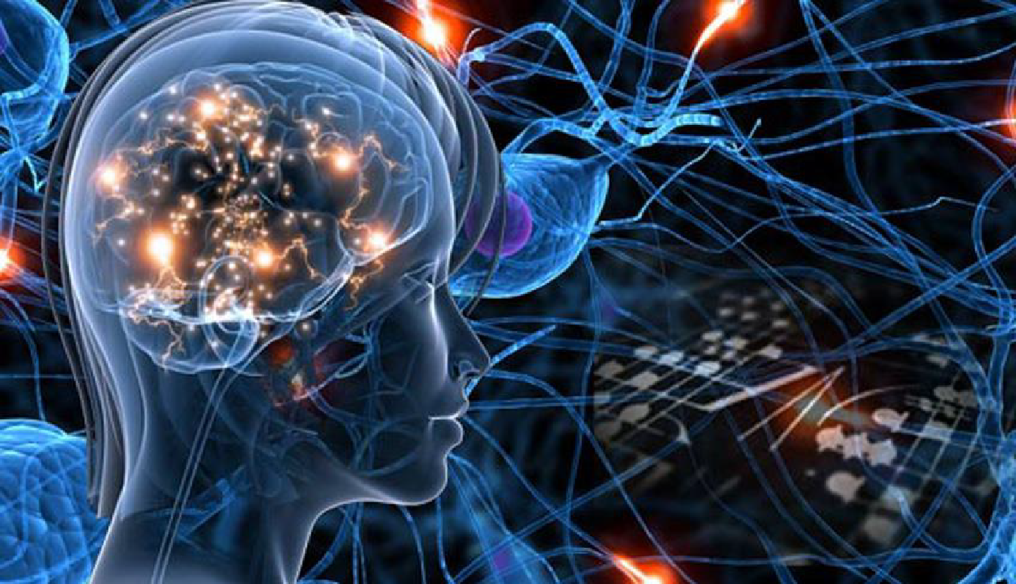
Deep Artificial Intelligence in Healthcare
Session 6: Reinforcement Learning

Slide 2
Reminder : Three "classes" of machine learning problem
Supervised Learning
Unsupervised Learning
III) Reinforcement learning: An autonomous agent acts in an environment and receives a reward (positive or negative) after each action. Its objective is to discover the policy - i.e. the rule indicating, for each state, the action to be taken - that maximizes these rewards, without knowing in advance the "rule" that determines these rewards.
Key features:
No explicit labels: There's no database indicating what the right action would have been. The only feedback comes from the reward.
No direct gradient: impossible to know immediately what to adjust; the agent progresses by trial and error.
Exploration/exploitation dilemma: explore new actions to discover better strategies, while exploiting what's already working.
Generally iterative: the agent executes a sequence of actions, receives a reward at each step. The policy is refined to maximize the expectation of the sum of rewards over time .

Slide 3
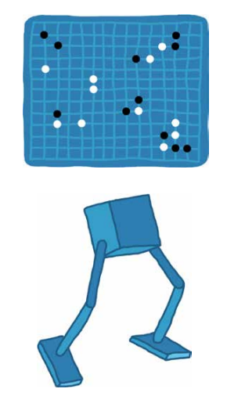


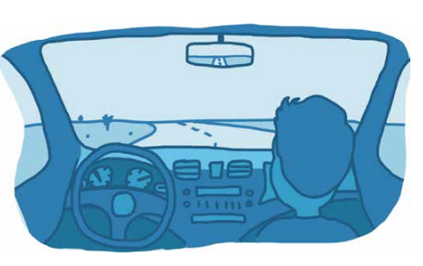

Applications
Playing games
Dynamic adjustment of radiotherapy, anesthesia, or insulin doses
Robotic control (including exoskeletons, surgical assistant robots)
Improving a model by collecting user feedback - Reinforcement Learning by Human Feedback (RLHF)
Drive a car
Digital Twin: A virtual replica of a patient or organ that simulates its physiology in real-time using medical data. RL (Reinforcement Learning) optimizes therapeutic strategies by virtually testing different treatments on the twin before they are applied to the actual patient.

Slide 4
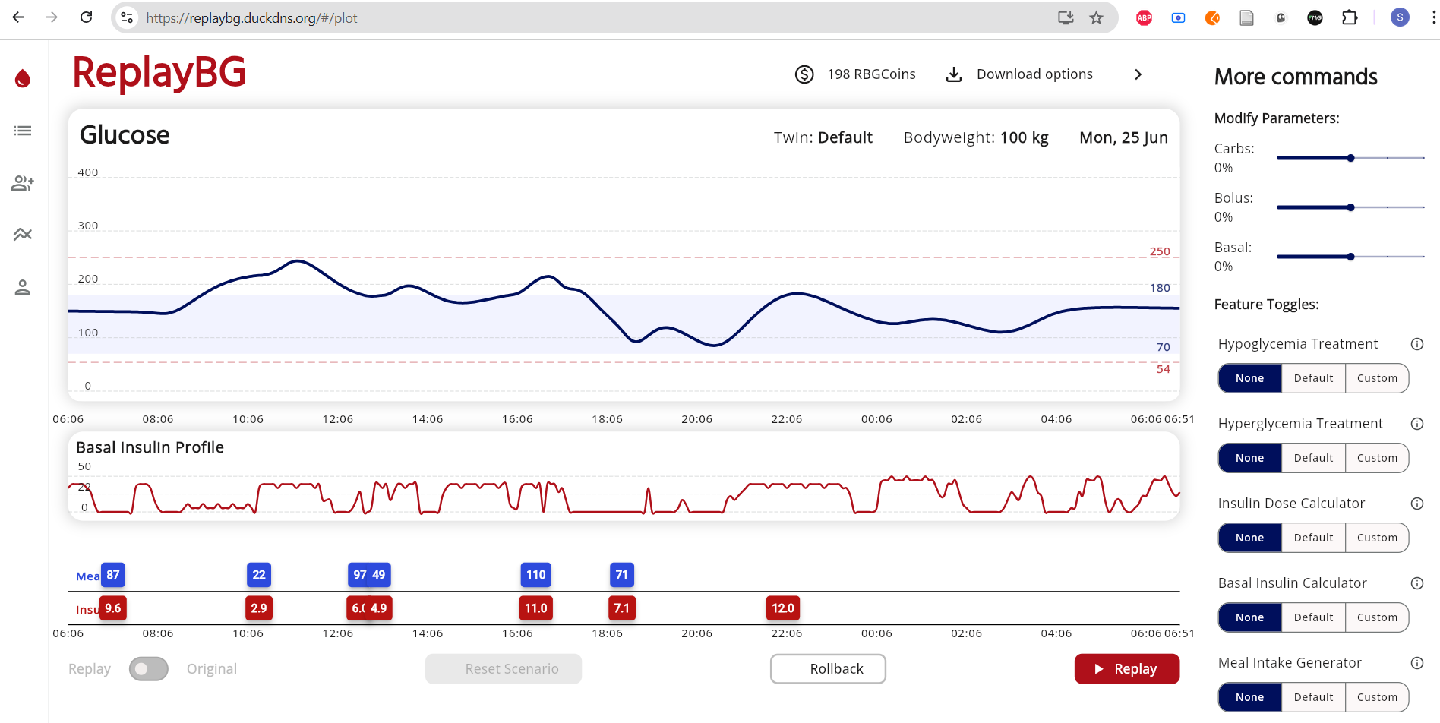
Exemple de jumeau numérique permettant au patient de simuler leur evolution de glucose et d’insuline en fonction des traitements et de leurs repas

Slide 5
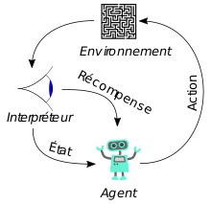
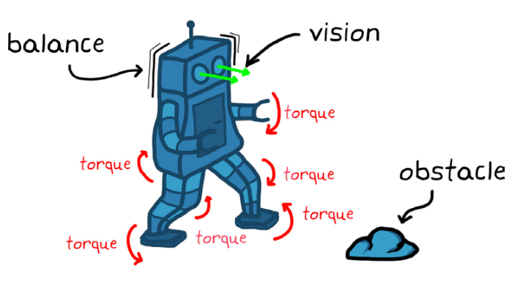

Slide 6

Actor Critic architecture
Environment
State (s) /Observation
Rewards
Action a
A deep learning model is created, named the critic. Supervised learning is used with all past actions that led to rewards to create a model that predicts the reward based on the agent's action.
Use a policy
trained by deep learning (model named actor):
To maximize the reward estimated by the critic model (exploitation)
To explore new strategies
Exploitation-exploration dilemma
Agent

Slide 7
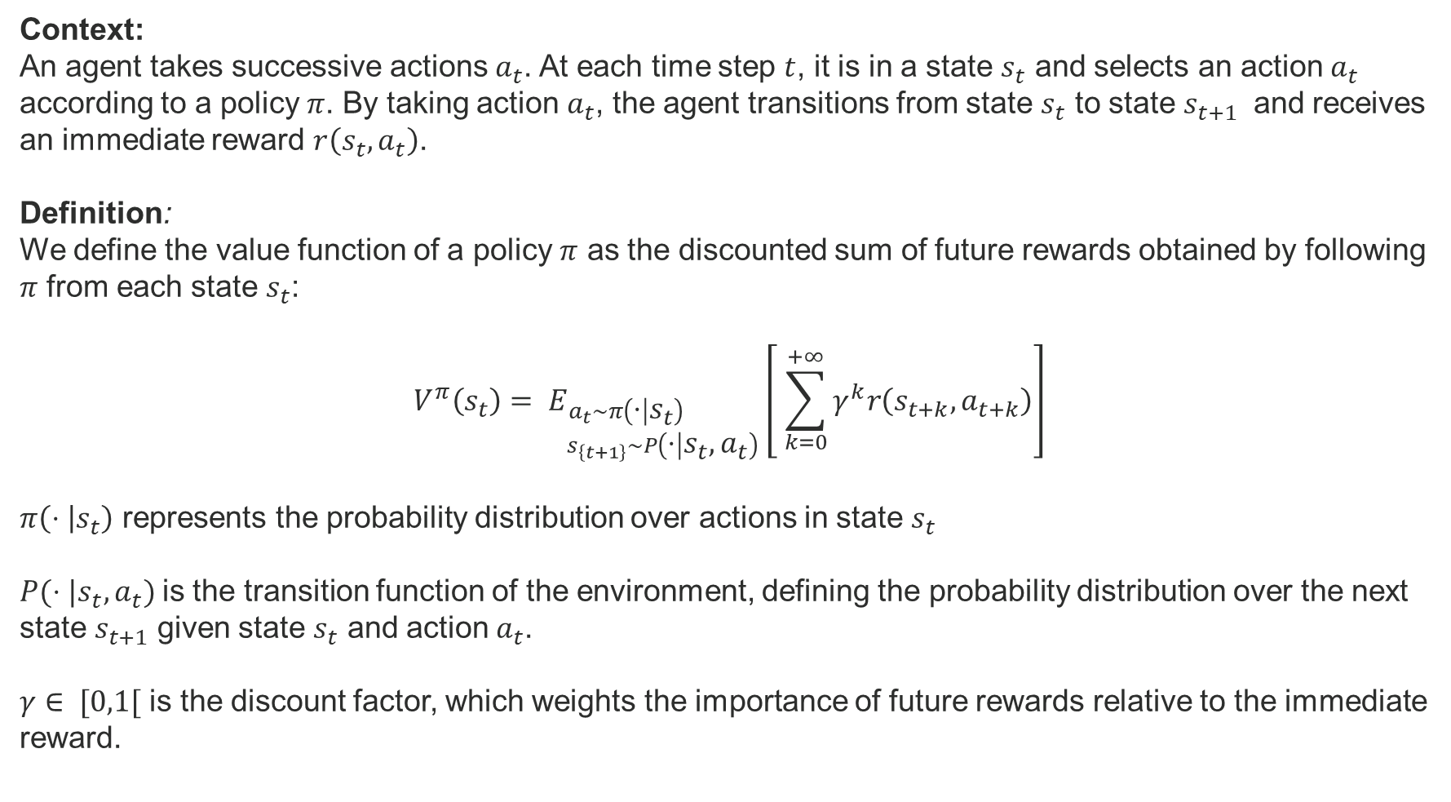
Maximizing the Value

Slide 8
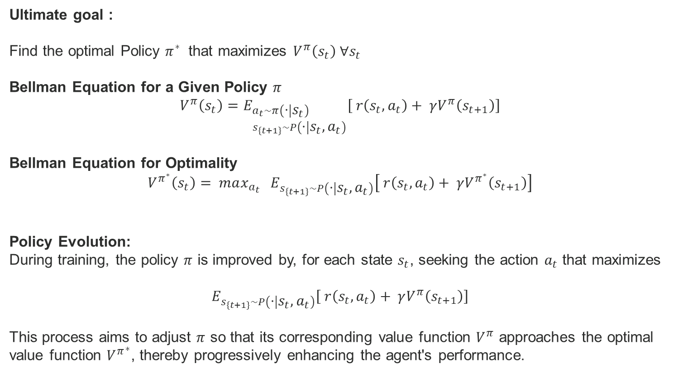
Maximizing the Value

Slide 9
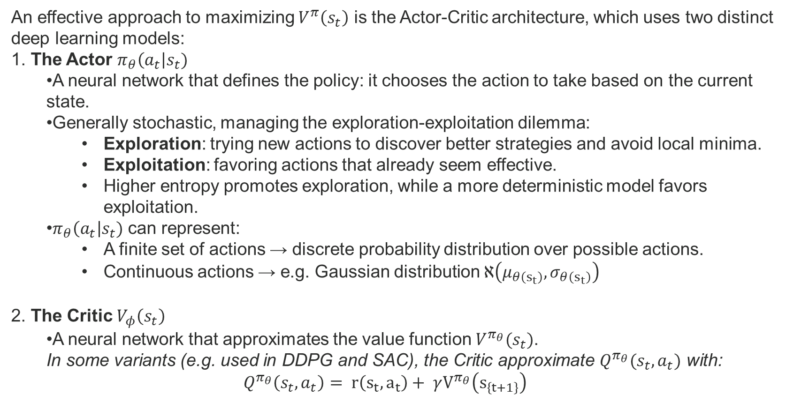
Actor-Critic

Slide 10
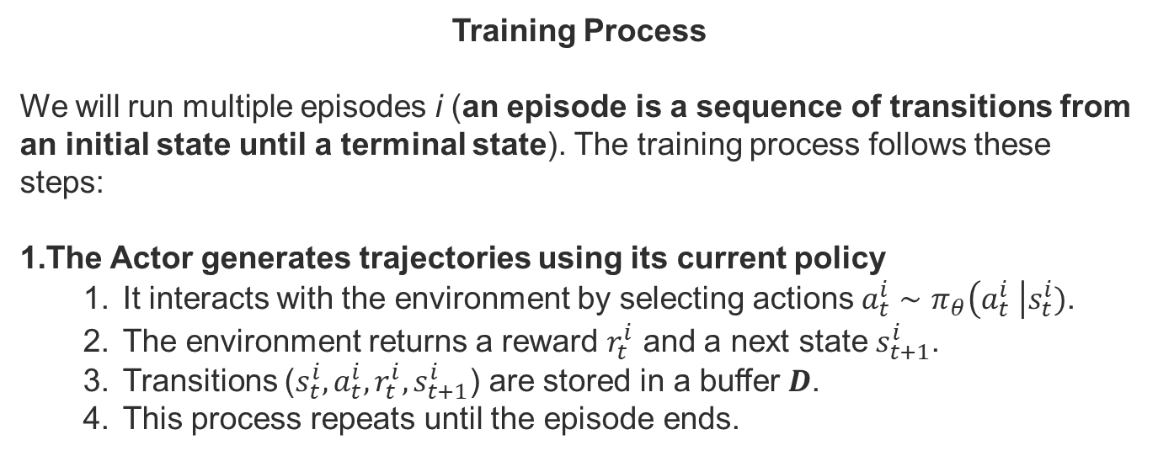

Slide 11
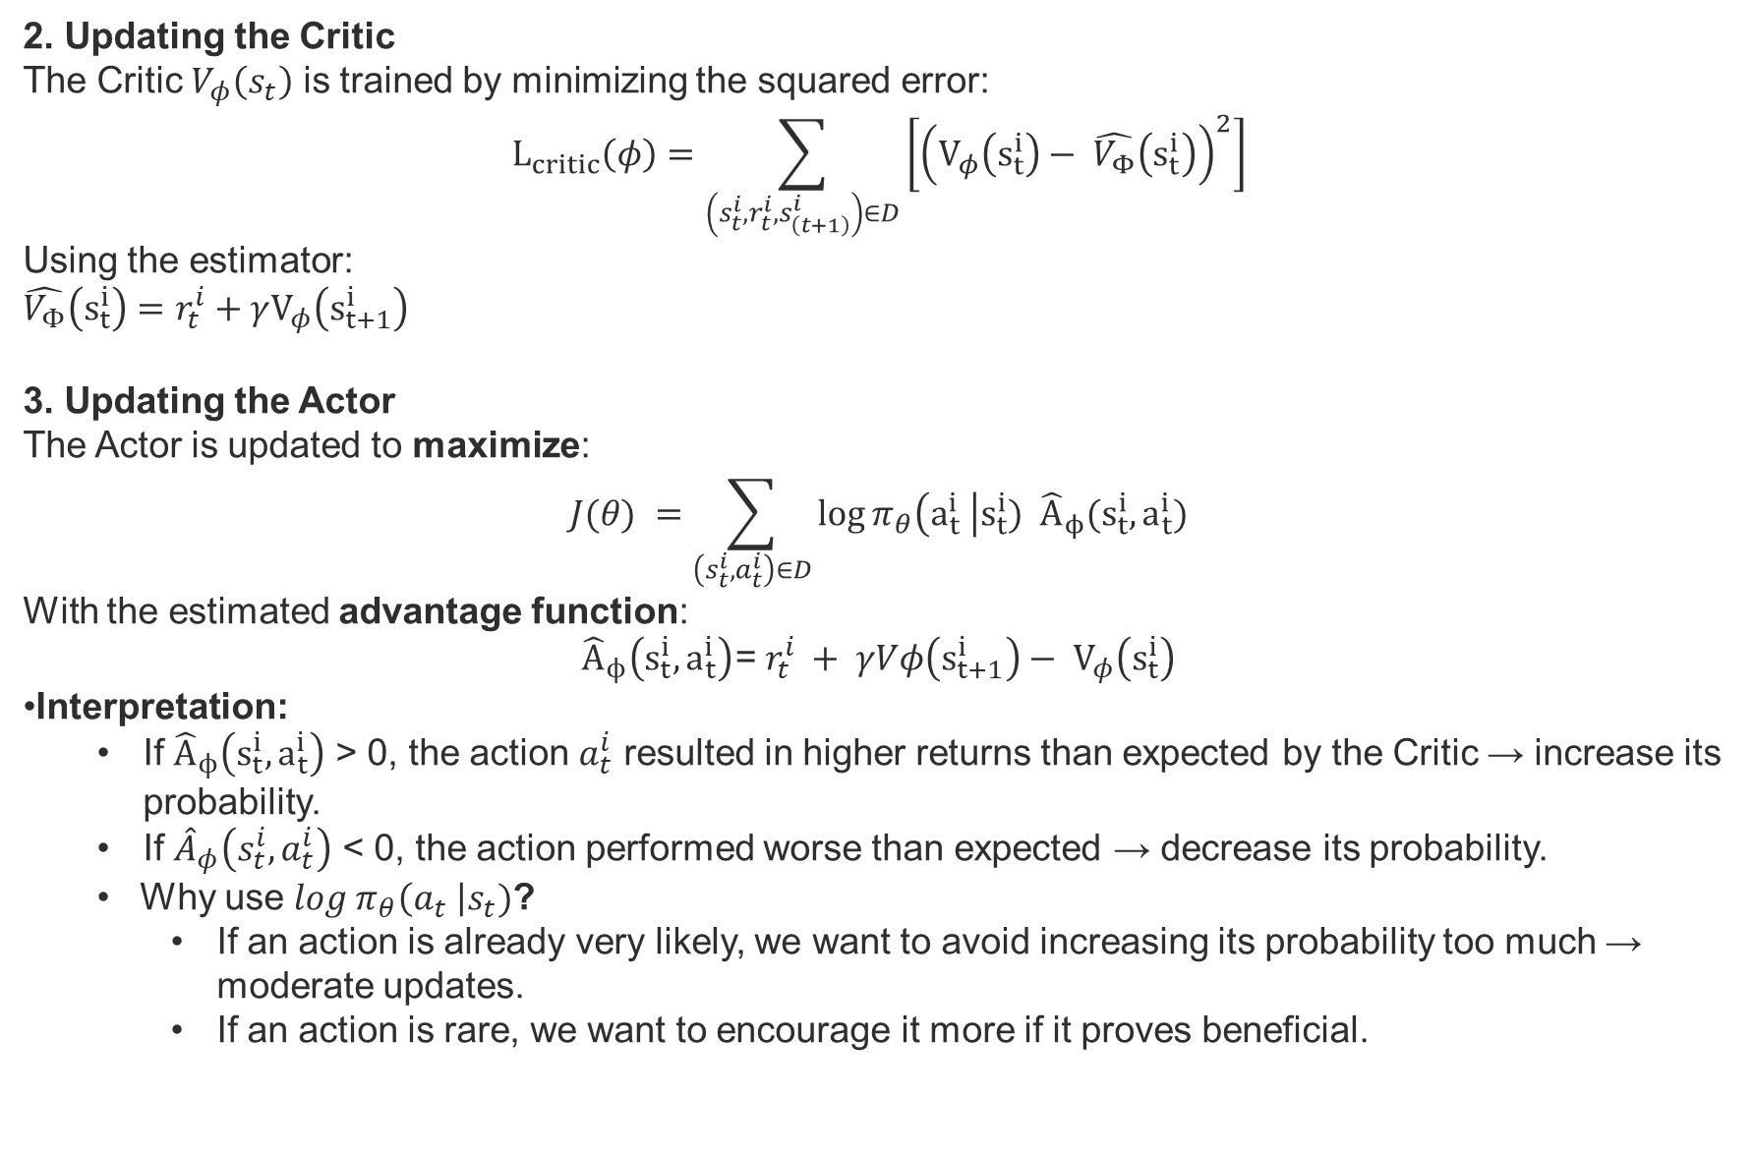

Slide 12
4. Experience Replay: Storing transitions
The buffer D can store the most recent episodes (Experience Replay).
A FIFO buffer is used:
If old experiences are kept too long, the rewards no longer match the current Actor.

Slide 13
Proximal Policy Optimization (PPO)
Proximal Policy Optimization (PPO) is a reinforcement learning algorithm introduced by John Schulman and colleagues at OpenAI in 2017. PPO became the default reinforcement learning algorithm at OpenAI.
Problem: Instability in Policy Updates
In standard Actor-Critic methods, updating the Actor can lead to large and unstable policy changes.
This instability can result in:
Divergence: The policy changes too drastically, leading to worse performance.
Catastrophic forgetting: Previously learned good behaviors are lost.
Solution: PPO – Controlled Policy Updates PPO introduces a clipping mechanism that prevents overly large updates to the policy, ensuring stable and gradual improvements.

Slide 14
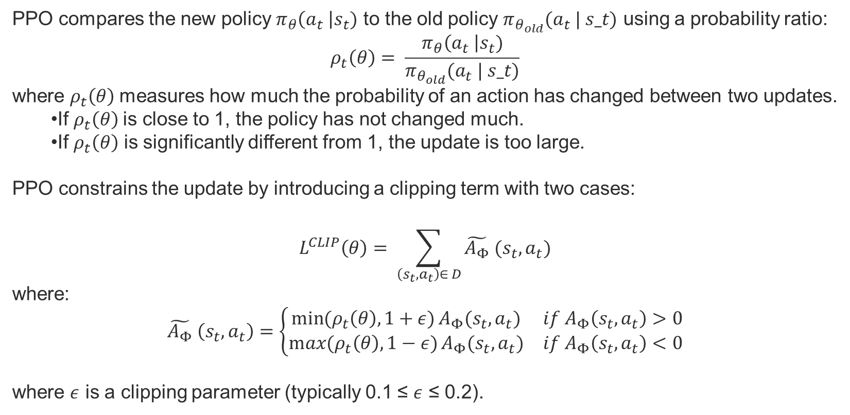
Proximal Policy Optimization (PPO)

Slide 15
Proximal Policy Optimization (PPO)
Remark:
PPO requires to empty the buffer of experiences after each training. Typically 10-20 episodes or 2048 timestamp. Then it is actor is first train on typically 100 epochs and then the critic on 100 epochs.
Conclusion:
This prevents the policy from changing too abruptly, even if the Actor strongly favors certain actions.
PPO thus ensures a balance between stability and progressive improvement.

Slide 16
SAC - Soft Actor-Critic (Stochastic Policy)
Key idea: Instead of directly predicting an action, the actor predicts a distribution
Continuous case: The actor predicts mu and sigma (mean and standard deviation)
The action is sampled: a ~ N(mu, sigma²)
Discrete case: The actor predicts a softmax distribution over actions
Entropy bonus: Objective = Sum(reward + alpha * entropy(pi))
The larger sigma is, the higher the entropy, and the more significant the bonus
The agent explores naturally without external noise
Elegant resolution of the exploration/exploitation dilemma

