Slide 1
MLB Season Team Statistics Dataset
Nolan Donley

Slide 2
Data
Aggregated from https://www.baseball-reference.com/
Statistics for all teams from 1911-2021 seasons
2772 x 60 data points

Slide 3
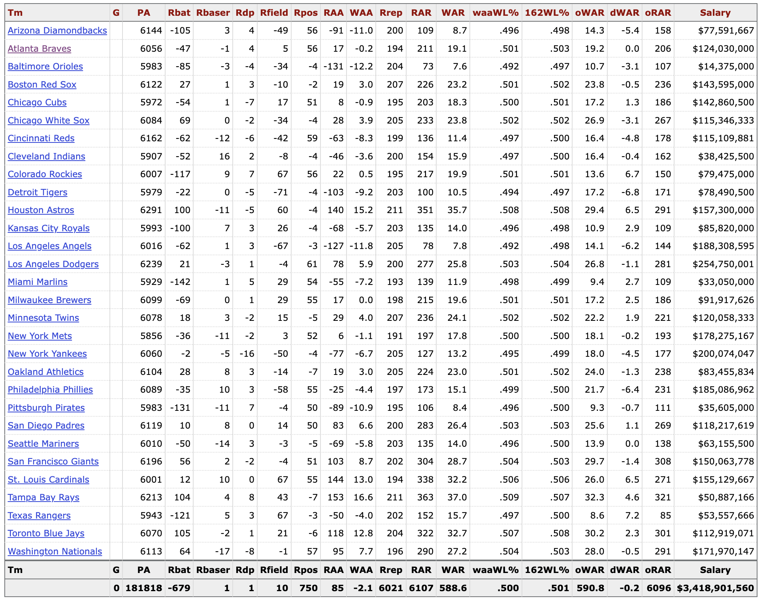
Batting
Value

Slide 4
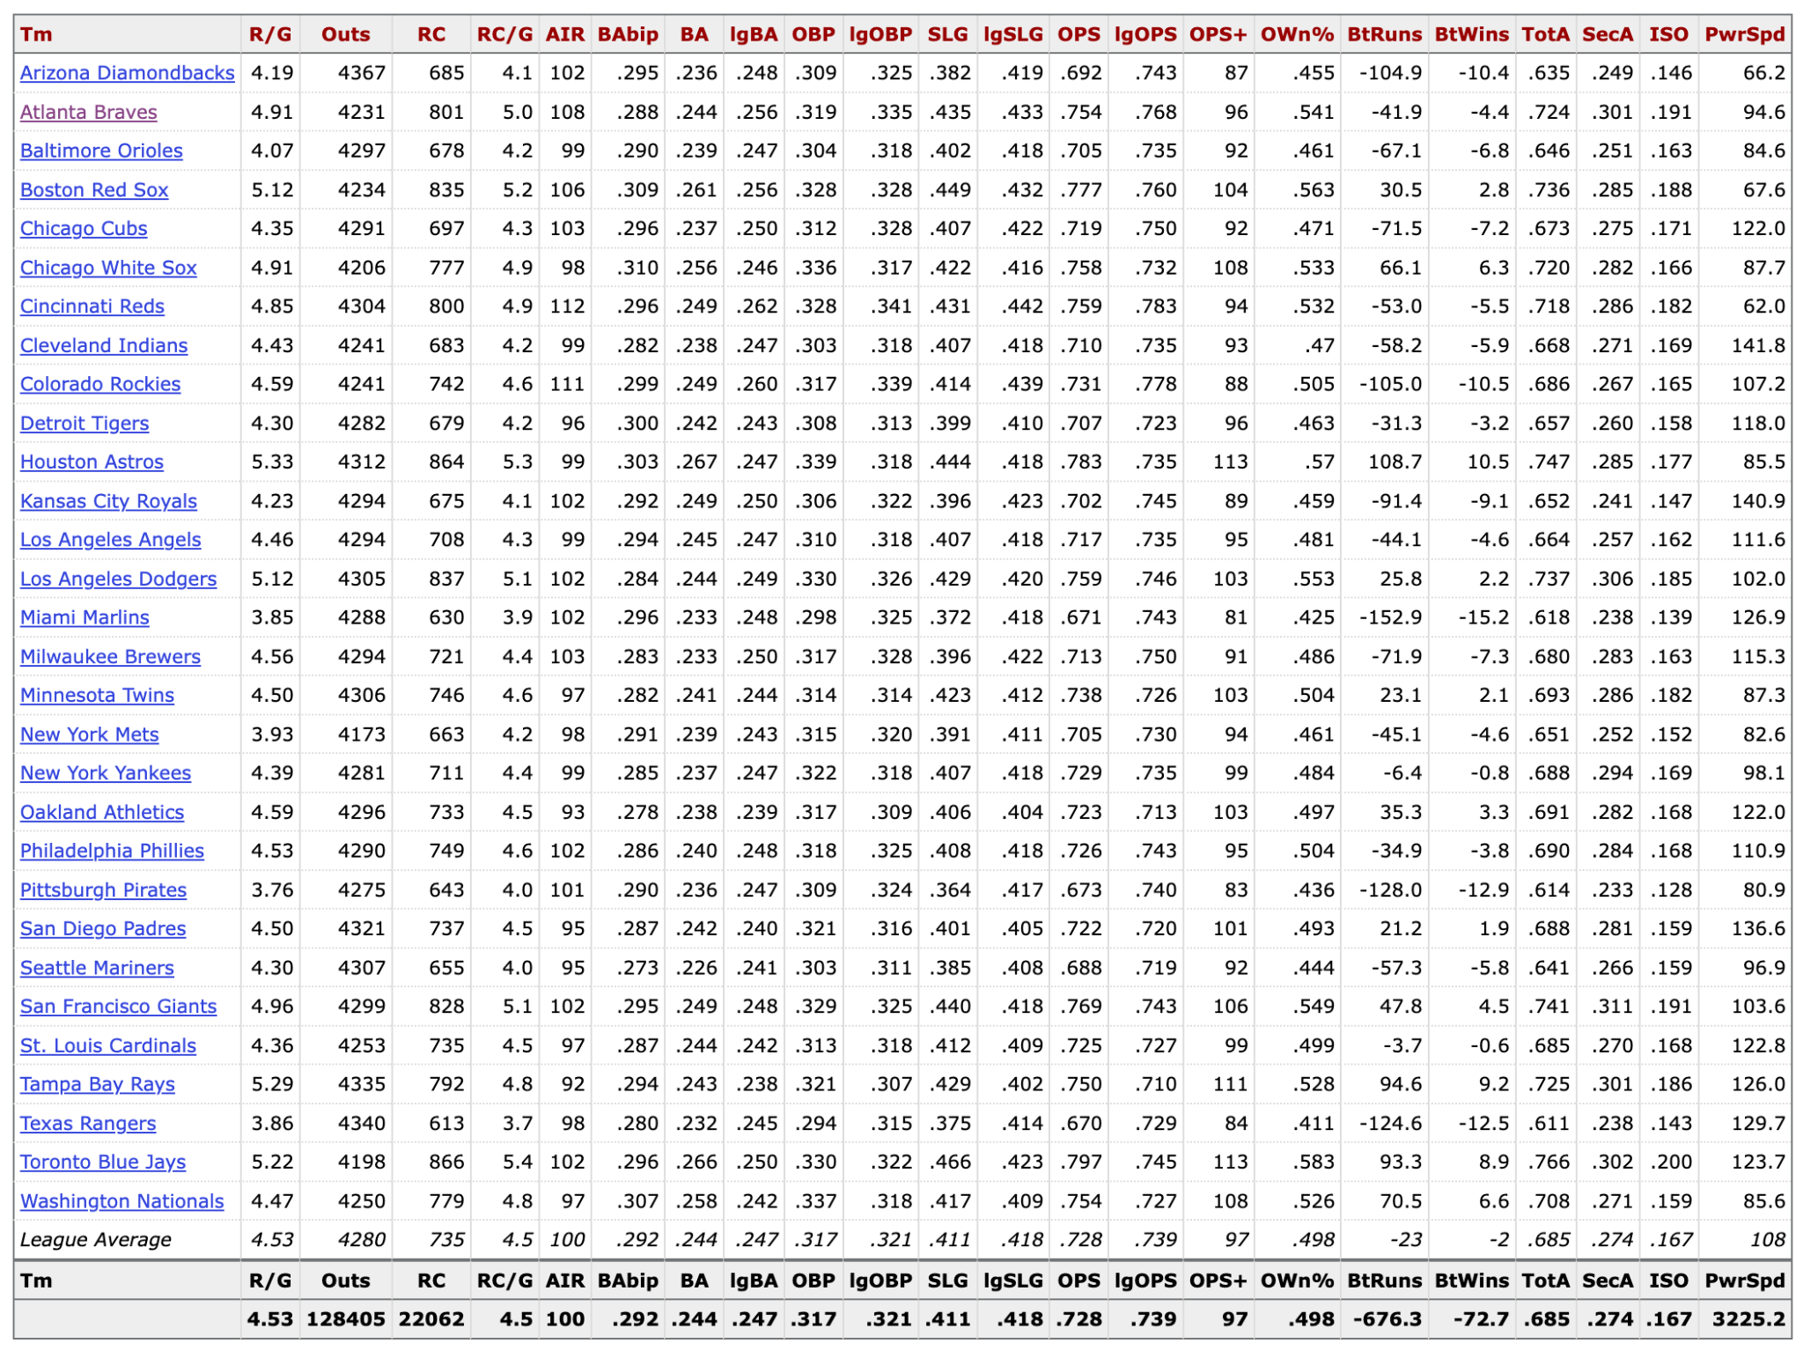
Batting
Sabermetric

Slide 5
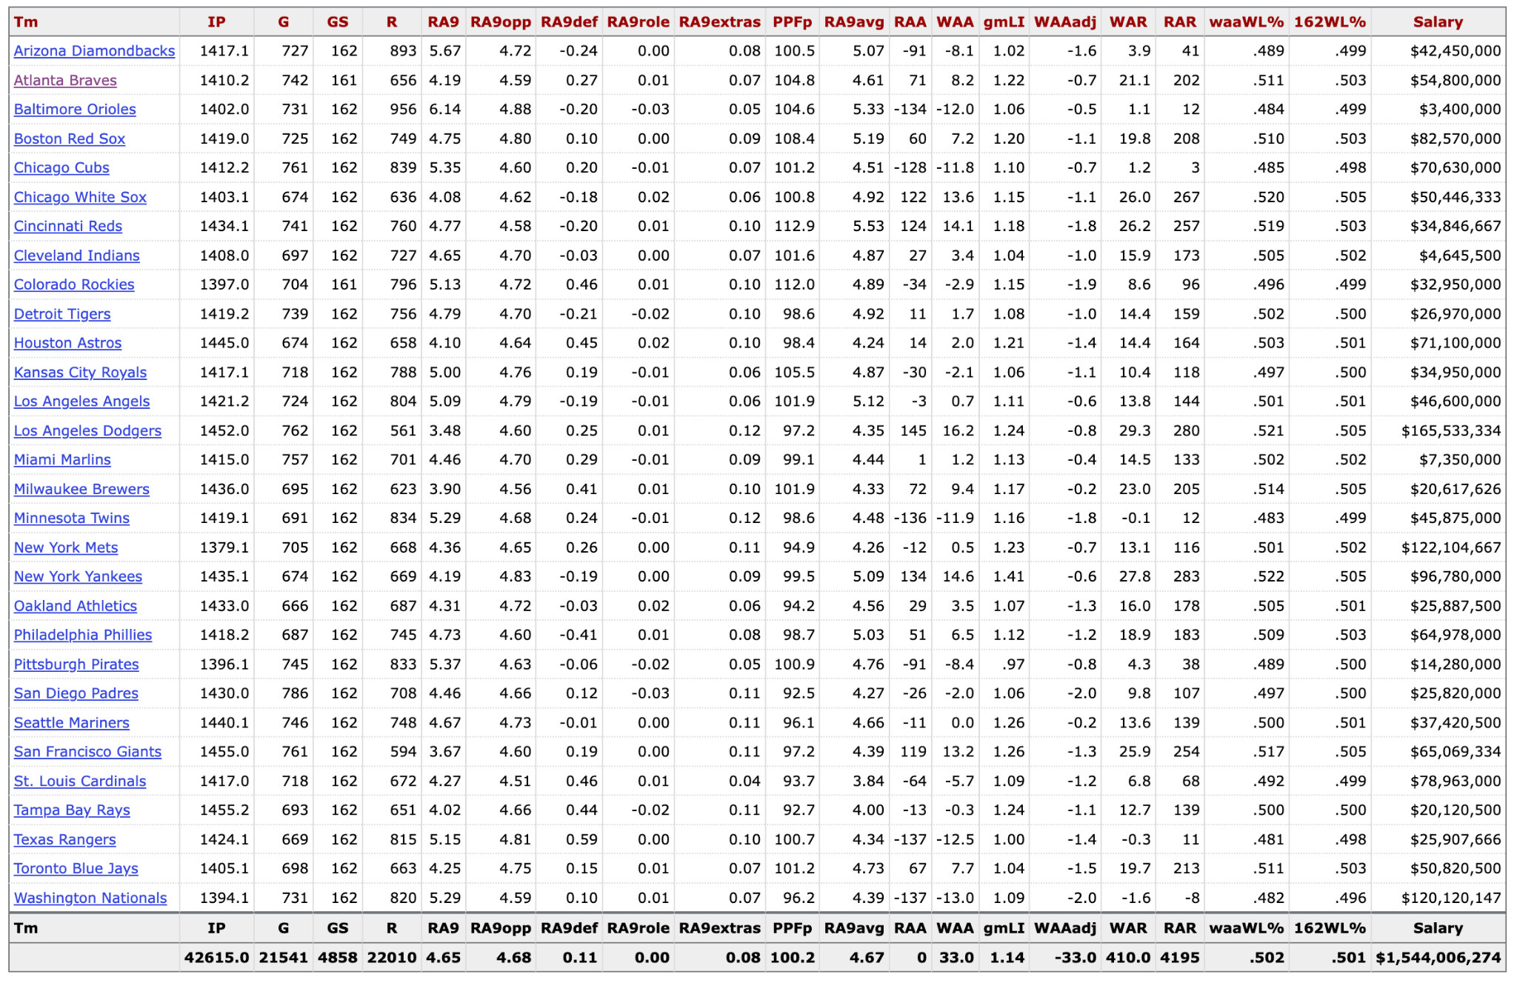
Pitching
Value

