Slide 1
MLB Team W-L% Neural Network Predictor Final Presentation
Nolan Donley

Slide 2
Problem and Background
Predicting W-L% of MLB teams using value statistics from the same season
Major League Baseball (MLB) is the highest level of professional baseball in the world and accounts for some of the most popular international sporting events. Many scholars have conducted research on predicting the outcome of MLB matches, however the accuracy in predicting the results of baseball games is low.
An example of a sabermetric is a player’s Power Speed Number (PSN) developed by Bill James (eq. 1). This is a simple formula computing the harmonic mean of a player’s home runs (HR) and stolen bases (SB).
PSN = (2 * HR * SB ) / HR + SB

Slide 3
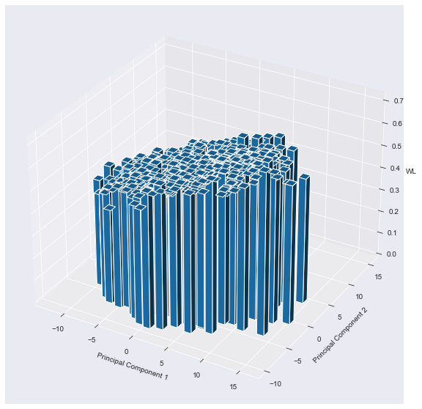
Data Collection and Processing
Aggregated all value batting and value pitching statistics as well as sabermetric batting statistics of all teams from 1911 through 2021 from www.baseball-reference.com.
Sanitized and normalized the data using a Keras Normalization layer and then performed a principal component analysis with a Scikit-learn PCA decomposition to reduce the feature set.

Slide 4
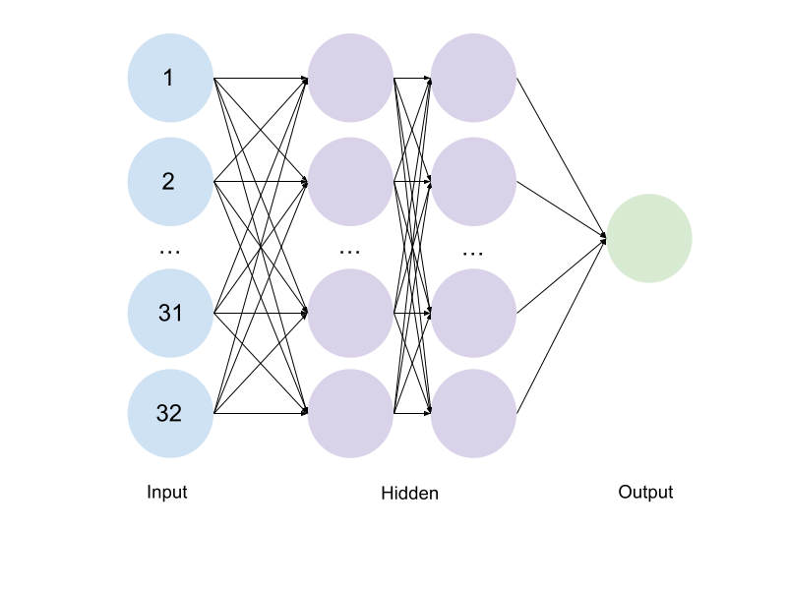
Model Architecture
PCR - Principal Component Regression
Input Layer
32 neurons, ReLU activation
Hidden Layers
32 neurons, ReLU activation
32 neurons, ReLU activation
Output Layer
1 neuron, Linear activation
Loss: Mean Absolute Error
Optimizer: Adam - LR = 0.001

Slide 5
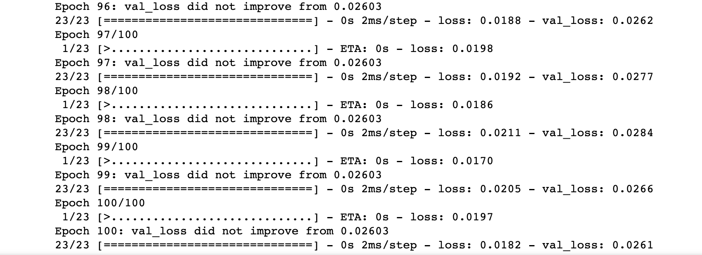
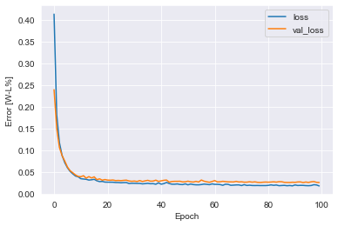
Tuning and Training
We used Keras-Tuner to determine the optimal number of neurons for the input and hidden layers as well as the number of hidden layers. We also we able to tune the optimizer function, kernel initializer, and activation functions for each of the layers. The Adam optimizer was employed with a learning rate of 0.001. The loss function was set to mean squared error, and the batch size was set to 64, and the epochs were set to 100.

Slide 6
Results
Team (Season) | Expected | Predicted
Boston Red Sox (2021) | 0.568 | 0.551
Florida Marlins (1998) | 0.494 | 0.501
Kansas City Monarchs (1948) | 0.660 | 0.627
Cleveland Indians (2000) | 0.556 | 0.562
New York Yankees (1977) | 0.617 | 0.540
Atlanta Braves (1969) | 0.574 | 0.559
New York Yankees (1936) | 0.667 | 0.615
Pittsburgh Rebels (1915) | 0.562 | 0.563
Texas Rangers (2006) | 0.494 | 0.527
Kansas City Athletics (1963) | 0.451 | 0.438
San Francisco Giants (1969) | 0.556 | 0.552
New York Mets (1992) | 0.444 | 0.434
Birmingham Black Barons (1943) | 0.568 | 0.557
Philadelphia Phillies (1933) | 0.395 | 0.426
Montreal Expos (1990) | 0.525 | 0.502
One metric we have created for the intuitive digestion of our results is the mean game prediction difference (MGPD). This is the average absolute difference in correct game prediction for a team’s season.
MGPD = G * MAE
Metric | Value
Mean Squared Error | 0. 00138769
Median Absolute Error | 0. 02329364
W-L % Standard Deviation | 0. 07911602
Mean Game Prediction Difference | 4. 68578703

Slide 7
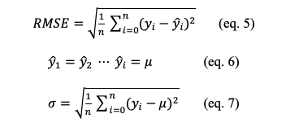
Analysis
Because the nature of this problem is so difficult, and our primary intention is to use this as a base indicator of hypothetical team performance in a genetic algorithm, we have declared any significant improvement above the W-L% standard deviation to be sufficiently effective.

Slide 8
Conclusions and Future Work
We predicted the W-L% of MLB matches by collecting the match data of all teams from the 1911 to 2021 seasons and using an ANN prediction model.
The prediction model proposed in this study achieved high prediction performance and can thus be used to provide some reference information for fans, team managers, and baseball enthusiasts.
The proposed prediction models can also be used to predict game playoff outcomes since the model can basically predict who the best team should be, in contrast to the teams that have been experiencing some amount of luck.
Future research should consider including traditional metrics or reducing the metrics size all together or construct a model to predict a teams win % based on the individual player statistics from its 26-man roster.

Slide 9
References
[1] Kaan Koseler & Matthew Stephan (2017) Machine Learning Applications in Baseball: A Systematic Literature Review, Applied Artificial Intelligence, 31:9-10, 745-763, DOI: 10.1080/08839514.2018.1442991
[2] Soto Valero,C.(2016).Predicting Win-Loss outcomes in MLB regular season games – A comparative study using data mining methods. International Journal of Computer Science in Sport,15(2) 91-112. https://doi.org/10.1515/ijcss-2016-0007
[3] Tolbert, B.; Trafalis, T. Predicting Major League Baseball Championship Winners through Data Mining. Athens J. Sport. 2016, 3, 239–252. https://www.athensjournals.gr/sports/2016-3-4-1-Tolbert.pdf
[4] Huang, M.-L.; Li, Y.-Z. Use of Machine Learning and Deep Learning to Predict the Outcomes of Major League Baseball Matches. Appl. Sci. 2021, 11, 4499. https://doi.org/ 10.3390/app11104499
[5] S.-L. Team, “Sklearn Decomposition PCA,” Scikit-Learn. [Online]. Available: https://scikit-learn.org/stable/modules/generated/sklearn.decomposition.PCA.html.
[6] K. Team, “Keras: Layer Normalization Layer,” Keras. [Online]. Available: https://keras.io/api/layers/normalization_layers/layer_normalization/.
[7] J. Sobanski, “Fast and easy regression with Keras and tensorflow 2.3 ,” John Sobanski, 28-Nov-2020. [Online]. Available: https://john.soban.ski/fast-and-easy-regression-with-tensorflow-part-2.html.

