Slide 1
Use of Machine Learning and Deep Learning to Predict the Outcomes of Major League Baseball Games: A Review
Nolan Donley

Slide 2
Problem Description
Predicting the outcome of a Major League Baseball game.
The accuracy in predicting the results of baseball games is low.
Notes:
The details and outcome of each game and the performance of the players have become a daily topic of interest for fans, giving rise to many business opportunities. Thus, game outcomes and player performance constitute sources of highly valuable information.

Slide 3
Why Use a Neural Network?
Baseball is regarded as quite complex, with many factors affecting the outcome of a game, including player performance, team spirit, weather, and tactics. The events of a baseball game are unpredictable because they are influenced by various factors; for fans, this unpredictability is what makes a baseball game so interesting
Neural networks have been used to successfully solve machine learning problems. A neural network can process data in various formats and is generally used in image processing and has achieved outstanding results. A one-dimensional (1D) CNN (1DCNN) is suitable for processing data such as sequences or signals, and it is relatively easy to train.
Notes:
A convolutional neural network (CNN) is one of the most popular deep learning networks and has been used to successfully solve machine learning problems [11]. A CNN can process data in various formats; it is generally used in image processing and has achieved outstanding results. A one-dimensional (1D) CNN (1DCNN) is suitable for processing data such as sequences or signals, and it is relatively easy to train [12]. These CNNs have been used for tasks such as crop yield prediction [13], the prediction of wind speed and direction [14], unipolar depression diagnosis [15], and the prediction of film and television ratings [16], with outstanding results.

Slide 4
Uniqueness of the problem
Only a few scholars have employed deep learning methods to predict the outcomes of sporting events.
No studies have used data from Baseball-Reference to predict the outcome of a baseball game.

Slide 5
About 1D Convolutional Neural Network
A 1DCNN is suitable for analyzing signal and time-series data. A 1DCNN, 2DCNN, and 3DCNN all have the same characteristics and follow the same processing method. The main difference lies in the dimensions of the input data and the manner in which the convolution kernel (also known as the filter) moves within the data. The 1DCNN moves in one direction, and the input and output data are 2D.
A CNN comprises convolutional layers, pooling layers, and fully connected layers. These layers are constructed differently according to the CNN architecture. A 1DCNN has no established network structure. The network structure of a 1DCNN is built and modified according to the type and size of the data.

Slide 6
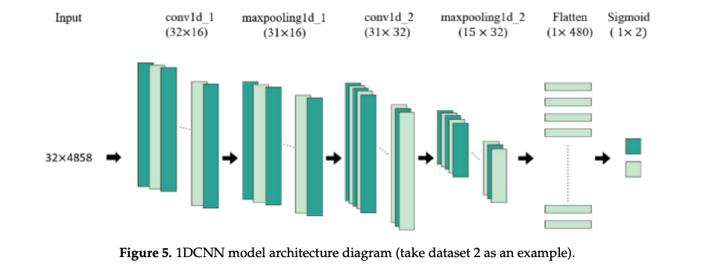
The Architecture

Slide 7
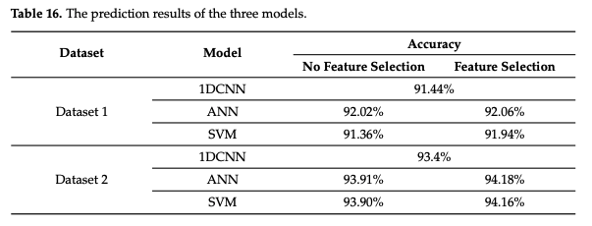
Results

Slide 8
Analysis
The prediction accuracies of the three prediction models for MLB matches proposed in this study were higher than 90%, which is considerably higher than the prediction accuracies obtained in related studies (accuracies of 55–74%).
This is the first study to employ a 1DCNN model to predict the outcomes of MLB matches, and the results indicate that the model achieved favorable prediction performance. Although the ANN and SVM models outperformed the 1DCNN model, the 1DCNN model can automatically extract features, thereby avoiding the time-consuming process of feature extraction.

Slide 9
References
Huang M-L, Li Y-Z. Use of Machine Learning and Deep Learning to Predict the Outcomes of Major League Baseball Matches. Applied Sciences. 2021; 11(10):4499. https://doi.org/10.3390/app11104499

