Slide 1
Structure of Neural Network
Nolan Donley

Slide 2
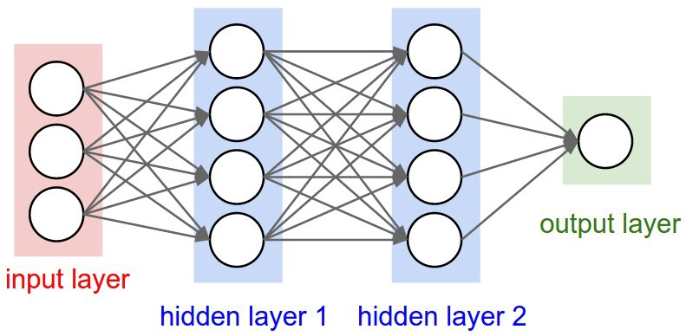
Feed-Forward Regressional ANN

Slide 3
Data Preprocessing
Before inputting the data, we are stripping any columns with Nan or Null values
We also will be stripping outlier teams (rows)
We then separate the input columns from the target column

Slide 4
Number of layers
5 layers total
1 input layer
38 nodes, kernel_init: normal, activation: relu
3 hidden layers
256 nodes, activation: relu
256 nodes, activation: relu
256 nodes, activation: relu
1 output layer
1 node, activation: linear

