Slide 1
on velcro and stochastics
Nolan Lem
MUS305C

Slide 2
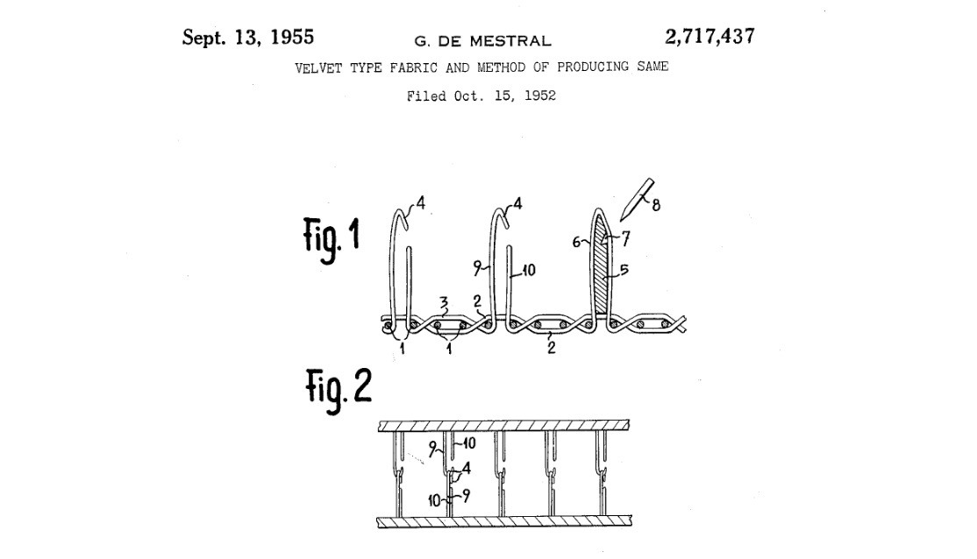
”hooked velvet”, invention of velcro
Georges de Mestral – Swiss inventor & engineer
Out in the woods (1941) – discovers burrs becoming affixed to his trousers.
Patents velcro in 1955, “velvet type fabric and method for producing the same”
+ Hook and Loop-Fastener design
+ NASA begins using it in 1960s and then the medical industry. Only becomes household consumer product after several years on the market.
Mestral, G. D, Velvet Type Fabric and Method of Producing the Same. U.S. Patent 2,717,437

Slide 3
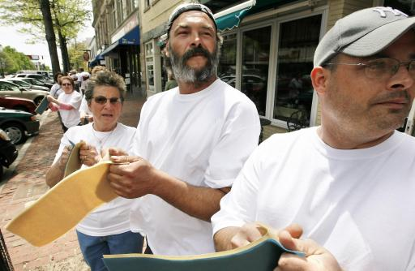
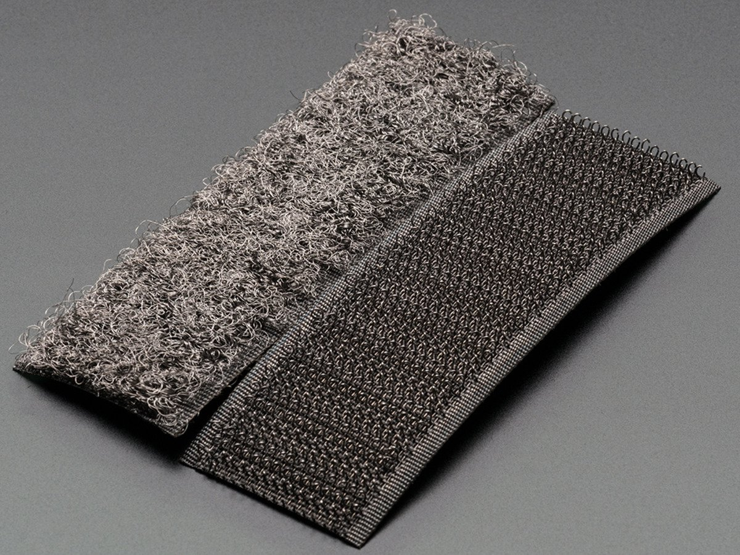
Velcro as sound object
Since its introduction, the sound of velcro has provoked a wide-range of emotional reactions/responses
ASMR community – ‘Velcrophilia’
Source of Acoustiphobia (fear of sounds)
Manchester, NH 2008 – Velcro Sound Wave organized by Velcro Factory Workers in celebration of 50th year Anniversary. 8” strips ripped apart in sequence.
Retrieved from: http://lubbockonline.com/stories/051508/liv_279222831.shtml#.V095AMcd7rI

Slide 4
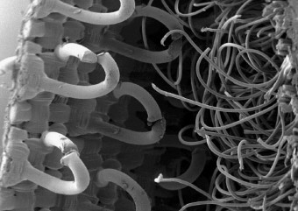
Mechanics of Velcro Sound
Hook and loop-fastener : strength of bond is a function of the number of fibers that become entangled and these attachments are a function of the density of the hooks and fasteners.
Ripping-apart sound is acoustic consequence of these fibers becoming extricated by some external force.
The sound and function of velcro is a result of statistical behaviors playing out in real-time.
Sound materializes from the simple kinetics of the complementary fibers’ binary logic: to be or not to be, attached…that is the coin toss

Slide 5
Stochastic Music in 1950-60s
Xenakis’ pens The Crisis of Serial Music in 1955 (probably around the same time de Mestral is filling his patent) and composes Achorripsis in 1957, his second piece using stochastic procedures.
“Linear polyphony destroys itself by its very complexity; what one hears is in reality nothing but a mass of notes in various registers […] when linear combinations and their polyphonic superpositions no longer operate, what will count will be the statistical mean of isolated states and of transformations of sonic components at a given moment. The macroscopic effect can then be controlled by the mean of the movements of elements which we select. The result is the introduction of the notion of probability, which implies, in this particular case, combinatory calculus. Here, in a few words, is the possible escape route from the "linear category" in musical thought.” – I. Xenakis, The Crisis of Serial Music (1955)
Xenakis’ frequently cites visual, spatial, or material references in his justification for stochastic procedures.
Notes:
Seems to be a phenomenological basis for pushing Xenakis into working with stochastic procedures. Eg. People just hear a mass of notes in various registers. In effect, Xenakis is promoting a sonification approach to composition, namely one that is derived from physical mathematics.

Slide 6
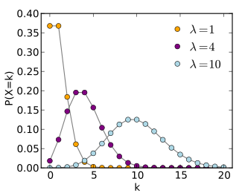
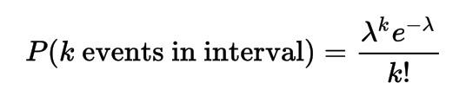
Achorripsis (1957) and Poisson Distributions
Draws from Poisson Distribution to parameterize the piece in terms of:
density of sound events
distribution of sound events by timbral (instrument) category
distribution of sound events over time
Poisson Distribution expresses probability of given number of events occurring in a fixed interval of time. Conditions: Events must occur with an average rate and independent of past events.

Slide 7
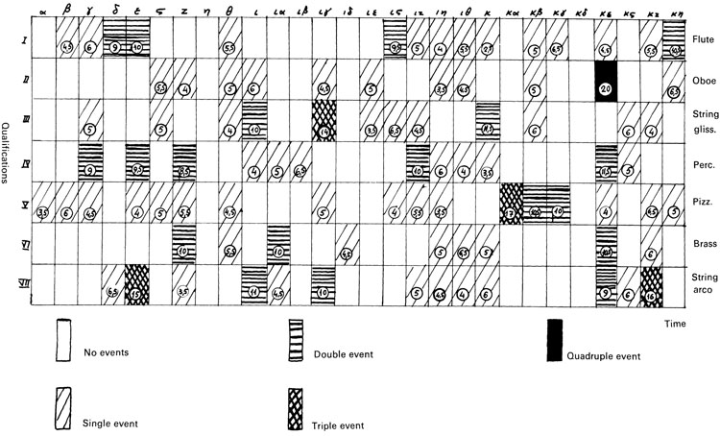
The Achorripsis matrix
+ columns:
28 vertical strips= 15 s intervals
+ rows:
7 horizontal strips = instrumental category
In general, Poisson distributions account for organization vertically (time)and horizontally (timbre) and within each cell (density)
Notes:
Emphasis on how Xenakis treates time: instrumental groups either play or don’t play. Binary distinction – because via Poisson PDF, the no-event category is the most likely to occur.

