Slide 1
Intro to CRISPR screens
Marco Jost
Assistant Professor of Microbiology
Genetics Bootcamp
01/09/2023

Slide 2
Agenda for today’s lecture
Principles of genetic screens
Why CRISPR has revolutionized genetic screens
CRISPR knockout, knockdown, and overexpression
Types of CRISPR screens
Selected applications of CRISPR screens

Slide 3
What is a genetic screen?
A genetic screen is a method to identify genetic bases for a phenotype of interest, by introducing genetic changes and asking how these changes affect the phenotype.
What does one need to perform a genetic screen?
a phenotype of interest that is readily observable
a way to introduce genetic changes (“genetic perturbations”)
a way to map which genes are perturbed in individuals that have the phenotype of interest

Slide 4
Classical “forward genetic screens” were pioneered in bacteria, yeast, and small animals
forward genetics: introduce random mutations -> test phenotypes -> map genes
Jones et al., Nature Reviews Drug Discovery 2005, 4, 321

Slide 5
Sequence-based genetic reagents allow for “reverse genetic screens”
reverse genetics: perturb defined genes -> measure phenotypes
Sequence-based genetic reagents that are also scalable/programmable allow for genome-scale genetic screens.
The first such method was RNA interference (RNAi).
Mohr et al., Nature Reviews Molecular Cell Biology 2014, 15, 591

Slide 6
CRISPR/Cas: an adaptive bacterial (and archaeal) immune system
e.g. Cas9
CRISPR: clustered regularly-interspaced short palindromic repeats
Cas: CRISPR-associated
Wright et al., Cell 2016, 164, 29

Slide 7
Cas9 is a programmable nuclease
Cas9:sgRNA complex
sgRNA-guided
DNA binding
Jinek et al., Science 2012, 337, 816

Slide 8
Cas9 is targeted by sequence complementarity to a bound guide RNA
Key features of Cas9:
Programmability: sequence of the RNA determines what DNA sequence Cas9 binds
Nuclease activity: Cas9 introduces a double-strand DNA break
Simplicity: a single protein contains all activities; a single RNA is sufficient to guide Cas9
Cas9 is a highly and easily programmable nuclease.
DNA target
Jinek et al., Science 2012, 337, 816

Slide 9
Cas9 is a programmable nuclease
Cas9:sgRNA complex
sgRNA-guided
DNA binding
This is generally called “CRISPR cutting” or “CRISPR nuclease (CRISPRn)”.
In mammalian cells, CRISPR cutting often leads to knockout of the targeted gene.
Jinek et al., Science 2012, 337, 816
Notes:
Why does this trigger knockout?

Slide 10
A catalytically inactive mutant of Cas9 (dCas9) is a programmable DNA-binding protein
dCas9: D10A/ H840A Cas9
Cas9:sgRNA complex
sgRNA-guided
DNA binding
Jinek et al., Science 2012, 337, 816
Qi et al., Cell 2013, 152, 1173

Slide 11
Fusion proteins of dCas9 enable knockdown and overexpression of genes in mammalian cells
knockdown (CRISPRi): dCas9 fused to transcriptional repressor domain (dCas9-KRAB / newest iteration: dCas9-Zim3)
overexpression (CRISPRa): dCas9 fused to transcriptional activator domains (multiple flavors)
Gilbert et al., Cell 2013, 154, 442
Tanenbaum et al., Cell 2014, 159, 635
Notes:
KRAB: Kruppel-associated box from Kox1, recruits transcriptional repressors through KAP-1; in particular histone deacetylases and histone lysine methyltransferases; trigger spread of heterochromatin

Slide 12
With CRISPR cutting, CRISPRi, and CRISPRa, we can knock out, knock down, or overexpress any gene in the human genome. This allows for very efficient genetic screens that can approach saturation.

Slide 13
For a CRISPR screen, we need to express sgRNAs targeting many different genes.
We can do this in 2 main ways:
one sgRNA per well -> arrayed screen
many different sgRNAs in a population of cells -> pooled screen

Slide 14
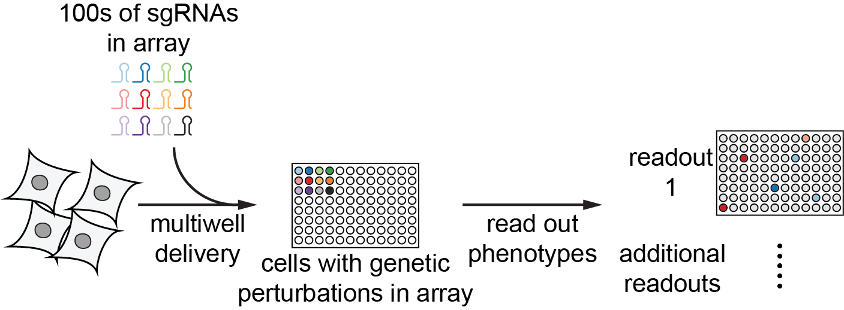
Principle of arrayed screens
Cells are grown in multi-well plates; each well contains a different sgRNA. Phenotypes are read out for each well.

Slide 15
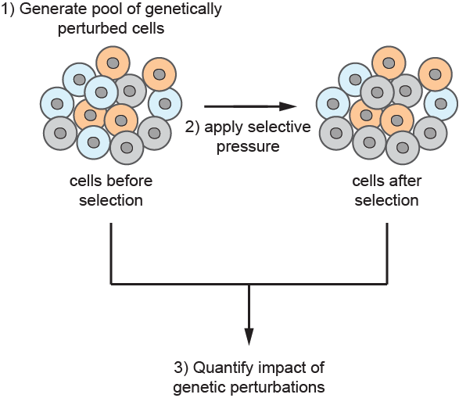
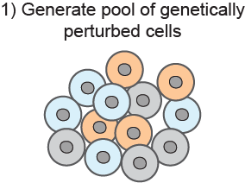
Principle of pooled screens
Cells with many different sgRNAs are grown together in a single vessel.
Phenotypes are measured by quantifying abundances of cells expressing each individual sgRNA after application of a selective pressure.

Slide 16
Principle of pooled screens
Cells with many different sgRNAs are grown together in a single vessel. Phenotypes are measured by quantifying abundances of cells expressing each individual sgRNA after application of a selective pressure.
Notes:
CRISPR has made screens so much easier because we can readily do parts 1 and 3

Slide 17
Why CRISPR-based pooled screens are feasible
sgRNA sequence specifies which gene is perturbed

Slide 18
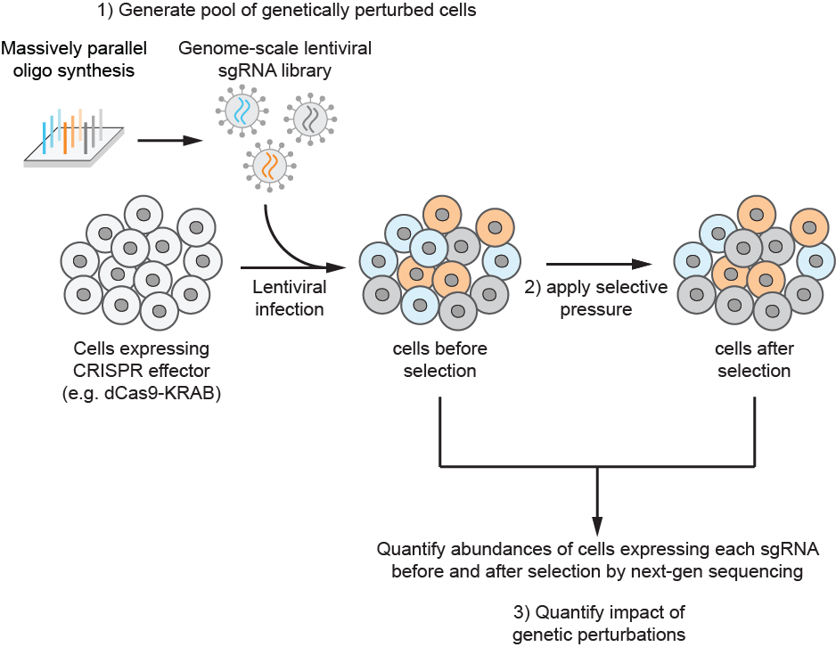
Why CRISPR-based pooled screens are feasible
sgRNA sequence specifies which gene is perturbed
we can synthesize sgRNAs targeting many (or all) genes in the genome
we can integrate constructs to stably express sgRNAs using lentivirus, such that each cell carries the identity of the perturbation in its genome (“barcode”)

Slide 19
Why CRISPR-based pooled screens are feasible
sgRNA sequence specifies which gene is perturbed
we can synthesize sgRNAs targeting many (or all) genes in the genome
we can integrate constructs to stably express sgRNAs using lentivirus, such that each cell carries the identity of the perturbation in its genome (“barcode”)
we can count the number of cells expressing each sgRNA in each population by deep sequencing

Slide 20
A genome-wide pooled screens requires hundreds of millions of cells
This is a lot!
# genes
20,000
# sgRNAs per gene
10
# cells per sgRNA
1,000
# cells in the screen
200 Million

Slide 21
Arrayed and pooled genetic screens
Shalem et al., Nature Reviews Genetics 2015, 16, 299
Notes:
principles largely independent of Cas9 effector

Slide 22
What types of phenotypes can we screen for?
Readily screenable phenotypes
growth
sensitivity to a chemical, biologic, or infectious agent
induction of a biological response
physical separation (migration, adhesion, biofilm, ...)
change in cell size or shape (sporulation, differentiation, …)
More difficult
transcriptional state
complex aspects of cell morphology
Essentially impossible with pooled screens but accessible with arrayed screens
non-cell autonomous phenotypes (hormone secretion, cell-cell contacts)
dynamic phenotypes

Slide 23
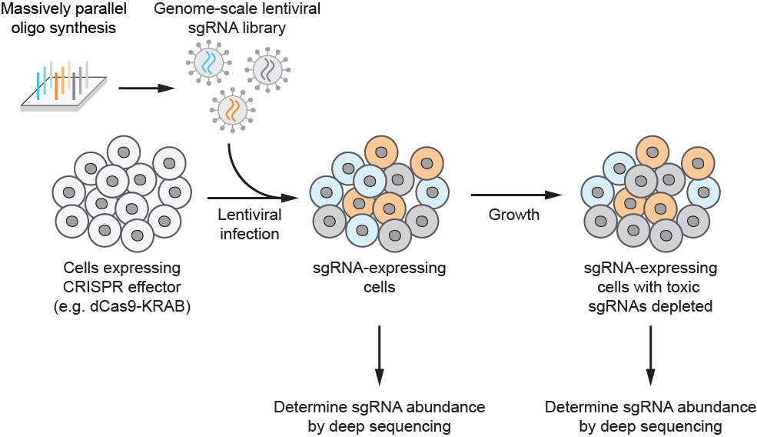
Growth-based CRISPR screens identify genes essential for growth
Shalem et al., Science 2014, 343, 84
Wang et al., Science 2014, 343, 80
Gilbert, Horlbeck et al., Cell 2014, 159, 647

Slide 24
Growth-based CRISPR screens identify genes essential for growth
Shalem et al., Science 2014, 343, 84
Wang et al., Science 2014, 343, 80
Gilbert, Horlbeck et al., Cell 2014, 159, 647

Slide 25
Growth-based CRISPR screens identify genes essential for growth
sgRNA abundance (endpoint)
no impact on growth
sgRNA abundance (endpoint)
detrimental to growth
Shalem et al., Science 2014, 343, 84
Wang et al., Science 2014, 343, 80
Gilbert, Horlbeck et al., Cell 2014, 159, 647
Notes:
sgRNAs targeting essential genes will deplete during growth

Slide 26
Growth-based CRISPR screens identify genes essential for growth
Shalem et al., Science 2014, 343, 84
Wang et al., Science 2014, 343, 80
Gilbert, Horlbeck et al., Cell 2014, 159, 647

Slide 27
Comparing gene essentiality across cell types can identify cancer-specific vulnerabilities
WRN is uniquely essential in microsatellite unstable cancers.
WRN inhibitors are now in development in the clinic.
Behan et al., Nature 2019, 568, 511
Chan et al., Nature 2019, 568, 551

Slide 28
Clustering genes by patterns of essentiality can reveal functions of genes of unknown function
TMEM189 clusters with genes involved in plasmalogen biosynthesis.
Wainberg et al., Nature Genetics 2021, 53, 638
TMEM189 independently characterized in Gallego-Garcia et al., Science 2019, 366, 128

Slide 29
Clustering genes by patterns of essentiality can reveal functions of genes of unknown function
C15orf57 clusters with genes involved in clathrin-mediated endocytosis.
Wainberg et al., Nature Genetics 2021, 53, 638
Notes:
C15orf57 turns out to be a regulator of clathrin-mediated endocytosis and specifically is required for endocytosis of transferrin

Slide 30
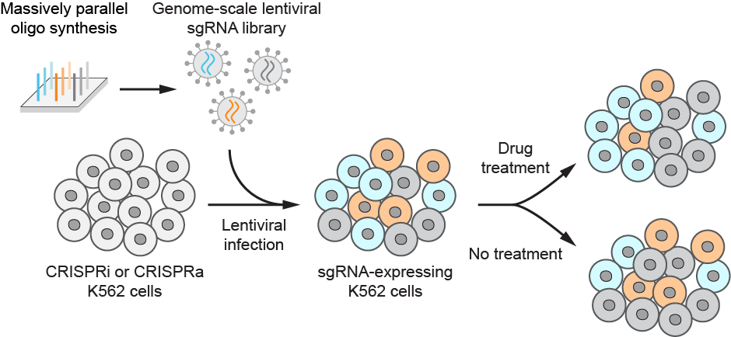
CRISPR screens for sensitivity to a bioactive agent identify genes in the targeted pathway

Slide 31
CRISPR screens for sensitivity to a bioactive agent identify genes in the targeted pathway
sgRNA abundance (treated)
sensitized to treatment
sgRNA abundance (treated)
protected against treatment

Slide 32
CRISPR screens for sensitivity to a bioactive agent identify genes in the targeted pathway
Knockout of oligosaccharyl transferase protects cells from Dengue virus infection.
This turns out to be because assembly of the Dengue virus replication machinery requires OST, likely as a structural scaffold.
Marceau, Puschnik et al., Nature 2016, 535, 159
Notes:
Similar for drugs – mechanisms of action of drugs or of resistance to chemotherapeutics

Slide 33
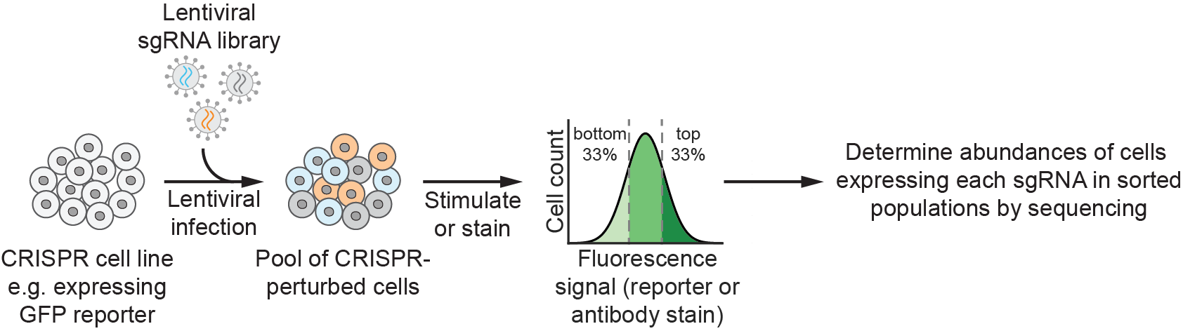
CRISPR screens for the magnitude of biological responses can identify regulators of signaling pathways
Possible approaches:
GFP fused to promoter of a gene of interest
Antibody stain for expression levels of a gene of interest
Fluorogenic small molecules e.g. for Ca²⁺ levels

Slide 34
CRISPR screens for the magnitude of biological responses can identify regulators of signaling pathways
Pusapati et al., Dev Cell 2018, 44, 113

Slide 35
Screens in primary cells identify aspects of tissue-specific cell biology
Saposin is required for lipid and redox homeostasis in human neurons.
Tian et al., Nature Neuroscience 2021, 24, 1020
Notes:
similar for T-cells

Slide 36
The value of different CRISPR modalities
CRISPR knockout, knockdown, and overexpression can provide different and complementary information
overexpression is gain-of-function – very few other approaches are available to do this systematically
knockout and knockdown both confer loss-of-function, but have different strengths and weaknesses

Slide 37
CRISPRi or CRISPR cutting, in brief
CRISPR cutting:
Cutting leads to a heterogeneous distribution of expression levels.
Cells with cutting in both alleles have complete loss of function. This enhances sensitivity for weak phenotypes.
But we cannot easily look at functions of essential genes.
CRISPRi
Knockdown leads to a homogeneous distribution of expression levels.
Partial loss-of-function allows us to study roles of essential genes in a biological process.
But if knockdown is too weak, we will not detect any phenotype.
Note: CRISPRi is also titratable – with the right approach, we can deplete genes by 20%, 50%, and 80% and ask what happens. (Jost, Santos et al., Nature Biotech 2020)
Shalem et al., Nature Reviews Genetics 2015, 16, 299
Notes:
CRISPR cutting suffers from non-specific toxicity, especially in genomically amplified regions
CRISPRi suffers from non-specific effects at bidirectional promoters (and potentially from false negatives for genes that are refractory to silencing)

Slide 38
Review: applications of CRISPR screens
identify genes essential for growth under specific conditions
define mechanisms of action of small molecules
identify genes that alter susceptibility to infectious agents
identify regulators of a signaling pathway
and many more

Slide 39
These screens generally produce a single “number” for each gene, i.e. their information content is low. Defining why a gene produces a given phenotype often requires extensive follow-up.
Methods to improve the information content of CRISPR screens expand biological insight. Examples:
Integrating data from multiple screens
Genetic interaction mapping
CRISPR screens with RNA-seq readout: perturb-seq
CRISPR screens with microscopy readout: pooled optical screens

Slide 40
Genetic interactions can provide deep information on gene function and pathway architecture
Horlbeck et al., Cell 2018, 174, 953
Notes:
synthetic lethality etc

Slide 41
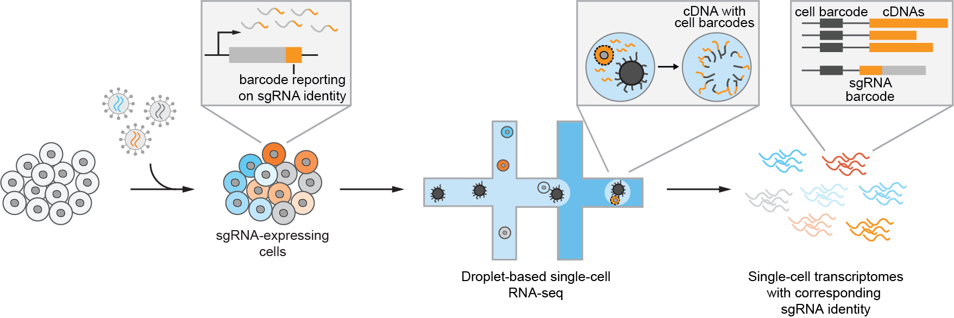
Perturb-seq: CRISPR-mediated screening with complex single-cell phenotypes (scRNA-seq)
Dixit, Parnas et al., Cell 2016, 167, 1853
Adamson, Norman et al., Cell 2016, 167, 1867

Slide 42
Perturb-seq: CRISPR-mediated screening with complex single-cell phenotypes (scRNA-seq)
C7orf26 is a novel component of the integrator complex.
Knockdown of different components of the integrator complex leads to different transcriptional phenotypes.
Replogle, Saunders et al., Cell 2022, 185, 1
Notes:
integrator is required for biogenesis of small nuclear RNAs (e.g. spliceosome components)
this revealed that integrator contains different modules that are functionally and biochemically somewhat distinct

Slide 43
Pooled optical screens: CRISPR-mediated screening with complex single-cell phenotypes (microscopy)
Feldman, Singh et al., Cell 2019, 179, 787

Slide 44
Topics not covered
how CRISPR enables interrogation of the non-coding genome
how CRISPR-mediated saturation mutagenesis, base editing, and prime editing allow for amino acid-specific dissection of protein function
in vivo screens using CRISPR
genetic interaction mapping
and many others

Slide 45
Useful resources
Literature:
Jinek et al. Science 2012
Gilbert, Horlbeck et al. Cell 2014
Doench. Nature Reviews Genetics 2017
Jost and Weissman. ACS Chemical Biology 2017
Kampmann. ACS Chemical Biology 2018
Hanna and Doench. Nature Biotech 2020
Przybyla and Gilbert. Nature Reviews Genetics 2021
Other resources:
Videos from Innovative Genomics Institute (IGI) CRISPR workshops: https://innovativegenomics.org/crispr-workshop-video-collection/

Slide 47
Workflow of a screen
1) identify biological question and establish screen design
2) validate cell model
3) select/generate sgRNA library
4) transduce cells with sgRNA library
5) apply selective pressure
6) harvest samples before and after pressure
7) count sgRNAs by next-gen sequencing
8) analyze data and identify hits

Slide 48
CRISPRi or CRISPR cutting?
 | CRISPRi | CRISPR cutting
Mechanism of gene disruption | Transcriptional repression resulting in partial or nearly complete loss-of-function | Frame-shift or other loss-of-function indel resulting in complete loss of function
Behavior across population | Usually homogeneous | Heterogeneity resulting from repair mechanisms and incomplete cutting of alleles
Behavior with essential genes | Enables study of phenotypes resulting from partial loss-of-function or reduced expression | Homozygous loss-of-function is lethal; heterozygous editing can lead to partial loss-of-function but suffers from heterogeneity
Reversibility | Reversible | Irreversible; can generate clonal deletion lines
Titrability | Titratable knockdown by modulating sgRNA strength | Difficult
sgRNA targeting | Near transcription start site | Usually first exon; ideally conserved/functionally relevant region
Non-specific effects | At bi-directional promoters | Gene-independent toxicity when targeting amplified regions

Slide 49
Pairing genetic screens enhances information content
knockdown slows cell growth
overexpression slows cell growth
Gilbert, Horlbeck et al., Cell 2014, 159, 647

Slide 50
dCas9 efficiently blocks transcription in bacteria
initial demonstration in E. coli
Qi et al., Cell 2013, 152, 1173
optimized inducible system in B. subtilis
Peters et al., Cell 2016
With appropriate engineering of dCas9, CRISPRi works in almost any bacterial species.
But in human cells, dCas9 alone only mediates ~50% transcriptional repression.
Notes:
M. tuberculosis: Rock et al., Nature Microbiology 2017

Slide 51
Fusions of dCas9 and KRAB domains mediate strong gene knockdown
original construct contains KRAB from Kox1 in a dCas9-BFP-KRAB(Kox1) fusion
Recent work suggests that KRAB from Zim3 outperforms KRAB from Kox1
Gilbert et al., Cell 2013, 154, 442
Alerasool et al., Nature Methods 2020, 17, 1093

Slide 52
CRISPRa comes in multiple flavors
Best CRISPRa activity achieved by delivering multiple transcriptional activators
Chavez et al., Nat. Methods 2016, 13, 563
Notes:
VP64 = four copies of VP16; VP16 = herpes virus transcriptional activation domain
P65 = activation domain of P65

Slide 53
CRISPRa using SunTag
co-express 2 components:
dCas9-SunTag_{10x} fusion (SunTag = repeats of an epitope tag)
cognate scFV fused to VP64
Tanenbaum et al., Cell 2014, 159, 635
Gilbert et al., Cell 2014, 159, 647
Notes:
VP64 = 4 tandem copies of VP16
VP16 = herpes simplex viral protein 16

Slide 54
CRISPRa using SAM (synergistic activation mediator)
express sgRNA with modified constant region (contains 2 MS2BP aptamers)
co-express dCas9-VP64 and MS2BP-p65-hsf1
Konermann et al., Nature 2015, 517, 583
Notes:
p65: RelA, transactivation domain of the nuclear form of NF-kB
hsf1 = heat shock factor 1

Slide 55
CRISPRa using VPR (VP64, p65, RTA)
express single dCas9-VPR construct
Chavez et al., Nat. Methods 2015, 12, 326
Notes:
p65: RelA, transactivation domain of the nuclear form of NF-kB
Rta: Eppstein-Barr virus R transactivator

