Slide 1
CRISPR-mediated genetic screens: principles and applications
Nolan Maier
2025 Genetics Bootcamp

Slide 2
Agenda for today’s lecture
Principles of genetic screens
Why CRISPR has revolutionized genetic screens
CRISPR knockout, knockdown, and overexpression
Selected applications of CRISPR screens

Slide 3
What is a genetic screen?
A genetic screen is a method to identify genetic bases for a phenotype of interest, by introducing genetic changes and asking how these changes affect the phenotype.
What does one need to perform a genetic screen?
a phenotype of interest that is readily observable
a way to introduce genetic changes (“genetic perturbations”)
a way to map which genes are perturbed in individuals that have the phenotype of interest

Slide 4
Classical “forward genetic screens” were pioneered in bacteria, yeast, and small animals
forward genetics: introduce random mutations -> test phenotypes -> map genes
Jones et al., Nature Reviews Drug Discovery 2005, 4, 321

Slide 5
Sequence-based genetic reagents allow for “reverse genetic screens”
reverse genetics: perturb defined genes -> measure phenotypes
Sequence-based genetic reagents that are also scalable/programmable allow for genome-scale genetic screens.
The first method to enable this was RNA interference (RNAi).
Mohr et al., Nature Reviews Molecular Cell Biology 2014, 15, 591

Slide 6
CRISPR/Cas: an adaptive bacterial (and archaeal) immune system
e.g. Cas9
CRISPR: clustered regularly-interspaced short palindromic repeats
Cas: CRISPR-associated
Wright et al., Cell 2016, 164, 29

Slide 7
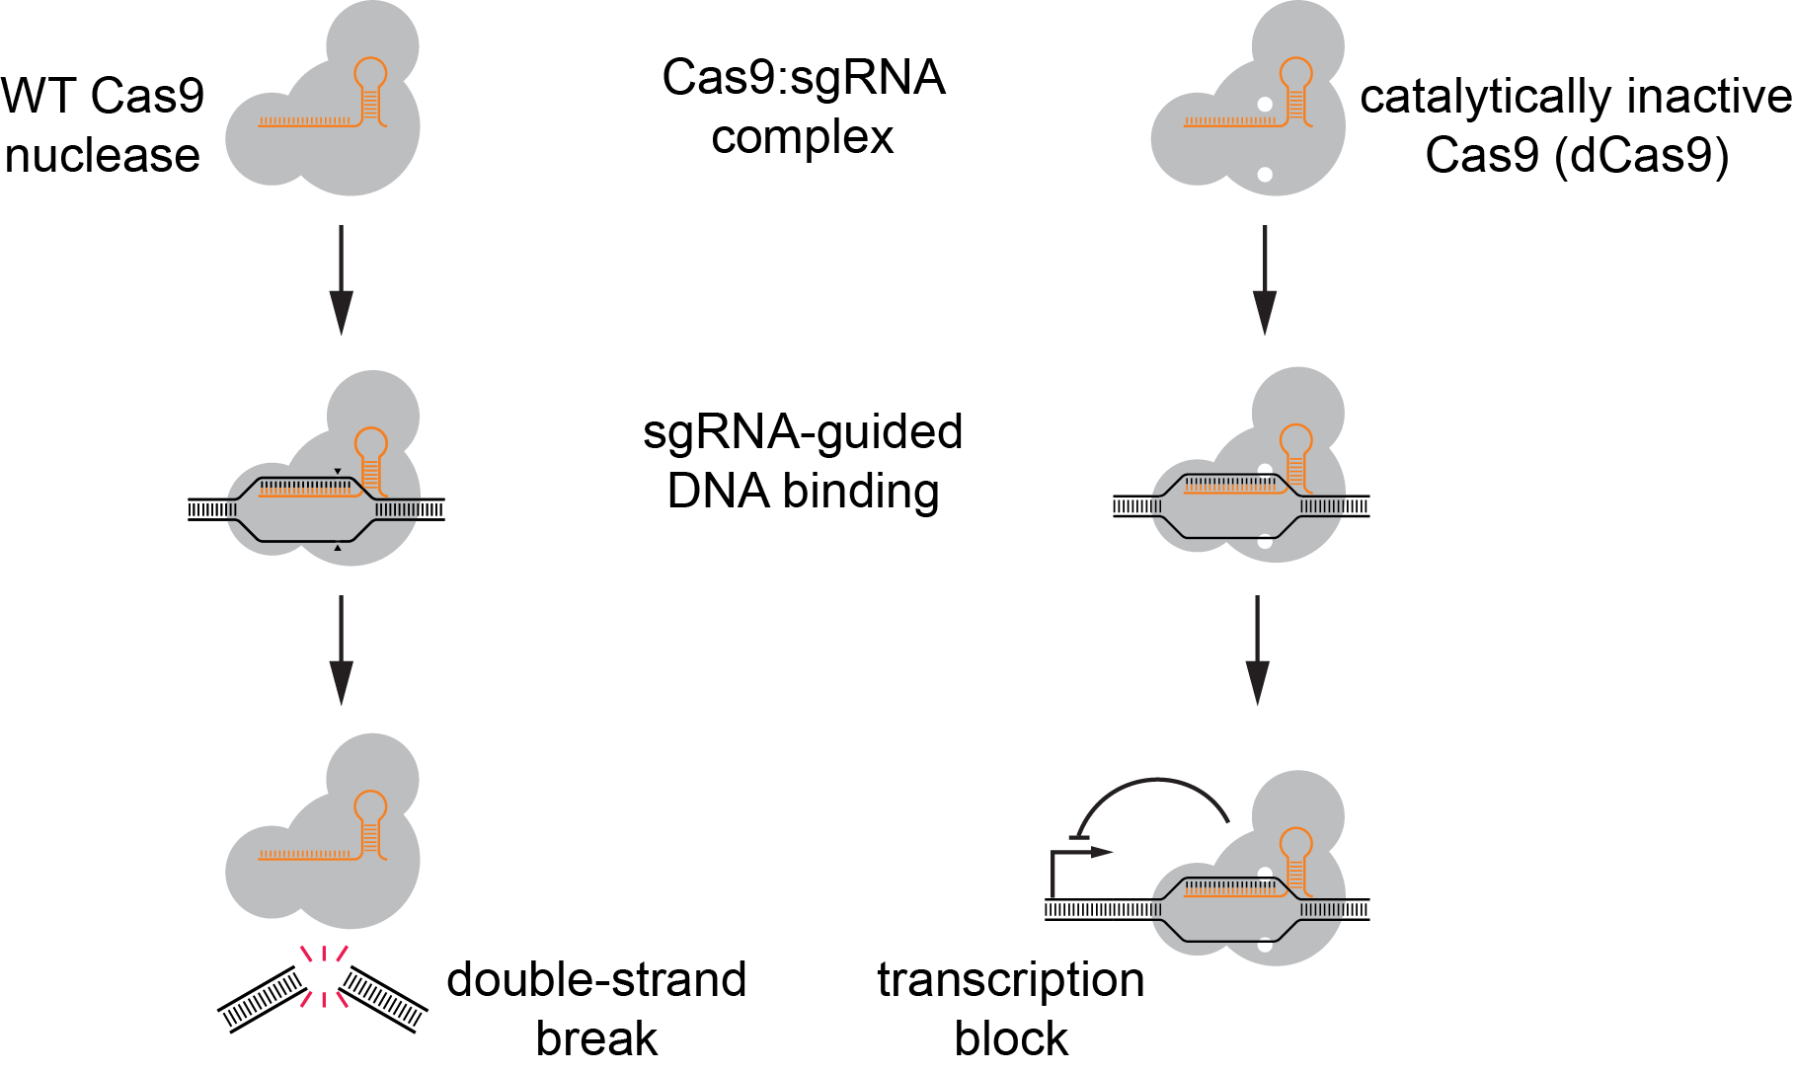
Cas9 is a programmable nuclease
Cas9 usually from Streptococcus pyogenes (SpCas9)
Jinek et al., Science 2012, 337, 816

Slide 8
Cas9 is targeted by sequence complementarity to a bound guide RNA
Key features of Cas9:
Programmability: sequence of the RNA determines what DNA sequence Cas9 binds
Nuclease activity: Cas9 introduces a double-strand DNA break
Simplicity: a single protein contains all activities; a single RNA is sufficient to guide Cas9
Cas9 is a highly and easily programmable nuclease.
DNA target
Jinek et al., Science 2012, 337, 816

Slide 9
Cas9 is a programmable nuclease
This is generally called “CRISPR cutting” or “CRISPR nuclease (CRISPRn)”.
In mammalian cells, CRISPR cutting often leads to knockout of the targeted gene.
Jinek et al., Science 2012, 337, 816

Slide 10
A catalytically inactive mutant of Cas9 (dCas9) is a programmable DNA-binding protein
Jinek et al., Science 2012, 337, 816
Qi et al., Cell 2013, 152, 1173

Slide 11
Fusion proteins of dCas9 enable knockdown and overexpression of genes in mammalian cells
knockdown (CRISPRi): dCas9 fused to transcriptional repressor domain (dCas9-KRAB / newest iteration: dCas9-Zim3)
overexpression (CRISPRa): dCas9 fused to transcriptional activator domains (multiple flavors)
Gilbert et al., Cell 2013, 154, 442
Tanenbaum et al., Cell 2014, 159, 635
Notes:
KRAB: Kruppel-associated box from Kox1, recruits transcriptional repressors through KAP-1; in particular histone deacetylases and histone lysine methyltransferases; trigger spread of heterochromatin

Slide 12
With CRISPR cutting, CRISPRi, and CRISPRa, one can knock out, knock down, or overexpress any gene in the human genome. This allows for very efficient genetic screens that can approach saturation.

Slide 13
For a CRISPR screen in human cells, we need to introduce a Cas9 effector as well as sgRNAs targeting many different genes.
We can do this in 2 main ways:
one sgRNA per well -> arrayed screen
many different sgRNAs in a population of cells -> pooled screen

Slide 14
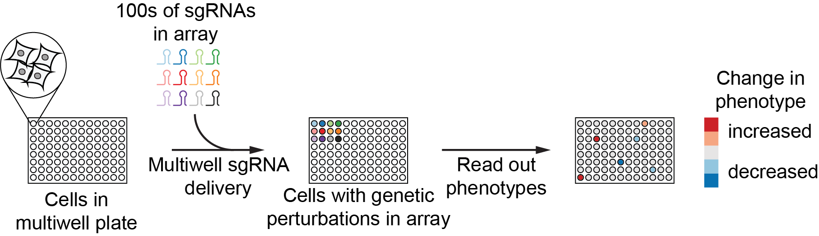
Principle of arrayed screens
Cells are grown in multi-well plates; each well contains a different sgRNA. Phenotypes are read out for each well.

Slide 15
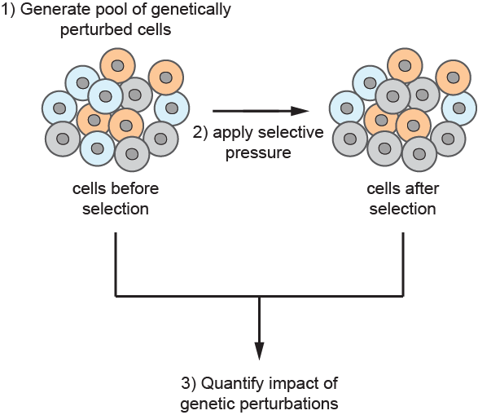
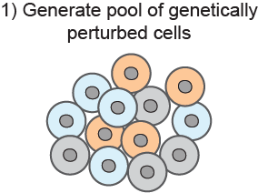
Principle of pooled screens
Cells with many different sgRNAs are grown together in a single vessel.
Phenotypes are measured by quantifying abundances of cells expressing each individual sgRNA after application of a selective pressure.

Slide 16
Principle of pooled screens
Cells with many different sgRNAs are grown together in a single vessel. Phenotypes are measured by quantifying abundances of cells expressing each individual sgRNA after application of a selective pressure.

Slide 17
Why CRISPR-based pooled screens are feasible
sgRNA sequence specifies which gene is perturbed

Slide 18
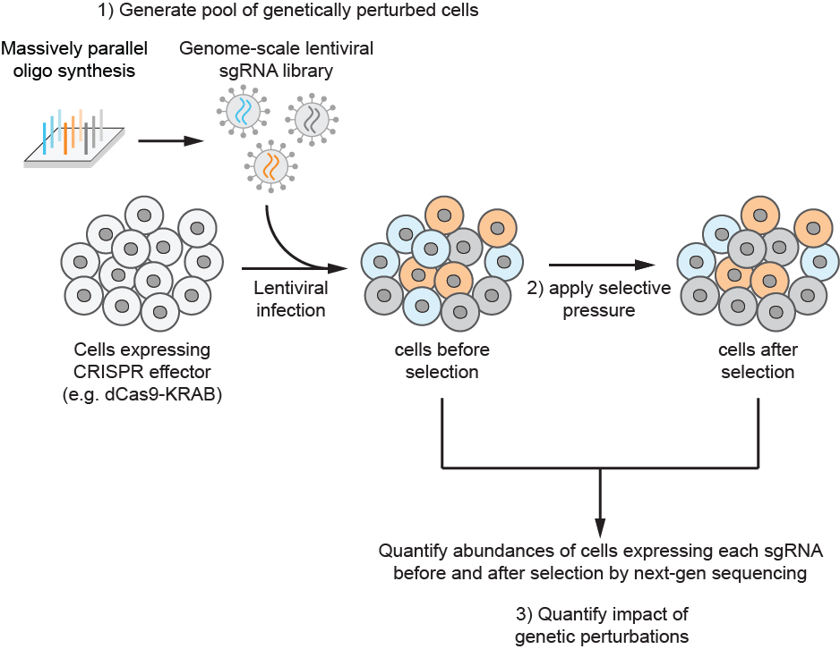
Why CRISPR-based pooled screens are feasible
sgRNA sequence specifies which gene is perturbed
we can synthesize sgRNAs targeting many (or all) genes in the genome
we can integrate constructs to stably express sgRNAs using lentivirus, such that each cell carries the identity of the perturbation in its genome (“barcode”)

Slide 19
Why CRISPR-based pooled screens are feasible
sgRNA sequence specifies which gene is perturbed
we can synthesize sgRNAs targeting many (or all) genes in the genome
we can integrate constructs to stably express sgRNAs using lentivirus, such that each cell carries the identity of the perturbation in its genome (“barcode”)
we can count the number of cells expressing each sgRNA in each population by deep sequencing

Slide 20
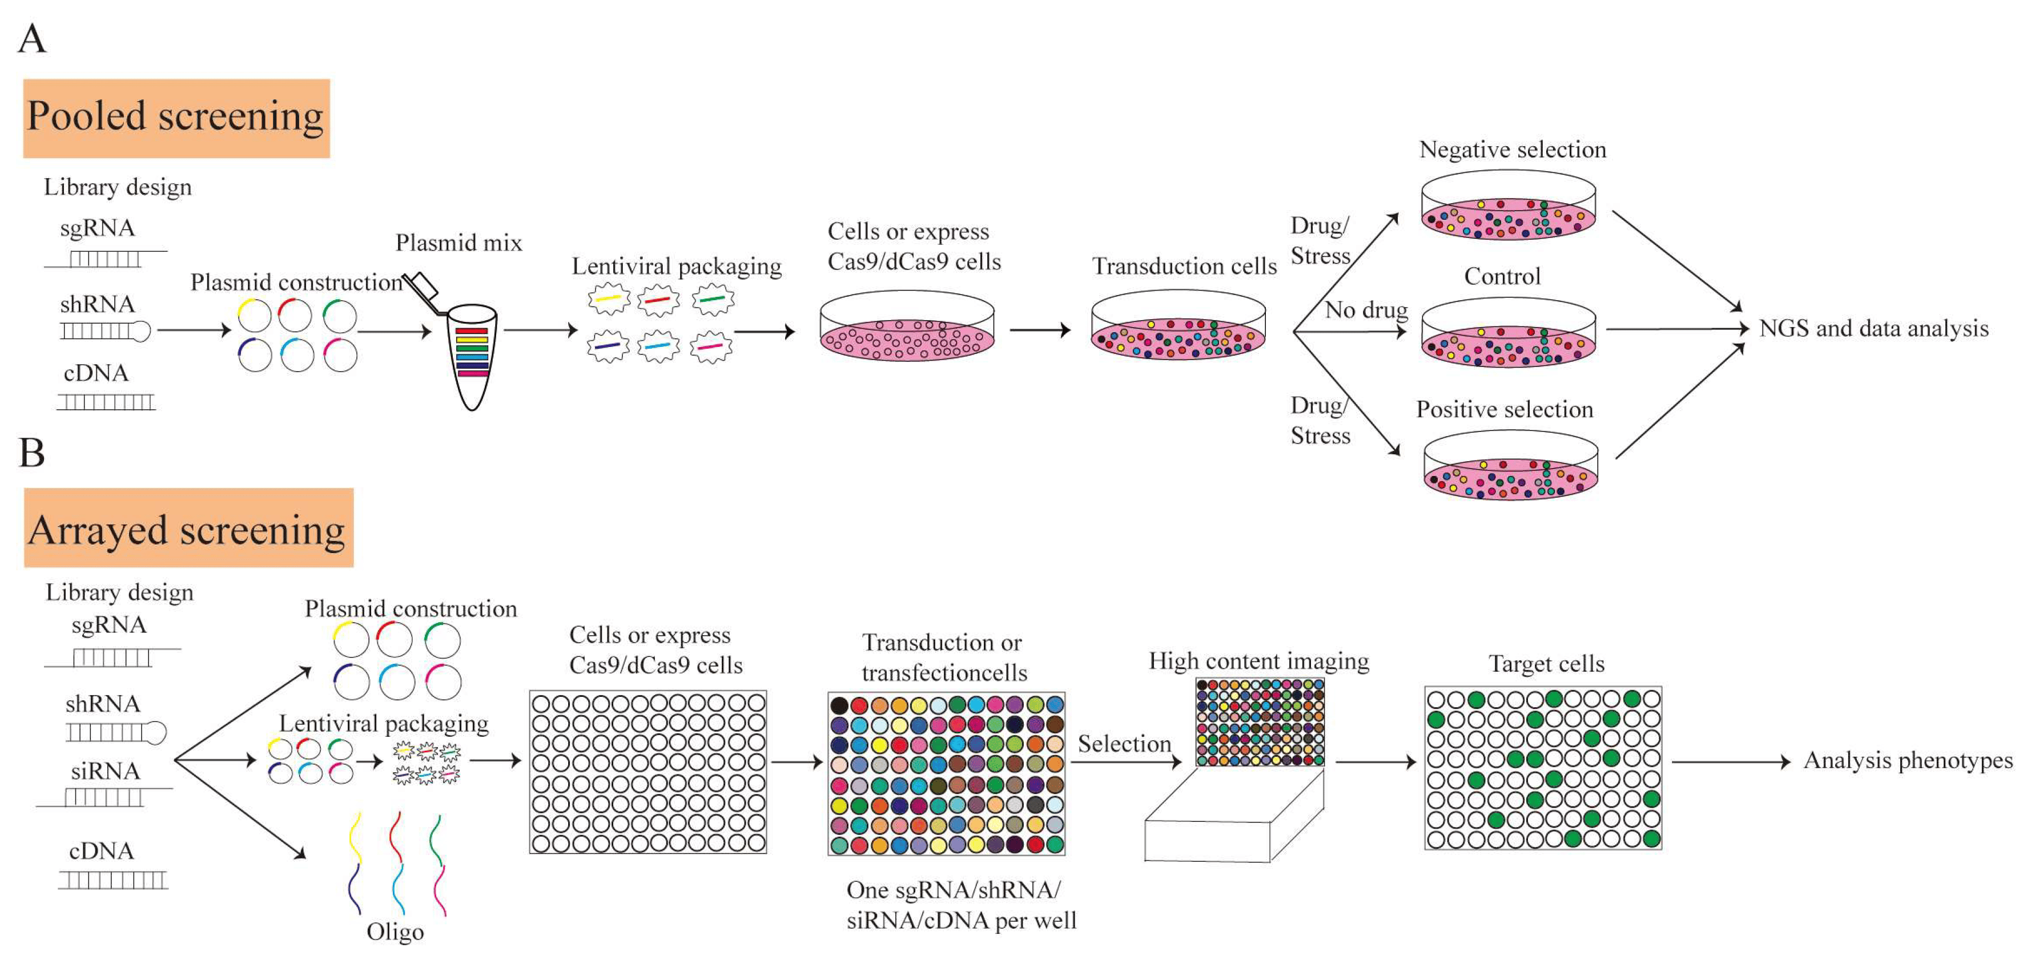
Arrayed and pooled genetic screens
Yang et al., 2024 Int. J. Mol. Sci.

Slide 21
A genome-wide pooled screens requires hundreds of millions of cells
This is a lot!
# genes
20,000
# sgRNAs per gene
10
# cells per sgRNA
1,000
# cells in the screen
200 Million

Slide 22
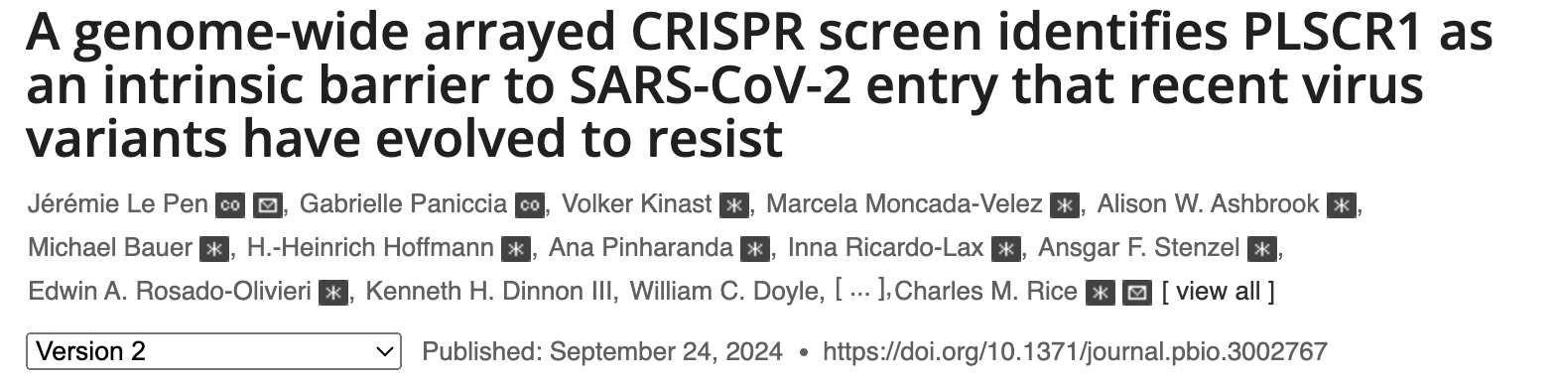
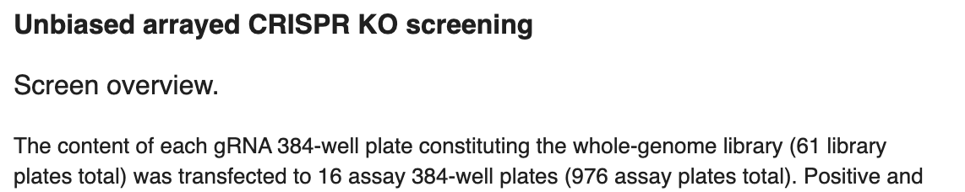

Whole genome arrayed CRISPR screens can be logistically challenging…
976 assay plates = 374,784 individual wells
30,000 cells/well = 11,243,520,000 cells

Slide 23
Types of phenotypes that can we screen for in a pooled screen
Readily screenable phenotypes
growth
sensitivity to a chemical, biologic, or infectious agent
induction of a biological response
physical separation (migration, adhesion, biofilm, ...)
change in cell size or shape (sporulation, differentiation, …)
More difficult
transcriptional state
complex aspects of cell morphology
Essentially impossible with pooled screens but accessible with arrayed screens
non-cell autonomous phenotypes (hormone secretion, cell-cell contacts)
dynamic phenotypes

Slide 24
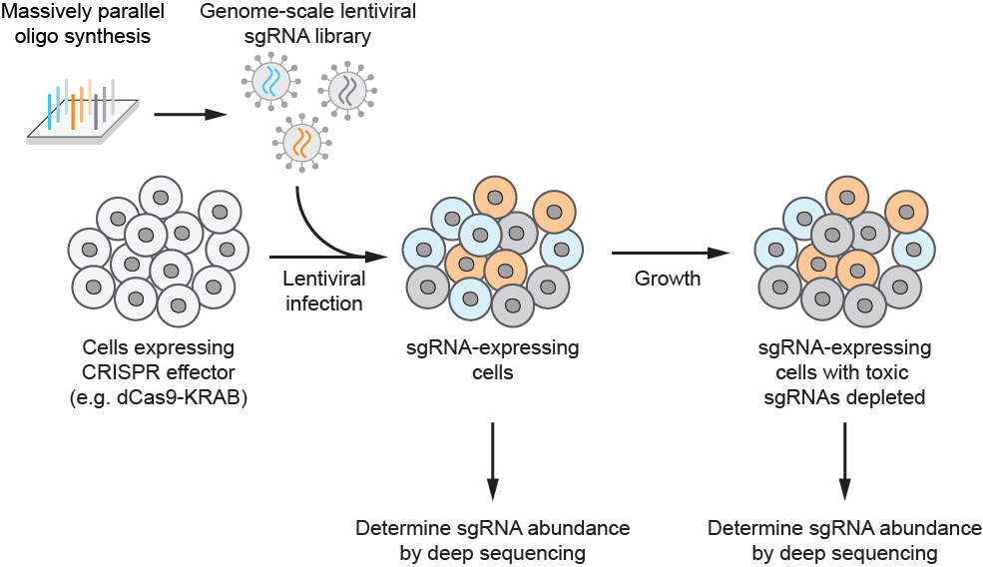
Growth-based CRISPR screens identify genes essential for growth
Shalem et al., Science 2014, 343, 84
Wang et al., Science 2014, 343, 80
Gilbert, Horlbeck et al., Cell 2014, 159, 647

Slide 25
Growth-based CRISPR screens identify genes essential for growth
sgRNA abundance (endpoint)
no impact on growth
sgRNA abundance (endpoint)
detrimental to growth
Shalem et al., Science 2014, 343, 84
Wang et al., Science 2014, 343, 80
Gilbert, Horlbeck et al., Cell 2014, 159, 647

Slide 26
Growth-based CRISPR screens identify genes essential for growth
sgRNA abundance (endpoint)
no impact on growth
sgRNA abundance (endpoint)
detrimental to growth
Shalem et al., Science 2014, 343, 84
Wang et al., Science 2014, 343, 80
Gilbert, Horlbeck et al., Cell 2014, 159, 647

Slide 27
Growth-based CRISPR screens identify genes essential for growth
Shalem et al., Science 2014, 343, 84
Wang et al., Science 2014, 343, 80
Gilbert, Horlbeck et al., Cell 2014, 159, 647

Slide 28
Comparing gene essentiality across cell types identifies cancer-specific vulnerabilities
WRN is uniquely essential in microsatellite unstable cancers.
WRN inhibitors are now in development in the clinic.
Behan et al., Nature 2019, 568, 511
Chan et al., Nature 2019, 568, 551

Slide 29
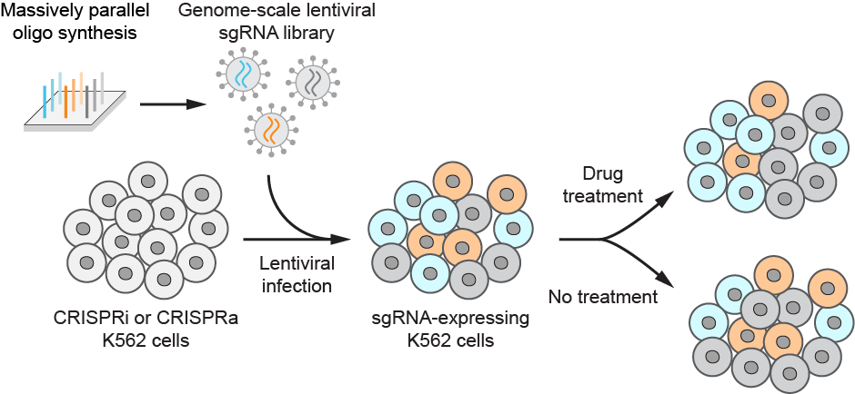
CRISPR screens for sensitivity to a bioactive agent identify genes in the targeted pathway

Slide 30
CRISPR screens for sensitivity to a bioactive agent identify genes in the targeted pathway
sgRNA abundance (treated)
sensitized to treatment
sgRNA abundance (treated)
protected against treatment

Slide 31
CRISPR screens for sensitivity to a bioactive agent identify genes in the targeted pathway
Knockout of oligosaccharyl transferase protects cells from Dengue virus infection.
This turns out to be because assembly of the Dengue virus replication machinery requires OST, likely as a structural scaffold.
Marceau, Puschnik et al., Nature 2016, 535, 159
Notes:
OST is responsible for N-linked glycosylation
Might think that Dengue requires this
But no, catalytic activity of OST not required!

Slide 32
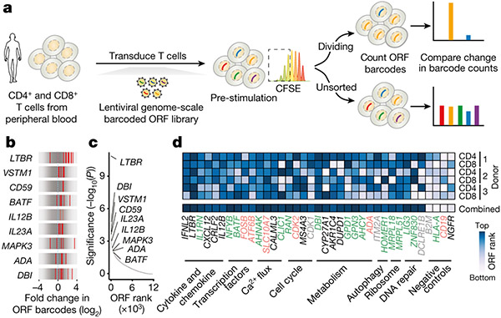
CRISPR overexpression can identify genes contributing to proliferation
Legut et al., Nature 2022, 603, 728
Notes:
Genome wide vs genome scale

Slide 33
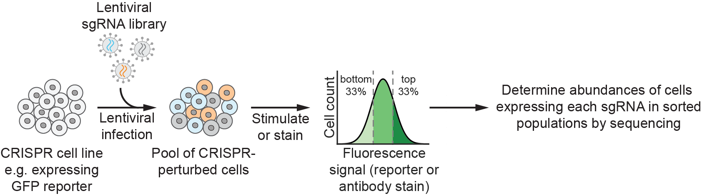
CRISPR screens for the magnitude of biological responses can identify regulators of signaling pathways

Slide 34
These screens generally produce a single “number” for each gene, i.e. their information content is low. Defining why a gene produces a given phenotype often requires extensive follow-up.
Methods to improve the information content of CRISPR screens expand biological insight. Examples:
Integrating data from multiple screens
Genetic interaction mapping
High-content readouts:
CRISPR screens with RNA-seq readout (perturb-seq)
CRISPR screens with microscopy readout (pooled optical screens)

Slide 35
Clustering genes by patterns of essentiality reveals functions of genes of unknown function
TMEM189 clusters with genes involved in plasmalogen biosynthesis.
Wainberg et al., Nature Genetics 2021, 53, 638
TMEM189 independently characterized in Gallego-Garcia et al., Science 2019, 366, 128

Slide 36
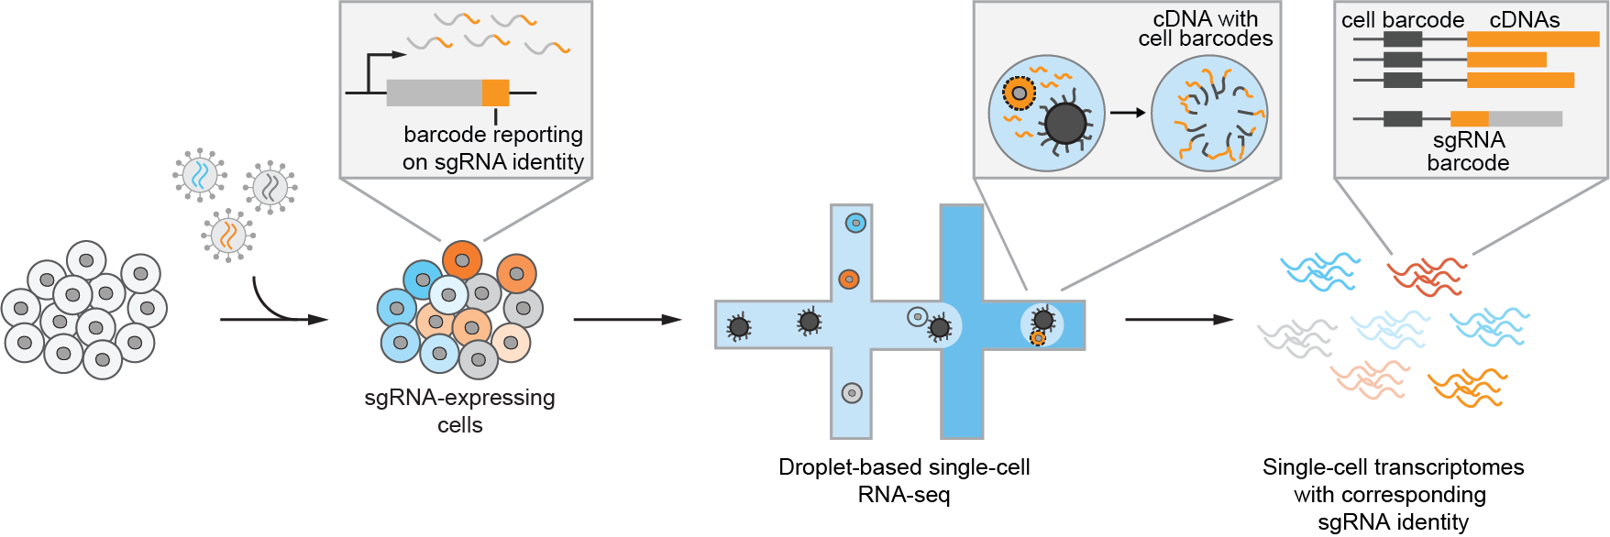
Perturb-seq: CRISPR-mediated screening with complex single-cell phenotypes (scRNA-seq)
Adamson, Norman et al., Cell 2016, 167, 1867; Dixit, Parnas et al., Cell 2016, 167, 1853;
Jaitlin, Weiner, Yofe et al., Cell 2016, 167, 1883; Datlinger et al, Nat. Methods 2017, 14, 297

Slide 37
Perturb-seq: CRISPR-mediated screening with complex single-cell phenotypes (scRNA-seq)
Adamson, Norman et al., Cell 2016, 167, 1867; Dixit, Parnas et al., Cell 2016, 167, 1853;
Jaitlin, Weiner, Yofe et al., Cell 2016, 167, 1883; Datlinger et al, Nat. Methods 2017, 14, 297

Slide 38
Perturb-seq: CRISPR-mediated screening with complex single-cell phenotypes (scRNA-seq)
C7orf26 is a novel component of the integrator complex.
Knockdown of different components of the integrator complex leads to different transcriptional phenotypes.
Replogle, Saunders et al., Cell 2022, 185, 1
Notes:
integrator is required for biogenesis of small nuclear RNAs (e.g. spliceosome components)
this revealed that integrator contains different modules that are functionally and biochemically somewhat distinct

Slide 39
Pooled optical screens: CRISPR-mediated screening with complex single-cell phenotypes (microscopy)
Feldman, Singh et al., Cell 2019, 179, 787

Slide 40
The value of different CRISPR modalities
CRISPR knockout, knockdown, and overexpression can provide different and complementary information
overexpression is gain-of-function – very few other approaches are available to do this systematically
knockout and knockdown both confer loss-of-function, but have different strengths and weaknesses

Slide 41
Topics not covered
sgRNA design
how CRISPR enables interrogation of the non-coding genome
CRISPR-mediated saturation mutagenesis, base editing, and prime editing and applications in amino acid-specific dissection of protein function
in vivo screens using CRISPR
and many others

Slide 42
Useful resources
Literature:
Jinek et al. Science 2012
Gilbert, Horlbeck et al. Cell 2014
Doench. Nature Reviews Genetics 2017
Jost and Weissman. ACS Chemical Biology 2017
Kampmann. ACS Chemical Biology 2018
Hanna and Doench. Nature Biotech 2020
Przybyla and Gilbert. Nature Reviews Genetics 2021
Other resources:
Videos from Innovative Genomics Institute (IGI) CRISPR workshops: https://innovativegenomics.org/crispr-workshop-video-collection/

