Slide 1



Indiana Pacers 2024-25 Offseason Evaluation
Nolan Popp

Slide 2
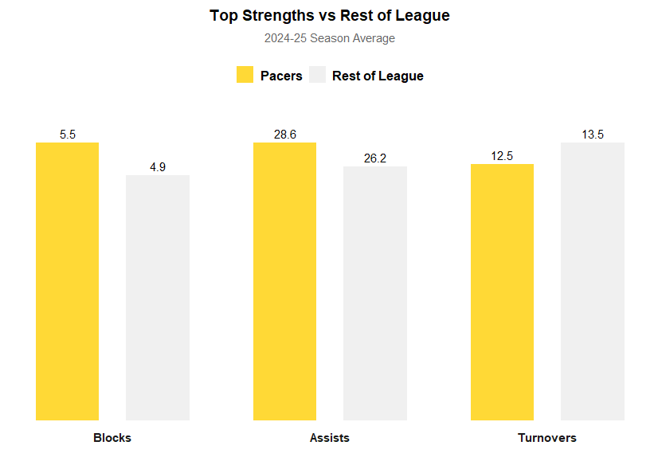
Blocks (+13.2%) – The Pacers average 13.2% more blocks than the league average, reflecting their active rim contests
Assists (+9.3%) – The Pacers are 9.3% above the league average in assists, showing strong ball movement
Turnovers (-7.5%) – The Pacers commit one fewer turnover per game than the league average, highlighting their strong ball security and smart decision making
Source: hoopR NBA Data

Slide 3
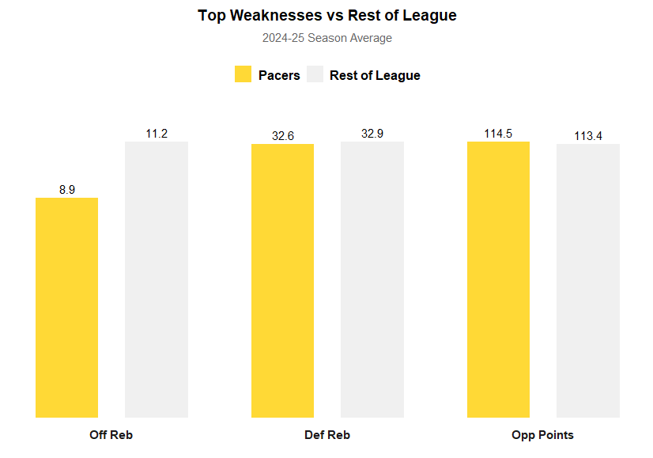
Offensive Rebounds (-20.3%) – The Pacers grab 20.3% fewer offensive rebounds than the league average, which limits second chance opportunities
Defensive Rebounds (-0.9%) – The Pacers average 0.9% fewer defensive rebounds than the league average, reinforcing their ongoing struggle to secure rebounds on both ends of the floor
Opponent Points Allowed (+0.9%) – Indiana allows 0.9% more points than the league average, suggesting that the defense remains as an area for improvement
Source: hoopR NBA Data

Slide 4
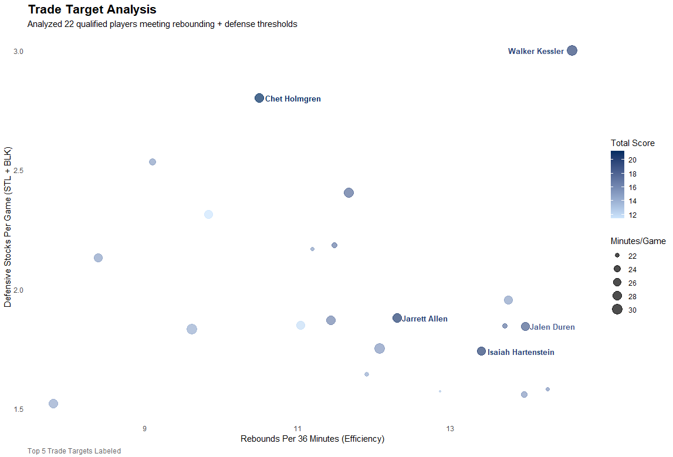
Total Score Calculation:
Rebounding = RPG + Reb/36
Defense = Stocks + Plus/Minus
Higher Score = Elite Rebounding & Defensive Versatility
Target Range = 20 - 32 MPG
Source: hoopR NBA Data

Slide 5
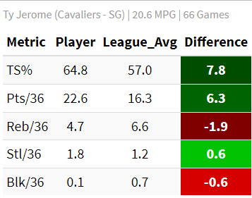
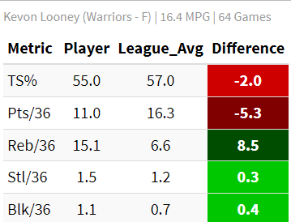
Ty Jerome – Undervalued Scoring Guard (CLE)
Kevon Looney – Undervalued Defensive Big (GS)
(Filtered for players averaging 15–28 minutes, 20+ games, and a positive plus/minus)
(Filtered for players averaging 15–28 minutes, 20+ games, and a positive plus/minus)
+7.8 TS% above league average, showing elite shooting efficiency and shot selection.
22.6 points per 36 minutes, well above the league average (16.3), indicating strong scoring impact in limited minutes.
+8.5 rebounds per 36 minutes above league average, ranking among the NBA’s most productive rebounders per minute.
Adds +0.4 blocks and +0.3 steals per 36 minutes, showing consistent defensive activity across rotations.
Source: hoopR NBA Data

