Slide 1
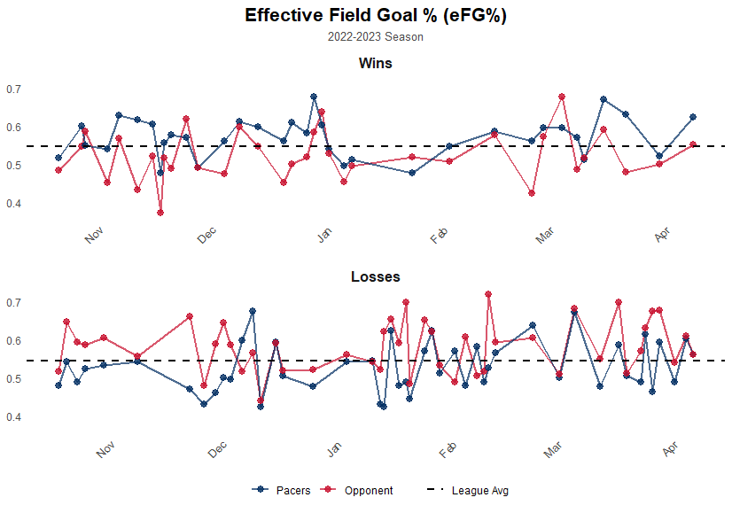

Slide 2
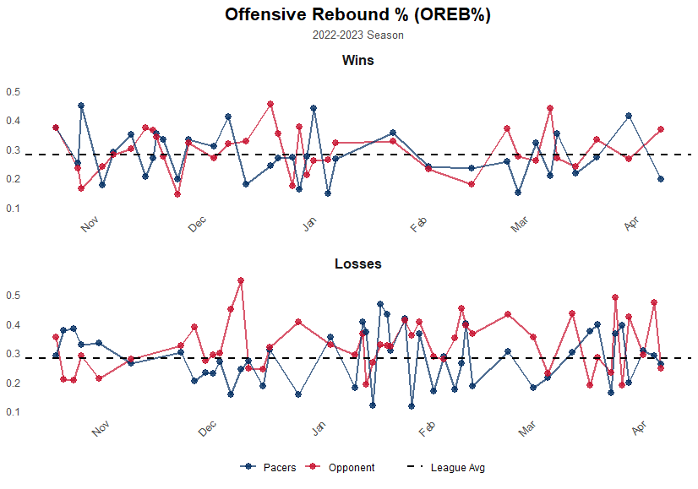

Slide 3
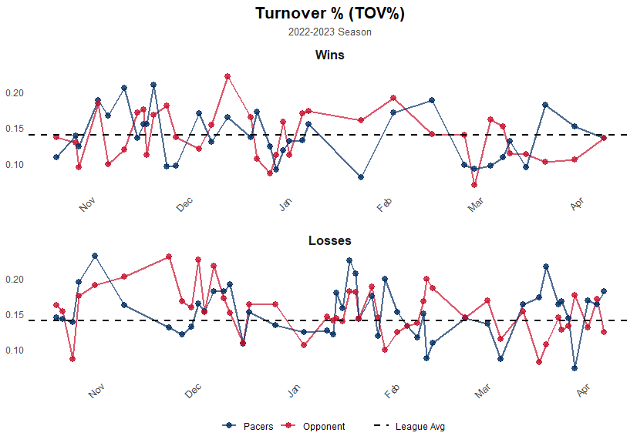

Slide 4
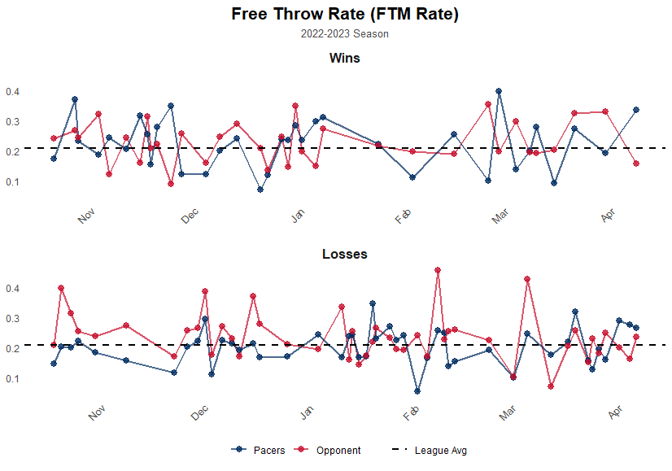

Slide 5
Four Factors Analysis: Wins vs Losses
Wins (35 Games):
eFG%: +4.87%
OREB%: -1.51%
TOV%: -0.11%
FTM Rate: -0.28%
Losses (47 Games):
eFG%: -5.39%
OREB%: -4.30%
TOV%: -0.11%
FTM Rate: -3.43%
eFG% was the only factor where the Pacers had a positive differential in wins. All other factors showed the team was outperformed regardless of game outcome

