Slide 1
Operating Systems CST-315
Topic 4 (2 weeks)
Memory Management
Chapters 7 and 8

Slide 2
Assignment 2: Monitors and Semaphores
Due February 13

Slide 3
Objectives
Manage memory resources to extend the memory available for processes to run.
Design, implement, and manage tables and frames.
Implement paging algorithms.

Slide 4
Introduction
Management
“The process of dealing with people.”
“The process of controlling things.”
Memory management is the process of controlling and coordinating computer memory.
It is not an easy topic.
There are many approaches and techniques to make it more efficient.

Slide 5
Introduction
Where can we find?
In hardware
In Operating Systems (OS)
In programs and applications
The distinction between areas become somehow fuzzy.
All three are present in Systems utilizing computers.

Slide 6
Memory Management In Hardware

Slide 7
What is Available
Electronic Devices to support data storage
DRAM (Dynamic Random-Access Memory).
SRAM (Static RAM)
DDR(1)(2)(3)(Double-Data-Rate Synchronous Dynamic Random Access Memory)
Caches
MMU (Memory Management Unit)
DMA (Direct Memory Access)

Slide 8
Architecture Example
Processor
AXI-LITE
DDR Memory Controller
AXI DMA
AXIS_MM2S
AXI Data FIFO
AXI_MM2S
AXIS_S2MM
AXI_S2MM

Slide 9
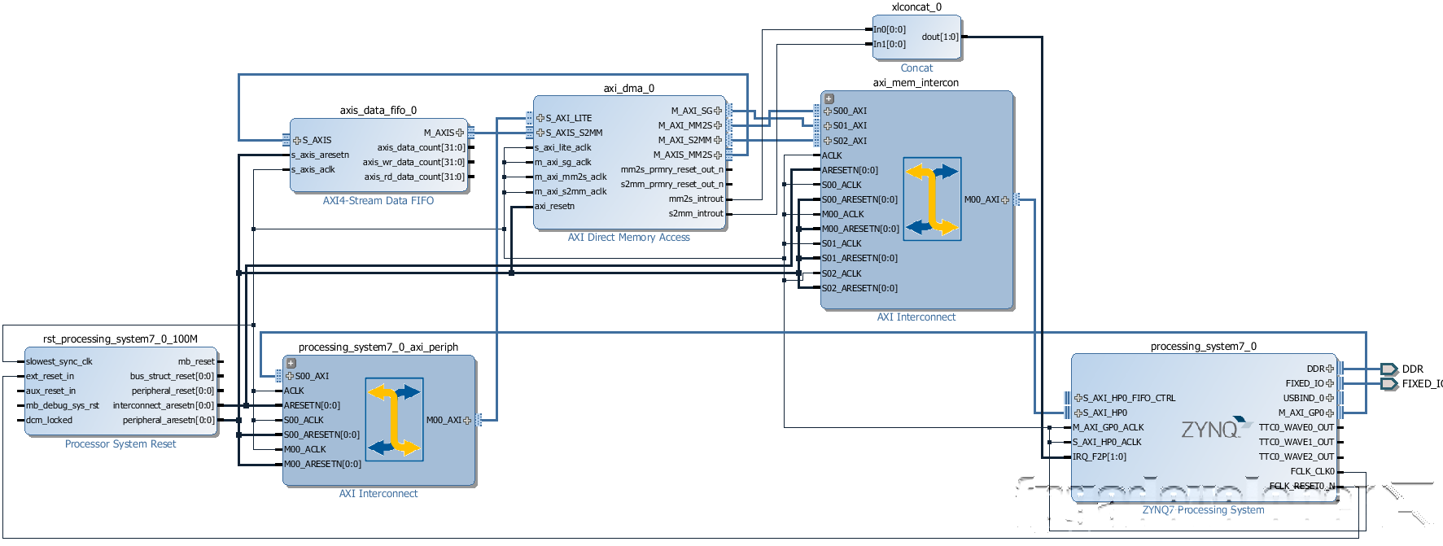
Block Design

Slide 10
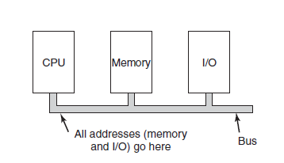
Architecture Example

Slide 11
Memory Management In Operating System (OS)

Slide 12
Background
What every programmer would like is a private, infinitely large, infinitely fast memory that is also nonvolatile, that is, does not lose its contents when the electric power is switched off.
Also, it must be inexpensive. Unfortunately, technology does not provide such memories at present.
Over the years, people discovered the concept of a memory hierarchy, in which computers have a few mega bytes of very fast, expensive, volatile cache memory, a few gigabytes of medium-speed, medium-priced, volatile main memory, and a few terabytes of slow, cheap, nonvolatile magnetic or
solid-state disk storage, not to mention removable storage, such as DVDs and USB sticks.
It is the job of the operating system to abstract this hierarchy into a useful model and then manage the abstraction.

Slide 13
Background
The part of the operating system that manages (part of) the memory hierarchy is called the memory manager. Its job is to efficiently manage memory: keep track of which parts of memory are in use, allocate memory to processes when they need it, and deallocate it when they are done.
In this topic we will investigate several different memory management models, ranging from very simple to highly sophisticated.
Since managing the lowest level of cache memory is normally done by the hardware, the focus of this topic will be on the programmer’s model of main memory and how it can be managed.
We will first look at the simplest possible schemes and then gradually progress to more and more elaborate ones.

Slide 14
Background
Different ways to manage memory in OS.
Bare Machine approach.
Paging.
Segmentation strategies.
Selection depends on hardware design.
Integration of hardware and OS is becoming more attractive.

Slide 15
Background
Program must be brought from disk/external storage unit into memory and placed within a process.
Process is an instance of a computer program.
Input queue or job queue – collection of processes on the disk that are waiting to be brought into memory to run the program
memory must be allocated to user programs and reused by other programs when it is no longer required.

Slide 16
In-Class Activity
Break in groups of 2 (your groups)
Read section 7.1 and 7.2 textbook (Chapter 7) and discuss with your fellow group member.

Slide 17
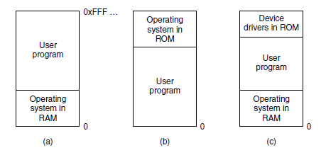
No Memory Abstraction
The simplest memory abstraction is to have no abstraction at all.
Early mainframe computers (before 1960), early minicomputers (before 1970), and early personal computers (before 1980) had no memory abstraction.
Every program simply saw the physical memory.
The operating system may be at the bottom of memory in RAM (Random Access Memory), as shown in Fig.(a), or it may be in ROM (Read-Only Memory) at the top of memory, as shown in Fig.(b), or the device drivers may be at the top of memory in a ROM and the rest of the system in RAM down below, as shown in Fig.(c).
Three simple ways of organizing memory with an operating system and one user process. Other possibilities also exist.

Slide 18
Running Multiple Programs Without a Memory Abstraction
Even with no memory abstraction, it is possible to run multiple programs at the same time.
What the operating system has to do is save the entire contents of memory to a disk file, then bring in and run the next program.
As long as there is only one program at a time in memory, there are no conflicts.
With the addition of some special hardware, it is possible to run multiple programs concurrently, even without swapping.
The early models of the IBM 360 solved the problem. Memory was divided into 2-KB blocks, and each was assigned a 4-bit protection key held in special registers inside the CPU.
A machine with a 1-MB memory needed only 512 of these 4-bit registers for a total of 256 bytes of key storage. The PSW (Program Status Word) also contained a 4-bit key.
The 360 hardware trapped any attempt by a running process to access memory with a protection code different from the PSW key.
Since only the operating system could change the protection keys, user processes were prevented from interfering with one another and with the operating system itself.

Slide 19
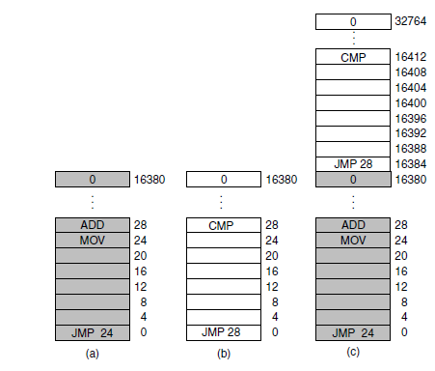
Running Multiple Programs Without a Memory Abstraction
Nevertheless, this solution had a major drawback, shown in Figure. Here we have two programs, each 16 KB in size, as shown in Fig.(a) and (b). The former is shaded to indicate that it has a different memory key than the latter.
The first program starts out by jumping to address 24, which contains a MOV instruction.

Slide 20
Running Multiple Programs Without a Memory Abstraction
The second program starts out by jumping to address 28, which contains a CMP instruction. The instructions that are not relevant to this discussion are not shown.
When the two programs are loaded consecutively in memory starting at address 0, we have the situation of Fig.(c).
After the programs are loaded, they can be run. Since they have different memory keys, neither one can damage the other.
But the problem is of a different nature. When the first program starts, it executes the JMP 24 instruction, which jumps to the instruction, as expected. This program functions normally.

Slide 21
Running Multiple Programs Without a Memory Abstraction
after the first program has run long enough, the operating system may decide to run the second program, which has been loaded above the first one, at address 16,384.
The first instruction executed is JMP 28, which jumps to the ADD instruction in the first program, instead of the CMP instruction it is supposed to jump to. The program will most likely crash in well under 1 sec.

Slide 22
Running Multiple Programs Without a Memory Abstraction
The core problem here is that the two programs both reference absolute physical memory. That is not what we want at all. What we want is that each program can reference a private set of addresses local to it.
What the IBM 360 did as a stop-gap solution was modify the second program on the fly as it loaded it into memory using a technique known as static relocation. It worked like this. When a program was loaded at address 16,384, the constant 16,384 was added to every program address during the load process (so ‘‘JMP 28’’ became ‘‘JMP 16,412’’, etc.).

Slide 23
Running Multiple Programs Without a Memory Abstraction
While this mechanism works if done right, it is not a very general solution and slows downloading. Furthermore, it requires extra information in all executable programs to indicate which words contain (relocatable) addresses and which do not.
history tends to repeat itself in the computer world. While direct addressing of physical memory is but a distant memory on mainframes, minicomputers, desktop computers, notebooks, and smartphones, the lack of a memory abstraction is still common in embedded and smart card systems.
Devices such as radios, washing machines, and microwave ovens are all full of software (in ROM) these days, and in most cases the software addresses absolute memory.
This works because all the programs are known in advance and users are not free to run their own software on their toaster.
While high-end embedded systems (such as smartphones) have elaborated operating systems, simpler ones do not. In some cases, there is an operating system, but it is just a library that is linked with the application program and provides system calls for performing I/O and other common tasks. The e-Cos operating system is a common example of an operating system as library.

Slide 24
A Memory Abstraction: Address Spaces
All in all, exposing physical memory to processes has several major drawbacks.
First, if user programs can address every byte of memory, they can easily trash the operating system, intentionally or by accident, bringing the system to a grinding halt (unless there is special hardware like the IBM 360’s lock-and-key scheme).
This problem exists even if only one user program (application) is running.
Second, with this model, it is difficult to have multiple programs running at once (taking turns, if there is only one CPU).
On personal computers, it is common to have several programs open at once (a word processor, an email program, a Web browser), one of them having the current focus, but the others being reactivated at the click of a mouse. Since this situation is difficult to achieve when there is no abstraction from physical memory, something had to be done.

Slide 25
The Notion of an Address Space
Just as the process concept creates a kind of abstract CPU to run programs, the address space creates a kind of abstract memory for programs to live in.
An address space is the set of addresses that a process can use to address memory.
Each process has its own address space, independent of those belonging to other processes (except in some special circumstances where processes want to share their address spaces).
Address spaces do not have to be numeric. The set of .com Internet domains is also an address space.
This address space consists of all the strings of length 2 to 63 characters that can be made using letters, numbers, and hyphens, followed by .com.
Somewhat harder is how to give each program its own address space, so address 28 in one program means a different physical location than address 28 in another program.

Slide 26
Base and Limit Register
This simple solution uses a particularly simple version of dynamic relocation.
What it does is map each process’ address space onto a different part of physical memory in a simple way.
The classical solution, which was used on machines ranging from the CDC 6600 (the world’s first supercomputer) to the Intel 8088 (the heart of the original IBM PC), is to equip each CPU with two special hardware registers, usually called the base and limit registers.
When these registers are used, programs are loaded into consecutive memory locations wherever there is room and without relocation during loading.

Slide 27
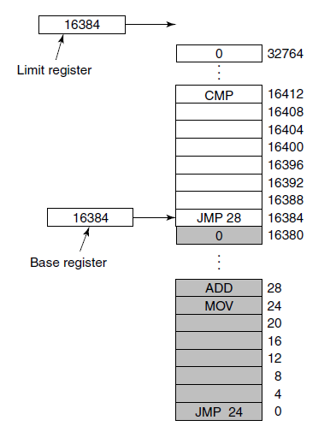
Base and Limit Register
When a process is run, the base register is loaded with the physical address where its program begins in memory and the limit register is loaded with the length of the program. In the Figure, the base and limit values that would be loaded into these hardware registers when the first program is run are 0 and 16,384, respectively. The values used when the second program is run are 16,384 and 32,768, respectively. If a third 16-KB program were loaded directly above the second one and run, the base and limit registers would be 32,768 and 16,384.
The Base and limit registers can be used to give each process a separate address space.

Slide 28
Swapping
If the physical memory of the computer is large enough to hold all the processes, the schemes described so far will more or less do.
But in practice, the total amount of RAM needed by all the processes is often much more than can fit in memory.
Two general approaches to dealing with memory overload have been developed over the years.
The simplest strategy, called swapping, consists of bringing in each process in its entirety, running it for a while, then putting it back on the disk.
Idle processes are mostly stored on disk, so they do not take up any memory when they are not running (although some of them wake up periodically to do their work, then go to sleep again).
The other strategy, called virtual memory, allows programs to run even when they are only partially in main memory.

Slide 29
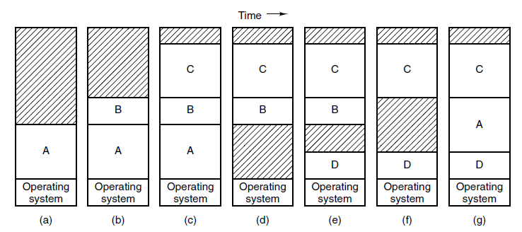
Swapping
The operation of a swapping system is illustrated in Figure(a)-(g).
Initially, only process A is in memory. Then processes B and C are created or swapped in from disk. In Figure(d) A is swapped out to disk. Then D comes in and B goes out.
Finally, A comes in again. Since A is now at a different location, addresses contained in it must be relocated, either by software when it is swapped in or (more likely) by hardware during program execution. For example, base and limit registers would work fine here.
Memory allocation changes as processes come into memory and leave it. The shaded regions are unused memory

Slide 30
Swapping
When swapping creates multiple holes in memory, it is possible to combine them all into one big one by moving all the processes downward as far as possible.
This technique is known as memory compaction. It is usually not done because it requires a lot of CPU time.
A point that is worth making concerns how much memory should be allocated for a process when it is created or swapped in.
If processes are created with a fixed size that never changes, then the allocation is simple: the operating system allocates exactly what is needed, no more and no less.

Slide 31
Swapping
If, however, processes’ data segments can grow, for example, by dynamically allocating memory from a heap, as in many programming languages, a problem occurs whenever a process tries to grow.
If a hole is adjacent to the process, it can be allocated, and the process allowed to grow into the hole.
On the other hand, if the process is adjacent to another process, the growing process will either have to be moved to a hole in memory large enough for it, or one or more processes will have to be swapped out to create a large enough hole.
If a process cannot grow in memory and the swap area on the disk is full, the process will have to suspended until some space is freed up (or it can be killed).
when swapping processes to disk, only the memory actually in use should be swapped; it is wasteful to swap the extra memory as well.

Slide 32
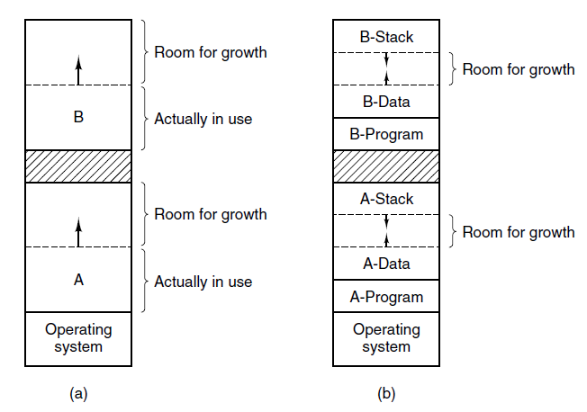
Swapping
In Figure(a) a memory configuration in which space for growth has been allocated to two processes.
If processes can have two growing segments—for example, the data segment being used as a heap for variables that are dynamically allocated and released and a stack segment for the normal local variables and return addresses—an alternative arrangement suggests itself, namely that of Figure (b).
(a) Allocating space for a growing data segment. (b) Allocating space for a growing stack and a growing data segment.

Slide 33
Logical vs. Physical Address Space
The concept of a logical address space that is bound to a separate physical address space is central to proper memory management.
Logical address – generated by the CPU; also referred to as virtual address.
Physical address – address seen by the memory unit.
Logical and physical addresses are the same in compile-time and load-time address-binding schemes; logical (virtual) and physical addresses differ in execution-time address-binding scheme
Logical address space is the set of all logical addresses generated by a program
Physical address space is the set of all physical addresses generated by a program

Slide 34
Memory Management Unit
Hardware device that at run time maps virtual to physical address.
MMU – Memory Management Unit.
In MMU scheme, the value in the relocation register is added to every address generated by a user process at the time it is sent to memory.
Base register now called relocation register
MS-DOS on Intel 80x86 used 4 relocation registers
The user program deals with logical addresses; it never sees the real physical addresses.
Execution-time binding occurs when reference is made to location in memory
Logical address bound to physical addresses

Slide 35
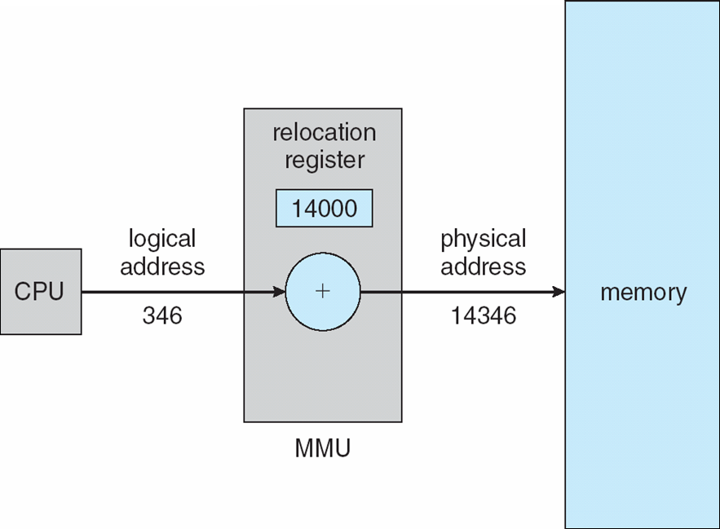
Memory Management Unit
Routine is not loaded until it is called
Better memory-space utilization; unused routine is never loaded
All routines kept on disk in relocatable load format
Useful when large amounts of code are needed to handle infrequently occurring cases
No special support from the operating system is required
Implemented through program design
OS can help by providing libraries to implement dynamic loading

Slide 36
Memory Management Unit

Slide 37
Swapping
A process can be swapped temporarily out of memory to a backing store, and then brought back into memory for continued execution
Backing store – fast disk large enough to accommodate copies of all memory images for all users; must provide direct access to these memory images.
Roll out, roll in – swapping variant used for priority-based scheduling algorithms; lower-priority process is swapped out so higher-priority process can be loaded and executed
Major part of swap time is transfer time; total transfer time is directly proportional to the amount of memory swapped
System maintains a ready queue of ready-to-run processes which have memory images on disk

Slide 38
Swapping
Does the swapped-out process need to swap back into same physical addresses?
Depends on address binding method
Plus consider pending I/O to / from process memory space
Modified versions of swapping are found on many systems (i.e., UNIX, Linux, and Windows)
Swapping normally disabled
Started if more than threshold amount of memory allocated
Disabled again once memory demand reduced below threshold

Slide 39
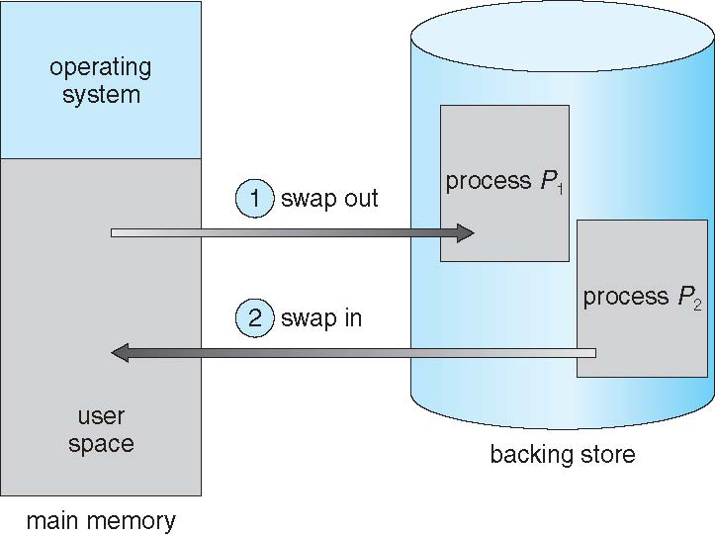
Swapping

Slide 40
Memory Allocations (Contiguous Allocation
Main memory must support both OS and user processes
Limited resource, must allocate efficiently
Contiguous allocation is one early method
Main memory usually divided into two partitions:
Resident operating system, usually held in low memory with interrupt vector
User processes then held in high memory
Each process contained in single contiguous section of memory
To separate each program’s memory space, we have to determine the range of legal addresses that the program may access.
Therefore, we need memory protection.
Provide protection by using two registers, that is, a base and a limit register.

Slide 41
Memory Allocations (Contiguous Allocation
Relocation registers used to protect user processes from each other, and from changing operating-system code and data
Base register contains value of smallest physical address
Limit register contains range of logical addresses – each logical address must be less than the limit register
MMU maps logical address dynamically
Can then allow actions such as kernel code being transient and kernel changing size

Slide 42
Memory Protection
Base Register – holds the smallest legal physical memory address.
Limit register – contains the size of the range.
If BR <= 30004
If LR <= 12090
Program can legally access all addresses from 30004 through 42094.

Slide 43
Base and a limit register define a logical address space

Slide 44
Memory Allocations (Contiguous Allocation)
Single-partition allocation
Relocation-register scheme used to protect user processes from each other, and from changing operating-system code and data
Relocation Register contains the value of the smallest physical address.
Limit Register contains the range of logical address.
Each logical address must be less than the limit register

Slide 45
Memory Allocations (Contiguous Allocation
If RR <= 100040
If LR <= 74600
With relocation and limit register, each logical address < LR.
MMU maps the logical address dynamically by adding the value in the RR.
Physical Address = RR+LR = 174640.

Slide 46
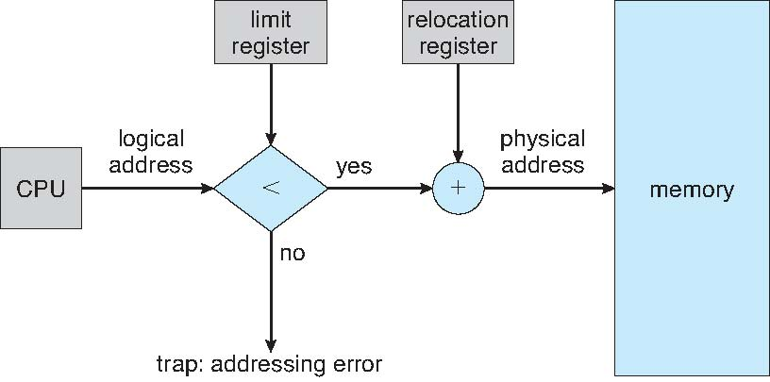
Hardware Support for Relocation and Limit Registers

Slide 47
Dynamic Storage-Allocation Problem
How to satisfy a request of size n from a list of free holes?
First-fit: Allocate the first hole that is big enough
Best-fit: Allocate the smallest hole that is big enough; must search entire list, unless ordered by size
Produces the smallest leftover hole
Worst-fit: Allocate the largest hole; must also search entire list
Produces the largest leftover hole

Slide 48
Fragmentation
External Fragmentation – total memory space exists to satisfy a request, but it is not contiguous
Internal Fragmentation – allocated memory may be slightly larger than requested memory; this size difference is memory internal to a partition, but not being used
First fit analysis reveals that given N blocks allocated, 0.5 N blocks lost to fragmentation
1/3 may be unusable -> 50-percent rule

Slide 49
Fragmentation
Reduce external fragmentation by compaction
Shuffle memory contents to place all free memory together in one large block
Compaction is possible only if relocation is dynamic, and is done at execution time
I/O problem
Latch job in memory while it is involved in I/O
Do I/O only into OS buffers
Now consider that backing store has same fragmentation problems

Slide 50
Segmentation
Memory-management scheme that supports user view of memory
A program is a collection of segments
A segment is a logical unit such as:
main program
procedure
function
method
object
local variables, global variables
common block
stack
symbol table
arrays

Slide 51
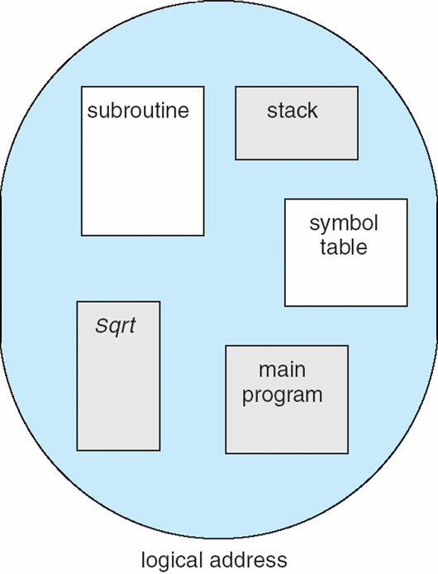
User’s View of a Program

Slide 52
Logical View of Segmentation
1
4
1
2
3
2
4
3
user space
physical memory space

Slide 53
Segmentation Architecture
Logical address consists of a two tuple:
<segment-number, offset>,
Segment table – maps two-dimensional physical addresses; each table entry has:
base – contains the starting physical address where the segments reside in memory
limit – specifies the length of the segment
Segment-table base register (STBR) points to the segment table’s location in memory
Segment-table length register (STLR) indicates number of segments used by a program;
segment number s is legal if s < STLR

Slide 54
Segmentation Architecture
Protection
With each entry in segment table associate:
validation bit = 0 ⇒ illegal segment
read/write/execute privileges
Protection bits associated with segments; code sharing occurs at segment level
Since segments vary in length, memory allocation is a dynamic storage-allocation problem
A segmentation example is shown in the following diagram

Slide 55
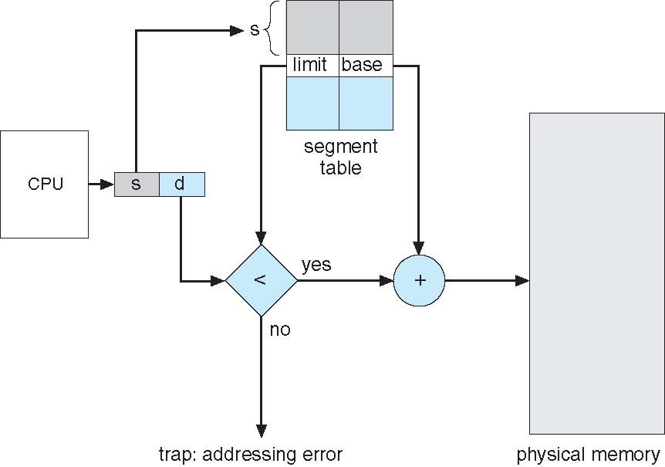
Segmentation Hardware
A logical address consists of two parts: a segment number, s, and an offset into that segment, d. The segment number is used as an index to the segment table. The offset d of
the logical address must be between 0 and the segment limit. If it is not, we trap to the operating system (logical addressing attempt beyond end of segment). When an offset is legal, it is added to the segment base to produce the address in physical memory of the desired byte. The segment table is thus essentially an array of base–limit register pairs.

Slide 56
Paging
Physical address space of a process can be noncontiguous; process is allocated physical memory whenever the latter is available
Avoids external fragmentation
Avoids problem of varying sized memory chunks
Divide physical memory into fixed-sized blocks called frames
Size is power of 2, between 512 bytes and 16 Mbytes
Divide logical memory into blocks of same size called pages
Keep track of all free frames
To run a program of size N pages, need to find N free frames and load program
Set up a page table to translate logical to physical addresses
Backing store likewise split into pages
Still have Internal fragmentation

Slide 57
Address Translation
Address generated by CPU is divided into:
Page number (p) – used as an index into a page table which contains base address of each page in physical memory
Page offset (d) – combined with base address to define the physical memory address that is sent to the memory unit
For given logical address space 2^{m} and page size 2^{n}

Slide 58
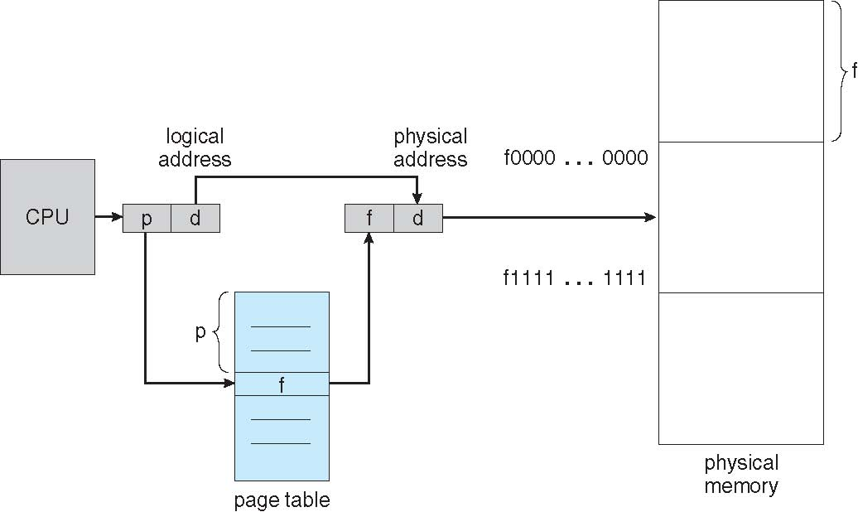
Paging Hardware
The hardware support for paging is illustrated in Figure. Every address generated by the CPU is divided into two parts: a page number (p) and a page offset (d). The page number is used as an index into a page table. The page table contains the base address of each page in physical memory. This base address is combined with the page offset to define the physical memory address that
is sent to the memory unit.

Slide 59
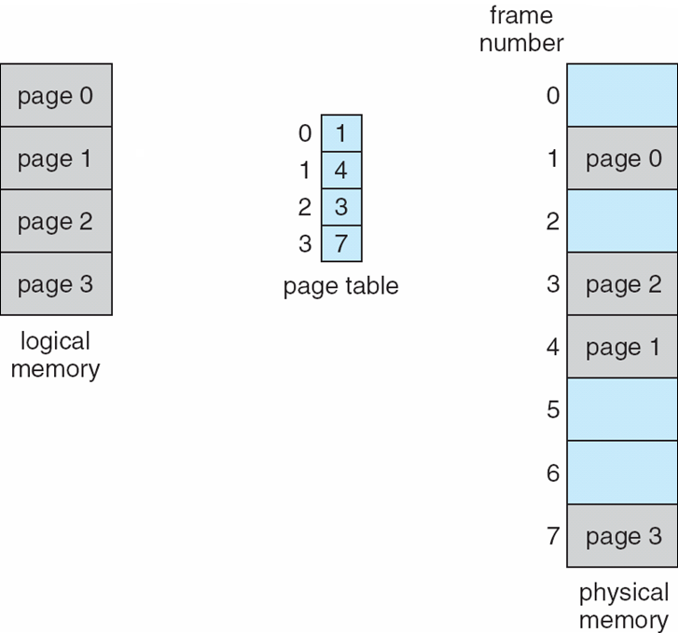
Paging Model of Logical and Physical Memory

Slide 60
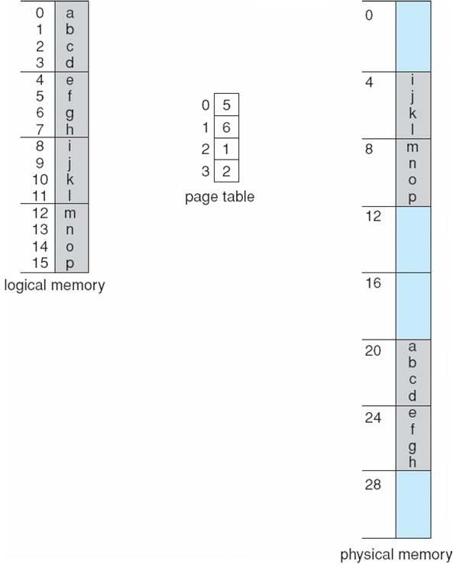
Paging Example
Using a page size of 4 bytes and a physical memory of 32 bytes
(8-pages), the user’s view od memory can be mapped into physical
memory.
Logical address 0 is page 0, offset 0. Indexing into the page table,
We find that page 0 is in frame 5. address 0 maps to physical address ((5 x 4)+0) = 20.
Logical address 3. Page 0 offset 3 -> ((5x4)+3 = 23
Logical address 4 is page 1, offset 0. maps to physical address ((6x4)+0) = 24
Logical address 8 is page 2, offset 0. Maps to physical address
((1x4)+0) = 4
Logical address 12 is page 3, offset 0. Maps to physical address
((2x4)+0) = 8

Slide 61
Paging
Calculating internal fragmentation
Page size = 2,048 bytes
Process size = 72,766 bytes
35 pages + 1,086 bytes
Internal fragmentation of 2,048 - 1,086 = 962 bytes
Worst case fragmentation = 1 frame – 1 byte
On average fragmentation = 1 / 2 frame size
So small frame sizes desirable?
But each page table entry takes memory to track
Page sizes growing over time
Solaris supports two-page sizes – 8 KB and 4 MB
Process view and physical memory now very different
By implementation process can only access its own memory

Slide 62
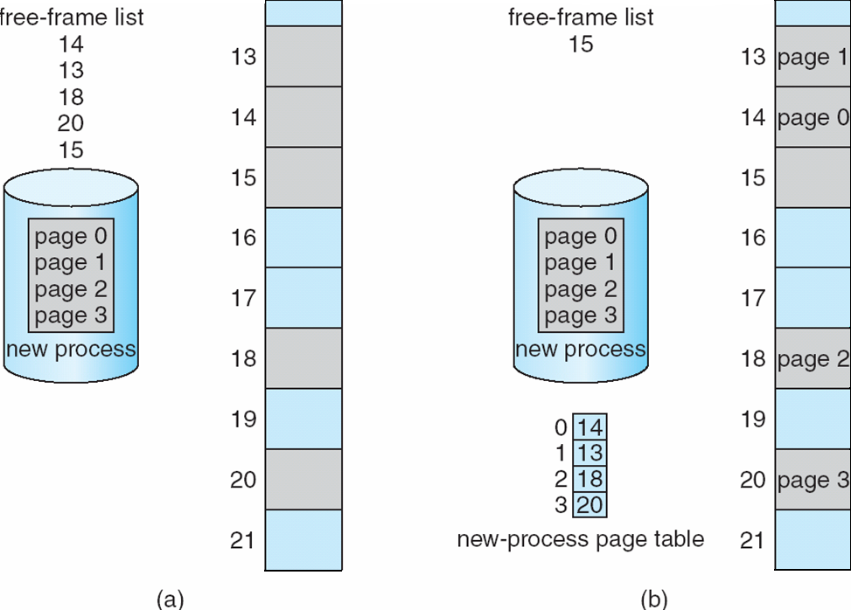
Free Frames

Slide 63
Implementation of Page Tables
Page table is kept in main memory
Page-table base register (PTBR) points to the page table
Page-table length register (PTLR) indicates size of the page table
In this scheme every data/instruction access requires two memory accesses
One for the page table and one for the data / instruction
The two memory access problem can be solved by the use of a special fast-lookup hardware cache called associative memory or translation look-aside buffers (TLBs)

Slide 64
Implementation of Page Tables
Some TLBs store address-space identifiers (ASIDs) in each TLB entry – uniquely identifies each process to provide address-space protection for that process
Otherwise need to flush at every context switch
TLBs typically small (64 to 1,024 entries)
On a TLB miss, value is loaded into the TLB for faster access next time
Replacement policies must be considered
Some entries can be wired down for permanent fast access

Slide 65
Virtual Memory
Virtual memory is a technique that allows the execution of processes that are not completely in memory.
One major advantage of this scheme is that programs can be larger than physical memory.
Further, virtual memory abstracts main memory into an extremely large, uniform array of storage, separating logical memory as viewed by the user from physical memory.
This technique frees programmers from the concerns of memory-storage limitations.
Virtual memory also allows processes to share files easily and to implement shared memory.
In addition, it provides an efficient mechanism for process creation. Virtual memory is not easy to implement, however, and may substantially decrease performance if it is used carelessly.
We discuss virtual memory in the form of demand paging and examine its complexity and cost.

Slide 66
Virtual Memory
The memory-management algorithms are necessary because of one basic requirement: The instructions being executed must be in physical memory.
The first approach to meeting this requirement is to place the entire logical address space in physical memory.
Dynamic loading can help to ease this restriction, but it generally requires special precautions and extra work by the programmer.
The requirement that instructions must be in physical memory to be executed seems both necessary and reasonable; but it is also unfortunate, since it limits the size of a program to the size of physical memory.
In fact, an examination of real programs shows us that, in many cases, the entire program is not needed.

Slide 67
Virtual Memory
consider the following:
Programs often have code to handle unusual error conditions. Since these errors seldom, if ever, occur in practice, this code is almost never executed.
Arrays, lists, and tables are often allocated more memory than they actually need. An array may be declared 100 by 100 elements, even though it is seldom larger than 10 by 10 elements. An assembler symbol table may have room for 3,000 symbols, although the average program has less than 200 symbols.
Certain options and features of a program may be used rarely. For instance, the routines on U.S. government computers that balance the budget have not been used in many years.
Even in those cases where the entire program is needed, it may not all be needed at the same time.

Slide 68
Virtual Memory
The ability to execute a program that is only partially in memory would confer many benefits:
A program would no longer be constrained by the amount of physical memory that is available. Users would be able to write programs for an extremely large virtual address space, simplifying the programming task.
Because each user program could take less physical memory, more programs could be run at the same time, with a corresponding increase in CPU utilization and throughput but with no increase in response time or turnaround time.
Less I/O would be needed to load or swap user programs into memory, so each user program would run faster.
Thus, running a program that is not entirely in memory would benefit both the system and the user.

Slide 69
Virtual Memory
Virtual memory involves the separation of logical memory as perceived by users from physical memory.
This separation allows an extremely large virtual memory to be provided for programmers when only a smaller physical memory is available (Figure 9.1).
Virtual memory makes the task of programming much easier, because the programmer no longer needs to worry about the amount of physical memory available; she can concentrate instead on the problem to be programmed.

Slide 70
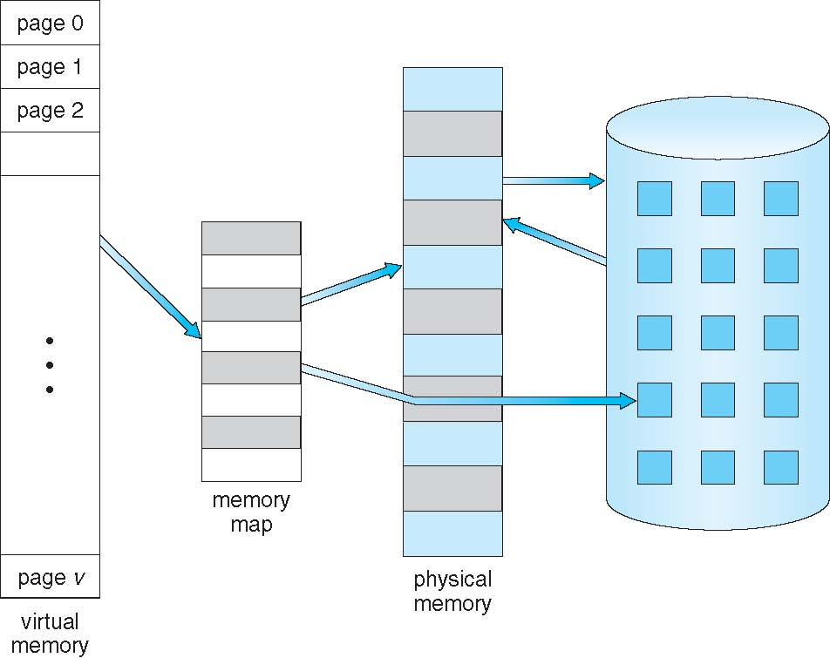
Virtual Memory

Slide 71
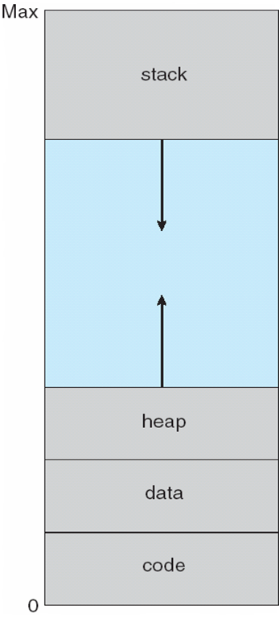
Virtual Memory
Physical memory may be organized in page frames and that the physical page frames assigned to a process may not be contiguous.
It is up to the memory management unit (MMU) to map logical pages to physical page frames in memory.
Note in Figure that we allow the heap to grow upward in memory as it is used for dynamic memory allocation.
Similarly, we allow for the stack to grow downward in memory through successive function calls.
The large blank space (or hole) between the heap and the stack is part of the virtual address space but will require actual physical pages only if the heap or stack grows.
Virtual address spaces that include holes are known as sparse address spaces.

Slide 72
Virtual Memory
The heap memory segment is an area of memory used for dynamic allocations, meaning that blocks of memory can be allocated and freed in an arbitrary order and accessed multiple times (as opposed to the stack, which is Last-In-First-Out).
Using a sparse address space is beneficial because the holes can be filled as the stack or heap segments grow or if we wish to dynamically link libraries (or possibly other shared objects) during program execution.
In addition to separating logical memory from physical memory, virtual memory allows files and memory to be shared by two or more processes through page sharing.

Slide 73
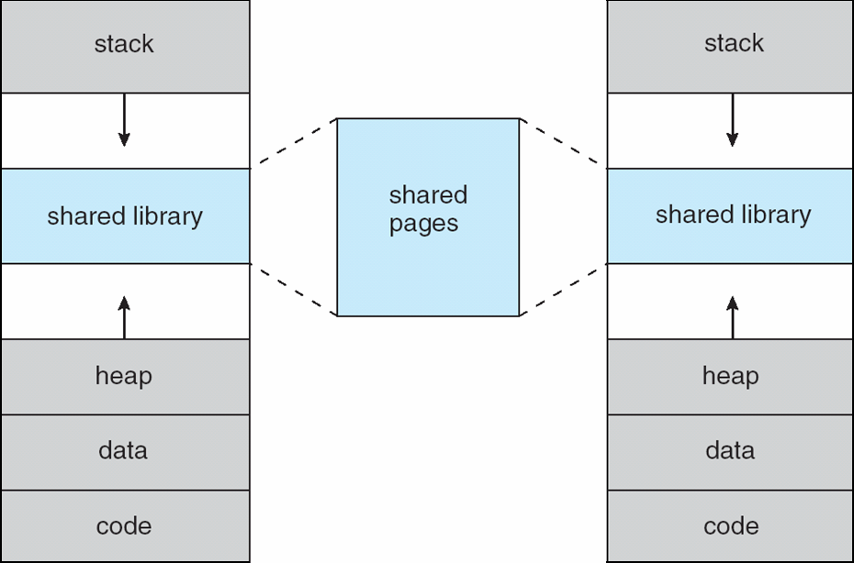
Virtual Memory
This leads to the following benefits:
System libraries can be shared by several processes through mapping of the shared object into a virtual address space. Although each process considers the libraries to be part of its virtual address space, the actual pages where the libraries reside in physical memory are shared by all the processes (Figure). Typically, a library is mapped read-only into the space of each process that is linked with it.

Slide 74
Virtual Memory
Similarly, processes can share memory. Two or more processes can communicate through the use of shared memory. Virtual memory allows one process to create a region of memory that it can share with another process. Processes sharing this region consider it part of their virtual address space, yet the actual physical pages of memory are shared, much as is illustrated in the Figure.
Pages can be shared during process creation with the fork() system call, thus speeding up process creation.

Slide 75
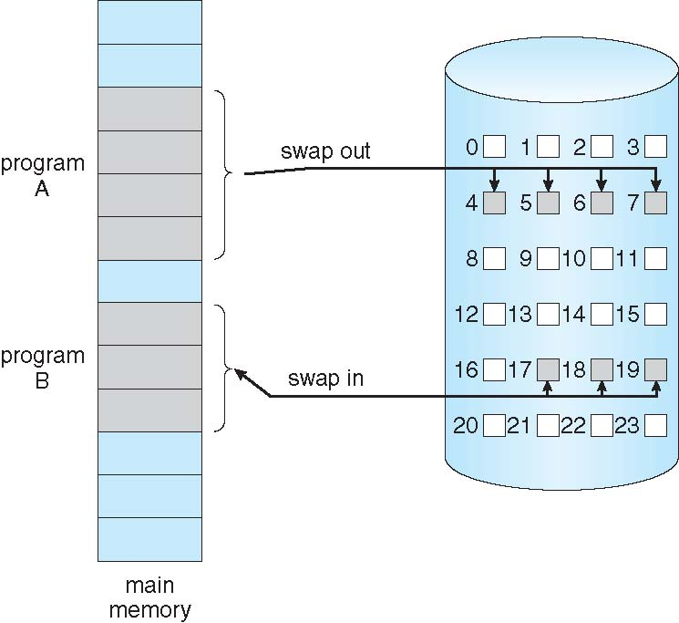
Virtual Memory(Demand Paging)
Could bring entire process into memory at load time
Or bring a page into memory only when it is needed
Less I/O needed, no unnecessary I/O
Less memory needed
Faster response
More users
Similar to paging system with swapping (diagram on right)
Page is needed ⇒ reference to it
invalid reference ⇒ abort
not-in-memory ⇒ bring to memory
Lazy swapper – never swaps a page into memory unless page will be needed
Swapper that deals with pages is a pager

Slide 76
Virtual Memory(Demand Paging)
With swapping, pager guesses which pages will be used before swapping out again
Instead, pager brings in only those pages into memory
How to determine that set of pages?
Need new MMU functionality to implement demand paging
If pages needed are already memory resident
No difference from non-demand-paging
If page needed and not memory resident
Need to detect and load the page into memory from storage
Without changing program behavior
Without programmer needing to change code

Slide 77
Virtual Memory (Demand Paging)
Memory protection in a paged environment is accomplished by protection bits associated with each frame.
Normally, these bits are kept in the page table. One bit can define a page to be read–write or read-only.
Every reference to memory goes through the page table to find the correct frame number.
At the same time that the physical address is being computed, the protection bits can be checked to verify that no writes are being made to a read-only page.
An attempt to write to a read-only page causes a hardware trap to the operating system (or memory-protection violation).
We can easily expand this approach to provide a finer level of protection.
We can create hardware to provide read-only, read–write, or execute-only protection; or, by providing separate protection bits for each kind of access, we can allow any combination of these accesses.
Illegal attempts will be trapped to the operating system.

Slide 78
Virtual Memory(Demand Paging)
One additional bit is generally attached to each entry in the page table: a valid–invalid bit.
When this bit is set to valid, the associated page is in the process’s logical address space and is thus a legal (or valid) page.
When the bit is set to invalid, the page is not in the process’s logical address space.
Illegal addresses are trapped by use of the valid–invalid bit. The operating system sets this bit for each page to allow or disallow access to the page.
Suppose, for example, that in a system with a 14-bit address space (0 to 16383), we have a program that should use only addresses 0 to 10468.

Slide 79
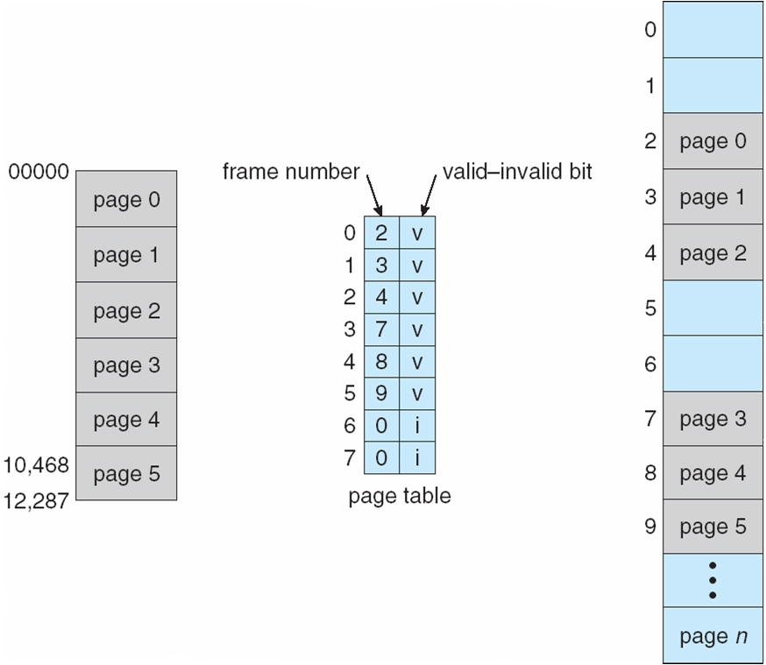
Virtual Memory(Demand Paging)
Given a page size of 2 KB, we have the situation shown in the Figure.
Addresses in pages 0, 1, 2, 3, 4, and 5 are mapped normally through the page table.
Any attempt to generate an address in pages 6 or 7, however, will find that the valid–invalid bit is set to invalid, and the computer will trap to the operating system (invalid page reference).

Slide 80
Virtual Memory(Demand Paging)
Notice that this scheme has created a problem.
Because the program extends only to address 10468, any reference beyond that address is illegal.
However, references to page 5 are classified as valid, so accesses to addresses up to 12287 are valid.
Only the addresses from 12288 to 16383 are invalid.
Problem is a result of the 2-KB page size and reflects the internal fragmentation of paging.

Slide 81
Virtual Memory(Demand Paging)
With this scheme, we need some form of hardware support to distinguish between the pages that are in memory and the pages that are on the disk.
The valid–invalid bit scheme can be used for this purpose.
This time, however, when this bit is set to “valid,” the associated page is both legal and in memory.
If the bit is set to “invalid,” the page either is not valid (that is, not in the logical address space of the process) or is valid but is currently on the disk.
The page-table entry for a page that is brought into memory is set as usual, but the page-table entry for a page that is not currently in memory is either simply marked invalid or contains the address of the page on disk.

Slide 82
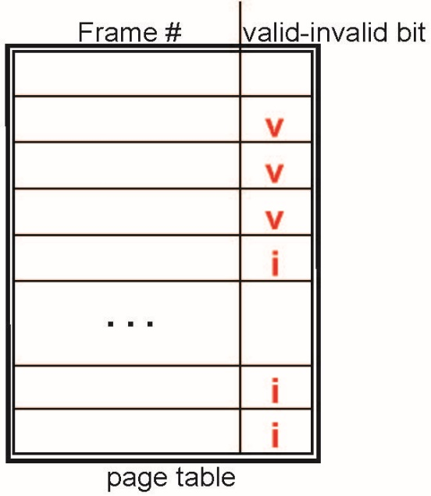
Virtual Memory(Valid-Invalid Bit)
With each page table entry, a valid–invalid bit is associated (v ⇒ in-memory – memory resident, i ⇒ not-in-memory)
Initially valid–invalid bit is set to i on all entries
Example of a page table snapshot:
During MMU address translation, if valid–invalid bit in page table entry is i ⇒ page fault

Slide 83
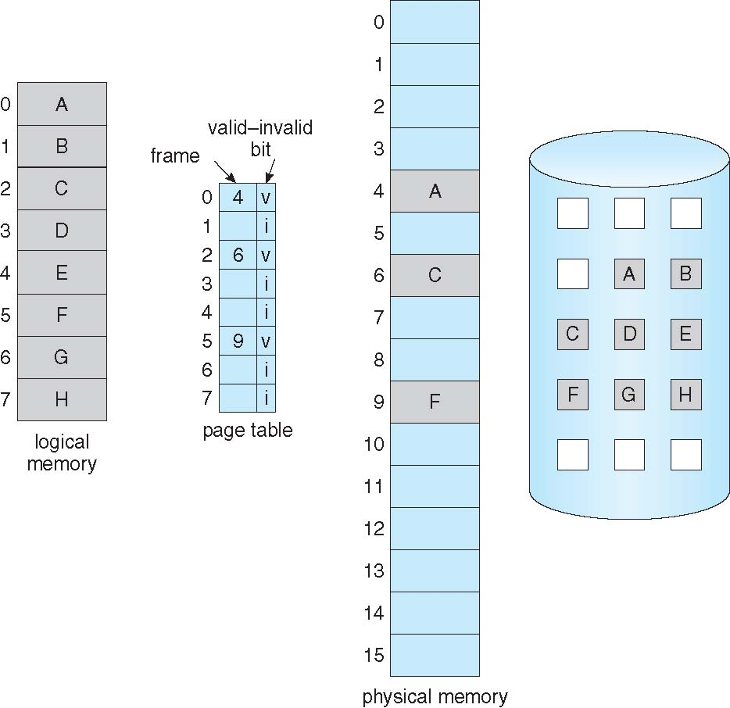
Page Table When Some Pages Are Not in Main Memory

Slide 84
Page Fault
If there is a reference to a page, first reference to that page will trap to operating system:
page fault
Operating system looks at another table to decide:
Invalid reference ⇒ abort
Just not in memory
Find free frame
Swap page into frame via scheduled disk operation
Reset tables to indicate page now in memory Set validation bit = v
Restart the instruction that caused the page fault

Slide 85
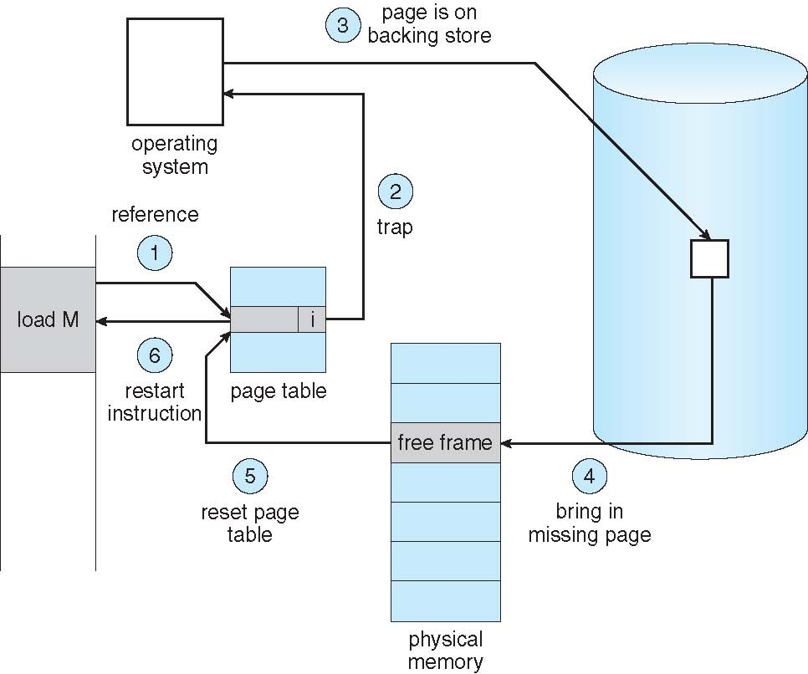
Steps in Handling Page Fault

Slide 86
Aspects of Demand Paging
Extreme case – start process with no pages in memory
OS sets instruction pointer to first instruction of process, non-memory-resident -> page fault
And for every other process pages on first access
Pure demand paging
Actually, a given instruction could access multiple pages -> multiple page faults
Consider fetch and decode of instruction which adds 2 numbers from memory and stores result back to memory
Pain decreased because of locality of reference
Hardware support needed for demand paging
Page table with valid / invalid bit
Secondary memory (swap device with swap space)
Instruction restart

Slide 87
Other Techniques
Dynamic Memory Allocation
First-fit: Allocate the first hole that is big enough.
Best-fit: Allocate the smallest hole that is big enough. Produces the smallest leftover hole.
Worst-fit: Allocate the largest hole. Produce the largest leftover hole.
First-fit and best-fit are better than worst-fit in terms of speed and storage utilization.

Slide 88
Other Techniques
Fragmentation
External Fragmentation – Gaps between allocated contiguous memory; memory space exists to satisfy a request, but it is not contiguous.
Internal Fragmentation – allocated memory may be slightly larger than requested memory; this size difference is memory internal to a partition, but not being used.
Paging
Divide physical memory into fixed-sized blocks called frames
Divide logical address into blocks of same size called pages.

Slide 89
Memory Management In Programs and Application

Slide 90
What Involves
Application memory management involves supplying the memory needed for a program’s objects and data structures from the limited resources available.
Recycling that memory for reuse when it is no longer required.
Two approaches to recycling memory:
Manual Memory Management - the programmer must decide when memory can be reused.
Automatic Memory Management – it is a service, either as a part of the language or as an extension, that automatically recycles memory that a program would not otherwise use again.

Slide 91
/* Base address for Control register. This constants are hardware dependent */
static const uint32_t TIMER_CONTROL_REGISTERS_BASE_ADDR = 0x43C20000
static const uint32_t PMEM_SIZE = 0x24; // 36 Bytes - The address space has 9 registers of 4 bytes each
Volatile uint32_t* _pmem_ptr; // used to hold the virtual address for user access the hardware device
// tells the compiler to not optimize the pointer, that is, make sure the value is
// not changed.
// Let's attempt to map a physical address to a virtual address and access the timer through user space
int fd = open("/dev/mem", O_RDWR); // obtain a file descriptor which is an abstract indicator (handler) used
if (fd <= 0) // to access a file or other input/output resource
{
HAL_IO_ERROR("Unable to open /dev/mem");
errors.fdError = true;
return false;
}
void* virtualAdd = mmap(NULL, PMEM_SIZE, PROT_READ | PROT_WRITE, MAP_SHARED, fd, (off_t)TIMER_CONTROL_REGISTERS_BASE_ADDR);
if(virtualAdd != MAP_FAILED)
{
_pmem_ptr = static_cast<uint32_t*> (virtualAdd);
}
else
{
HAL_IO_ERROR("Unable to map Physical to Virtual");
_errors.phytovrtError = true;
close(fd);
return false;
}
close(fd);

Slide 92
Some Notes on Memory Leaks

Slide 93
Notes on Memory Leaks
1. Use “delete” to avoid memory leaks when memory is allocated with “new”.
uint16_t *Ppointer = new uint16_t; → creates a pointer of type uint16_t on the free store
*Ppointer = 72; // assign the value 72 to the area on the free store to
// which Ppointer points
delete Ppointer; // frees the memory

Slide 94
Notes on Memory Leaks
2. Calling delete again on a pointer after it has been deleted will crash the program.
uint16_t *Ppointer = new uint16_t; → creates a pointer of type uint16_t on the free store
*Ppointer = 32; // assign the value 32 to the area on the free store to
// which Ppointer points
delete Ppointer; // frees the memory
delete Ppointer;
IT WILL CRASH THE PROGRAM!!!!
How to solve?

Slide 95
Notes on Memory Leaks
Set the pointer to null (‘0’) after deleting the pointer. Calling delete on a “null” pointer is guaranteed to be safe.
uint16_t *Ppointer = new uint16_t; → creates a pointer of type uint16_t on the free store
*Ppointer = 32; // assign the value 32 to the area on the free store to
// which Ppointer points
delete Ppointer; // frees the memory
Ppointer = 0; // sets the pointer to null
-----------------
-----------------
delete Ppointer; // harmless

Slide 96
Notes on Memory Leaks
3. Re-assigning the pointer before deleting the memory to which it points
uint16_t *Ppointer = new uint16_t; → creates a pointer of type uint16_t on the free store
*Ppointer = 32; // assign the value 32 to the area on the free store to
// which Ppointer points
uint8_t *Ppointer = new uint8_t; // points to an unsigned 8 bits and no
// longer unsigned 16 bits
MEMORY LEAKS BROTHER!!!!!!!

Slide 97
Notes on Memory Leaks
4. When we call delete on a pointer freeing the memory that it points to and later try to use that pointer again without re-assigning it
uint16_t *Ppointer = new uint16_t; → creates a pointer of type uint16_t on the free store
*Ppointer = 32; // assign the value 32 to the area on the free store to
// which Ppointer points
delete Ppointer;
*Ppointer = 8;
STRAY OR DANGLING POINTER!!!!!!!

Slide 98
In-Class Activity
Activity 1
Go to the link
https://www.geeksforgeeks.org/program-first-fit-algorithm-memory-management/
First Fit algorithm. Copy the program, understand, compile and execute.
Activity 2.
Best fit algorithm
Go to the link
https://www.geeksforgeeks.org/program-best-fit-algorithm-memory-management/
Copy the program, paste to your editor, understand the code, compile and run.
Activity 3
Worst fit algorithm
Go to the link
https://www.geeksforgeeks.org/program-worst-fit-algorithm-memory-management/
Copy the program, paste to your editor, understand the code, compile and run.

Slide 99
In-Class Activity
Activity 4
Page Replacement Algorithm
Go to the Link. Understand the algorithm, understand the implementation, copy the program paste to your editor, compile and run. Study the program and how it functions.
https://www.geeksforgeeks.org/program-optimal-page-replacement-algorithm/

