Slide 1
Operating Systems Concepts CST-221
Topic 2 – Lecture 1
Chapter 2
Processes and Threads

Slide 2
Lecture for Topic 2 – Week 3
Verify Linux pthreads works in your installation
Processes
Threads

Slide 3
General Overview of pthreads
a POSIX standard (IEEE 1003.1c) API (Application Programming Interface) for thread creation and synchronization.
API specifies behavior of the thread library, implementation is up to development of the library.
Common in UNIX operating systems.

Slide 4
Linux pthreads
Linux refers to them as tasks rather than threads.
Thread creation is done through clone() system call.
Clone() allows a child task to share the address space of the parent task (process)

Slide 5
Linux pthreads
Hello world pthread example.
To use pthreads you will need to include pthread.h in your program
To compile use –pthread (or –lpthread) option. This option tells the compiler that your program requires threading support
To create a thread use the function pthread_create
This function takes four arguments:
int pthread_create(pthread_t *thread, const pthread_attr_t *attr, void *(*start_routine) (void *), void *arg);

Slide 6
Linux pthread
int pthread_create(pthread_t *thread, const pthread_attr_t *attr, void *(*start_routine) (void *), void *arg);
The first is a pointer to a variable that will hold the id of the newly created thread.
The second is a pointer to attributes that we can use to tweak and tune some of the advanced features of pthreads.
The third is a pointer to a function that we want to run
Fourth is a pointer that will be given to our function

Slide 7
Linux pthread
#include <stdio.h>
#include <pthread.h>
// remember to set compilation option -pthread
void *busy(void *ptr)
{
// ptr will point to "Hi"
puts("Hello World");
return NULL;
}
int main()
{
pthread_t id;
pthread_create(&id, NULL, busy, "Hi");
while (1) {} // Loop forever
}

Slide 8
Processes
A process is just an instance of an executing program, including the current values of the program counter, registers, and variables.
Conceptually, each process has its own virtual CPU.
In reality, the real CPU switches back and forth from process to process, but to understand the system, it is much easier to think about a collection of processes running in parallel than to try to keep track of how the CPU switches from program to program.
This rapid switching back and forth is called multiprogramming.

Slide 9
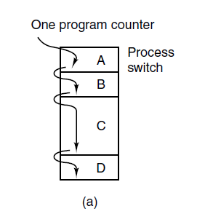
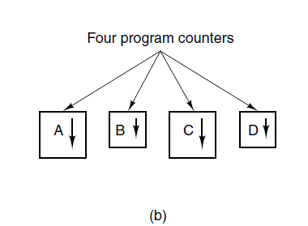
Process Model
A Multiprogramming four programs.
Conceptual model of four independent, sequential processes.
(c) Only one program is active at once.

Slide 10
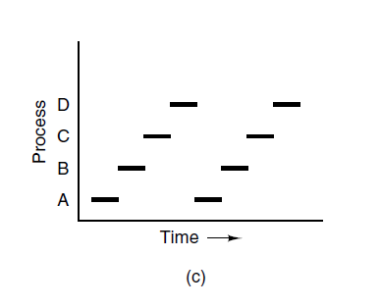
Process Model
Viewed over a long enough time interval, all the processes have made progress, but at any given instant only one process is actually running.

Slide 11
Process Model
For the time being, it is simpler just to think of one CPU at a time.
when we say that a CPU can really run only one process at a time, if there are two cores (or CPUs) each of them can run only one process at a time.
The difference between a process and a program is subtle, but absolutely crucial.
The key idea here is that a process is an activity of some kind. It has a program, input, output, and a state.
A single processor may be shared among several processes, with some scheduling algorithm being accustomed to determine when to stop work on one process and service a different one.
In contrast, a program is something that may be stored on disk, not doing anything.

Slide 12
Process Model
It is worth noting that if a program is running twice, it counts as two processes.
It is often possible to start a word processor twice or print two files at the same time if two printers are available.
The fact that two processes happen to be running the same program does not matter; they are distinct processes

Slide 13
Process Creation
Four principal events that cause processes to be created:
System initialization.
Execution of a process creation system call by a running process.
A user request to create a new process.
Initiation of a batch job.

Slide 14
Process Creation
#include <stdio.h>
#include <pthread.h>
// remember to set compilation option -pthread
void *busy(void *ptr)
{
// ptr will point to "Hi"
puts("Hello World");
return NULL;
}
int main()
{
pthread_t id;
pthread_create(&id, NULL, busy, "Hi"); ←----create a process
while (1) {} // Loop forever
}

Slide 15
Process Termination
Typical conditions which terminate a process:
Normal exit (voluntary).
Error exit (voluntary).
Fatal error (involuntary).
Killed by another process (involuntary).
In Linux we can kill a stubborn process with the shell command
Kill pid (kill processor id) or in the case the process is not terminated use a more drastic option
Kill -9 pid

Slide 16
Process termination
#include <stdio.h>
#include <pthread.h>
// remember to set compilation option -pthread
void *busy(void *ptr)
{
// ptr will point to "Hi"
puts("Hello World");
return NULL;
}
Void *busy1(void *ptr)
{
puts(“I am hanging you");
return NULL;
}
int main()
{
pthread_t id;
pthread_create(&id, NULL, busy, "Hi");
Pthread_create(&id, NULL, busy1, “Ola”);
while (1) {} // Loop forever
}

Slide 17
Process termination
Run the program thread. First with
./run
Second run with
./run &
Two options:
Cntr-C (terminate the process)
Execute the program with a ‘&’ after the command. The process will run in background. We cannot terminate the process just by invoking ctrl-c. Now use the ‘kill’ shell command.

Slide 18
Process Hierarchies
In some systems, when a process creates another process, the parent process and child process continue to be associated in certain ways. The child process can itself create more processes, forming a process hierarchy.
In UNIX, a process and all of its children and further descendants together form a process group.
When a user sends a signal from the keyboard, the signal is delivered to all members of the process group currently associated with the keyboard.
Individually, each process can catch the signal, ignore the signal, or take the default action, which is to be killed by the signal.
As another example of where the process hierarchy plays a key role, let us look at how UNIX initializes itself when it is started, just after the computer is booted.
A special process, called init, is present in the boot image. When it starts running, it reads a file telling how many terminals there are. Then it forks off a new process

Slide 19
Process Hierarchies
A special process, called init, is present in the boot image. When it starts running, it reads a file telling how many terminals there are. Then it forks off a new process per terminal. These processes wait for someone to log in.
If a login is successful, the login process executes a shell to accept commands. These commands may start up more processes, and so forth.
All the processes in the whole system belong to a single tree, with init at the root.
In contrast, Windows has no concept of a process hierarchy. All processes are equal.
Processes in UNIX cannot disinherit their children.

Slide 20
Process States
In the shell command
cat chapter1 chapter2 chapter3 | grep tree
the first process, running cat, concatenates and outputs three files.
The second process, running grep, selects all lines containing the word ‘‘tree.’’
Depending on the relative speeds of the two processes (which depends on both the relative complexity of the programs and how much CPU time each one has had), it may happen that grep is ready to run, but there is no input waiting for it. It must then block until some input is available.

Slide 21
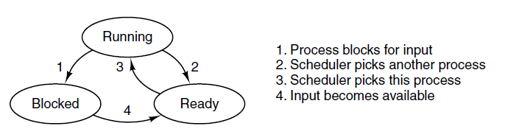
Process States
Basically, a process has three states:
Running (actually using the CPU at that instant).
Ready (runnable; temporarily stopped to let another process run).
Blocked (unable to run until some external event happens).

Slide 22
Process States
Logically, the first two states are similar.
In both cases the process is willing to run, only in the second one, there is temporarily no CPU available for it.
The third state is fundamentally different from the first two in that the process cannot run,
even if the CPU is idle and has nothing else to do.

Slide 23
Process States
Transitions 2 and 3 are caused by the process scheduler, a part of the operating system, without the process even knowing about them.
Transition 2 occurs when the scheduler decides that the running process has run long enough, and it is time to let another process have some CPU time.
Transition 3 occurs when all the other processes have had their fair share and it is time for the first process to get the CPU to run again.
The subject of scheduling, that is, deciding which process should run when and for how long, is an important one; we will look at it later in this class.

Slide 24
Process States
Transition 4 occurs when the external event for which a process was waiting (such as the arrival of some input) happens.
If no other process is running at that instant, transition 3 will be triggered and the process will start running.
Otherwise, it may have to wait in ready state for a little while until the CPU is available and its turn comes.

Slide 25
Process States
When a disk interrupt occurs, the system makes a decision to stop running the current process and run the disk process, which was blocked waiting for that interrupt.
instead of thinking about interrupts, we can think about user processes, disk processes, terminal processes, and so on, which block when they are waiting for something to happen. When the disk has been read or the character typed, the process waiting for it is unblocked and is eligible to run again.

Slide 26
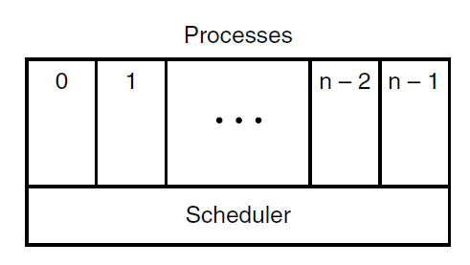
Process States
The lowest level of the operating system is the scheduler, with a variety of processes on top of it.
All the interrupt handling and details of actually starting and stopping processes are hidden away in what is here called the scheduler, which is actually not much code.
The rest of the operating system is nicely structured in process form. Few real systems are as nicely structured as this, however.
The lowest layer of a process-structured operating system handles interrupts and scheduling. Above that layer are sequential processes.

Slide 27
Implementation of Processes
To implement the process model, the operating system maintains a table (an array of structures), called the process table, with one entry per process.
Others call these entries process control blocks.
This entry contains important information about the process’ state, including its program counter, stack pointer, memory allocation, the status of its open files, its accounting and scheduling information, and everything else about the process that must be saved when the process is switched from running to ready or blocked state so that it can be restarted later as if it had never been stopped.

Slide 28
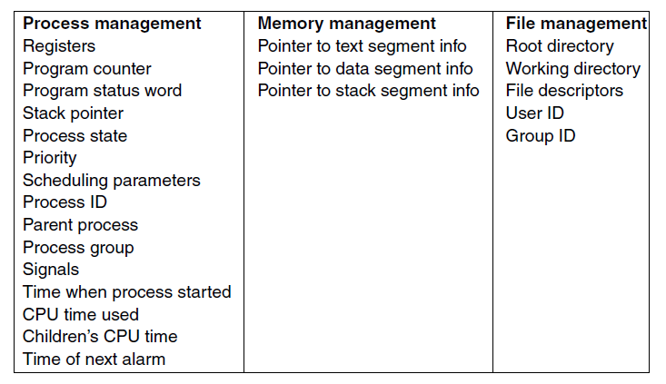
Implementation of Processes
Some of the fields of a typical process table entry.

Slide 29
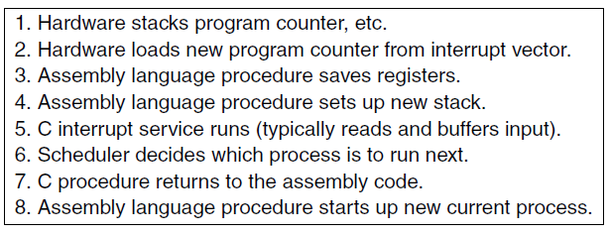
Implementation of Processes
Skeleton of what the lowest level of the operating system does when an interrupt occurs.

Slide 30
In-Class Activity (10 minutes)
Write a program in C that implements the three states. It must have as an stdin a state choice and then the state machine must go to the appropriate state and prints the status.
If not able to conclude in class, finish in home and bring the code for next class.

Slide 31
How To Use the chmod command in Linux
We use indicators to represent short “permissions statements” such as u+x, where “u” means ” user”, “+” means add, and “x” means the execute permission.
u: User, meaning the owner of the file.
g: Group, meaning members of the group the file belongs to.
o: Others, meaning people not governed by the u and g permissions.
a: All, meaning all of the above.
If none of these are used, chmod behaves as if “a” had been used.

Slide 32
How To Use the chmod command in Linux
–: Minus sign. Removes the permission.
+: Plus sign. Grants the permission. The permission is added to the existing permissions. If you want to have this permission and only this permission set, use the = option, described below.
=: Equals sign. Set a permission and remove others.
r: The read permission.
w: The write permission.
We want the user dave to have read and write permissions and the group and other users to have read permissions only. We can do using the following command:
chmod u=rw,og=r new_file.txt
chmod -R 777 . New_file.txt avoids permission denied issues.

