Slide 1
Operating Systems Concepts CST-221
Topic 2 – Lecture 2
Chapter 2
Processes and Threads

Slide 2
Lecture for Topic 2 – Week 4
Threads

Slide 3
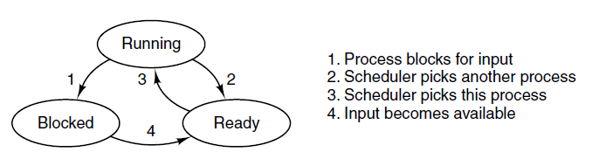
In-Class Activity (10 minutes)
Write a program in C that implements the three states. It must have as an stdin a state choice and then the state machine must go to the appropriate state and prints the status.
If not able to conclude in class, finish in home and bring the code for next class.

Slide 4
Threads
In traditional operating systems, each process has an address space and a single thread of control.
In fact, that is almost the definition of a process.
Nevertheless, in many situations, it is desirable to have multiple threads of control in the same address space running in quasi-parallel, as though they were (almost) separate processes (except for the shared address space).
Because threads have some of the properties of processes, they are sometimes called lightweight processes.
Therefore, a Thread is an instance of a process.
Why would anyone want to have a kind of process within a process?
It turns out there are several reasons for having these mini-processes, called threads.

Slide 5
Threads
Let us now examine some of them.
First Argument
The main reason for having threads is that in many applications, multiple activities are going on at once.
Some of these may block from time to time. By decomposing such an application into multiple sequential threads that run in quasi-parallel, the programming model becomes simpler.
Instead, of thinking about interrupts, timers, and context switches, we can think about parallel processes.
Only now with threads we add a new element: the ability for the parallel entities to share an address space and all of its data among themselves.
This ability is essential for certain applications, which is why having multiple processes (with their separate address spaces) will not work.

Slide 6
Threads
Second Argument
A second argument for having threads is that since they are lighter weight than processes, they are easier (i.e., faster) to create and destroy than processes.
In many systems, creating a thread goes 10–100 times faster than creating a process.
When the number of threads needed changes dynamically and rapidly, this property is useful to have.
Third Reason
A third reason for having threads is also a performance argument.
Threads yield no performance gain when all of them are CPU bound, but when there is substantial computing and, also substantial I/O, having threads allows these activities to overlap, thus speeding up the application.

Slide 7
Threads
Fourth Reason
Finally, threads are useful on systems with multiple CPUs, where real parallelism is possible.
Example of where threads are useful
A server for a Website.
Requests for pages come in and the requested page is sent back to the client.
At most Websites, some pages are more commonly accessed than other pages.
For example, Sony’s home page is accessed far more than a page deep in the tree containing the technical specifications of any particular camera.
Web servers use this fact to improve performance by maintaining a collection of heavily used pages in main memory to eliminate the need to go to disk to get them.

Slide 8
Threads
Such a collection is called a cache and is used in many other contexts as well.
One way to organize the Web server is to have one thread, the dispatcher, reads incoming requests for work from the network.
After examining the request, it chooses an idle (i.e., blocked) worker thread and hands it the request, possibly by writing a pointer to the message into a special word associated with each thread.
The dispatcher then wakes up the sleeping worker, moving it from blocked state to ready state.
When the worker wakes up, it checks to see if the request can be satisfied from the Web page cache, to which all threads have access.
If not, it starts a read operation to get the page from the disk and blocks until the disk operation completes.

Slide 9
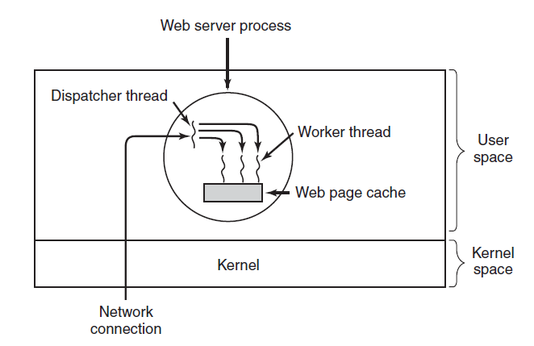
Threads
When the thread blocks on the disk operation, another thread is chosen to run, possibly the dispatcher, in order to acquire more work, or possibly another worker that is now ready to run.
A multithreaded Web server.

Slide 10
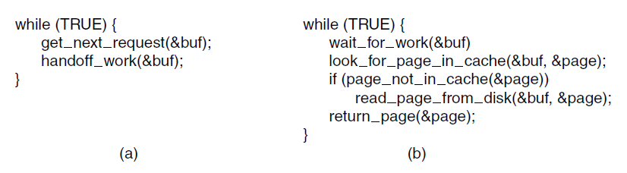
Threads
A rough outline of the code is below. Here, TRUE is assumed to be the constant 1. Also, buf and page are structures appropriate for holding a work request and a Web page, respectively.
A rough outline of the code. (a) Dispatcher thread. (b) Worker thread.

Slide 11
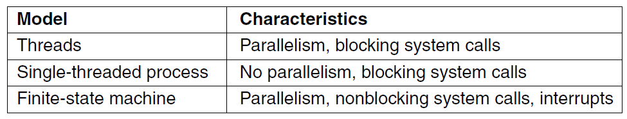
Thread Usage
Three ways to construct a server.
In computing, a system call is the way in which a computer program requests a service from the kernel of the operating system it is executed on. A system call is a way for programs to interact with the operating system. A computer program makes a system call when it makes a request to the operating system’s kernel. System call provides the services of the operating system to the user programs via Application Program Interface(API). It provides an interface between a process and operating system to allow user-level processes to request services of the operating system. System calls are the only entry points into the kernel system. All programs needing resources must use system calls.

Slide 12
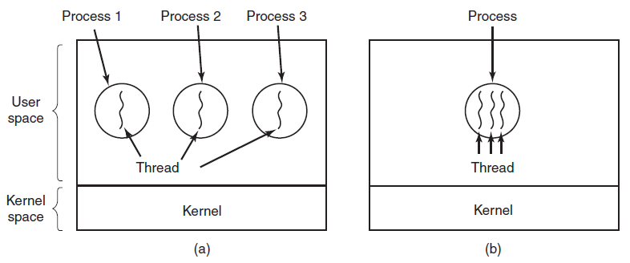
The Classical Thread Model
In Fig. (a) three traditional processes. Each process has its own address space and a single thread of control.
In contrast, in Fig.(b) a single process with three threads of control.
(a) Three processes each with one thread. (b) One process with three threads.

Slide 13
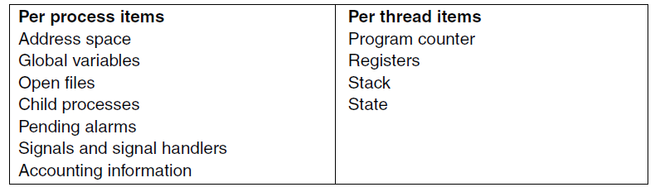
The Classical Thread Model
The first column lists some items shared by all threads in a process. The second one lists some items private to each thread.

Slide 14
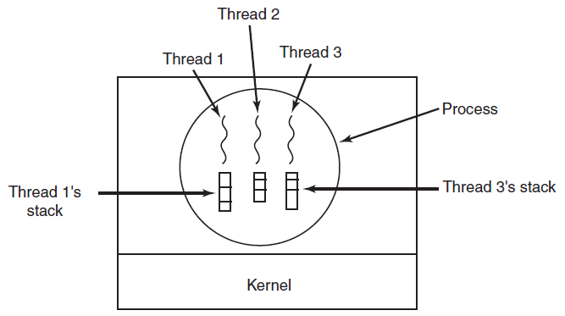
The Classical Thread Model
Each thread has its own stack.

