Slide 1
Operating Systems Concepts CST-221
Topic 2
The Producer and Consumer Problem

Slide 2
Topic 2 – Week 4
Producer and Consumer
Semaphores
Mutexes
Mutexes in Pthreads
Inter-Process Communication
Scheduling
In-Class Activity

Slide 3
Producer and Consumer
The producer-consumer problem (also known as the bounded-buffer problem).
Conceptually, two processes share a common, fixed-size buffer.
One of them, the producer, puts information into the buffer.
The other one, the consumer, takes it out.
Buffer
Producer
Consumer
Grand Canyon University

Slide 4
The Producer and Consumer
Trouble arises when the producer wants to put a new item in the buffer, but it is already full.
The solution is for the producer to go to sleep, to be awakened when the consumer has removed one or more items.
Similarly, if the consumer wants to remove an item from the buffer and sees that the buffer is empty, it goes to sleep until the producer puts something in the buffer and wakes it up.
This approach sounds simple enough, but it leads to a racing condition.
A race condition is an undesirable situation that occurs when a device or system attempts to perform two or more operations at the same time.
To keep track of the number of items in the buffer, we will need a variable, count.
If the maximum number of items the buffer can hold is N, the producer’s code will first test to see if count is N.
If it is, the producer will go to sleep; if it is not, the producer will add an item and increment count.
Grand Canyon University

Slide 5
Producer-Consumer using Semaphores
Producer consumer problem can be solved by using semaphores.
A semaphore S is an integer variable that can be accessed only through two standard operations : wait() and signal().
The wait() operation reduces the value of semaphore by 1 and the signal() operation increases its value by 1.
There are two types of semaphores:
Binary Semaphores - This is also known as mutex lock. It can have only two values – 0 and 1. Its value is initialized to 1. It is used to implement solution of critical section problem with multiple processes.
Counting Semaphore – Its value can range over an unrestricted domain. It is used to control access to a resource that has multiple instances.

Slide 6
Producer-Consumer using Semaphores
To solve the producer-consumer problem using semaphores, we need two counting semaphores – Full and Empty.
“Full” keeps track of number of items in the buffer at any given time.
“Empty” keeps track of number of unoccupied slots.
Initialization of Semaphores:
mutex = 1
Full = 0 // Initially, all slots are empty. Thus, full slots are 0
Empty = n // All slots are empty initially

Slide 7
Producer-Consumer using Semaphore
Producer:
To produce an item the value of “empty” is reduced by 1 and one slot can be filled.
The value of mutex is also reduced to prevent consumer to access the buffer.
The producer has placed the item and the value of “full” is increased by 1.
The value of mutex is also increased by 1
Since mutex has increased by 1, the task of producer has been completed and consumer can access the buffer.

Slide 8
Producer-Consumer using Semaphore
Consumer:
As the consumer removes an item from buffer, the value of “full” is reduced by 1
The value mutex is also reduced so that the producer cannot access the buffer.
Since the consumer has consumed the item, the value of “empty” is increased by 1.
The value of mutex is also increased and the producer can access the buffer.

Slide 9
Mutexes
When the semaphore’s ability to count is not needed, a simplified version of the semaphore, called a mutex, is sometimes used.
Mutexes are good only for managing mutual exclusion to some shared resource or piece of code.
They are easy and efficient to implement, which makes them especially useful in thread packages that are implemented entirely in user space.
A mutex is a shared variable that can be in one of two states: unlocked or locked. Consequently, only 1 bit is required to represent it, but in practice an integer often is used, with 0 meaning unlocked and all other values meaning locked.

Slide 10
Mutexes in Pthreads
Pthreads provides a number of functions that can be used to synchronize threads.
The basic mechanism uses a mutex variable, which can be locked or unlocked, to guard each critical region.
A thread wishing to enter a critical region first tries to lock the associated mutex.
If the mutex is unlocked, the thread can enter immediately and the lock is atomically set, preventing other threads from entering.
If the mutex is already locked, the calling thread is blocked until it is unlocked.
If multiple threads are waiting on the same mutex, when it is unlocked, only one of them is allowed to continue and relock it.
These locks are not mandatory. It is up to the programmer to make sure threads use them correctly.

Slide 11
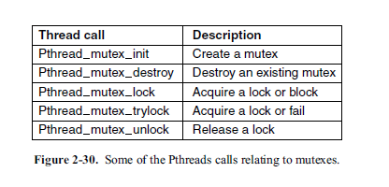
Mutexes in Pthreads

Slide 12
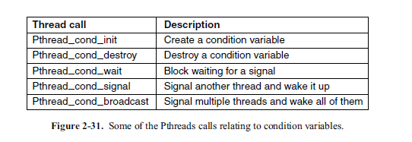
Mutexes in Pthreads

Slide 13
Inter-process Communication
Processes frequently need to communicate with other processes.
For example, in a shell pipeline, the output of the first process must be passed to the second process, and so on down the line.
There is a need for communication between processes, preferably in a well-structured way not using interrupts.
Inter-Process Communication is also known as IPC.

Slide 14
Inter-process Communication
There are three issues here.
How one process can pass information to another.
The second has to do with making sure two or more processes do not get in each other’s way, for example, two processes in an airline reservation system each trying to grab the last seat on a plane for a different customer.
The third concerns proper sequencing when dependencies are present: if process A produces data and process B prints them, B has to wait until A has produced some data before starting to print.

Slide 15
Inter-process Communication
It is also important to mention that two of these issues apply equally well to threads.
The first one—passing information—is easy for threads since they share a common address space (threads in different address spaces that need to communicate fall under the heading of communicating processes).
However, the other two—keeping out of each other’s hair and proper sequencing—apply equally well to threads. The same problems exist, and the same solutions apply.

Slide 16
Scheduling
When a computer is multi-programmed, it frequently has multiple processes or threads competing for the CPU at the same time.
This situation occurs whenever two or more of them are simultaneously in the ready state. If only one CPU is available, a choice has to be made which process to run next.
The part of the operating system that makes the choice is called the scheduler, and the algorithm it uses is called the scheduling algorithm.
The important thing to notice is that some processes spend most of their time computing called compute-bound or CPU-bound.
while other processes spend most of their time waiting for I/O called I/O bound.

Slide 17
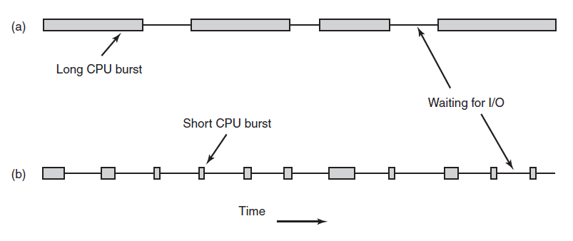
Scheduling
Bursts of CPU usage alternate with periods of waiting for I/O. (a) A CPU-bound process. (b) An I/O-bound process.

Slide 18
Categories of Scheduling Algorithms
Batch.
Interactive.
Real time.

Slide 19
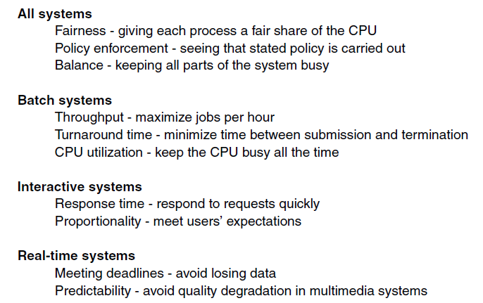
Scheduling Algorithm Goals
Some goals of the scheduling algorithm under different circumstances.

Slide 20
Scheduling in Batch Systems
First-Come First-Served
Shortest Job First
Shortest Remaining Time Next

Slide 21
First-Come First-Served
Probably the simplest of all scheduling algorithms ever devised is non-preemptive first-come, first-served.
With this algorithm, processes are assigned the CPU in the order they request it.
Basically, there is a single queue of ready processes.
When the first job enters the system from the outside in the morning, it is started immediately and allowed to run as long as it wants to.
It is not interrupted because it has run too long. As other jobs come in, they are put onto the end of the queue.
When the running process blocks, the first process on the queue is run next.
When a blocked process becomes ready, like a newly arrived job, it is put on the end of the queue, behind all waiting processes.

Slide 22
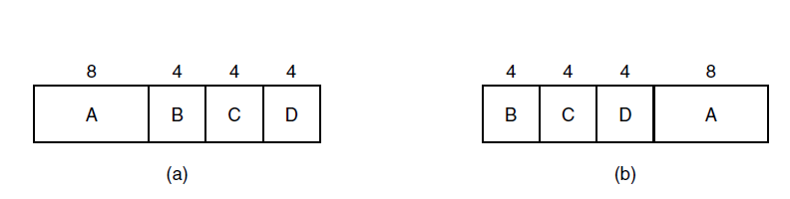
Shortest job First
An example of shortest job first scheduling. (a) Running four jobs in the original order. (b) Running them in shortest job first order.

Slide 23
Shortest Remaining Time Next
A preemptive version of shortest job first is shortest remaining time next.
With this algorithm, the scheduler always chooses the process whose remaining run time is the shortest.
Again here, the run time has to be known in advance.
When a new job arrives, its total time is compared to the current process’ remaining time.
If the new job needs less time to finish than the current process, the current process is suspended, and the new job started.
This scheme allows new short jobs to get good service.

Slide 24
Scheduling in Interactive Systems
Round-Robin Scheduling
Priority Scheduling
Multiple Queues
Shortest Process Next
Guaranteed Scheduling
Lottery Scheduling
Fair-Share Scheduling

Slide 25
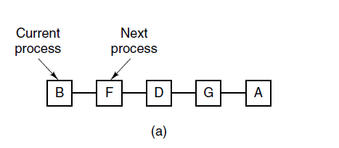
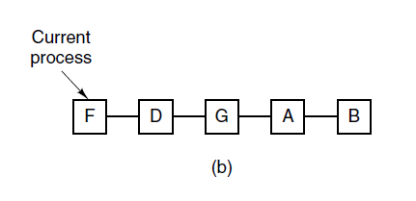
Round-Robin Scheduling
Round-robin scheduling. (a) The list of runnable processes. (b) The list of runnable processes after B uses up its quantum.

Slide 26
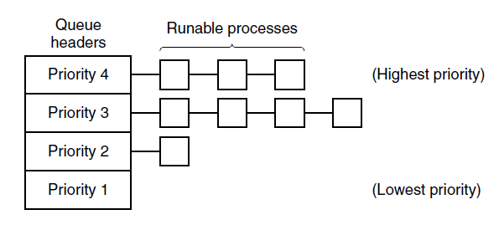
Priority Scheduling
A scheduling algorithm with four priority classes.

Slide 27
Scheduling in Real-Time Systems
Real-time systems are generally categorized as hard real time, meaning there are absolute deadlines that must be met—or else!—
And soft real time, meaning that missing an occasional deadline is undesirable, but nevertheless tolerable.
The events that a real-time system may have to respond to can be further categorized as periodic (meaning they occur at regular intervals) or aperiodic (meaning they occur unpredictably).
A system may have to respond to multiple periodic event streams. Depending on how much time each event requires for processing, handling all of them may not even be possible.
Depending on how much time each event requires for processing, handling all of them may not even be possible.

Slide 28
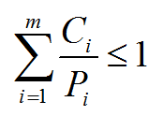
Scheduling in Real-Time Systems
For example, if there are m periodic events and event i occurs with period Pi and requires Ci sec of CPU time to handle each event, then the load can be handled only if

Slide 29
Thread Scheduling
When several processes each have multiple threads, we have two levels of parallelism present: processes and threads.
Scheduling in such systems differs substantially depending on whether user-level threads or kernel-level threads (or both) are supported.

Slide 30
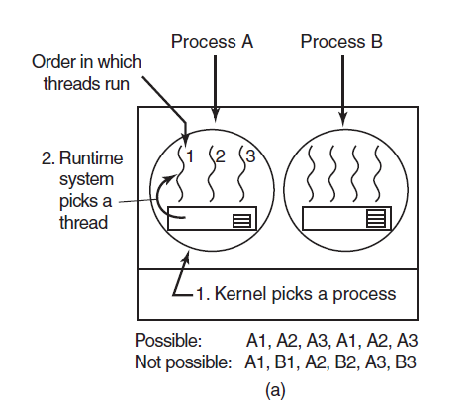
Thread Scheduling
(a) Possible scheduling of user-level threads with a 50-msec process quantum and threads that run 5 msec per CPU burst.

Slide 31
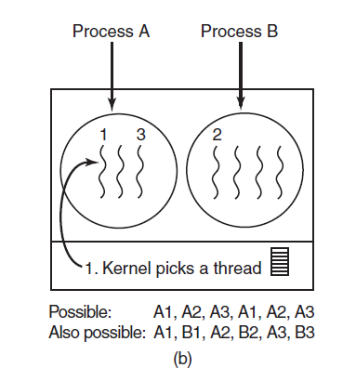
Thread Scheduling
(b) Possible scheduling of kernel-level threads with the same characteristics as (a).

Slide 32
In-Class Activity for Assignment 1
Using threads, implement a producer-consumer. The program must have:
A thread producer() function
A thread consumer() function
A join thread for producer and consumer
A lock and unlock mutex for producer and consumer.
Use a value of “mutex” to prevent produce/consumer to access the buffer.
Buffer
Producer
Consumer

Slide 33
In-Class Activity for Assignment 2
Using semaphores, implement a producer-consumer. The program must have:
A producer() function
A consumer() function
A wait() function
A signal() function
Use a value of “mutex” to prevent produce/consumer to access the buffer.
Buffer
Producer
Consumer

