Slide 1
Operating Systems CST-315
Topic 3 (2 weeks)
Mutual Exclusion and Concurrency
Chapters 5 & 6

Slide 2
Topic 3 Objectives
Demonstrate your understanding of the difference between monitors and semaphores.
Implement a simple scenario (in the context of processes and threads in Unix/Linux) in two separate C programs.
Assess the efficiency of a timer to solve deadlock situations.
Design a shell that handles multiple commands simultaneously.
Grand Canyon University

Slide 3
Topic 3 Project & Assignment
Project 1: Unix/Linux Command Line Interpreter (due on Feb. 12)
Assignment 2: Monitors and Semaphores (due on Feb. 19)
Topic 4
Project 1: Improved UNIX/Linux Command Line Interpreter (due on Feb. 26)
Assignment 3: Deadlock Avoidance (due on March 5)
Grand Canyon University

Slide 4
Monitors
To make it easier to write correct programs, Brinch Hansen (1973 ) and Hoare (1974 ) proposed a higher-level synchronization primitive called a monitor .
Their proposals differed slightly, as described below. A monitor is a collection of procedures, variables, and data structures that are all grouped together in a special kind of module or package.
Processes may call the procedures in a monitor whenever they want to, but they cannot directly access the monitor's internal data structures from procedures declared outside the monitor.
This rule, which is common in modern object-oriented languages such as Java, was relatively unusual for its time.

Slide 5
Monitors
We can illustrate a monitor written in an imaginary language,
monitor example
integer i;
condition c;
procedure producer (x);
.
.
.
end;
procedure consumer (x);
.
.
.
end;
end monitor;

Slide 6
Monitors
Monitors have a key property that makes them useful for achieving mutual exclusion: only one process can be active in a monitor at any instant.
Monitors are a programming language construct, so the compiler knows they are special and can handle calls to monitor procedures differently from other procedure calls.
Typically, when a process calls a monitor procedure, the first few instructions of the procedure will check to see if any other process is currently active within the monitor.
If so, the calling process will be suspended until the other process has left the monitor. If no other process is using the monitor, the calling process may enter.
It is up to the compiler to implement the mutual exclusion on monitor entries, but a common way is to use a mutex or binary semaphore.
Because the compiler, not the programmer, arranges for the mutual exclusion, it is much less likely that something will go wrong.

Slide 7
Monitors
In any event, the person writing the monitor does not have to be aware of how the compiler arranges for mutual exclusion.
It is sufficient to know that by turning all the critical regions into monitor procedures, no two processes will ever execute their critical regions at the same time.
Although monitors provide an easy way to achieve mutual exclusion, that is not enough.
We also need a way for processes to block when they cannot proceed.
In the producer-consumer problem, it is easy enough to put all the tests for buffer-full and buffer-empty in monitor procedures, but how should the producer block when it finds the buffer full?
The solution lies in the introduction of condition variables , along with two operations on them, wait and signal.

Slide 8
Monitors
When a monitor procedure discovers that it cannot continue (e.g., the producer finds the buffer full), it does a wait on some condition variable, say, full . This action causes the calling process to block. It also allows another process that had been previously prohibited from entering the monitor to enter now.
This other process, for example, the consumer, can wake up its sleeping partner-by doing a signal on the condition variable that its partner is waiting on.
To avoid having two active processes in the monitor at the same time, we need a rule telling what happens after a signal.
Hoare proposed letting the newly awakened process run, suspending the other one.
Brinch Hansen proposed finessing the problem by requiring that a process doing a signal must exit the monitor immediately.

Slide 9
Monitors
In other words, a signal statement may appear only as the final statement in a monitor procedure.
We will use Brinch Hansen's proposal because it is conceptually simpler and is also easier to implement. If a signal is done on a condition variable on which several processes are waiting, only one of them, determined by the system scheduler, is revived.
There is also a third solution, not proposed by either Hoare or Brinch Hansen. This is to let the signaler continue to run and allow the waiting process to start running only after the signaler has exited the monitor.
Condition variables are not counters. They do not accumulate signals for later use the way semaphores do.
If a condition variable is signaled with no one waiting on it, the signal is lost. In other words, the wait must come before the signal .

Slide 10
Monitors
This rule makes the implementation much simpler. In practice it is not a problem because it is easy to keep track of the state of each process with variables, if need be.
A process that might otherwise do a signal can see that this operation is not necessary by looking at the variables.
A skeleton of the producer-consumer problem with monitors is shown in Padlets (Monitor.txt) – This is not a working program.
The automatic mutual exclusion on monitor procedures guarantees that if, say, the producer inside a monitor procedure discovers that the buffer is full, it will be able to complete the wait operation without having to worry about the possibility that the scheduler may switch to the consumer just before the wait completes.
The consumer will not even be let into the monitor at all until the wait is finished and the producer is marked as no longer runnable.

Slide 11
Monitors
By making the mutual exclusion of critical regions automatic, monitors make parallel programming much less error-prone than with semaphores. Still, they too have some drawbacks.
It is not for nothing that the program Monitor(in padlet – pseudo-code like) is written rather than in C. Monitors are a programming language concept.
The compiler must recognize them and arrange for the mutual exclusion somehow.
C, Pascal, and most other languages do not have monitors, so it is unreasonable to expect their compilers to enforce any mutual exclusion rules.
In fact, how could the compiler even know which procedures were in monitors and which were not?

Slide 12
Monitors
These same languages do not have semaphores either, but adding semaphores is easy: all you need to do is add two short assembly code routines to the library to issue the up and down system calls.
The compilers do not even have to know that they exist. Of course, the operating systems have to know about the semaphores, but at least if you have a semaphore-based operating system, you can still write the user programs for it in C or C++ (or even FORTRAN if you are masochistic enough).
With monitors, you need a language that has them built in.

Slide 13
Monitors
Another problem with monitors and, also with semaphores, is that they were designed for solving the mutual exclusion problem on one or more CPUs that all have access to a common memory.
By putting the semaphores in the shared memory and protecting them with TSL instructions, we can avoid races.
When we go to a distributed system consisting of multiple CPUs, each with its own private memory, connected by a local area network, these primitives become inapplicable.
The conclusion is that semaphores are too low level and monitors are not usable except in a few programming languages.
Also, none of the primitives provide for information exchange between machines. Something else is needed.

Slide 14
Semaphores
This was the situation until E. W. Dijkstra (1965 ) suggested using an integer variable to count the number of wakeups saved for future use.
In his proposal, a new variable type, called a semaphore , was introduced.
A semaphore could have the value 0, indicating that no wakeups were saved, or some positive value if one or more wakeups were pending.
Dijkstra proposed having two operations, down and up (which are generalizations of sleep and wakeup , respectively).
The down operation on a semaphore checks to see if the value is greater than 0.
If so, it decrements the value (i.e., uses up one stored wakeup) and just continues.
If the value is 0, the process is put to sleep without completing the down for the moment.

Slide 15
Semaphores
Checking the value, changing it, and possibly going to sleep is all done as a single, indivisible, atomic action.
It is guaranteed that once a semaphore operation has started, no other process can access the semaphore until the operation has completed or blocked.
This atomicity is absolutely essential to solving synchronization problems and avoiding race conditions.
The up operation increments the value of the semaphore addressed. If one or more processes were sleeping on that semaphore, unable to complete an earlier down operation, one of them is chosen by the system (e.g., at random) and is allowed to complete its down .
Thus, after an up on a semaphore with processes sleeping on it, the semaphore will still be 0, but there will be one fewer process sleeping on it. The operation of incrementing the semaphore and waking up one process is also indivisible.

Slide 16
Semaphores
No process ever blocks doing an up , just as no process ever blocks doing a wakeup in the earlier model.
As an aside, in Dijkstra's original paper, he used the names p and v instead of down and up , respectively, but since these have no mnemonic significance to people who do not speak Dutch (and only marginal significance to those who do).

Slide 17
Semaphores (Producer and Consumer)
The producer-consumer problem (also known as the bounded-buffer problem).
Conceptually, two processes share a common, fixed-size buffer.
One of them, the producer, puts information into the buffer.
The other one, the consumer, takes it out.
Trouble arises when the producer wants to put a new item in the buffer, but it is already full.
The solution is for the producer to go to sleep, to be awakened when the consumer has removed one or more items.
Similarly, if the consumer wants to remove an item from the buffer and sees that the buffer is empty, it goes to sleep until the producer puts something in the buffer and wakes it up.
This approach sounds simple enough, but it leads to a racing condition.
A race condition is an undesirable situation that occurs when a device or system attempts to perform two or more operations at the same time.

Slide 18
Semaphores (Producer and Consumer)
To keep track of the number of items in the buffer, we will need a variable, count.
If the maximum number of items the buffer can hold is N, the producer’s code will first test to see if count is N.
If it is, the producer will go to sleep; if it is not, the producer will add an item and increment count.
One way to solve the bounden buffer or the producer-consumer problem is by using Semaphores.

Slide 19
Semaphores (Producer and Consumer)
Producer consumer problem can be solved by using semaphores.
A semaphore S is an integer variable that can be accessed only through two standard operations : wait() and signal().
The wait() operation reduces the value of semaphore by 1 and the signal() operation increases its value by 1.
There are two types of semaphores:
Binary Semaphores - This is also known as mutex lock. It can have only two values – 0 and 1. Its value is initialized to 1. It is used to implement solution of critical section problem with multiple processes.
Counting Semaphore – Its value can range over an unrestricted domain. It is used to control access to a resource that has multiple instances.

Slide 20
Producer-Consumer using Semaphores
To solve the producer-consumer problem using semaphores, we need two counting semaphores – Full and Empty.
“Full” keeps track of number of items in the buffer at any given time.
“Empty” keeps track of number of unoccupied slots.
Initialization of Semaphores:
mutex = 1
Full = 0 // Initially, all slots are empty. Thus, full slots are 0
Empty = n // All slots are empty initially

Slide 21
Producer-Consumer using Semaphore
Producer:
To produce an item the value of “empty” is reduced by 1 and one slot can be filled.
The value of mutex is also reduced to prevent consumer to access the buffer.
The producer has placed the item and the value of “full” is increased by 1.
The value of mutex is also increased by 1
Since mutex has increased by 1, the task of producer has been completed and consumer can access the buffer.

Slide 22
Producer-Consumer using Semaphore
Consumer:
As the consumer removes an item from buffer, the value of “full” is reduced by 1
The value mutex is also reduced so that the producer cannot access the buffer.
Since the consumer has consumed the item, the value of “empty” is increased by 1.
The value of mutex is also increased and the producer can access the buffer.

Slide 23
Mutexes
When the semaphore's ability to count is not needed, a simplified version of the semaphore called a mutex, is sometimes used.
Mutexes are good only for managing mutual exclusion to some shared resource or piece of code.
They are easy and efficient to implement, which makes them especially useful in thread packages that are implemented entirely in user space.
A mutex is a variable that can be in one of two states: unlocked or locked. Consequently, only 1 bit is required to represent it, but in practice an integer often is used, with 0 meaning unlocked and all other values meaning locked.
Two procedures are used with mutexes. When a process (or thread) needs access to a critical region, it calls mutex_lock .
If the mutex is currently unlocked (meaning that the critical region is available), the call succeeds, and the calling thread is free to enter the critical region.

Slide 24
Mutexes
On the other hand, if the mutex is already locked, the caller is blocked until the process in the critical region is finished and calls mutex_unlock.
If multiple processes are blocked on the mutex, one of them is chosen at random and allowed to acquire the lock.

Slide 25
In-Class Activity
Separate in groups of 2 – your group
Activity 1
Understand the pseudo-code Monitor.txt in padlet. Make sure you understand the consumer waits (is blocked) until the producer finishes to produce and the producer waits (blocked) until consumer finishes to consume.
Activity 2
With the producer-consumer code in padlet implementing semaphores, modify the program by increasing the buffer size, remove the query and make it run freely by switching between producer and consumer

Slide 26
Operating Systems CST-315
Topic 3
Deadlocks

Slide 27
Topic 3
How deadlocks occur.
Detect the formation of a deadlock.

Slide 28
Reasoning
For many applications, a process needs exclusive access to not one resource, but several.
Common examples include printers, tape drives for backing up company data, and slots in the system’s internal tables. Having two processes simultaneously writing to the printer leads to gibberish.
Having two processes using the same file-system table slot invariably will lead to a corrupted file system.
Process A requests permission to use the scanner and is granted it.
Process B is programmed differently and requests the Blu-ray recorder first and is also granted it.
Now A asks for the Blu-ray recorder, but the request is suspended until B releases it.
Unfortunately, instead of releasing the Bluray recorder, B asks for the scanner.
At this point both processes are blocked and will remain so forever. This situation is called a deadlock.

Slide 29
Resources
A major class of deadlocks involves resources to which some process has been granted exclusive access. These resources include devices, data records, files, and so forth.
To make the discussion of deadlocks as general as possible, we will refer to the objects granted as resources.
A resource can be a hardware device (e.g., a Blu-ray drive) or a piece of information (e.g., a record in a database).
A computer will normally have many different resources that a process can acquire.
For some resources, several identical instances may be available, such as three Blu-ray drives.
When several copies of a resource are available, any one of them can be used to satisfy any request for the resource.
In short, a resource is anything that must be acquired, used, and released over the course of time.

Slide 30
In-Class Activity
Break in groups of two (your group)
Execute the code (located in padlet)
DeadlockCase.c
DeadlockCase2.c
Explain what is happening.
Careful when starting the thread process. Always start with the ‘&’ at the end like
./run &
This is to make sure you can kill the process in case it is not possible to terminate by ctrl-c

Slide 31
Preemptable and Non-preemptable Resources
Resources come in two types: preemptable and non-preemptable.
A preemptable resource is one that can be taken away from the process owning it with no ill effects. Memory is an example of a preemptable resource.
Consider, for example, a system with 1 GB of user memory, one printer, and two 1-GB processes that each want to print something.
Process A requests and gets the printer, then starts to compute the values to print. Before it has finished the computation, it exceeds its time quantum and is swapped out to disk.
Process B now runs and tries, unsuccessfully as it turns out, to acquire the printer.
Potentially, we now have a deadlock situation, because A has the printer and B has the memory, and neither one can proceed without the resource held by the other.
Fortunately, it is possible to preempt (take away) the memory from B by swapping it out and swapping A in. Now A can run, do its printing, and then release the printer. No deadlock occurs.

Slide 32
Preemptable and Non-preemptable Resources
A non-preemptable resource, in contrast, is one that cannot be taken away from its current owner without potentially causing failure.
If a process has begun to burn a Blu-ray, suddenly taking the Blu-ray recorder away from it and giving it to another process will result in a garbled Blu-ray.
Blu-ray recorders are not preemptable at an arbitrary moment.
Whether a resource is preemptible depends on the context. On a standard PC, memory is preemptible because pages can always be swapped out to disk to recover it.
However, on a smartphone that does not support swapping or paging, deadlocks cannot be avoided by just swapping out a memory hog.
In general, deadlocks involve non-preemptable resources. Potential deadlocks that involve preemptable resources can usually be resolved by reallocating resources from one process to another. Thus, we will focus on non-preemptable resources.

Slide 33
Preemptable and Non-preemptable Resources
Sequence of events required to use a resource
Request the resource.
Use the resource.
Release the resource.

Slide 34
Preemptable and Non-preemptable Resources
If the resource is not available when it is requested, the requesting process is forced to wait.
In some operating systems, the process is automatically blocked when a resource request fails and awakened when it becomes available.
In other systems, the request fails with an error code, and it is up to the calling process to wait a little while and try again. A process whose resource request has just been denied will normally sit in a tight loop requesting the resource, then sleeping, then trying again.
Although this process is not blocked, for all intents and purposes it is as good as blocked, because it cannot do any useful work.

Slide 35
Preemptable and Non-preemptable Resources
We will assume that when a process is denied a resource request, it is put to sleep.
The exact nature of requesting a resource is highly system dependent.
In some systems, a request system call is provided to allow processes to explicitly ask for resources.
In others, the only resources that the operating system knows about are special files that only one process can have open at a time.
These are opened by the usual open call. If the file is already in use, the caller is blocked until its current owner closes it.

Slide 36
Resource Acquisition
For some kinds of resources, such as records in a database system, it is up to the user processes rather than the system to manage resource usage themselves.
One way of allowing this is to associate a semaphore with each resource.
These semaphores are all initialized to 1.
Mutexes can be used equally well.
The three steps listed above are then implemented as a down on the semaphore to acquire the resource, the use of the resource, and finally an up on the resource to release it.

Slide 37
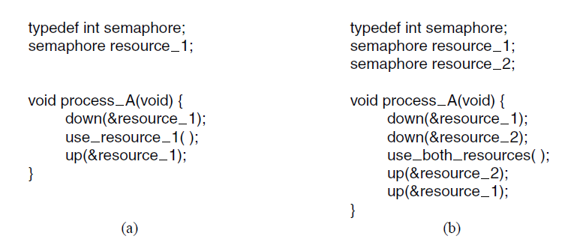
Resource Acquisition
Using a semaphore to protect resources. (a) One resource. (b) Two resources.

Slide 38
Resource Acquisition
Sometimes processes need two or more resources. They can be acquired sequentially.
If more than two resources are needed, they are just acquired one after another.
As long as only one process is involved, everything works fine.
With only one process, there is no need to formally acquire resources, since there is no competition for them.

Slide 39
Resource Acquisition
Now let us consider a situation with two processes, A and B, and two resources.
Two scenarios are depicted.
In (a), both processes ask for the resources in the same order.
In (b), they ask for them in a different order.
This difference may seem minor, but it is not. In (a), one of the processes will acquire the first resource before the other one, that process will then successfully acquire the second resource and do its work.
If the other process attempts to acquire resource 1 before it has been released, the other process will simply block until it becomes available

Slide 40
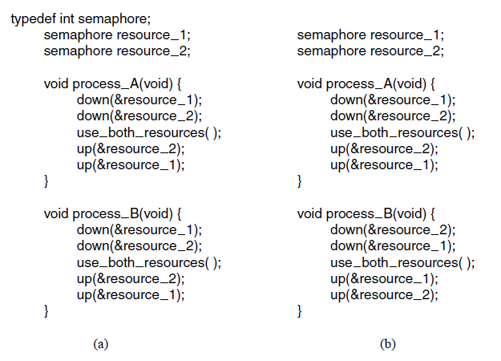
Resource Acquisition
(a) Deadlock-free code. (b) Code with a potential deadlock.

Slide 41
Deadlock Definition
Deadlock can be defined formally as follows:
A set of processes is deadlocked if each process in the set is waiting for an event that only another process in the set can cause.
Therefore, a set of processes is deadlocked if …
Each process in the set waiting for an event
That event can be caused only by another process

Slide 42
Conditions for Resource Deadlocks
four conditions must hold for there to be a (resource) deadlock:
Mutual exclusion condition. Each resource is either currently assigned to exactly one process or is available.
Hold-and-wait condition. Processes currently holding resources that were granted earlier can request new resources.
No-preemption condition. Resources previously granted cannot be forcibly taken away from a process. They must be explicitly released by the process holding them.
Circular wait condition. There must be a circular list of two or more processes, each of which is waiting for a resource held by the next member of the chain.
All four of these conditions must be present for a resource deadlock to occur. If one of them is absent, no resource deadlock is possible.

Slide 43
Deadlock Modeling
Holt (1972) showed how these four conditions can be modeled using directed graphs.
The graphs have two kinds of nodes: processes, shown as circles, and resources, shown as squares.
A directed arc from a resource node (square) to a process node (circle) means that the resource has previously been requested by, granted to, and is currently held by that process.

Slide 44
Resource-Allocation Graph
A set of vertices V and a set of edges E.
V is partitioned into two types:
P = {P₁, P₂, …, P_{n}}, the set consisting of all the processes in the system
R = {R₁, R₂, …, R_{m}}, the set consisting of all resource types in the system
request edge – directed edge P_{i} → R_{j}
assignment edge – directed edge R_{j} → P_{i}

Slide 45
Resource-Allocation Graph
Process
Resource Type with 4 instances
P_{i} requests instance of R_{j}
P_{i} is holding an instance of R_{j}
P_{i}
R_{j}
P_{i}
R_{j}

Slide 46
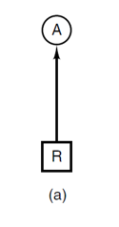
Deadlock Modeling
In Figure (a), resource R is currently assigned to process A.
(a) Holding a resource.

Slide 47
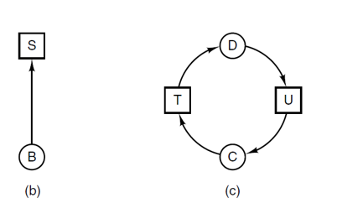
Deadlock Modeling
A directed arc from a process to a resource means that the process is currently blocked waiting for that resource.
In Figure (b), process B is waiting for resource S.
In Figure (c) we see a deadlock: process C is waiting for resource T, which is currently held by process D. Process D is not about to release resource T because it is waiting for resource U, held by C.
Both processes will wait forever. A cycle in the graph means that there is a deadlock involving the processes and resources in the cycle (assuming that there is one resource of each kind). In this example, the cycle is C − T − D − U − C.
(b) Requesting a resource. (c) Deadlock.

Slide 48
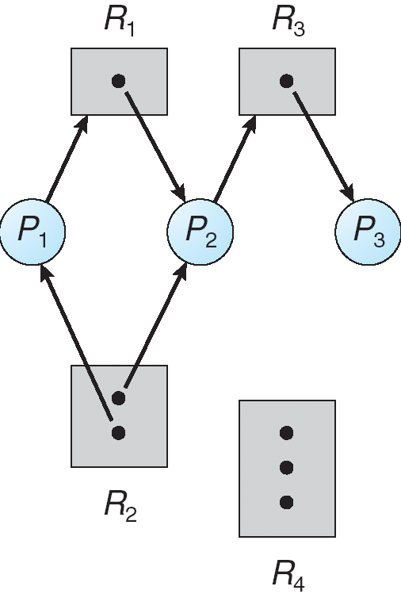
Example of a Resource Allocation Graph
Pictorially, we represent each process P_{i} as a circle and each resource type R_{j} as a square.
Since resource type R_{j} may have more than one instance, we represent each such instance as a dot within the square.
Note that a request edge points to only the square R_{j}, whereas an assignment edge must also designate one of the dots in the square.

Slide 49
Example of a Resource Allocation Graph
The resource-allocation graph shown in the figure depicts the following situation.
The sets P, R and E:
P = {P1,P2,P3}
R = (R1,R2,R3,R4}
E = {P1->R1, P2->R3,R1->P2,R2->P2,R2->P1,R3->P3}
Resource instances:
One instance of resource type R1
Two instances of resource type R2
One instance of resource type R3
Three instances of resource type R4
Process states:
Process P1 is holding an instance of resource type R2, and waiting for an instance of resource type R1
Process P2 is holding an instance of R1 and R2, and waiting for an instance of resource type R3
Process P3 is holding an instance of R3

Slide 50
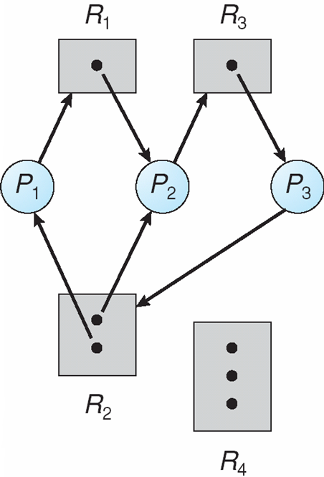
Resource Allocation Graph With A Deadlock
Process P3 requests an instance of resource type R2
Since no resource instance is currently available, a request edge P3->R2 is added to the graph.
At this point, two minimal cycles exist in the system:
P1->R1->P2->R3->P3->R2->P1
P2->R3->P3->R2->P2
Processes P1,P2, and P3 are deadlocked.
Process P2 is waiting for the resource R3, which is held by process P3.
On the other hand, is waiting either process P1 or process P2 to release resource R2.
In addition, process P1 is waiting for process P2 to release resource R1.

Slide 51
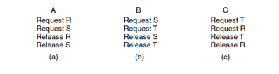
Deadlock Modeling
Now let us look at another example of how resource graphs can be used.
Imagine that we have three processes, A, B, and C, and three resources, R, S, and T. The requests and releases of the three processes are given in Fig. (a)–(c).
The operating system is free to run any unblocked process at any instant, so it could decide to run A until A finished all its work, then run B to completion, and finally run C.

Slide 52
Deadlock Modeling
This ordering does not lead to any deadlocks (because there is no competition for resources) but it also has no parallelism at all.
In addition to requesting and releasing resources, processes compute and do I/O.
When the processes are run sequentially, there is no possibility that while one process is waiting for I/O, another can use the CPU. Thus, running the processes strictly sequentially may not be optimal.
On the other hand, if none of the processes does any I/O at all, shortest job first is better than round robin, so under some circumstances running all processes sequentially may be the best way.

Slide 53
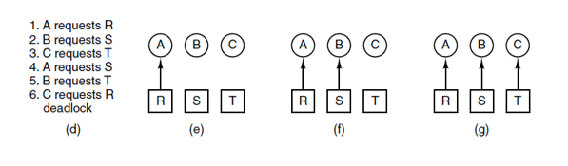
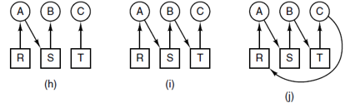
Deadlock Modeling
Let us now suppose that the processes do both I/O and computing, so that round robin is a reasonable scheduling algorithm.
The resource requests might occur in the order of Figure (d).
If these six requests are carried out in that order, the six resulting resource graphs are as shown in Figure (e)–(j).
After request 4 has been made, A blocks waiting for S, as shown in Figure (h).
In the next two steps B and C also block, ultimately leading to a cycle and the deadlock of Figure (j).

Slide 54
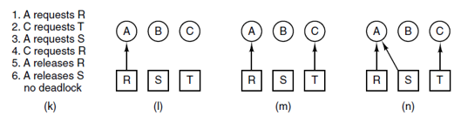
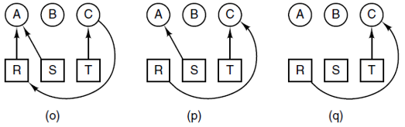
Deadlock Modeling
However, as we have already mentioned, the operating system is not required to run the processes in any special order.
In particular, if granting a particular request might lead to deadlock, the operating system can simply suspend the process without granting the request (i.e., just not schedule the process) until it is safe.
In the Figure, if the operating system knew about the impending deadlock, it could suspend B instead of granting it S.
By running only A and C, we would get the requests and releases of Figure (k) instead of Figure (d).
This sequence leads to the resource graphs of Figure (l)–(q), which do not lead to deadlock.

Slide 55
Deadlock Modeling
After step (q), process B can be granted S because A is finished, and C has everything it needs.
Even if B blocks when requesting T, no deadlock can occur. B will just wait until C is finished.

Slide 56
Deadlock Modeling
Strategies are used for dealing with deadlocks:
Ignore the problem, maybe it will go away.
Detection and recovery. Let deadlocks occur, detect them, and take action.
Dynamic avoidance by careful resource allocation.
Prevention, by structurally negating one of the four required conditions.

Slide 57
The Ostrich Algorithm
Stick your head in the sand and pretend there is no problem. People react to this strategy in different ways.
Mathematicians find it unacceptable and say that deadlocks must be prevented at all costs.
Engineers ask how often the problem is expected, how often the system crashes for other reasons, and how serious a deadlock is.
If deadlocks occur on the average once every five years, but system crashes due to hardware failures and operating system bugs occur once a week, most engineers would not be willing to pay a large penalty in performance or convenience to eliminate deadlocks.
To make this contrast more specific, consider an operating system that blocks the caller when an open system call on a physical device such as a Blu-ray driver or a printer cannot be carried out because the device is busy.
Typically, it is up to the device driver to decide what action to take under such circumstances.
Blocking or returning an error code are two obvious possibilities. If one process successfully opens the Blu-ray drive and another successfully opens the printer and then each process tries to open the other one and blocks trying, we have a deadlock. Few current systems will detect this.

Slide 58
Deadlock Detection with One Resource of Each Type
Example of a system – is it deadlocked?
Process A holds R, wants S
Process B holds nothing, wants T
Process C holds nothing, wants S
Process D holds U, wants S and T
Process E holds T, wants V
Process F holds W, wants S
Process G holds V, wants U

Slide 59
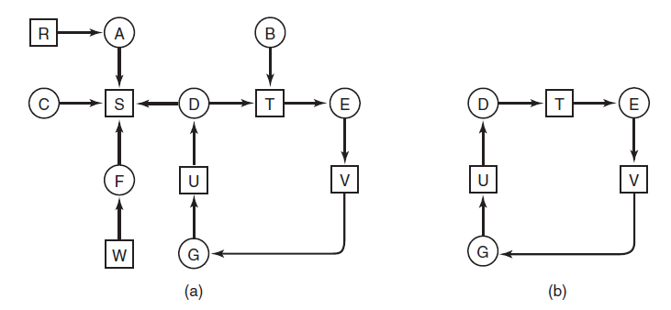
Deadlock Detection with One Resource of Each Type
Process A holds R, wants S
Process B holds nothing, wants T
Process C holds nothing, wants S
Process D holds U, wants S and T
Process E holds T, wants V
Process F holds W, wants S
Process G holds V, wants U
(a) A resource graph. (b) A cycle extracted from (a)

Slide 60
Algorithm to Detect Deadlocks
For each node, N in the graph, perform following five steps with N as starting node.
Initialize L to empty list and designate all arcs as unmarked.
Add current node to end of L, check to see if node now appears in L two times. If so, graph contains a cycle (listed in L) and algorithm terminates

Slide 61
Algorithm to Detect Deadlocks
From given node, see if there are any unmarked outgoing arcs. If so, go to step 5; if not, go to step 6.
Pick unmarked outgoing arc at random, mark it. Then follow to new current node and go to step 3.
If this is initial node, graph does not contain cycles, algorithm terminates. Otherwise, dead end. Remove it and go back to the previous node.

Slide 62
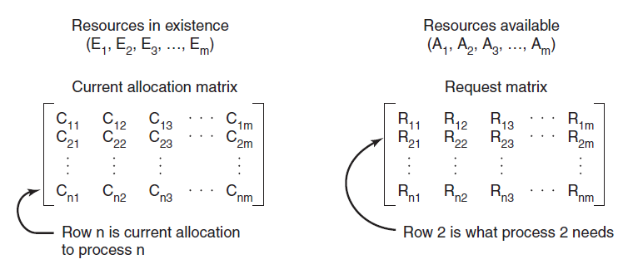
Deadlock Detection with Multiple Resources of Each Type
The four data structures needed by the deadlock detection algorithm.

Slide 63
Deadlock Detection with Multiple Resources of Each Type
Deadlock detection algorithm:
Look for unmarked process, P_{i} , for which the i-th row of R is less than or equal to A.
If such a process is found, add the i-th row of C to A, mark the process, go back to step 1.
If no such process exists, algorithm terminates.

Slide 64
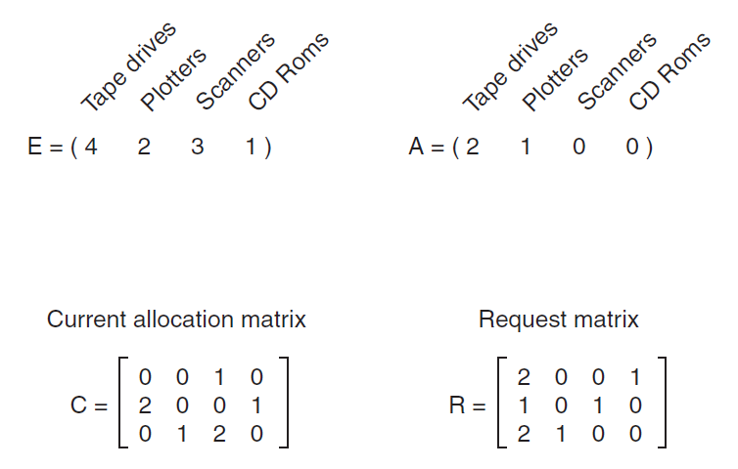
Deadlock Detection with Multiple Resources of Each Type
Here we have three processes and four resource classes, which we have arbitrarily
labeled tape drives, plotters, scanners, and CD Rom drives. Process 1 has one scanner.
Process 2 has two tape drives and a CD Rom drive. Process 3 has a plotter and
two scanners. Each process needs additional resources, as shown by the R matrix.
An example for the deadlock detection algorithm

Slide 65
Deadlock Detection with Multiple Resources of Each Type
To run the deadlock detection algorithm, we look for a process whose resource
request can be satisfied. The first one cannot be satisfied because there is no CD Rom
drive available. The second cannot be satisfied either, because there is no scanner
free. Fortunately, the third one can be satisfied, so process 3 runs and eventually
returns all its resources, giving
A = (2 2 2 0)
At this point process 2 can run and return its resources, giving
A = (4 2 2 1)
Now the remaining process can run. There is no deadlock in the system.
An example for the deadlock detection algorithm

Slide 66
Recovery from Deadlock
Possible Methods of recovery (though none are “attractive”):
Preemption
Rollback
Killing processes

Slide 67
Recovery Through Preemption
The ability to take a resource away from a process, have another process use it, and then give it back without the process noticing it is highly dependent on the nature of the resource.
Recovering this way is frequently difficult or impossible.
Choosing the process to suspend depends largely on which ones have resources that can easily be taken back.

Slide 68
Recovery Through Roolback
When a deadlock is detected, it is easy to see which resources are needed.
To do the recovery, a process that owns a needed resource is rolled back to a point in time before it acquired that resource by starting at one of its earlier checkpoints. All the work done since the checkpoint is lost (e.g., output printed since the checkpoint must be discarded, since it will be printed again).
In effect, the process is reset to an earlier moment when it did not have the resource, which is now assigned to one of the deadlocked processes.
If the restarted process tries to acquire the resource again, it will have to wait until it becomes available

Slide 69
Recovery through Killing Processes
The crudest but simplest way to break a deadlock is to kill one or more processes.
One possibility is to kill a process in the cycle. With a little luck, the other processes will be able to continue.
If this does not help, it can be repeated until the cycle is broken.
Alternatively, a process not in the cycle can be chosen as the victim in order to release its resources.
In this approach, the process to be killed is carefully chosen because it is holding resources that some process in the cycle needs.
For example, one process might hold a printer and want a plotter, with another process holding a plotter and wanting a printer.
These two are deadlocked.
A third process may hold another identical printer and another identical plotter and be happily running. Killing the third process will release these resources and break the deadlock involving the first two.

Slide 70
Deadlock Avoidance
Requires that the system has some additional a priori information available
Simplest and most useful model requires that each process declare the maximum number of resources of each type that it may need.
The deadlock-avoidance algorithm dynamically examines the resource-allocation state to ensure that there can never be a circular-wait condition.
Resource-allocation state is defined by the number of available and allocated resources, and the maximum demands of the processes.

Slide 71
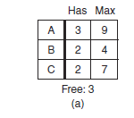
Safe and Unsafe States
A state is said to be safe if there is some scheduling order in which every process can run to completion even if all of them suddenly request their maximum number of resources immediately
It is easiest to illustrate this concept by an example using one resource.
In Figure (a) we have a state in which A has three instances of the resource but may need as many as nine eventually.
B currently has two and may need four altogether, later.
Similarly, C also has two but may need an additional five.
A total of 10 instances of the resource exist, so with seven resources already allocated, three there are still free.
Grand Canyon University

Slide 72
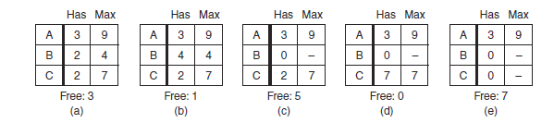
Safe and Unsafe States
The state of Figure (a) is safe because there exists a sequence of allocations that allows all processes to complete.
Namely, the scheduler can simply run B exclusively, until it asks for and gets two more instances of the resource, leading to the state of Figure (b).
When B completes, we get the state of Figure (c). Then the scheduler can run C, leading eventually to Figure (d).
When C completes, we get Figure (e).
Now A can get the six instances of the resource it needs and also complete.
Thus, the state of Figure (a) is safe because the system, by careful scheduling, can avoid deadlock.
Grand Canyon University

Slide 73
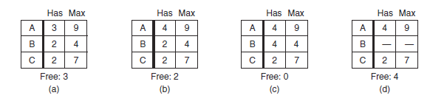
Safe and Unsafe States
Now suppose we have the initial state shown in Figure (a), but this time A requests and gets another resource, giving Figure (b).
Can we find a sequence that is guaranteed to work? Let us try.
The scheduler could run B until it asked for all its resources, as shown in Figure (c).
Eventually, B completes, and we get the state of Figure (d).
At this point we are stuck.
We only have four instances of the resource free, and each of the active processes needs five.
Grand Canyon University

Slide 74
Safe and Unsafe States
There is no sequence that guarantees completion.
Thus, the allocation decision that moved the system from Figure (a) to Figure (b) went from a safe to an unsafe state.
Running A or C next starting at Figure (b) does not work either.
In retrospect, A’s request should not have been granted.
It is worth noting that an unsafe state is not a deadlocked state.
Starting at Figure (b), the system can run for a while.
In fact, one process can even complete.
Furthermore, it is possible that A might release a resource before asking for any more allowing C to complete and avoiding deadlock altogether.
Thus, the difference between a safe state and an unsafe state is that from a safe state the system can guarantee that all processes will finish; from an unsafe state, no such guarantee can be given.
Grand Canyon University

Slide 75
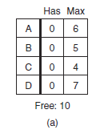
Banker’s Algorithm for a Single Resource
A scheduling algorithm that can avoid deadlocks is due to Dijkstra (1965).
it is known as the banker’s algorithm.
It is modeled on the way a small-town banker might deal with a group of customers to whom he has granted lines of credit. (Years ago, banks did not lend money unless they knew they could be repaid.)
What the algorithm does is check to see if granting the request leads to an unsafe state.
If so, the request is denied. If granting the request leads to a safe state, it is carried out.
In Figure (a) we see four customers, A, B, C, and D, each of whom has been granted a certain number of credit units (e.g., 1 unit is 1K dollars).
The banker knows that not all customers will need their maximum credit immediately, so he has reserved only 10 units rather than 22 to service them. (In this analogy, customers are processes, units are, say, tape drives, and the banker is the operating system.)
Grand Canyon University

Slide 76
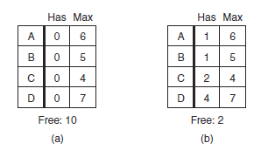
Banker’s Algorithm for a Single Resource
The customers go about their respective businesses, making loan requests from time to time (i.e., asking for resources).
At a certain moment, the situation is as shown in Figure (b).
This state is safe because with two units left, the banker can delay any requests except C’s, thus letting C finish and release all four of his resources. With four units in hand, the banker can let either D or B have the necessary units, and so on.
Grand Canyon University

Slide 77
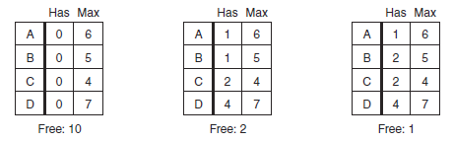
Banker’s Algorithm for a Single Resource
Consider what would happen if a request from B for one more unit were granted in Figure (b).
We would have situation Figure (c), which is unsafe.
If all the customers suddenly asked for their maximum loans, the banker could not satisfy any of them, and we would have a deadlock.
An unsafe state does not have to lead to deadlock, since a customer might not need the entire credit line available, but the banker cannot count on this behavior.
Grand Canyon University

Slide 78
Banker’s Algorithm for a Single Resource
The banker’s algorithm considers each request as it occurs, seeing whether granting it leads to a safe state.
If it does, the request is granted; otherwise, it is postponed until later.
To see if a state is safe, the banker checks to see if he has enough resources to satisfy some customer.
If so, those loans are assumed to be repaid, and the customer now closest to the limit is checked, and so on.
If all loans can eventually be repaid, the state is safe, and the initial request can be granted.
Grand Canyon University

Slide 79
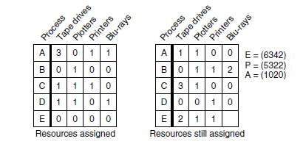
Banker’s Algorithm for Multiple Resource
The banker’s algorithm can be generalized to handle multiple resources. The Figure below shows how it works.
In the Figure we see two matrices.
The one on the left shows how many of each resource are currently assigned to each of the five processes.
The matrix on the right shows how many resources each process still needs in order to complete.
-> Existing resources
-> Currently owned resources
-> Available resources
Grand Canyon University

Slide 80
Banker’s Algorithm for Multiple Resource
These matrices are just C and R from Figure.
As in the single-resource case, processes must state their total resource needs before executing, so that the system can compute the right-hand matrix at each instant.
The three vectors at the right of the figure show the existing resources, E, the possessed resources, P, and the available resources, A, respectively.
From E we see that the system has six tape drives, three plotters, four printers, and two Blu-ray drives.
Of these, five tape drives, three plotters, two printers, and two Blu-ray drives are currently assigned.
This fact can be seen by adding up the entries in the four resource columns in the left-hand matrix.
The available resource vector is just the difference between what the system has and what is currently in use.
-> Existing resources
-> Currently owned resources
-> Available resources
Grand Canyon University

Slide 81
Banker’s Algorithm for Multiple Resource
The algorithm for checking to see if a state is safe can now be stated.
Look for a row, R, whose unmet resource needs are all smaller than or equal to A. If no such row exists, the system will eventually deadlock since no process can run to completion (assuming processes keep all resources until they exit).
Assume the process of the chosen row requests all the resources it needs (which is guaranteed to be possible) and finishes. Mark that process as terminated and add all of its resources to the A vector.
Repeat steps 1 and 2 until either all processes are marked terminated (in which case the initial state was safe) or no process is left whose resource needs can be met (in which case the system was not safe).
Grand Canyon University

Slide 82
Banker’s Algorithm for Multiple Resource
If several processes are eligible to be chosen in step 1, it does not matter which one is selected: the pool of available resources either gets larger, or at worst, stays the same.
Now let us get back to the example of Figure.
The current state is safe.
Suppose that process B now makes a request for the printer. This request can be granted because the resulting state is still safe (process D can finish, and then processes A or E, followed by the rest). Now imagine that after giving B one of the two remaining printers, E wants the last printer.
Granting that request would reduce the vector of available resources to (1 0 0 0), which leads to deadlock, so E’s request must be deferred for a while.
-> Existing resources
-> Currently owned resources
-> Available resources
Grand Canyon University

Slide 83
Banker’s Algorithm for Multiple Resource
The banker’s algorithm was first published by Dijkstra in 1965. Since that time, nearly every book on operating systems has described it in detail.
Innumerable papers have been written about various aspects of it. Unfortunately, few authors have had the audacity to point out that although in theory the algorithm is wonderful, in practice it is essentially useless because processes rarely know in advance what their maximum resource needs will be.
In addition, the number of processes is not fixed, but dynamically varying as new users log in and out.
Furthermore, resources that were thought to be available can suddenly vanish (tape drives can break).
Thus, in practice, few, if any, existing systems use the banker’s algorithm for avoiding deadlocks.
Some systems, however, use heuristics similar to those of the banker’s algorithm to prevent deadlock.
For instance, networks may throttle traffic when buffer utilization reaches higher than, say, 70%—estimating that the remaining 30% will be sufficient for current users to complete their service and return their resources.
Grand Canyon University

Slide 84
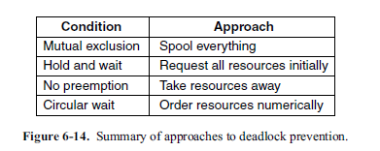
Deadlock Prevention
Having seen that deadlock avoidance is essentially impossible, because it requires information about future requests, which is not known, how do real systems avoid deadlock?
The answer is to go back to the four conditions stated by Coffman et al. (1971) to see if they can provide a clue. If we can ensure that at least one of these conditions is never satisfied, then deadlocks will be structurally impossible (Havender, 1968).
Attacking the Mutual-Exclusion Condition
Attacking the Hold-and-Wait Condition
Attacking the No-Preemption Condition
Attacking the Circular Wait Condition
Grand Canyon University

Slide 85
Safe State
When a process requests an available resource, system must decide if immediate allocation leaves the system in a safe state.
System is in safe state if there exists a safe sequence of all processes.
Sequence <P₁, P₂, …, P_{n}> is safe if for each P_{i}, the resources that P_{i} can still request can be satisfied by currently available resources plus the resources held by all the P_{j} with j<i.
If P_{i} resource needs are not immediately available, then P_{i} can wait until all P_{j} have finished.
When P_{j} is finished, P_{i} can obtain needed resources, execute, return allocated resources, and terminate.
When P_{i} terminates, P_{i+1} can obtain its needed resources, and so on.

Slide 86
Basic Facts
If a system is in a safe state ⇒ no deadlocks.
If a system is in unsafe state ⇒ possibility of deadlock.
Avoidance ⇒ ensure that a system will never enter an unsafe state.

Slide 87
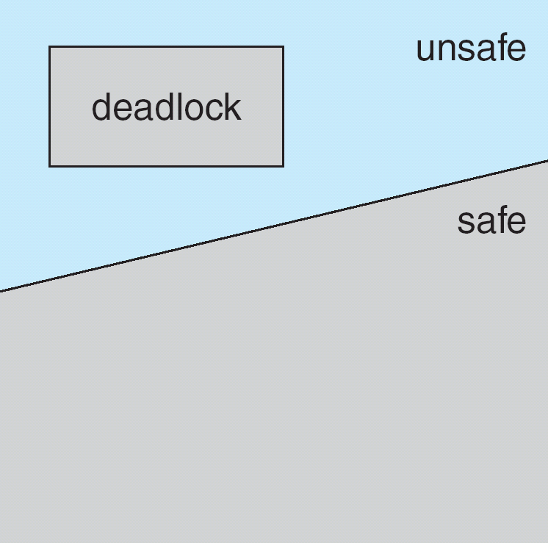
Safe and Unsafe Deadlock State

Slide 88
Avoidance Algorithms
Single instance of a resource type
Use a resource-allocation graph
Multiple instances of a resource type
Use the banker’s algorithm

Slide 89
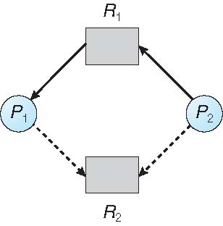
Resource-Allocation Graph Scheme
Claim edge P_{i} → R_{j} indicated that process P_{j} may request resource R_{j}; represented by a dashed line
Claim edge converts to request edge when a process requests a resource
Request edge converted to an assignment edge when the resource is allocated to the process
When a resource is released by a process, assignment edge reconverts to a claim edge
Resources must be claimed a priori in the system

Slide 90
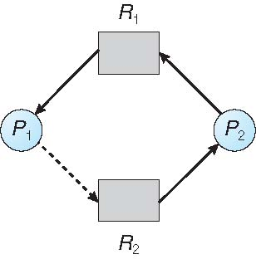
Unsafe State In Resource-Allocation Graph
Suppose that P₂ requests R₂.
Although R₂ is currently free, we cannot allocate it to P₂, since this action will create a cycle in the graph.
A cycle indicates that the system is in an unsafe state.
If P₁ requests R₂, and P₂ requests R₁, then a deadlock will occur.
The request can be granted only if converting the request edge to an assignment edge does not result in the formation of a cycle in the resource allocation graph.

Slide 91
Banker’s Algorithm
The resource-allocation graph algorithm is not applicable to a resource-allocation system with multiple instances of each resource type.
The deadlock-avoidance algorithm that we describe is applicable to such a system but is less efficient than the resource-allocation graph scheme.
This algorithm is commonly known as the banker’s algorithm.
The name was chosen because this algorithm could be used in a banking system to ensure that the bank never allocates its available cash such that it can no longer satisfy the needs of all customers.

Slide 92
Banker’s Algorithm
Multiple instances
Each process must a priori claim maximum use
When a process requests a resource, it may have to wait
When a process gets all its resources it must return them in a finite amount of time

Slide 93
Data Structures for the Banker’s Algorithm
Let n = number of processes, and m = number of resources types.
Available: Vector of length m. If available [j] = k, there are k instances of resource type R_{j} available
Max: n x m matrix. If Max [i,j] = k, then process P_{i} may request at most k instances of resource type R_{j}
Allocation: n x m matrix. If Allocation[i,j] = k then P_{i} is currently allocated k instances of R_{j}
Need: n x m matrix. If Need[i,j] = k, then P_{i} may need k more instances of R_{j} to complete its task
Need [i,j] = Max[i,j] – Allocation [i,j]

Slide 94
Safety Algorithm
The algorithm for finding out whether or not a system is in a safe state can be described as follows:
Let Work and Finish be vectors of length m and n, respectively. Initialize:
Work = Available
Finish [i] = false for i = 0, 1, …, n- 1
2. Find an i such that both:
(a) Finish [i] = false
(b) Need_{i} ≤ Work
If no such i exists, go to step 4
3. Work = Work + Allocation_{i} Finish[i] = true go to step 2
4. If Finish [i] == true for all i, then the system is in a safe state

Slide 95
Resource-Request Algorithm for Process P_{i}
Request_{i} = request vector for process P_{i}. If Request_{i} [j] = k then process P_{i} wants k instances of resource type R_{j}
1. If Request_{i} ≤ Need_{i} go to step 2. Otherwise, raise error condition, since process has exceeded its maximum claim
2. If Request_{i} ≤ Available, go to step 3. Otherwise, P_{i} must wait, since resources are not available
3. Pretend to allocate requested resources to P_{i} by modifying the state as follows:
Available = Available – Request_{i};
Allocation_{i} = Allocation_{i} + Request_{i};
Need_{i} = Need_{i} – Request_{i};
If safe ⇒ the resources are allocated to P_{i}
If unsafe ⇒ P_{i} must wait, and the old resource-allocation state is restored

Slide 96
In-Class Activity
Separate in groups of two (your group)
Activity 1
A system has two processes and three identical resources. Each process needs a maximum of two resources. Is deadlock possible? Explain your answer.
The system is deadlock free. Suppose that each process has one resource. There is one resource free. Either process can ask for it and get it, in which case it can finish and release both resources. Consequently, deadlock is impossible.
Activity 2
Go to padlet and get the program Bakker’s_deadlock_avoidance.c.
Read the explanation before getting the code and attempt to run. Understand what the code is doing. Talk between each other. Execute the code and understand the behavior. Modify the code and try other options.

Slide 97
Example of Banker’s Algorithm
5 processes P₀ through P₄;
3 resource types:
A (10 instances), B (5 instances), and C (7 instances)
Snapshot at time T₀:
Allocation Max Available
A B C A B C A B C
P₀ 0 1 0 7 5 3 3 3 2
P₁ 2 0 0 3 2 2
P₂ 3 0 2 9 0 2
P₃ 2 1 1 2 2 2
P₄ 0 0 2 4 3 3

Slide 98
Example (Cont.)
The content of the matrix Need is defined to be Max – Allocation
Need
A B C
P₀ 7 4 3
P₁ 1 2 2
P₂ 6 0 0
P₃ 0 1 1
P₄ 4 3 1
The system is in a safe state since the sequence < P₁, P₃, P₄, P₂, P₀> satisfies safety criteria

Slide 99
Example: P₁ Request (1,0,2)
Check that Request ≤ Available (that is, (1,0,2) ≤ (3,3,2) ⇒ true
Allocation Need Available
A B C A B C A B C
P₀ 0 1 0 7 4 3 2 3 0
P₁ 3 0 2 0 2 0
P₂ 3 0 2 6 0 0
P₃ 2 1 1 0 1 1
P₄ 0 0 2 4 3 1
Executing safety algorithm shows that sequence < P₁, P₃, P₄, P₀, P₂> satisfies safety requirement
Can request for (3,3,0) by P₄ be granted?
Can request for (0,2,0) by P₀ be granted?

