Slide 1
Empirical Evaluation of Recurrent Neural Networks for System Identification
Nolan Wagener

Slide 2
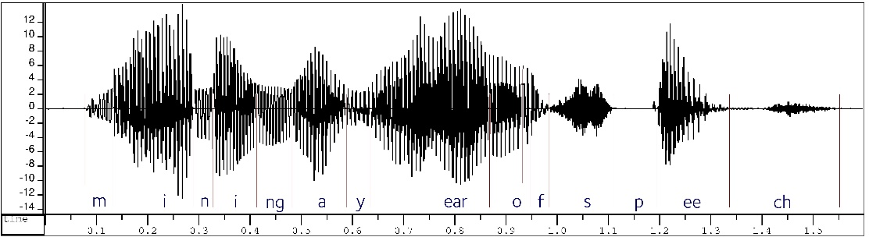
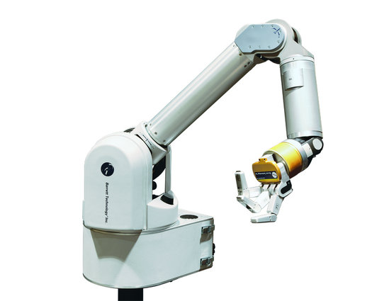
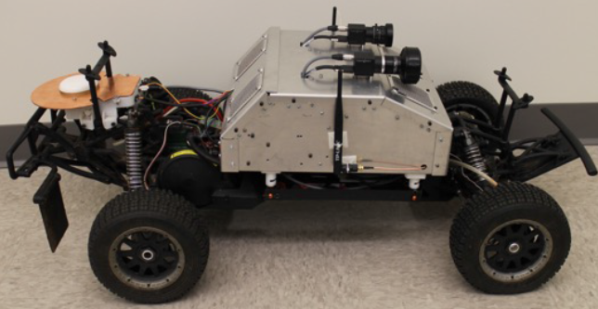
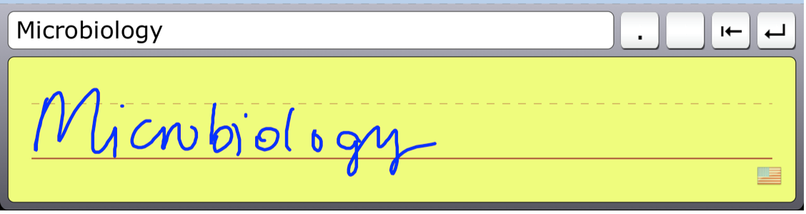
Why Recurrent Neural Nets?
Successes
Relatively unexplored
Phenome recognition
Physical system identification and control
Handwriting recognition

Slide 3
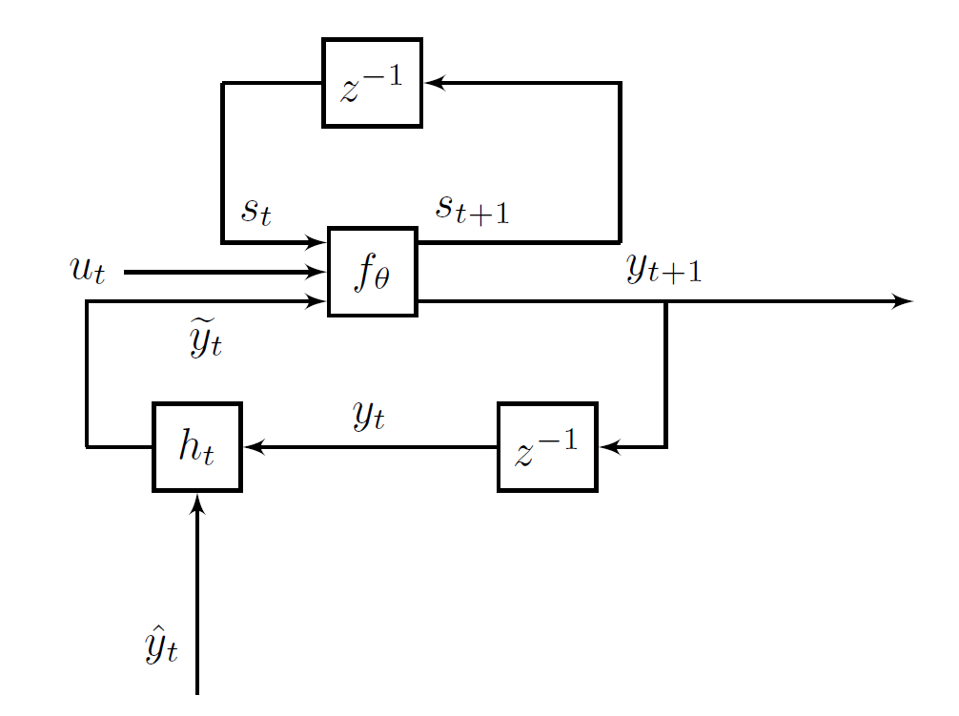
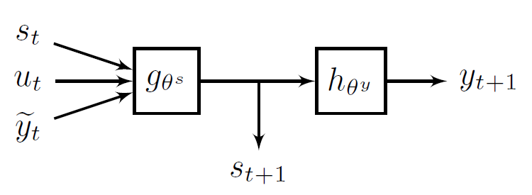
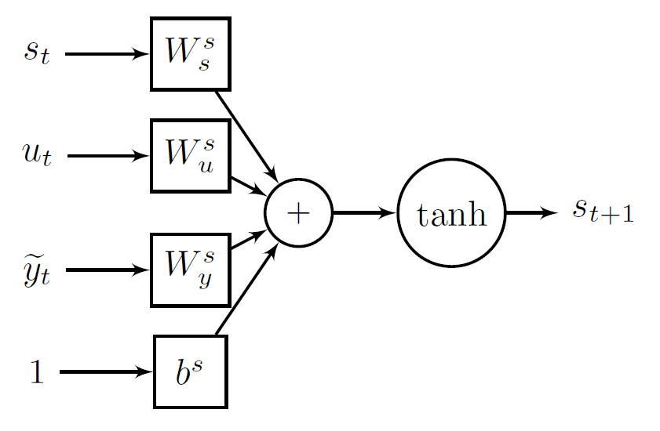
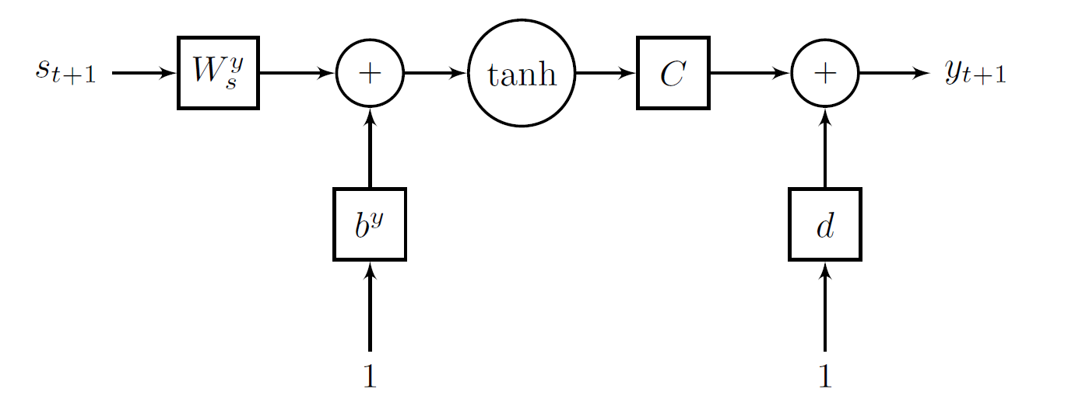
Our recurrent neural network
Returns one of the inputs

Slide 4
Pretraining
Learn the state representation
Learn the state dynamics
Learn the observation equation

Slide 5
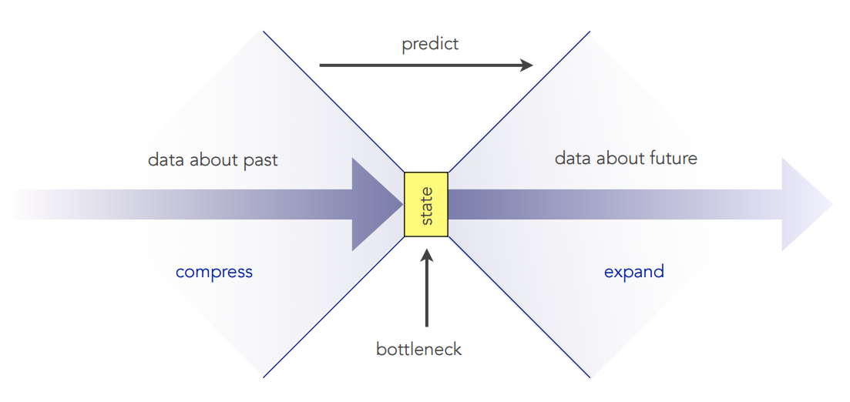
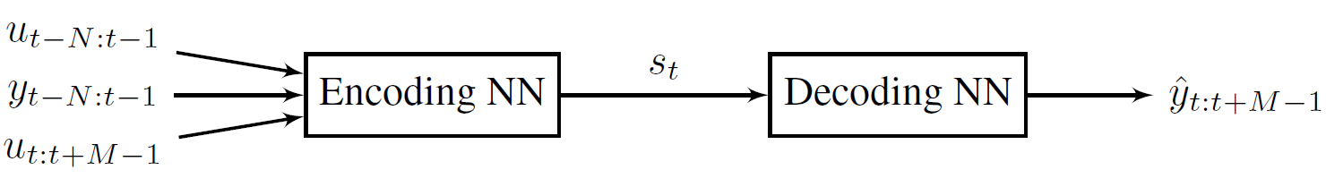
Pretraining I: State representation
State: “statistic of history sufficient to predict the future”
Input: Dataset of inputs and observations
Output: Collection of states s_{t}

Slide 6
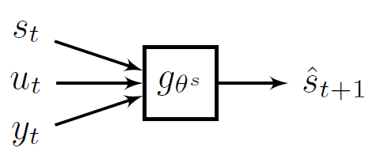
Pretraining II: State Dynamics
Input: States from previous step, dataset of inputs and observations
Output: Dynamics parameters

Slide 7
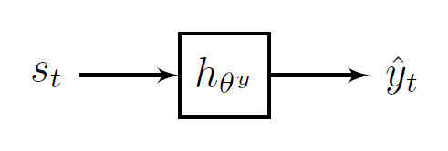
Pretraining III: Observation
Input: States from first step, dataset of observations
Output: Observation parameters

Slide 8
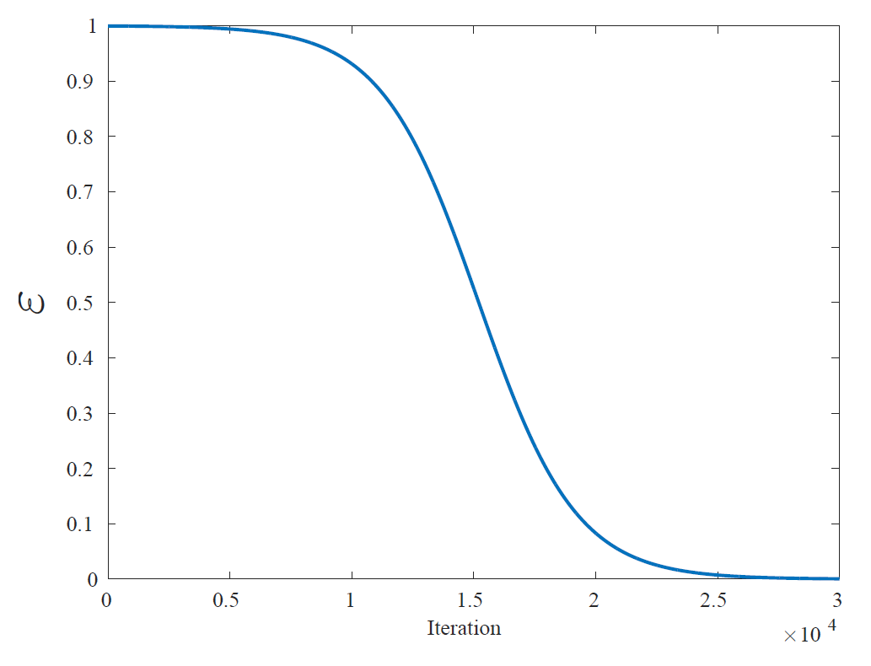
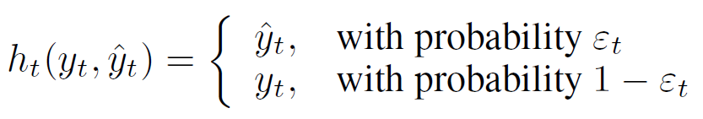
Training
Backpropagation through time (BPTT) with curriculum learning
Early on, learn to predict given true observation
Later, become good at predicting on own
Validation
Compared against linear system generated from N4SID and EM
Feedback on true observations for first half of dataset (filtering)
Feedback on prediction observations for second half (inference)

Slide 9
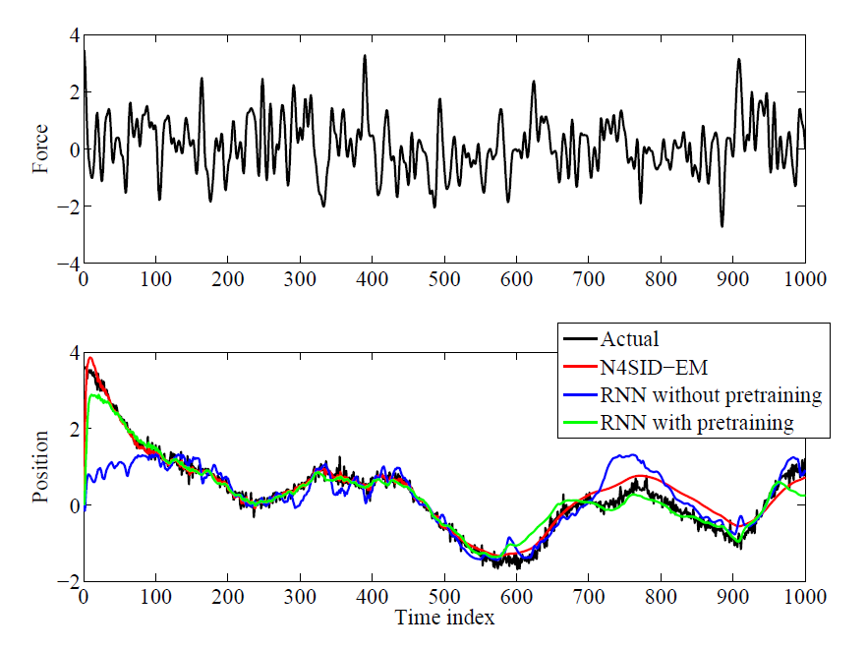
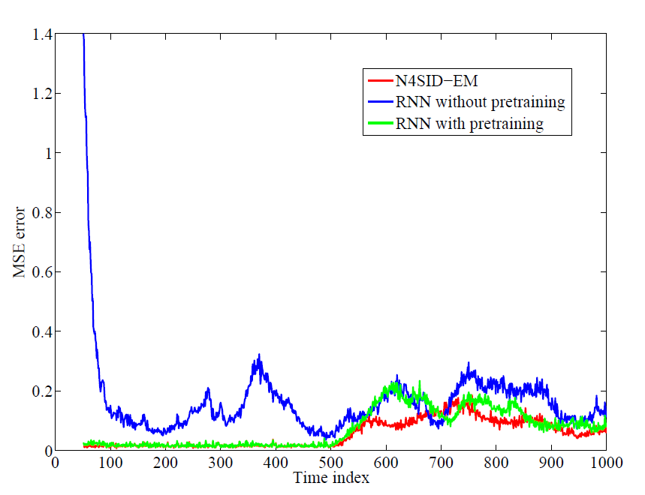
Results: Linear mass-spring-damper

Slide 10
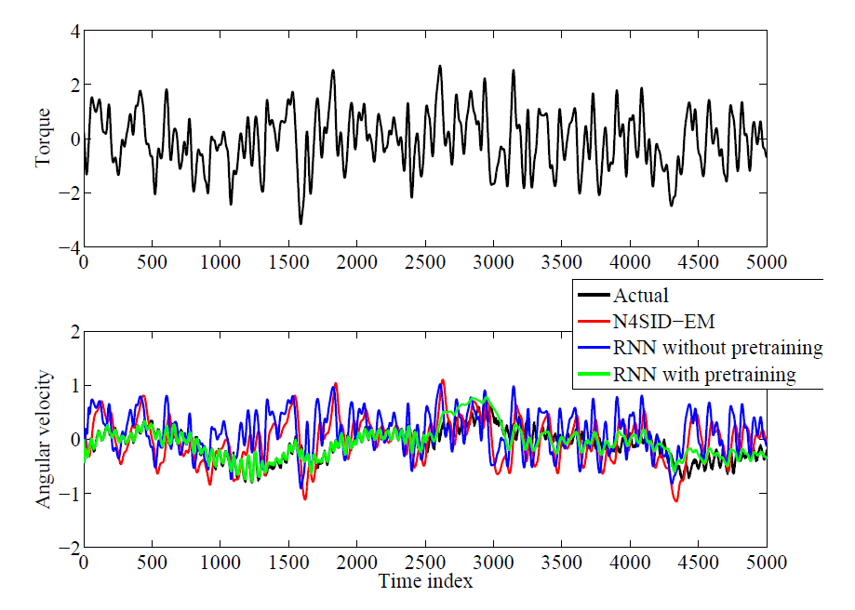
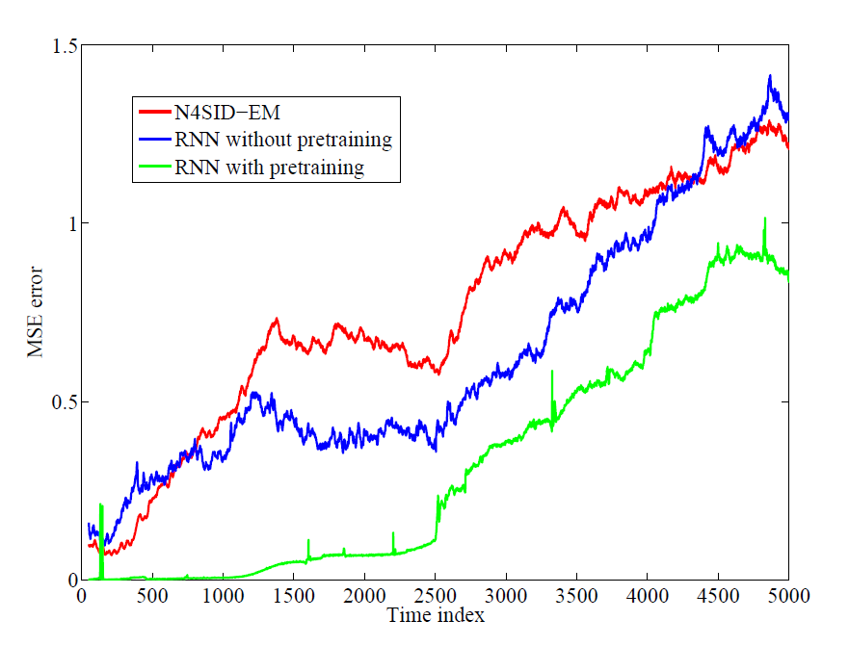
Results: MDOF nonlinear mass-spring-damper

Slide 11
Conclusions and Future Work
Pretraining seems to help but still difficult to train RNNs
Will try different RNN designs that might make learning simpler
If successful, will perform control with RNN models

Slide 12
Questions?

Slide 13
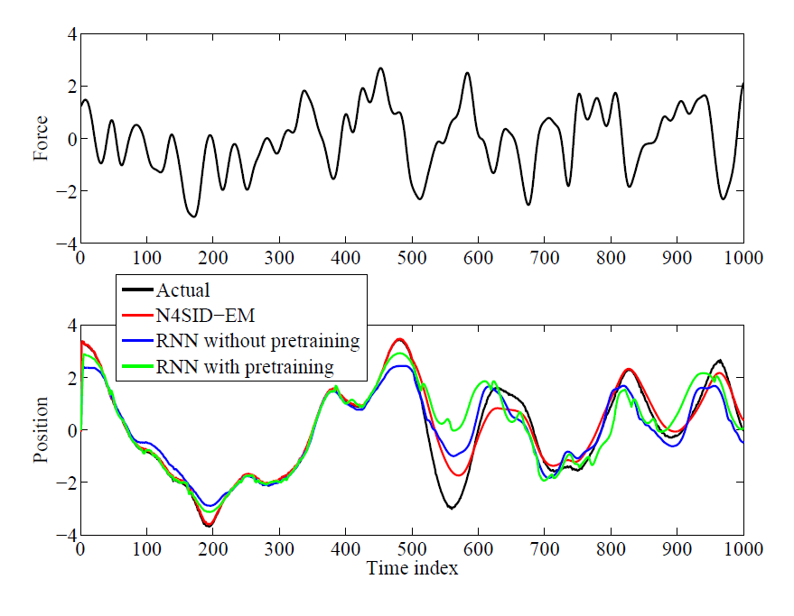
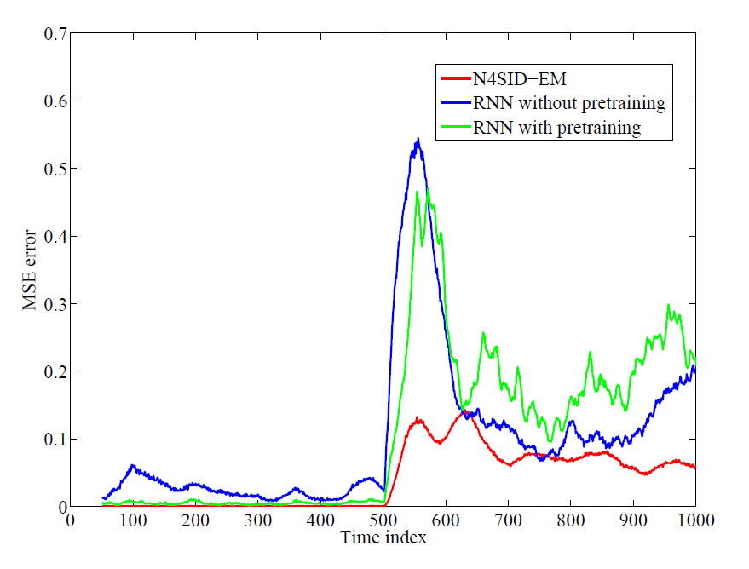
Results: SDOF nonlinear mass-spring-damper

