Slide 1
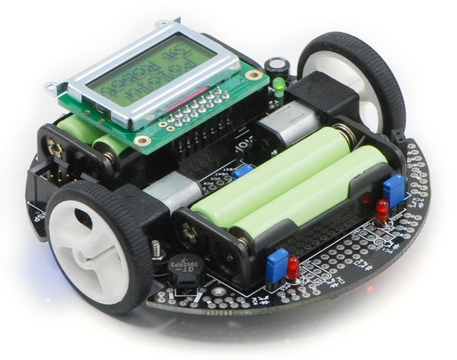
Line-Maze Solving Robot
Nolan Wagener & Kyle Chiang

Slide 2
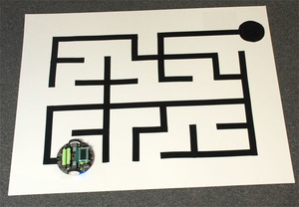
The Standard Maze Problem
No loops!
Fixed start and end points

Slide 3
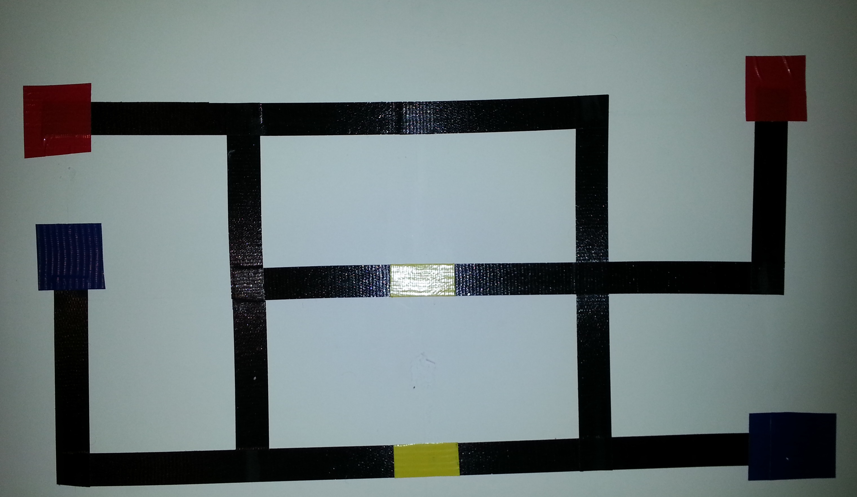
Task: Solve Maze to Visit Destinations
Robot Can Start Anywhere
Door
Destinations

Slide 4
Two Phase Solution: Mapping and Solving
Mapping
Robot visits unexplored edges, tells computer about intersections
Computer tells robot actions to take, generates internal map
Solving
User tells what destinations it wants visited and what doors are open/closed
Computer generates optimal path for destinations, sends commands to robot

Slide 5
Levels of Control
User input
Path-finding
PID
Actuator

Slide 6
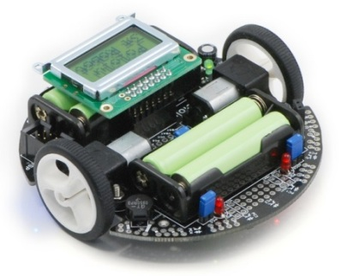


Tools Used
m3pi robot
mbed microcontroller
BlueSMIRF Bluetooth modem
S371 color sensor
Laptop with Bluetooth
Python program for maze solving and communication to robot

Slide 7
Technical Challenge I: Maze Exploration
Can’t just do left hand on the wall
Main idea of our algorithm: Keep track of vertices that must be visited
Any new vertex that is visited and has edges we haven’t explored get added to our “must-visit” set
Use uniform cost search to get to vertices that must be explored
Whenever all edges of vertex is explored, we remove vertex from set

Slide 8
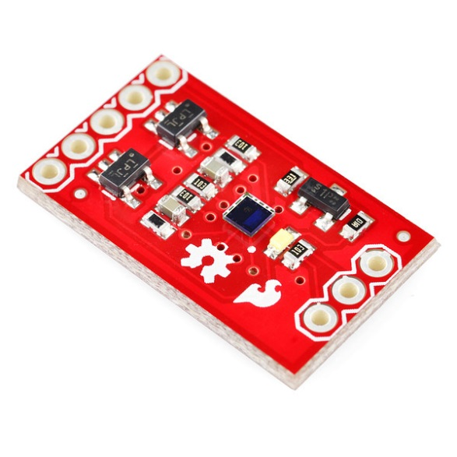
Technical Challenge II: Color Sensor
Takes too long to get accurate color reading
If included in PID loop, robot cannot track line
Solution
Use colored tape that can be differentiated by reflectance sensors
Break out of PID loop and stop robot before reading color sensor

Slide 9
Technical Challenge III: Reflectance Sensor
Inaccurate detection of intersections
Incorrectly detect path
Would cause robot to veer off the map
Neglect to detect path
Incorrect detection during exploration leads to unexplored edges
Solution
Careful tweaking of thresholds

Slide 10
Summary
Robot can solve maze with loops
Code can create optimal paths, even under changing conditions
Future Work
Resolve timing issues
Optimize PID loop to increase sampling rate

Slide 11
Questions?

