Slide 1
CSYE 7200 : Big-Data Systems Engineering Using Scala SEC 01
Mobile Phone Recommender System
Team 2
Suoge Zhu
Ke Wang
Silu Zhao

Slide 2
Project Goals
Perform statistical and sentiment analyses on Amazon Mobile Phone Reviews dataset
Compare rating and review text sentiment scores to analyze Rater Bias^{[1]}
Develop a recommendation system with the analysis results above
[1] Rater Bias: To check whether there is a tendency for customers to give a higher rating than the normalized review text sentiment score, or vice versa.

Slide 3
Methodologies
Spark for storing data
Sentiment analyses on customer reviews
Clustering algorithm and machine learning for brands and reviews
HTML

Slide 4
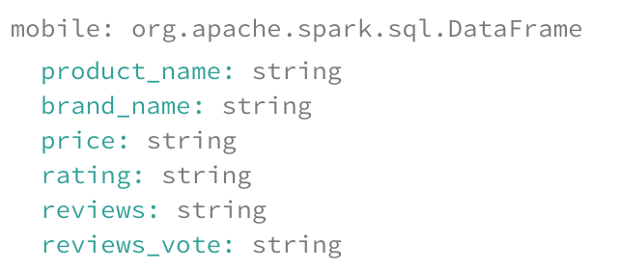
Dataset Overview Amazon Reviews: Unlocked Mobile Phones (34.78 MB CVS file) (2016)

Slide 5
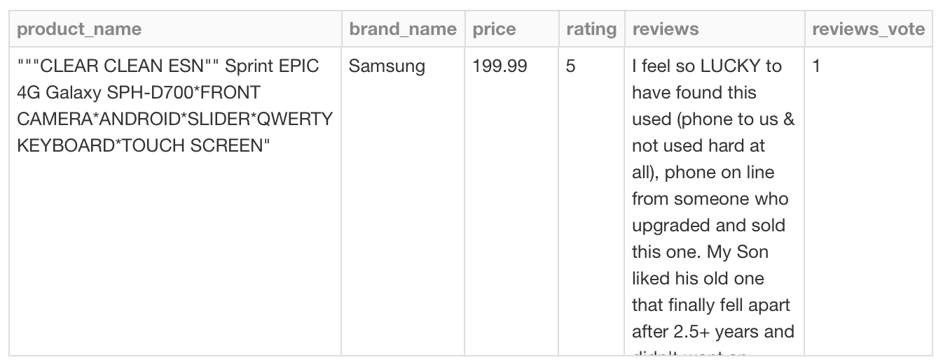
Dataset Overview (Cont.) Amazon Reviews: Unlocked Mobile Phones (34.78 MB CSV file) (2016)

Slide 6
Use Case 1: Brand Navigation
Display top 10 mobile phone brands with average price, rating, average rating, average sentiment score and average combined score
User input: select a brand
Output:
Show 20 keywords in reviews of that brand
Show top 10 products of selected brand with average price,
rating, average rating, average sentiment score and average combined score

Slide 7
Use Case 2: Price Navigation
For every price interval, compute average price, count the total number of products and calculate average rating
For each rating score (1-5), calculate average price
User input:
Select price ranges
Output:
Show top 10 products of selected brand with average price, rating, average rating, average sentiment score and average combined score

Slide 8
Acceptance Criteria
1. According to TheTopTens^{[1]} , for top 10 brands of mobile phones, our recommender system accuracy is 77.8%
2. According to same site^{[2]} , for each brand, the best seller is accurate
[1] https://www.thetoptens.com/best-cell-phone-brands/
[2] https://www.thetoptens.com/best-cell-phone-brands/

Slide 9
Reference
1. https://www.kaggle.com/PromptCloudHQ/amazon-reviews-unlocked-mobile-phones
2. https://databricks-prod-cloudfront.cloud.databricks.com/public/4027ec902e239c93eaaa8714f173bcfc/3741049972324885/3783546674231782/4413065072037724/latest.html
3. https://acadgild.com/blog/twitter-sentiment-analysis-using-spark/

