Slide 1
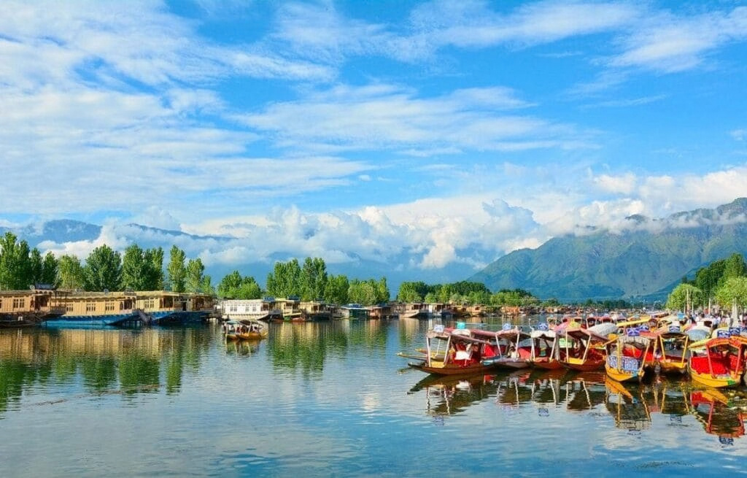
01
A TALE OF TWO REALITIES
KASHMIR: HEAVEN & HELL
Natural beauty, living culture, conflict and the search for a more peaceful future.
KEY POINTS
• A region known for its Himalayan landscapes and rich cultural heritage.
• Its modern history also includes conflict, displacement and political change.
• This presentation looks at both sides of that story.
KASHMIR

Slide 2
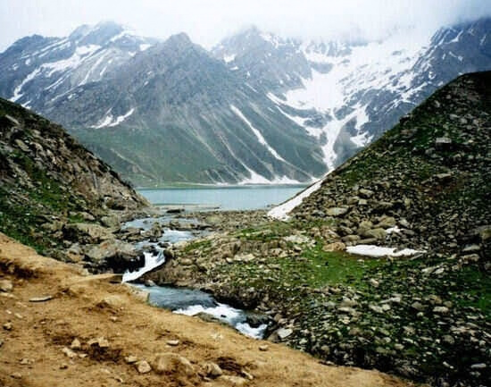
02
NATURAL BEAUTY
The Heaven of India — Natural Beauty & Geography
Kashmir’s landscape is shaped by mountains, lakes, rivers and fertile valleys.
KEY POINTS
• Dal Lake, Gulmarg, Pahalgam and Sonamarg are major scenic destinations.
• The Himalayan setting gives Kashmir a distinctive natural character.
• Tourism is closely connected with its landscapes and changing seasons.
KASHMIR

Slide 3
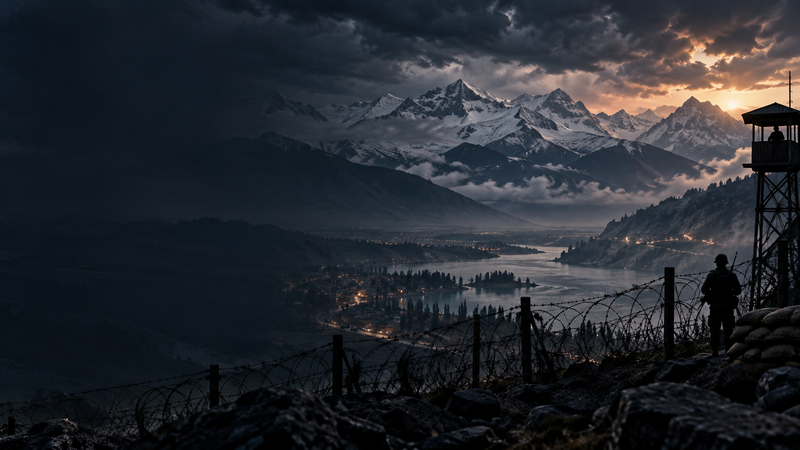
03
NATURAL BEAUTY
Landmarks, Flora, Fauna & Four Seasons
Each season changes the appearance and experience of Kashmir.
KEY POINTS
• Winter brings snow; spring brings flowers and tulips.
• Summer creates green valleys and clear mountain views.
• Autumn is known for golden Chinar foliage.
• Hangul and saffron are notable parts of the region’s natural heritage.
KASHMIR

Slide 4
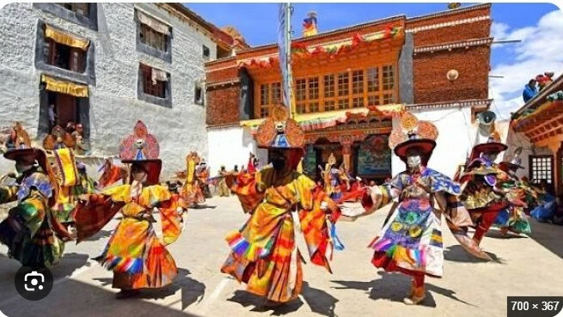
04
CULTURE
The Soul of Kashmir — Culture & Kashmiriyat
Kashmiri culture reflects a long history of shared traditions and diverse influences.
KEY POINTS
• Kashmiriyat is commonly used to describe a shared cultural ethos.
• Sufi traditions have had an important influence on Kashmiri culture.
• Muslim, Pandit and Sikh communities have contributed to its heritage.
• Hospitality, poetry, music and family traditions remain significant.
KASHMIR

Slide 5
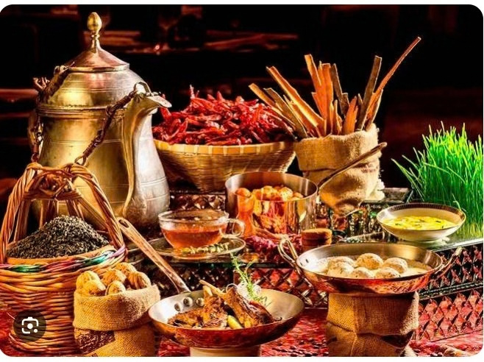
05
CULTURE
Arts, Crafts, Cuisine & Community Life
Culture is visible in the things people create, cook, wear and share.
KEY POINTS
• Pashmina, papier-mâché, carpet weaving and walnut carving are well-known crafts.
• Wazwan and kahwa are important parts of Kashmiri cuisine.
• Rouf, traditional music, poetry and storytelling add to the cultural identity.
• Craft skills and hospitality continue across generations.
KASHMIR

Slide 6
06
HISTORY
Partition, Accession & the First War
The Kashmir dispute developed during the political transition of 1947.
KEY POINTS
• Partition created India and Pakistan and left princely states to decide their accession.
• Maharaja Hari Singh initially sought to remain independent.
• In October 1947, armed tribal forces entered the state and the ruler signed the Instrument of Accession to India.
• Fighting followed in 1947–48 and ended with a UN-brokered ceasefire.
KASHMIR

Slide 7
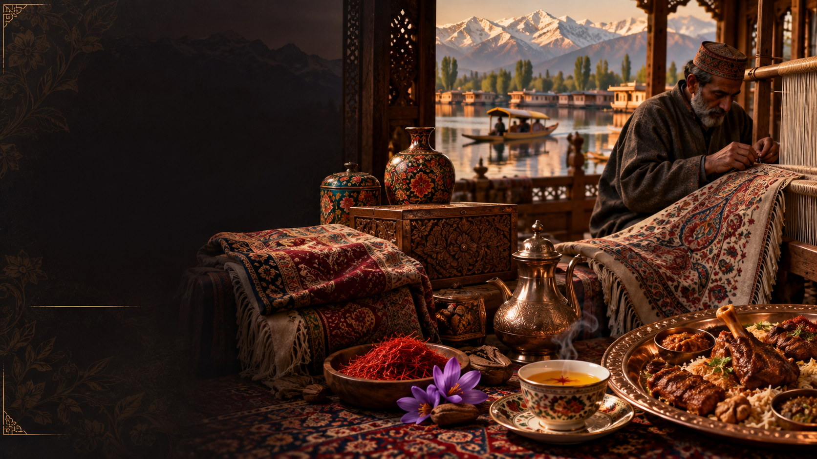
07
HISTORY
Indo–Pak Wars, Division & the Line of Control
Later conflicts changed the region’s military and political geography.
KEY POINTS
• 1947–48 — First India–Pakistan war over Jammu & Kashmir.
• 1965 — Kashmir remained central to another India–Pakistan war.
• 1971 — War in East Pakistan was followed by the 1972 Simla Agreement.
• The ceasefire line was renamed the Line of Control (LoC).
KASHMIR

Slide 8
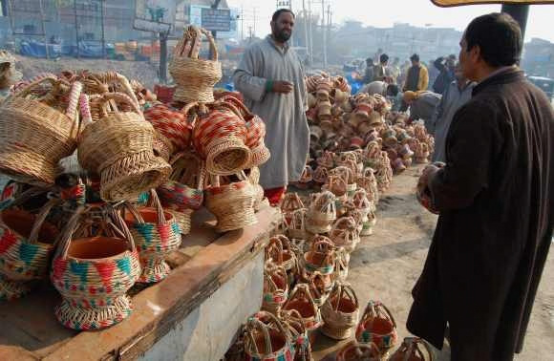
08
HUMAN COST
Insurgency, Exodus & Civilian Life
From the late 1980s, violence and security operations deeply affected daily life.
KEY POINTS
• Armed insurgency expanded in the Valley and security operations continued for decades.
• Large-scale migration of Kashmiri Pandit families occurred around 1990.
• The 1999 Kargil conflict became another major phase of India–Pakistan fighting.
• Civilian life was affected through fear, loss, disruption and displacement.
KASHMIR

Slide 9
09
HUMAN COST
Displacement, Education & Livelihoods
Conflict affected homes, education, work, memories and opportunities.
KEY POINTS
• Displacement created long-term questions about home, identity and return.
• Periods of unrest disrupted schooling and everyday routines.
• Tourism, trade, agriculture and local businesses were affected by instability.
• The human cost remains an important part of Kashmir’s modern history.
KASHMIR

Slide 10
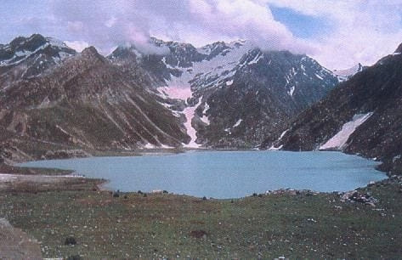
10
MODERN SHIFT
Conclusion — Beauty, Conflict & Hope
Kashmir is best understood through its landscape, culture, history and the human experiences shaped by conflict.
KEY POINTS
• BEAUTY — Himalayan landscapes, lakes and a rich cultural heritage.
• CONFLICT — decades of violence, insecurity and displacement.
• HUMAN COST — disruption to homes, livelihoods, education and everyday life.
• OPERATION SINDOOR — On 7 May 2025, India announced precision strikes on nine sites in Pakistan and the part of Jammu and Kashmir administered by Pakistan, following the 22 April 2025 Pahalgam attack.
• HOPE — safety, opportunity, development and preservation of heritage.
KASHMIR

Slide 11
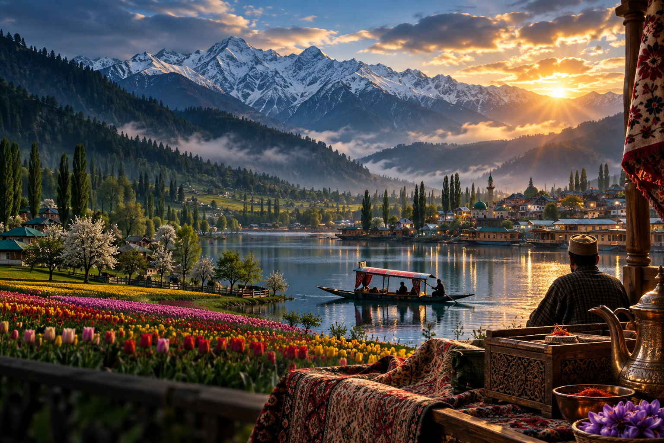
THANK YOU
Kashmir: Heaven & Hell
Questions & Discussion

