Slide 1
Measuring the Language Share of Multilingual Representations
Waiz Khan

Slide 2
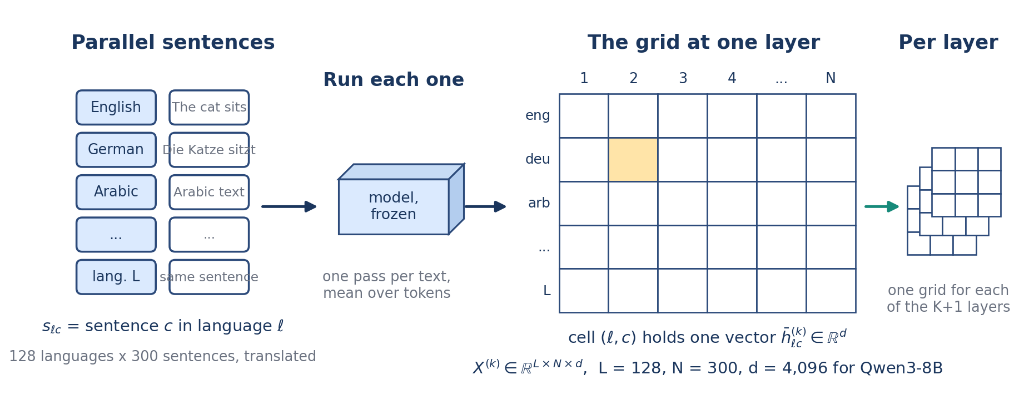
How LFS works, 1 of 3: from parallel sentences to a grid of vectors
The same 300 NTREX sentences in 128 languages are run once through a frozen base model. At every layer the hidden states of a text are mean-pooled in fp32 into one vector, so each layer gives a grid: one row per language, one column per sentence. Each coordinate is then standardized jointly over the whole grid, never per language, because per-language standardization would remove the language differences being measured.
Key numbers
• L = 128 languages, N = 300 sentences, 38,400 cells per layer
• d = 4,096 for Qwen3-8B; K = 36 blocks, so 37 layers
• joint standardization matters: Qwen3-8B, layer 19, reads 0.347 raw and 0.608 standardized
Measuring the Language Share of Multilingual Representations
2 / 24
Notes:
The same 300 NTREX sentences in 128 languages are run once through a frozen base model. At every layer the hidden states of a text are mean-pooled in fp32 into one vector, so each layer gives a grid: one row per language, one column per sentence. Each coordinate is then standardized jointly over the whole grid, never per language, because per-language standardization would remove the language differences being measured.

Slide 3
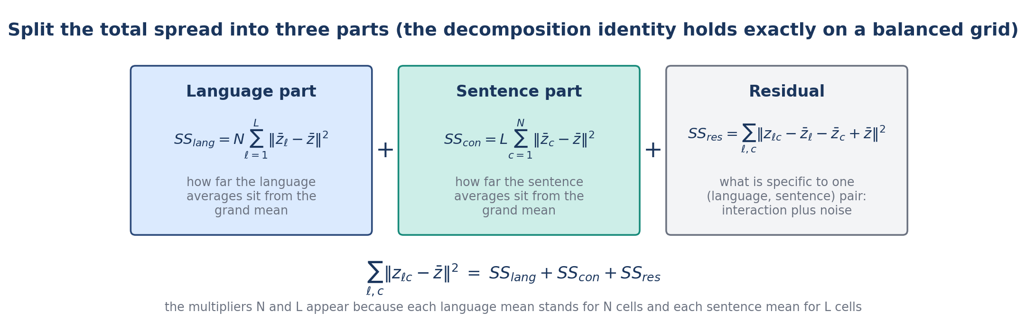
How LFS works, 2 of 3: the decomposition and the share
The total spread of the standardized grid splits exactly into a language part (how far the language means sit from the grand mean), a sentence part (the same for sentence means), and a residual (interaction plus noise). LFS is the language part as a share of the two systematic parts; the residual is excluded on purpose. Repeating this at every layer gives the depth profile, summarized by the minimum layer, the minimum share, and the dip depth.
Key numbers
• LFS = SS_lang / (SS_lang + SS_con), defined when the sum is positive
• expected value under pure noise: (L − 1)/(L + N − 2) = 0.298 on this grid
• dip depth = LFS at layer 0 minus the minimum LFS
Measuring the Language Share of Multilingual Representations
3 / 24
Notes:
The total spread of the standardized grid splits exactly into a language part (how far the language means sit from the grand mean), a sentence part (the same for sentence means), and a residual (interaction plus noise). LFS is the language part as a share of the two systematic parts; the residual is excluded on purpose. Repeating this at every layer gives the depth profile, summarized by the minimum layer, the minimum share, and the dip depth.

Slide 4
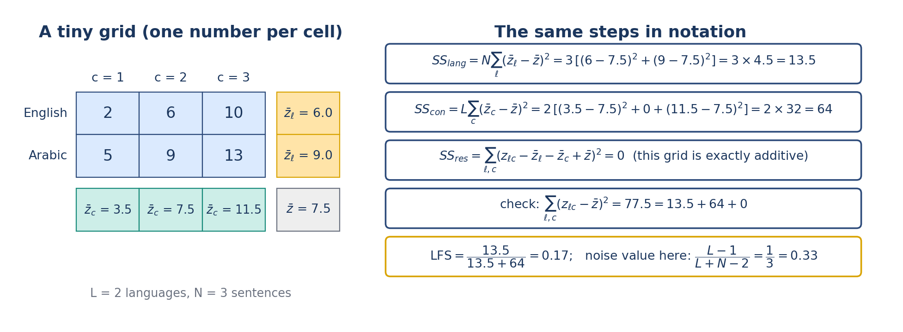
How LFS works, 3 of 3: a numerical example
On a two-language, three-sentence grid with one number per cell the arithmetic is visible: language means 6 and 9, sentence means 3.5, 7.5, 11.5, grand mean 7.5; the language part is 13.5, the sentence part 64, the residual 0, so LFS is 0.17. The real computation is the same over 4,096 coordinates. For Qwen3-8B at layer 19 the language part is 55.2 million and the sentence part 35.6 million, giving 0.608, against 0.945 at layer 0 and 0.958 at the last layer.
Key numbers
• tiny grid: SS_lang 13.5, SS_con 64, SS_res 0, LFS 0.17
• Qwen3-8B, layer 19: 55.2M / (55.2M + 35.6M) = 0.608
• profile: 0.945 at layer 0, 0.608 at layer 19, 0.958 at layer 36; dip depth 0.336
Measuring the Language Share of Multilingual Representations
4 / 24
Notes:
On a two-language, three-sentence grid with one number per cell the arithmetic is visible: language means 6 and 9, sentence means 3.5, 7.5, 11.5, grand mean 7.5; the language part is 13.5, the sentence part 64, the residual 0, so LFS is 0.17. The real computation is the same over 4,096 coordinates. For Qwen3-8B at layer 19 the language part is 55.2 million and the sentence part 35.6 million, giving 0.608, against 0.945 at layer 0 and 0.958 at the last layer.

Slide 5
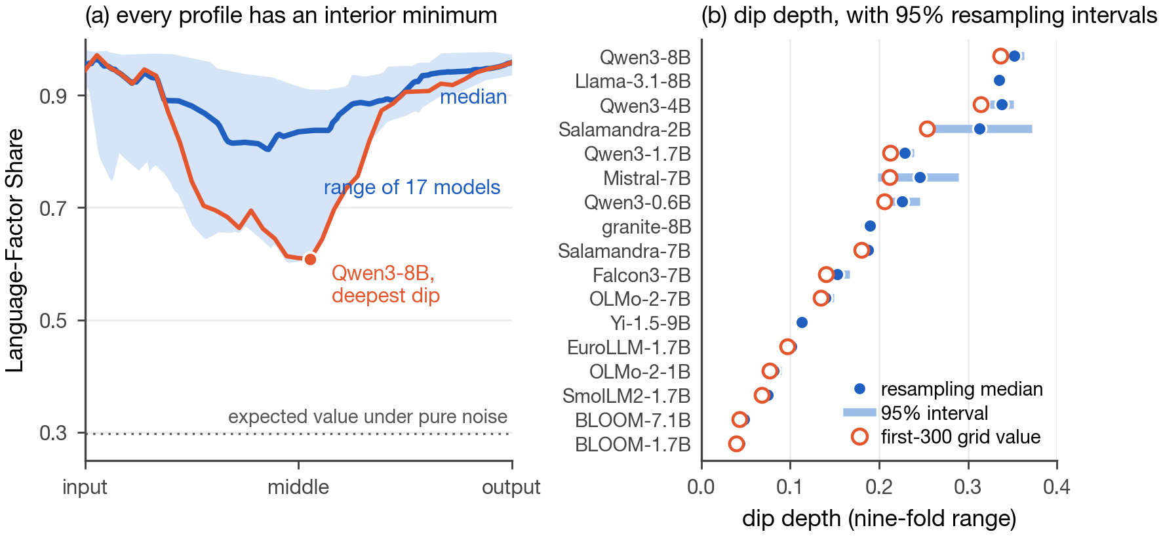
Evidence 1: every profile has an interior minimum, and it replicates
All 17 primary models (direct sums of squares) and all 19 expansion models (the variance-component estimator, LFS-VC) have a profile that is high at the input, lowest at an interior layer, and high again at the output. Dip depth ranges nine-fold and is set by training recipe more than by size. The profile replicates on FLORES-200, is stable under sentence resampling, survives instruction tuning, and held on two model families whose predictions were frozen before the run.
Key numbers
• dip depth 0.039 (BLOOM-1.7B) to 0.336 (Qwen3-8B); 36 of 36 profiles
• FLORES-200: 17 of 17, depth ordering Spearman 0.92
• resampling: half-widths 0.004 to 0.020 for 12 of 14 models; ordering Spearman ≥ 0.90 in 2,000 of 2,000
• instruction tuning: six pairs, dip depth within 0.01; unseen families: 4 of 4 predictions held
Measuring the Language Share of Multilingual Representations
5 / 24
Notes:
All 17 primary models (direct sums of squares) and all 19 expansion models (the variance-component estimator, LFS-VC) have a profile that is high at the input, lowest at an interior layer, and high again at the output. Dip depth ranges nine-fold and is set by training recipe more than by size. The profile replicates on FLORES-200, is stable under sentence resampling, survives instruction tuning, and held on two model families whose predictions were frozen before the run.

Slide 6
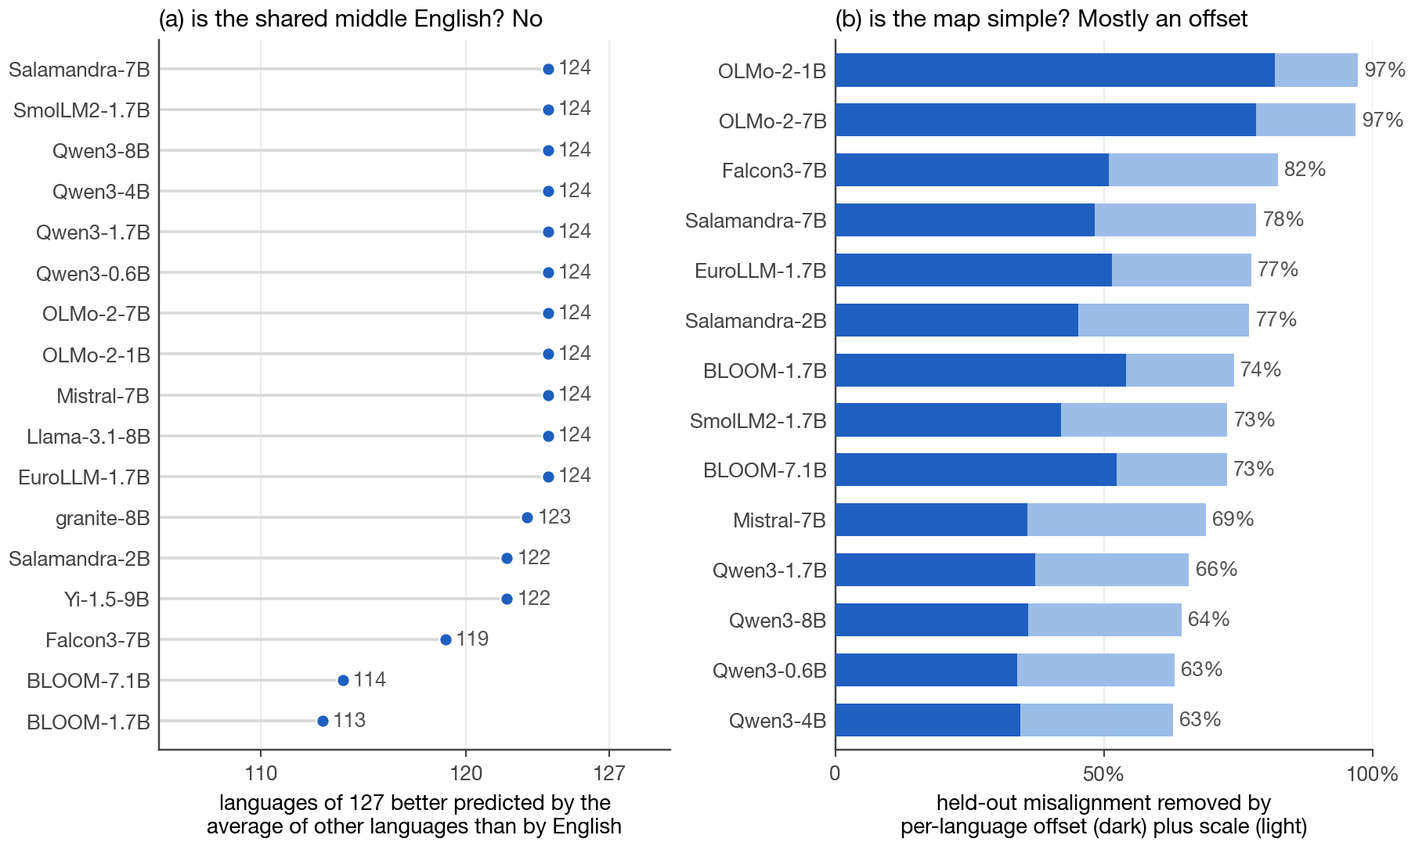
Evidence 2: the shared middle is multilingual, and the map between languages is simple
Left: at each model's dip layer, the average of the other languages predicts a language's vectors better than English does for 113 to 124 of 127 languages, so the shared middle is not English. Right: mapping each language into a shared reference space with nested maps, a per-language offset plus a scale removes 63 to 97 percent of the held-out cross-language misalignment; rotation never adds more than 0.7 percent.
Key numbers
• hub test: 17 models, ridge on 64 principal components, 3-fold cross-validation; median gain +0.06 to +0.16 R²
• decomposition: 14 models, 1,500 sentences, common rank 64; offset + scale 63% to 97%
• rotation at most 0.7%; the difference between languages is mostly an offset
Measuring the Language Share of Multilingual Representations
6 / 24
Notes:
Left: at each model's dip layer, the average of the other languages predicts a language's vectors better than English does for 113 to 124 of 127 languages, so the shared middle is not English. Right: mapping each language into a shared reference space with nested maps, a per-language offset plus a scale removes 63 to 97 percent of the held-out cross-language misalignment; rotation never adds more than 0.7 percent.

Slide 7
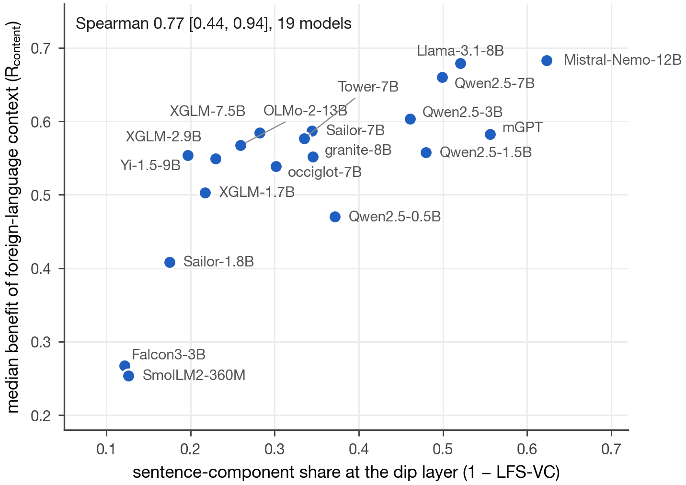
Evidence 3: the sentence-component share and the use of foreign-language context
Under a protocol frozen before the run, 19 models from 13 families were scored on whether a preceding sentence in another language (41 languages) lowers the loss on the English sentence that follows, against a length-matched mismatched context. Models with a smaller language share at the dip layer, one minus LFS-VC, use the foreign context more. The association holds after adjusting for training-data exposure, language family, script, and tokenizer fertility. The same share shows no clear association with pooled benchmark accuracy, which the paper reports as a limit.
Key numbers
• Spearman 0.77 [0.44, 0.94] unadjusted; 0.51 [0.19, 0.71] after covariate adjustment
• positive under leave-one-family-out; 157,700 scored sequences
• pooled Belebele and INCLUDE accuracy, 33 models: 0.04 [−0.05, 0.12]; MEXA 0.24 for reference
Measuring the Language Share of Multilingual Representations
7 / 24
Notes:
Under a protocol frozen before the run, 19 models from 13 families were scored on whether a preceding sentence in another language (41 languages) lowers the loss on the English sentence that follows, against a length-matched mismatched context. Models with a smaller language share at the dip layer, one minus LFS-VC, use the foreign context more. The association holds after adjusting for training-data exposure, language family, script, and tokenizer fertility. The same share shows no clear association with pooled benchmark accuracy, which the paper reports as a limit.

Slide 8
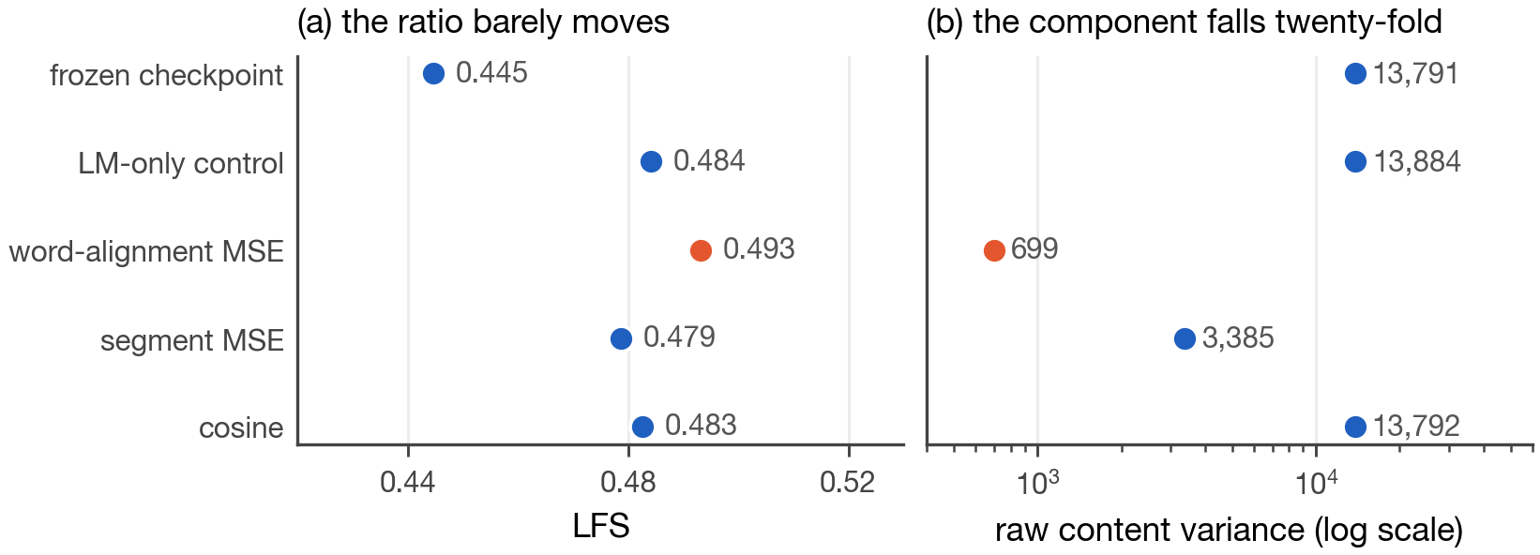
What limits the claims: uniform scaling and training interventions
A share cannot see uniform scaling. A word-alignment fine-tuning of Qwen3-0.6B shrank the representation norm from 451 to 42 and the raw content variance twenty-fold while LFS moved only from 0.445 to 0.493 and the retrieval score rose; only the raw component caught it. And LFS is not a training objective: across 28 conditions at three seeds, objectives that pushed LFS down moved tail alignment down with it, and training on LFS itself doubled the dip while Belebele fell. The paper therefore presents LFS as a diagnostic reported with its raw components, not as a score or a loss.
Key numbers
• norm 451 → 42; raw content variance 13,791 → 699; LFS 0.445 → 0.493; MEXA +0.09 over the control
• Belebele unchanged for the shrunk model (0.395 vs 0.390): representation change, not demonstrated harm
• training interventions: Pearson +0.92 over 18 condition-seed points; LFS as a loss: dip doubled, Belebele −2.9 vs −1.7 for the control
Measuring the Language Share of Multilingual Representations
8 / 24
Notes:
A share cannot see uniform scaling. A word-alignment fine-tuning of Qwen3-0.6B shrank the representation norm from 451 to 42 and the raw content variance twenty-fold while LFS moved only from 0.445 to 0.493 and the retrieval score rose; only the raw component caught it. And LFS is not a training objective: across 28 conditions at three seeds, objectives that pushed LFS down moved tail alignment down with it, and training on LFS itself doubled the dip while Belebele fell. The paper therefore presents LFS as a diagnostic reported with its raw components, not as a score or a loss.

Slide 9
What I need your feedback on before submission
Contribution
Framing
Decisions and gaps
The paper leads with LFS as a structural diagnostic: a two-way analysis-of-variance share with a known noise value, profiles on 33 models, one behavioral association, and explicit limits. Is that the right claim to lead with, or should the behavioral result carry more weight?
It is presented as a measurement paper, not a method that improves models. The English question is phrased as "a multilingual average predicts better than English", MEXA is a reference measure and is never ranked against, and the limits get a full section. Does that read as careful or as weak?
Title: current choice or one of the two alternatives. Author order and the reciprocal reviewer by 18 September; paper by 25 September. Open evidence: the 19 expansion models are measured with LFS-VC only; a direct-SS re-measurement needs cluster time. The anonymous code link is added at submission.
Measuring the Language Share of Multilingual Representations
9 / 24
Notes:
The paper leads with LFS as a structural diagnostic: a two-way analysis-of-variance share with a known noise value, profiles on 33 models, one behavioral association, and explicit limits. Is that the right claim to lead with, or should the behavioral result carry more weight? It is presented as a measurement paper, not a method that improves models. The English question is phrased as "a multilingual average predicts better than English", MEXA is a reference measure and is never ranked against, and the limits get a full section. Does that read as careful or as weak? Title: current choice or one of the two alternatives. Author order and the reciprocal reviewer by 18 September; paper by 25 September. Open evidence: the 19 expansion models are measured with LFS-VC only; a direct-SS re-measurement needs cluster time. The anonymous code link is added at submission.

Slide 10
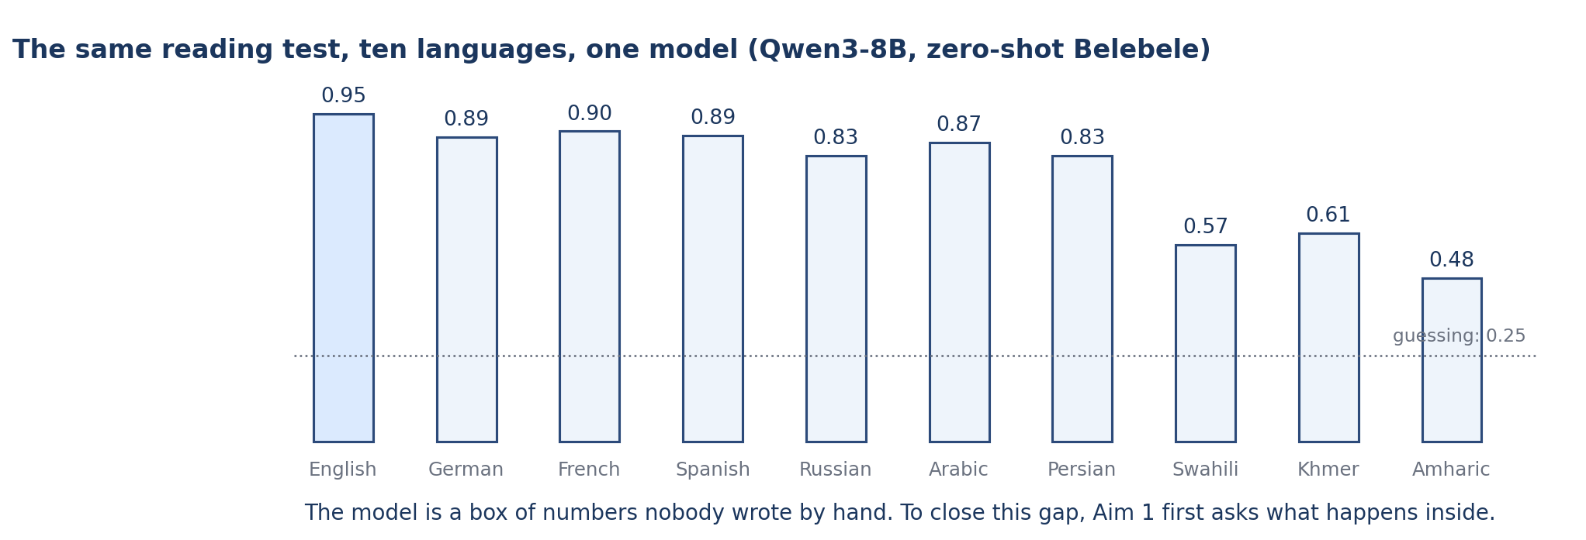
Appendix: the problem
Give one model the same reading test in ten languages and the scores fall from 0.95 in English to 0.48 in Amharic. These are real zero-shot Belebele accuracies for Qwen3-8B. Aim 1 of the proposal asks what happens inside the model before anyone tries to fix this. The model is a block of numbers nobody wrote by hand, so the first step is a measurement that shows where the languages part ways.
Key numbers
• Qwen3-8B, zero-shot Belebele accuracy, ten languages
• English 0.953, German 0.887, French 0.903, Spanish 0.890
• Russian 0.833, Arabic 0.870, Persian 0.833
• Swahili 0.573, Khmer 0.607, Amharic 0.477
Measuring the Language Share of Multilingual Representations
10 / 24
Notes:
Give one model the same reading test in ten languages and the scores fall from 0.95 in English to 0.48 in Amharic. These are real zero-shot Belebele accuracies for Qwen3-8B. Aim 1 of the proposal asks what happens inside the model before anyone tries to fix this. The model is a block of numbers nobody wrote by hand, so the first step is a measurement that shows where the languages part ways.

Slide 11
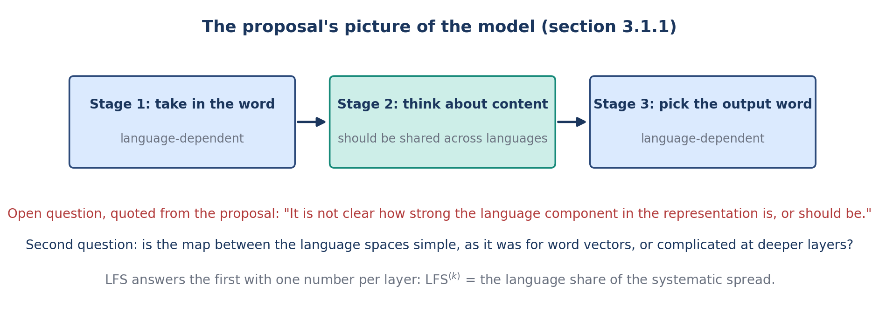
Appendix: what the proposal asks (Aim 1)
Section 3.1.1 of the proposal pictures three stages: take in the word, process the content, pick the output word. The first and last should depend on the language; the middle should be shared. The proposal then states the open question this project answers: it is not clear how strong the language component in the representation is, or should be. It also asks whether the spaces of different languages can be joined by a simple map, as older word-vector spaces could.
Key numbers
• Question 1: how strong is the language component, layer by layer?
• Question 2: is English privileged in the middle layers?
• Question 3: how simple is the map between languages?
• Question 4: does any of this show in behavior?
Measuring the Language Share of Multilingual Representations
11 / 24
Notes:
Section 3.1.1 of the proposal pictures three stages: take in the word, process the content, pick the output word. The first and last should depend on the language; the middle should be shared. The proposal then states the open question this project answers: it is not clear how strong the language component in the representation is, or should be. It also asks whether the spaces of different languages can be joined by a simple map, as older word-vector spaces could.

Slide 12
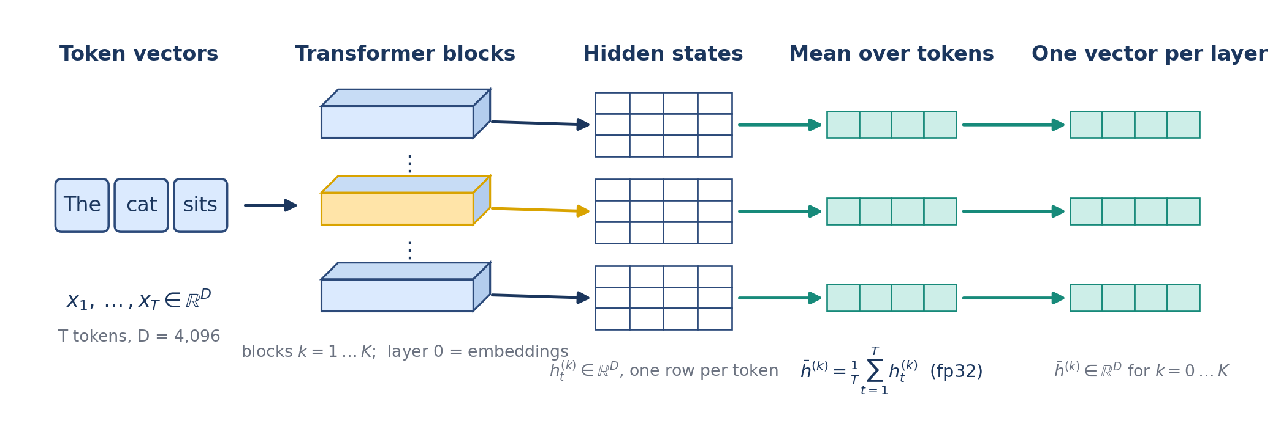
Appendix, Step 1: from a sentence to one vector per layer
A sentence is split into tokens. Each token starts as a vector, and every Transformer block rewrites all of them; layer 0 is the embedding output and layer K the last block. At each layer we take the hidden states, one row per token, and average them over the tokens in full precision. That gives one vector per sentence per layer. Nothing is generated; we only read the states of frozen base models.
Key numbers
• pooled vector: h̄^(k) = (1/T) Σ_t h_t^(k)
• d = 4,096 for Qwen3-8B; K = 36 blocks, so 37 layers
• fp32 pooling; base (not instruction-tuned) models
Measuring the Language Share of Multilingual Representations
12 / 24
Notes:
A sentence is split into tokens. Each token starts as a vector, and every Transformer block rewrites all of them; layer 0 is the embedding output and layer K the last block. At each layer we take the hidden states, one row per token, and average them over the tokens in full precision. That gives one vector per sentence per layer. Nothing is generated; we only read the states of frozen base models.

Slide 13
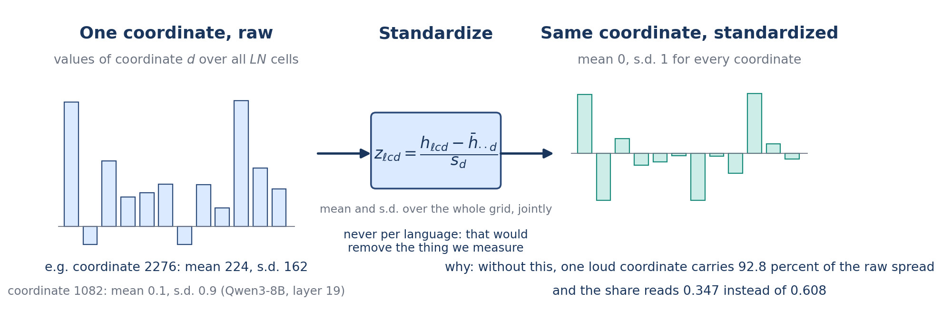
Appendix, Step 3: put every coordinate on the same scale
Before any arithmetic, every coordinate is standardized over the whole grid: subtract its mean and divide by its standard deviation, both computed over all 38,400 cells. This is done jointly across languages, never per language, because per-language standardization would remove exactly the language differences we want to measure. It matters: in Qwen3-8B one coordinate, number 2276, carries 92.8 percent of the raw spread at layer 19.
Key numbers
• z_ℓcd = (h_ℓcd − mean_d) / s_d
• without this step the share reads 0.347; with it, 0.608 (Qwen3-8B, layer 19)
• after standardization coordinate 2276 carries 0.02 percent of the language part
Measuring the Language Share of Multilingual Representations
13 / 24
Notes:
Before any arithmetic, every coordinate is standardized over the whole grid: subtract its mean and divide by its standard deviation, both computed over all 38,400 cells. This is done jointly across languages, never per language, because per-language standardization would remove exactly the language differences we want to measure. It matters: in Qwen3-8B one coordinate, number 2276, carries 92.8 percent of the raw spread at layer 19.

Slide 14
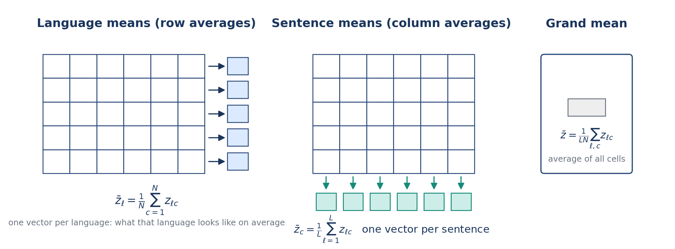
Appendix, Step 4: three kinds of mean
From the standardized grid we take three averages. Averaging across a row gives the language mean: what that language looks like on average. Averaging down a column gives the sentence mean: what that sentence looks like across languages. Averaging every cell gives the grand mean. Everything that follows is built from how far these means sit from each other.
Key numbers
• language mean: z̄_ℓ = (1/N) Σ_c z_ℓc
• sentence mean: z̄_c = (1/L) Σ_ℓ z_ℓc
• grand mean: z̄ = (1/LN) Σ_ℓc z_ℓc
Measuring the Language Share of Multilingual Representations
14 / 24
Notes:
From the standardized grid we take three averages. Averaging across a row gives the language mean: what that language looks like on average. Averaging down a column gives the sentence mean: what that sentence looks like across languages. Averaging every cell gives the grand mean. Everything that follows is built from how far these means sit from each other.

Slide 15
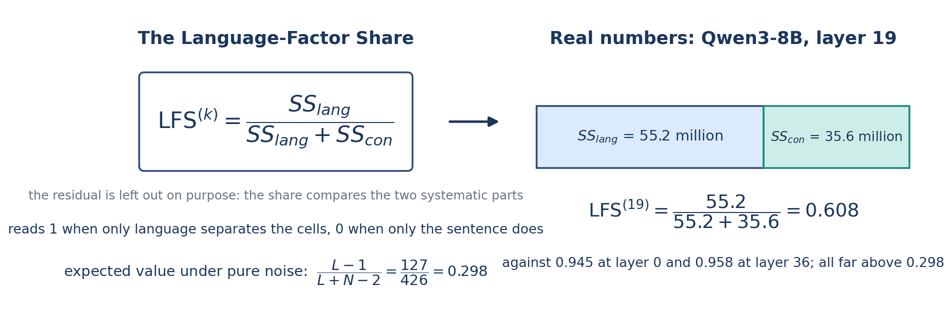
Appendix, Step 6: the Language-Factor Share
The Language-Factor Share is the language part divided by the language part plus the sentence part. The residual is left out on purpose, so a noisy model does not look language-neutral only because its residual is large. LFS is 1 when only language separates the cells and 0 when only the sentence does. Under pure noise it is not zero but 0.298 on this grid, because averages of random numbers still differ by chance; every real value is read against that number.
Key numbers
• LFS = SS_lang / (SS_lang + SS_con), defined when the sum is positive
• noise expectation (L − 1)/(L + N − 2) = 127/426 = 0.298
• Qwen3-8B, layer 19: SS_lang 55.2 million, SS_con 35.6 million, residual 66.5 million (left out)
• LFS = 55.2 / (55.2 + 35.6) = 0.608; as shares of the total: 0.351, 0.226, 0.423
Measuring the Language Share of Multilingual Representations
15 / 24
Notes:
The Language-Factor Share is the language part divided by the language part plus the sentence part. The residual is left out on purpose, so a noisy model does not look language-neutral only because its residual is large. LFS is 1 when only language separates the cells and 0 when only the sentence does. Under pure noise it is not zero but 0.298 on this grid, because averages of random numbers still differ by chance; every real value is read against that number.

Slide 16
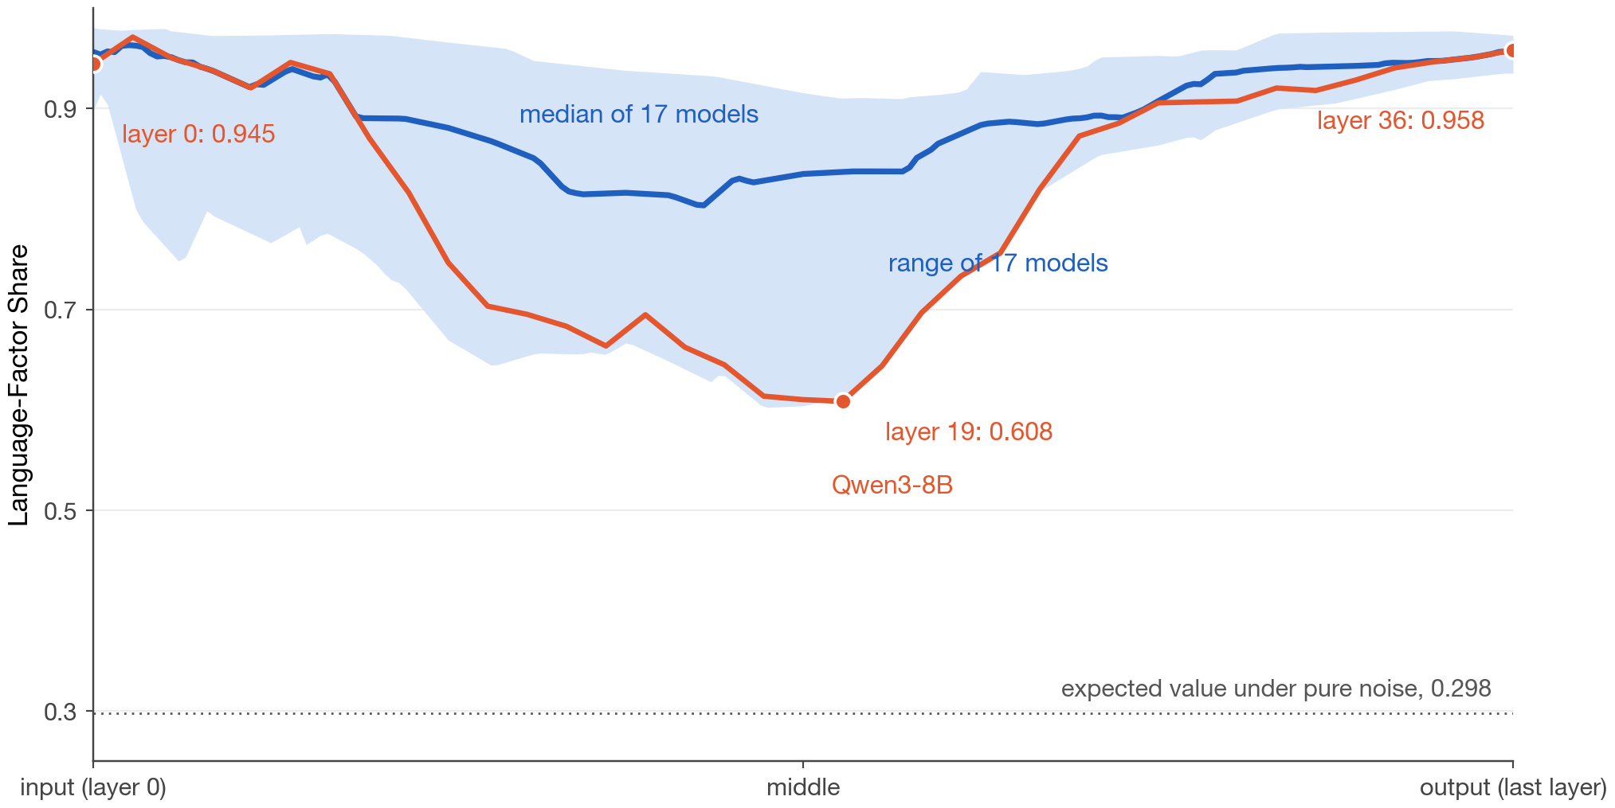
Appendix, Step 7: repeat at every layer and read the curve
The computation is repeated at every layer, giving one share per layer: the depth profile. At the input the vectors are still the words, so language decides where they land and the share is near 1. In the middle the model has worked out what is being said, so the same sentence lands close together across languages and the share falls. At the output the model must produce a word in the right language, so the share rises again. Three numbers summarize a profile: the minimum layer, the minimum share, and the dip depth, the layer-0 value minus the minimum.
Key numbers
• Qwen3-8B: 0.945 at layer 0, 0.608 at layer 19, 0.958 at layer 36; dip depth 0.336
• band: the range of 17 models; every one has this shape
• expected value under pure noise: 0.298; language never fully leaves
Measuring the Language Share of Multilingual Representations
16 / 24
Notes:
The computation is repeated at every layer, giving one share per layer: the depth profile. At the input the vectors are still the words, so language decides where they land and the share is near 1. In the middle the model has worked out what is being said, so the same sentence lands close together across languages and the share falls. At the output the model must produce a word in the right language, so the share rises again. Three numbers summarize a profile: the minimum layer, the minimum share, and the dip depth, the layer-0 value minus the minimum.

Slide 17
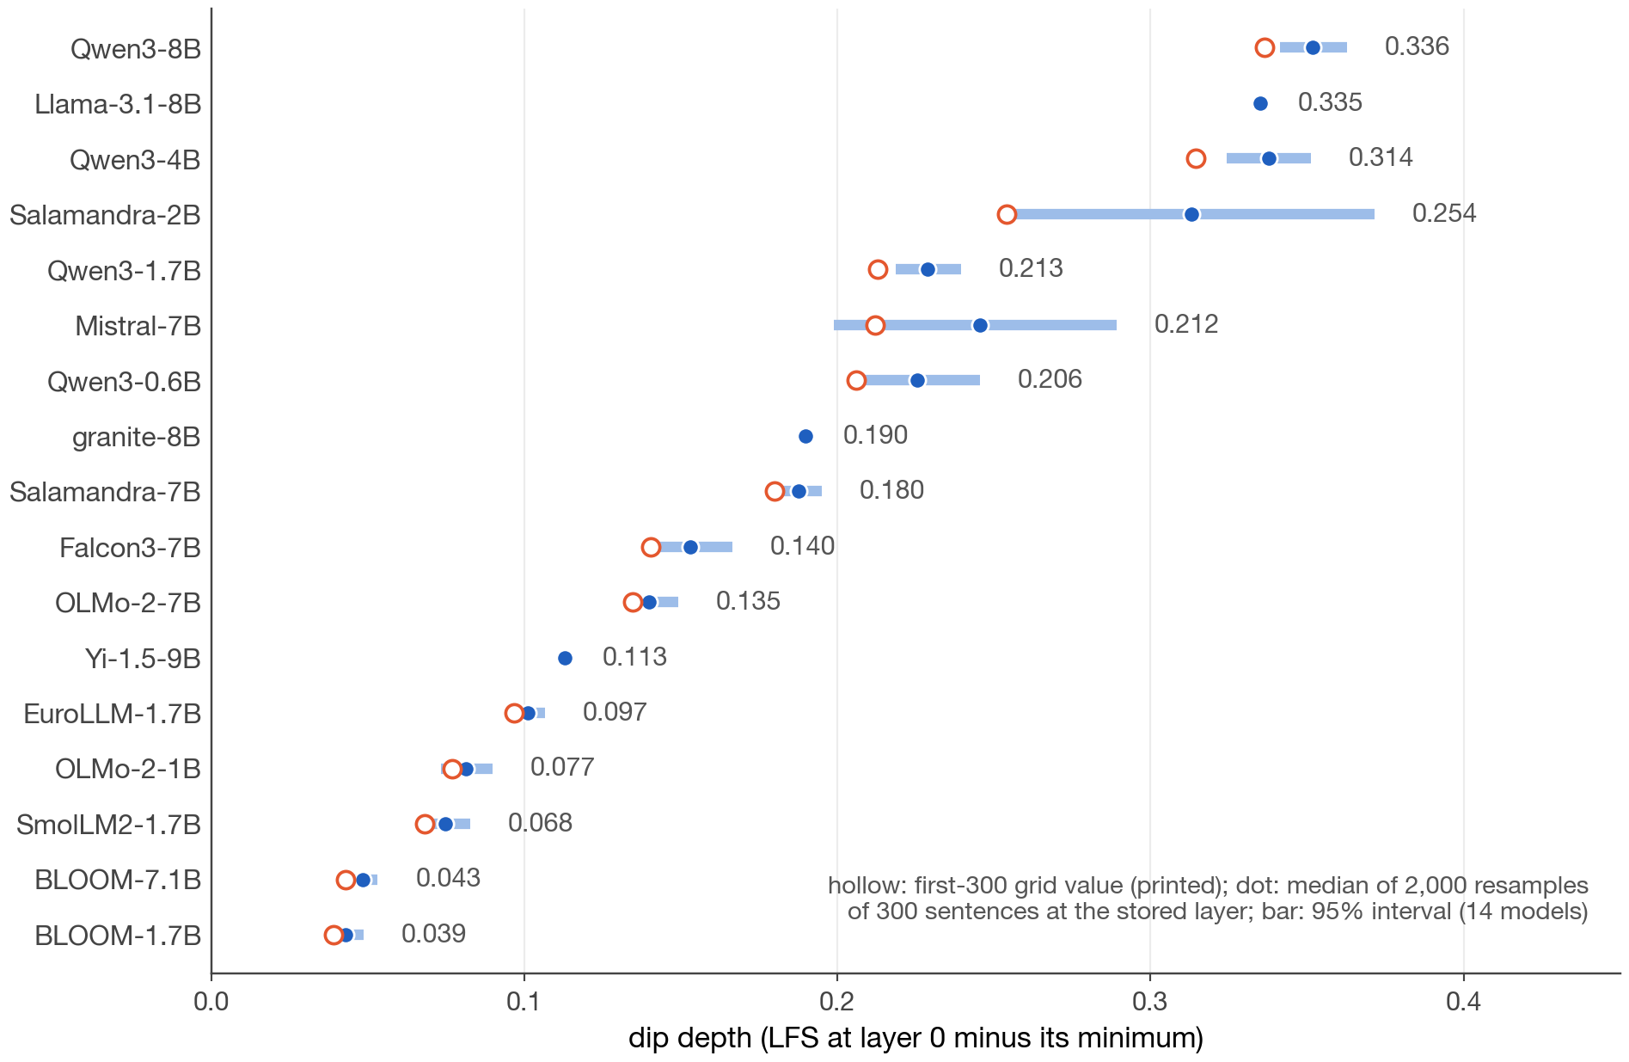
Appendix, Experiment 1: 17 models, every profile has an interior minimum
We ran the measurement on 17 open base models from 11 families. All 17 profiles have an interior minimum with both ends higher. What differs is how deep: from 0.039 for BLOOM-1.7B to 0.336 for Qwen3-8B, a nine-fold range. To see how much a dip depth depends on which 300 sentences were used, we resampled 2,000 sets of 300 from 1,500 stored sentences. The bars are the resulting 95 percent intervals: narrow for 12 of 14 models, wide only for the two whose minimum sits at an early layer.
Key numbers
• 17 of 17 dip and recover; 19 of 19 in the 19-model expansion set
• dip depth 0.039 (BLOOM-1.7B) to 0.336 (Qwen3-8B)
• interval half-widths 0.004 to 0.020 for 12 models; 0.045 (Mistral-7B) and 0.059 (Salamandra-2B)
• model ordering agrees with the full grid at Spearman ≥ 0.90 in 2,000 of 2,000 resamples
Measuring the Language Share of Multilingual Representations
17 / 24
Notes:
We ran the measurement on 17 open base models from 11 families. All 17 profiles have an interior minimum with both ends higher. What differs is how deep: from 0.039 for BLOOM-1.7B to 0.336 for Qwen3-8B, a nine-fold range. To see how much a dip depth depends on which 300 sentences were used, we resampled 2,000 sets of 300 from 1,500 stored sentences. The bars are the resulting 95 percent intervals: narrow for 12 of 14 models, wide only for the two whose minimum sits at an early layer.

Slide 18
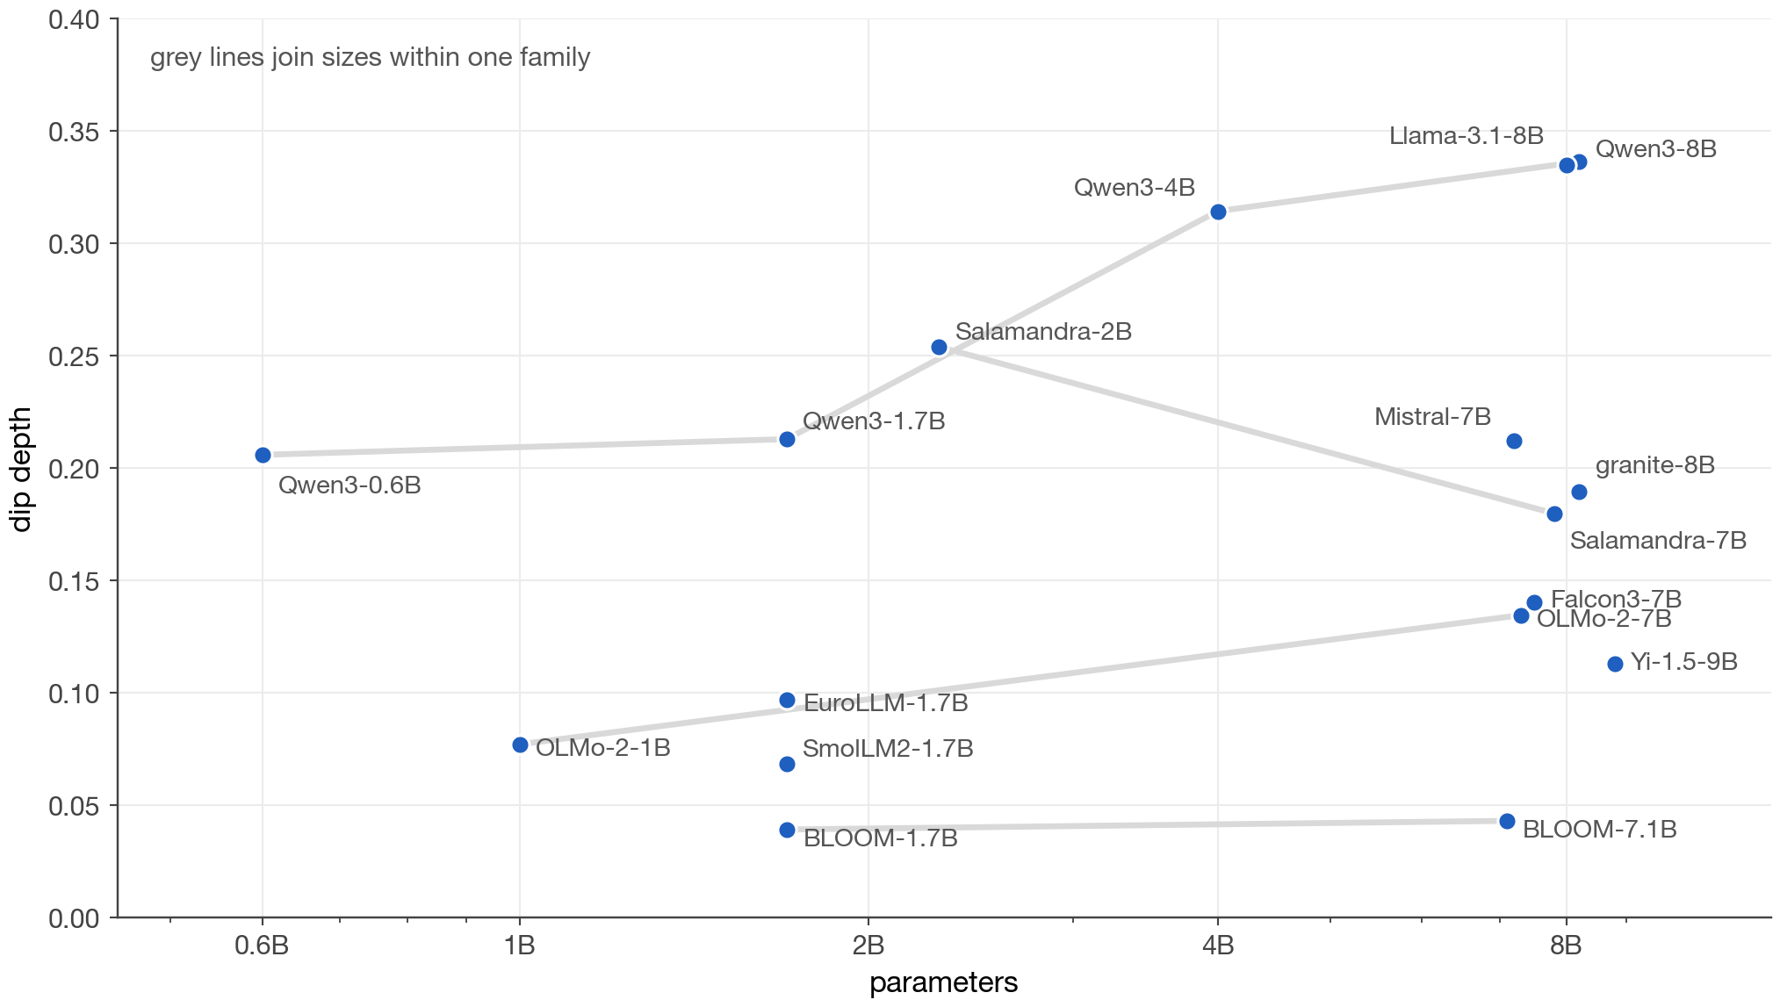
Appendix, Experiment 2: does size decide the dip?
Within one family the dip deepens with size: Qwen3 goes 0.206, 0.213, 0.314, 0.336 from 0.6B to 8B. But families at the same size differ far more than sizes within a family. Qwen3-1.7B dips deeper than every 7B model from another lab except Llama-3.1-8B; BLOOM, trained on a balanced 46-language mix, barely dips at either size; Salamandra dips more at 2B than at 7B. So dip depth is set by how a model was trained more than by how big it is. This is a descriptive comparison: we do not separate data, tokenizer, and training recipe.
Key numbers
• Qwen3: 0.206 → 0.213 → 0.314 → 0.336
• BLOOM: 0.039 (1.7B) and 0.043 (7.1B)
• Salamandra: 0.254 (2B) versus 0.180 (7B)
• nine-fold range across families at similar sizes
Measuring the Language Share of Multilingual Representations
18 / 24
Notes:
Within one family the dip deepens with size: Qwen3 goes 0.206, 0.213, 0.314, 0.336 from 0.6B to 8B. But families at the same size differ far more than sizes within a family. Qwen3-1.7B dips deeper than every 7B model from another lab except Llama-3.1-8B; BLOOM, trained on a balanced 46-language mix, barely dips at either size; Salamandra dips more at 2B than at 7B. So dip depth is set by how a model was trained more than by how big it is. This is a descriptive comparison: we do not separate data, tokenizer, and training recipe.

Slide 19
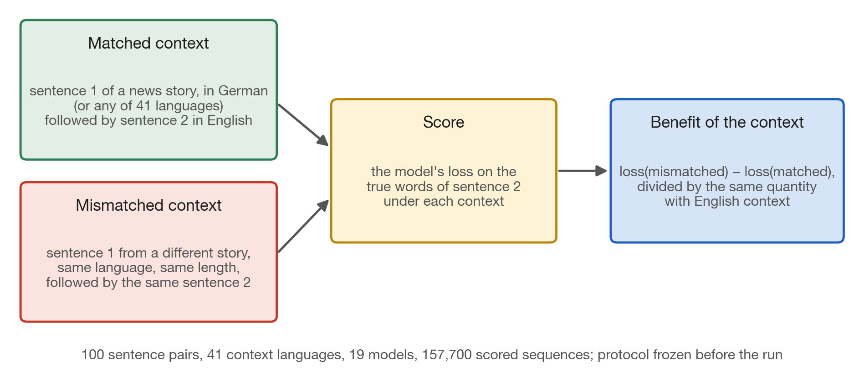
Appendix, Experiment 5: does the model use context given in another language?
The proposal's third question is whether information given in one language is used in another. We took an English sentence and the sentence before it from the same news story, translated into 41 languages. We measured the model's loss on the English sentence with the true foreign-language context, and with a context of the same language and length taken from a different story. The difference is the benefit of the context, normalized by the same benefit with English context. The mismatched control matters, because foreign text from the wrong story hurts.
Key numbers
• 100 sentence pairs from 100 documents; 41 context languages
• 19 models from 13 families; 157,700 scored sequences
• teacher-forced fp32 loss on the target tokens only
• protocol and predictions frozen before the run
Measuring the Language Share of Multilingual Representations
19 / 24
Notes:
The proposal's third question is whether information given in one language is used in another. We took an English sentence and the sentence before it from the same news story, translated into 41 languages. We measured the model's loss on the English sentence with the true foreign-language context, and with a context of the same language and length taken from a different story. The difference is the benefit of the context, normalized by the same benefit with English context. The mismatched control matters, because foreign text from the wrong story hurts.

Slide 20
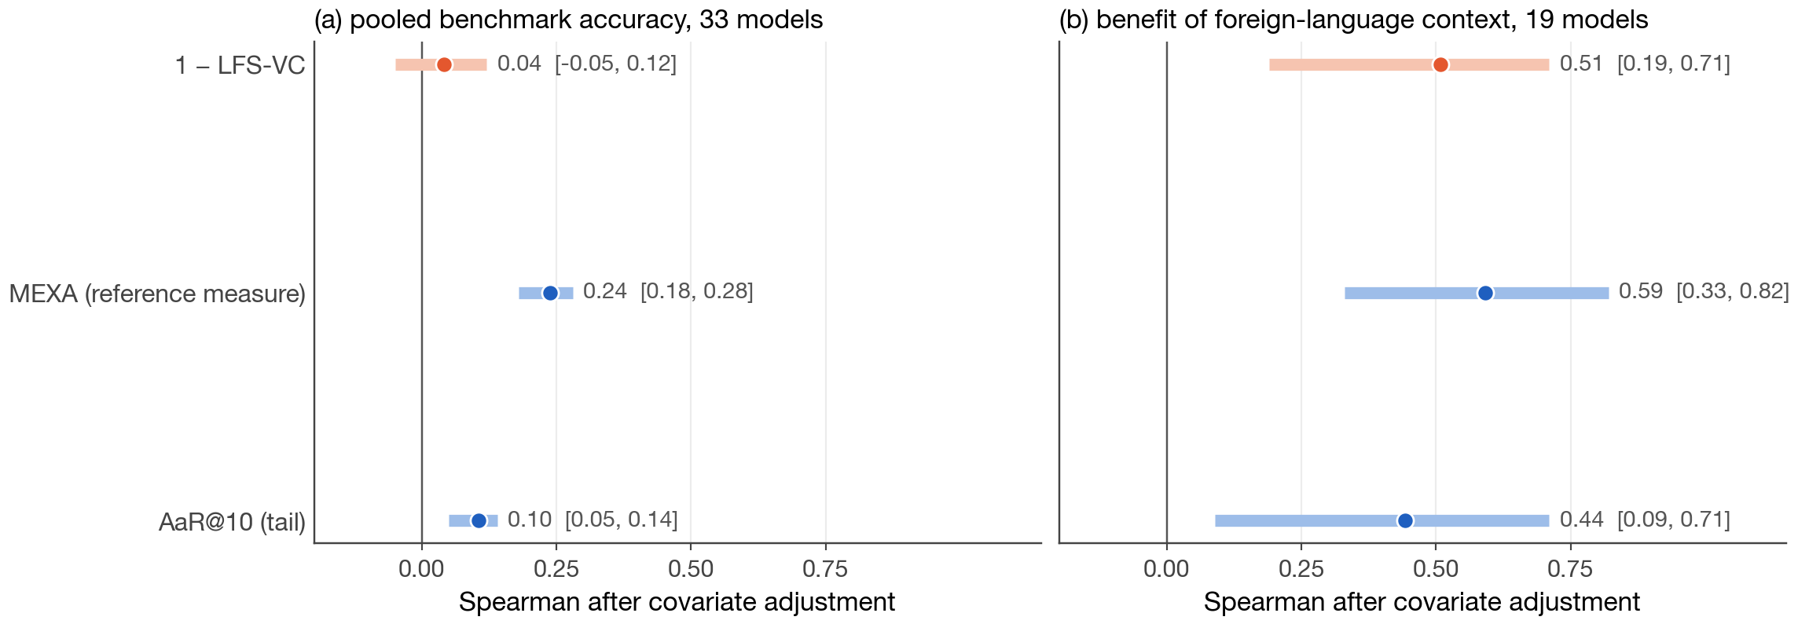
Appendix, Experiment 6: two behaviors, the same three measures
The same three measures tested against two behaviors. Left: pooled multiple-choice accuracy (Belebele and INCLUDE) on 33 models, 70 languages, 1,740 rows after covariate filtering. No measure predicts it well, LFS least of all. Right: the foreign-context benefit on 19 models, where all three are clearly associated. Part of the reason is the target: two benchmarks on the same cells agree on only about a third of their adjusted variation. We report the null result as a limit, not a defect to tune away.
Key numbers
• pooled accuracy: 1 − LFS-VC 0.04 [−0.05, 0.12]; MEXA 0.24; AaR 0.10
• foreign-context benefit: 0.51, 0.59, 0.44
• two benchmarks agree on 0.315 of their adjusted residual variation
Measuring the Language Share of Multilingual Representations
20 / 24
Notes:
The same three measures tested against two behaviors. Left: pooled multiple-choice accuracy (Belebele and INCLUDE) on 33 models, 70 languages, 1,740 rows after covariate filtering. No measure predicts it well, LFS least of all. Right: the foreign-context benefit on 19 models, where all three are clearly associated. Part of the reason is the target: two benchmarks on the same cells agree on only about a third of their adjusted variation. We report the null result as a limit, not a defect to tune away.

Slide 21
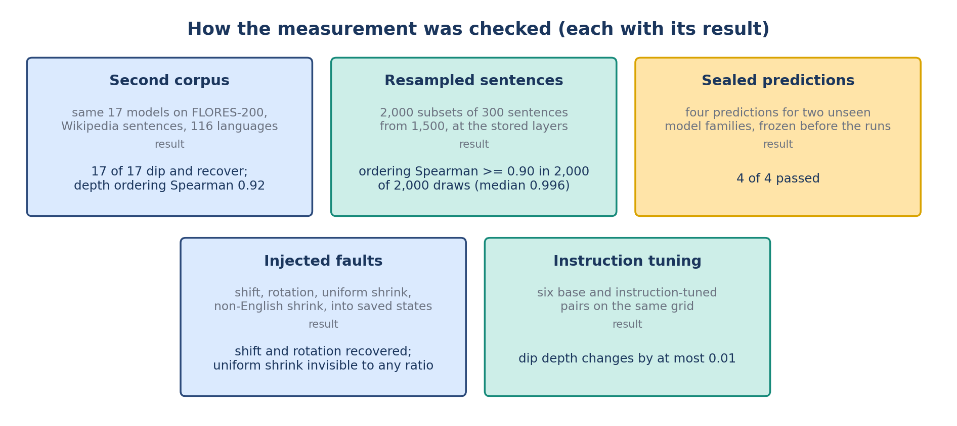
Appendix: how the measurement was checked
Before trusting the measurement we tried to break it five ways, each with predictions written down first. A second corpus, FLORES-200 with Wikipedia sentences: 17 of 17 profiles dip and recover, depth ordering Spearman 0.92. Resampled sentences: the intervals of Experiment 1, ordering preserved in every draw. Sealed predictions for two unseen families, SmolLM2 and Falcon3: 4 of 4 held. Injected faults: shifts and rotations recovered, uniform shrinking invisible to any ratio. Instruction tuning: six base and instruct pairs move dip depth by at most 0.01.
Key numbers
• FLORES-200: 17 of 17; Spearman 0.92; median |Δ depth| 0.011; granite the outlier (0.190 → 0.074)
• one frozen prediction of twelve failed: the precision bound (Mistral-7B 0.045, Salamandra-2B 0.059 above 0.03)
• SmolLM2 0.068 (predicted ≤ 0.15); Falcon3 0.140 (predicted intermediate)
Measuring the Language Share of Multilingual Representations
21 / 24
Notes:
Before trusting the measurement we tried to break it five ways, each with predictions written down first. A second corpus, FLORES-200 with Wikipedia sentences: 17 of 17 profiles dip and recover, depth ordering Spearman 0.92. Resampled sentences: the intervals of Experiment 1, ordering preserved in every draw. Sealed predictions for two unseen families, SmolLM2 and Falcon3: 4 of 4 held. Injected faults: shifts and rotations recovered, uniform shrinking invisible to any ratio. Instruction tuning: six base and instruct pairs move dip depth by at most 0.01.

Slide 22
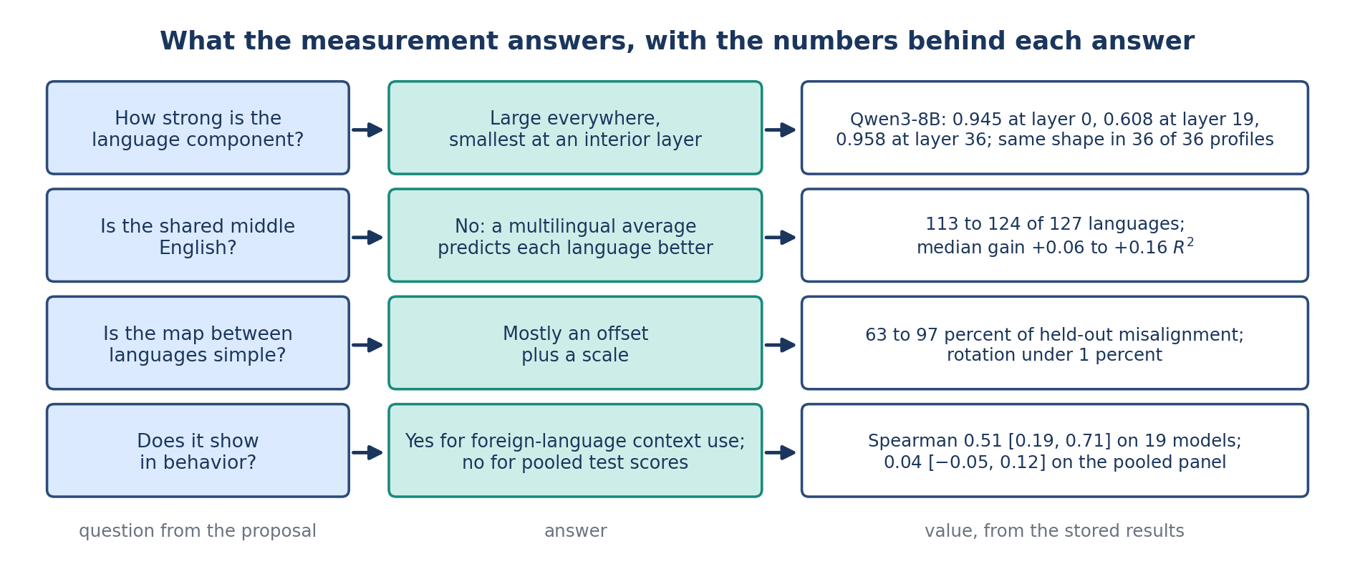
Appendix: what this answers in the proposal
Back to the proposal's questions. How strong is the language component, layer by layer? Large everywhere and smallest at an interior layer, with the same shape in all 36 measured profiles from 33 models. Is the shared middle English? No: the multilingual average predicts 113 to 124 of 127 languages better than English does. Is the map between languages simple? Yes: an offset plus a scale removes 63 to 97 percent of the misalignment. Does it show in behavior? Yes for foreign-language context use; no for pooled test scores.
Key numbers
• profiles: 36 of 36 measured (33 models)
• English privileged: no, 113 to 124 of 127
• map: offset + scale, 63 to 97 percent
• behavior: 0.51 for context use; 0.04 for pooled scores
Measuring the Language Share of Multilingual Representations
22 / 24
Notes:
Back to the proposal's questions. How strong is the language component, layer by layer? Large everywhere and smallest at an interior layer, with the same shape in all 36 measured profiles from 33 models. Is the shared middle English? No: the multilingual average predicts 113 to 124 of 127 languages better than English does. Is the map between languages simple? Yes: an offset plus a scale removes 63 to 97 percent of the misalignment. Does it show in behavior? Yes for foreign-language context use; no for pooled test scores.

Slide 23
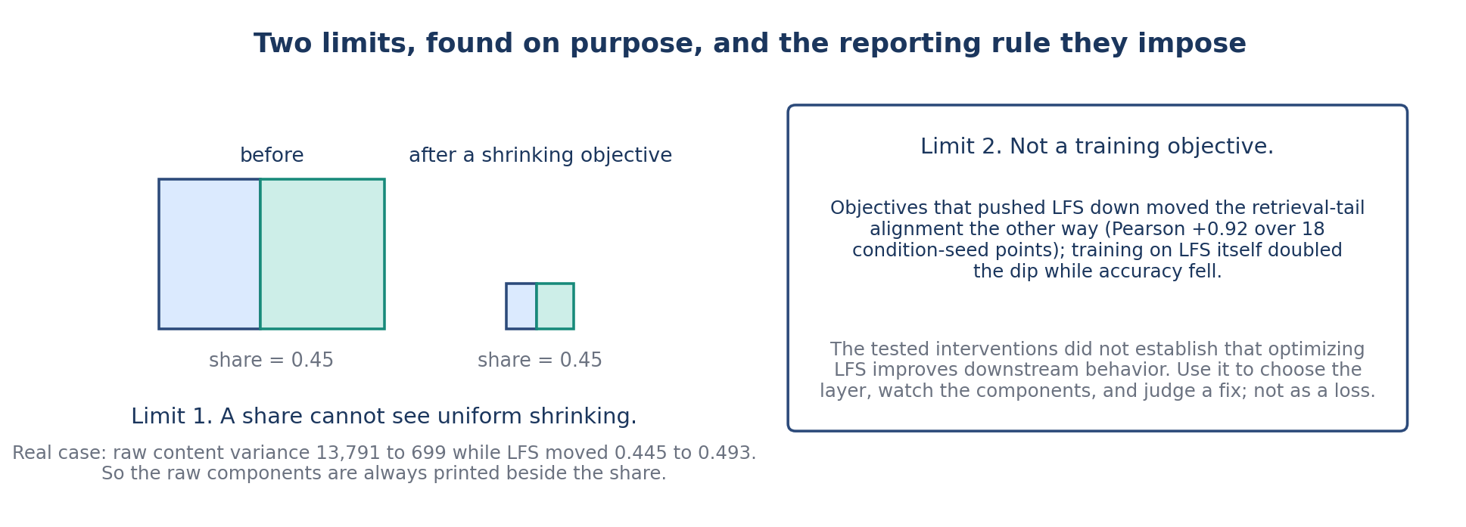
Appendix: the reporting rule and the limits
Two limits, found on purpose. A share is blind to size, so the raw components are always printed beside it. And LFS is not a training objective: across 28 training conditions at three seeds on one small model, objectives that pushed LFS down moved tail alignment down with it, and training on LFS itself doubled the dip while Belebele fell 2.9 points. Its place in the next aim is design, monitoring, and evaluation, not the loss.
Key numbers
• 28 conditions × 3 seeds on Qwen3-0.6B
• Pearson +0.92 between LFS and tail alignment over 18 condition-seed points (six conditions)
• LFS as a loss: dip doubled in 400 steps, Belebele −2.9 points
Measuring the Language Share of Multilingual Representations
23 / 24
Notes:
Two limits, found on purpose. A share is blind to size, so the raw components are always printed beside it. And LFS is not a training objective: across 28 training conditions at three seeds on one small model, objectives that pushed LFS down moved tail alignment down with it, and training on LFS itself doubled the dip while Belebele fell 2.9 points. Its place in the next aim is design, monitoring, and evaluation, not the loss.

Slide 24
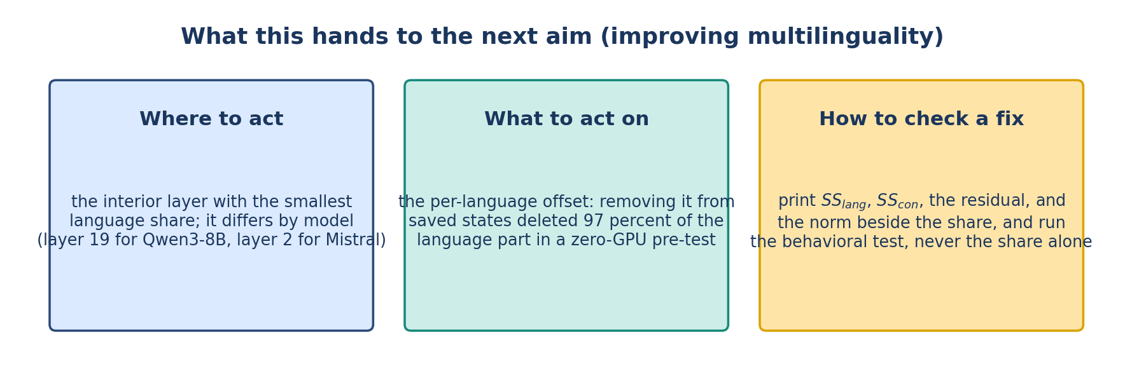
Appendix: what Aim 2 gets from this
What this hands to Aim 2. Where to act: the interior layer with the smallest language share, layer 19 for Qwen3-8B and layer 2 for Mistral-7B. What to act on: the per-language offset, which carries most of the language leftover; removing it from saved states deleted 97 percent of the language part in a pre-test that needed no training. How to check a fix: print the raw components and run the behavioral test, never the share alone.
Key numbers
• dip layers: Qwen3-8B 19 of 36, Mistral-7B 2 of 32
• offset removal: 97 percent of SS_lang gone, offline, no GPU
• checks: SS_lang, SS_con, residual, norm, and a behavioral test
Measuring the Language Share of Multilingual Representations
24 / 24
Notes:
What this hands to Aim 2. Where to act: the interior layer with the smallest language share, layer 19 for Qwen3-8B and layer 2 for Mistral-7B. What to act on: the per-language offset, which carries most of the language leftover; removing it from saved states deleted 97 percent of the language part in a pre-test that needed no training. How to check a fix: print the raw components and run the behavioral test, never the share alone.

