Slide 1
Language-Factor Share
Measuring multilingual representation structure
NSF Aim 1 progress and an ICLR 2027 submission plan
Waiz Khan, Johns Hopkins University, 7 September 2026
1
Notes:
Thank you for the time. I will take about twenty minutes, and I would like to leave with three decisions: the framing and title, the author list and who registers as a reviewer, and a yes to submit. Everything else is detail you can read in the draft.
The paper is the Aim 1 deliverable. It proposes one measurement, the Language-Factor Share, or LFS, establishes it on 33 open models, validates it against behavior after covariate adjustment, and maps where it fails. The title on this slide is the working title; I want your view on it at the end.
Here is the one sentence. LFS measures, at every layer, how much of the systematic variation in a model's hidden states follows the language of a sentence rather than its meaning, on a grid of matched translations. The paper establishes the measurement, validates it against behavior, and maps where it fails.
Two framing notes before I start. First, the finance framing you found obscuring in July is gone from the paper; LFS is described as what it is, a two-way variance decomposition. Second, the paper ranks no metric against another. MEXA is a published reference measure computed alongside our measures, and nothing is ranked against it. This is not a leaderboard paper.
The draft PDF, the revised technical report, and the two-page explainer are attached to the calendar invitation. I will open the draft to Figure 1 on page 2 as we go.

Slide 2
The question in one sentence
How much systematic variation in hidden states follows language rather than meaning, at each layer?
 | A | B | Mean
Sentence 1 | 2 | 5 | 3.5
Sentence 2 | 6 | 9 | 7.5
Sentence 3 | 10 | 13 | 11.5
Mean | 6 | 9 | 7.5
SS_{lang} = 13.5
SS_{con} = 64
LFS = 13.5/77.5 = 0.17
An illustration, not model data.
2
Notes:
The question in one sentence: at each layer, how much of the systematic variation in hidden states follows which language a sentence is in, rather than which sentence it is?
The table is the whiteboard version: one coordinate, two languages, three sentences. It is an illustration, not model data. Language A has the values 2, 6, 10 and language B has 5, 9, 13. The language means are 6 and 9. The sentence means are 3.5, 7.5, and 11.5. The grand mean is 7.5.
The language sum of squares is the number of sentences, three, times the squared distance of each language mean from the grand mean: 3 times 2.25 plus 2.25, which is 13.5. The concept sum of squares is the number of languages, two, times the squared distance of each sentence mean from the grand mean: 2 times 16 plus 0 plus 16, which is 64. LFS is 13.5 over 77.5, about 0.17. Most of the systematic variation here follows the sentence, not the language.
In the real measurement every entry is a 4,096-dimensional vector, so squared differences become squared norms, and there are 128 languages and 300 sentences instead of two and three. Nothing else changes. If someone says this is analysis of variance: yes, a balanced two-way layout with one observation per cell. The contribution is the operationalization on translation grids, the null, 33 models, confounder-adjusted validation, and the measured failure modes.

Slide 3
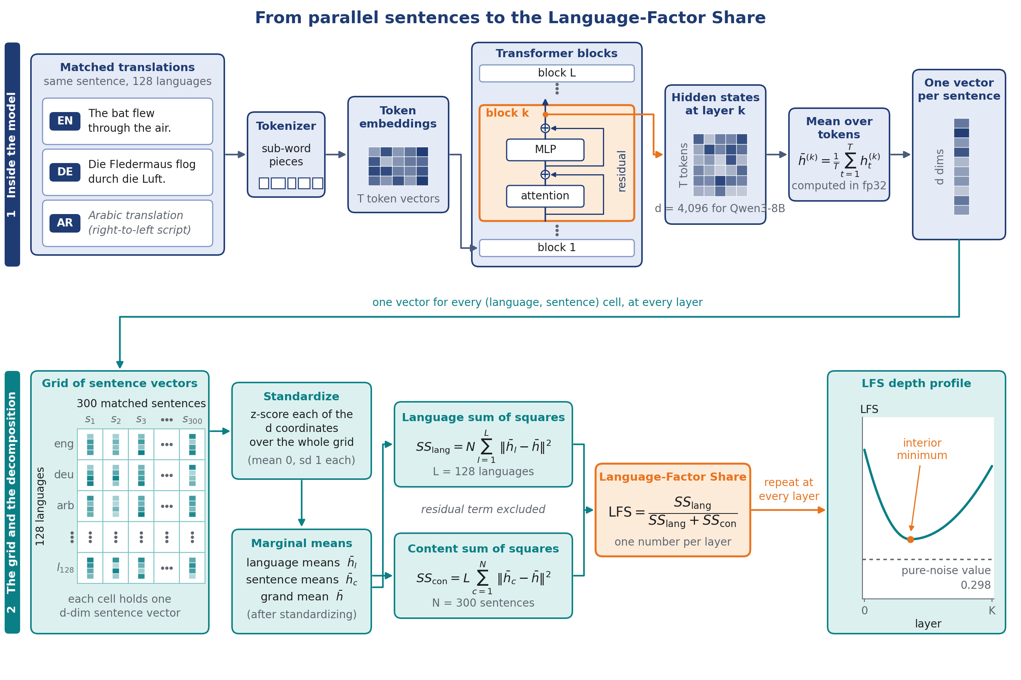
What happens inside the model
Tap the residual stream after block k; mean-pool tokens in fp32.
One 4,096-d vector per (language, sentence) cell, at every layer.
Standardize jointly; split systematic variation into language and sentence means.
3
Notes:
This is the whole pipeline in one picture. The top row is inside the model. Take one sentence, its German translation, and its Arabic translation. Each string goes through the tokenizer and the token embeddings, then through the stack of Transformer blocks. At block k, highlighted in orange, we tap the residual stream after the block. That gives a T by 4,096 matrix of hidden states for a sentence of T tokens. We mean-pool over the non-padding tokens in fp32, and we get one 4,096-dimensional vector per sentence, per layer.
The connector carries the point that matters: one vector for every language and sentence cell, at every layer.
The bottom row is the grid and the decomposition. The vectors fill a 128-language by 300-sentence table. We standardize each coordinate jointly over the whole grid, mean zero and standard deviation one, so a few high-variance coordinates do not dominate the sums. Standardization is joint, never per language; per-language standardization would remove the quantity being measured. Then we take language means, sentence means, and the grand mean, form the two sums of squares, and read the share. The residual term is excluded from the ratio and reported beside it.
We repeat at every layer and plot the profile. The sketch at the right is what we see: an interior minimum with both ends higher, and a dotted line at the pure-noise value 0.298. Extraction is the only GPU work; everything after the tap is CPU arithmetic on saved dumps.

Slide 4
Definition and the pure-noise value
128 languages × 300 matched NTREX sentences; tokens mean-pooled; coordinates standardized jointly over the grid.
SS_{lang} = N Σ_{ℓ} ‖z̄_{ℓ} − z̄‖²
SS_{con} = L Σ_{c} ‖z̄_{c} − z̄‖²
LFS = SS_{lang}/(SS_{lang} + SS_{con})
Pure noise gives (L−1)/(L+N−2) = 0.298 on this grid. Every measured value sits far above it.
4
Notes:
The definition, precisely. Take N sentences translated into L languages. At one layer, mean-pool the token hidden states in fp32 and get one vector per cell of a balanced L by N grid. Standardize each coordinate jointly over all L times N cells.
SS_lang is N times the sum over languages of the squared norm of the centered language mean. SS_con is L times the sum over sentences of the squared norm of the centered sentence mean. On a balanced grid these two terms and the residual are mutually orthogonal, so total variation equals SS_lang plus SS_con plus the residual, exactly. LFS is SS_lang over SS_lang plus SS_con.
The residual is deliberately excluded. LFS asks how the two systematic main effects divide, so that a model's idiosyncratic noise level does not masquerade as shared structure. The residual, and the raw magnitudes of all three terms, are reported beside the ratio as part of the measurement.
The pure-noise value is the calibration. Under an additive model with isotropic noise and no language or concept structure, the estimator returns the degrees-of-freedom ratio, L minus 1 over L plus N minus 2, which is 0.298 at 128 languages and 300 sentences. Synthetic noise across nine configurations and pseudo-language splits of real representations reproduce it to three decimals. Every measured value sits far above it, and in fact above 0.5, so even at the dip layer the measure is relative. Absolute values are comparable only at fixed grid, pooling, and standardization.

Slide 5
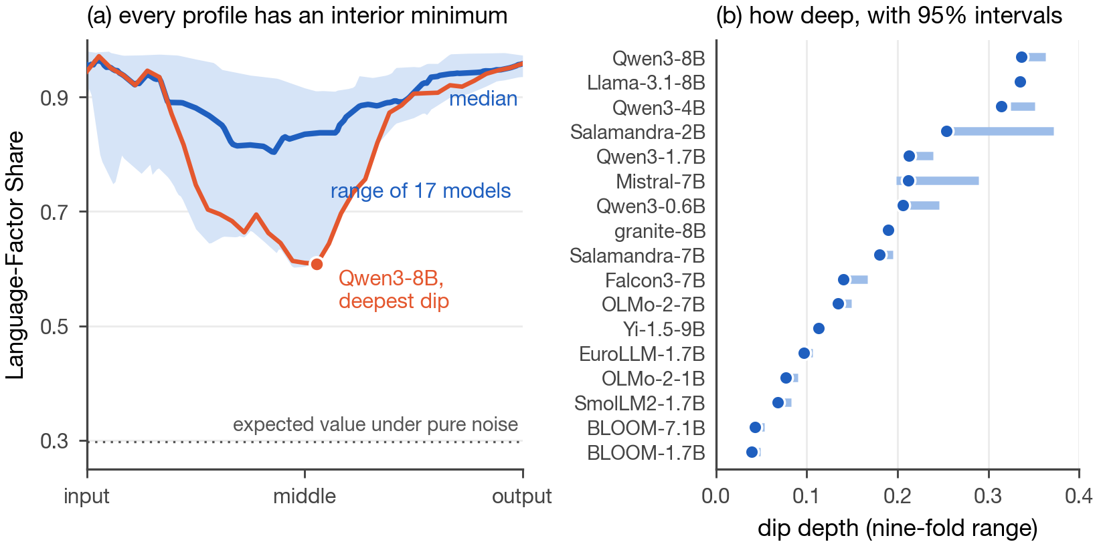
Every profile dips and recovers
Same 300 sentences, 128 languages. High at the input, lowest mid-network, high again at the output: 17 of 17 here, 19 of 19 in the expansion set. Dotted line: pure-noise value 0.298.
5
Notes:
This is Figure 1 of the draft. Same 300 sentences in 128 languages, LFS by relative depth for the 17 primary-set models, four highlighted and the rest in gray. High at the input, lowest mid-network, high again at the output, in all 17 models here and in 19 more measured with a restricted-maximum-likelihood variant in the expansion set. On the 14 models measured by both estimators the dip-depth rankings agree at Spearman 1.000.
Every value lies far above the grid's pure-noise value of 0.298, the dotted line. The minimum lies at relative depth 0.06 to 0.66, most between 0.35 and 0.6. Three models, Mistral-7B and the continued-pretraining models TowerBase-7B and occiglot-7b-eu5, place a sharp minimum at layer 2 followed by a broad plateau, which no summary of the form "middle layers are less language dependent" predicts.
If you say this confirms what we already knew, the answer is yes for the shape. What is new is the number and what it does: a comparable depth with a nine-fold spread, recipe over scale, three models with a minimum at layer 2, script and meaning leaving on different schedules, and a validated relationship to cross-lingual context use.
The right-hand panel is dip depth, layer-0 LFS minus the minimum, for all 17 models; that is the next slide. One caution in wording: the paper says interior minimum with endpoint recovery and does not test for a formally smooth shape.

Slide 6
Dip depth: recipe over scale
Dip depth = first-layer LFS minus the minimum. Nine-fold spread across 17 models, 0.039 to 0.336.
Qwen3-8B
0.336
Qwen3-1.7B dips deeper than every other lab's 7B model except Llama-3.1-8B.
BLOOM, deliberately balanced over 46 languages, is shallowest at both sizes.
Llama-3.1-8B
0.335
Qwen3-1.7B
0.213
Mistral-7B
0.212
BLOOM-1.7B
0.039
6
Notes:
Dip depth is the first-layer LFS minus the minimum. It ranges from 0.039 for BLOOM-1.7B to 0.336 for Qwen3-8B, a nine-fold spread across the 17 primary models, and it tracks the training recipe more than the size.
Within the Qwen3 series the dip deepens monotonically with size: 0.206, 0.213, 0.314, 0.336 from 0.6B to 8B. But the spread across families at fixed size dwarfs that slope. Qwen3-1.7B at 0.213 dips deeper than every 7B model from another lab except Llama-3.1-8B at 0.335. Mistral-7B sits at 0.212 with its minimum at layer 2. BLOOM, the only deliberately balanced 46-language model in the grid, has the shallowest profile and does not deepen from 1.7B to 7B, 0.039 to 0.043. Salamandra dips more at 2B, 0.254, than at 7B, 0.180, while its retrieval alignment improves, so dip depth is not a monotone scaling proxy.
The claim is descriptive. Two unseen families were run under frozen predictions: SmolLM2-1.7B dipped to 0.068 against a prediction of at most 0.15, and Falcon3-7B to 0.140 against a prediction of intermediate.
On pooling, which you asked about in August: absolute depth moves by 0.13 to 0.20 across mean, final-token, unit-norm, and length-matched pooling, the cross-model ordering changes by at most one adjacent transposition, and the within-family result holds for two Qwen3 sizes that share a tokenizer.

Slide 7
It replicates and it is stable
Second corpus
Sentence bootstrap
Instruction tuning
FLORES-200, 116 languages: 17 of 17 recover, dip depths agree at Spearman 0.917.
2,000 draws: 95% half-widths 0.004 to 0.020 for 12 of 14 models.
Six base and instruct pairs: dip depth moves at most 0.008.
7
Notes:
Three reasons to trust the profile as a measurement.
It replicates on a second corpus. We re-measured all 17 models on FLORES-200 devtest, 116 languages, English plus 115 of the 127 non-English languages, 300 sentences, under five frozen predictions. Seventeen of seventeen profiles recover at both endpoints, dip depths agree at Spearman 0.917 with a median absolute difference of 0.011, the minimum layer agrees within two layers for 14 of 17, and per-layer profiles correlate at 0.94 to 1.00.
It is stable under resampling. Sentence-bootstrap intervals on dip depth, 2,000 draws of 300 sentences from the 1,500-sentence dumps with identical index sets for every model, have 95 percent half-widths of 0.004 to 0.020 for 12 of the 14 models. The two wider ones, 0.045 and 0.059, are Mistral-7B and Salamandra-2B, whose minimum sits at layer 2 or 6 where the profile is steep. The cross-model ordering is preserved in 2,000 of 2,000 replicates.
It is a property of pretraining. For six base and instruct pairs, Qwen3 0.6B to 8B, Qwen2.5-7B, and Llama-3.1-8B, dip depth changes by at most 0.008, the minimum layer agrees within two layers for five of six, and the final-layer share differs by at most 0.003. Instruction tuning does not move the profile.
The wording to use is depth profile, measured on a fixed grid, as a structural diagnostic.

Slide 8
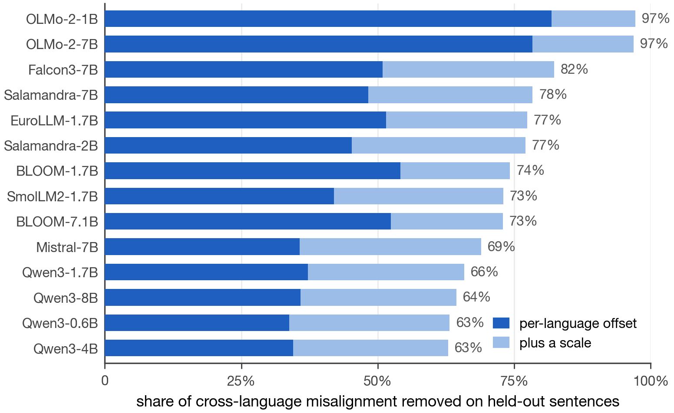
What the remaining differences are
At the dip layer, additive offset plus isotropic scale explain 63 to 97 percent of held-out cross-language misalignment. Rotation: under 1 percent.
The shared factor is multilingual, not English: it predicts each language better than English does for 113 to 124 of 127 languages.
8
Notes:
Once most of the variation sits on meaning at the dip layer, what differences between languages remain? Two results.
First, offsets and scale explain most measured misalignment. At each model's dip layer we fit a nested sequence of maps from each language into a generalized-Procrustes consensus: offset, isotropic scale, rotation, general linear, and a nonlinear kernel, each map credited with its held-out reduction in reconstruction error on 20 cross-fitted splits against per-language permutation nulls. Offset plus scale account for 63 to 97 percent of held-out cross-language misalignment across the 14-model study. Rotation accounts for minus 0.2 to plus 0.7 percent, and the instrument recovers injected rotations of 0.1 to 0.8 radians, so the small rotation share means additional orthogonal alignment adds little under this protocol. The general linear map adds 0.4 to 8 percent. A document-purged re-audit on Qwen3-1.7B leaves offset plus scale at about 64 percent, so the legacy nonlinear percentages are upper bounds.
Second, a multilingual average predicts each language better than an English donor. For each target language we compare the cross-validated R-squared of predicting its dip-layer representations from English against predicting them from the mean of all other languages. The multilingual latent factor predicts better than English does for 113 to 124 of 127 languages depending on the model, 124 for most and BLOOM lowest, by a median of plus 0.06 to plus 0.16 R-squared. English is the best single donor for 9 of 10 high-resource targets but 1 of 8 low-resource ones.

Slide 9
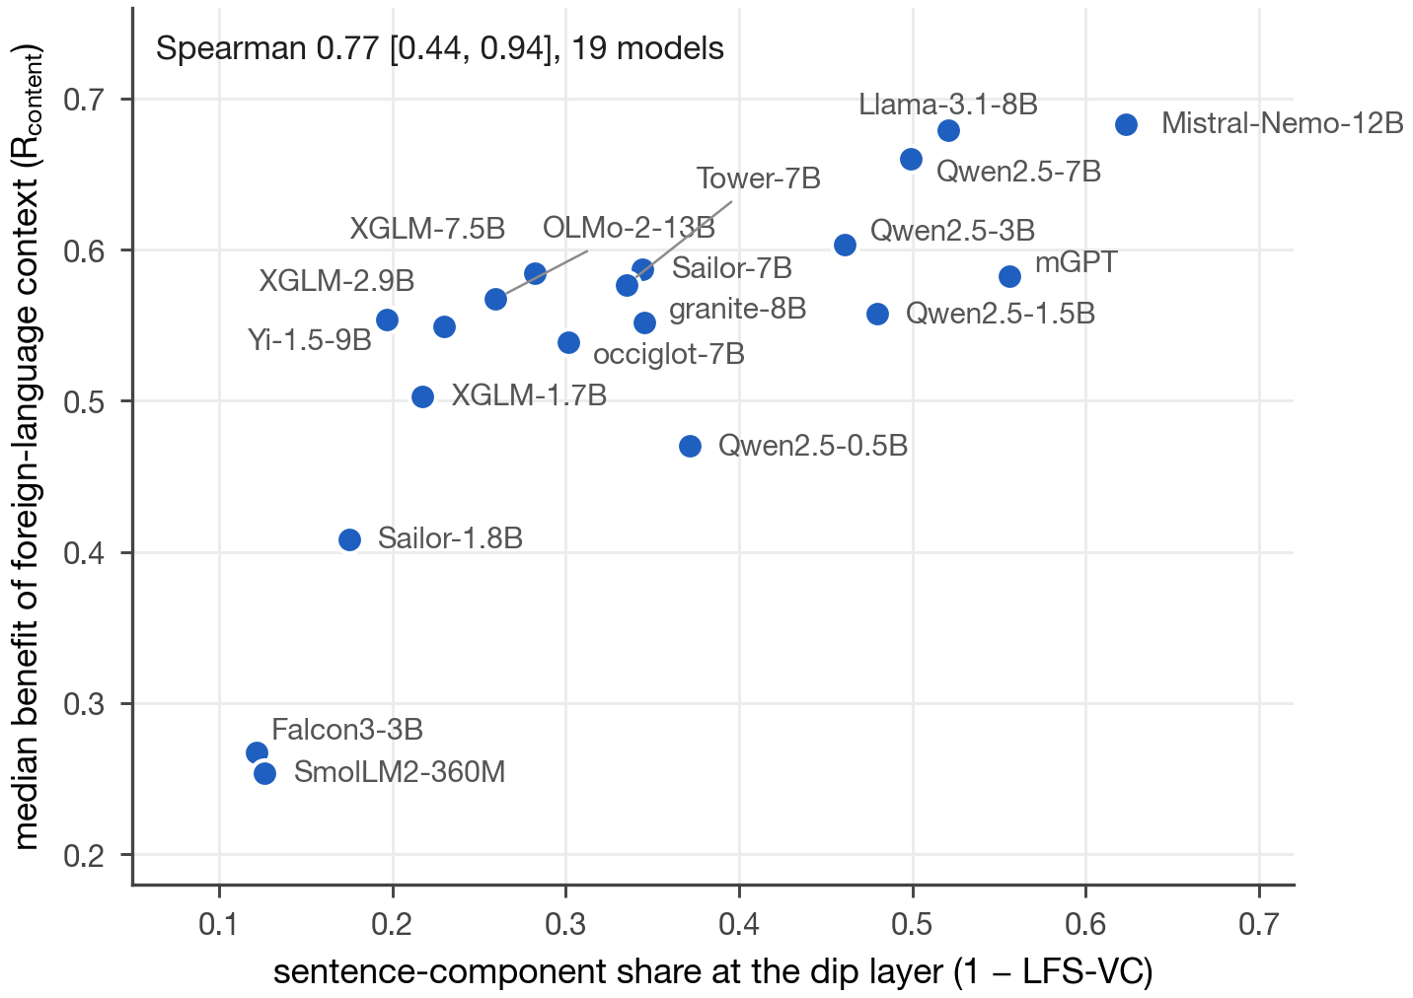
Behavior: cross-lingual content transfer
Does context in another language help a model predict English text? Content benefit: matched minus wrong-document context, normalized by English.
1 − LFS at the dip predicts R_{content} at Spearman 0.508, model-bootstrap CI [0.19, 0.71]; 19 frozen models, 13 families; positive under every leave-one-family-out deletion.
9
Notes:
The behavior most directly tied to a shared representation is using information given in one language to predict text in another. From NTREX we take an English target sentence and its preceding same-document sentence, and measure the target's teacher-forced negative log-likelihood with no context, with the preceding sentence in each of 41 context languages, and with a length-matched wrong-document context in the same language. The content benefit is the mismatched NLL minus the matched NLL, normalized by the English benefit. The mismatched control matters: wrong-document foreign text hurts prediction in most languages, so raw context benefits understate content transfer.
A four-model pilot gave 0.84 but cannot support a model-level claim. So we froze a protocol on 19 new models from 13 families and ran it: 157,700 scored sequences.
The sentence to say: across 19 models and 13 families, models with a smaller language share at the dip layer make more use of foreign-language context when predicting English text, after controlling for data size, family, script, and fertility. Confounder-adjusted Spearman 0.508, model-bootstrap interval 0.19 to 0.71, positive under every leave-one-family-out deletion, 0.770 at the model level. Each point in the figure is one model, placed by its sentence-component measure at the dip and its median normalized content benefit over 34 languages.
This is a predictive association, not causation. MEXA has a larger point estimate on the same test, 0.591; the two answer different questions and are not ranked.

Slide 10
Where it fails: pooled benchmark accuracy
0.041
The reliability ceiling
Two independent benchmarks agree on only 0.315 of their residual variation, so pooled scores are a noisy criterion. Averaging the two recovers a positive interval.
A scope condition, not a defect.
95% CI [−0.05, 0.12]
Adjusted Spearman, 1 − LFS-VC vs pooled Belebele and INCLUDE accuracy; 33 models.
10
Notes:
Now the two boundaries, before they are raised. The first is pooled benchmark accuracy.
Raw correlations between intrinsic alignment and Belebele accuracy are moderate, but the correlation decreases after adjustment for exposure-related covariates. We fit a confounder adjustment model on the logit scale: model fixed effects, log training tokens from CulturaX, macro-family, script, and tokenizer fertility, R-squared 0.86 with a positive and significant token coefficient. Validity is the Spearman correlation between residualized metric and residualized outcome, with cluster bootstrap intervals by language, by model, and crossed.
On the 33-model panel (1,740 rows, 70 languages), the sentence-component share, one minus LFS-VC, has covariate-adjusted Spearman 0.041 with interval minus 0.05 to 0.12. There is no clear adjusted association with pooled benchmark accuracy. Neither does anything else strongly: MEXA is 0.238 and the tail measure 0.105 on the same panel.
The measured reason is the target. Two independent benchmarks of the same 420 cells agree on only 0.315 of their adjusted residual rank variation, which bounds how closely any predictor can track one benchmark's residual. Averaging the two benchmarks recovers a positive interval, plus 0.10 with interval 0.003 to 0.18. On 30 natively authored INCLUDE languages the picture is the same, and the loss traces to that panel's narrow resource range, not to translationese.
Own this: it is a scope condition, not a defect to be tuned away. The July benchmark-capable-subset number of about 0.59 has no stored artifact and is withdrawn; it re-derives at about 0.49.

Slide 11
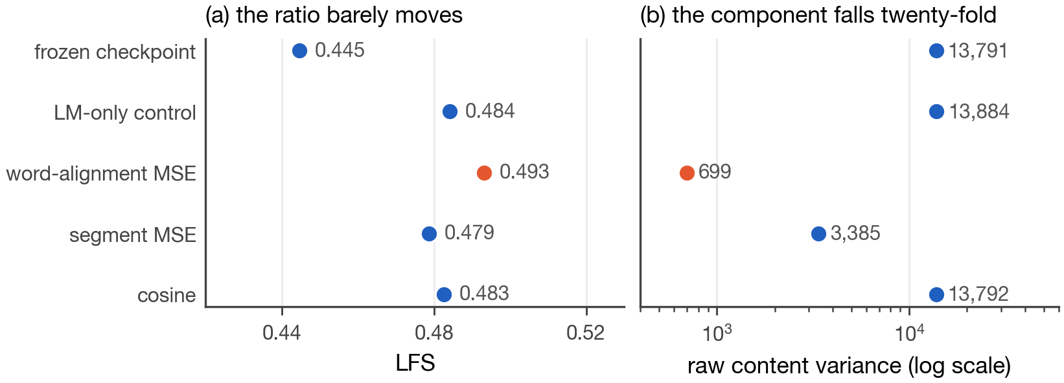
The collapse blind spot
The proposal's word-alignment MSE loss shrank representation norm 451 to 42 and raw concept variance 13,791 to 699. LFS moved 0.445 to 0.493; retrieval measures rose for the collapsed model, which posted among the highest scores first. Only the raw concept-variance measure (CVP) caught it.
11
Notes:
The second boundary is one every scale-invariant measure shares. Any statistic unchanged when all representations are multiplied by the same nonzero constant is unchanged when all representations shrink together. Injecting calibrated shrinkage toward the global centroid into saved representations leaves LFS unchanged to one part in a million, and leaves MEXA and the tail measure flat even at 90 percent collapse, because retrieval is order-based. Only a raw concept-variance preservation check, CVP, concept variance relative to a frozen reference, fires, and it returns the predicted value.
A trained model exhibits this failure. The word-level alignment objective from the proposal's section 3.2.2, a squared difference between representations of dictionary-linked words in a sentence and its translation, is globally minimized when every representation is zero. Fine-tuning Qwen3-0.6B with it for 400 steps, three seeds, shrank mean representation norm from 451 to 42 and raw concept variance at the measured layer from 13,791 to 699, a factor of twenty. LFS moved from 0.445 to 0.493. MEXA and AaR ranked the collapsed model first.
The figure reads the five conditions two ways. Left, the ratio separates the collapsed condition from the sound cosine condition by 0.01. Right, raw concept variance separates them by a factor of twenty. The decomposition sees it; the ratio divides it out. That is why the paper reports LFS with its raw components.
A bound: the collapsed model matched its control on a 40-language Belebele panel, 0.395 versus 0.390, so collapse detection is a reorganization flag, not a harm measurement.

Slide 12
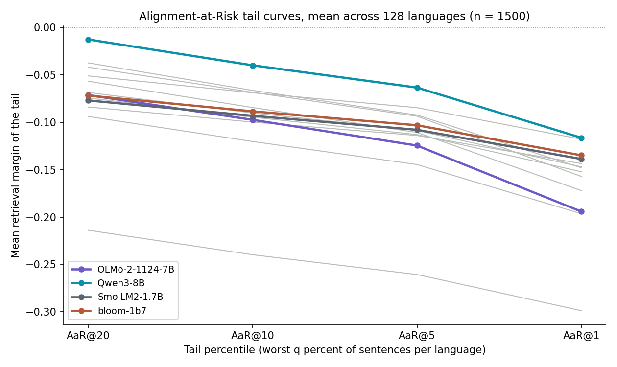
The tail: means hide failing sentences
AaR@q: mean retrieval margin of the worst q percent of sentences per language; 13 models of the 1,500-sentence study, 1,500 sentences.
A steep descent toward AaR@1 means rare, severe failures; a flat low curve means broad fragility.
The tail measure tracks content transfer at 0.443 [0.09, 0.71].
12
Notes:
Averages across sentences hide the sentences that fail. The family's tail measure is Alignment-at-Risk: for each language, rank sentences by their retrieval margin, the gap between the correct translation's similarity and the strongest wrong candidate, and take the mean margin over the worst q percent. AaR@10 is the worst decile.
The figure shows the tail curves for 13 of the 14 models of the 1,500-sentence study at the dip layer, 1,500 sentences, averaged across the 128 languages; Salamandra-2B sits far below the axis and is omitted for legibility. Reading the curves: a steep descent toward AaR@1 means rare but severe failures, a catastrophic-tail profile; a flat low curve means broad fragility. Qwen3-8B has the healthiest tail throughout. OLMo-2-7B is ordinary at the worst 20 percent and falls steeply at the worst 1 percent. Two models with a similar mean can have very different tails, and that is what a mean hides.
The tail measure is validated on its own question. Against content transfer on the 19 frozen models it reaches 0.443 with model interval 0.09 to 0.71. Against pooled benchmark accuracy it reaches 0.105 after confound removal on the 33-model panel. Per-language estimates are noisy because the worst decile of 300 sentences is 30 sentences, so cross-language and cross-model aggregates are the reliable objects.
The point for the family: this is a different question from the share, answered by a different measure, and never averaged into it.

Slide 13
A family, not a score
Language vs meaning, by layer | LFS profile
Did concept variance collapse? | Raw components
Is the cross-language map simple? | Nested maps
Is the shared factor English? | Hub test
Do the hardest sentences align? | Tail measure
MEXA: published reference measure, reported alongside, never ranked.
In Aim 2: design, monitoring, evaluation. Never the loss.
13
Notes:
Here is the framing I would like you to approve. A family of measures, each answering one question, none averaged into a score. The proposal asks for metrics, plural; the paper delivers a family. This is not a leaderboard paper.
The five rows. The LFS profile and its dip depth answer how variation splits between language and meaning at each layer. The raw components, SS_lang, SS_con, the residual, and the norm against a frozen reference, answer whether scale or concept variance collapsed, which the ratio hides. The nested map sequence answers whether the cross-language map is simple: additive, rotational, or nonlinear. The hub test answers whether the shared factor is English. The tail measure answers whether the hardest sentences align.
MEXA is a published reference measure computed alongside. It asks whether a translation is the nearest neighbor against an English pivot; LFS asks how variance splits, with no pivot, a null, size stability, and components that catch what MEXA ranked first. Different questions, and the paper ranks nothing against it.
For Aim 2, the family's demonstrated role is to choose the layer, watch for collapse, and evaluate whether structure and behavior moved. Not the loss. Minimizing LFS as a training loss reversed the observational association, Pearson plus 0.92 between LFS and tail alignment across 18 condition-seed points, and a bounded variance-preservation penalty cannot restrain an unbounded alignment term. The constraint form, align subject to preserving raw concept variance and capability, is the Aim 2 design.

Slide 14
Four asks, two dates
1
Framing and title: a family of measures, a structural diagnostic, not a leaderboard.
2
Author list and order, final by 18 September.
3
One registered reviewer for three papers, or the submission is desk-rejected.
4
Green light to register the abstract.
Abstract 18 September AOE · Full paper 25 September AOE
14
Notes:
The asks, in order.
First, the framing and the title. A family of measures, a structural diagnostic reported with its raw components and behavioral checks, not a universal score and not a loss.
Second, the author list and order. The abstract registration deadline is 18 September, anywhere on earth, and the author list must be final by then. I would like to register the abstract as soon as you approve the list.
Third, a registered reviewer. ICLR requires an author on each submission to register and review three papers, or the submission is desk-rejected. One of you or Kenton would need to register.
Fourth, a green light to register the abstract with the approved list. The full paper is due 25 September, anywhere on earth. Both documents are attached; the draft is complete, and the remaining items are the anonymous code link, pinned revisions for the primary set, and the wording of the ethics and AI-use statements, which need your confirmation.
If we have time, the weakest point is the benchmark target, and I would rather discuss it now than have a reviewer raise it. Two independent benchmarks agree on only a third of their per-language residual variation, so the ceiling for any predictor is about 0.56; that is a finding about evaluation, not a hole in the metric.
Closing sentence: I would like to register the abstract by the 17th with the author list you approve. The full paper goes in on the 25th.

