Slide 1
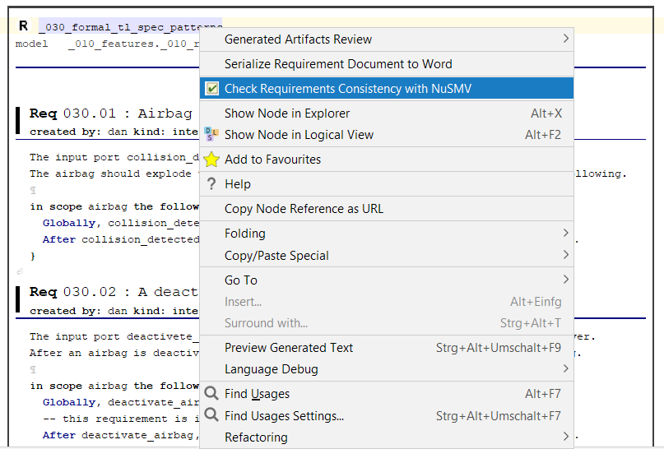
Formally defined requirements using TL
patterns can be checked for consistency.

Slide 2
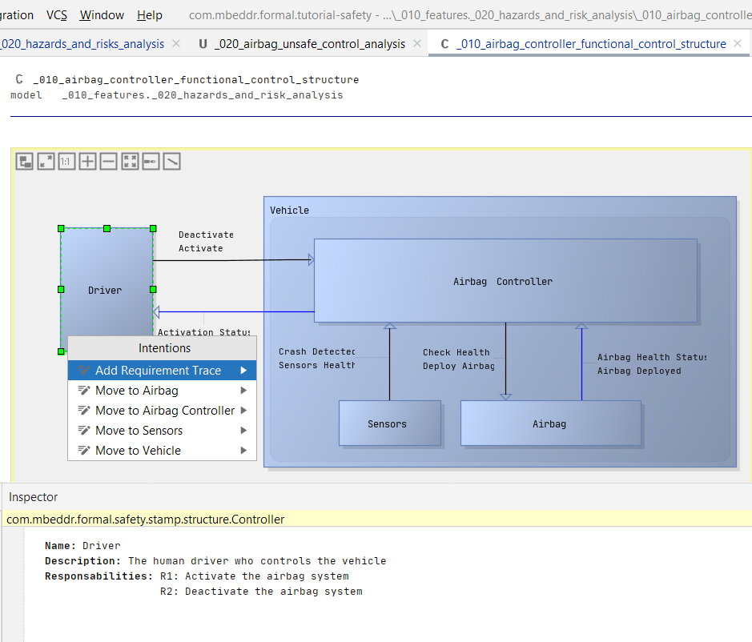
By selecting a box (controller) or line (control/feedback actions), we can change its name, description, etc in the „Inspector“ window.
Pressing Alt+Enter on a box (controller) opens the intentions menu which allows the creation of hierarchies of controllers.

