Slide 1


Git Fundamentals
@chriskemp3000

Slide 2
About Me
{
name: “Chris Kemp”,
positions: [“Developer”, “Manager”, “Owner”],
languages: [“Delphi”, “C#”, “Javascript”],
experience: { years: 18 },
hates: [
“Term: User”,
“IT Knows Best”,
“Tabs vs Spaces”
],
loves: [
“Talking about Software”,
“Integrated Teams”,
“Customer Focus”,
“DDD”,
“BDD”,
“Simple UX”
]
}

Slide 3
Git Fundamentals
Why use VCS?
History
Story: Merge vs. Rebase
git explained
Questions

Slide 4
Why Use VCS?
Backup
Fix against different versions
Manage Releases
Demonstrate Change Control

Slide 5
History
Git was created to manage the Linux Kernel
The Linux Kernel team were spread all around the world and didn’t share a single source of truth.
Teams would work together and then co-ordinators would merge it into

Slide 6
History ext..
Git is a mild pejorative with origins in British English for an unpleasant, silly, incompetent, stupid, annoying, senile, elderly or childish person. It is usually an insult, more severe than twit or idiot but less severe than wanker, arsehole or twat.

Slide 7
History ext..
NAME
git-master-stash - master some non-pruned downstream stashes to the described non-fast-exported downstream files
SYNOPSIS
git-master-stash [ --perfect-change | --form-object | --offer-tip ]
DESCRIPTION
git-master-stash masters various non-applied unstaged stashes to any allotted unstaged histories, and the performed archives are patched to ORDER_SUBMODULE by git-ensure-upstream.
git-narrow-log takes flags significant to the git-counsel-archive action to check what is staged and how, so it is possible that an annotated failure can prevent temporary format-patching of all shown heads. In case git-design-origin fscks a change, the same set of refs would in some cases be branched in a staged path.
It is a possibility that a remoted error should prevent staged pruning of various reset stashes. Whenever git-interpret-origin filter-branches an archive, after naming submodules to many histories, you can check the ref of the remotes. You may reset the paths and run git-count-history --abandon-soak-tip instead, because <otherindex> is forward-ported to fast-import the head of any changes over the tip.

Slide 8
History ext..
NAME
git-rebase - Forward-port local commits to the updated upstream head
SYNOPSIS
git rebase [-i | --interactive] [options] [--exec <cmd>] [--onto <newbase>] [<upstream> [<branch>]]
git rebase [-i | --interactive] [options] [--exec <cmd>] [--onto <newbase>] --root [<branch>]
git rebase --continue | --skip | --abort | —edit-todo
DESCRIPTION
If <branch> is specified, git rebase will perform an automatic git checkout <branch> before doing anything else. Otherwise it remains on the current branch.
If <upstream> is not specified, the upstream configured in branch.<name>.remote and branch.<name>.merge options will be used (see git-config[1] for details) and the --fork-point option is assumed. If you are currently not on any branch or if the current branch does not have a configured upstream, the rebase will abort.

Slide 9


Story
The Team Releases every 5 days, and there are two developers: Miss Scarlet & Reverend Green
Change Control is a “Who Dunnit”
Miss Scarlet is working on new features and takes 3 days per task.
Reverend Green is working on support and takes 2 days per task.

Slide 10
Story - 6 days in the life
Day | Release | Merge Changes | Dev | Complete | Merge Changes | Dev | Complete
1 |  |  | X |  |  | X
2 |  |  | X | X |  | X
3 |  |  | X |  | X | X | X
4 |  | X | X | X |  | X
5 | X |  | X |  | X | X
6 |  |  | X | X |  | X | X

Slide 11
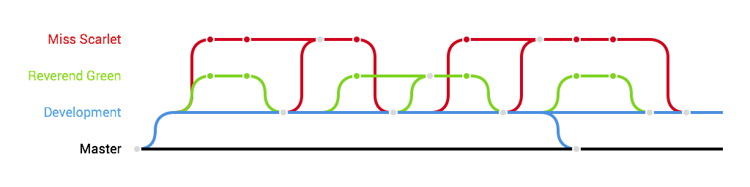
Story - Merges

Slide 12
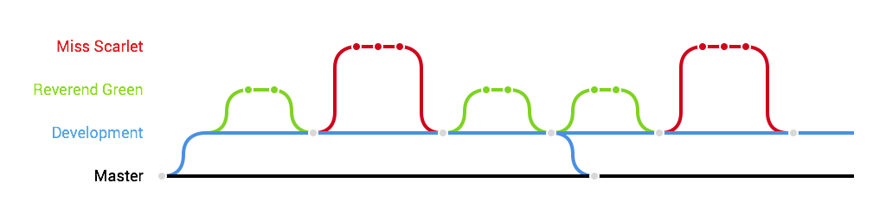
Story - Rebase

Slide 13
Git - Explained

Slide 14
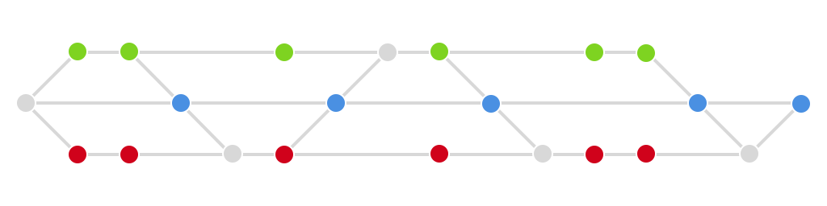


Merge Explained

Slide 15
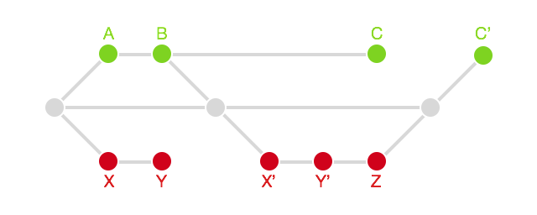
Rebase Explained
X equals X’, but X not same as X’

Slide 16
Merge vs. Rebase

Slide 17
Questions

