Slide 1
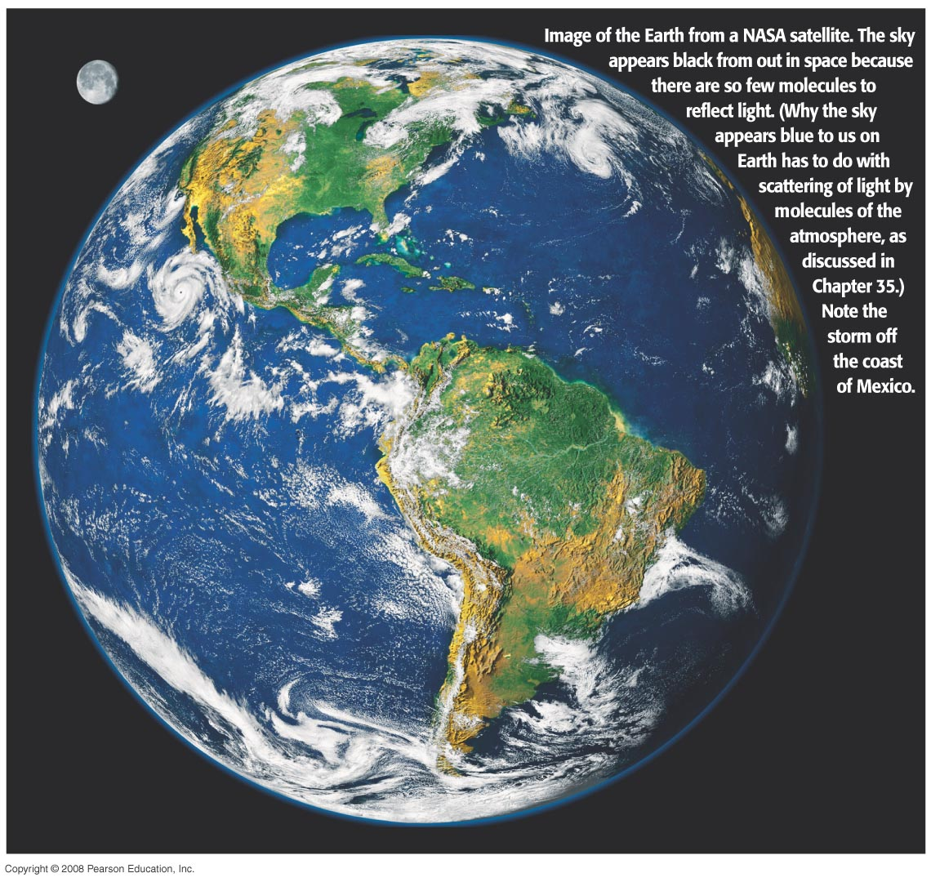
Chapter 1
Introduction, Measurement, Estimating
Notes:
Chapter Opening Image. Caption: Image of the Earth from a NASA satellite. The sky appears black from out in space because there are so few molecules to reflect light. (Why the sky appears blue to us on Earth has to do with scattering of light by molecules of the atmosphere, as discussed in Chapter 35.) Note the storm off the coast of Mexico.

Slide 2
Units of Chapter 1
The Nature of Science
Models, Theories, and Laws
Measurement and Uncertainty; Significant Figures
Units, Standards, and the SI System
Converting Units
Order of Magnitude: Rapid Estimating
Dimensions and Dimensional Analysis

Slide 3
1-1 The Nature of Science
Observation: important first step toward scientific theory; requires imagination to tell what is important
Theories: created to explain observations; will make predictions
Observations will tell if the prediction is accurate, and the cycle goes on.
No theory can be absolutely verified, although a theory can be proven false.

Slide 4
1-1 The Nature of Science
How does a new theory get accepted?
Predictions agree better with data
Explains a greater range of phenomena
Example: Aristotle believed that objects would return to a state of rest once put in motion.
Galileo realized that an object put in motion would stay in motion until some force stopped it.

Slide 5
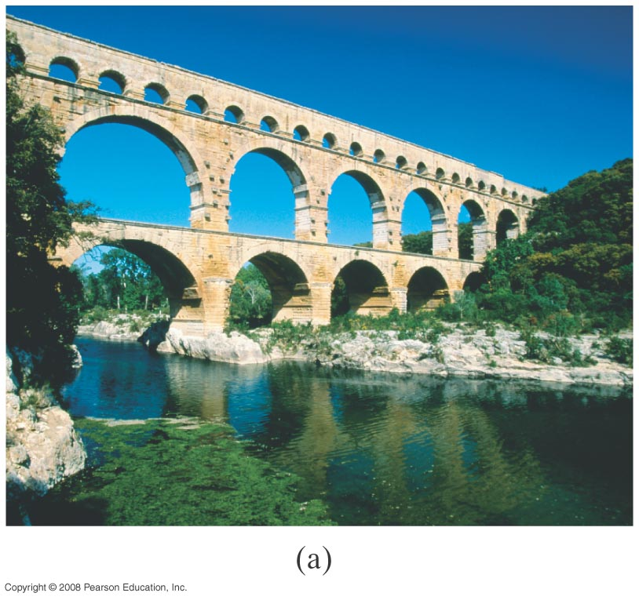
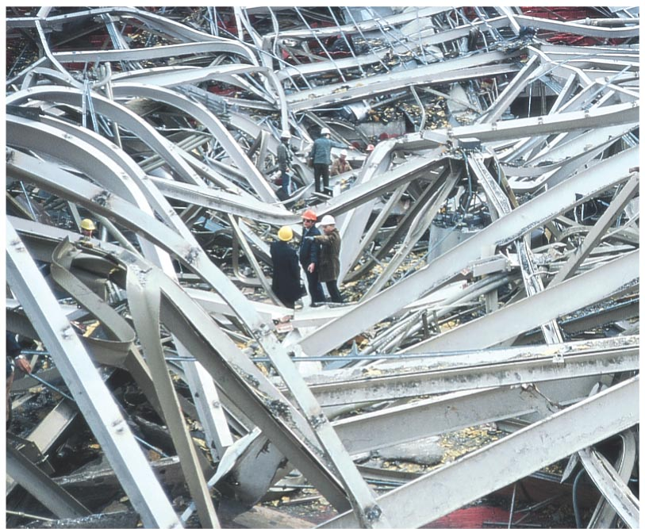
1-1 The Nature of Science
The principles of physics are used in many practical applications, including construction. Communication between architects and engineers is essential if disaster is to be avoided.
Notes:
Figure 1-1. Caption: (a) This Roman aqueduct was built 2000 years ago and still stands. (b) The Hartford Civic Center collapsed in 1978, just two years after it was built.

Slide 6
1-2 Models, Theories, and Laws
Models are very useful during the process of understanding phenomena. A model creates mental pictures; care must be taken to understand the limits of the model and not take it too seriously.
A theory is detailed and can give testable predictions.
A law is a brief description of how nature behaves in a broad set of circumstances.
A principle is similar to a law, but applies to a narrower range of phenomena.

Slide 7
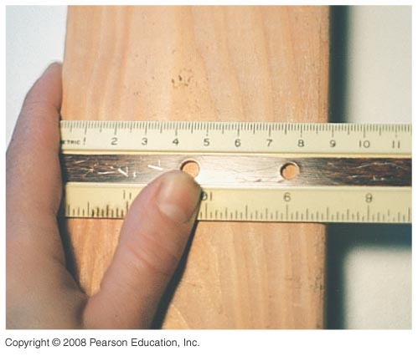
1-3 Measurement and Uncertainty; Significant Figures
No measurement is exact; there is always some uncertainty due to limited instrument accuracy and difficulty reading results.
The photograph to the left illustrates this – it would be difficult to measure the width of this board more accurately than ± 1 mm.
Notes:
Figure 1-2. Caption: Measuring the width of a board with a centimeter ruler. The uncertainty is about ±1 mm.

Slide 8
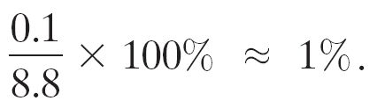
1-3 Measurement and Uncertainty; Significant Figures
Estimated uncertainty is written with a ± sign; for example: 8.8 ± 0.1 cm.
Percent uncertainty is the ratio of the uncertainty to the measured value, multiplied by 100:

Slide 9
1-3 Measurement and Uncertainty; Significant Figures
The number of significant figures is the number of reliably known digits in a number. It is usually possible to tell the number of significant figures by the way the number is written:
23.21 cm has four significant figures.
0.062 cm has two significant figures (the initial zeroes don’t count).
80 km is ambiguous—it could have one or two significant figures. If it has three, it should be written 80.0 km.

Slide 10
1-3 Measurement and Uncertainty; Significant Figures
When multiplying or dividing numbers, the result has as many significant figures as the number used in the calculation with the fewest significant figures.
Example: 11.3 cm x 6.8 cm = 77 cm.
When adding or subtracting, the answer is no more accurate than the least accurate number used.
The number of significant figures may be off by one; use the percentage uncertainty as a check.

Slide 11
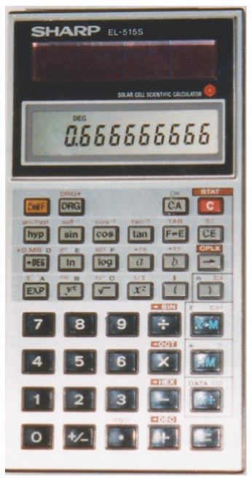
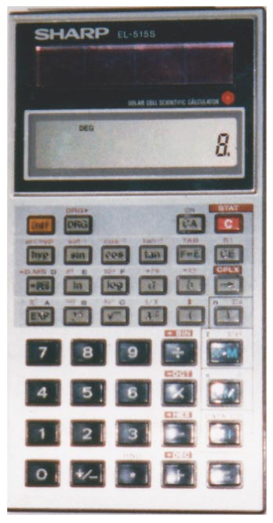
1-3 Measurement and Uncertainty; Significant Figures
Calculators will not give you the right number of significant figures; they usually give too many but sometimes give too few (especially if there are trailing zeroes after a decimal point).
The top calculator shows the result of 2.0/3.0.
The bottom calculator shows the result of 2.5 x 3.2.
Notes:
Figure 1-3. Caption: These two calculators show the wrong number of significant figures. In (a), 2.0 was divided by 3.0. The correct final result would be 0.67. In (b), 2.5 was multiplied by 3.2.The correct result is 8.0.

Slide 12
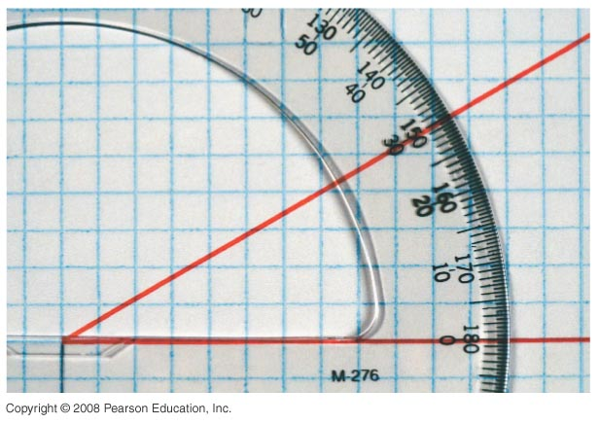
1-3 Measurement and Uncertainty; Significant Figures
Conceptual Example 1-1: Significant figures.
Using a protractor, you measure an angle to be 30°. (a) How many significant figures should you quote in this measurement? (b) Use a calculator to find the cosine of the angle you measured.
Notes:
Figure 1-4. Caption: Example 1–1. A protractor used to measure an angle.
Response: (a) If you look at a protractor, you will see that the precision with which you can measure an angle is about one degree (certainly not 0.1°). So you can quote two significant figures, namely, 30° (not 30.0°). (b) If you enter cos 30° in your calculator, you will get a number like 0.866025403. However, the angle you entered is known only to two significant figures, so its cosine is correctly given by 0.87; you must round your answer to two significant figures.

Slide 13
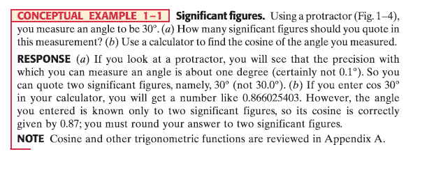

Slide 14
1-3 Measurement and Uncertainty; Significant Figures
Scientific notation is commonly used in physics; it allows the number of significant figures to be clearly shown.
For example, we cannot tell how many significant figures the number 36,900 has. However, if we write 3.69 x 10⁴, we know it has three; if we write 3.690 x 10⁴, it has four.
Much of physics involves approximations; these can affect the precision of a measurement also.

Slide 15

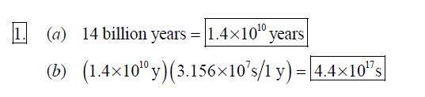

Slide 16


Slide 17
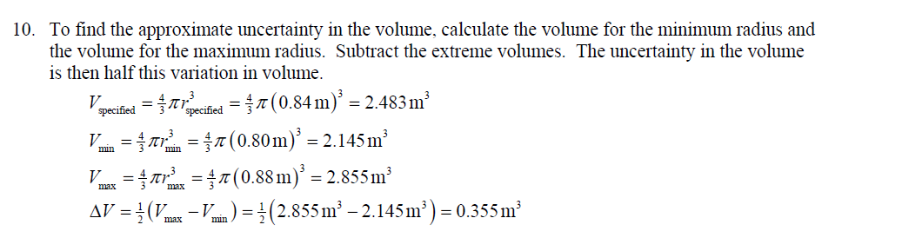

Slide 18


Slide 19
1-3 Measurement and Uncertainty; Significant Figures
Accuracy vs. Precision
Accuracy is how close a measurement comes to the true value.
Precision is the repeatability of the measurement using the same instrument.
It is possible to be accurate without being precise and to be precise without being accurate!

Slide 20
1-4 Units, Standards, and the SI System
Quantity | Unit | Standard
Length | Meter | Length of the path traveled by light in 1/299,792,458 second
Time | Second | Time required for 9,192,631,770 periods of radiation emitted by cesium atoms
Mass | Kilogram | Platinum cylinder in International Bureau of Weights and Measures, Paris

Slide 21
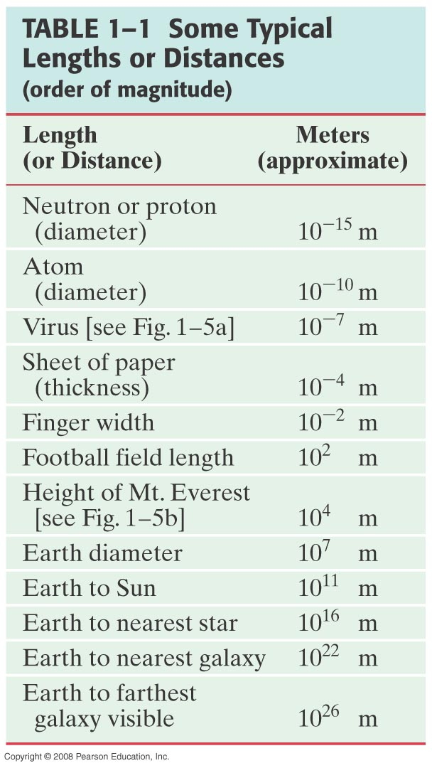
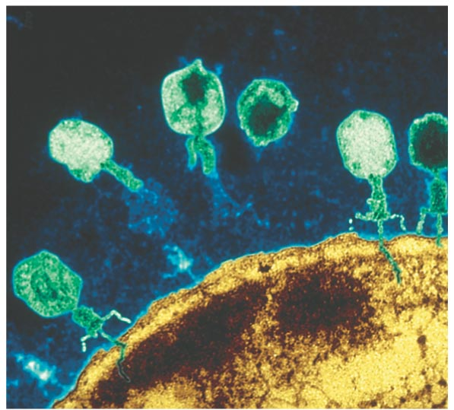
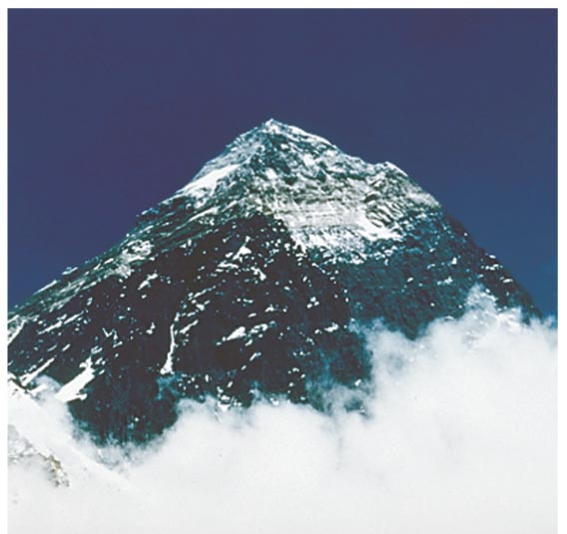
1-4 Units, Standards, and the SI System
Notes:
Figure 1-5. Caption: Some lengths: (a) viruses (about 10⁻⁷ m long) attacking a cell; (b) Mt. Everest’s height is on the order of 10⁴ m (8850 m, to be precise).

Slide 22
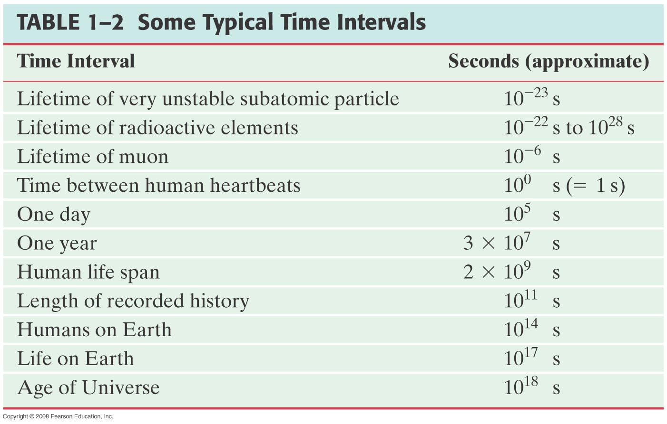
1-4 Units, Standards, and the SI System

Slide 23
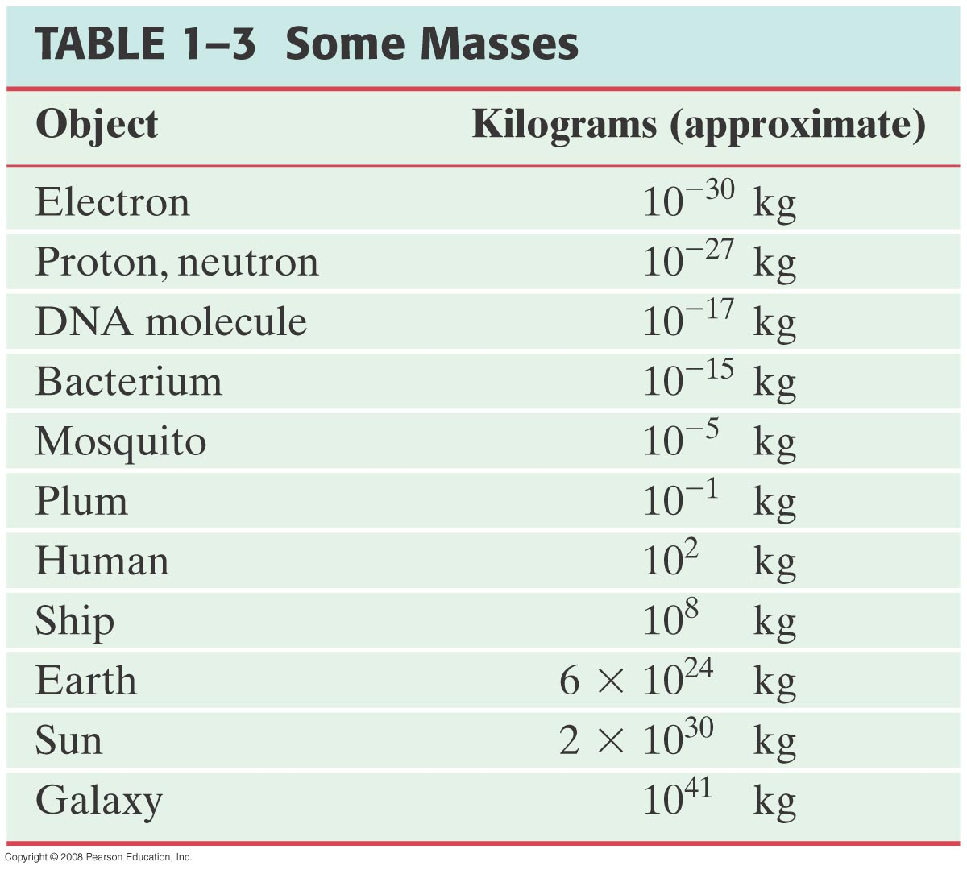
1-4 Units, Standards, and the SI System

Slide 24
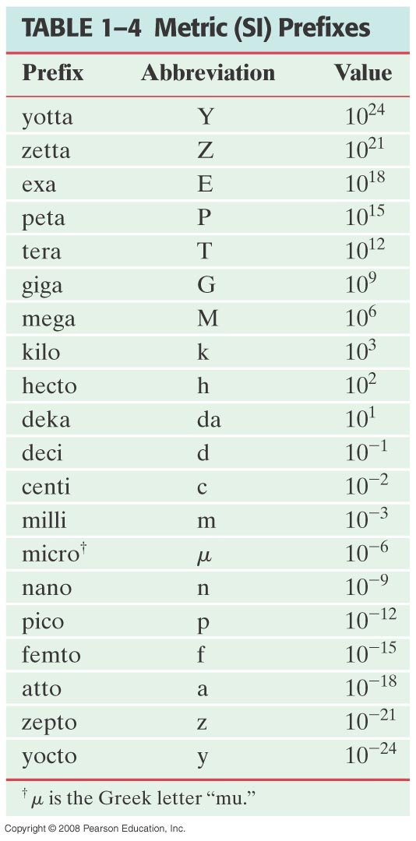
1-4 Units, Standards, and the SI System
These are the standard SI prefixes for indicating powers of 10. Many are familiar; yotta, zetta, exa, hecto, deka, atto, zepto, and yocto are rarely used.

Slide 25
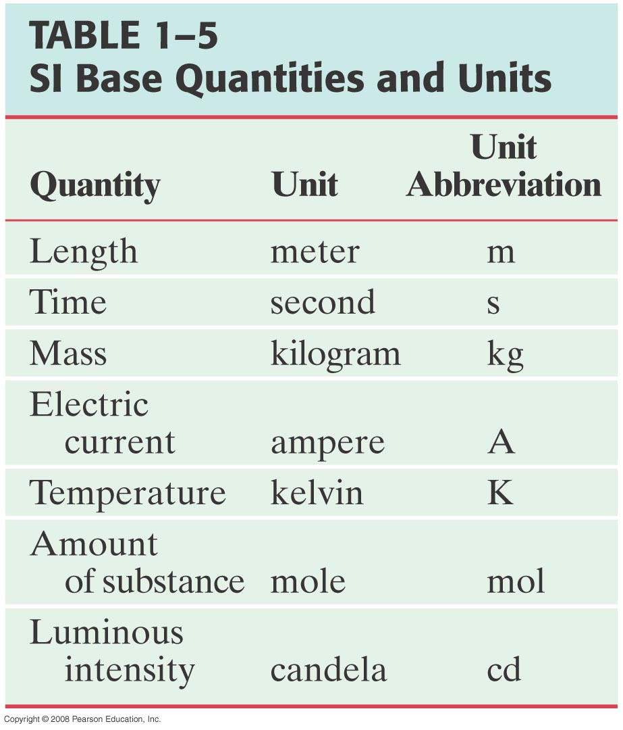
1-4 Units, Standards, and the SI System
We will be working in the SI system, in which the basic units are kilograms, meters, and seconds. Quantities not in the table are derived quantities, expressed in terms of the base units.
Other systems: cgs; units are centimeters, grams, and seconds.
British engineering system has force instead of mass as one of its basic quantities, which are feet, pounds, and seconds.

Slide 26
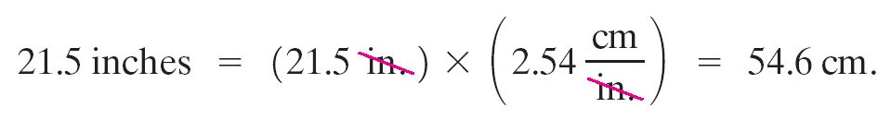
1-5 Converting Units
Unit conversions always involve a conversion factor.
Example: 1 in. = 2.54 cm.
Written another way: 1 = 2.54 cm/in.
So if we have measured a length of 21.5 inches, and wish to convert it to centimeters, we use the conversion factor:

Slide 27
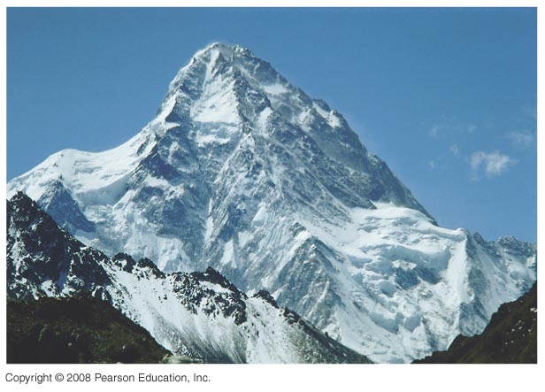
1-5 Converting Units
Example 1-2: The 8000-m peaks.
The fourteen tallest peaks in the world are referred to as “eight-thousanders,” meaning their summits are over 8000 m above sea level. What is the elevation, in feet, of an elevation of 8000 m?
Notes:
Figure 1-6. Caption: The world’s second highest peak, K2, whose summit is considered the most difficult of the “8000-ers.” K2 is seen here from the north (China).
Answer: An elevation of 8000 m is 26,247 ft above sea level.

Slide 28
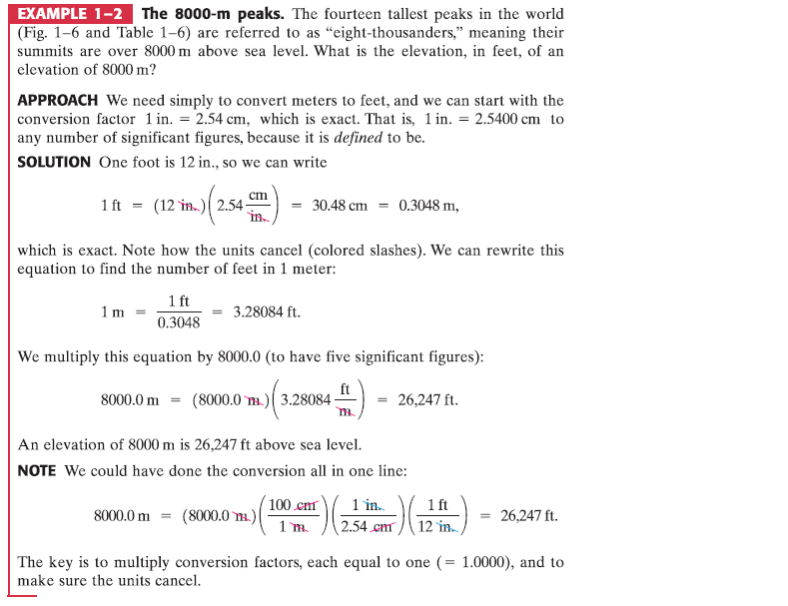

Slide 29
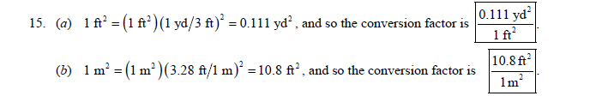

Slide 30



Slide 31
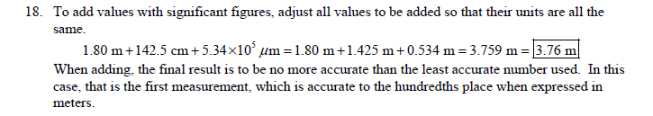
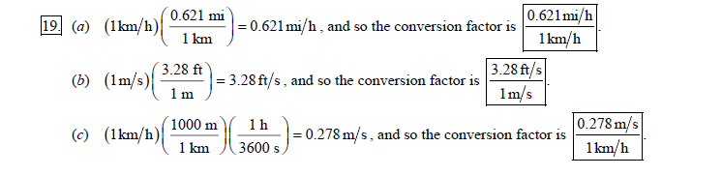
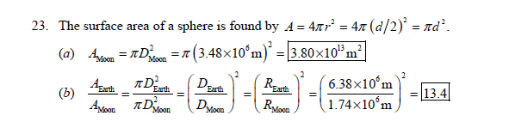

Slide 32
1-6 Order of Magnitude: Rapid Estimating
A quick way to estimate a calculated quantity is to round off all numbers to one significant figure and then calculate. Your result should at least be the right order of magnitude; this can be expressed by rounding it off to the nearest power of 10.
Diagrams are also very useful in making estimations.

Slide 33
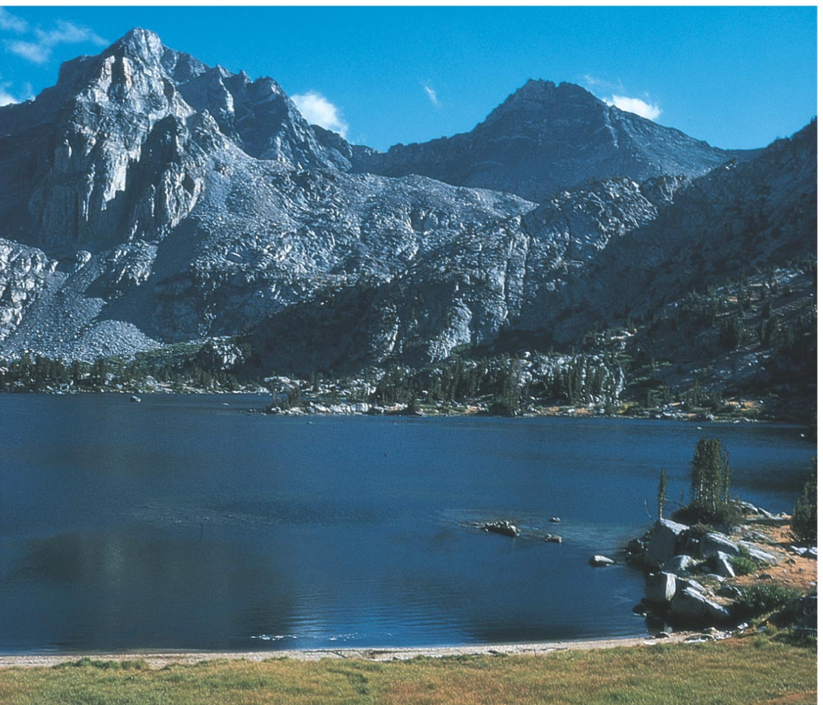
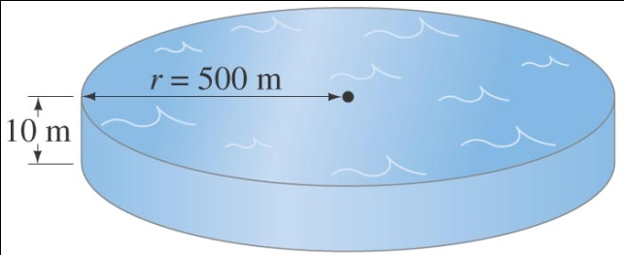
1-6 Order of Magnitude: Rapid Estimating
Example 1-5: Volume of a lake.
Estimate how much water there is in a particular lake, which is roughly circular, about 1 km across, and you guess it has an average depth of about 10 m.
Notes:
Figure 1-7. Caption: Example 1–5. (a) How much water is in this lake? (Photo is of one of the Rae Lakes in the Sierra Nevada of California.) (b) Model of the lake as a cylinder. [We could go one step further and estimate the mass or weight of this lake. We will see later that water has a density 1000 kg/m³, of so this lake has a mass of about (10³ kg/m³)(10⁷ m³) ≈ 10¹⁰ kg, which is about 10 billion kg or 10 million metric tons. (A metric ton is 1000 kg, about 2200 lbs, slightly larger than a British ton, 2000 lbs.)]
Answer: The volume of the lake is about 10⁷ m³.

Slide 34
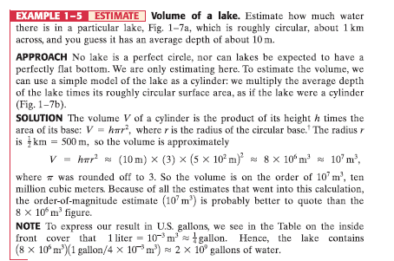

Slide 35
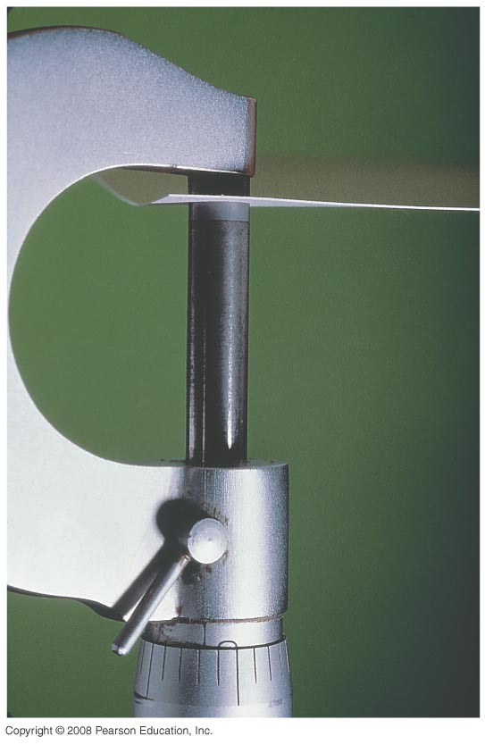
1-6 Order of Magnitude: Rapid Estimating
Example 1-6: Thickness of a page.
Estimate the thickness of a page of your textbook. (Hint: you don’t need one of these!)
Notes:
Figure 1-8. Caption: Example 1–6. Micrometer used for measuring small thicknesses.
Answer: Measure the thickness of 100 pages. You should find that the thickness of a single page is about 6 x 10⁻² mm.

Slide 36
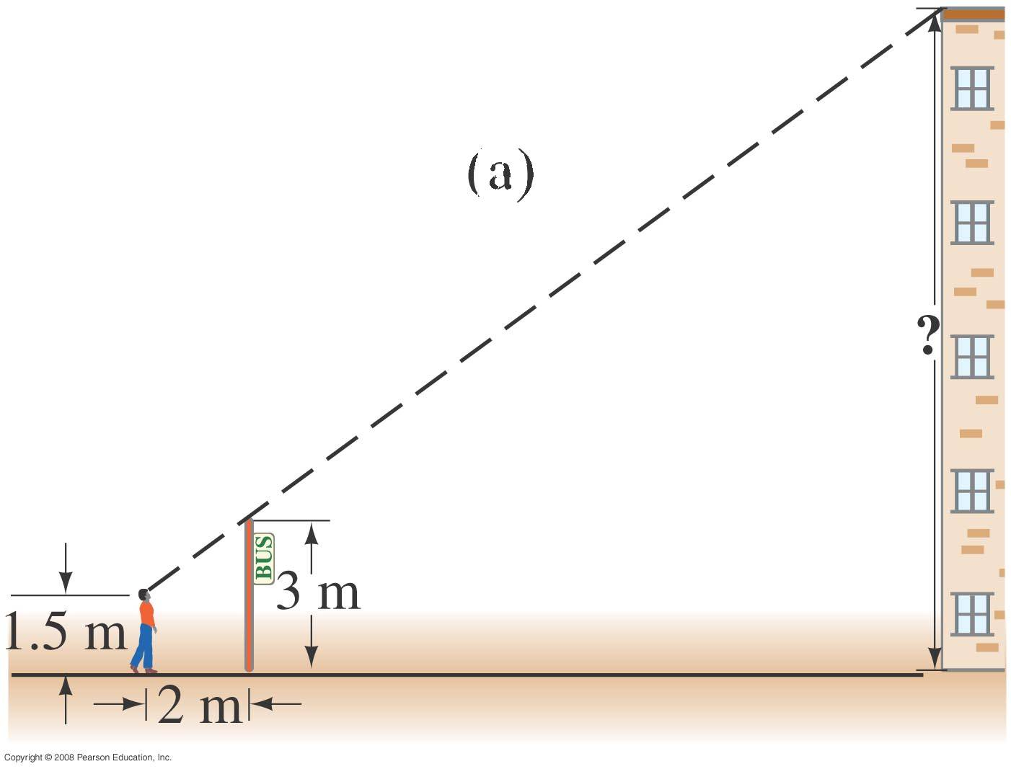
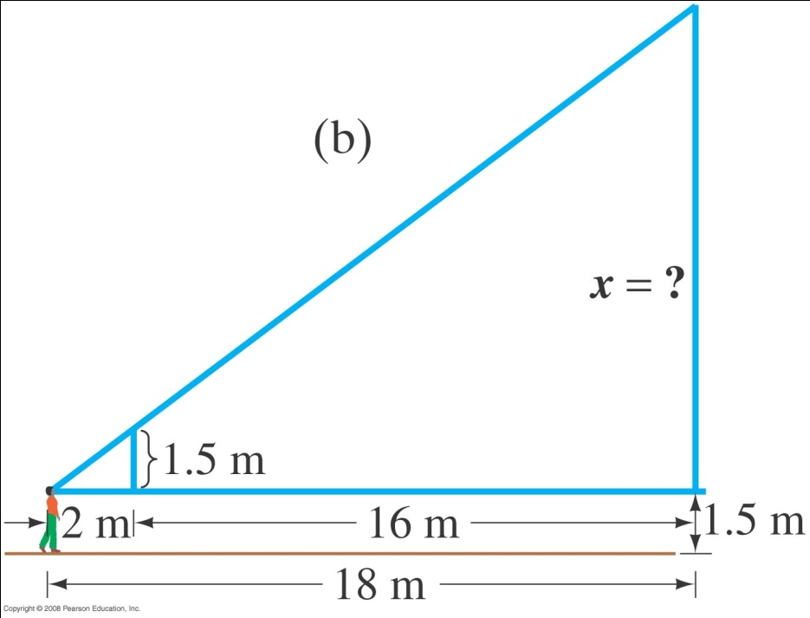
1-6 Order of Magnitude: Rapid Estimating
Example 1-7: Height by triangulation.
Estimate the height of the building shown by “triangulation,” with the help of a bus-stop pole and a friend. (See how useful the diagram is!)
Notes:
Figure 1-9. Caption: Example 1–7. Diagrams are really useful!
Answer: The building is about 15 m tall.

Slide 37
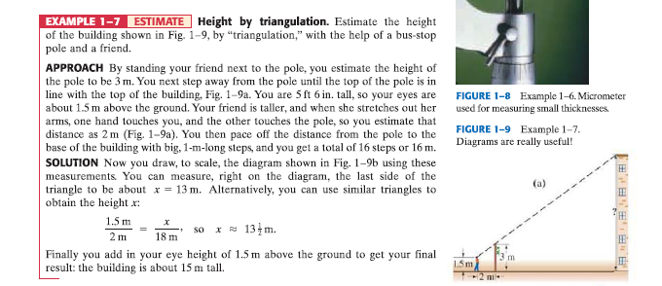

Slide 38
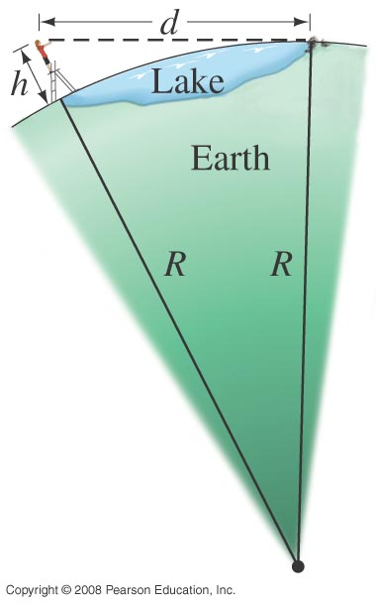
1-6 Order of Magnitude: Rapid Estimating
Example 1-8: Estimating the radius of Earth.
If you have ever been on the shore of a large lake, you may have noticed that you cannot see the beaches, piers, or rocks at water level across the lake on the opposite shore. The lake seems to bulge out between you and the opposite shore—a good clue that the Earth is round. Suppose you climb a stepladder and discover that when your eyes are 10 ft (3.0 m) above the water, you can just see the rocks at water level on the opposite shore. From a map, you estimate the distance to the opposite shore as d ≈ 6.1 km. Use h = 3.0 m to estimate the radius R of the Earth.
Notes:
Figure 1-10. Caption: Example 1–8, but not to scale. You can see small rocks at water level on the opposite shore of a lake 6.1 km wide if you stand on a stepladder.
Answer: This calculation gives the radius of the Earth as 6200 km (precise measurements give 6380 km).

Slide 39
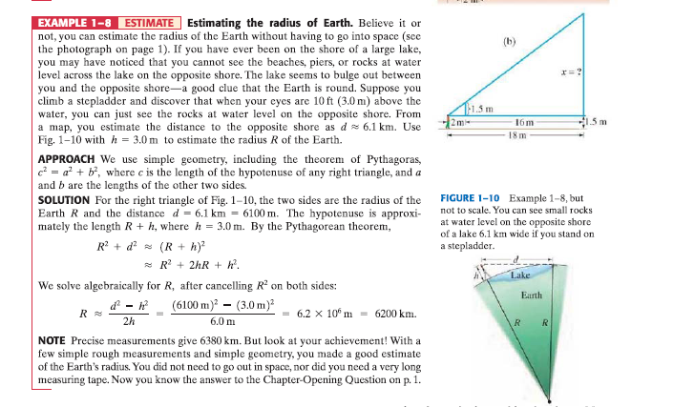

Slide 40
1-7 Dimensions and Dimensional Analysis
Dimensions of a quantity are the base units that make it up; they are generally written using square brackets.
Example: Speed = distance/time
Dimensions of speed: [L/T]
Quantities that are being added or subtracted must have the same dimensions. In addition, a quantity calculated as the solution to a problem should have the correct dimensions.

Slide 41

1-7 Dimensions and Dimensional Analysis
Dimensional analysis is the checking of dimensions of all quantities in an equation to ensure that those which are added, subtracted, or equated have the same dimensions.
Example: Is this the correct equation for velocity?
Check the dimensions:
Wrong!

Slide 42
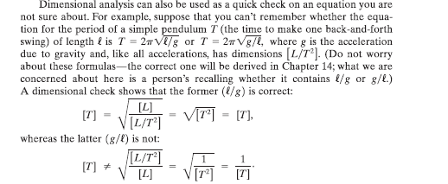

Slide 43
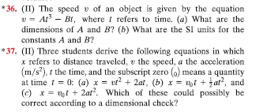

Slide 44
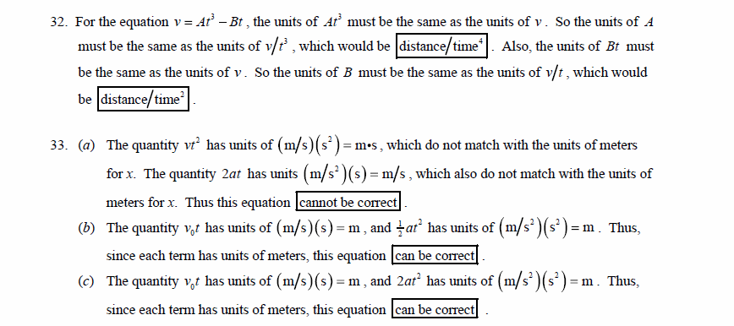

Slide 45

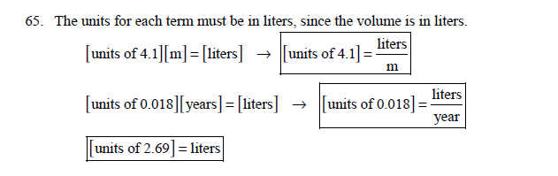

Slide 46
Summary of Chapter 1
Theories are created to explain observations, and then tested based on their predictions.
A model is like an analogy; it is not intended to be a true picture, but to provide a familiar way of envisioning a quantity.
A theory is much more well developed, and can make testable predictions; a law is a theory that can be explained simply, and that is widely applicable.
Dimensional analysis is useful for checking calculations.

Slide 47
Summary of Chapter 1
Measurements can never be exact; there is always some uncertainty. It is important to write them, as well as other quantities, with the correct number of significant figures.
The most common system of units in the world is the SI system.
When converting units, check dimensions to see that the conversion has been done properly.
Order-of-magnitude estimates can be very helpful.

