Slide 1
Chapter Program Handbook
2026–2027 PROGRAM YEAR

Slide 2
SECTION 1 | Program Handbook Checklist and Chapter History | 03
SECTION 2 | Chapter Information | 06
 | Chapter Officers
 | Chapter Teen Officers
 | Chapter Rosters
SECTION 3 | National Recognition Days | 66
 | Carole Robertson Day (September 2026)
 | Jack and Jill Day (September 2026)
 | MLK Day of Service (January 2027)
 | Founders’ Day (January 2027)
 | National Black Family Day (May 2026)
SECTION 4 | National Program Committee Programming Grade Group Activity Forms | 73
 | An individual form will be submitted for each grade group activity
SECTION 5 | Chapter Appreciation Days | 122
 | Associate Appreciation (February 2027)
 | Section 5B: Father’s Appreciation (April 2027)
SECTION 6 | Annual Program Planning Day | 125
 | Annual Program Planning Meeting Description

Slide 3
TABLE OF CONTENTS
SECTION 1
Program Handbook Checklist and Chapter History

Slide 4

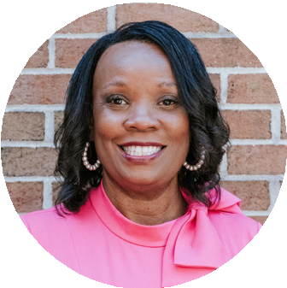
Dear Mothers,
As President of this incredible organization, I am truly honored to serve alongside such mission- focused, powerful, and multi-talented mothers who share our passion for shaping the leaders of tomorrow. Together, we are making a profound and lasting impact on the lives of children and families throughout our community.
The Montgomery County Maryland Chapter stands proudly on an extraordinary 63-year legacy of excellence in service to African American children and families. Our enduring success has been built on the vision of our founders and strengthened by the leadership of our Past National, Regional, and Chapter Officers. For over six decades, our creative and committed mothers have worked side by side to design social, cultural, and educational programs that celebrate our African American heritage, cultivate leadership skills, promote mutual respect, and contribute to the growth and prosperity of our children — and all children.
On behalf of our 120 dynamic and multi-talented mothers, we proudly continue to embraceour 2024–2026 theme, “Together We Rise: Building a Brighter Future for Our Families.” Together, we remain mission-focused—strengthening our families, enriching our programs, and deepening our community partnerships. My vision is to empower, encourage, and embrace every mother as we work together to build a stronger foundation for our children, nurture confident and compassionate leaders, and create a brighter, more connected community — one filled with unlimited possibilities.
Our Chapter continues to reflect the national mission of Jack and Jill of America,
Incorporated through youth leadership development, dedicated community service, and impactful volunteerism. As we begin this exciting program year, I am inspired by the enthusiasm and creativity that each of you brings. The year ahead holds unlimited opportunities to elevate our work, deepen our sisterhood, and continue shining as a model of excellence.
I am truly humbled and honored to serve as the 32nd President of the Montgomery County Maryland Chapter. With your continued energy, grace,
and commitment, I know that together we will rise to new heights.
For the Children,
Holli Townsend,
President Montgomery County Maryland Chapter
Jack and Jill of America, Incorporated
President
Erica Pollard
Vice President
Sheila Stewart
Program Director
Torie Comeaux Plowden
Recording Secretary
Janelle Miller
Corresponding Secretary
Brandi Brandon
Financial Secretary
Calandra Moore
Treasurer
KaShauna Rohlehr
Editor
Renee Canody
Parliamentarian
Carrie Holmes
Chaplain
Maria Byrd
Historian
Carrie Holmes
Foundation Chair
Ellyn Lanier
Sergeant-at-Arms
Stephanie Johnson
Associates’ Chair
Lasheka Brown
Immediate Past President
Holli Townsend
Charter Member
Henrietta Brown Franklin
Jack and Jill of America, Inc. is a membership organization of mothers with children ages 2–19, dedicated to nurturing future African-American leaders by strengthening children through leadership development, volunteer service, philanthropic giving and civic duty.

Slide 5
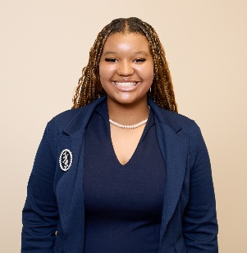
Teen President
Messiah Phelps
Te
Teen Vice President
Joshua Jacas
Teen Recording Secretary
Jolie Plowden
Teen Corresponding
Secretary
Amira Mhoon
Teen Financial Secretary
Chanel Washington
Teen Treasurer
Jessica Taylor
Teen Editor
Adam White
Teen Parliamentarian
Tyson Bellamy
Teen Chaplain
Daniel Montgomery
Teen Historian
Olivia Fordjour
Teen Foundation Chair
Travis Riemer
Sergeant-at-Arms
Langston Cephas
Teen Legislative Chair
Candice Conerly

Slide 6
TABLE OF CONTENTS
SECTION 2
Chapter Information

Slide 7
Chapter Officers 2026–2027 Program
Chapter Officer | Chapter Officer Email
Erica Pollard, President | president@jjmcmc.org
Sheila Stewart, Vice-President | vicepresident@jjmcmc.org
Torie Comeaux Plowden, Program Director | programming@jjmcmc.org
Janelle Miller, Recording Secretary | recordingsec@jjmcmc.org
Brandi Brandon, Corresponding Secretary | correspondingsec@jjmcmc.org
KaShauna Rohlehr, Treasurer | treasurer@jjmcmc.org
Calandra Moore, Financial Secretary | financialsec@jjmcmc.org
Renee Canody, Editor | editor@jjmcmc.org
Carrie Holmes, Parliamentarian | parliamentarian@jjmcmc.org
Ellyn Lanier, Foundation Chair | foundationchair@jjmcmc.org
Maria Byrd, Chaplain | mariasmedia@gmail.com
Jessica Taylor White, Historian | jessicataylorwhite@gmail.com
Stephanie Johnson, Protocol Chair | johnsonsa_2005@yahoo.com

Slide 8
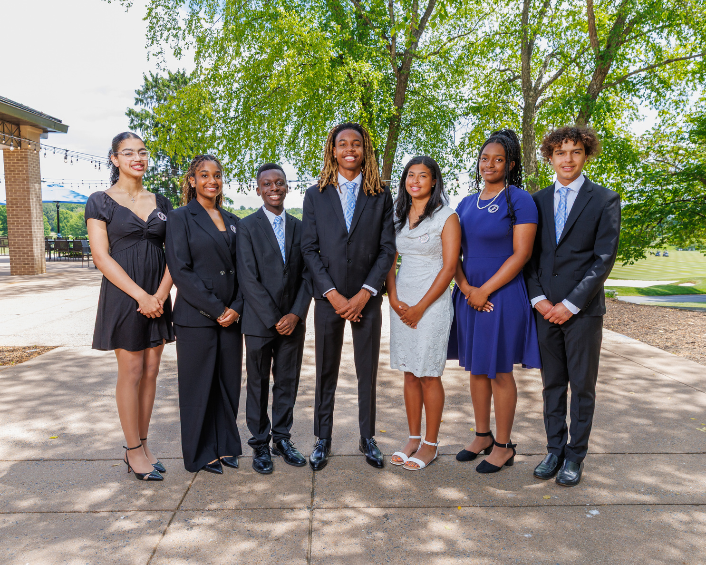
Teen Officers 2025–2026 Program
Teen Officer | Teen Officer Email
Messiah Phelps, Teen President | messiahxd@icloud.com
Ethann Jacas, Teen Vice-President | ethannjacas@gmail.com
Jolie Plowden, Teen Recording Secretary | jolie.plowden@gmail.com
Amira Mhoon, Teen Corresponding Secretary | amira.mhoon123@icloud.com
Jessica Taylor, Teen Treasurer | jessica_nt@iclout.com
Chanel Washington, Teen Financial Secretary | chanelew22@gmail.com
Travis Riemer, Teen Foundation Chair | travismriemer@gmail.com
Adam White, Teen Editor & Public Relations Chair | adamwhite09@icloud.com
Olivia Fordjour, Teen Historian | livfordjour@gmail.com
Tyson Bellamy, Teen Parliamentarian | tysonc2023@gmail.com
Daniel Montgomery, Teen Chaplain | danjammont@outlook.com
Adonni Adams, Teen Protocol Chair | adonniadams@gmail.com
Langston Cephas, Teen Sargent-at-Arms | langstonrc526@icloud.com

Slide 9
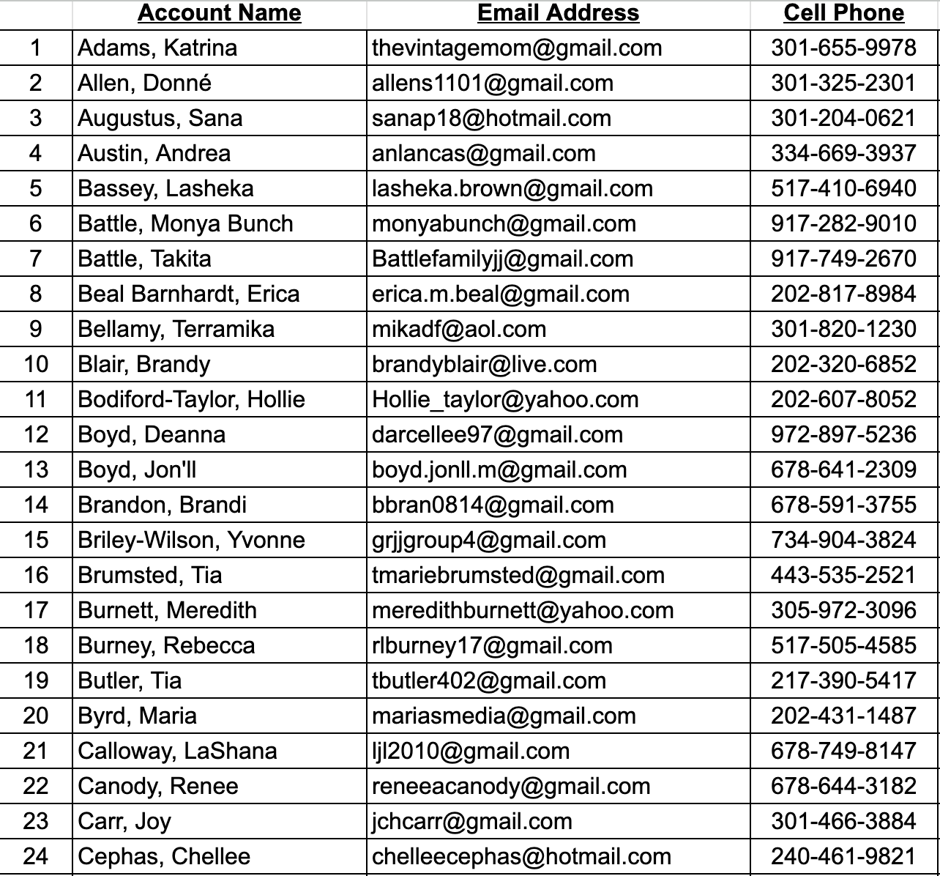
Mother Chapter Rosters
Program Year 2026-2027

Slide 10
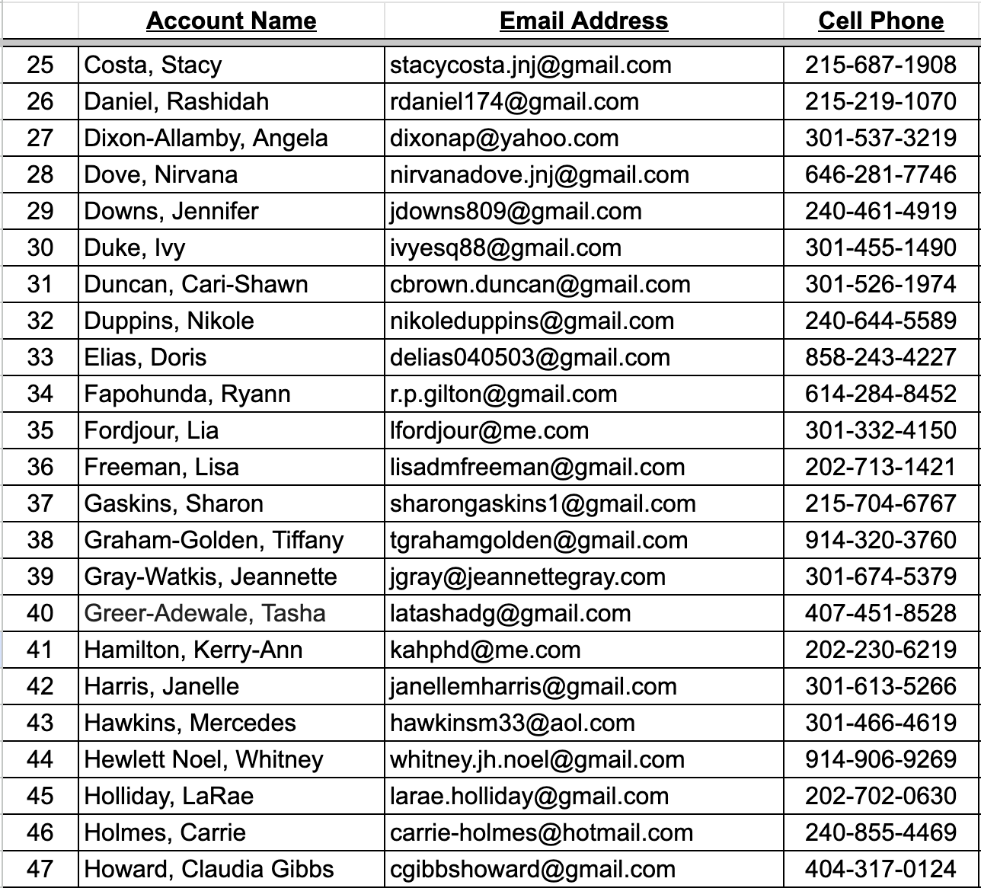
Mother Chapter Rosters
Program Year 2026-2027

Slide 11
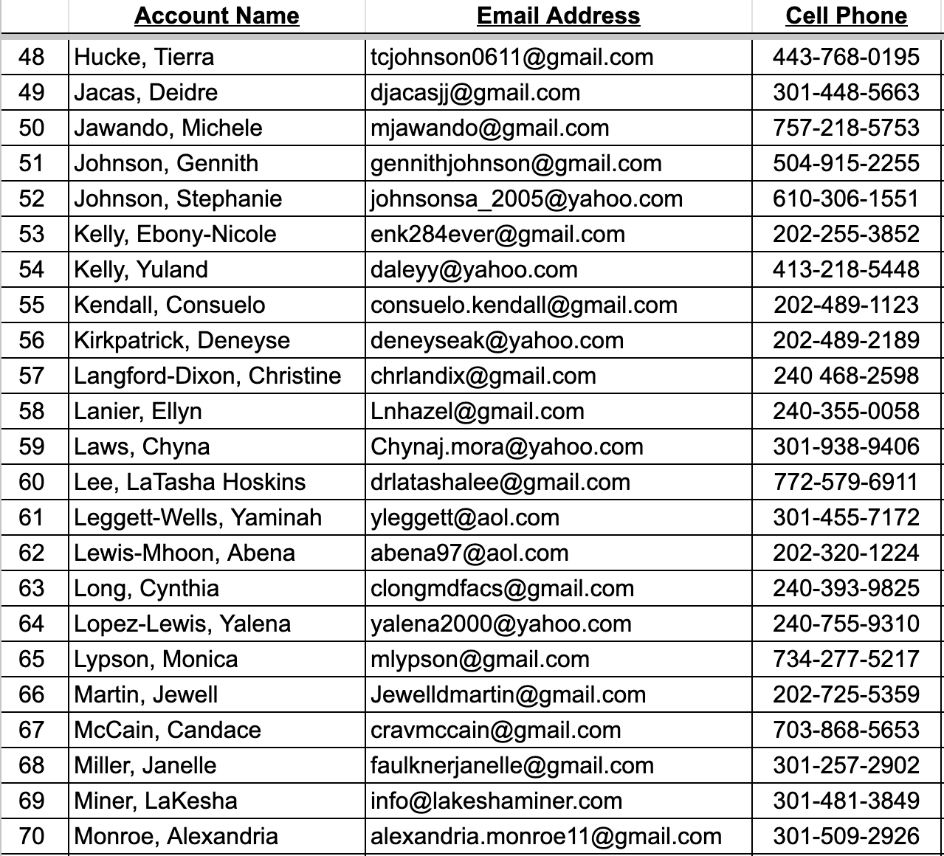
Mother Chapter Rosters
Program Year 2026-2027
11

Slide 12
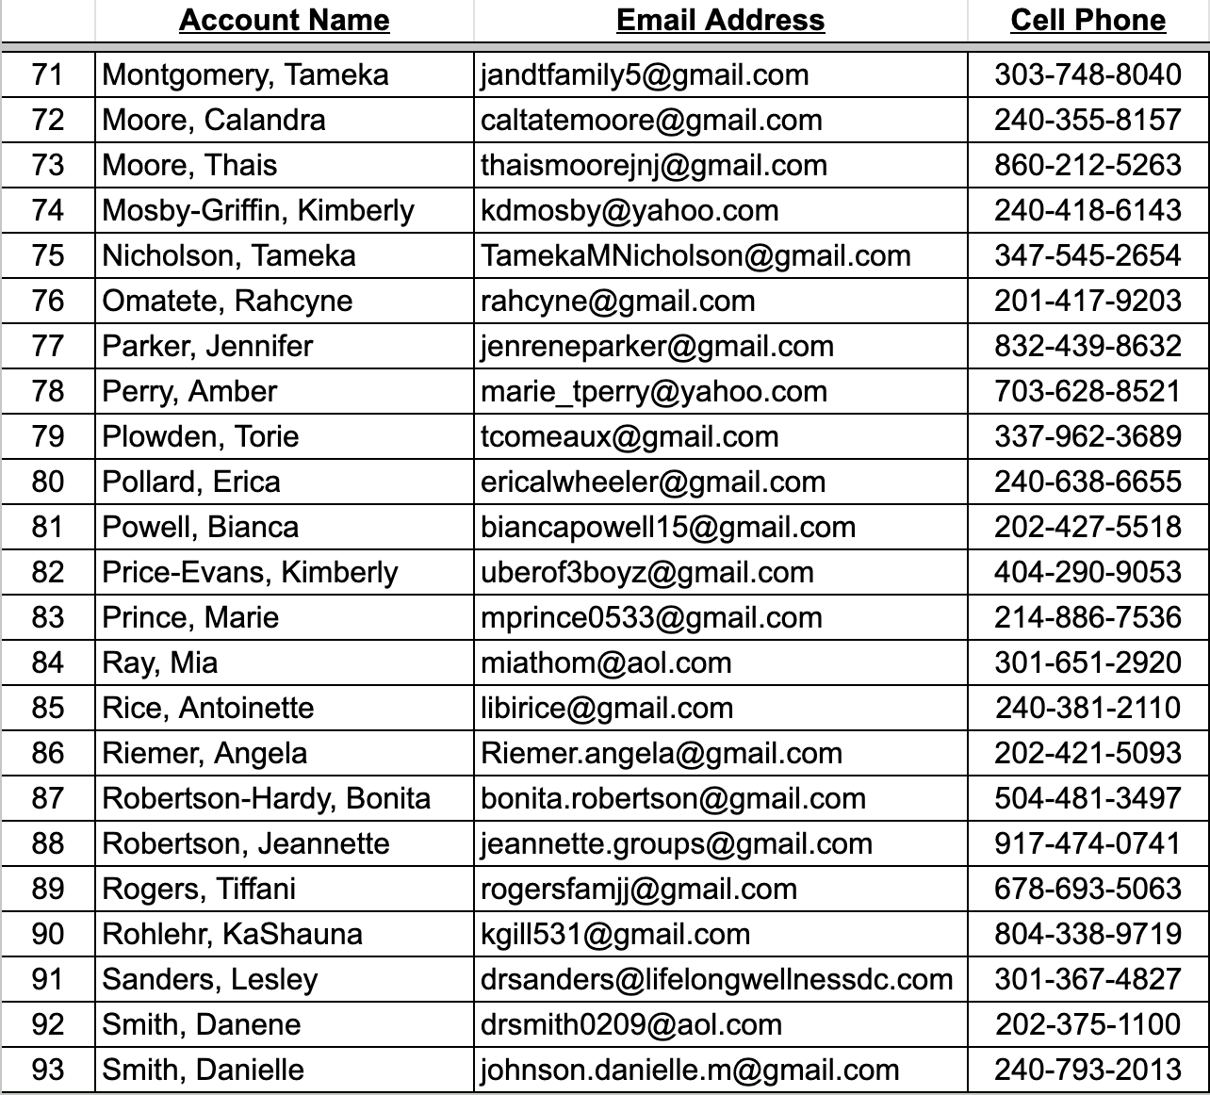
Mother Chapter Rosters
Program Year 2026-2027

Slide 13
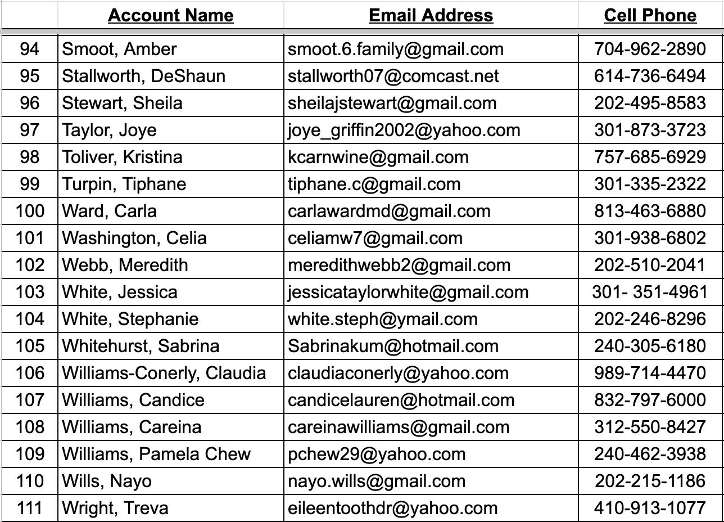
Mother Chapter Rosters
Program Year 2026-2027

Slide 14
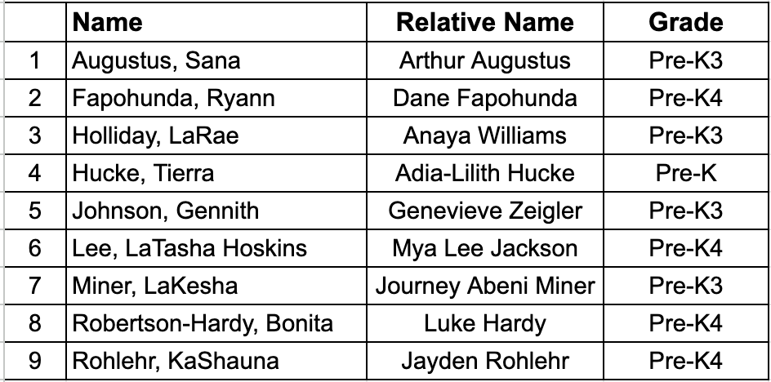
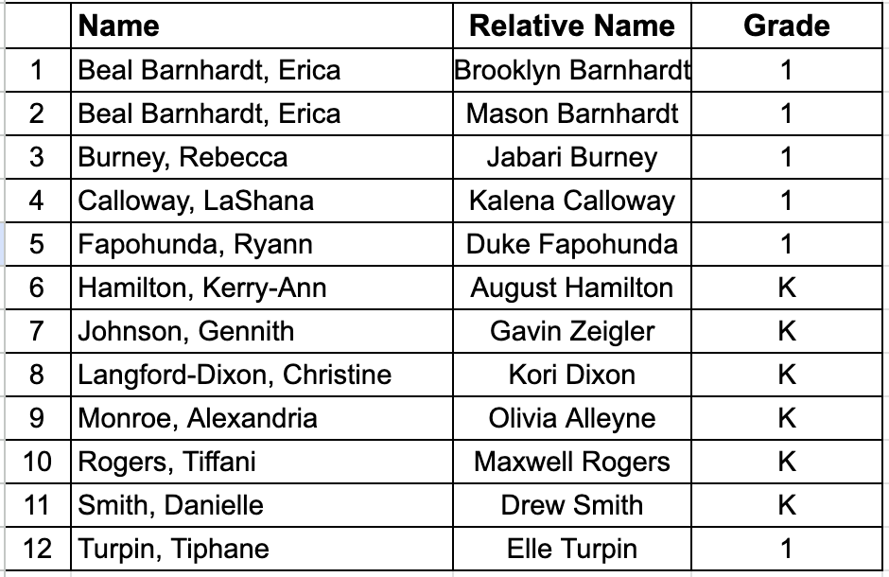
Group I
Program Year 2026-2027
Group II
Program Year 2026-2027

Slide 15
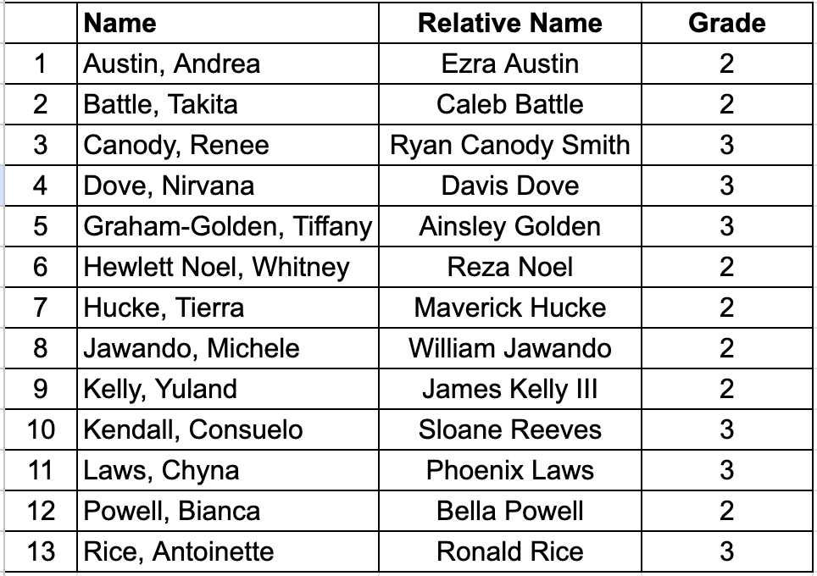
Group III
Program Year 2026-2027

Slide 16
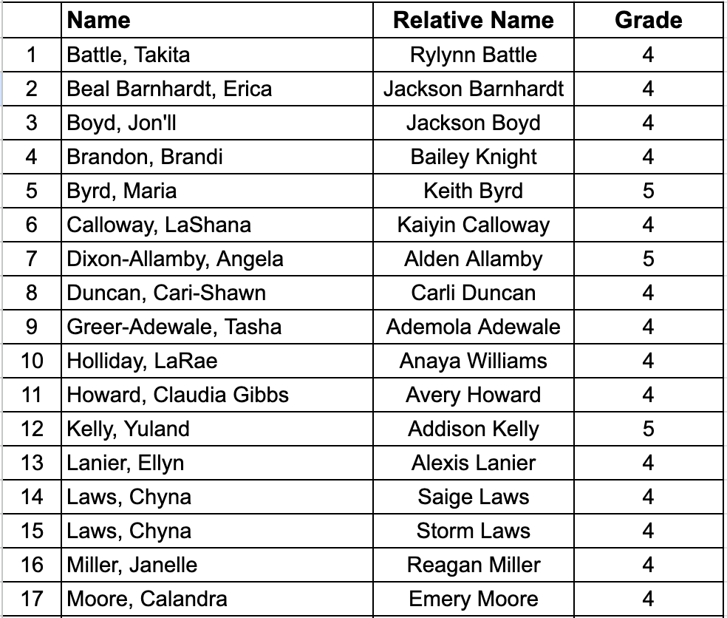
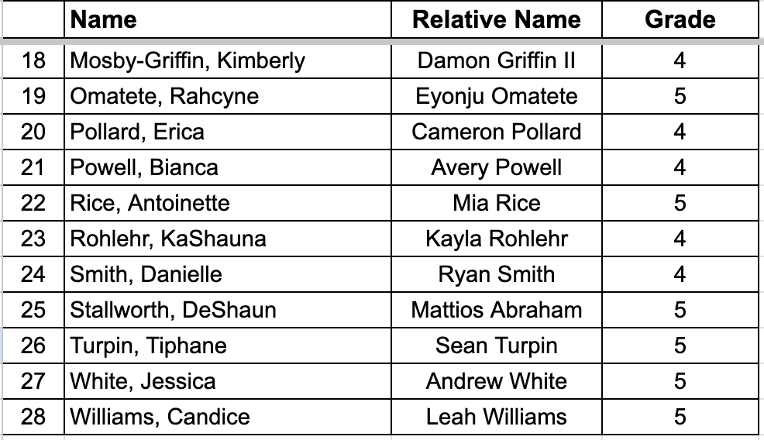
Group IV
Program Year 2026-2027

Slide 17
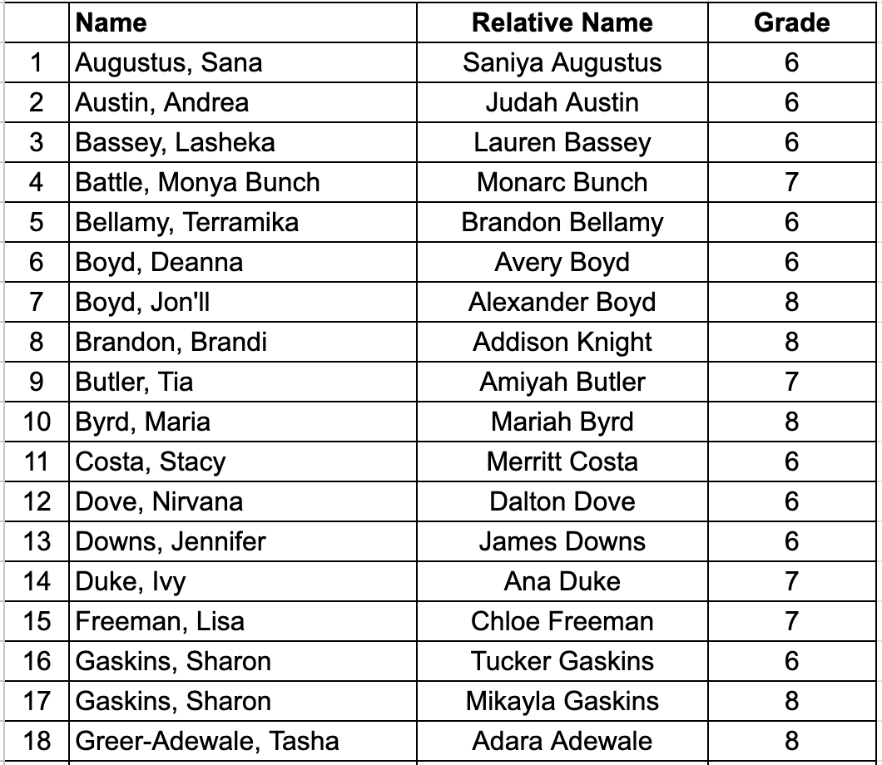
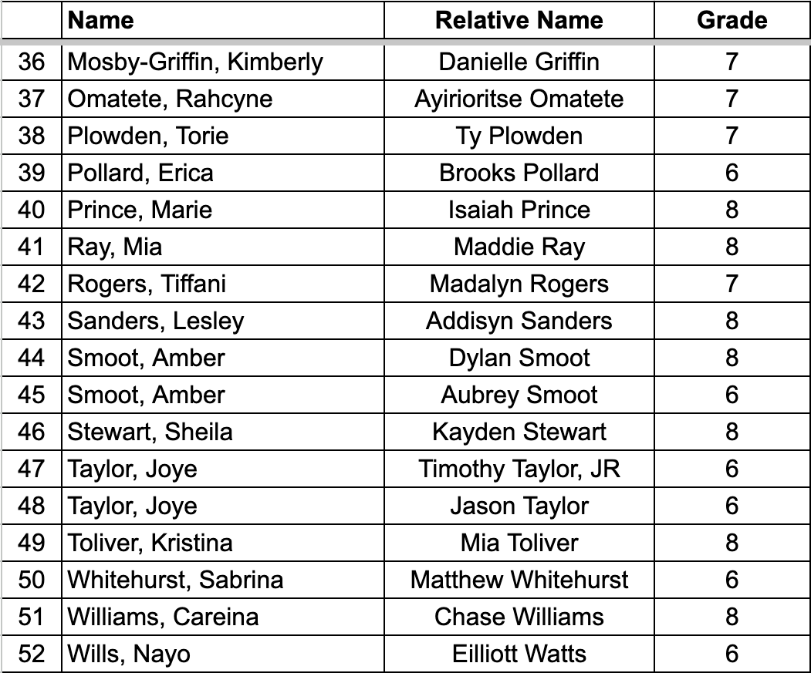
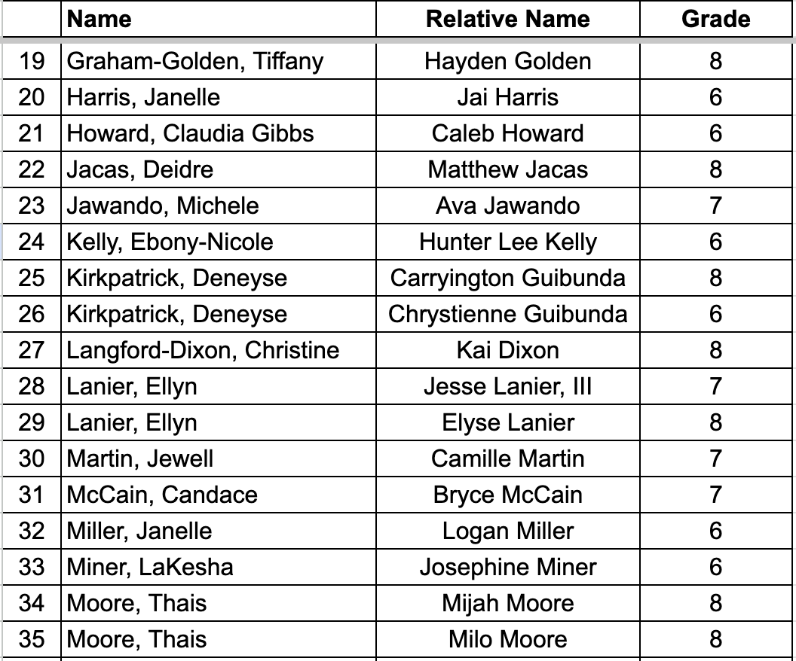
Group V
Program Year 2026-2027

Slide 18
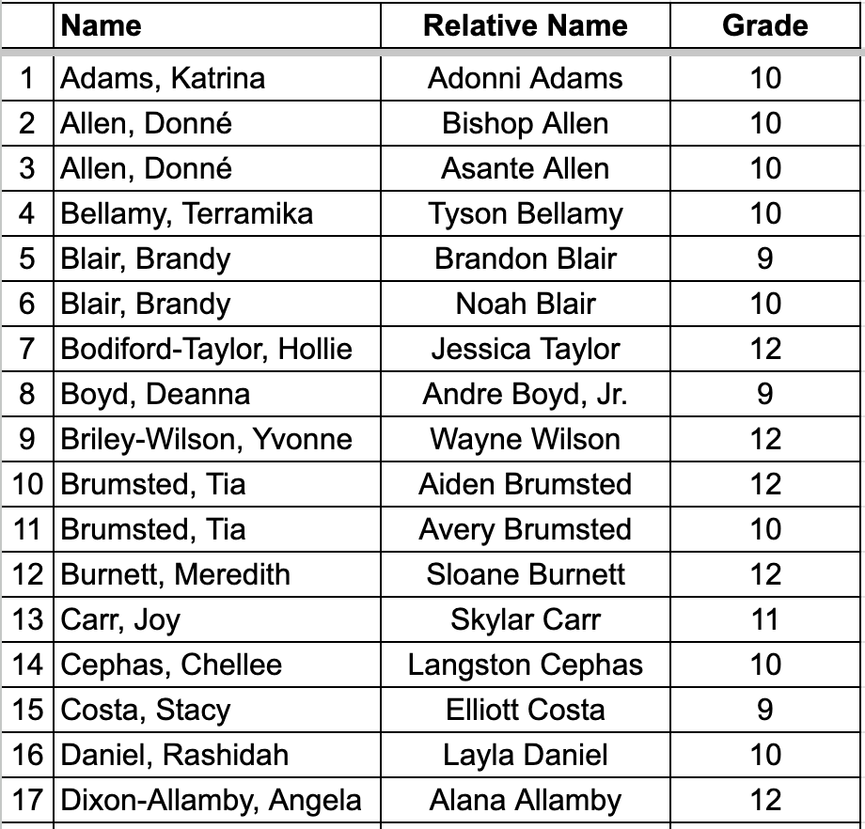
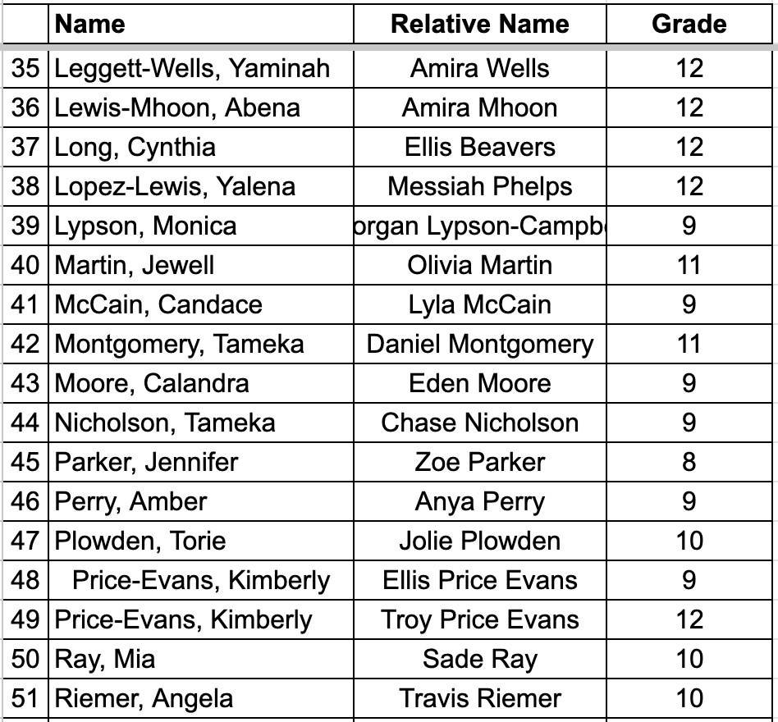
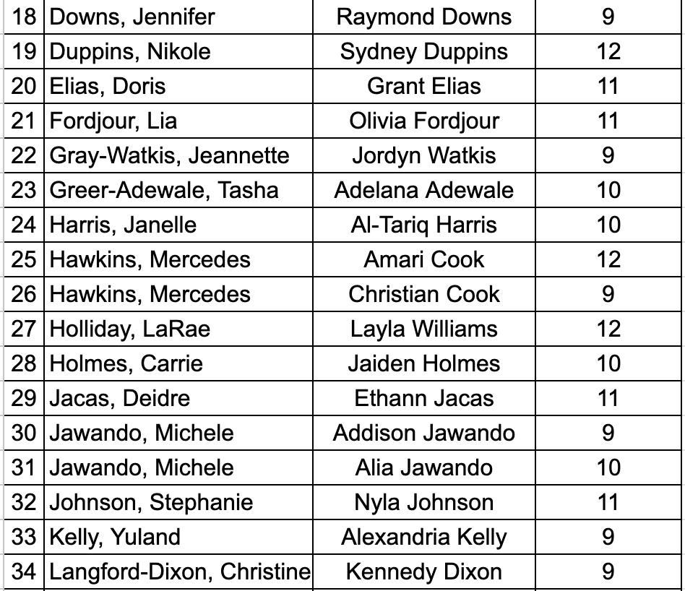
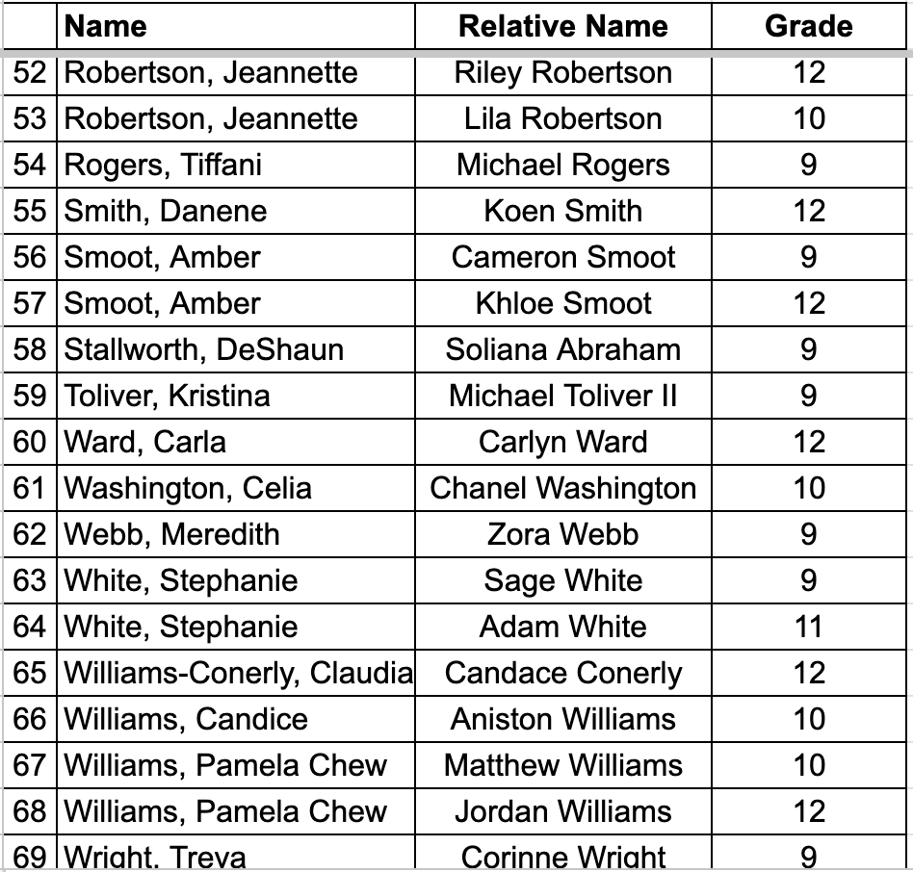
Group VI
Program Year 2026-2027

Slide 19
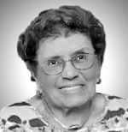
CHAPTER HISTORY
In the late winter of 1960, President Henrietta Franklin founded the Montgomery County Maryland Chapter of Jack and Jill, Incorporated. It was through her “cultural activism” that she
shaped the vision of a Jack and Jill experience that would buttress the
leadership, largess, cultural, educational, and social skills of her children and those in the Montgomery County, MD jurisdiction. If not strategically addressed, de jure and de facto segregation could have negatively impacted the lives of her children, but Mrs. Franklin had a different plan.
Franklin moved quickly toward starting the chapter by calling upon Carolyn French, President of the Washington, DC Chapter. She also wrote to then National President, Ruth B. Howard of San Francisco who counseled her by stating “If you can readily get together 15 mothers who are congenial and who have the same aims for their children, you should write at once to Mrs. Osbeth Adams of Chicago, National Vice President, who is in charge of forms and information.”
She successfully recruited five other mothers from a small couple’s club, which she had previously started. She secured the sponsorship of the Washington, DC Chapter. Thirteen mothers met at Mrs. Franklin’s home, along with Carolyn French and Juanita Fletcher of DC for an orientation of the organization. One of the first orders of business was to write National Vice President Adams for chartering information. The perspectives were hoping to submit the documents in time to be considered for ratification during an imminent National Convention but had not received the application from Mrs. Adams just days prior to the biennial convention. If they were unsuccessful in getting a provisional charter, this threatened to defer the provisional chartering of the chapter for two years, until the next convention.
Franklin’s machine went to work. She reached out to National President Howard, Vice President Adams, and other friends in Washington, DC. These efforts got the attention of National Program Director (NPD) Burma
Whitted and friend, Ruth B. Spencer. NPD Whitted agreed to take a petition from Montgomery County, in lieu of the chartering forms, to the National Executive Committee, which would meet just before the convention. Mrs.
Franklin hand delivered the petition package to NPD Whitted as she headed for the airport. Montgomery County, Maryland, was granted provisional status at the 1960 National Convention and honored to receive
permanent charter status in 1962 from the National body at the biennial convention.
For the two-year provisional period, the group was called The Children's Hour. Each time the children met; they would start by reading a story. Mrs. Franklin chaired the group during its first two years and was elected President for the first two years after chartering—a truly challenging, but fruitful four-year long task.
Installation took place at Mrs. Franklin’s home in October 1962. Present were Eastern Regional Director ViCurtis Hinton as the installing officer, and standing by as proud, honored guests were NPD Whitted, Carolyn French, and Juanita Fletcher.
The Charter Members of the Chapter included the following mothers:
The Charter Members
Ellen L. Davis Catherine King Henrietta Franklin Louise Mathieu Edithe Gordon Novella Monk Catherine Hanks
Evelyn Page
Emily Hill Syvesta Roberts Ella Horad Martha Swanson Eleanor Jackson Alda Taylor
Mary Williams
Catherine Williams

Slide 20
CHAPTER HISTORY
Since its organization, the following persons have served as president of the Montgomery County, Maryland chapter:
Examples of some of the signature programming and milestones that have solidified our presence and relevance in the community include:
Henriette Franklin, Founding President | 1960–1962
Louise Mathieu | 1962–1964
Dr. Loretta Webb | 1964–1966
Myra Wesley | 1966–1968
Odessa Shannon (Eastern Region Regional Director 1973–1974) | 1968–1970
Margaret Hayes | 1970–1972
Sherene Webb | 1972–1974
Norma Allen | 1974–1976
Gladys Magwood | 1976–1978
Casma Huie | 1978–1980
Evelyn Boyer | 1980–1982
Barbara J. Ward | 1982–1986
Dr. Maxine Jenkins (Eastern Region Regional Director 1996–1997) | 1986–1990
Brenda Arnwine | 1990–1994
JoAnn Mussenden | 1994–1998
Leslye M. Fraser, Esquire | 1998–2000
Debra Liverpool | 2000–2002
Dr. Lorraine Bassette | 2002–2004
Debra Liverpool | 2004–2006
Patricia Hureston Lee, Esquire | 2006–2008
Brenda Baldwin White, Esquire | 2008–2010
Paulette Walker Campbell (Eastern Regional Editor 2018–2020) | 2010–2012
Kimberly McLurkin-Harris | 2012–2014
Doreen C. Hope, Esquire | 2014–2016
Yaminah Leggett-Wells | 2016–2018
Bamidele “Kiki” Alexander (Eastern Regional Sergeant at Arms 2020–2024) | 2018 –2022
Sherri Sampson (Eastern Regional Membership Chair 2022–2024) | 2022–2024
Holli Townsend | 2024–present
Celebrated Chapter’s 60th Anniversary, 2022–2023
Recognized as a Jack and Jill Five Star Chapter, 2020
Awarded Jack and Jill Foundation Grant to launch Turn the Page Virtual Reading Corner, 2020
Celebrated Teen Tatiana Young for having the highest number of community service hours of all teens in the Eastern Region (2,514 hours), 2020
Congratulated our own Regional Teen Protocol Chair Jessica Holloway for being selected as the 2020 Eastern Regional Carole Robertson Award Winner, 2020
Hosted our Annual Middle School Civil Rights Tour Experience: Alabama, New Orleans, Tennessee, South Carolina and Tulsa 2017–2021
Celebrated Teen Adalia Winters for receiving the award for highest GPA for a 9th grader in the Eastern Region, 2019
Celebrated 10th Anniversary of Annual Spelling Bee and Benjamin E. Mays Oratorical Competition, 2019
Celebrated Chapter’s 55th Anniversary, 2017
Selected as Chapter of the Year, 2014
Received a STAR for excellence in Programming in 2014
Active Fathers Auxiliary
Held Poetry and Speech Workshop with Harvard Graduate, Donovan Livingston
Held Carol Robertson Day Recognition
Held a fundraiser for the March of Dimes
Sponsored a HBCU College Fair & Highly Selective Admissions Workshop
First Chapter to be Awarded three Jack and Jill Foundation Grants, 2013

Slide 21
CHAPTER HISTORY
The chapter has been carrying out National Jack and Jill program thrusts by shaping quality experiences for our children for sixty years. Currently we have 125 active mothers, 33 active associates and 207 active children and teens. The chapter is poised to continue the journey of getting and giving value by nurturing highly motivated and socially responsible learners and leaders.
Now it’s time for a historical celebration of JJMCMC from 2004-2014:
2004-2005: A Year Rooted in Tradition and Service
Under the leadership of President Debra Liverpool, the Montgomery County Maryland Chapter of Jack and Jill of America, Inc. embraced the theme, "It’s All About the Children," reflecting a deep commitment to empowering youth through education and service. This year was marked by an array of enriching programs that both educated and entertained the chapter's children, emphasizing leadership, cultural awareness, and community service.
The chapter began the year with a Mother’s Retreat aimed at energizing the membership and aligning activities with the national theme of creating a legacy of leadership and service. Throughout the year, nearly 100 educational, cultural, and service activities were organized. From the Pooh Group's pumpkin festival at Butler Orchards to Group II’s trip to the Kennedy Center, each group engaged in activities that fostered both learning and the spirit of giving back. The senior teens participated in a team-building course at Hemlock Overlook, focusing on self-reliance and community trust, while their community service included a Christmas party for the elderly and a street cleanup project.
The chapter's annual Family Thanksgiving Dinner, now in its third decade, was themed "An Expression of Thanksgiving through the Art of Mime." Performances by the children honored the chapter's graduating seniors and welcomed new members. The year culminated with a successful fundraiser, raising money for the United Negro College Fund and the Jack and Jill Foundation.
2005-2006: Responding to National Tragedy with Compassion
The devastation caused by Hurricane Katrina in September 2005 had a profound impact on the chapter's programming.
Under the continued presidency of Debra Liverpool, the chapter rallied in support of the Gulf Coast region. The youngest members, the Pooh Group and Group II, prepared and shipped over 100 backpacks filled with essentials for children affected by the disaster. Group V presented a collage in appreciation of local first responders who contributed to the relief efforts.
True to its tradition, the chapter hosted its annual Family Thanksgiving Dinner, themed “Songs of the South,” which paid homage to the Gulf Coast’s resilience. The chapter’s major black-tie fundraiser, "Celebrating All Things New Orleans," raised funds for two African American schools impacted by the hurricane, in addition to its regular donations to the United Negro College Fund and the Jack and Jill Foundation.
In addition to their relief efforts, the children engaged in almost 100 activities, including educational trips to museums and workshops, and community service projects such as food drives for local shelters and volunteering at the SOME (So Others Might Eat) program. The chapter bid farewell to 12 graduating teens, urging them to "Fly, Eagle, Fly," as they spread their wings toward bright futures.
2006-2007: Honoring Legacy and Celebrating Community
The chapter entered its 2006-2007 program year with Patricia H. Lee as President, continuing the strong tradition of leadership and community involvement. The year began with a Family Picnic, hosted by the Father’s Auxiliary, and the children commemorated Carole Robertson, a Jack and Jill member who perished in the Birmingham church bombing in 1963. Through projects like creating a Peace Quilt and writing poems, the children reflected on the legacy of civil rights activism.
With a strong emphasis on community service, the children participated in nearly 100 activities, many in alignment with the national theme, "Empowering Our Youth to Excel through Leadership and Service in Our Communities." From sponsoring a homeless family to leading food and toiletry drives, the chapter's commitment to service was evident across all age groups. Senior teens took part in the “Help The Homeless Walkathon” and continued their tradition of street cleaning.
2004–2005
Chapter Officers
President, Debra Liverpool
Vice President, Jean Moody-Williams Program Director, Jean Moody-Williams Recording Secretary, Monice Sanders Corresponding Secretary, Lori Moore Treasurer, Francine Hill
Financial Secretary, Pamela Monroe Chapter Editor, Claudia Nash-Simmons Parliamentarian, Lesly Wilson-Bradley Foundation, Vacant
Chaplain, Clevette Ridguard Historian, Anita Holmes Johnson Fathers’ Auxiliary: Melvin Moore

Slide 22
CHAPTER HISTORY
The chapter also organized its inaugural "Rise Up Reading" book drive to promote literacy, reflecting the legacy of its founder’s passion for education. The annual family Thanksgiving Dinner celebrated the theme “Celebrating our Ancestors through the Ages,” further honoring the chapter’s commitment to heritage, community, and service. A black-tie dinner dance, “Rhapsody in Blue,” raised funds for local charities while evoking the elegance of the Cotton Club, highlighting both the chapter’s celebratory spirit and its dedication to philanthropy.
2008-2009: Continuing the Legacy
The chapter, now under the leadership of President Brenda Baldwin-White, carried forward its legacy in the 2008-2009 year. This year began with a summer Mothers’ Retreat, which featured Blanche Williams, an author who motivated attendees with insights on designing a mindset for greatness. The fall was marked by the annual Jack and Jill Day picnic, emphasizing family and community. National Vice President Gail Johnson returned to the chapter’s first mothers’ meeting of the year, encouraging members to maximize their Jack and Jill experience.
The year’s programming continued to focus on leadership, community service, and family. Group activities included cultural excursions, such as Group III’s visit to the Soulful Symphony at Strathmore Music Hall, and the inaugural “Children’s Inaugural Ball,” a tribute to the election of President Barack Obama. A recurring theme of historical reflection carried into the Thanksgiving Dinner, where the chapter honored the legacy of Black Greek letter organizations under the theme “Stepping in Time with the Divine Nine.” This reflection on history and community culminated in a fundraising “No Show” ball, acknowledging the economic climate while still supporting local causes.
2009-2010: National Recognition and Historic Moments
As the chapter entered its 47th year, programming continued to reflect both local and national achievements. The year began with a leadership retreat, followed by a Jack and Jill Day picnic hosted by the Fathers’ Auxiliary. Highlighting the chapter’s national involvement, several members participated in the Jack and Jill “On the Hill” Summit, meeting with Maryland Congressman Christopher Van Hollen to advocate for issues affecting children.
The chapter’s signature events, including the Thanksgiving Dinner themed “Proverbs and Parables: Celebrating the Wisdom of our Ancestors” and the annual black-tie fundraiser, "One Love, One Heart," were highlights of the year. Proceeds benefited local organizations, including The George B. Thomas Learning Academy and YMCA Youth and Family Services.
The chapter honored 15 graduating teens and reflected on the founding principles of Jack and Jill, mindful that their focus remains steadfast—“It’s all about the children!”
This period (2004-2007) highlights the JJMCMC chapter’s unwavering dedication to leadership, service, and the nurturing of future generations. Through service to both local and national communities, the chapter fostered an environment where children thrived and were empowered to soar.
2007-2008: The Sapphire Year
The 2007-2008 program year marked a significant milestone as the Montgomery County, Maryland Chapter of Jack and Jill of America, Inc. celebrated its Sapphire (45th) anniversary. Under the leadership of President Patricia H. Lee, the chapter launched this special year with a Mother's Leadership and Program Planning retreat, featuring National Vice President Gail Johnson as the keynote speaker. The retreat aimed to inspire leadership while fostering community engagement. At the heart of this year’s programming was the introduction of the Rites of Passage program, designed to guide the chapter’s children through leadership, community service, and family-focused activities, creating a continuum of growth from toddlers to teens.
Group I toddlers collected canned food, crafted a genealogy quilt, and participated in a “Dinosaur Jamboree” performance. Group II, meanwhile, immersed themselves in cultural and educational experiences such as an etiquette workshop, ice skating, and a visit to the Smithsonian Museum of African History. Group III’s investment club and outings like the Washington Nationals baseball game fostered financial literacy and cultural appreciation. The older groups delved deeper into leadership and service, culminating in Group V’s Kwanzaa feast and the Senior Teens’ leadership modules and community outreach projects, including volunteering at So Others Might Eat (SOME).
2004–2005
Chapter Officers
President, Debra Liverpool
Vice President, Jean Moody-Williams Program Director, Jean Moody-Williams Recording Secretary, Monice Sanders Corresponding Secretary, Lori Moore Treasurer, Francine Hill
Financial Secretary, Pamela Monroe Chapter Editor, Claudia Nash-Simmons Parliamentarian, Lesly Wilson-Bradley Foundation, Vacant
Chaplain, Clevette Ridguard Historian, Anita Holmes Johnson Fathers’ Auxiliary: Melvin Moore

Slide 23
CHAPTER HISTORY
2011-2012: Milestones and Growth
The 2011-2012 year was marked by groundbreaking achievements and impactful programs. Under the leadership of President Paulette Walker Campbell, the chapter hosted the 27th Eastern Region Mothers Conference, a first-of-its-kind destination conference held aboard Royal Caribbean’s Enchantment of the Seas. This bold move set a new standard for future regional conferences, as they began exploring family-friendly venues like Atlantis and Orlando, Florida.
Following this success, the chapter held a retreat for mothers titled Renew, Reconnect, Rejoice, featuring acclaimed author Sophia Nelson as the guest speaker. The retreat set the tone for an engaging year, punctuated by traditional events like the Jack and Jill Day family picnic, Black Family Day Thanksgiving Dinner, and Talent Showcase. The latter celebrated Black Broadway and honored the graduating teens of 2012.
In the realm of community service, members engaged in various initiatives, including compiling toiletry baskets for A Wider Circle and organizing canned food drives for Manna Food Center. The chapter also hosted its 3rd Annual Community Spelling Bee and the 2nd Biennial Cotillion-Beautillion, raising funds for organizations like Crossway Community, Inc., the Jack and Jill Foundation, and the Henrietta B. Franklin College Scholarship Fund.
Age groups participated in a wide range of educational and cultural activities, such as visits to historical landmarks, art explorations, and performances. Highlights included the **Martin Luther King, Jr. Memorial**, Frederick Douglass National Historic Site, and a Kennedy Center performance of Mozart. The teens contributed through fundraising efforts and volunteering, and they honed their leadership and organizational skills in preparation for the 2012 Eastern Region Teen Conference.
2012-2013: JJMCMC Celebrates 50 Years
The chapter’s 50th anniversary was celebrated in 2012-2013 under the theme Literacy, Legacy, and Leadership, paying homage to the chapter's history and founder. President Kimberly McLurkin-Harris guided the chapter through a reflective and active year, beginning with the annual Jack and Jill Day picnic and participation in the March of Dimes March for Babies Walk.
As the year progressed, members focused on expanding programming to include the inaugural Crystal Elegance Cotillion-Beautillion, a Black History Month Spelling Bee and Debate, and annual spring fundraising efforts. Programming at every age level remained robust, with Group I visiting Croyden Creek Nature Center, and the Senior Teens participating in a fashion show fundraiser, a Poverty Dinner, and a New Year’s Eve celebration. Sixteen graduating teens were honored, each preparing for matriculation at prestigious universities.
2010-2011: AIM – Achieving Excellence,
Inspiring Greatness
The chapter’s 48th year, led by President Paulette Walker Campbell, embraced the national theme: AIM—Achieving Excellence, Inspiring Greatness, Motivating Youth to Lead and Serve. This vision permeated all chapter activities, from the annual Jack and Jill Day picnic, which featured noted historian Elizabeth Clark-Lewis, to the Thanksgiving Dinner and Talent Showcase. The talent show honored the legacy of Michael Jackson while also celebrating the achievements of seven graduating teens.
Community service was a focal point of the year’s initiatives, as evidenced by the chapter’s Bone Marrow Drive, addressing a critical shortage of Black donors in the National Marrow Donor Program. The chapter also hosted its First Annual Human Rights Symposium, with a focus on human trafficking, bringing together students, legislators, and community leaders to tackle this critical issue.
Programming highlights included an array of cultural, educational, and leadership activities. Children across all groups participated in outings to museums, cooking classes, theater performances, and historical tours. Group V middle schoolers engaged in community service activities such as the Martin Luther King Day of Service and prepared for future academic success with SAT prep workshops. Senior Teens, meanwhile, organized a Poverty Dinner, attended the Alvin Ailey Dance Theatre, and partook in various social and leadership events.
As the chapter looked toward its 50th anniversary, the legacy of service, leadership, and community remained strong, guided by the chapter’s commitment to shaping the next generation of leaders.
2004–2005
Chapter Officers
President, Debra Liverpool
Vice President, Jean Moody-Williams Program Director, Jean Moody-Williams Recording Secretary, Monice Sanders Corresponding Secretary, Lori Moore Treasurer, Francine Hill
Financial Secretary, Pamela Monroe Chapter Editor, Claudia Nash-Simmons Parliamentarian, Lesly Wilson-Bradley Foundation, Vacant
Chaplain, Clevette Ridguard Historian, Anita Holmes Johnson Fathers’ Auxiliary: Melvin Moore

Slide 24
CHAPTER HISTORY
Community service continued to be a focal point, with activities like the March of Dimes Walk for Babies, the Annual Spelling Bee, and participation in the Golden Legacy Cotillion-Beautillion. The latter raised funds for the National Center for Children and Families, supporting children in need.
Children from all age groups participated in educational and fun-filled activities ranging from art workshops and birdwatching to Tae Kwan Do clinics and financial literacy programs. The Senior Teens remained busy, participating in a Greek step show, completing leadership modules, and volunteering. They capped the year with a visit to the Civil Rights Exhibit at the Newseum and a Go Strong Olympics event, demonstrating their growing leadership and commitment to the chapter’s mission.
Through these three years, the chapter fostered leadership, community service, and cultural appreciation, solidifying its role as a pillar in the community and a nurturing environment for future leaders.
In November, the Black Family Day celebration honored the chapter’s history by having each age group represent a different decade, showcasing the progress of Montgomery County Maryland. The tributes to President Obama and Trayvon Martin were a powerful reflection of the chapter’s ongoing commitment to social justice and racial pride.
In addition to commemorating its past, the chapter engaged in numerous service activities, including Loose Change fundraising and preparing for the National Museum of African American History and Culture. The Senior Teens spearheaded a Genealogy Project, helping younger children explore family heritage. Events such as the MLK Day of Service with A Wider Circle, the 4th Annual Community Spelling Bee, and the Black-Tie Dinner Dance raised funds for First Book, promoting literacy among low-income children.
The chapter’s youngest children learned about nutrition, history, and the arts through hands-on experiences. Meanwhile, the older groups embraced sports, literacy, and STEM-based learning, with the teens expanding their leadership through workshops and community service initiatives.
2013-2014: Embracing Legacy and Leadership
As the chapter moved into 2013-2014, it maintained its commitment to service, leadership, and the arts, building upon its 50-year legacy. President Kimberly McLurkin-Harris continued to lead the chapter through a productive year, starting with the annual Jack and Jill Day celebration and participation in the National Book Festival.
The chapter paid tribute to Motown during Black Family Day, with performances celebrating the music and culture of the era. Seniors reflected on their journey within Jack and Jill, sharing how the chapter had shaped their lives.
For the first time, the chapter held a Town Hall Event for Teens, recognizing their second-place win for legislative programming at the On The Hill Summit. Partnering with the National Institutes of Health National Human Genome Institute, members participated in a cultural and genetic history project, further enhancing the chapter’s dedication to STEM and arts initiatives.
2004–2005
Chapter Officers
President, Debra Liverpool
Vice President, Jean Moody-Williams Program Director, Jean Moody-Williams Recording Secretary, Monice Sanders Corresponding Secretary, Lori Moore Treasurer, Francine Hill
Financial Secretary, Pamela Monroe Chapter Editor, Claudia Nash-Simmons Parliamentarian, Lesly Wilson-Bradley Foundation, Vacant
Chaplain, Clevette Ridguard Historian, Anita Holmes Johnson Fathers’ Auxiliary: Melvin Moore
2014–2015
Chapter Officers
President: Doreen C. Hope
Vice President: Yaminah Leggett-Wells Program Director: Bamidele “Kiki” Alexander Recording Secretary: Monica Rodia Corresponding Secretary: Dina Jackson Treasurer: Jacqueline Sykes-Washington Financial Secretary: Jaclynne White Nnawuchi Editor: Jeanine Grain
Parliamentarian: Chandra Holloway, Foundation Chair: Stacye Loman Chaplain: Nina Rivera
Historian: Tanya Brooks succeeded by Rhea Ballard-Thrower
Teen Advisors: Schonay Barnett-Jones, Candace Galvin Ross, Stephanie Matlock Maynor, Lisa Napoleon

Slide 25
CHAPTER HISTORY
Associates Chair: Tonya Brooks Father’s Auxiliary: Robert Grimes - Chair
Teen Officers
President: Elana Harris Vice-President: Cameron Jones
Recording Secretary: Alexis Harden
Corresponding Secretary: Demetri McCray- Buggs
Treasurer: Carmen Moore Financial Secretary: Tatiyana Lewis Editor: Hillary Cyrus Parliamentarian: William McMillian
Foundation Chair: Laila-Rose Galvin Chaplain: Isiah Wells
Historian: Maraya Maynor Sergeant-At-Arms: Matthew Brooks
age groups provided entertainment highlighting each child’s individual talent. Graduating Senior Teens were celebrated as they came forward to share how Jack and Jill Montgomery County had shaped their lives.
The chapter sponsored an activity about the legislative process and using advocacy strategies that work. Each age group participated and the kids visited a County Council and Board of Education meeting and advocated for legislative issues and educational programs. The Chapter sponsored two workshops about college preparedness for the public. Mothers promoted ways
to reduce the risk for cardiovascular disease, Type 2 diabetes and obesity and continued their monthly
power walks at Wheaton Mall. The chapter continued its partnership with the March of Dimes by participating in the annual Walk for Babies event in April. The Chapter held
its annual MLK community service event with local charity, A Wider Circle to address the impact of poverty among children in January 2015. The 5th Annual Community Spelling Bee and Oratorical was held on Feb. 21, 2015.
The Pooh Group started the year off with an obstacle course that included sack jumping, speed agility rope ladders and balance beams in support of the “Let’s Move” Initiative. They supported the Down Syndrome Network of Montgomery County by participated in their 2014 Buddy Walk., and enjoyed Mommy and Me Cooking and a Holiday Potluck (where they collected “Toys for Tots”). They learned about banking and visited the Trolley Museum, the Dairy Mooseum, and the “Jack and the Bean Stalk” puppet show.
Our kindergarten and first graders kicked-off the year with an activity that combined financial fitness with physical fitness. They attended the Native American Powwow where they were exposed to traditional dances from various tribes, drum circles, crafts and jewelry making.
Our second and third graders supported the “Let’s Move” Initiative with a skating activity. They participated in a forensic science STE[A]M activity which placed the kids in the midst of a fabricated laboratory designed to expose them to various chemical, biological, and math tests and experiments used in crime scene investigation. They
also held a Ronald McDonald Giving: The Goody Bag Celebration.
2004–2005
Chapter Officers
President, Debra Liverpool
Vice President, Jean Moody-Williams Program Director, Jean Moody-Williams Recording Secretary, Monice Sanders Corresponding Secretary, Lori Moore Treasurer, Francine Hill
Financial Secretary, Pamela Monroe Chapter Editor, Claudia Nash-Simmons Parliamentarian, Lesly Wilson-Bradley Foundation, Vacant
Chaplain, Clevette Ridguard Historian, Anita Holmes Johnson Fathers’ Auxiliary: Melvin Moore
This year, mothers started off the year with the Chapter’s first overnight retreat. The theme of the retreat was: “Celebrating our Motherhood, Our Chapter and One Another!” Next up was the annual Jack and Jill Day celebration to bond and fellowship with one another as we began a new program year. Our Teen President, Elana Harris, lead the Junior Teens in presenting a moving memorial ceremony in honor of Carole Robertson. The Fathers Auxiliary planned and executed a wonderful event for Jack and Jill Day. We had 189 people attend
this event.
On December 6, the chapter held its first Holiday Dinner Dance entitled “Snowflakes and Silver.” Moms, dads and kids danced the night away. Jack and Jillers from all

Slide 26
CHAPTER HISTORY
Our fourth and fifth grade aerial adventurists met at Terrapin Adventures and engaged in an activity of
‘physically challenging’ activity. They conducted a book discussion in November. They all got a copy of Charlie and the Chocolate Factory, and took a ‘real-live’ guided tour of a minority owned Chocolate Factory. They also toured TD Bank and learned about saving versus spending, how to open a bank account and how a savings account works.
The sixth, seventh and eighth graders started the year off with their Lets Move–Field Day Activity where they discussed healthy living options and participated in recreational sport activities. They volunteered at the Making Strides Against Breast Cancer Walk. The kids passed out breast cancer literature, food, t-shirts and conducted surveys. The Art of Public Speaking activity empowered our Jack and Jillers to think critically, devise well-reasoned arguments and effectively communicate their ideas. This activity helped prepare our junior teens for the JJMCMC oratorical competition held in February.
The Senior Teens started the year off with a bang when it hosted a well-attended college prep workshop and
a teen social. The teens went into leadership mode, by participating in the leadership and financial modules earlier in the year. For the third year, the teens sponsored the Reading Buddies club during the mothers meetings, reading to the younger children while the mothers planned for Jack and Jill events and activities.
Foundation Chair: Stacye Loman Chaplain: Nina Rivera Historian: Tanya Brooks
Teen Advisors: Schonay Barnett-Jones, Stephanie Matlock Maynor, Lisa Napoleon, Ayana Machen, and Saudeia Martin
Associates Chair: Tanya Brooks Father’s Auxiliary: Isaac H. Marks, Sr. and Fred Beavers, Co-Chairs
Teen Officers
Teen President - Maraya Maynor Vice President - Tatiyana Lewis Recording Secretary- Kiev Gambrell
Corresponding Secretary - Haley Porter Treasurer- Jordan Washington Financial Secretary- Hillary Cyrus Editors: Camryn Cross and Nia Hope Parliamentarian: Isiah Wells Foundation Chair –Jada Roberts Chaplain: Benjamin Mahone
Historian: Matthew Brooks Legislative Chair: Ava Campbell
2015–2016
Chapter Officers
President: Doreen C. Hope
Vice President: Yaminah Leggett-Wells Program Director: Bamidele “Kiki” Alexander Recording Secretary: Monica Rodia Corresponding Secretary: Sabrina Cobb Treasurer: Jacqueline Sykes-Washington Financial Secretary: Ashyia Johnson
Editor: Jeanine Grain Parliamentarian: Rhea Ballard-Thrower
We started off the year with our second overnight retreat with the theme: “The Power of Renewal: Strengthening Leadership and Friendship to Achieve Excellence!” Next, mothers and children met at the annual Jack and Jill Day celebration where our Junior Teens presented a moving memorial ceremony in honor of Carole Robertson. The Programming Committee and Fathers Auxiliary planned and executed a wonderful event for Jack and Jill Day. We had 135 people attend this event. On December 5, we held our second Holiday Dinner Dance entitled “Holiday Sparkle.” Jack and Jillers from all age groups provided entertainment highlighting each child’s individual talent. Graduating Senior Teens were celebrated as they came forward to share how Jack and Jill Montgomery County had shaped their lives.

Slide 27
We organized a college application workshop during the On the Hill Teen Legislative Summit, in September, that was attended by 300 teens and moms. Admissions directors from MIT, the New School, Hampton, Emory, Dickinson, Brown, Johns Hopkins, Pomona, University of Virginia and the University of Maryland participated. We continued our partnership with the March of Dimes, participating in the annual Walk for Babies in April. We held our annual MLK Community Service event with A Wider Circle to address the impact of poverty among children in January 2015. The 6th Annual Community Spelling Bee and Oratorical Competition was held in February 2016.
The Pooh Group started the year by visiting Clark’s Eliok Farm. They supported the Down Syndrome Network
of Montgomery County “2015 Buddy Walk” in Potomac Maryland, and enjoyed the “A Year with Frog and Toad,” at Imagination Stage in Bethesda, Maryland. They held a holiday card making party, attended an auto show in
Washington, D.C., and observed the stars and the moons at the Planetarium in Baltimore. They also participated in Yoga for Kids in support of the “Let’s Move” Initiative. To top it off the Poohs visited the American History Museum in Washington, D.C.
Our kindergarten and first graders kicked off the year with a discussion of “That’s Just Me,” with author Shannon Jones. They learned about people living with disabilities through the Smile Don’t Stare Campaign, The Lollipop Kids Foundation. They explored the College Park Aviation Museum and celebrated the holidays by learning about Kwanzaa and participating in an African drumming workshop. They visited the National Museum of Dentistry in Baltimore, enjoyed Bubbles the Clown presents Financial Literacy and attended Dinosaur Park in Laurel, Maryland.
Our second and third graders started off the year with a STEaM with NASA Rocket Scientists activity and practiced financial literacy component by purchasing various components to create rockets. In support of the “Let’s Move” Initiative, they participated in the Marine
Corps Kids Marathon and a rock climbing activity at Climb Zone in Laurel, Maryland. They visited the KID Museum in Bethesda, Maryland, cooked with the tiny Chefs and had a Career Day with Dads.
Our fourth and fifth graders learned about careers in radio through a “Radio One Experience”. They visited the National Harbor and leaned about the science and engineering behind the wheel. They read “The
Apprenticeship of Lucas Whitaker,” by Cynthia DeFelice, discussed the book and toured the Stonestreet Museum with a museum curator. They visited a small business accelerator and listened to local young entrepreneurs discuss their experiences on starting a business. They supported the “Let’s Move” Initiative at Foot Golf at Sligo Creek and toured the Bureau of Engraving.
The middle schoolers held their first annual Group 5 Inaugural Overnight Retreat, on Sept. 19, 2015 at Camp Letts in Edgewater, Maryland. They participated in the Jack and Jill version of the “Amazing Race;” bonded with one another at the Icebreaker/Game Night Activity; enjoyed a cooking class and etiquette activity with a financial literacy component; and toured the National Museum of Health and Medicine. They supported the “Let’s Move” Initiative with a fencing activity. They
enhanced their literacy as they participated in a book club and had an opportunity to do the Underground Railroad Immersion Experience.
The Senior Teens started the year with a mini-retreat and game night. They attended the Alvin Ailey Family Show at the Black Rock Performing Arts Center, and participated in the leadership and financial modules. They continued to sponsor the Reading Buddies club during the mothers meetings, reading to the younger children. They attended COPA in New York City, and held a voter registration drive at Paint Branch High School. The teens ended the year with an adventurous white-water rafting activity.
2016–2017
Chapter Officers
President: Yaminah Leggett-Wells Vice President: Bamidele “Kiki” Alexander
Program Director: Katrina Adams Recording Secretary: Stacia Geiger Alston Corresponding Secretary: Lena Grimes Treasurer: Saudeia Martin

Slide 28
Financial Secretary: Barbara Brown Edler Editor: Vacant
Parliamentarian: Tonia Bair Johnson Foundation Chair: Tameka Montgomery Chaplain: Yashima White AziLove Historian: Hermalene Taylor
Teen Advisors: Stephanie Matlock Maynor, Laurece Laws, Ayana Machen, Lynn Moore Hill, Sherri Sampson
Associates Chair: Kay Hairston Father’s Auxiliary: Adonis Adams and Ken
Smith – Co-Chairs
Teen Officers
Teen President – Hillary Cyrus Vice President – Jordan Williams Recording Secretary- Nia Hope
Corresponding Secretary – Nihira Mugamba Treasurer- Haley Porter
Financial Secretary- Camryn Martin Editors: Vacant
Parliamentarian: Vacant Foundation Chair – Zachary Jackson
Chaplain: Matthew Brooks Historian: Vacant Legislative Chair: Isiah Wells
Mondi Kumbula-Fraser and Eastern Regional Legislative Chair, Tameka Bumbry. Also, JJMCMC’s own Chaplain, Yashima White AziLove presented on the “Seven
Laws of Agreement.” The highlight of the retreat was the bonding event, the “Pajama Mama Jam III” where Mothers worked on a paint-by-number masterpiece that will be hung in the Healing Garden of The Children’s Inn at the National Institute of Health Hospital. We held our annual Jack and Jill Day, during which our Senior Teens presented a memorial ceremony in honor of Carole Robertson. The Programming Committee and Fathers Auxiliary planned and executed a wonderful event for Jack and Jill Day. A DJ, Bounce House, field games, and creek exploration made the event better than ever. We had 225 people attend this event!
On December 3, we held our third Annual Holiday Dinner Dance entitled “Jingle and Mingle.” Jack and Jillers from all age groups provided entertainment highlighting each child’s individual talent, and graduating Senior Teens were celebrated as they and their parents came forward to share how Jack and Jill Montgomery County had shaped their lives.
We organized a selective college admission workshop in September., attended by approximately 300 teens and moms. Admissions directors from MIT, Wofford College, Hampton, Emory, Dickinson, Brown, Johns Hopkins, Pomona, University of Virginia and the University of Maryland participated. We continued our partnership with the March of Dimes by participating in the annual Walk for Babies event in April. In December 2016,
we adopted families for the holidays in partnership with Stepping Stones shelter to address the impact of poverty among children and families. The 7th Annual Community Spelling Bee and Oratorical Competition was held in February 2017.
The Pooh Group started the year off with an equestrian class at Kings Valley Stables. Next, they participated in the Pumpkin Festival at Butler’s Orchard in Clarksburg, MD, complete with hayrides, slides, pumpkin picking and farm animal observation. They also enjoyed the “The Freshest Snow Whyte” at the Imagination Stage in Bethesda, Maryland. During the election season, our Poohs learned the importance of voting with the aid
of age-appropriate videos and they also learned the
We kicked off the program year with our third annual overnight retreat! Based on the African proverb, “Our Family is Like a Tree. We can bend, but we cannot break!”, this year’s theme was: “Build. Strengthen. Grow.” Fresh off the 42nd National Convention, our Chapter President presented the recent updates including the importance
of preserving Jack and Jill’s legacy while embracing our future and the modern opportunities that come with it. Mothers were also treated to informative and
encouraging presentations by Eastern Regional Director

Slide 29
importance of community service and healthy living during their wall climbing and sock and shoe donation activity at Climb Zone in Laurel, MD.
Our kindergarten and first graders kicked-off the year with a STEM nature walk and creek exploration activity. Next they cozied up to several puppies being trained as guide dogs with the organization Guiding Eyes for the Blind. The group also attended “Beauty and the Beast,” at Imagination Stage in Bethesda, and learned about personal space, identifying “tricky adults,” and self- defense moves.
Our second and third graders started off the year running, jumping and climbing at ZavaZone. They also worked on preparing for the spelling bee and oratorical competition with an informative speech coaching and public speaking workshop. During the holiday season, they spread cheer to military families by creating holiday cards to send to troops far and wide. They rounded out the year with cultural and legislative activities. The first was a guided tour of the Banneker-Douglass Museum which specializes in Maryland African American History.
Then they were educated on the Federal Court System by a real Federal Judge. They toured her chambers and the Federal Courthouse in which she works, then finished the afternoon off with high tea at the historic Dolly Madison House!
Our fourth and fifth graders started the year off with poetry and a book drive. They were coached on best practices for public speaking, and then charged with drafting their own poem to read in front of their
peers. Books they donated were given to the children at Stepping Stones Shelter. Next they were able to experience the dynamic and new National Museum of African American History and Culture in Washington,
DC. As a group, they explored the history behind African Americans in sports, the Civil Rights movement and
the arts. Next the children participated in a community service activity that raised their consciousness about homelessness by making sandwiches and donating them to a shelter. Lastly, the group experienced a legislative activity by role playing the characters in a mock trial. This activity was great for their leadership development and public speaking skills.
The sixth, seventh and eighth graders started the programming year off with a paintball activity that focused on teamwork and critical thinking skills. Next they experienced their 2nd Annual Group 5 Overnight Retreat, which was held on October 1–2, 2016 at the Skycroft Conference Center in Middleton, MD. The children and mothers both had an amazing time. The Seventh and Eighth graders really did an excellent job of mentoring the Sixth Graders and most importantly welcoming them into Group 5. They participated in unstructured play, campfire activities and a public speaking and financial literacy module. This awesome program year continued with
two community service activities: Fighting Hunger and Feeding Hope at the Manna Food Center and Blankets for Linus, where the children will hand-make blankets for critically ill children. The highlight of their program year was an organized group tour at the National Museum of African American History and Culture. While there, they were immersed in historical and cultural icons and stories “Through the African American Lens.”
The Senior Teens started the year off with the REMIX. At REMIX they fed their souls with teen-focused preaching, group worship and fellowship made fun by a band. Next, at their mini-retreat and murder mystery night, they were able to fellowship with one another, engage in competitive fun and hone their teamwork skills to stay alive and solve a murder! They learned the dynamics of physics and gravity at IFLY, an indoor skydiving venue.
The teens went into leadership mode, by participating in the leadership and financial modules presented at the
mini-retreat, but stepped up to the plate when they went before the Montgomery County Council’s Student Town Hall Meeting on October 5, 2016. Led by Teen Legislative Chair Isiah Wells, the teens prepared an issue paper and presented their recommendations for closing the student achievement gap in Montgomery County. They spoke eloquently to County Council members and received advice from Councilman Craig Rice on how to get their recommendations implemented. For the fifth year, the teens sponsored the Reading Buddies club during the mothers meetings, reading to the younger children while the mothers planned for Jack and Jill events and activities. They continued the Jack and Jill tradition of attending COPA in New York City. They gave back to the community by coming together to cook meals for families living at
the Stepping Stones Shelter and by planting trees in a local park.

Slide 30
2017–2018
Chapter Officers
President: Yaminah Leggett-Wells Vice President: Bamidele “Kiki” Alexander
Program Director: Katrina Adams Recording Secretary: Stacia Geiger Alston Corresponding Secretary: Lena Grimes Treasurer: Saudeia Martin
Financial Secretary: Barbara Brown Edler Editor: Danene Smith
Parliamentarian: Tonia Bair Johnson Foundation Chair: Tameka Montgomery Chaplain: Yashima White AziLove Historian: Lauren Laws
Teen Advisors: Laurece Laws, Sherri Sampson, Lynn Moore Hill, Tracy Davis
Associates Chair: Kay Hairston Sergeant-at-Arms: Ayo Atterberry
Father’s Auxiliary: Adonis Adams and Ken Smith – Co-Chairs
Teen Officers
Teen President: Jordan Williams Vice President: Nia Hope
Recording Secretary: Laurielle Johnson Corresponding Secretary: Jessica Holloway Treasurer- Monieya Maynor
Financial Secretary- David Hill Editors: Alana Campbell Parliamentarian: Zende Wells Foundation Chair – Jayden Martin Chaplain: Jelani Machen Historian: Victoria “Tori” Sampson
Legislative Chair: Joshua Holloway Protocol Chair: Lanelle Johnson Sergeant-at-Arms: Haley Porter
This year, mothers started off the year with the Chapter’s fourth overnight retreat! This has proven to be an exceptional way to usher in the new program year after the summer off. The retreat proved to be a renewing and refreshing time for all who attended. This year’s theme was: “Build. Strengthen. Grow. 2.0”. Our Chapter President shared her vision of upcoming program year to focus on the Mind, Body and Soul of our J&J Families. Our Vice President shared her thoughts about how to strengthen the body of our chapter and our Program Director presented the latest programming updates.
Mothers were also treated to informative, engaging and encouraging presentations by Dr. Monique Rainford- Borne (“Seven F Words for a Healthy Life”) and Sam Foster (“African American Cultural Experiences from Childhood to Adulthood”). Mothers were encouraged to pursue Five Star Chapter excellence through the inspiring presentation of Past National Vice President Gail Johnson.
Mothers also learned valuable skills as parents in terms of navigating the IEP System, discovering our children’s giftedness and raising privileged children. A highlight of
the retreat was the bonding event, the “Pajama Mama Jam IV” where Mothers played games, danced and enjoyed the fellowship experience. A good time was had by all, and mothers are already looking forward to next year’s overnight retreat.
Next, mothers and children enthusiastically met at the annual Jack and Jill Day celebration to bond and
fellowship with one another as we began a new program year. Our Senior Teens presented a moving memorial ceremony in honor of Carole Robertson, sharing powerful personal insights of how the civil rights struggles of
the past are still very present today. The Membership Committee and Fathers Auxiliary planned and executed a wonderful event for Jack and Jill Day. A DJ, Bounce
House, field games, and creek exploration made the event better than ever. We had over 200 people attend this event!

Slide 31
On December 10, the chapter held its fourth Annual Holiday Dinner Dance with an African Royalty theme. Moms, Dads and kids danced the night away. Jack and Jillers from all age groups provided entertainment highlighting each child’s individual talent. We had kids sing, dance and read poems. Graduating Senior Teens
were celebrated as they and their parents came forward to share how Jack and Jill Montgomery County had shaped their lives.
The chapter year was filled with activity as the members awaited another outstanding year of programming!
The chapter organized a selective college admission workshop in September. The workshop was attended by approximately 300 teens and moms. Admissions directors from MIT, Wofford College, Hampton, Emory, Dickinson, Brown, Johns Hopkins, Pomona, University of Virginia and the University of Maryland participated. The chapter continued its partnership with the March of
Dimes by participating in the annual Walk for Babies event in April. In December 2017, the chapter adopted families for the holidays in partnership with Stepping Stones shelter to address the impact of poverty among children and families. The 8th Annual Community Spelling Bee
and Oratorical Competition was held in February 2018. Everyone enjoyed the food, fun and fellowship of Black Family Day on May 5, 2018 at Adventure Park USA. The go-karts were a definite hit!
The Pooh Group started the year off with a wonderful welcome BBQ and Yoga activity. Next, they learned about the importance of caring for neglected, abused or abandoned animals at the Poplar Spring Animal
Sanctuary. They learned how fun dental care can be at a local dental practice run by a chapter Jack and Jill Mother. During the election season, our Poohs learned about the legislative process with a U.S. Capitol tour, used their creativity to make pottery at Color Me Mine, created art during Crayola Experience and learned about butterflies at the Wings of Fancy exhibit at the Brookside Gardens.
Our kindergarten and first graders kicked-off the year with a Kingdom Culture Kids empowerment and black history event. They enjoyed learning about their African American heritage. Next, they got moving by participating in a Zumba class. They learned the value of a dollar and financial management during the Wegmans Shopping
Trip and served their local community seniors with Meals on Wheels. They learned about the legislative process as they toured the U.S. Capitol, charted out their dreams by creating Vision Boards, traced their genealogical roots and shared stories during the Genealogical Journey and spent a day learning about space exploration and science at NASA’s Franklin Institute.
Our second and third graders started off serving families by sorting clothing and performing other needed tasks at A Wider Circle. They enjoyed learning about African culture and dance during the African Dance Workshop.
During the election season, they participated in their own election process during a Mock “Candydate” Election activity. They developed their minds and bodies working through the obstacle courses at Badlands Play Space and enhanced their knowledge of Black History and Culture. The group learned how to speak on their feet in an Improvisation class and spent a day learning about space exploration and science at NASA’s Franklin Institute.
Our fourth and fifth graders started the year off with the Science of Sailing touring and learning about how to sail the historic U.S. Coast Guard “Eagle” Tall Ship. They
asked excellent questions and kept the crew on their toes. Next, they learned teamwork and problem-solving skills and had fun working their way out of an Escape Room.
They learned about African American history and culture by playing African American Jeopardy. As a group, they participated in a community service activity that raised their consciousness about homelessness by making sandwiches and stuffing Christmas stockings to benefit a local homeless shelter. The group learned the dynamics of physics and gravity at IFLY, an indoor skydiving venue. They also learned budgeting and teamwork as Savvy Shoppers and explored what is was like to run for freedom as they toured the Harriet Tubman Cultural Center. A highlight of their program year was a State Dinner where they learned about basic civics, local Maryland politics and the importance of voting from special invited guests as well as Nigerian food and culture!
The sixth, seventh and eighth graders started the programming year off at Harper’s Ferry learning about the abolitionist camps and what life was like at the time (Lives in Limbo: Contraband Camp). Next, they experienced their 3rd Annual Group 5 Overnight Retreat, which was

Slide 32
held on October 28-29, 2017 at the Skycroft Conference Center in Middleton, MD. The children and mothers both had an amazing time. The Seventh and Eighth graders really did an excellent job of mentoring the Sixth Graders and most importantly welcoming them into Group 5. They participated in unstructured play, campfire activities and a public speaking and financial literacy module. They learned about the election process by participating in a mock election. This awesome program year continued with making dinner for families at the Stepping Stones Shelter. The highlight of their program year was an organized group civil rights tour in New Orleans,
Louisiana. While there, they toured plantations, performed community service at a food bank with a local Jack and Jill chapter and enjoyed famous New Orleans beignets! They also learned about technology and credit management
at the Visa Financial Center getting an exclusive view of the facility. In addition, they enjoyed the experience of learning about the influence of African culture on the Washington DC monuments during the Egypt on the Potomac experience.
The Senior Teens started the year off getting their blood pumping with a Field Day and CPR training experience. Next, they learned about the importance of civic engagement and public speaking at Montgomery County Council Youth Town Hall. They learned the dynamics of physics and gravity at IFLY, an indoor skydiving venue.
The teens went into leadership mode, by participating in the leadership and financial modules presented at the
mini-retreat. They continued the Jack and Jill tradition of attending COPA in New York City. They gave back to the community by coming together to cook meals for families living at the Stepping Stones Shelter and wrapping Christmas gifts for children to donate to a local charity.
They demonstrated teamwork and problem-solving during the Breakout Games Escape Room experience, learned about African American DC History by touring the Anacostia Community, enjoyed snow tubing together and learned about technology and credit management at the Visa Financial Center getting an exclusive view of the facility. They also toured local George Washington
University to learn about the college experience and how to be successful.
2018–2019
Chapter Officers President: Bamidele “Kiki” Alexander Vice President: Stacia Geiger-Alston Program Director: Sherri Sampson
Recording Secretary: Stephanie Johnson Corresponding Secretary: Lena Grimes Treasurer: Saudeia Martin
Financial Secretary: Martha Mugamba Editor: Danene Smith
Parliamentarian: Holli Townsend Foundation Chair: Ayo Atterberry Chaplain: Donné Settles Allen Historian: Lauren Laws
Teen Advisors: Schonay Barnett-Jones, Kay Hairston, Eve-Lyn Johnson, Zana Marks and Michelle Mitchell Associates Chair: Stephanie Matlock Maynor
Sergeant-At-Arms: Abena Lewis-Mhoon
Father’s Auxiliary: Jonathan Montgomery and Wayne Jacas—Co-Chairs
Teen Officers
Teen President: Jessica Holloway Vice President: Nya Loman
Recording Secretary: Ninsiima Mugamba Corresponding Secretary: Carter Rodia Treasurer: Lanelle Johnson
Financial Secretary: Brielle Loman Editor: Skylar Johnson Parliamentarian: Jayden Martin Foundation Chair: Joshua Holloway Chaplain: Langston Posey Historian: Alana Campbell

Slide 33
Legislative Chair: Zende Wells Protocol Chair: Sydney Johnson Sergeant-at-Arms: Jelani Machen
activity made the event better than ever. We had over 175 people attend this event!
On December 16th, the chapter continued its African family theme by hosting its fifth Annual Holiday Dinner Dance entitled “Wakanda: We Are Family”. Moms, Dads and kids enjoyed dinner and danced the night away. Jack and Jillers from all age groups provided entertainment highlighting each child’s individual talent, including a special dance performance by our second and third graders. Graduating Senior Teens were celebrated as they and their parents came forward to share how Jack and Jill Montgomery County had shaped their lives.
The chapter year was filled with activity as the members shared another outstanding year of programming!
The chapter helped to organize a Young Gifted and Black selective college admission fair in October. The fair was attended by approximately 300 teens and moms. Admissions directors from Bates College, Emory University, Johns Hopkins University, Pomona College, University of Maryland and Williams College participated. The chapter identified the plight of homeless children as its community service theme and found various ways to do so ranging from its work with Stepping Stones Shelter and with grade group community service activities. The
chapter continued its partnership with the March of Dimes by participating in both a Kendra Scott benefit fundraiser in December as well as the annual Walk for Babies
event in April. In December 2018, the chapter adopted families for the holidays in partnership with Stepping Stones shelter to address the impact of poverty among children and families. The chapter celebrated its hosting the 10th Annual Community Spelling Bee and Oratorical Competition and community event held on February
23, 2019. This community event was well attended and showcased the impact our chapter is making to uplift the value of literacy and education for all children. We showcased the importance of water safety as part of our annual Ski Trip and Black Family Day. Everyone enjoyed
the food, fun and fellowship of Black Family Day on May 5, 2019.
The Pooh Group started the year off with a wonderful Apple Picking and Fall Harvest Festival outing where they enjoyed a day at a local farm picking apples and learning about farming and where healthy foods come from.
This year, mothers started off the year with the Chapter’s fifth overnight retreat! This has proven to be an exceptional way to usher in the new program year after the summer off. The retreat proved to be a renewing and refreshing time for all who attended. This year’s theme was: “We Are Family”. Our Chapter President shared her vision of upcoming program year to focus on fostering both self-care and a family spirit amongst one another and our families, truly caring, supporting and enjoying our time with one another. We kicked off the experience with a fun and informative ice breaker. Then Mothers were treated
to informative, engaging and uplifting presentations by Dr. Tanna Jackson (“Navigating the IEP Process 2.0”) and Dr. Marcia Levi (“Living Your Best Life: Tips for a Healthy Mind, Body and Soul”).
Mothers thoroughly enjoyed the sessions with makeup artist Tameka Butler (“3-3-3: 3 Brow, 3 Foundation and 3 Transitions”) and wine expert Carrie Elliot (“Wine Tasting and Dessert Pairing”). We felt beautiful and learned a lot about different wines and their characteristics. A highlight of the retreat was the bonding event, the “Saturday Night Live” where Mothers ate, played games and enjoyed the fellowship experience. The next morning, we shared our dreams with one another while learning about “The 7 Steps to Significant Leadership Development” from Andre Thornton and made commitments to take active steps to make our dreams a reality. A good time was had by all, and mothers are already looking forward to next year’s overnight retreat.
Next, mothers and children enthusiastically met at the annual Jack and Jill Day celebration to bond and
fellowship with one another as we began a new program year. Our Senior Teens presented a moving memorial ceremony in honor of Carole Robertson, sharing powerful personal insights of how the civil rights struggles of
the past are still very present today. The Membership Committee and Fathers Auxiliary planned and executed a wonderful event for Jack and Jill Day. Great food, fellowship, a DJ, field games, basketball and a yoga

Slide 34
Next, they enjoyed a private yoga class which included a mental health component to encourage healthy minds and bodies. During the election season, our Poohs learned about civic leadership, democracy and the legislative process with a U.S. Capitol tour. They also learned the art of storytelling through puppetry at the Glen Echo Park Puppet Company. Our Poohs used their creativity with blocks and learned budgeting skills while pretend grocery shopping at the Playseum. They also learned about West African culture, music and dance participating in a class taught by members of the KanKouran West African Dance Company, were introduced to basketball play through a Baby Ballers class with Pat the Roc Basketball Academy and learned about the art of building structures at the National Building Museum.
Our kindergarten and first graders kicked-off the year with an Industrial Bank tour focused on building financial and educational wealth. Our children learned the building blocks of, saving money and investing. Then they enjoyed a stellar experience at the NASA Goddard Visitor Center participating in International Observe the Moon Night,
a global celebration of lunar and planetary science and exploration, as well as our personal and cultural connections to the Moon. The event marked the 50th anniversary of the Apollo program, one of the nation’s
earliest human spaceflight programs. They experienced hands-on activities, lunar art, and telescope observations of the Moon and night sky as well as speakers sharing the impact of the Apollo program on the lives of Americans. During the election season, they learned about civic leadership, democracy and the legislative process with
a U.S. Capitol tour. They served their community by assembling comfort cases
(backpacks containing necessities such as toiletries, pajamas and coloring books/crayons and a nice note) for children left in child protective services and learned all about making maple syrup at the Brookside Gardens, including identifying maple trees, drilling holes and
setting up buckets to collect sap. They learned about the history of African Americans in Aviation at the College Park Aviation Museum, used their creativity in painting stories they heard while learning about literacy and African cultural awareness through Tutu’s Storybooks and the Books to Brushes program. They also learned about science and the human body at the Medical Museum.
Our second and third graders started off participating in a DC area Bus Tour learning little known facts and their significance for African Americans at Arlington National Cemetery, the Tomb of the Unknown Soldier, the Lincoln Memorial and the Martin Luther King Jr. Memorial. The children did a lot of walking even in the windy and rainy weather! Then they enjoyed a tour of the National Portrait
Gallery, including the stunning portrait of former President Barack Obama and Mrs. Michelle Obama painted by African American artists Kehinde Wiley and Amy Sherald, respectively. They served their community by collecting necessary clothing and other items to benefit homeless children. They dazzled the crowd with a wonderful dance performance as part of the Holiday Dinner Dance event, enjoyed fun, games and social time at Dave and Busters and learned about STEM, art and culture at the Kid Museum. They enjoyed the movement, freedom and fun of Parkour and Climbed the Labyrinth at the Adventure Park.
Our fourth and fifth graders started the year off at Brookside Gardens exploring hundreds of brilliant live butterflies from North America, Costa Rica, Africa and Asia as well as learning about the process of metamorphosis and the important role of butterflies in healthy ecosystems. Then they kicked off soccer fever with the DC United Soccer Team for a game with VIP seating and then participated in an amazing mock trial experience which incorporated public speaking, problem-solving and role play and leadership skill building. They gave back to their local community by serving homeless families through the We Care Shoebox/Warm Hearts program, providing food, personal items, warm blankets and clothing to meet their needs. The children learned about budgeting, investing and saving with a trip to a local bank and then learned about and tried Capoeira, the exciting Brazilian martial art combining the elements of self-defense, acrobatics, music, dance and African rituals. They learned about pursuing careers in medicine, the fun and cultural significance of African dance and traced their genealogical roots with
the “Where I Come From Family Tree Project” which culminated in sharing their family histories at our chapter Black Family Day event.
The sixth, seventh and eighth graders started the programming year off at their 4th Annual Group 5 Overnight Retreat, which was held on September 22-23, 2018 at the Skycroft Conference Center in Middleton,

Slide 35
MD. Both the children and mothers had an amazing time. The Seventh and Eighth graders really did an excellent job of mentoring the Sixth Graders and most importantly welcoming them into Group 5. They participated in unstructured play, campfire activities and a public speaking and financial literacy module. They learned about the chemistry of cosmetics, creating their own special effects products in time for Halloween using principles of chemistry science. They learned about the election process by participating in a mock election. Then they sponsored a Middle School Mixer and Fundraiser to support the homeless children and families of Stepping Stones Shelter as well as the Jack and Jill Foundation.
They participated in a Forensics Mystery experience at the National Museum of Health and Medicine. The highlight
of their program year was an organized group civil rights tour in Tennessee and Arkansas. While there, they toured historic sites, performed community service at a food bank with a local Jack and Jill chapter and enjoyed great food and fellowship! They honed their public speaking skills
as part of The Great Debate experience, learned about and tried the art and strategy of fencing and developed teamwork, collaboration and problem-solving skills through the Texas Panic Room experience.
The Senior Teens started the year off bonding through ice breakers, playing games and enjoying food and fellowship during a Game Night: Eat and Play experience. The Mothers had fun too! Next, they learned about the contributions of African American soldiers by visiting
the African American Civil War Museum and Memorial in Washington DC. They enjoyed the unique privilege of sitting with renown African American scholar and professor Dr. Andrew Billingsley and learned about the extraordinary life of African American sailor and hero Mr. Robert Smalls. Then they participated in a
Module Madness and Vision Board creation experience. They served their community by sorting clothing and performing other needed tasks at A Wider Circle and
by hosting a holiday toy drive and social event during the Christmas holiday season. Next, they learned about the importance of civic engagement at the Women’s Legislative Briefing. They learned the dynamics of
civic engagement, public speaking, leadership and problem-solving through the 12 Angry Men Review and Jury Deliberation experience. They learned about entrepreneurship and financial literacy through a Shark
Tank Simulation and experienced skiing, snowboarding and ski tubing fun at the annual chapter Ski Trip. They expressed their creativity through a Paint and Snack experience and learned the art of African Drumming through a special class.
2019-2020
Chapter Officers President: Bamidele “Kiki” Alexander Vice President: Stacia Geiger-Alston Program Director: Sherri Sampson
Recording Secretary: Stephanie Johnson Corresponding Secretary: Lena Grimes Treasurer: Saudeia Martin
Financial Secretary: Martha Mugamba Editor: Danene Smith
Parliamentarian: Holli Townsend Foundation Chair: Ayo Atterberry Chaplain: Donné Settles Allen Historian: Lauren Laws
Teen Advisors: Schonay Barnett-Jones, Kay Hairston, Eve-Lyn Johnson, Zana Marks, Michelle Mitchell and Candace Ross
Associates Chair: Lynn Moore Hill Sergeant-At-Arms: Abena Lewis-Mhoon
Father’s Auxiliary: Jonathan Montgomery and Wayne Jacas—Co-Chairs
Teen Officers
Teen President: Lanelle Johnson Vice President: Skylar Johnson
Recording Secretary: Stephanie Williams Corresponding Secretary: Carter Rodia Treasurer: Isaac Marks
Financial Secretary: Open Editor: Olivia Jones

Slide 36
Parliamentarian: Adalia Winters Foundation Chair: Kendall Johnson Chaplain: Russell Campbell Historian: Alana Campbell Legislative Chair: Malia Adams Protocol Chair: David Alexander III Sergeant-at-Arms: Camille Wyatt
our children, our binds with one another and Jack and Jill as a whole.
After the workshop, we were grouped into teams and engaged in a fun scavenger hunt. We had to be creative, resourceful and work well with our teammates. It was a great way to get to know one another while having fun at the same time! Then Mothers were treated to informative, engaging and uplifting lunch and keynote presentation by Past National Vice President Gail Johnson.
After lunch, the Programming Committee hosted an afternoon of Program Planning Meetings for the 2019- 2020 program year. All Pooh through Middle School groups met, discussed and selected their activities for the year. Our High school Teen group met separately to do their planning for the upcoming program year.
Led by the Group Chairs, Mothers came prepared to discuss enriching and impactful activities for the children and teens and ended the afternoon excited about the experiences to come. In the meantime, those Mothers who had already completed their planning sessions were able to enjoy time shopping with onsite vendors, swimming in the indoor pool, enjoying spa services or getting much needed rest. After dinner, we enjoyed an
encore Wine Tasting and Dessert Pairing experience with Sommelier Carrie Elliott. We had a wonderful time learning more about different kinds of wine and enjoying delicious desserts.
The next morning, we enjoyed an impactful session entitled “Calling a Family Meeting” led by former JJMCMC chapter mother and National Public Relations Chair Dr.
Yashima White Azilove. We learned a lot about ourselves and our fellow Mothers and she challenged us to serve according to our personalities, gifts and talents. We then enjoyed a Hair Care Workshop led by Khadija Harris and a Skin Care Workshop led by Chastity Evans. We asked lots of questions and gained more knowledge about taking care of our appearance. We ended our retreat with a chapter photo, giveaways and wrap up, thanking the Retreat Committee led by Chair Laurece Laws for an incredible experience.
The Fathers Auxiliary planned and executed a wonderful event for Jack and Jill Day. Great fellowship, a DJ and great food, including a food truck hosted by one of our
The 2019-2020 program year began as most years with the Chapter’s mother’s overnight retreat! However, due to the world pandemic, we ended the year stepping up to the challenge of shifting all of our programming to the virtual world. The retreat was held in June for the first time this year at the beautiful Cambria Hills Hotel in Arundel Mills, Maryland. It proved to be a wonderful bonding, renewing and refreshing time for all who attended. This year’s theme was: “We Are Family 2.0”. Our Chapter President shared her vision of the upcoming program year to focus on building stronger bonds within and amongst our families, more self-care and truly caring, supporting and enjoying our time with one another.
We experienced a moving Swimming Saves Lives workshop conducted by one of our Mothers who lost her young son in a tragic pool drowning which occurred
silently with lots of people around. She led us through the history of why so many African Americans lack swimming skills and the role played by historic segregation and racism as well as cultural norms. We committed ourselves to ensuring that we, our children and African American children and adults in our community learn how to swim to save lives. After a fun and informative ice breaker,
we participated in an engaging succession planning workshop led by our current chapter President and three past Presidents of our chapter sharing their insights, advice, and reflections about leadership opportunities within our illustrious chapter. We are fortunate to have such a wealth of knowledge residing within our chapter about the challenges and opportunities of serving as
a leader in all capacities– hosted activities, events, committees, group chairs and elected and appointed positions. Mothers were encouraged to seek leadership opportunities and to serve to enhance the experiences of

Slide 37
Jack and Jill families, made the event better than ever. We had over 170 people attend this event! Our Senior Teens presented a moving memorial ceremony in honor of Carole Robertson, sharing powerful personal insights of how the civil rights struggles of the past are still very present today.
On December 15th, the chapter celebrated the holiday season by hosting its sixth Annual Holiday Party with a brunch theme entitled “Classic Holiday”. Moms, Dads and kids enjoyed delicious food and fun fellowship. Jack and Jillers from all age groups provided entertainment highlighting each child’s individual talents. Graduating Senior Teens were celebrated as they and their parents came forward to share how Jack and Jill Montgomery County had enriched their lives.
The chapter year was filled with activity as the members shared another outstanding year of programming!
The chapter helped to organize a Young Gifted and Black selective college admission fair in November. The fair was attended by approximately 300 teens and moms. Admissions directors from Bates College, Emory University, Johns Hopkins University, Pomona College,
University of Maryland and Williams College participated. The chapter identified the plight of homeless children as its community service theme and found various ways to do so ranging from its work with Stepping Stones Shelter and with grade group community service activities. The chapter continued its partnership with the March of Dimes by participating in both a Kendra Scott benefit fundraiser in December as well as the annual Walk for Babies
event in April. In December 2019, the chapter adopted families for the holidays in partnership with Stepping Stones shelter to address the impact of poverty among children and families. The chapter celebrated its hosting the 11th Annual Community Spelling Bee and Oratorical Competition and community event held on February
23, 2019. This community event was well attended and showcased the impact our chapter is making to uplift the value of literacy and education for all children.
During the 2019-2020 program year, we held our 6th Biennial Cotillion-Beautillion Leadership Development program for male and female students (debutantes and beaux) in the 10th, 11th and 12th grades. We had 16 participants from Montgomery and Prince George’s
Counties and the District of Columbia. During the seven- month program, students were provided an outstanding program of educational and cultural workshops and leadership retreats, as well as extolling the importance of community service.
The Debutantes and Beaux have also raised thousands of dollars through the sale of advertisements for the event’s Souvenir Journal. A portion of the proceeds will benefit the Stepping Stones Shelter in Rockville, Maryland, which provides support to homeless families and the Jack
and Jill of America Foundation. The program typically ends with a presentation event, however because of the pandemic, the Legacy & Vision Presentation Ball, was postponed until 2021. The black-tie gala is one of the signature fundraisers for our chapter, and over the years we’ve raised tens of thousands of dollars for nonprofit organizations that shore up children and families in Montgomery County.
During the 2019-2020 program year, our age group activities began with dynamic and engaging in person activities. We ended the final months of the program year in the midst of the COVID-19 world pandemic which ceased all face to face interactions. Our activities had
to quickly pivot to the virtual space. The Pooh Group started the year off with a wonderful urban gardening experience with the local garden and food justice awareness organization Everybody Grows. They learned about planting healthy food through urban gardening, container gardens and different kinds of fall crops that can be grown at home. Next, they enjoyed “A Day at the
Dentist” where they learned about the importance of good dental hygiene with one of our very own chapter Mothers who is a Pediatric Dentist. Our Poohs then learned about the science behind fire prevention, fire safety and more through a Fire Station Tour. They also learned about the partnership between local government and community safety through a member of the local county council. Our Poohs then flexed their muscles and minds at the Agility Center where they combined the art of Ninja Warrior training with gymnastics techniques. They learned to navigate all obstacles in their path with strength, agility, precision and fluidity. Our Poohs then experienced the Natural History Museum and the Butterfly Pavilion to better understand the natural world and their place in it
as well as the role Butterflies have in nature. They then

Slide 38
received an enriching cultural experience by touring the National Museum of African Art and learning about the rise and fall of ancient kingdoms in Africa (like Mali and Ghana) and the heritage left behind. Our Poohs even created masks for themselves! They then learned about monetary items from different cultures and time periods at the American History Museum Money Exhibit. They discussed the importance of using money responsibly, counting and saving it. They then explored the child-size kitchen, farm and boat in the Wegmans play land to finish off the day with fun. Our Poohs then enjoyed the Blossom Kite Festival, learning about the aerodynamic nature of kite flying and many different designs. It was a fun and festive experience as part of the National Cherry Blossom Festival on the Washington Monument Grounds. Our
Poohs finished off the year virtually with an online financial literacy activity.
Our kindergarten and first graders kicked-off the year at the Marine Museum and Boat Trip learning about marine biology by examining fossils and some of the animals that in the Chesapeake Bay. The experience culminated in a relaxing boat ride along the Patuxent River learning about boating history and prominent sites along the way. Then our kindergarten and first graders enjoyed
an impactful mental health and emotional wellness Meditation activity where they learned how to center their minds and find peace when emotions are running high.
They then enjoyed a Fire Station Tour learning about the science behind fire prevention, fire safety and more through a Fire Station Tour. They also learned about the partnership between local government and community safety through a member of the local county council.
Our kindergarten and first graders then learned about the value of a dollar and teamwork as part of a Shopping Trip experience purchasing school supplies. They also learned the value of community service by donating
the purchased supplies to a homeless shelter. Then our kindergarten and first graders enjoyed a practical and fun Self-Defense workshop centered on safety, health, wellness and recreation. They then enjoyed an enriching cultural experience at the National Museum of African Art learning about the rise and fall of ancient kingdoms in
Africa. They even created masks as part of the experience.
Our kindergarten and first graders then had fun at the play “Zomo the Rabbit: A Hip Hop Creation Myth” learning
about local African American culture through music. Then our kindergarten and first graders enjoyed a fun and educational Bee Keeping experience learning about the inner workings of a bee colony and the importance of bees in nature and our eco-system. They also learned about the financial aspects of beekeeping and the tools necessary to be a beekeeper.
Our second and third graders kicked off the year with an amazing Eco-Adventures Rainforest Overnight experience with an interactive and engaging presentation with live animals learning about their habitat. After dinner and a movie, they camped out “under the stars” in a simulated rainforest environment. Then they learned how nature supports them in their feelings and emotions followed
by an educational guided tour of Great Falls and a lovely Canal Boat ride. Our second and third graders then enjoyed the newly erected Silver Spring Art Library learning about the myriad of technology used in today’s modern public library. They then enjoyed an evening of grade group service, family, food, fun, music and s’mores at the annual Holiday Party with Community Service.
They supported our troops writing holiday cards while bonding and enjoying the festive holiday party scene.
Our second and third graders then participated in an enriching Financial Literacy experience. They learned a lot the importance of managing money and other resources well. Then they had an engaging and emotionally moving experience at the Sandy Spring Slave Museum where they learned about African American heritage from Africa through the Middle Passage, the Underground Railroad, the struggle for Civil Rights and their accomplishments in the US and African Diaspora. Afterwards they enjoyed a mindfulness/meditation experience to help them process what they learned. Our second and third graders learned the ropes of how to conduct a Legislative Campaign, the importance of exercising our right to vote and what it’s like to serve as a Montgomery County Council leader
and legislator. In preparation for the upcoming election, our second and third graders finished off the year with a virtual at home election.
Our fourth and fifth graders kicked off the year with an inspiring historical journey with the legacy of The Pullman Porters! They rode the train from Washington DC to Baltimore and back and enjoyed learning about the most famous African Americans in the 100 years following the

Slide 39
end of the civil war, having been featured in more movies than any other African American actor, having helped start the Civil Rights movement after WWII and whose children and grandchildren became doctors, lawyers, preachers, teachers and great national leaders. The children then served their community by assembling comfort cases (backpacks containing necessities such as toiletries, pajamas and coloring books/crayons and a nice note) for children left in child protective services. Our fourth and fifth graders then enjoyed a STEMKIDS experience with hands-on, educational and fun opportunities to conduct interactive experiments and projects that will encourage them to become problem-solvers. The children then participated in a hands-on, interactive experience learning about the science and art of pottery making and made their own pottery pieces. They also learned to appreciate the role art creation plays in mental health. Our fourth
and fifth graders then learned about the history and art of fencing. Through that experience they learned about important life skills such as decision-making, confidence, self-discipline, focus and respect. They then enjoyed a moving experience at the National Great Blacks in Wax Museum in Baltimore, the first wax museum of African American history in the United States. They learned about the 400 year history of the Atlantic Slave trade, the role of youth in making history and the contributions of Marylander African Americans. Our fourth and fifth
graders then engaged in a fun and interactive Shark Tank experience, challenged to think of innovative business ideas in teams. They had a great time learning how to put together a business pitch, estimate funding needs and other aspects of entrepreneurship and business.
Our middle schoolers kicked off the year with an educational and fun overnight retreat. They did leadership and financial literacy modules, did teambuilding exercises, played basketball, did a bungee rope jump and more.
They are already looking forward to next year’s retreat. They then built their confidence and strength to handle bullying scenarios for themselves and to assist others being bullied through practicing kid-based strategies and as well as self-defense techniques. Then our middle schoolers learned about budgeting, healthy eating and giving back through a Shopping to Serve activity. They had fun creating Thanksgiving baskets for donation to Wings of Joy, which provides guidance and support to women and children in underserved communities. Our
middle schoolers participated in a First Aid & Safety workshop and learned proper bandaging techniques and ways to prevent injuries. It was a great practical training that they will be able to use throughout their lives. They then enjoyed an amazing multi-day Civil Rights Trip to Charleston, South Carolina. They learned about the struggle for Civil Rights in America through the lens of South Carolina’s institutions and leaders, including the Gullah/Geechie traditions. The experience encompassed cultural, educational, social, recreational and community service experiences that our junior teens will never forget. They then expressed themselves creatively through a unique woodworking and painting experience being guided by professional instructors. Next, our middle schoolers participated in a Voter Registration Drive, first discussing voting rights, the voter registration process and the tools available for voter registration. They put
the training to good use by actively registering people to vote at an outdoor shopping venue. Our middle schoolers then hosted a fundraiser dance party, planning the event from soup to nuts to ensure a fun and successful event.
They donated the proceeds to Stepping Stones Shelter to benefit homeless families. Our middle schoolers wrapped up the year with a virtual demonstration by one of our Fathers who talked to the jr. teens about physical fitness and good health.
Our high school senior teens kicked off the year with a fun and exciting weekend retreat at Camp Wabanna.
They participated in teambuilding activities, leadership and financial modules, basketball, s’mores by the fire, an enriching community service project and more. A highlight from the retreat was the Game of Life activity which simulated real life choices and decisions around careers, budgeting, paying bills, investment options and more. It was both educational and fun and opened the eyes of
our teens to the realities of managing money, careers and life as an adult. Teens then engaged in a meaningful
exploration of teen mental health and the challenges they face in coping with the stresses of daily life as a teenager in America, particularly for African American teens. Teens had an opportunity to express themselves in a safe space guided by a professional, licensed clinical psychologist.
There was a separate session held for the parents to help them learn about the signs of anxiety and depression and equip them with tools and strategies to address these matters with their teens. Our senior teens then attended

Slide 40
August Wilson’s play “Fences” and enjoyed the unique opportunity of talking with the cast and sharing reflections afterwards. It was a special way to understand the African American experience through the arts. The teens then engaged in a module madness experience, completing a wide range of leadership and financial literacy modules taught by professionals in their fields. Through the experience they obtained skills they will be able to use
for a lifetime! Our senior teens then had a blast at their festive and fun Teen Holiday Party. They bonded and created new memories with one another while dancing, enjoying food, bowling and more! The Teens then participated in the Women’s Legislative Briefing hosted by the Montgomery County Commission for Women.
They learned about local, state, and national legislation addressing issues of concern to women and hosted a table, attended sessions and networked. Our high school teens then served their community by volunteering at Shepherd’s Table, a non-profit organization devoted to assisting the homeless and in need. Due to the worldwide pandemic, the teens’ final activity was a virtual mental health workshop.
The world pandemic shut the nation down which required that we move all Jack and Jill programming online. We bid farewell to six mothers and twelve graduating seniors. We inducted seventeen new mothers which included seven new mothers and ten legacy and transfer mothers. The chapter received the Five Star designation at the virtual 44th National Biennial Convention. During the conference, group 6 teen Tatiana Young was recognized for having the highest number of community service hours of all
teens in the Eastern Region with 2,514 hours of community service. Additionally, recent JJMCMC graduate Jessica Holloway received the distinction as the 2020 Eastern Regional Carole Robertson Award Winner. The chapter was awarded the Jack and Jill Foundation Grant to launch Turn the Page Virtual Reading Corner. In 2019, our chapter grew to 105 families and 184 children.
The final mother’s meeting of 2019–2020 program year also brought in a change in the administration with a new set of officers. The following individuals were elected and appointed to serve as leaders for the 2020–2021 program year:
2020-2021
Chapter Officers
President: Bamidele “Kiki” Alexander Vice President: Sherri Sampson Program Director: Tameka Montgomery Recording Secretary: Ayo Atterberry
Corresponding Secretary: Jeanine Williams Grain
Treasurer: Celia Washington Financial Secretary: Mignon McLemore Pierce
Editor: Donné Settles Allen Parliamentarian: Holli Townsend Foundation Chair: Angela Riemer Chaplain: Lena Grimes
Historian: Tameka Bennett Watt Sergeant-At-Arms: Abena Lewis-Mhoon
Father’s Auxiliary: Jonathan Montgomery and Tyren Sutton—Co-Chairs
Teen Officers
Teen President: Kendall Johnson Vice President: Vierra Queen Recording Secretary: Morgan King
Corresponding Secretary: Braden Groce Treasurer: Isaac Marks
Financial Secretary: Cole Rodia Editor: Tatiana Young Parliamentarian: Adalia Winters Foundation Chair: David Alexander III Chaplain: Lindsay Townsend Historian: Olivia Jones
Sergeant-at-Arms: Camille Wyatt

Slide 41
JJMCMC Group 1 hosted a variety of exciting, engaging and interactive educational activities across the 2020- 2021 program year. Despite all but one activity being virtual, we managed to spark our kids’ creativity and facilitate ongoing learning experiences across the year. In Fall 2020, JJMCMC Group 1 children participated in virtual “Zumbini” and Chef-led Cooking Classes. Zumbini enabled them to explore culture through music and dance, promoting cognitive, social, and gross motor skills, and social development. In the cooking class, our children learned to prepare biscuits and strawberry jam, focusing on basic cooking skills and emphasizing the
health benefits of using natural vs. processed ingredients. We sneaked in a little math and fine motor development through measuring ingredients, pouring, mixing and stirring. Fall also marked the introduction of civic and community engagement, as we held a community service project to collect used shoes to aid impoverished families in our global community. We closed out the election year by hosting our own simple mock election, led by a sitting Elected Official, Montgomery County Councilmember Will Jawando. Councilmember Jawando also read a children’s story and shared a video about the importance of voting. Children had the opportunity to utilize basic math when tallying the votes of our mock election.
In Winter 2020–2021, we focused on recycling, financial literacy, and art and culture. JJMCMC Group 1 children were treated to a book reading of “Tutu Goes Green” by Black author/Jack and Jill mother, Tulani Thomas, and completed an art project using recyclable objects. Our kids learned the value of money during our “What It’s Worth” activity, led by a financial educator. The virtual activity included a mock auction using pretend money, where children bid on purchases after being coached on making careful choices based on how each child “valued” a given item, and how much money they had remaining. For Black History Month, we hosted “The ABC’s of Percussion,” a virtual musical learning activity
led by local children’s percussionist Uncle Devin. Children explored African-American music and movement origins, and learned about percussion instruments from Africa and around the world, and how they were used to
help people communicate. We then hosted “Canvas & Cookies,” a virtual art workshop that explored the colors and formation of rainbows as a means of focusing on STEAM. The activity included a story-time focused on how
rainbows are formed, and the kids closed out the session by painting rainbows and experimenting with mixing colors.
Finally, we ushered in Spring 2021 with our only in-person Group 1 activity, a “Habitat Hike” in Seneca Creek Park.
Children focused on STEAM with a scavenger hunt through the park, investigating the elements of a healthy habitat and looking for signs of the animals that lived there. They left with a deeper understanding that science is all around them, and of the importance of preserving a healthy environment, where all animals can happily co- exist. It was a great way to close out the program year, and an opportunity to finally spend time together after months of virtual engagement.
The 2020–2021 program year was unique for Group 2 because all of our events were held virtually, but our children (and host mothers) rose to the challenge. Group 2 children were engaged, inquisitive, and considerate as they made the most of their virtual activities. Our children had a civics lesson on national, state, and local government. They learned that as citizens, if there are
things they want to change in their communities, then they should contact their county and state representatives.
They were involved in the scientific study of bones and learned about STEAM careers. Additionally, they learned about measurements and fractions through a fun cooking lesson where they made pancakes. Continuing with
the STEAM thrust, Group 2 children used Legos with an instructor from Play-Well TEKnologies to engage in engineering, data analysis, and communication, while developing critical thinking and collaboration skills. In another activity, our children used household items
to learn about the scientific method and engaged in a chemistry experiment about acid base reactions and what results from the mixtures.
To help them burn off energy, Group 2 children took a fun and interactive Zumba class. They also learned the benefit of finding calm through an instructor-led art therapy activity. Finally, Group 2 children learned the importance of saving, spending, and sharing through the Smart Choice Mom’s financial lessons. To solidify what they learned about sharing, they donated their used shoes to Rukundo International, an organization committed to using donated shoes to create microenterprise opportunities in developing countries.

Slide 42
Group 3 had an exciting and enriching program year, despite spending the majority of the year in virtual activities. It started with a hybrid (in-person/and virtual) fun walk FUNdraiser where they learned philanthropy by raising money for the NACCP legal defense fund. It
ended with them learning money matters when they met MSNBC’s financial advisor, “Budgetnista” Tiffany Aliche and were taught why budgeting is important.
The months in between were filled with engaging learning opportunities which spanned all of the programmatic thrusts and included community service and leadership development. The children built a human skeleton and learned about nutrition with the Little Medical School.
This was facilitated by another local chapter, Jack and Jill mother. They also participated in a group cooking activity, led by Chef/Culinary Instructor Tiore McFarland
of Ready, Prep, Eat., where they learned safe cooking tips and made three dishes to add to their Thanksgiving meals. Also during the holiday season, community service was integrated as the children partnered with Small Things Matter and made holiday cheer mugs for the residents
at Bonifant Senior Center, a local assisted living facility. Being cognizant of their current virtual environment, the group 3 children participated in a digital citizenship
activity. This taught them important safety tips when on a device, app or internet as part of this Cyber Safety in the Digital World.
They celebrated and learned more about their culture in two special cultural related activities. The first was a Hip Hop Dance activity where they learned rhythm, creative expression and spatial awareness; as well as
the fundamentals and history of Hip Hop. In the second they got to embrace their diversity and celebrate the importance of people from our culture. Outschool instructor Alycia Wright shared a story and craft in her activity, Beautiful Shades of Brown.
Although the children lacked time to spend together in person, the program year was full of rich and interactive learning opportunities.
Group 4 started the virtual activity year with a Nature Scavenger Hunt at various nature trails and parks around the area. Children were able to learn about animals, insects, foliage, in the local environment that surrounds them. The objective of this activity was to encourage
physical exercise and expose children to nature. 2020 was an important election year, so it was only appropriate that Group 4 had an Election Day activity. On October
4, the boys and girls of Group 4 learned how to we elect the President of the United States. They became electors themselves and had their own Presidential Election! The objective of this activity was to familiarize the children with elections and civic engagement. They benefited from the activity by expanding their knowledge of the democratic process. The Group 4 children also participated in an improvisation class, presented by a professional acting instructor from the Imagination Stage with a special guest actress from The Chi and The Second City Improvisation Group. The objective of the class was to challenge the youth to think on their feet and tap into their creative side. They benefited from this activity because it encouraged them to develop their public speaking skills. The children also donated charitable items for children in need during the holiday season. The Group 4 children celebrated the holiday season by experiencing the Festival of Lights Festival at Merriweather Post Pavilion. The children
and families enjoyed the illuminated displays as well as exhibited the spirit of giving with gift card donations to benefit families in need. The objective of this activity is to capture the joy of the holiday season and also benefited by giving back to families in need.
Group 4 kicked off the start of the new year by being introduced to stocks and trades through a course entitled Stock Market 101 for KIDS. The children learned the fundamental basics of the Stock Market process.
The youth were able to research companies they were interested in and played the Stock Market Game with a $100,000 virtual cash. This activity helped lay a foundation for our children for future financial success. Group 4 also took a Virtual Cooking Class. They were able to improve their knowledge of kitchen safety as
well as basic cooking skills including mixing, measuring, weighing, and preparing food. Through these skills they learned and practiced some basic math concepts and were able to expand their language and reading skills. The objective of the activity was to promote lifetime skills of healthy cooking and eating starting at a young age. During the 2020–2021 activity year, the Group 4 children also became Mad Scientists! This fun and interactive activity taught the children the four signs of a chemical reaction through foaming and color changing experiments, balloon

Slide 43
inflation and explosions. The activity concluded with Mad Science Bubbling Potions where the kids learned about dry ice and learned how to create clouds through chemical reactions. Through this activity the children learned the importance of science in everyday life. After an unusual and stressful year of quarantine, the Group 4
children were introduced to Art therapy and meditation as a way to process emotions. The youth had a short-guided meditation in which they focused on how to self-regulate negative feelings to enhance mental well-being. They then learned about the history of graffiti and its evolution from being considered vandalism to a form of art. They were introduced to famous artists such as Jean-Michel Basquiat, Banksey, and Dondi White. Then they had a hands-on component where they experimented with paint, markers and spray paint to create their own custom graffiti art piece with their name or unique tag. The objective of the activity was to teach the children healthy ways to relieve stress and educate them on the rich history of graffiti art, with a special focus on Black artists. The children benefited because they learned coping techniques to self-regulate their emotions while also improving self-esteem and pride in Black culture.
The activity year closed with Black Family Day at the Drive-in movie theater, where our families were able to enjoy two movies “Sing” and “Avengers End Game”.
Despite the challenges the world faced with COVID-19, it was a great year of innovative and engaging activities for Group 4.
Our Group 5, middle school, children opened the program year with a hybrid/virtual in-person Junior Teen Retreat.
The virtual opening featured the movie “Massively Mixed Up Middle School Mystery” and breakout sessions led by our very own junior teens. Day two featured in-person and virtual financial modules and a bond fire at Camp Wabanna. Nature photography was the feature of the October’s program at Croydon Creek Nature Center.
Junior teens received instant cameras allowing them to take photos during a scavenger hunt. Once completed, their photos became part of a photo contest. With COVID-19, wearing masks is an important way to protect your neighbor from the spread of the disease. The mask
making activity allowed junior teens to learn how to make sewn and no-sew masks that were donated to a youth- focused community organization. The Junior Master Chef
winner and Jack and Jill alumnae Jasmine Stewart walked our children through the preparation of a healthy, tasty meal. Over the Martin Luther King weekend, junior teens gathered virtually and in-person to learn more about
the significance of Tulsa, Oklahoma in the quest for civil rights. They learned about our history of entrepreneurship and cooperative economics as they studied Black Wall Street and the Tulsa riot of 1921. Panda’s Karate led our teens through a self-defense workshop during February for National Bullying Prevention Month. Ideas for “Kids Kaves” were on display during the interior design
program where our teens discussed their ideas with three African American designers. They walked through the fundamentals of design including design themes, styles, techniques, art, etc. Finally, Mad Scientists led junior teens through advanced STEM experiments.
Group 6 kicked off the program year with a virtual retreat where the teens learned about goal setting and character building. The teens also participated in a virtual tribute
to Carole Robertson in September 2021. In October the teens attended a virtual legislative activity with
Councilman Reimer where they learned about the Voting Rights Act to better understand the election process. In November the teens attended a cooking extravaganza event where they practiced budgeting while shopping for their ingredients and then worked with a chef to learn
how to create their own meals. The teens also participated in a community service activity where they shopped and created Thanksgiving baskets for families in need. The virtual escape room was the highlight for the teens in December in addition to participating in an all-day Module Madness activity.
In January the teens participated in MLK Day activities to promote goodness throughout the community. Teens participated in the Jack & Jill Oratorical Competition in collaboration with Gavel Club for Black history month
in February and they also attended a virtual cultural story telling activity with Ayanna Gregory. In March the teens prepared for and attended Virtual Regional Teen Conference. Teens enjoyed a game of virtual jeopardy in April and completed the year with an in-person event for to celebrate Black family Day as well as our graduating seniors in May.

Slide 44
JJMCMC Group 1 started off the 2021–2022 programming year planning age appropriate, engaging, hands-on and fun activities for the children. The year commenced at Cabin John Regional Park with All-Aboard: Exploring STEAM with trains. The children explored aspects of engineering by building miniature trains, a story about trains, learned about being a train conductor and capping the experience by riding the Train at Cabin John Regional Park. The learning and exploration continued throughout the year with a at Green Meadows Farm and learning about all types of animals and even got watch a pig
race. The Group 1 children continued their experiences exploring the thrusts of Health & Wellness, Social and Recreational with activities such as Kid Power: Skills for safety and confidence, which taught the children
empowerment by applying safety skills for them to use in daily life and to help them understand who to trust and who will take care of them (i.e., their parents, relatives, etc.) and know when to say “no” if they were faced with
a dangerous situation. The children continued to be exposed to community service by packing meals for families in need in partnership with Shepherd’s Table and they learned the importance of families in their
communities have the food the need in the winter months. After that activity the children built their confidence, resilience, and leadership skills by learning how to ice skate for a social, fun and a few falls around the ice rink
in Silver Spring, Maryland. In the spring the children continued to engage in the financial literacy, cultural and racial identity thrusts by taking part in creating piggy banks with pottery at Color Me Mine and an interactive painting activity lead by a local black female artist, where the children had the opportunity to paint portraits of Langston Hughes while learning about his contribution to the Harlem Renaissance and black history. At the end of the program year the children finished with one more
STEAM activity learning all about reptiles and the highlight of the program year was the History of Tennis activity.
During that activity the children were introduced to a local black tennis instructor, read a story about Arthur Ashe and got to practice their emerging tennis skills at an indoor tennis court.
Group 2 children had a stellar year of programming for the 2021–2022 program year. The new program year started off with a lot of bubbles, fizz and chemical reactions as the children dabbled with chemistry with their Things That
2021–2022
Chapter Officers
President: Bamidele “Kiki” Alexander Vice President: Sherri Sampson Program Director: Tameka Montgomery Recording Secretary: Ayo Atterberry
Corresponding Secretary: Jeanine Williams Grain
Treasurer: Celia Washington Financial Secretary: Mignon McLemore Pierce
Editor: Donné Settles Allen Parliamentarian: Holli Townsend Foundation Chair: Angela Riemer Chaplain: Lena Grimes
Historian: Tameka Bennett Watt Sergeant-At-Arms: Abena Lewis-Mhoon Father’s Auxiliary: Jonathan Montgomery
Teen Officers
Teen President: Madison Wilson Vice President: Lindsay Townsend Recording Secretary: Olivia Jones
Corresponding Secretary: Braden Groce Treasurer: Cole Rodia
Financial Secretary: Sage Crittenden Parliamentarian: David Alexander III Foundation Chair: Dana Roberts Chaplain: Namara Mugamba Historian: Christopher Sampson Sergeant-at-Arms: McKinley Wilson Legislative Chair: Sydney Mitchell

Slide 45
Go Boom activity. The children engaged in this STEAM activity with hands on demonstration in a workshop where they learned how Styrofoam is made and the uses of acids and bases to create a rainbow of chemical reaction. The program year continued to focus on the thrusts of leadership and culture/racial identity where the children learned about the importance of their safety and know who to trust in partnership with Kid Power. Kid Power taught the children on how to develop a safety plan with their grown up and self-defense skills. The most important skill taught was “mouth power” not talking to a strange without their adult approval and how to say “no”. Then
the children moved on to exploration of the benefits of living in Montgomery Country Maryland and our important history along the Underground Railroad. The children celebrated Maryland’s Emancipation Day and followed the drinking gourd along the Underground Railroad at Woodland Cultural Park.
Group 3 children kicked off the 2021-2021 program year by setting sail with a social activity known as “Pirates of the Chesapeake.” The children dressed up as pirates and princesses, engaged in reconnecting with each and then set sail on the Chesapeake Bay on an interactive pirate adventure where they had the opportunity to hunt for actual buried treasure. They kept the spirit of adventure throughout their program year with a health & wellness activity of Geocaching. In this activity the children used
a GPS and other navigational techniques throughout Sligo Creek Park to find more hidden treasures. Taking all the treasure they acquired in their other activities they explored the economic development thrust with putting some a-side learning the financial importance of selecting a career, research compensation and building a real budget with expenses. As the programming
year continued to progress the children navigated the STEAM and community service thrusts with Coding 101 and touring the Planet Word Museum where they were exposed to languages that comes in many forms such as sign, spoken and sung and understand how this helps humans interpret the worlds around them. As the
children approached the spring of the programming year, they learned legislative principals with a Mock Trial of “Goldilocks vs The Three Bears” by retelling the story with African-America characters and it played out in a real courtroom. The children found Leola (Goldilocks)
guilty of her crime. The thrust of cultural/racial identity was navigated through the activities of the Heritage tour of U Street in Washington, DC, and Black People Swim. These historical adventures explored the African American History of U Street, and the cultural influences
of the neighborhood and Black People Swim exposed the children to swimming techniques and applied important safety skills about swimming.
Group 4 children had engaged in their 2021–2022 program year with all the thrusts of STEAM, Health & Wellness, Social, Recreational, Cultural/Racial
Identity, Civic, Legislative and Economic Development represented. They began the program year exploring Sligo Creek Park by Geocaching. The STEAM techniques they used allowed them to socialize and actively hiking while looking for hidden treasures by using GPS and navigational skills. They explored their culture and racial activity by visiting the Harriet Tubman Museum and other points of interest in Cambridge, Maryland. On
this day trip the children had an opportunity to listen to historical stories from residents and the museum curator. They also learned about the legislation to have Harriet Tubman represented on the $20 bill. They learned African American history is closer to them and impacts their everyday lives. The Group 4 children continue to refine their interpersonal skills with a social, recreational and health activity by attending a Fine Dining and Etiquette course at Seasons 52 in Rockville, Maryland. This course was led by the Crystal Bailey of Etiquette Institute of Washington. The children learned appropriate social graces, table manners, and place setting etiquette.
The children then explored the Planet Word Museum, Operation Room Insights and Entrepreneurship 101. In these three activities the children were introduced the importance of literacy and language at Plant Word, the equipment necessary in an Operating Room and ensuring a surgery is successful, and the importance of being
an entrepreneur as they spent time with some existing JJMCMC families who own their own small businesses and listened to what makes a person a successful entrepreneur. The children wrapped up their legislative thrust and the program year by hosting a Mock Trial in “The Case of the Missing Puppy.” The mock trial was set up with a judge, 12 juror, 2 lawyers, plaintiff, defendants, and 2 witnesses. Two JJMCMC Mothers, IPP/LTA Kiki Alexander and Mother Michelle Jawando, educated the

Slide 46
children about the juris prudence process works and how a trial is run. This was hands on learning about our legal system.
Group 5 children experienced their 2021–2022 programming year by focusing on reconnecting together and being in person as much as possible after an
18-month hiatus due to the Covid-19 pandemic. Group 5 was excited to revitalized some of the traditional and successful programming of years in past with the kickoff their Junior (Jr.) Teen Retreat at Camp Wabana in Edgewater, Maryland. They focused on the STEAM and economic empowerment thrusts while integrating the leadership module with team building, problem
solving and critical thinking challenges, and games. The children also completed components of the Jack & Jill Curriculum and financial literacy modules from Smart Money, focusing on investing, understanding credit and money management. They wrapped up the day with a bon fire with games and a cookout. The Group 5 children continued to interact with each other at Six Flags where they engaged in fun activities at the amusement park with activities to increase their mental wellness and grow their interpersonal skills.
The Group 5 community service activity supported Comfort Cases. The children volunteered to create personal bags for children who are moved from family to family in foster care. The children then focused on developing their leadership skills at the Escape Room named “Antidote.” The children had to utilize their leadership skills to escape a “virus” that was highly contagious that fell to the ground and not acquire the virus. This activity was very relevant to the times they were experiencing. The month of January provided the Group 5 children their annual Civil Rights trip that incorporates the thrusts of civic, cultural/racial identity and legislative, spent Martin Luther King, Jr. Weekend in Philadelphia, Pennsylvania. This 2-day immersive experience exposed the children to the rich African
American history and culture in Philadelphia. The Jr. Teens also had the opportunity to spend time with the Jack & Jills of the founding chapter.
In the spring, the Group 5 children were apart of amazing, hands-on, and experiential for the children as they explored the wonderful post-secondary options and the
offerings of HBCUs by participating in the HBCU college fair in Montgomery County. The children had a Virtual Baking competition lead by Kellee’s Kitchen and covered the modules of confidence as they learned to bake a cake in a virtual competition. The children rounded out their program year horseback riding and understanding its legacy in the African American community. The children had hands on instruction, how to care for horses, rode the horses for 20 minutes and how horseback riding has been passed on through generations in our community.
Group 6, the Senior (Sr.) Teens, 2021–2022 programming was enriching, hands-on, experiential and covered the required thrusts and the modules needed to be completed for the year. In Group 6 fashion the Sr. Teens started
their program year with their annual retreat at Camp Wabana in Edgewater, Maryland. The children applied their leadership development thrust and completed financial, goal setting, and character-building modules at the retreat. The children worked on resume writing, interviewing skills and had a conversation with a college
admission officer. The Sr. Teens then moved forward with some social and recreational fun at Top Golf where they were broken up into to teams for a fun and competitive game of golf. Then they moved into the fall season with the “Power of Voting” where they applied their legislative thrusts with an activity focused on understanding the election process and learning the power of their vote as they prepared to become future voters. The Sr. Teens dove in deep to learn about the Voting Rights Act of 1964 and the importance of local, state, and federal elections and the activity capped off with a mock election. The Sr. Teens explored the importance of making their money grow. This activity was led by Jacqueline Marshall
from the non-profit of A/S.I.D.E.S and Chris Brummer, A Georgetown University Law Professor. These two speakers educated the children on the importance of knowing their financial future and health and they completed the modules: Smart Money.
The Sr. Teens continued to have fun by applying the STEAM thrust to hosting a virtual Chocolate-Making Experience where they partnered with a chocolate maker virtual to craft their own chocolate. In the spring, the Sr.

Slide 47
Teens moved into Economic Empowerment Thrusts by hosting Risky Business and a Virtual HBCU tour which covered the cultural/racial identity thrusts. Risky Business taught the children the value of risk and reward when smart business decisions are made and the Virtual
HBCU tour feature JJMCMC Alumni and their current experiences at college and their personal experience attending an HBCU.
The Sr. Teens also had the opportunity to attend the Teen Conference at Gaylord National Resort. Three JJMCMC teens were recognized for their achievements in academics and community service. The seniors had an amazing send-off with their recognition gala.
The highlight of the programming year for the Sr. Teens was food and history tour of Georgetown in Washington, DC. During this activity the children toured Georgetown and learned about its culture significance as a location for commerce among African Americans after the end
of slavery and go to try food from local Georgetown restaurants that were women, minority and veteran owned locations.
All age groups 1 thru 6, culminated the 2021–2022 programming year with an in-person Black Family Day in May. The theme was “JJMCMC Field Day” in partnership with the Father’s Auxiliary we took it back to the good ole days. The children participated in traditional games such as tug-of-war, three-legged race, a photo booth and had bouncy houses for our families to play together. Food and beverages were provided to all attendees and fellowship was abound. It was a wonderful way to end the program year after returning from the Covid-19 pandemic.
2022-2023
Chapter Officers
President: Sherri Sampson Vice President: Holli Townsend Program Director: Erica Pollard
Recording Secretary: KaShauna Rohlehr Corresponding Secretary: Meredith Webb Treasurer: Celia Washington
Financial Secretary: Kimberly Mosby-Griffin Editor: Lia Fordjour
Parliamentarian: Mignon McLemore Pierce Foundation Chair: Angela Riemer Chaplain: Christine Langford-Dixon Historian: Tameka Bennett Watt
Sergeant-At-Arms: Tonia Johnson Father’s Auxiliary: Erwin Sampson
Teen Officers
Teen President: Lindsay Townsend Vice President: Spencer Johnson Recording Secretary: Canady Conerly
Corresponding Secretary: Katelyn Stewart Treasurer: Isaiah Daniel
Financial Secretary: Kai Murray Parliamentarian: Namara Mugamba Foundation Chair: Kendall Alexander Chaplain: McKinley Wilson
Historian: Brenden Noel Sergeant-at-Arms: Zachary Johnson
Editor/Legislative Chair: Sydney Mitchell

Slide 48
In the vibrant world of JJMCMC Group 1's 2022–2023 Program Year, children embarked on a journey filled with curiosity, adventure, and learning. From the rustling leaves of the Woodend Nature Sanctuary to the imaginative wonders of a fantastical island, this chapter explores the rich tapestry of experiences that shaped the young minds of Group 1. On September 10, 2022, the program year began with a Nature Walk/Exploration at the Woodend Nature Sanctuary, guided by the knowledgeable Frank Sanford, an ANS Naturalist. Amongst the sanctuary's trees, meadows, streams, and the symphony of insects and birds, children discovered the marvels of the natural world. Their next adventure took them to Port Discovery, where the children's imaginations soared. Starting with a captivating group read-aloud of "Why Not You?" by Ciara and Russell Wilson, the young minds were inspired to picture themselves in STEM careers. Engaging activities and exhibits in engineering, problem-solving, and creative challenges transported them to a world of endless possibilities, from cargo shipping trucks to grocery stores in the sky. Tiny Chefs brought a delightful blend of kitchen security and culinary creativity to the program. Children were introduced to kitchen utensils and appliances, and they learned the science of cooking while honing their culinary skills. Fresh ingredients and scratch cooking
were the order of the day, and young chefs learned to be helpful in the heart of the kitchen. In December, the children celebrated diversity by participating in cultural and educational activities. They learned about holidays
from various religions and cultures, engaging in crafts that represented these festivities. It was a chance to embrace different traditions and broaden their horizons. The children also learned the value of compassion through their involvement with Comfort Cases. They played a role in providing special bags, pajamas, blankets, and stuffed animals to children in foster care, offering comfort during challenging transitions. Assembling hygiene kits and backpacks became a meaningful and age-appropriate activity. Imagination ran wild as children ventured into a fantastical island world. Fish soared, lemons lit up the sky, and sheep paraded by in an interactive exploration of play. With gentle music, puppets, and props, they delved into creative and theater arts, all while discovering the magic of nature and science. Days End Farm Horse Rescue was a destination where the G1 Poohs learned about equine welfare and advocacy. They saw the transformative
journey of neglected horses to rehabilitation. Minimum care standards for horses in Maryland, including food, water, veterinary care, and shelter, were highlighted.
Interacting with "Barney," a former police horse, left a lasting impression. The program year concluded with a visit to VisArts, where Group One Artists Liam, William Isaiah, and friends delved into sculpting techniques. Using clay, texture mats, stamps, and their boundless creativity, they crafted ceramic artwork, taking their first steps towards becoming visionary artists.
Group 2's 2022–2023 Program Year, was a tapestry of experiences unfolded, fostering knowledge, resilience, and community. This chapter takes you on a journey through their diverse activities, each designed to inspire growth and learning. The program year commenced with a legislative focus as Group 2 visited the native bees and honey bees apiary at Brookside Gardens and Nature Center. Here, they delved into the significance
of bees in our environment, understanding the vital role these pollinators play in sustaining our ecosystems. A memorable evening at Butler's Orchard brought families together around a bonfire. This open event welcomed new members and prospective moms to enjoy a cool, fall night. The evening started with a hayride around the farm, a prelude to the warmth of the bonfire. Safety around fire was emphasized, and families roasted hotdogs on fire- safe skewers. Children and adults introduced themselves, and the historical significance of the "drinking gourd"
was shared, connecting them to the past. The night ended with marshmallow roasting and cherished family moment. On November 21, 2022, Group 2 immersed themselves in a virtual STEM activity focusing on germs and healthy habits. Dr. Leigh-Ann Webb, a UVA physician, shared her COVID-19-themed children's book, "We're Going to Be O.K." The children engaged in hands-on experiments to learn about germs, proper handwashing techniques, and the role of soap. The activity reinforced the importance of hygiene and health in an engaging
and educational manner. Group 2 extended their hearts and hands at Comfort Cases, where they contributed to providing personal care items to children entering foster care. Activities like making bookmarks, labeling books, folding bibs, and assembling toiletry bags allowed them to understand the impact of their efforts on foster children. Trying on donated backpacks and exploring their contents

Slide 49
fostered empathy and connection. In a practical lesson on budgeting, the children were tasked with a grocery store challenge. They learned to budget while shopping
for essential items, considering costs and healthy choices. Meeting with Giant pharmacists added insights into healthy eating, and a delicious, nutritious lunch concluded the day. The Prince George's County Department of
Parks and Recreation imparted crucial knowledge about water safety. Group 2 learned about pool dangers, water safety skills, and drowning prevention. Hands-on activities and aquatic fun under lifeguard supervision made for
an educational and enjoyable experience. At Flying Kick Fitness Studio, Group 2 took on self-defense techniques. They gained valuable skills to protect themselves and boost their confidence.A visit to South Mountain Creamery in Middletown, Maryland, provided children with a firsthand look at a working dairy farm. They learned about the farm-to-table process and enjoyed feeding calves and savoring farm-fresh ice cream.
In the inspiring journey of Group 3 during the 2022–2023 program year, leadership development and conquering fears took center stage. This chapter delves into the diverse activities that enriched their minds, bodies, and spirits, fostering a sense of community and growth. The program year began with an exhilarating adventure at Urban Air Adventure Park in Frederick, MD. Children formed new bonds as they tackled indoor obstacle courses and leaped through trampoline dodgeball arenas. Leadership was encouraged through public speaking, and "Would You Rather" questions sparked engaging conversations. The day concluded with team-based laser tag, fostering teamwork and problem-solving skills. Group 3 ventured into the world of horseback riding at Wheaton Park Stables. After introductions and sharing horse facts, they delved into horse care, safety, and riding skills.
Each child had the opportunity to ride, gaining balance, control, and confidence. The day ended with lunch and socializing, and goodie bags included a book titled "Black Equestrians: The Trailblazers." On a Saturday in November,
Group 3 engaged in interactive activities led by peers and adults. They delved into the lives and challenges of enslaved people, raising awareness of the Underground Railroad's significance. This activity encouraged leadership and speaking skills, with participants receiving "freedom bags" and lunch. Group 3 embarked on a heartwarming community service activity, creating
over 75 seasonal activity bags for children at Children's Hospital in Washington DC during the Christmas holidays. The children filled these bags with fun and distraction, spreading joy to young patients and sending holiday messages. "Beyond King Tut: The Immersive Experience" transported Group 3 into the world of King Tutankhamun, celebrating the 100-year anniversary of the tomb's discovery. Through cinematic storytelling and projection imagery, the children explored the mysteries of the Golden King's life and the ancient practice of mummification. Group 3 learned the value of healthy shopping on a budget, meeting with Giant Nutritionists to
understand good eating habits. They also connected with Karima Anderson of the Kingdom Cares Pantry to learn about food insecurity and their contributions to helping those in need. Each group of children had a budget
to purchase food items for the pantry, promoting both education and community support.Children delved into the world of DNA and healthy behaviors in a superhero- themed activity. They learned about the role of genes, health equity, and how to activate genes that support optimal health. Practical exercises included yoga, exercise, choosing healthy foods, and positive thoughts, all with a superhero twist. A guided walking tour traced the life of young Frederick Douglass, offering insights into his experiences as an enslaved 8-year-old. The tour led the group through the streets he walked, highlighting key locations in his early life.
Group 4's 2022–2023 Program Year, was a story that unfolded of personal growth, leadership development, civic engagement, and the pursuit of knowledge. This chapter takes you on a journey through their enriching activities, each designed to empower young minds and hearts. The program year began with a focus on self- awareness, wellness, and assurance. Hosted by The Co- Glamourate Collective, children learned the importance of self-care rituals and habits. Licensed experts provided education on hair, skin, and nail care. The class aimed to
instill a sense of self-confidence and self-love. On October 22nd, Group 4 delved into the world of politics and civic engagement. Montgomery County, MD Councilmember Will Jawando joined the group for a discussion on the responsibilities of the Montgomery County Council. The highlight was a mock election, encouraging children to become informed voters and understand the importance of local representation. Group 4 embraced the great

Slide 50
outdoors, challenging themselves with obstacle courses and tree climbing. Overcoming fears and obstacles, they navigated Adventure Park, fostering leadership and resilience. The day included a continental breakfast, boxed lunch, and an Explore the Great Outdoors
activity book to continue learning. December brought a heartwarming community service event in partnership with the Children's Inn at the National Institute of Health. Group 4 recorded Christmas carols, decorated ornaments, and delivered gift bags, bringing joy to children undergoing treatment. It was a meaningful way to kick off the holiday season. A visit to Fox45 studios in Baltimore introduced Group 4 to the world of media. Led by veteran radio personality and host Marc Clarke, children learned about radio, TV, and podcasting. They toured studios, operated cameras, and even practiced on-camera skills, gaining insights into the world of media. A board game session with "LIFE" helped children understand real-life situations and financial challenges. They navigated the game, learning about finances and life choices. In an interactive STEM class, children explored the physics, engineering, and math principles related to skydiving
and wind tunnels. Through experiments and wind tunnel experiences, they learned about the science behind flying. A guided walking tour in Old Town Alexandria immersed children in African American history. They visited sites connected to the early Alexandria slave trade and explored locations significant to African American spirituality.
Group 5's 2022–2023 Program Year, explored growth, learning, and community engagement. The Junior Teens, embarked on a journey filled with experiential programs and activities designed to empower and educate ensuring all JJOA and modules were woven throughout the programming. The program year kicked off with the annual Jr. Teen Retreat, where young minds engaged
in leadership development, team-building challenges, and financial literacy modules. Through critical thinking and problem-solving activities, the Junior Teens honed their skills while strengthening their bonds. The retreat culminated with a bonding bonfire, setting the tone for the year ahead. Inclement weather may have canceled the planned activity, but the October Host Moms ensured the Junior Teens could still enjoy some quality time
together. A private screening of "Black Adam" provided an opportunity for fellowship and entertainment, reinforcing
the sense of community within the group. Community service took center stage as Group 5 members crafted specialty items and curated care kits for cancer patients. Their efforts aimed to provide hope and self-care encouragement to those facing health challenges. Not only did they make a difference in the lives of others, but participants also earned SSL credits for their dedication. Indoor fun and physical activity were on the agenda as Group 5 gathered at Urban Air. Dodgeball, climbing walls, ball pits, and trampolines offered opportunities for good physical health, endurance, and socializing. Laughter
and excitement filled the large indoor arena during this memorable event. MLK weekend brought a transformative journey to New Orleans, Louisiana. The Junior Teens and their parents/guardians explored historical sights, toured universities, and dined at black-owned businesses. The experience included visits to Whitney Plantation and significant landmarks that shed light on African American history. Group 5 had the privilege of attending a Sunday matinee performance by the renowned Alvin Ailey dance company at the Kennedy Center. The day was not only about enjoying dance but also featured a talk by Matthew Rushing, Associate Artistic Director and former principal dancer. It was an opportunity to witness Black History
in motion. The Junior Teens embarked on a self-guided Secret Door Experience tour at Washington, DC's historic O Street Mansion. With its themed rooms and secret doors, the mansion provided a unique journey through architecture, history exhibits, music memorabilia, and more. The day ended with a delightful meal at Pizzeria Paradiso.The program year concluded with a bang as Group 5 gathered for the Neon Lights Party. Featuring
a professional DJ, a photo booth, savory and sweet refreshments, and plenty of fun, it was a memorable way to celebrate the end of a successful year.
Group 6, our Senior Teens, embraced the 2022–2023 program year with enthusiasm and creativity. Their calendar of engaging and interactive activities showcased their leadership, camaraderie, and commitment to
making a difference in their community. Let's dive into the chapters of their remarkable year. The program year began with the Annual Senior Teen Retreat, where Senior Teens took the reins in planning and strategizing for the 2023 Eastern Regional Teen Conference. Their creative minds came together to develop a theme
and craft ideas for banners, displays, and apparel.

Slide 51
Alongside this, they engaged in meaningful discussions about effective leadership and the philanthropic role
of Jack and Jill. The retreat set the stage for a year of inspiration and innovation. In October, Group 6 Senior Teens headed to Six Flags for Fright Fest. This thrilling amusement park adventure allowed them to unwind and strengthen the bonds formed during their September retreat. Chaperoned into groups, they embraced new experiences, from daring rides to games and tantalizing foods. Laughter and excitement echoed through the park, making it a memorable day. A unique opportunity unfolded as Senior Teens embarked on a behind-the- scenes tour of the U.S. Capitol. They explored Speaker of the House meeting spaces, learned about the history of Black Congresspeople, and posed questions to
congressional staff. The tour also unveiled the significance of The Rotunda and showcased statues of former Presidents, as well as new additions honoring Harriet Tubman and Rosa Parks. A journey to New York City marked a significant chapter. Chartered buses carried
39 teens to the bustling city, where they explored iconic Macy's store displays and dined at Times Square's Dallas BBQ. The evening was reserved for the annual Jack
and Jill Metropolitan Teen party fundraiser. After the festivities, teens enjoyed pizza and shared stories before returning home, creating lasting memories. The Senior Teens demonstrated their commitment to community service by partnering with Kingdom CARES to address food insecurity. Together, they sorted and packed over 300 bags of food, making a meaningful impact on their neighbors' lives. This activity fostered teamwork, boosted confidence, and highlighted the importance of giving back. Marvel's "Black Panther Live In Concert" provided a
cinematic treat for Group 6. They relived the excitement of the film while the Baltimore Symphony Orchestra performed the Oscar and Grammy-winning score live. Goodie bags awaited them after the show, enhancing their experience.A A thrilling indoor track race served as a learning opportunity. Senior Teens delved into the world of Blacks in the racing industry, gaining valuable insights and broadening their horizons.
The program year culminated in a celebration and recognizing National Black Family for our JJMCMC Families. We gathered at Mountainside Education & Enrichment Center in Frederick, MD. Families contributed items to create kits for those rising out of homelessness, partnering with the Montgomery County Coalition for the Homeless to support our community service initiatives. Activities included rope climbing, zip-lining, playground fun, sports, and fellowship.

Slide 52
Group 1 (The Poohs ages 2 – Pre-K 4) kicked off the year on September 10th, 2023 with a fun-filled day at Wheaton Regional Park, where the children became "train conductors for a day." They rode the Wheaton Miniature Train and Carousel, while also learning about the contributions of Black inventors and leaders like A. Phillip Randolph and the Pullman Porters to the railroad industry. Train conductor costumes and books were provided to enhance the experience, and the children even had the opportunity to ask questions to one of the train conductors.
As the fall season continued, Group 1 enjoyed a special outing to the Kennedy Center for a live performance of Bluey’s Big Play, based on the popular children’s television series. The experience offered creative interactions
with talented artists and musical play spaces, sparking imaginative conversations.
In December, the group visited the Red Panda Art Studio, where the children learned about polar bears and
sustainability. Using materials like organic clay, moss, and wood disks, they crafted polar bear habitats and observed chemical reactions while creating “snow” with baking soda and vinegar.
For Black History Month, Group 1 participated in an interactive African dance workshop at the home of Brooklyn and Mason Barnhardt. The children learned African dance moves, fostering cultural appreciation through movement and celebration.
In January 2024, Group 1 children had an exciting time at the Silver Spring Civic Building with a special guest, public servant Will Jawando. The children explored
various themed play stations, learned about pet care, and discussed laws, voting, and leadership. They highlighted influential African American women like Vice President Kamala Harris and Justice Ketanji Brown Jackson. The day concluded with cupcake decorating and pretend play in different city-themed shops.
As we turned to Spring, the Poohs visited the So What Else Food Bank, where the children learned about food insecurity, toured the warehouse, and packed food bags for families in need. This activity helped instill a sense
of empathy and service in the children, emphasizing the importance of giving back to the community.
Throughout the year, Group 1 has engaged in meaningful learning experiences, combining fun, creativity, and
2023–2024
Chapter Officers
President: Sherri Sampson Vice President: Holli Townsend Program Director: Erica Pollard
Recording Secretary: KaShauna Rohlehr Corresponding Secretary: Meredith Webb Treasurer: Celia Washington
Financial Secretary: Kimberly Mosby-Griffin Editor: Lia Fordjour
Parliamentarian: Mignon McLemore Pierce Foundation Chair: Angela Riemer Chaplain: Christine Langford-Dixon Historian: Tameka Bennett Watt
Sergeant-At-Arms: Tonia Johnson Father’s Auxiliary: Erwin Sampson
Teen Officers
Teen President: Namara Mugamba Vice President: Kendall Alexander Recording Secretary: Canady Conerly
Corresponding Secretary: Katelyn Stewart Treasurer: Henry Riemer
Financial Secretary: Leila McCarthy Parliamentarian: Isaiah Daniel Foundation Chair: Isaac Fordjour Chaplain: Joshua Jacas
Historian: Alexander Allamby Sergeant-at-Arms: Avery Grain Co-Editors: Grace Sampson and Gabriella Young
Legislative Chair: Sydney Mitchell

Slide 53
service, all while celebrating history and developing essential life skills.
Group 2 (Kindergarten and 1st Grade) 2023-2024 programming year was filled with engaging, educational, and hands-on experiences designed to foster growth in leadership, social skills, and cultural awareness.
The year began on September 24, 2023, with a virtual activity focused on sustainable growing practices. The children learned about agriculture, planting techniques, and the importance of nutrition and sustainable food practices, equipping them with essential knowledge for a healthy lifestyle
On October 7, 2023, the children visited the NASA Goddard Space Flight Center for a self-guided tour.
They explored topics related to the sun, earth, and the universe and had the opportunity to meet with an African-
American meteorologist. The children were captivated by discussions on the weather and the solar system, engaging in thought-provoking questions during the experience.
During the month of November 2023, Group 2 participated in a session on etiquette at the Wheaton Recreation Center. During this fun and interactive lesson, they learned table-setting techniques, how to hold utensils properly, and essential social manners. This activity helped boost their confidence and reinforced the importance of respect and effective communication in social settings.
On December 17, 2023, the children attended CROWNS: Confidence, Culture, Civics, and Community**, an activity that focused on African American hair care. Led by haircare specialist Keianna Johnson at Aspen Hill Library, the children learned about cultural relevance, civic advocacy (such as the CROWN Act), and self-love. The activity also supported the nonprofit "Embracing My Natural," which promotes natural hair care, highlighting civic engagement and community service.
In January 2024, Group 2 participated in the Body Detectives experience at the Museum of Health and Medicine. The children explored the human body, medical advancements, and health practices through interactive exhibits. This hands-on activity sparked curiosity about science and medicine and encouraged healthy lifestyle habits.
February 2024 marked Black History Month, and the children participated in a phonics-focused interactive event that included spelling exercises with whipped cream, movement-based learning through charades, and leadership exercises with introductions using alliteration. This engaging event helped strengthen literacy and leadership skills.
On March 3, 2024, the group learned about the history of jump roping and its cultural significance within the African American community. The children also participated in a live jump rope demonstration with a competitive team, blending physical activity with cultural education.
Finally, on April 20, 2024, Group 2 families attended The Joys and Business of Soccer at Audi Field. They enjoyed the Washington Spirit vs. NY/NJ Gotham women’s soccer game and met with RaShauna Hamilton, VP of Community Development, to learn about the business side of sports. The day concluded with a meet-and-greet with the players, autograph sessions, and fun activities like face painting, offering a well-rounded and exciting experience.
Group 2’s activities over the year provided a rich mix of learning, cultural appreciation, physical activity, and fun, nurturing well-rounded growth for the children.
Throughout the 2023-2024 programming year, the JJMCMC Group 3 children (2nd and 3rd graders) participated in an array of enriching and diverse activities that focused on education, leadership, creativity, and social development.
The year kicked off with an Education Day at Hershey Park, where the children engaged in a STEM workshop, exploring the science behind roller coasters and food manufacturing. The day also emphasized leadership, as the children introduced themselves to their peers, and they bonded over a shared group meal.
In October 2023, the group visited the Hyper Kidz indoor play facility, where they enjoyed active play on giant slides, ball-blasters, and obstacle courses. This activity encouraged physical health while fostering teamwork and social interaction.
During the month of November 2023, the group took part in a guided tour of the National Museum of Dentistry, where they learned about the history of oral health and explored STEAM careers in dentistry. The children wore lab coats and engaged in interactive exhibits, learning about African American trailblazers in the field.

Slide 54
The Spark Business Academy in December provided financial literacy training, teaching the children about budgeting, saving, and investing. This session equipped them with essential life skills for future financial security.
In early 2024, the group participated in JJMCMC's Annual Spelling Bee. Competitors and volunteers alike contributed to the event, with participants receiving certificates and trophies for their efforts. This activity emphasized bravery, teamwork, and community service.
In March 2024, the group explored Afrofuturism and Anime through an art workshop led by Zsudayka Nzinga, an award-winning African American artist. The children created self-portraits blending Japanese anime with African culture, enhancing their creative skills while celebrating their heritage.
Finally, in April 2024, the group visited the Maryland State House and took part in a mock legislative process, reinforcing the importance of civic engagement and voting. Afterward, the children enjoyed playtime at Lawyers Square, which balanced learning with social interaction.
Throughout the year, Group 3 children were exposed to a variety of enriching experiences designed to foster their intellectual, social, and emotional development while promoting leadership, cultural appreciation, and lifelong learning.
Group 4 (4th and 5th Grades) had a dynamic and enriching year filled with educational, cultural, and community- centered activities that focused on developing their leadership, teamwork, and social skills while fostering cultural awareness.
The year kicked off on September 16, 2023, with an engaging session on the history of stepping. The children learned about its African origins and its significance in Black Greek-letter organizations. The activity culminated in a fun group stepping exercise, blending Cultural and Recreational Thrusts.
On October 14, 2023, Group 4 explored financial literacy by setting savings goals through an interactive
financial workshop. Children expressed their dreams and aspirations by creating vision boards, learning essential financial planning skills in a creative and engaging way.
On November 17, 2023, the students learned about how a bill becomes a law. They explored the legislative process, from proposing a bill to its passage into law,
while emphasizing the importance of public speaking and communication skills in lawmaking. Afterward, they
engaged in bowling and laser tag, combining learning with team-building recreational fun.
In December 2023, Group 4 participated in a dining etiquette course. Children practiced proper conversation, table manners, utensil use, and place settings. They also supported the Sharp Street United Methodist Church Food Pantry as part of the event’s community service component. The event helped instill confidence and social graces in various dining situations.
On January 28, 2024, the children enjoyed a tennis clinic where they learned about the history of African Americans in tennis, including the role of the American Tennis Association and the contributions of pioneers like Althea Gibson and Arthur Ashe. Under the guidance of Coach Ness, they practiced tennis fundamentals, participated
in competitive drills, and enjoyed healthy snacks. Each child left with a custom tennis bag, and two children won private tennis lessons in a raffle.
In February 2024, Group 4 embarked on a Camp-In at the Maryland Science Center. This overnight adventure featured interactive science workshops such as Blast Off, Rover Lab, and Beyond the Visible, along with an IMAX movie and planetarium show. Children explored aerospace engineering, planetary rovers, and the night sky while bonding with their peers in a fun, immersive environment. The experience fostered teamwork, curiosity, and a deeper understanding of science.
In April 2024, Group 4 children met at Cookology to learn about the versatility of fruits and vegetables. Under the guidance of an expert chef, they prepared dishes like vegetable egg rolls, bruschetta, and fruit fondue. Each child left with a kid's knife set and recipes to try at home, promoting healthy eating habits and culinary skills.
Additionally, during the month of March, Group 4’s community service efforts in support of Foster the Family DC exceeded expectations. The children raised over $1,700, surpassing their original goal of $600.
They assembled hair care kits featuring Black-owned brands like Thank God It’s Natural (TGIN) and provided personalized cards for recipients. Through this experience, Group 4 demonstrated leadership, philanthropy, and a commitment to giving back to the community.

Slide 55
This year’s activities provided a well-rounded blend of education, cultural enrichment, and community service, empowering Group 4 children to grow in confidence, leadership, and social awareness.
The 2023-2024 year for Group 5 (6th thru 8th Grades) began with a culturally enriching event on September 23, 2023, at the Bill Pickett Rodeo in Upper Marlboro, MD. The Junior Teens and their families, dressed in their cowboy and cowgirl attire, enjoyed the rodeo, which featured a parade of competitors, live music, and thrilling competitions. They were gifted the book Let 'Er Buck about George Fletcher, a Black cowboy, highlighting cultural history and perseverance in the face of racism.
On October 7-8, 2023, the Junior Teens participated in a team-building retreat at Camp Wabana in Edgewater,
MD. The weekend was filled with trust-building exercises and confidence-boosting activities. The highlight was
a bonding bonfire where new friendships blossomed, strengthening the group's sense of unity and camaraderie.
On November 18, 2023, took Group 5 to Howard University for a day of football. They watched the Howard Bison take on the Morgan State Bears, enjoyed halftime performances, and relished in food truck offerings. This outing allowed for socializing and family engagement on a beautiful fall day.
In December 2023, Group 5 headed to the Autobahn Raceway in Jessup, MD, for an exciting STEM-focused racing activity. Participants raced on the speedway, with a STEM twist as they analyzed their speed and driving performance. The day ended with pizza and socializing, blending learning and fun.
Group 5’s signature Civil Rights Tour over Martin Luther King Jr. weekend in January 2024 took them to Atlanta, GA, where they toured Spelman College and Morehouse College, gaining insight into the HBCU experience.
Highlights included a tour of Dr. Martin Luther King’s birthplace, visiting Ebenezer Baptist Church for Sunday worship with U.S. Senator Raphael Warnock, and a stop at the National Center for Civil and Human Rights. The experience was profound, as students connected with civil rights history and current leadership.
In February 2024, Group 5 partnered with Children’s National Hospital for the “Hair for You” task force, providing hair care kits for BIPOC children. The initiative
supported CNH patients with textured hair, contributing 100 kits and raising awareness about representation in healthcare.
On March 1, 2024, the group toured the U.S. Department of State, visiting the National Museum of American Diplomacy, meeting with Ambassador Dereck Hogan, and exploring career paths in diplomacy. This tour offered a rare glimpse into U.S. diplomatic operations and international relations.
In the month of April 2024, Group 5 will engaged in a Farm-to-Table cooking challenge that focused on healthy eating, STEM, and environmentally friendly practices.
After touring a research farm and learning about food sustainability, the Junior Teens will worked with African American chefs to prepare healthy meals, gaining hands- on culinary experience and valuable lessons on food sourcing and nutrition.
This activity-packed year has allowed Group 5 to blend
**cultural enrichment, social bonding, STEM learning, and community service, fostering well-rounded growth for the Junior Teens.
The 2023 Annual Senior Teen Retreat for Group 6 (9th thru 12th Grades), held by Kendall Alexander, Zachary Johnson, Leila McCarthy, Amari Mhoon, Grace Sampson, Evan Winters, and Malcolm Wyatt, was a teen-led event filled with fun and self-reflection. The retreat included icebreakers like Bingo and Pictionary, an Olympic-style gym competition that concluded with a lively dance-off, and a wellness workshop where participants meditated and reflected on their lives. Teens discussed aspects
of their social, academic, spiritual, and physical well- being, and wrote down the names of three trusted adults they could turn to for support. The retreat ended with
an evening bonfire, spontaneous dancing, and pizza, followed by breakfast the next morning before parent pickup.
On October 21, 2023, the Senior Teens embarked on a self-guided tour and hike along the Underground Railroad Trail in Sandy Spring, MD, learning about the historic Woodlawn Manor estate and its connection to the fight for freedom. The estate, once home to slaves, played a vital role in the Underground Railroad, with support from the local Quaker community. The museum at the site featured photos and audio stories about both the enslaved and their abolitionist allies.

Slide 56
On November 11, 2023, Group 6 partnered with Kingdom CARES to address food insecurity in Montgomery County. The teens packed 287 boxes of food for local families in need, contributing to their community while bonding with each other. Volunteering not only allowed them to make
a difference but also boosted their confidence and self- esteem—crucial for their mental health and development.
December 27, 2023, brought an exciting trip to New York City, where Group 6 teens attended the New York Metropolitan Chapter’s COPA Dance fundraiser at
Capitale. Before the dance, the teens explored the African Burial Grounds, learning about the deep cultural history and the resilience of African Americans in the city.
As the teens kicked off the new year, in January 2024, they also participated in an interactive, live-action version of the LIFE board game, practicing essential life skills such as budgeting and decision-making that made the Leadership and Financial Modules come life In this experience.
The teens kicked off Black History Month on February 3, 2024, with a deeply enriching day in Annapolis, Maryland, tracing the arc of African American history. Renowned historian, Anthony Cohen, led them through a tour of the city, highlighting historic African American landmarks
like Highland Beach and the Alex Haley Memorial. A visit to the Banneker Douglass Museum emphasized the importance of preserving Black history and celebrating
community activism. The day culminated in a memorable meeting with Governor Wes Moore, Maryland's first African American Governor, who shared his journey and the significance of service and leadership. The experience was a powerful reminder of how closely their lives are connected to both their ancestors and modern-day history makers.
In March 2024, the teens enjoyed a unique experience—a slumber party at an aquarium, where they spent the night among sea creatures. The group received private tours of the exhibits, watched a 4D movie, and were treated to a dolphin show, making it an unforgettable night of fun and learning.
Finally, in April 2024, the Senior Teens gathered at Top Golf in Germantown, MD, for a day of competitive fun. Golf, which has been a sport historically dominated by barriers for African Americans, now serves as a symbol of progress and inclusion. Black golfers like Tiger Woods
have broken these barriers, inspiring future generations. The teens embraced the sport’s legacy while enjoying light hors d'oeuvres and friendly competition.
This year’s activities have empowered Group 6 teens to build leadership skills, embrace their history, and
strengthen their bonds with one another. Each experience has contributed to their growth as future leaders and changemakers in their community.
JJMCMC closed out another successful programming year with a celebration of Black Family Day at Morningside Education and Enrichment Center in Urbana, Maryland,
on Saturday, May 11, 2024. Families from all age groups, Group 1 through Group 6, came together for a day of food, fun, and community. DJ 24/7 kept the energy high with great music as children tested their perseverance on the ropes course and zipline, played basketball, soccer, and tug-of-war. There were two highlights of the day, first the host moms celebrated all the children who were moving up with a Bridging Ceremony for those who transitioned to a new age group and the second highlight of the day was the celebration of HBCUs, with families proudly representing their favorite schools. Host mothers provided an HBCU information table, offering children a chance to learn about institutions in Maryland, Virginia, and DC. It was a day of joy, learning, and celebrating culture.

Slide 57
2024–2025
Chapter Officers:
President: Holli Townsend Vice President: Celia Washington
Program Director: Erica Pollard Recording Secretary: Sheila Stewart
Corresponding Secretary: Lasheka Bassey Treasurer: KaShauna Rohlehr
Financial Secretary: Kimberly Mosby-Griffin Editor: Renee Canody
Parliamentarian: Mignon McLemore Pierce Foundation Chair: Antoinette “Libi” Rice Chaplain: Claudia Williams-Conerly Historian: Stephanie Johnson
Sergeant-At-Arms: Lia Fordjour Father’s Auxiliary: Amos Townsend & Prentice
Pollard
Teen Officers
Teen President: Kendall Alexander Vice President: Joshua Jacas Recording Secretary: Canady Conerly
Corresponding Secretary: Victoria Townsend Treasurer: Messiah Phelps
Financial Secretary: Henry Reimer Parliamentarian: Kai Murray Foundation Chair: Katelyn Stewart Chaplain: Avery Grain
Historian: Rachel Cushenberry Sergeant-at-Arms: Koen Smith
Co-Editors: Gabrielle Hill and Nya Prince Legislative Chair: Taylor Cushenberry
The 2024–2025 program year was nothing short of remarkable for our Group 6 Senior Teens. From the very first retreat to the final celebration, our teens embraced every opportunity to lead, learn, serve, and grow together. Their collective efforts exemplified the values of Jack and Jill, and each activity demonstrated their commitment to all five Culture Thrusts—Cultural, Civic/Legislative, Educational, Health, and Social/Recreational. What follows is a reflection on a year defined by creativity, civic engagement, academic exploration, service, and joyful fellowship.
The year began with the Group 6 Senior Teen Retreat, hosted September 7–8 at Camp Wabana. The hosts led activities centered on confidence building, teamwork, and leadership. Icebreakers, team-building games, and play-based exercises kept spirits high—highlights included a tissue-paper fashion design challenge and a round of telephone charades. Teens also gave back through a community service project, handcrafting nearly 80 toys for cats and dogs at the Montgomery County Animal Services & Adoption Center. The retreat closed with a signature bonfire, where seniors shared lessons learned with younger teens, alongside recreational activities such as the giant swing and basketball. Host mothers even treated the group to shaved ice from a local food truck.
In October, teens interested in higher education traveled to Virginia Commonwealth University and Hampton University. They met with college students, admissions officers, and financial aid staff, gaining valuable insight into the college experience. The day ended on a high note with a Hampton University Step Show, strengthening bonds while exposing teens to HBCU culture.
Our teens also embraced civic leadership through the initiative “A Deeper Look into Democracy,” serving as poll workers during the 2024 Presidential Election. Between October 24 and November 5, twenty-six teens completed training, and twenty-five served during early voting or on Election Day—collectively contributing over 210 volunteer hours. On November 17, JJMCMC father Eric Mitchell, a federal lobbyist, facilitated a Post-Election Discussion and Reflection.
Teens shared their experiences, learned about the history of voting rights, and reflected on the significance of their service. Each participant received commemorative books and gift cards, making the civic thrust a deeply rewarding highlight of the year.

Slide 58
In December, teens traveled to New York City for COPA 2024, a two-day experience blending fun and philanthropy. Held December 27 at the Metropolitan Pavilion, the event raised funds to support community organizations. Day two expanded the tradition with snow sports—skiing, tubing, and snowboarding—allowing teens to learn new skills, relax, and bond.
In January, teens participated in a hands-on STEAM and entrepreneurship workshop where they learned the art of shoe design and customization while exploring sketching, industry techniques, and money management. This creative session merged arts and industry with the Life Skills and Financial Literacy Modules, inspiring confidence, innovation, and entrepreneurial thinking.
In February, thirty-one teens enhanced their culinary skills while learning about food insecurity at St. Mark’s Episcopal Church. Divided into groups, they prepared a full meal, guided by Cosmopolitan Plated, a Black-owned catering company. Teens also donated food items for SSL hours and discussed solutions to hunger in their community.
In March, Group 6 teens also explored Washington, DC’s history through a guided night tour. The trolley ride included stops at the Lincoln, Vietnam, Korean, FDR, and MLK memorials, along with illuminated views of the Capitol, White House, and Washington Monument.
During the month of April, Group 6 teens hosted the Pink and Blue Sunset Soirée, a Potomac River cruise fundraiser. With 136 tickets sold, the event raised over $5,000 to benefit the Children’s Opportunity Alliance. Teens collaborated on event planning, promotion, and guest engagement, while enjoying music, dancing, and fireworks.
The 2024–2025 program year truly stands as a testament to the vision and spirit of our Senior Teens. Their commitment to service, their passion for learning, and their ability to celebrate culture and community exemplify the very best of Jack and Jill. As they move forward, the lessons learned and bonds forged this year will continue to inspire them to lead with purpose, strengthen their communities, and carry the legacy of excellence into the future.
The 2024–2025 program year was nothing short of remarkable for our Group 5 Junior Teens. Through a dynamic range of activities, our middle schoolers embraced every Jack and Jill Programmatic Thrust—Cultural, Civic/Legislative, Educational, Health, and Social/Recreational—while building friendships, developing leadership, and expanding their understanding of community and heritage. From overnight retreats to historic tours, health training to HBCU celebrations, each experience offered meaningful opportunities for growth, service, and joy.
The year began with an overnight retreat at Camp Wabanna in Edgewater, Maryland, from September 21–22. This kickoff event encouraged bonding and leadership through team-building exercises, interactive modules, and moments of reflection and fellowship. The experience embodied the Social and Recreational Thrust, providing a nurturing space for connection and collaboration among peers.
As the fall progressed, the teens participated in a scheduled training session with Unity Boat Club (UBC), a Black-owned rowing organization based at the Navy Yard in Washington, DC. There, they learned about the rich legacy of rowing in the Black community and practiced rowing techniques—first on machines, then on the water—gaining athletic skills and a deeper sense of history and representation. This activity connected naturally to our Cultural Thrust, bridging physical skill-building with cultural awareness and pride in Black excellence across diverse sports.
With health and wellness as a continuing priority, Junior Teens took part in a CPR and AED certification session led by Maryland CPR Training at the Kensington Park Library. Forty participants practiced life-saving techniques, learned choking prevention, and gained a deeper understanding of emergency response. A “Health and Wealth” discussion led by Mother Lesley Sanders, M.D., emphasized how wellness choices influence long-term quality of life. Teens left empowered with CPR certificates, first aid kits, and renewed purpose. This hands-on learning powerfully advanced the Health Thrust, equipping participants with essential life skills that strengthen both body and mind.

Slide 59
Transitioning from health to service, Group 5 demonstrated compassion and community commitment through volunteer experience at Leveling the Playing Field, a nonprofit dedicated to expanding access to youth sports. Teens sorted and packaged donated equipment, wrote thank-you notes, and reflected on the role sports play in mental wellness. This day of service represented the Civic and Legislative Thrust, reinforcing the values of advocacy, community involvement, and social responsibility through tangible action.
Cultural enrichment continued later in the year with a sleepover at the National Aquarium in Baltimore. After dinner at the Baltimore Observatory, thirty-six teens explored the aquarium’s immersive exhibits, from the rainforest canopy to the ocean depths. They viewed a 3D film on sea turtles, learned about dolphin care, and benefited from firsthand insights from Mother Chellee Chephas, a dolphin caretaker. This event beautifully fulfilled the Cultural Thrust, allowing participants to explore environmental stewardship and marine science through a lens of curiosity and appreciation.
In January, the Junior Teens traveled to Richmond, Virginia, for a powerful Civil Rights and history tour. Over three days, they visited 26 sites of African American significance, including the homes of Governor Douglas Wilder and Maggie Walker. They explored the legacy of education and equity at Virginia Commonwealth University and the University of Richmond and met with community leaders to discuss the intersection of history, leadership, and justice. This experience advanced the Educational and Civic/Legislative Thrusts, immersing teens in both past and present struggles for equality while inspiring thoughtful engagement as future advocates.
In March, the focus shifted toward innovation and sustainability as the Junior Teens participated in a career-focused STEM workshop hosted by Pepco at the Rockville Service Center. Nearly 50 participants explored topics such as power distribution, renewable energy, and drone technology while learning from Pepco executives about professional pathways in science and technology. The activity reflected the Educational Thrust, promoting career exploration, environmental awareness, and STEM literacy—all crucial to preparing our teens for future leadership in an evolving world.
The program year culminated in April with MoCoChella: An HBCU-Themed Party with a Purpose, held at the historic Great Room at Savage Mill. Teens from across the region gathered to celebrate the legacy and cultural power of Historically Black Colleges and Universities. Highlights included a high-energy performance by the Morgan State University Drumline, a live DJ, interactive games, a henna station, and HBCU-themed photo booths. Teens helped execute the event while supporting a service initiative to provide care packages to HBCU students. This experience beautifully represented both the Cultural and Social/Recreational Thrusts, blending fun, service, and cultural pride in one unforgettable celebration.
From life-saving CPR training to environmental STEM exploration, from community service to cultural immersion, from leadership retreats to historical tours, Group 5 Junior Teens fully embodied the spirit of Jack and Jill this year’s program. They grew in knowledge, confidence, and civic awareness, while building lasting friendships and memories. The 2024–2025 year was one of learning, service, and joy—a testament to their vision, excellence, and the enduring spirit of leadership that defines the Junior Teens of Jack and Jill of America.
Group 4, our fourth and fifth grade Jacks and Jills are at a wonderful age—curious, eager to lead, and open to new ideas—which made this year’s journey of learning, service, and cultural exploration especially meaningful.
The program began on Friday, September 20, 2024, when Group 4 children gathered at the Show Place Arena in Upper Marlboro, MD, to attend the 40th Anniversary Bill Pickett Rodeo. The evening began with a lively “Get to Know You” Bingo icebreaker, where children connected with peers by matching cards filled with traits, hobbies, and experiences. The group then shifted to an important civic discussion about the Justice for Black Farmers Act, exploring the historical discrimination Black farmers faced and the fight for restitution and equity. Host mothers drafted a letter of support for the legislation, which the children signed and personalized with their own messages before sending it to Congresswoman Alma Adams. The evening culminated with the rodeo, where children celebrated the legacy and skill of Black cowboys and cowgirls. This event seamlessly connected the Cultural and Civic/Legislative thrusts while fostering community-building.

Slide 60
Health and wellness were also central to Group 4’s programming. At the University of Maryland Medical Center in Baltimore, the children participated in CPR training and learned three lifesaving techniques through Stop the Bleed training. The session concluded with a discussion led by an African American cardio-thoracic surgeon, who shared the demands of her work and the educational pathway required to achieve such a career. This hands-on experience reinforced the Health and Educational thrusts while inspiring future career exploration.
Financial literacy was highlighted during a visit to the Howard University School of Business. Guided by the Director of Community Engagement and eight Student Ambassadors, the Group 4 Jacks and Jills learned the importance of saving, investment, and understanding how tax dollars impact society.
Working in small groups, they brainstormed how money could be used to build communities with fairness and opportunity for all. Following the workshop, the children attended a Howard University football game, complete with an exciting halftime band show, which gave them a firsthand taste of HBCU pride and culture. Together, this experience blended the Educational and Cultural thrusts.
In December, Group 4 children participated in an intergenerational workshop at Kingdom Fellowship AME Church, where teaching artist Denise Jones and seniors from the Thrive Ministry guided them through the history of the Underground Railroad.
Together, participants explored the meaning of quilt block patterns such as North Star, Log Cabin, and Boat, and reflected on how hidden messages communicated courage and direction to Freedom Seekers. The children then created their own quilt blocks while learning about the heroes and sheroes of resistance, making this cultural and civic experience both educational and deeply personal. This program exemplifies the Cultural, Educational, and Civic/Legislative thrusts.
Teamwork and leadership development took center stage during the Beat the Bomb challenge in January. Children engaged in a series of high-energy games designed to test problem-solving, communication, and resilience, from navigating laser mazes to decoding sound patterns and maneuvering a virtual robot. Host children led teams of four to six, guiding peers through each challenge. While some participants initially struggled with group dynamics or the intensity of the games, all grew in confidence and perseverance, leaving the event smiling and proud of their efforts. This activity reflected the Educational and Social/Recreational thrusts, with strong ties to leadership development.
In February, entrepreneurship and economic education were emphasized in the Zoey and Zander’s Guide to Success program. Through this interactive experience, children explored goal setting, leadership, and diligence, while learning fundamental economic concepts in age-appropriate ways. By making connections between financial literacy and personal empowerment, Group 4 children deepened their appreciation for wealth-building and economic independence. This program fulfilled the Educational thrust while supporting economic literacy.
Cultural pride came alive in March, during an immersive African dance and drumming workshop hosted by Karibfit Dance Studio at Takoma Park Elementary School. Children rotated through both drumming and dance sessions before uniting to perform a demonstration of what they learned.
The activity emphasized discipline, teamwork, and joy, while also connecting them to the rhythmic traditions of the African diaspora. This event brought the Cultural, Health, and Social/Recreational thrusts together beautifully.
The year also included an overnight adventure at the National Aquarium, where children explored behind-the-scenes exhibits, from the Living Seashore to the shark catwalk, and engaged with aquatic life in new and exciting ways. Equipped with sleeping bags and curiosity, Group 4 bonded through this unique recreational experience that combined fun with scientific discovery. The program also incorporated a Jacqueline Moore Bowles Leadership Module focused on communication and listening, providing structured leadership skill development alongside the adventure. This overnight fulfilled the Educational and Social/Recreational thrusts.

Slide 61
From rodeos to quilt blocks, from financial workshops to African drumming, and from civic advocacy to CPR training, Group 4’s program year offered a rich variety of experiences that nurtured leadership, celebrated culture, and promoted health, service, and financial literacy. With every activity, our fourth and fifth grade Jacks and Jills grew in confidence and awareness, laying a strong foundation as they prepare to step into the next stage of their Jack and Jill journey.
Our children, standing right at the bridge between childhood and young adolescence, reminded us this year of the joy, resilience, and possibility that comes with this age—and their journey shows us just how brightly the future shines.
Curious, courageous, and full of creativity, our Group 3 Jacks and Jills—second and third graders—embraced a year of exploration, learning, and leadership that reflected every Jack and Jill national thrust. From civic engagement to STEAM innovation, they grew not just in knowledge but in confidence and community spirit.
The year began on September 7, 2024, with a STEAM and Community Service activity at Henry’s Sweet Shop. The children learned how to bake sweet treats while exploring concepts of measurement, shapes, and color mixing—an engaging way to connect math and science with creativity. Because it was the first Group 3 activity of the year, each child received a personalized Jack and Jill name badge and introduced themselves to the group, practicing public speaking and building social confidence. The community service component came through a presentation from Schinnell Leake, Executive Director of Extraordinary Birthdays, a nonprofit that provides birthday parties for homeless children. The Jacks and Jills discussed the importance of generosity and peer compassion, raising $100 from their own contributions to support the organization’s mission. This meaningful start to the year represented both the STEAM/Educational and Community Service thrusts.
As the 2024 election season approached, our Group 3 children participated in a Legislative thrust experience at the U.S. Capitol Visitors Center. The host mothers led the children through a “Civics 101” session, reviewing key terms such as voting, election, ballot, and laws. Children were asked what kinds of laws they would pass if given the chance, sparking thoughtful and imaginative discussions.
During the Capitol tour, the guide highlighted statues of Rosa Parks, Dr. Martin Luther King Jr., and Mary McLeod Bethune, connecting the lessons of civic responsibility to the legacy of Black leadership and advocacy. Each child received a folder with educational materials, worksheets to use on election night, and a book about voting. The event instilled civic pride and underscored the power of informed participation in democracy.
Next, in December, Group 3 children strengthened their confidence and perseverance through a Health and Leadership Development thrust activity at Sport Rock indoor climbing gym. Guided by instructors, the children learned how to set and achieve SMART Goals—Specific, Measurable, Achievable, Relevant, and Time-bound. They worked in small groups to climb both structured and free-form rock walls, developing teamwork, trust, and resilience. Matching group t-shirts added a sense of unity and pride as the children encouraged one another to reach new heights—literally and figuratively.
In January, Financial empowerment was the focus of the next Educational thrust event, where the children participated in a hands-on financial literacy workshop. They explored the concepts of earning, spending, saving, and investing, learning how money can be used not only for personal goals but also to support community well-being. Interactive exercises helped them understand the value of saving early, and each child crafted a personalized piggy bank to take home—an engaging symbol of their commitment to financial growth.
During the month of February, civic awareness deepened through a Cultural and Educational experience featuring four distinguished Black attorneys: Danielle Moore, Dyan Owens, Shadawn Deas, and Sheila Stewart. The lawyers discussed fairness, justice, and equity within the legal system, noting that only 5% of lawyers in the United States are Black. Through an imaginative “Goldilocks mock trial,” children were divided into teams representing the state and the defense, taking on roles as witnesses, defendants, and judges. They learned about accountability and the importance of understanding consequences—both in law and in life. As part of their Community Service thrust, the children also donated new books and stuffed animals to the Montgomery County Family Justice Center, supporting children impacted by family hardship.

Slide 62
Group 3 also explored history through a memorable Cultural thrust experience at The Mansion on O Street, once home to civil rights icon Rosa Parks. The children watched a short film about Rosa Parks’s life and legacy, then toured the mansion’s famous 100 hidden doors and themed rooms, connecting her story of courage to the physical space she once called a sanctuary. This outing made history tangible, inspiring pride and reflection in every child.
Rounding out the year, Health and Recreational thrusts came together at Kids First Swim School, where professional instructors taught water safety and drowning prevention. The children practiced identifying “safe vs. unsafe” water scenarios, learned how to respond to emergencies, and then enjoyed supervised aquatic play. This fun yet vital experience-built awareness and confidence while reinforcing the importance of safety and self-care.
Through a year filled with purpose and discovery, Group 3 Jacks and Jills demonstrated that leadership begins with curiosity and compassion. Whether baking cupcakes, writing letters, or climbing walls, they exemplified how learning can be joyful and meaningful at every age.
Our bright and determined Group 3 children remind us that even at eight or nine years old, young leaders can dream boldly, serve joyfully, and rise to every challenge—proving that the future is in very capable hands.
Bright, curious, and brimming with imagination, our Group 2 Jacks and Jills—kindergartners and first graders—spent the program year discovering the world through music, movement, creativity, and community. Their journey beautifully reflected each of the five national programmatic thrusts—Civic/Legislative Advocacy, Educational, Health, Cultural, and Social/Recreational—introducing our youngest members to leadership and learning in joyful, age-appropriate ways.
The year began on September 22, 2024, with a delightful Cultural and Educational experience at the Kennedy Center, where the children attended Mo @ the NSO featuring beloved author Mo Willems, creator of Piggie and Gerald, and the National Symphony Orchestra.
The children were enchanted as familiar stories came alive through music, sound, and storytelling, sparking their curiosity and deepening their appreciation for literature and the performing arts. This magical afternoon served as a creative foundation for understanding how art and imagination connect to learning and culture.
Their next adventure introduced a new challenge—and plenty of fun—during a Health and Social/Recreational thrust activity at Top Golf in Germantown. Guided by an on-site golf instructor, the children learned how to select the right club, perfect their stance, and practice their swing, discovering the patience, balance, and focus that the sport requires. Between turns, they encouraged one another, cheered on their friends, and shared laughter with parents in attendance. This activity highlighted not only physical wellness but also social connection and sportsmanship.
In November, Group 2 embraced the Health and Wellness thrust once again with their Let’s Move! event, introducing the children to Parkour, a globally recognized sport that promotes agility, strength, and safe movement through obstacles. The 90-minute session emphasized confidence, coordination, and teamwork as the children ran, jumped, and tumbled under careful supervision. Those who preferred a different pace joined a fun Nerf Battle, ensuring every participant could shine at their comfort level. The inclusive structure of the day reflected the We Are One initiative, celebrating every child’s individuality while reinforcing that everyone is an athlete.
December brought another powerful learning experience through Civic/Community Service and Health/Safety thrusts with a visit to the Takoma Park Fire Station. The children explored fire engines and equipment, met local firefighters, and learned vital fire safety tips, including how to stay safe during the holidays. Their service component—donating toys through the Toys for Tots program—taught the importance of generosity and supporting families in need. A real-time emergency response during the tour made the visit even more memorable, showing firsthand how teamwork and courage protect communities.
As winter arrived, our young members engaged in a rich, interdisciplinary experience at the Baltimore Museum of Industry in January, encompassing the Educational: Financial Literacy, Educational: Leadership Development, Civic/Legislative Advocacy, and Cultural/STEAM thrusts. Through interactive exhibits, the children learned about work, industry, and community, discovering how different professions contribute to society and how labor connects to income and savings.

Slide 63
Each child took on a role—ship captain, grocer, pharmacist, baker, banker, or oyster shucker—earning tokens for their “work.” They deposited their earnings into a mock bank and received a deposit book to take home, reinforcing the importance of saving and responsibility. The day’s lessons on city planning, fairness, and community contribution left a lasting impression on these budding citizens.
With the birth of spring Group 2 took a calm and reflective note with Mindfulness Moments at Jazzercise in Gaithersburg, Maryland, integrating the Health and Cultural thrusts. The children learned yoga poses, breathing techniques, and gratitude practices that encouraged mindfulness and emotional wellness. They also discovered that African Americans have long contributed to the practice of yoga, learning about pioneers such as Rosa Parks and John Coltrane, whose focus on reflection and rest was revolutionary in its own right. Each child created a gratitude jar to take home—an ongoing family activity to celebrate small joys and kind acts throughout the year. The event closed with a short dance party and “Be Kind” coloring sheets, embodying the spirit of positivity and self-expression.
Throughout the year, our Group 2 Jacks and Jills exemplified what it means to learn through joy, curiosity, and compassion. From music and mindfulness to teamwork and community service, their experiences built a strong foundation for leadership and empathy that will continue to grow with them.
Our younger Jacks and Jills remind us that the seeds of greatness are planted early—in laughter, discovery, and wonder. With every song sung, swing taken, and act of kindness shared, they showed that even our littlest leaders already hold the promise of a bright and brilliant future.
Our youngest Jacks and Jills, Group 1 ages 2 to pre-K4 also affectionately known as the Poohs, spent a joyful and discovery-filled year exploring the world through all their senses — learning, creating, and growing together. Their year beautifully reflected the foundational Cultural, Educational, Civic, Health, and Social/Recreational Thrusts that nurture curiosity, compassion, and connection in our youngest members.
The Poohs began their adventures with an exciting visit to a real working farm, aligning with the Educational and Cultural Thrusts as they discovered where their food comes from. They met dairy cows and watched them being milked, learning about how milk travels from farm to table. The highlight of the trip came when they tasted fresh ice cream made from the farm’s own milk — a delicious and tangible lesson in the circle of food production. The exploration continued with apple picking, where they discovered that apples come in many colors, flavors, and textures, and each one is unique. Their curiosity and joy grew as they climbed aboard a tractor-pulled cart headed to the pumpkin patch, learning that pumpkins, too, vary in shape, size, and color. Each Pooh proudly selected their own pumpkin to take home, reinforcing independence and appreciation for nature’s variety.
Building on that curiosity, President Holli led the Poohs in a fun hands-on science activity demonstrating how milk can be turned into ice cream using ice and salt. Through this engaging Educational and Health-focused experience, the children practiced patience, teamwork, and problem-solving. They added vanilla and sugar to flavor their creations, then used their muscles to shake and squeeze the bags until the mixture froze. Once the ice cream was ready, the Poohs celebrated with sprinkles and smiles, delighting in the science — and the sweetness — of their success.
The Poohs focused on Health and Social/Recreational Development during an energetic “Fun and Fit” session at The Tot Space in Rockville, MD. They began with Tot Zumba, dancing joyfully to upbeat music, building coordination, balance, and confidence. Their laughter filled the room as they jumped, twirled, and stretched in rhythm. The class concluded with Imaginative Play, where the children transformed into explorers, builders, and superheroes in a vibrant, safe environment. This creative play nurtured independence, cooperation, and self-expression — essential building blocks of early childhood development.
The spirit of giving and empathy came alive during a special Civic Thrust activity. The Poohs arrived in their pajamas, each bringing a new pair to donate to displaced children served by The National Center for Children and Families. Together, they read How Full Is Your Bucket? learning that kindness fills others’ lives — and their own — with joy.

Slide 64
They assembled donation bags with their pajama gifts, decorated their individual “sleep areas,” and participated in activities focused on compassion and sharing. The afternoon ended with holiday cookie decorating and hot chocolate, reminding everyone that giving back can be both heartwarming and fun.
Later in the year, the Poohs explored Health and Educational Thrusts through a mindfulness and breathing activity. After listening to a story about calm and focus, they learned simple breathing techniques to help manage big feelings and to be more mindful of their surroundings. The session concluded with a mindful breakfast, where the children used their senses to notice the textures, colors, and flavors of their food — a meaningful way to connect awareness with nourishment.
Rounding out their year, the Poohs enjoyed a Cultural and Educational Tiny Chef Food Tasting Party. Each child sampled foods representing every letter of the alphabet, from adventurous bites to familiar favorites. They rated the foods and created their own tasting menus, learning about new flavors and celebrating diversity through cuisine. The experience encouraged curiosity, open-mindedness, and appreciation for different tastes and traditions.
From farms and fitness to friendship and food, this year was a beautiful celebration of early exploration. Through play, service, and discovery, our Poohs embodied every thrust of Jack and Jill programming — learning about the world, caring for others, and growing strong in body and spirit. Their laughter, wonder, and open hearts remind us that even the smallest hands can hold the biggest dreams — and that every great journey begins with curiosity and joy.
To close out the program year, all Grade Groups from 1 through 6 came together for a joyful and meaningful celebration of unity — our annual Black Family Day. The event offered Jack and Jill families of all ages the opportunity to connect, play, and reflect while enjoying all the excitement and adventure of Great Wolf Lodge. Laughter echoed from the water park as Jacks and Jills splashed, swam, and built friendships that extended across age groups, a true reflection of our shared bond and community spirit.
This experience also embodied our Cultural and Educational Thrusts, as it highlighted the rich history and excellence of Black people in aquatics. Our Group 6 Teens led this learning experience by researching and designing an inspiring set of tabletop displays and a multimedia slideshow that showcased notable Black athletes and pioneers from HBCUs and across swimming, diving, water polo, and other water sports. Their work offered all attendees — from our youngest Poohs to our senior teens — the opportunity to celebrate heritage, achievement, and perseverance through education and storytelling. The continuous slideshow and detailed table displays sparked meaningful conversations among families and inspired pride in our shared legacy.
The day also served as a reflection of our Social and Recreational Thrust, as families enjoyed a wonderful buffet lunch together, celebrating fellowship and honoring Jacks and Jills who transitioned into their next age groups. It was a heartwarming moment filled with applause, smiles, and the promise of new beginnings.
Following the program, families were free to explore and enjoy all that Great Wolf Lodge had to offer — from wave pools and water slides to games and shared adventures — making the day as fun-filled as it was inspiring.
Black Family Day was more than just an end-of-year event; it was a celebration of heritage, learning, and community. Through fellowship, cultural pride, and the joy of family, the experience perfectly captured the spirit of Jack and Jill — nurturing every child’s potential while strengthening the bonds that make our organization a true family.

Slide 65
2025–2026
Chapter Officers:
President: Holli Townsend
Vice President: Celia Washington
Program Director: Erica Pollard Recording Secretary: Sheila Stewart
Corresponding Secretary: Lasheka Bassey Treasurer: KaShauna Rohlehr
Financial Secretary: Kimberly Mosby-Griffin
Editor: Renee Canody
Parliamentarian: Mignon McLemore Pierce
Foundation Chair: Antoinette “Libi” Rice Chaplain: Claudia Williams-Conerly
Historian: Stephanie Johnson
Sergeant-At-Arms: Lia Fordjour
Father’s Auxiliary: Amos Townsend &
Prentice Pollard
Teen Officers
Teen President: Victoria Townsend
Vice President: Messiah Phelps
Recording Secretary: Rachel Cushenberry Corresponding Secretary: Alana Allamby
Treasurer: Isaac Fordjour
Financial Secretary: Justin Townsend
Parliamentarian: Nyla Johnson Foundation Chair: Henry Riemer Chaplain: Nya Prince
Historian: Grace Simpson Sergeant-at-Arms: Koen Smith
Editor: Ethann Jacas
Legislative Chair: ???
The 2025–2026 program year was a fantastic year of bonding, growth, development, and fun for our Group 6 Senior Teens.
From the very first retreat to the final celebration, our teens embraced every opportunity to lead, learn, serve, and grow together.
Their collective efforts exemplified the values of Jack and Jill, and each activity demonstrated their commitment to all five Culture Thrusts—Cultural, Civic/Legislative, Educational, Health, and Social/Recreational. What follows is a reflection on a year defined by creativity, civic engagement, academic exploration, service, and joyful fellowship.

Slide 66
TABLE OF CONTENTS
SECTION 3
National Recognition Days

Slide 67
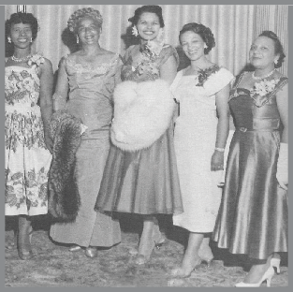
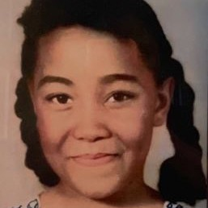
National Recognition Days
As we reflect on the past, we are inspired to carry forward the torch of justice and equality for future generations. The Senior Teens of the Montgomery County Maryland Chapter came together with a profound sense of purpose, reflecting on the sacrifice of Carole Robertson and her companions. The Senior Teens of the Montgomery County Maryland Chapter came together with a keen sense of purpose, reflecting on the sacrifice of Carole Robertson and her companions. In remembering Carole and learning from Father Townsend and Ms. Jimerson, we honor Carole’s memory and rededicate ourselves to the ongoing struggle for civil rights, equality, and justice for all.
When: September 20, 2026
Where: Ridge Park, Gaithersburg, MD
How: Planned and executed by Group 6-Sr.
Teens and Teen Advisors
In Loving Memory of Carole Robertson
Who: The Senior Teens of the Montgomery County Maryland Chapter
What: In a poignant and meaningful moment during the Jack and Jill Day festivities, the Senior Teens of the Montgomery County Maryland Chapter came together to pay tribute to Carole Robertson, a young life lost to the tragic events of September 15, 1963, at the 16th Street Baptist Church in Birmingham, AL. Weeks before the picnic, a one-page resource guide providing links to videos, media, activity sheets, and books, including the book "Seven Days with Carole," was included in the chapter’s bi-weekly newsletter. This document, which provided information for all ages and learning differences, helped prime our children and teens for the tribute that would take place at the picnic. In Carole’s honor, the participating teens, along with chapter members, wore black shirts with the first names of each girl who perished in the church bombing printed on the front of the shirt.
Immediately after the Remembrance Ceremony, Teen President Victoria Townsend conducted a brief Q&A session with Father Amos Townsend and his guest, Ann Jimerson. Both were adolescents living in Birmingham, AL, that day in 1963. Ann was the daughter of a white minister who was serving as executive director of the Alabama Council on Human Relations at that time. Decades later, she shares the impact that day had on her and her family. She also shared with our chapter a project called Kids in Birmingham 1963, which offers a platform for people who were living in Birmingham to tell their personal stories of coming of age in that turbulent time, stories that may otherwise be left out of history.
Why: This tribute was a powerful reminder of the importance of the sacrifices that were made on our behalf. It also recognizes the value of oral and documented stories told by those who were witnesses to historical events.
Jack and Jill Day
Who: The families of JJMCMC hosted by the Father's Auxiliary
What: The Father's Auxiliary hosted a fun-filled Jack and Jill Day! With over 110 family members in attendance, the annual cookout was well attended. Held at the picturesque Ridge Park in Gaithersburg, MD, it marked the exciting beginning of our program year.
Why: Jack and Jill Day provided a much-needed opportunity for our members to come together and get to know our newly initiated members. The event was filled with music, laughter, games, dance, and mouthwatering food that left everyone with lasting memories.
When: September 20, 2026
Where: Ridge Park, Gaithersburg, MD
How: Planned and executed by the Fathers Auxiliary

Slide 68
Honoring a Visionary: Founder's Day Celebration in Tribute to Marion Stubbs Thomas
Who: The Montgomery County, MD Chapter jointly with the MD/DC Coalition of Presidents
What: This year, Montgomery County, MD Chapter of Jack and Jill of America, Inc. will proudly host a Founder's Day Celebration paying tribute to our visionary founder, Marion Stubbs Thomas. Under the leadership of the Chapter President, and in collaboration with fellow Presidents from the Maryland and Washington, D.C. chapters, this gathering will honor the remarkable woman whose vision continues to inspire generations of families and children across the nation.
Why: In that same spirit of unity, the coalition of Presidents will also encourage their chapters to participate in the Founder's Day and Children's March in Washington, D.C., a powerful recognition of Jack and Jill of America’s long-standing legacy. This symbolic gathering will bring together members young and old to honor the past, celebrate the present, and reaffirm our commitment to shaping a brighter future for all children.
As we come together in celebration and purpose, we honor Marion Stubbs Thomas not only for founding Jack and Jill of America, but for planting a seed of vision and possibility that continues to grow—strong, proud, and everlasting.
When: Sunday, January 31, 2027
Where: Howard University
How: Planned and executed by the Coalition
of Presidents of DC and Maryland
Martin Luther King, Jr. Day of Service
“Service in Action, Change in Motion”
Who: The Families of JJMCMC in partnership with the Divine 9 organizations of Montgomery County Maryland
What: The Community Service Committee of JJMCMC, is collaboration with the Divine 9 organizations, is proud to host its annual Martin Luther King, Jr. Day of Service. This event will feature valuable wellness information and resources, including access to physical and mental health services available in our community.
Participants will also take part in ____ service projects, assembling kits to support:
TBD
Why: Dr. King’s vision of a more equitable and inclusive society aligns with our mission to serve and uplift our community, especially children and families. Through this event, we aim to honor his legacy by improving access to essential services and inspiring collective action for positive change.
When: TBD
Where: TBD
How: This event will be thoughtfully planned and executed by the JJMCMC Community Service Committee, with support from our partners and volunteers.

Slide 69
National Black Family Day: A Day of Unity and Exploration
Who: The Montgomery County MD Chapter
What: As we close out our program year, the Montgomery County MD Chapter invites all our members and their families to join us for an exciting chapter-wide celebration in honor of National Black Family Day.
Why: National Black Family Day offers a unique opportunity to celebrate the enduring strength and
unbreakable bonds of our families. Hosted by the dedicated mothers from each of our six grade groups, this
event promises an unforgettable day filled with laughter, adventure, and cherished memories.
When: TBD
Where: TBD
How: Planned and executed by the Black Family Day Host
Moms from each age group. They are also represented on
each age group calendar.

Slide 70
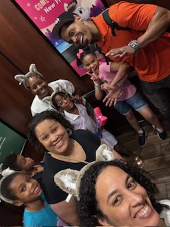
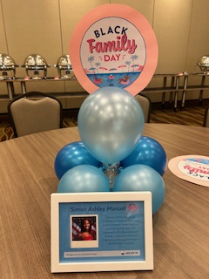
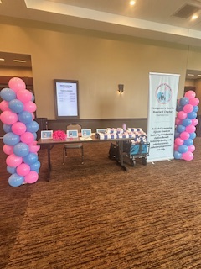
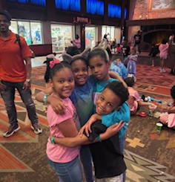
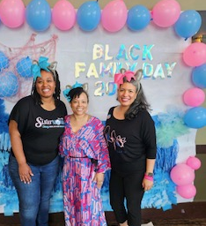
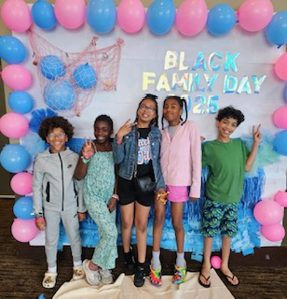
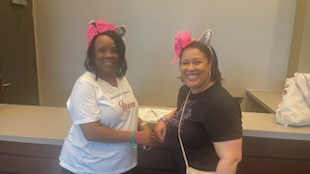
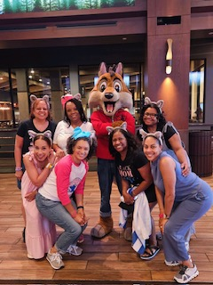
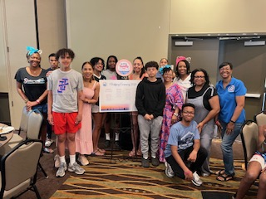
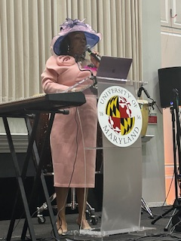
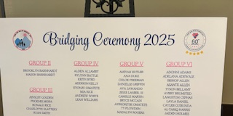

Slide 71
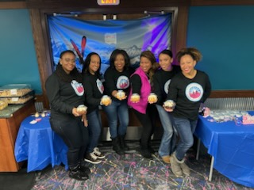
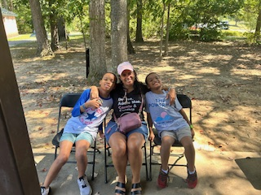
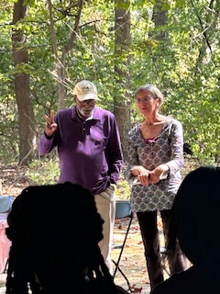
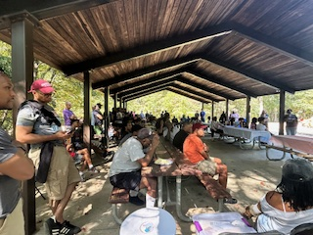
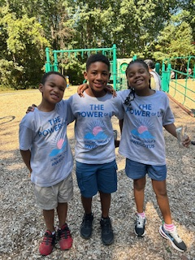
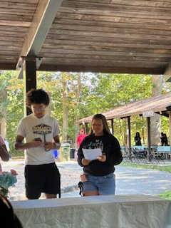
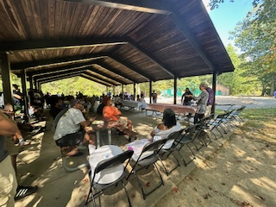
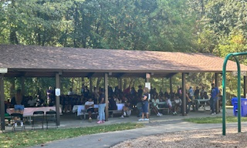

Slide 72

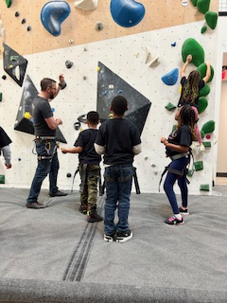
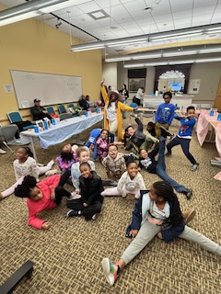
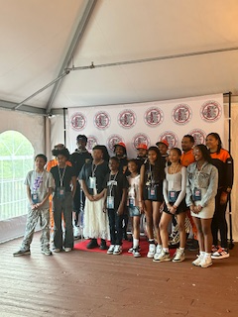
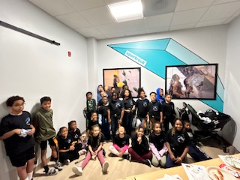
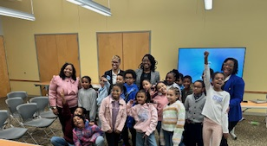
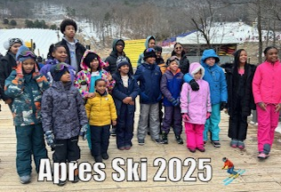

Slide 73
TABLE OF CONTENTS
SECTION 4
National Program Committee Programming
Grade Group Activity Forms

Slide 74
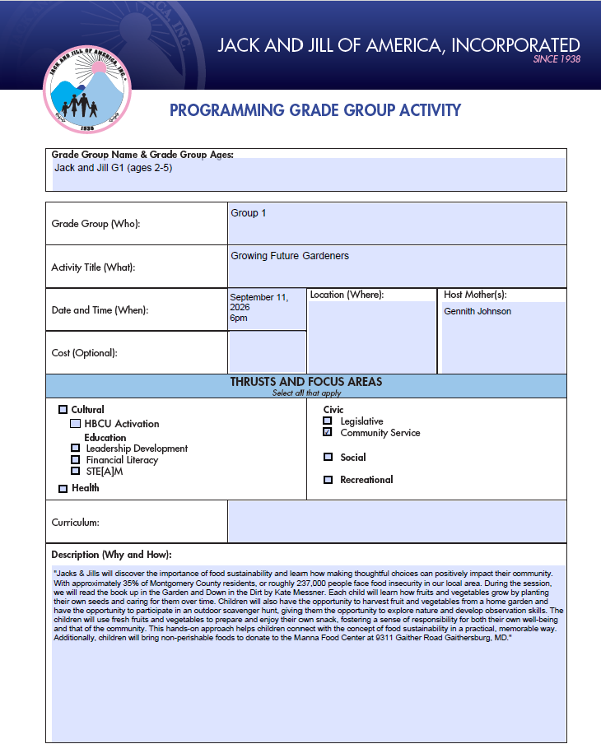

Slide 75
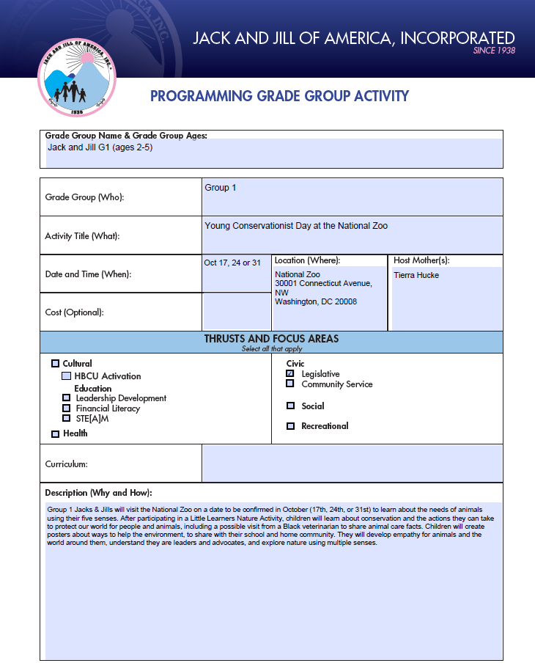

Slide 76


Slide 77


Slide 78


Slide 79


Slide 80


Slide 81


Slide 82


Slide 83


Slide 84


Slide 85


Slide 86


Slide 87


Slide 88


Slide 89


Slide 90


Slide 91


Slide 92


Slide 93


Slide 94


Slide 95


Slide 96


Slide 97


Slide 98


Slide 99


Slide 100


Slide 101


Slide 102


Slide 103


Slide 104


Slide 105


Slide 106


Slide 107


Slide 108


Slide 109


Slide 110


Slide 111


Slide 112


Slide 113


Slide 114


Slide 115


Slide 116


Slide 117


Slide 118


Slide 119


Slide 120


Slide 121


Slide 122
TABLE OF CONTENTS
SECTION 5
Chapter Appreciation Days

Slide 123
Fathers Auxiliary Appreciation
Honoring Strength, Service, and Brotherhood: The JJMCMC Father’s Auxiliary Father’s Appreciation Event
Who: The JJMCMC Fathers Appreciation
What: In April, the JJMCMC Father’s Auxiliary will host a Father’s Appreciation Event designed to uplift, celebrate, and recognize the vital role of fathers within our families and communities. More than just a gathering, this event will serve as a moment of reflection, connection, and affirmation—spotlighting the enduring strength, leadership, and love that African-American fathers bring to their homes and to the world around them.
The day will focus on four central themes: father bonding, family provision, community service, and brotherhood fellowship. Fathers will come together to share experiences, celebrate one another’s commitment, and reaffirm what it means to be a steadfast presence in the lives of their children. Through meaningful conversation and shared activities, the event will emphasize the importance of nurturing both family and community ties, while also creating space for fathers to recharge and connect in a spirit of joy and camaraderie.
Why: In a society that too often overlooks or misrepresents the image of Black fatherhood, this event stands as a powerful counter-narrative—one rooted in pride, authenticity, and truth. African American fathers have long been pillars of resilience, guidance, and hope. The JJMCMC Father’s Auxiliary seeks to honor that legacy, highlighting the countless men who lead with compassion, work tirelessly to provide, and pour their hearts into shaping the next generation.
As the fathers come together in April, they not only celebrate fatherhood itself, but also the shared journey of brotherhood—standing shoulder to shoulder in purpose and pride. Through unity and positive example, the JJMCMC Father’s Auxiliary continues to redefine what it means to be a father, a role model, and a leader within our community.
When: TBD
Where: Montgomery County, MD
How: The Father’s Auxiliary will take the lead in the coordination, securing the location and planning of the programming for this day event.

Slide 124
Associate Appreciation
Who: The Montgomery County, MD Chapter Associates Committee
What: The loving and esteemed Mothers of JJMCMC will gather to recognize the amazing Associate Mothers who have been the cornerstone of our chapter's success. Members will express their heartfelt gratitude and appreciation to our Jewels for their invaluable support to our chapter during a ……….(TBD)
Why: These incredible women have exemplified leadership, sisterhood, and unwavering commitment to our chapter’s mission. They continue to show up for our chapter through activities such as providing care packages to JJMCMC college freshmen, fundraising, and volunteering with us to support vulnerable populations in our county. They are crucial to helping JJMCMC make a difference in the community.
When: TBD
Where: TBD
How: Planned and executed by the Montgomery County, MD Associates Committee

Slide 125
TABLE OF CONTENTS
SECTION 6
Annual Program Planning Day

Slide 126


2026-2027 Annual Program Planning Meeting Summary
The Chapter’s Annual Program Planning meeting for the 2026-2027 Program Year took place on Saturday, June 13, 2026, at the Gaithersburg Public Library.
The meeting took place in person with 68 mothers attending, representing more than 61% of chapter members participating. To accommodate maximum attendance, we utilized 2 meeting rooms.
Before the planning day, the age-group mothers held significant pre-planning sessions to ensure their in-person time was productive. Each age group had its own planning session (Groups 1 and 2 had both a joint and separate session), and Program Director Torie Comeaux Plowden was present to answer mothers’ questions. PD Torie shared key updates and insights, particularly highlighting the importance of creating unique and memorable experiences for our children.
She emphasized the criticality of each Programming Thrust and discussed her excitement about hosting an engaging Black Family Day event. Each of the age groups strategically ensured that their activity ideas aligned with the national thrusts. Light refreshments were served.
2026-2027 Annual Program Planning Meeting Agenda
10:30 AM–11:30 AM | Group 1 AKA Poohs (2 year old to Prek-4) and Group 2 (Kindergarten and 1st Grade)
10:30 AM–11:30 AM | Group 3 (2nd Grade & 3rd Grade)
11:30 PM–12:30 PM | Group 4 (4th Grade & 5th Grade)
12:00 PM–2:00 PM | Group 5 (6th Grade thru 8th Grade)
2:00 PM–4:00 PM | Group 6 Sr. Teens (information session for mothers only, teens had a separate session)

Slide 127
Jack and Jill of America, Inc.
Montgomery County Maryland Chapter

